Slide 1
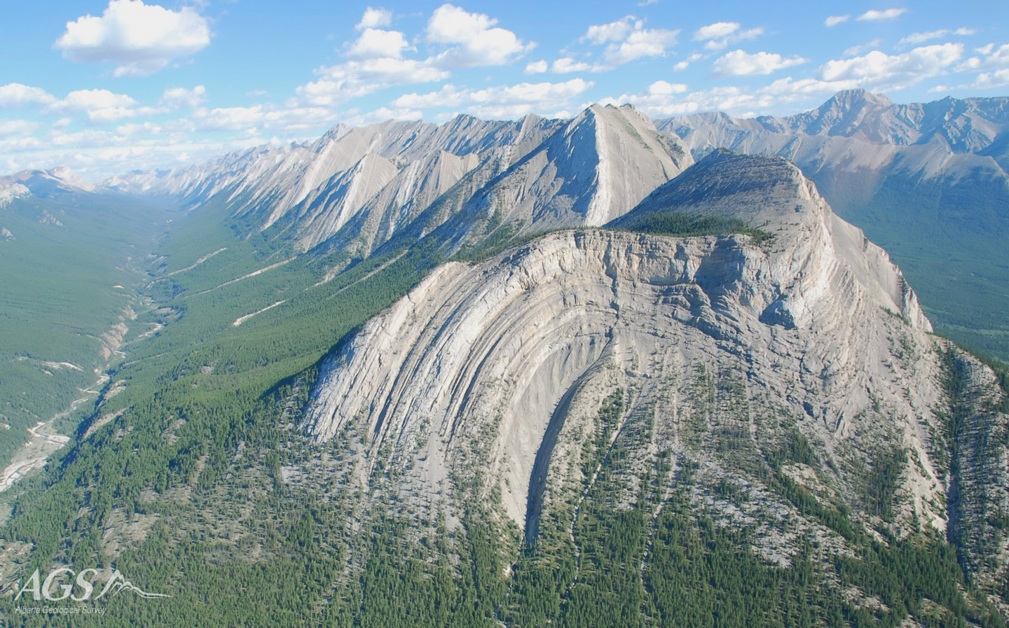
Structural Diagrams
Methods & Interpretation
Presented By:
Monika Kanwar Rathore
Inspire Fellow-DST
Department of Geology,
Faculty of Earth Science,
M.L. Sukhadia University, Udaipur

Slide 2
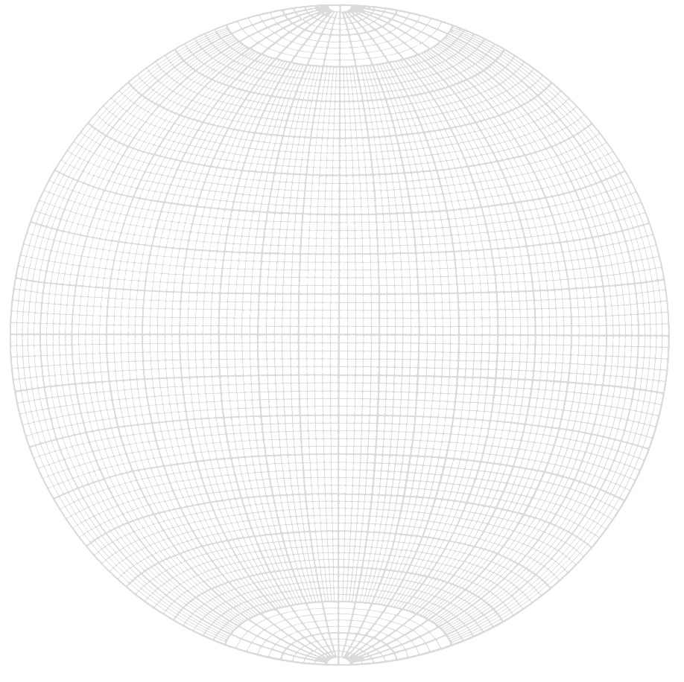
Stereonet Basics
Stereonets are used for plotting and analyzing 3-D orientations of lines and planes in 2-D space

Slide 3
Stereonets are used in:
Landslide hazard/slope failure studies
Earthquake studies
Fracture analyses used in hydrogeology and/or groundwater pollution potentials
Mining industry (fossil fuels included)
Engineering
Practically anything that deals with relative orientations of planes and lines

Slide 4
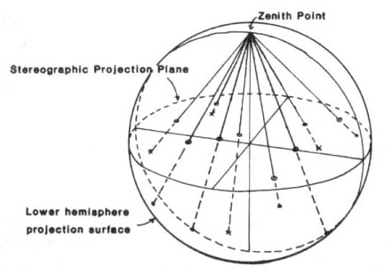
Spherical Projections
The stereographic projection puts the joining point at the top of the sphere (North point), and the projection plane along the equator.

Slide 5
Lines and planes are plotted as stereograms by combining the great and the small circles on the stereonets

Slide 6
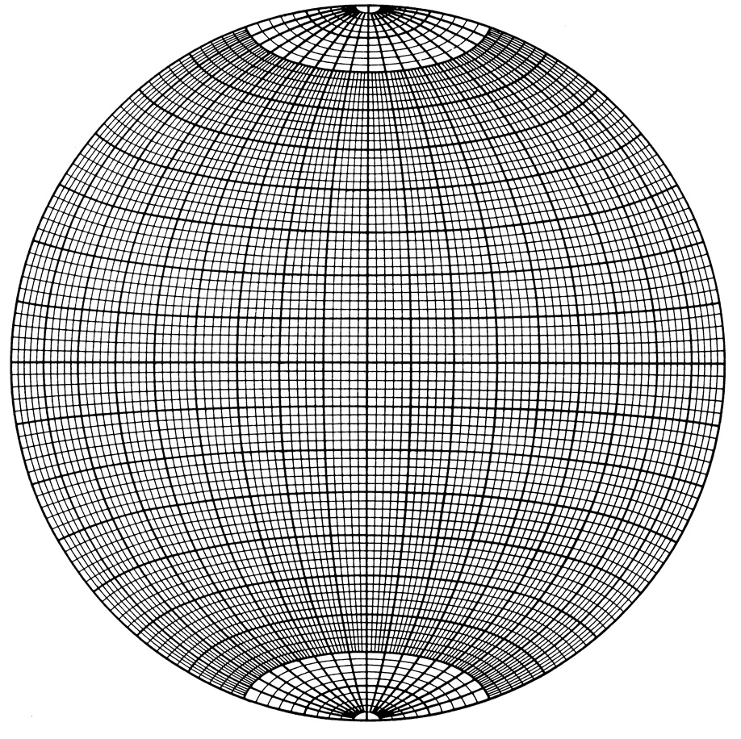
The heavy lines are at 10º intervals and the light lines show planes at 2º intervals.

Slide 7
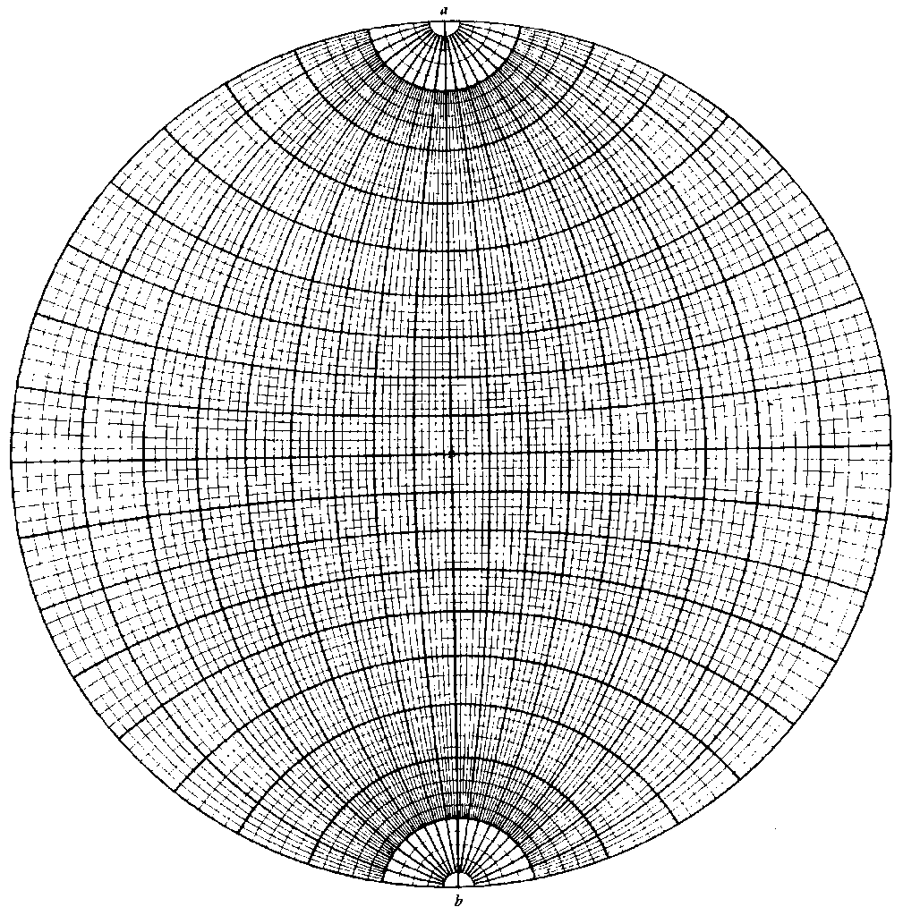
The Wulff Net
Equatorial projection / stereographic projection nets
The Schmidt Net

Slide 8
Small circles
(Look like LATITUDES)
Great circles
(Look like LONGITUDES)
The Schmidt Net

Slide 9
Equatorial circle = horizontal plane
Straight lines = vertical planes
0
20
40
60
80
80
60
40
20
0
Dip angles
Great circles = inclined planes

Slide 10
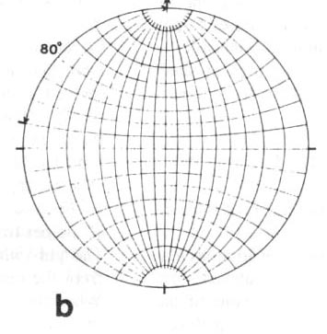
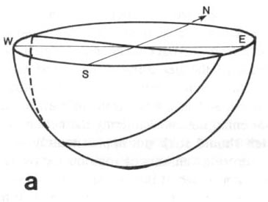
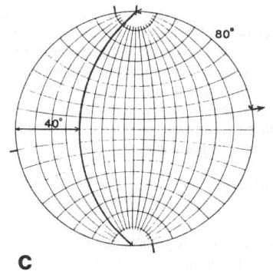
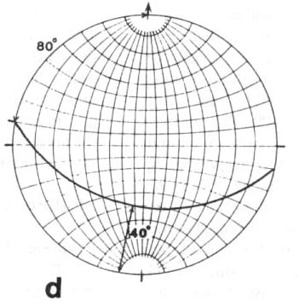
Plotting a Plane using the Stereonet
Plot the layer striking
280/ 40 SW (N80W, 40S)

Slide 11
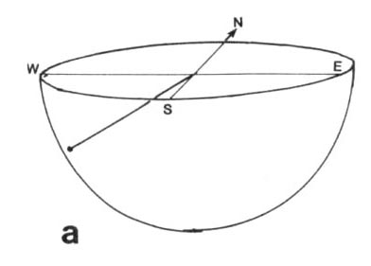
Plotting a Line using the Stereonet
The line is a fold axis plunges 38 towards 222 (38 towards S42W)
Visualize the line in space plunging 38º to the SW

Slide 12
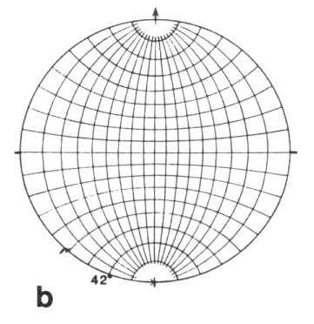
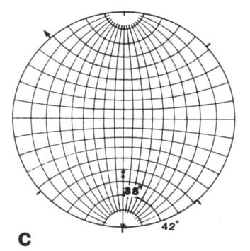
Next, place the overlay on the net and mark N, S, E, & W on the overlay.
Measure 222º on the stereonet (or S42W) and make a tick mark at that position on the primitive circle.
Next, rotate the tick mark to EW axes of
the net.
Measure 38º along the line from the
primitive circle and put a dot. This is the
projection of the point where the line
penetrates the sphere.

Slide 13
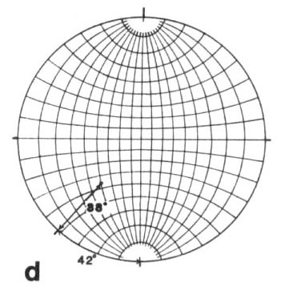
Finally, rotate the transparency so that North coincides with North on the stereonet. Check to make sure your dot is in the SW quadrant

Slide 14
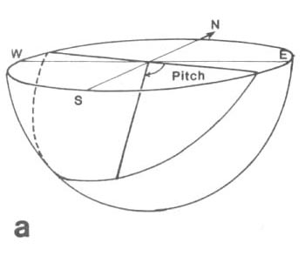
Plotting a Line on a plane
The plane (cleavage) is N110, 43SW. The line (a mineral lineation) trends 160. Plot the plane and the line and find the plunge of the line.
Visualize the problem: A plane (cleavage) with a line (lineation) lying in the plane.

Slide 15
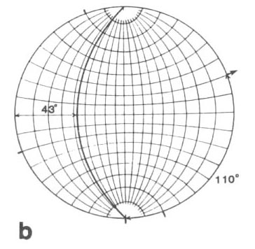
Plotting a Line on a plane
The plane (cleavage) is 290, 43 SW (110, 43SW). The line (a mineral lineation) trends 160. Plot the plane and the line and find the plunge of the line.
Plot the plane on the overlay:
Put a mark at 290; rotate the
overlay to 0 or 180. find the
great circle that dips 43º to
the SW and trace the arc.

Slide 16
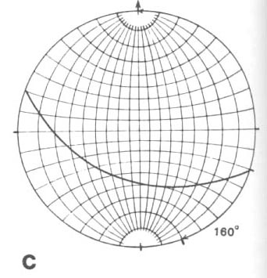
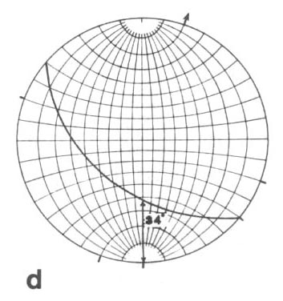
Rotate the overlay so that the 160º mark
is at the 0-180 axis of the net. The line
from the center of the net to the 160 mark
is the trend of the lineation. Where that
trend line intersects the arc of the plane
(cleavage), is the projection of the
lineation that lines in the plane.
Rotate the overlay so that N
is at 0. Mark the primitive at
the trend of the lineation,
160º.

Slide 17
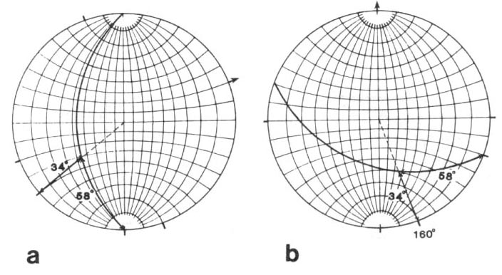
The Pitch of a Line on a plane
The plane (cleavage) is 290, 43 SW (110, 43S). The line (a mineral lineation) trends 160, 34. What is the pitch/rake of the lineation of the cleavage plane?
Rotate the transparency so the plane lies along a great circle. The pitch/ rake is the acute angle measured along the great circle.

Slide 18
Trend & Plunge a Line from its Pitch/Rake
The plane (cleavage) is 290, 43SW (110, 43S). The line (a mineral lineation) has a rake of 58ºE. What is the trend and plunge of the lineation?
1. Rotate the transparency so the plane lies along a great circle. The rake is 58º measured from the primitive along the great circle from its East end. (a)
2. Finally, rotate the transparency so its N coincides with North on the net and then measure the trend bearing. (b and c).

Slide 19
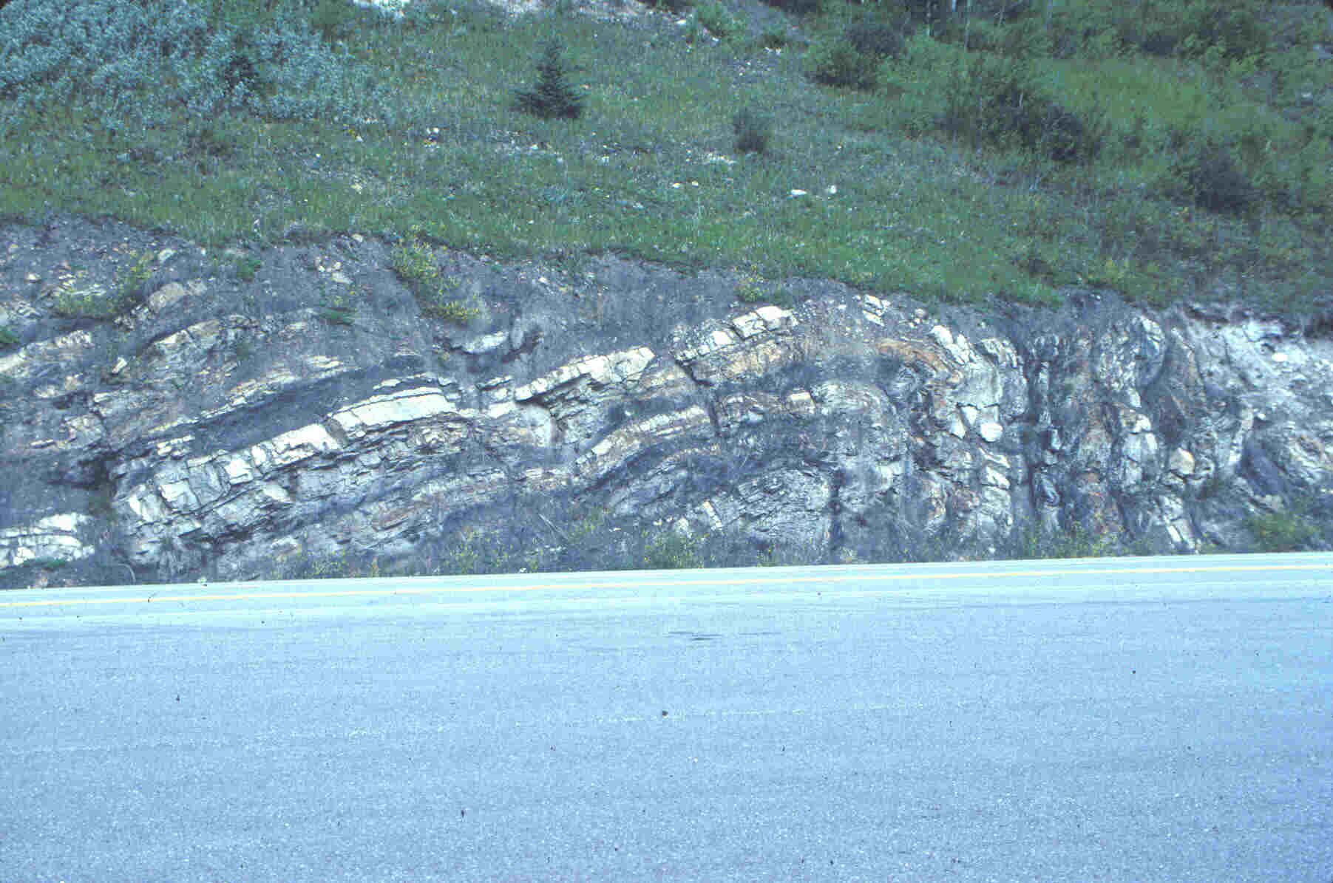
Structural analyses on the basis of planar features
How to determine major fold axis and axial surface in the field
Two methods are:
1) Beta diagrams: β-diagrams 2) Pi diagrams: π diagrams

Slide 20
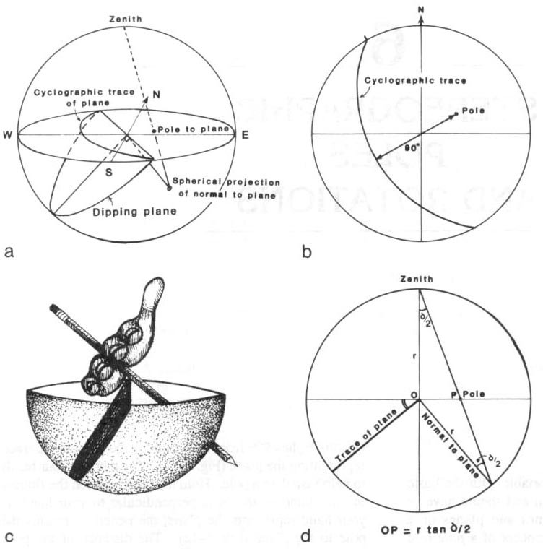
Poles to Planes
So far, we have represented a plane on the stereographic projection as a great circle.
A plane, however, can be represented by its pole, the unique line drawn perpendicular to the plane. Because the pole is a line, it plots as a point on the stereographic projection.

Slide 21
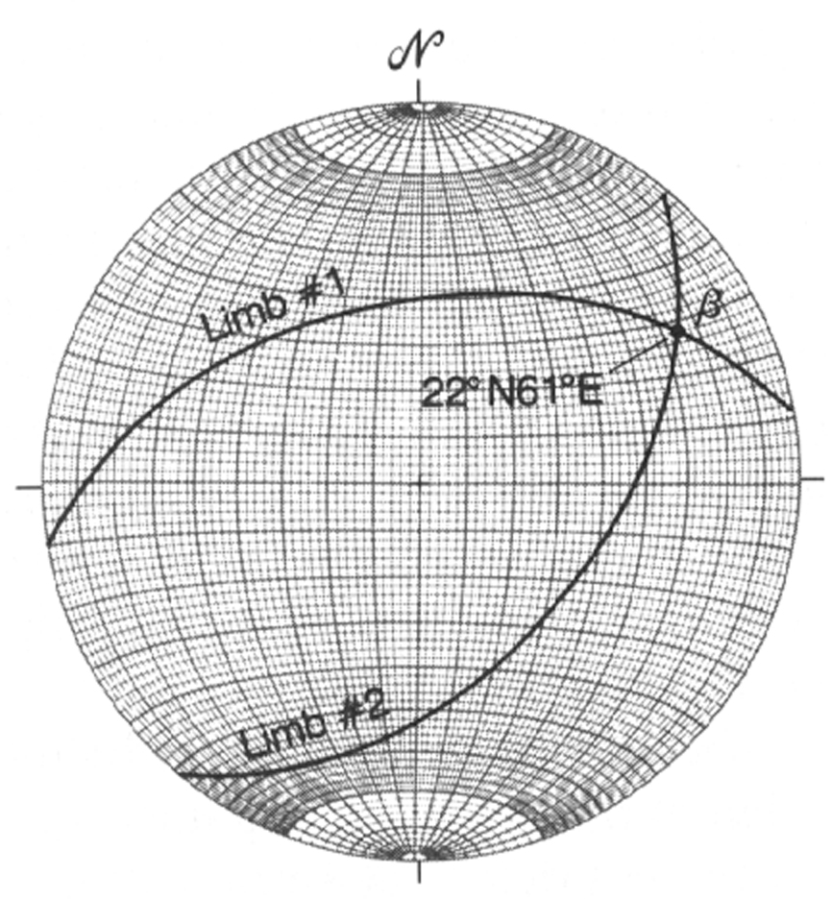
The intersection of two bedding planes (e.g., great circles) represents a close approximation to trend and plunge of the hinge line.
The intersection of the great circles is labeled beta (β).
This is called a beta ( β ) diagram.

Slide 22
Beta diagram: ( β ) fold axis at intersection of bedding planes

Slide 23
Pi diagrams:
Another way to calculate the orientation of a fold.
plots uses at least 2 poles to bedding, results in the orientation of the fold axis.

Slide 24
Pi diagrams:
π plots uses at least 2 poles to bedding, results in the orientation of the fold axis.
π uses multiple poles to bedding, fits a best-fit great circle to those poles, and also results in the orientation of the fold axis.
Pole to pi great circle shows the orientation of the fold axis

Slide 25
Pi diagrams: p-diagrams

Slide 26
Pi diagrams: p-diagrams

Slide 27
Pi diagrams: p-diagrams

Slide 28
Pi diagrams: p-diagrams

Slide 29
Pi diagrams: π−diagrams

Slide 30
Thank You

