Slide 1
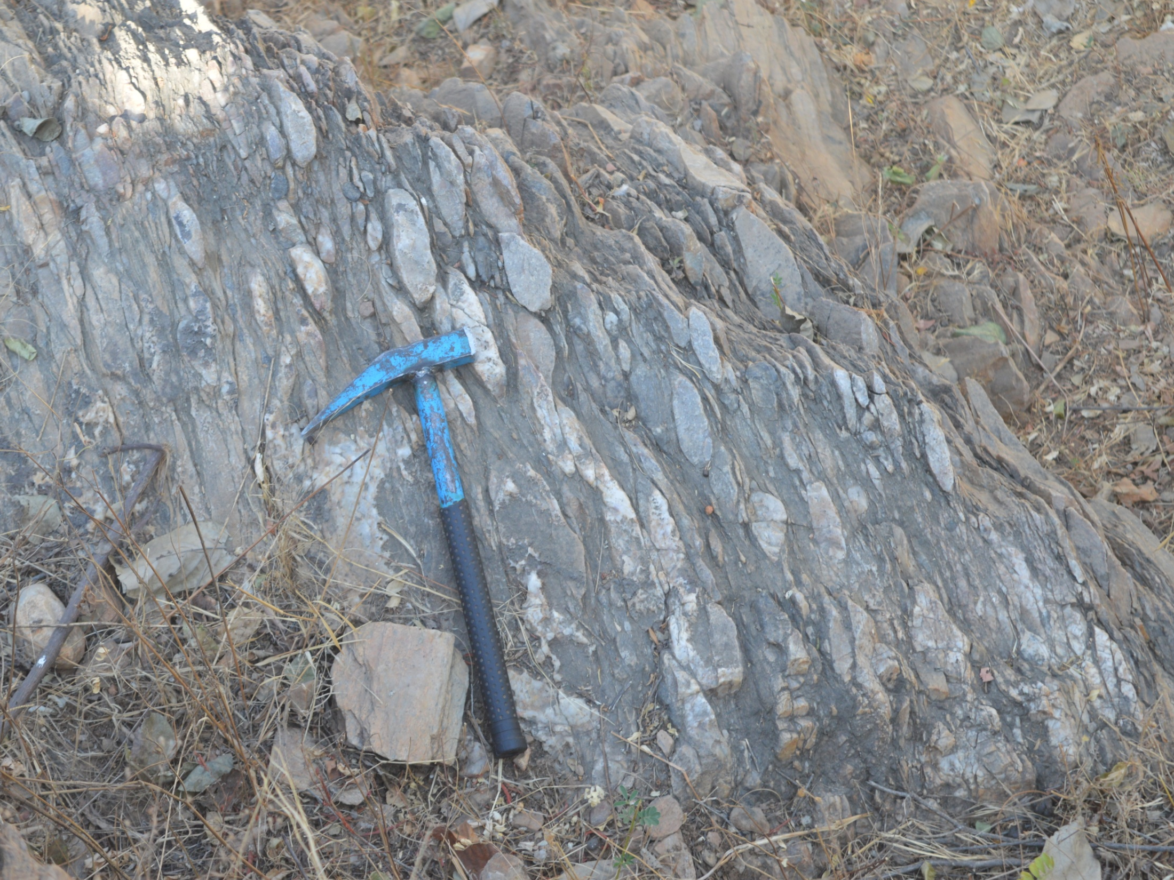
Unconformity
&
Basement cover relationship
Dr. Harish Kapasya

Slide 2
Unconformitiy
Major breaks in sedimentation are called “UNCONFORMITIES”.

Slide 3
An unconformity may be defined as an old erosion surface which separates younger series of rocks from the older series.
Unconformities represent an interval of time of unknown length which is spent in the erosion of the underlying strata before the deposition of the overlying rocks.

Slide 4
UNCONFORMITIES = gaps in rock layers
Form when layers of rock are removed by erosion
Form when a period of time passes without any new deposition to produce new layers of rock
The recognition of an unconformity is of considerable importance in structural geology.
It serves as an important marker surface during geological mapping.

Slide 5
Types of Unconformity:-
Angular Unconformity
Disconformity
Nonconformity

Slide 7
Angular Unconformity:-
The rocks beds on opposite sides of an “Angular Unconformity” are not parallel.
The angular unconformities occur where the older series of beds have been tilted, deformed and eroded before the deposition of younger beds.

Slide 8
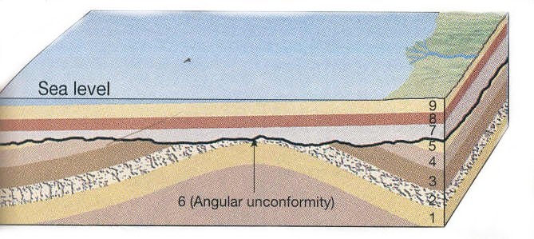

Slide 9
Disconformity:-
The rocks beds on opposite sides of a “Disconformity” are parallel.
Disconformities occurs where the strata of the older series have not been tilted or deformed before the deposition of younger beds.

Slide 10
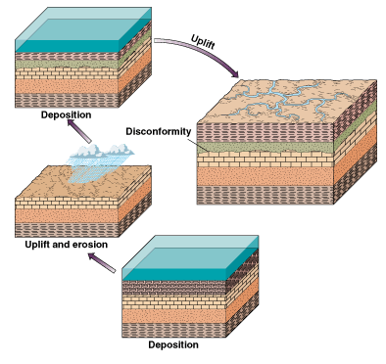

Slide 11
Nonconformity:-
Where a series of sedimentary layers is deposited over igneous or metamorphic rooks, mostly plutonic igneous rocks, it forms nonconformity.

Slide 12
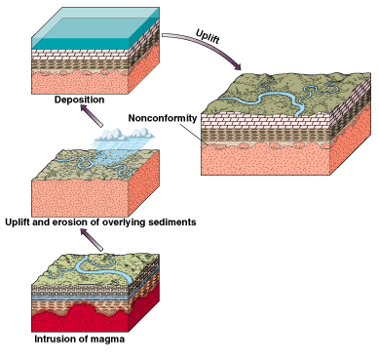

Slide 13
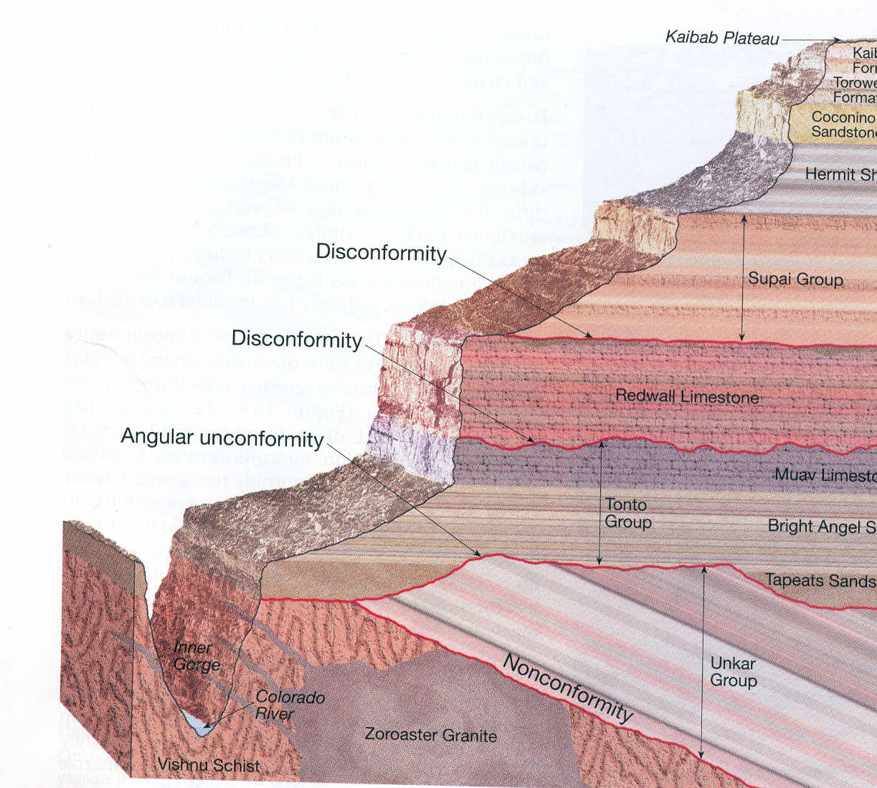
3 types of unconformities are seen

Slide 15
Basement-cover relationship
The basement-cover relationship is important for stratigraphy, structural geology and also for an overall understanding of the process of crustal evolution.

Slide 16
Identification of the basement becomes extremely difficult in many Precambrian terrains where the stratigraphic control is poor and where the cover and the basement have undergone multiple deformations and polyphase metamorphism.

Slide 17
The occurrence of a conglomerate bed along the schist-gneiss contact no doubt strongly suggests that the interface represents an unconformity surface.
However, a conglomerate may not be present in all such terrains. While identifying a surface of erosion from the presence of a conglomerate bed in such strongly deformed terrains, one should be careful to distinguish between a true sedimentary conglomerate and an autoclastic conglomerate.
An autoclastic conglomerate is generally produced by intense deformation and fragmentation of a layer and may look very similar to a true conglomerate.

Slide 18
While establishing the presence of an angular unconformity in such strongly deformed terrains, one should always remember that the angular relation must be between the depositional surfaces of the two groups of rocks.

Slide 19
The nature of the complex relationship between the basement and the cover in such terrains can be understood from the following example of the Precambrians of central and southern Rajasthan in the western part of the Indian shield.
Here we have a vast terrain of metamorphosed sediments and lava flows of the Aravalli Group. The Aravalli cycle of orogeny closed around 2000 to 1900 Ma. The Aravalli group of rocks is bordered by terrains of migmatites forming the Banded Gneissic Complex (B.G.C.).

Slide 20
the B.G.C. in southern Rajasthan contains rocks as old as 3500 Ma. in certain places a conglomerate containing gneissic pebbles occurs at the contact between the Aravallis and the B.G.C. These relations are in agreement with the conclusion that the B.G.C. represents an ancient basement on which the Aravalli sediments were unconformably deposited.

Slide 21
a. The nature of the original interface can also be identified when the basement is weakly deformed to produce large warps on the interface or when it is broken up by a number of faults while the cover passively adjusts itself by folding.

Slide 22
b. The interface, however, becomes greatly modified in a type of deformation in which slices of the basement are thrust into the cover as basement wedges.
Example:
The Eastern Alps, a slice of the basement is dragged over a low-angle thrust over rocks which form the sedimentary cover of the Western Alps.

Slide 24
The basement along with its sedimentary cover may be deformed together in a ductile manner and may give rise to a mantled gneiss dome.
d. A remarkable ductility of the basement is shown by the Monte Rosa type of nappes in the Western Alps and elsewhere where the basement forms the cores of huge recumbent folds.

Slide 25
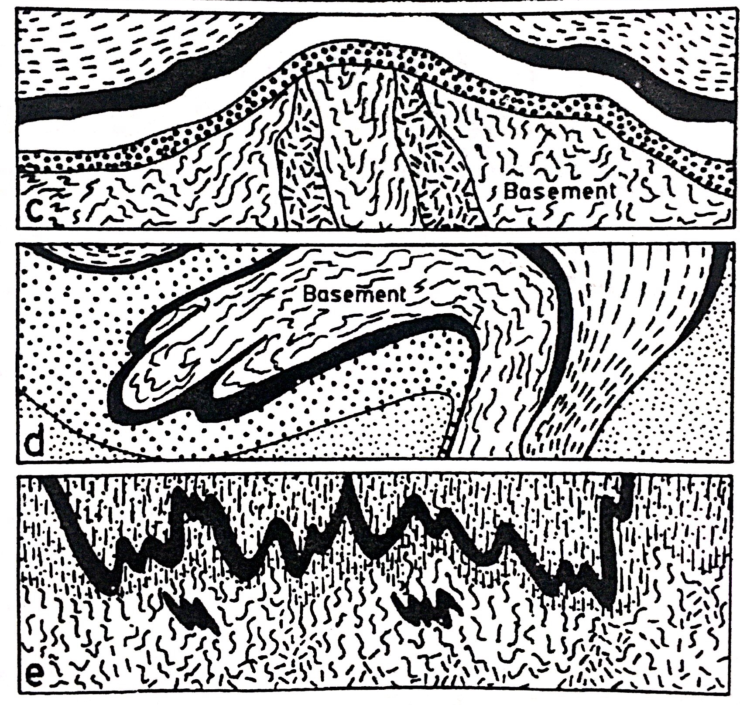

Slide 26
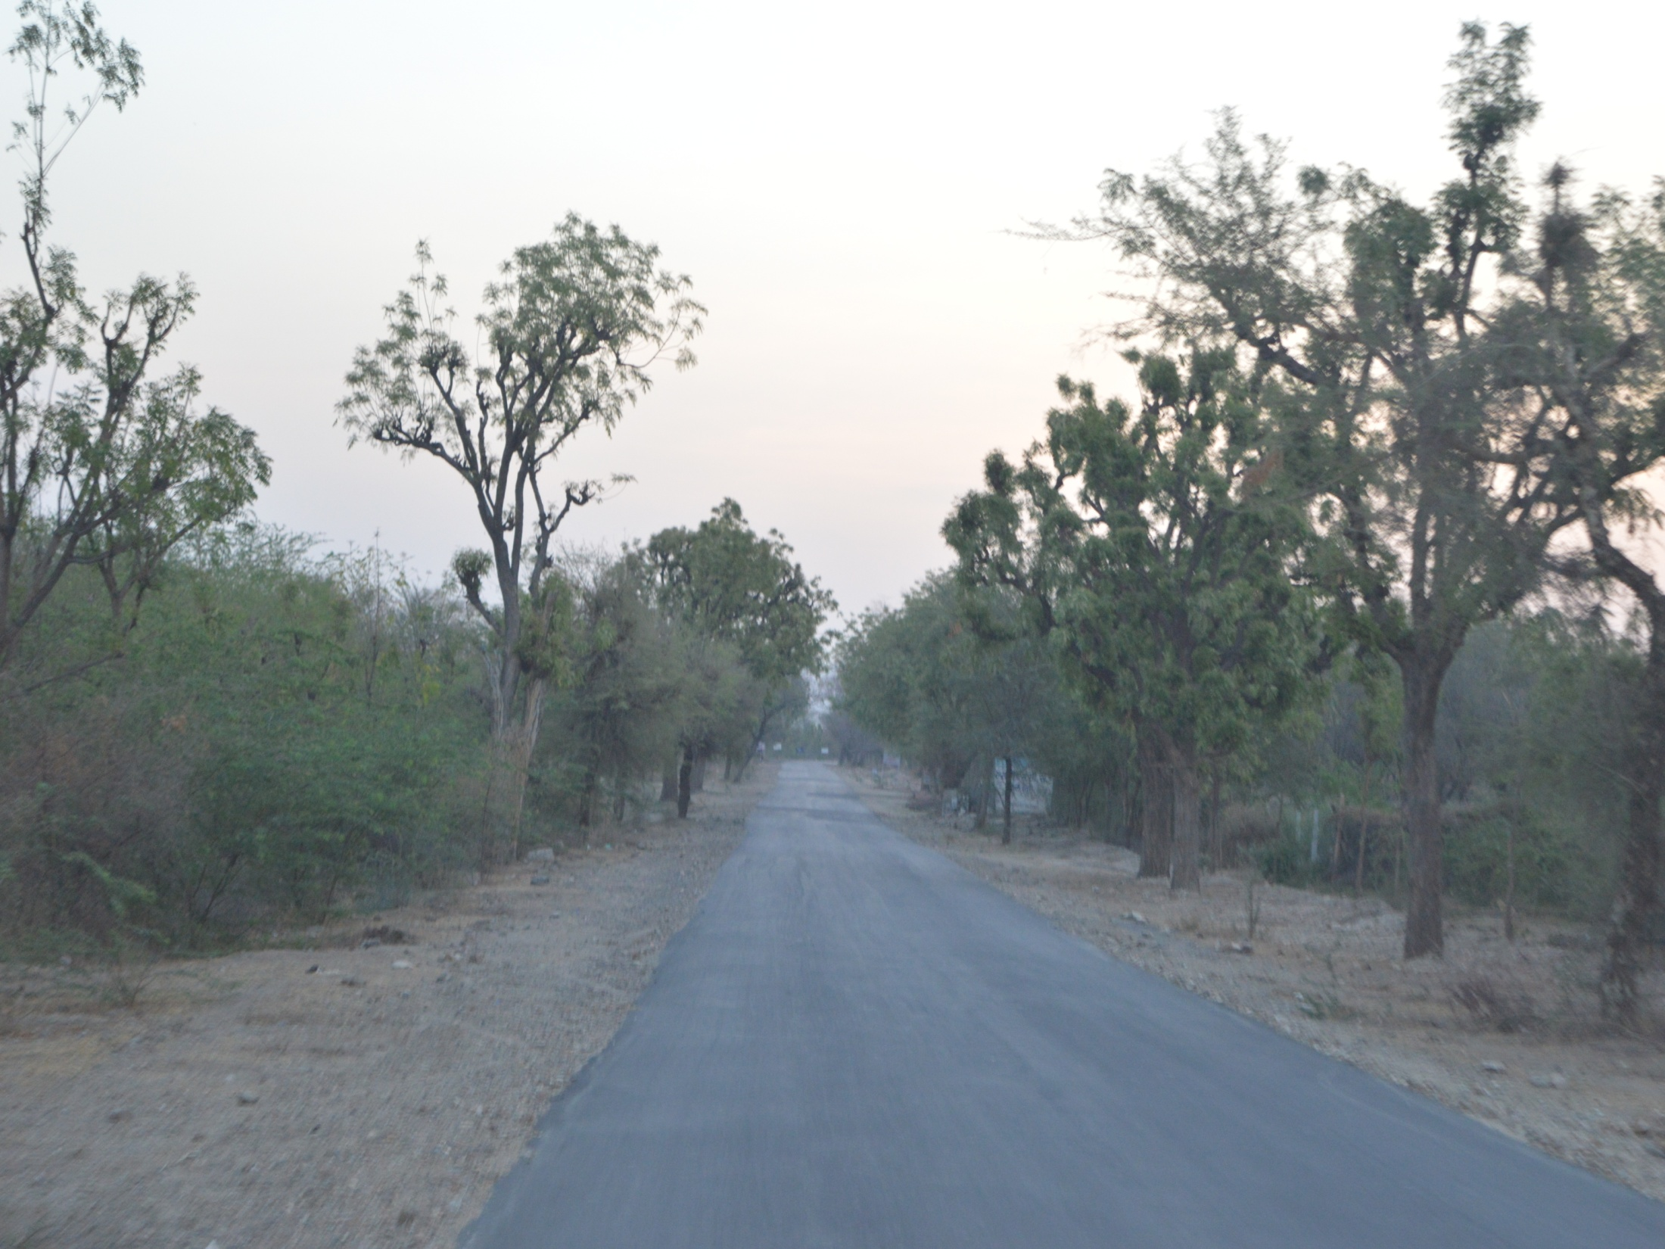
Thank You

