Slide 1
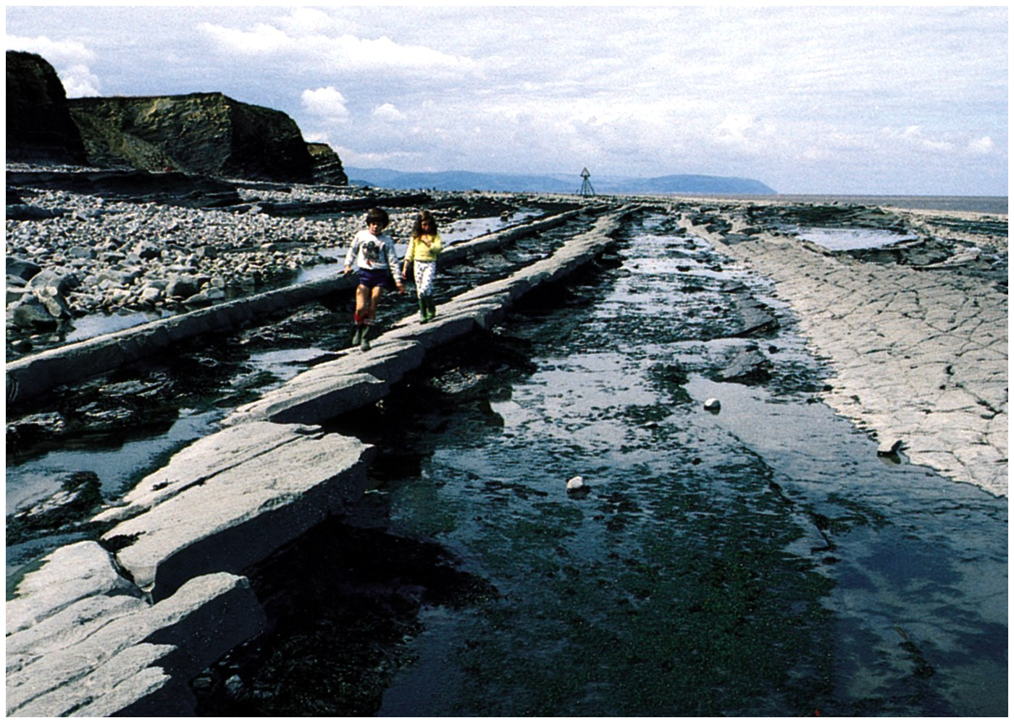
Joints

Slide 2
Joints
When rock masses are subjected to tensional and compressional forces, regular and irregular fractures develop in rock.
Such fractures along which there has been no relative displacement are called “Joints”.
Joints occur in almost every type of rock. They may be vertical, inclined or even horizontal.

Slide 3
Classification of Joints
Depending on the mode of formation, the joints are classified into two groups:
Tension Joints
Shear Joints

Slide 4
Tension Joints
“Tension joints” are those which are formed as a result of tension forces.
These joints are relatively open and have rough and irregular surfaces.
Example:- Columnar joints
Longitudinal joints
(Run parallel to the fold axis)

Slide 5
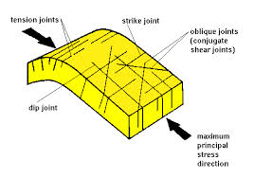

Slide 6
Shear Joints
“Shear joints” are those which formed due to compressional forces involved in the folding and faulting of rocks.
These joints are rather clean cut and tightly closed.

Slide 7
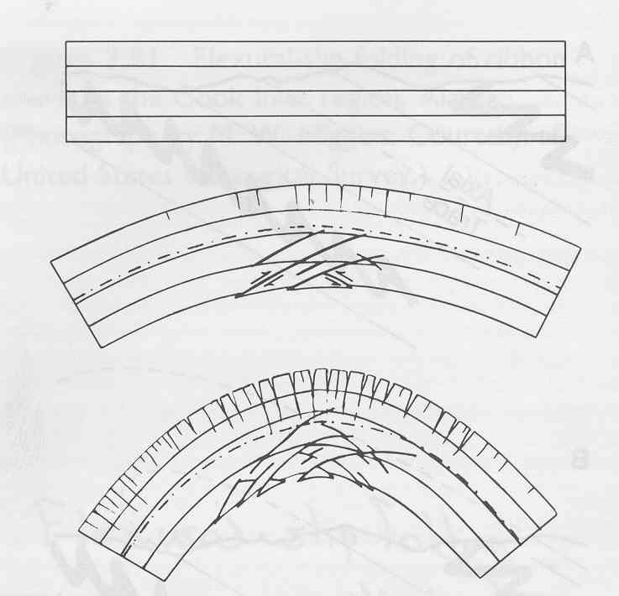

Slide 8
Depending on their attitude and geometry, the joints are classified into 3 groups:
Strike Joints : Run parallel to the strike of country rocks.
Dip Joints : Run parallel to the direction of dip of country rocks.
Oblique Joints : Run oblique to the strike and dip direction of the country rocks.

Slide 10
Common Joints
Master Joints
In sedimentary rocks, the joints usually run in two directions at nearly right angles.
One set of joints run parallel to the dip direction and the other parallel to the strike direction.
One set of joints is commonly more strongly developed and extends for long distances.

Slide 11
Bedding Joints
The joints which are parallel to the bedding planes in sedimentary rocks, called the “Bedding Joints”.
Primary Joints
Joints are formed during cooling & contraction of magma in igneous rocks, are called “Primary Joints”.

Slide 12
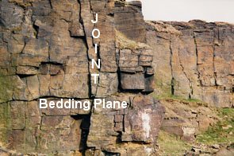

Slide 13
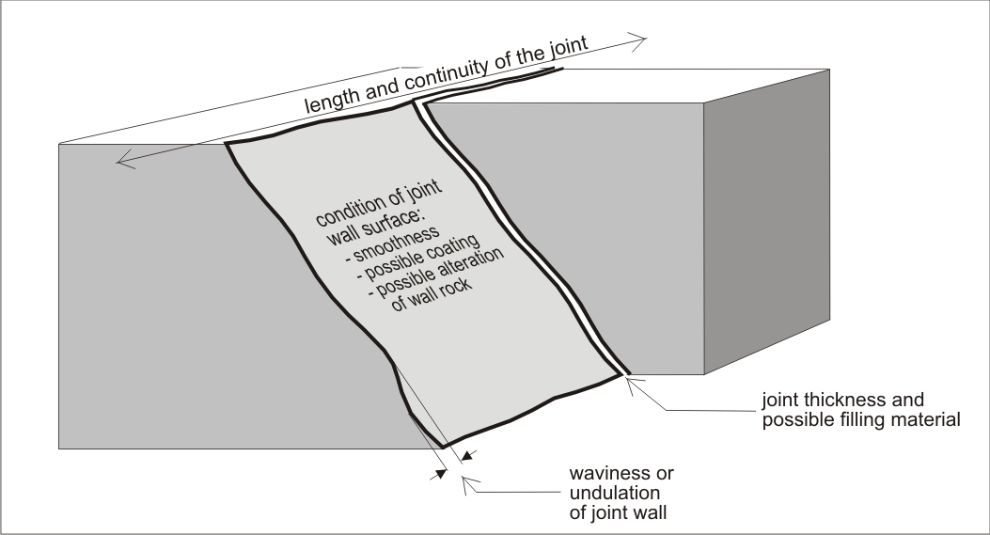

Slide 14
The primary joints are of following types:
Mural Joints
Granites commonly show 3 sets of joints mutually at right angles which divide the rock mass into more or less cubical blocks. Such joints are called “Mural Joints”.
Sheet Joints
These joints are often seen in the granites, which formed as tension cracks and run in the horizontal direction.

Slide 15
Columnar Joints
Columnar Joints are formed in tabular igneous masses such as dykes, sills and lava flows.
These joints divide the rock masses into hexagonal, square, rhombic or triangular columns.
Such columns develop due to the chief cooling surface.

Slide 16
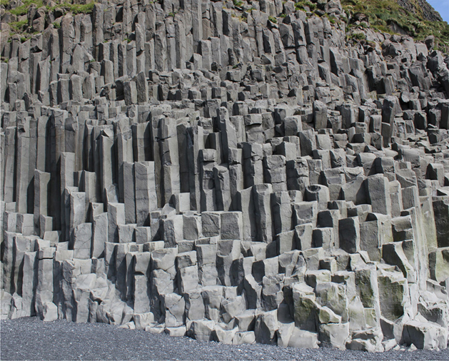

Slide 17
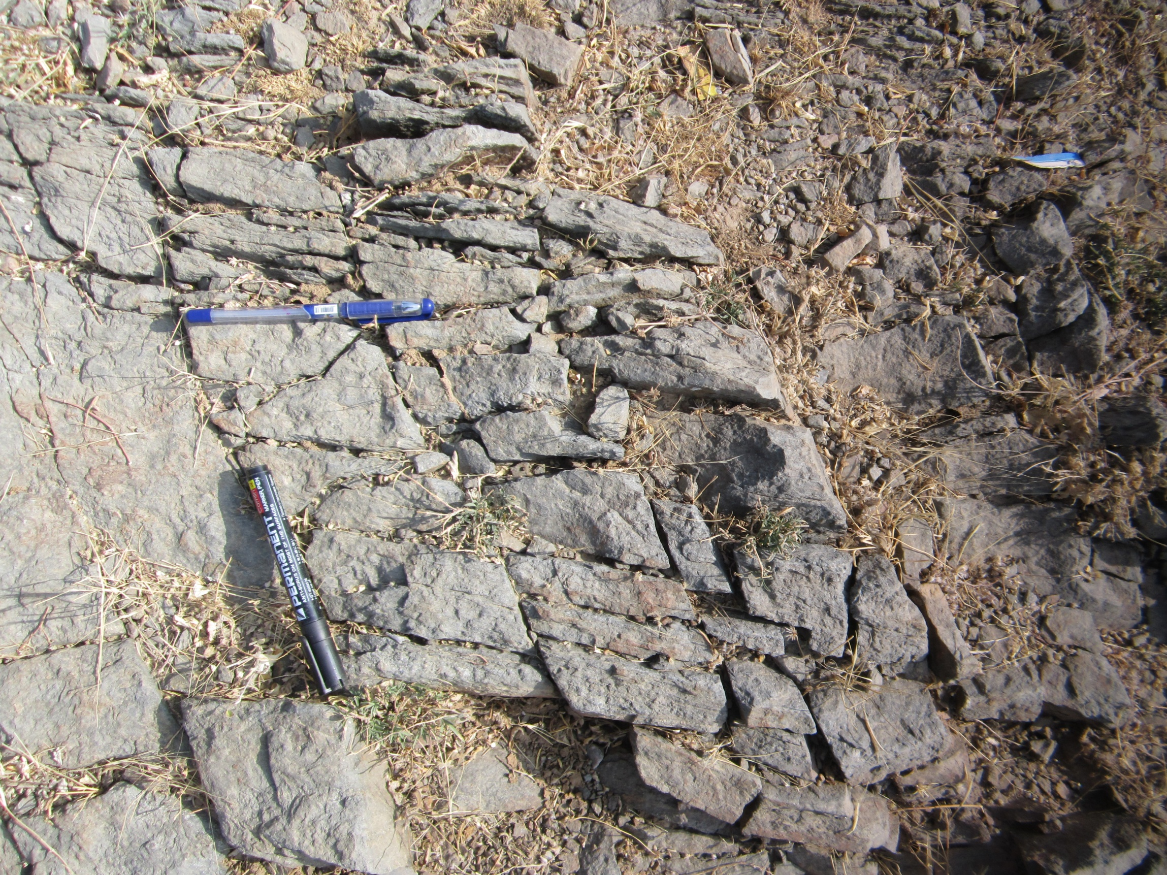

Slide 18
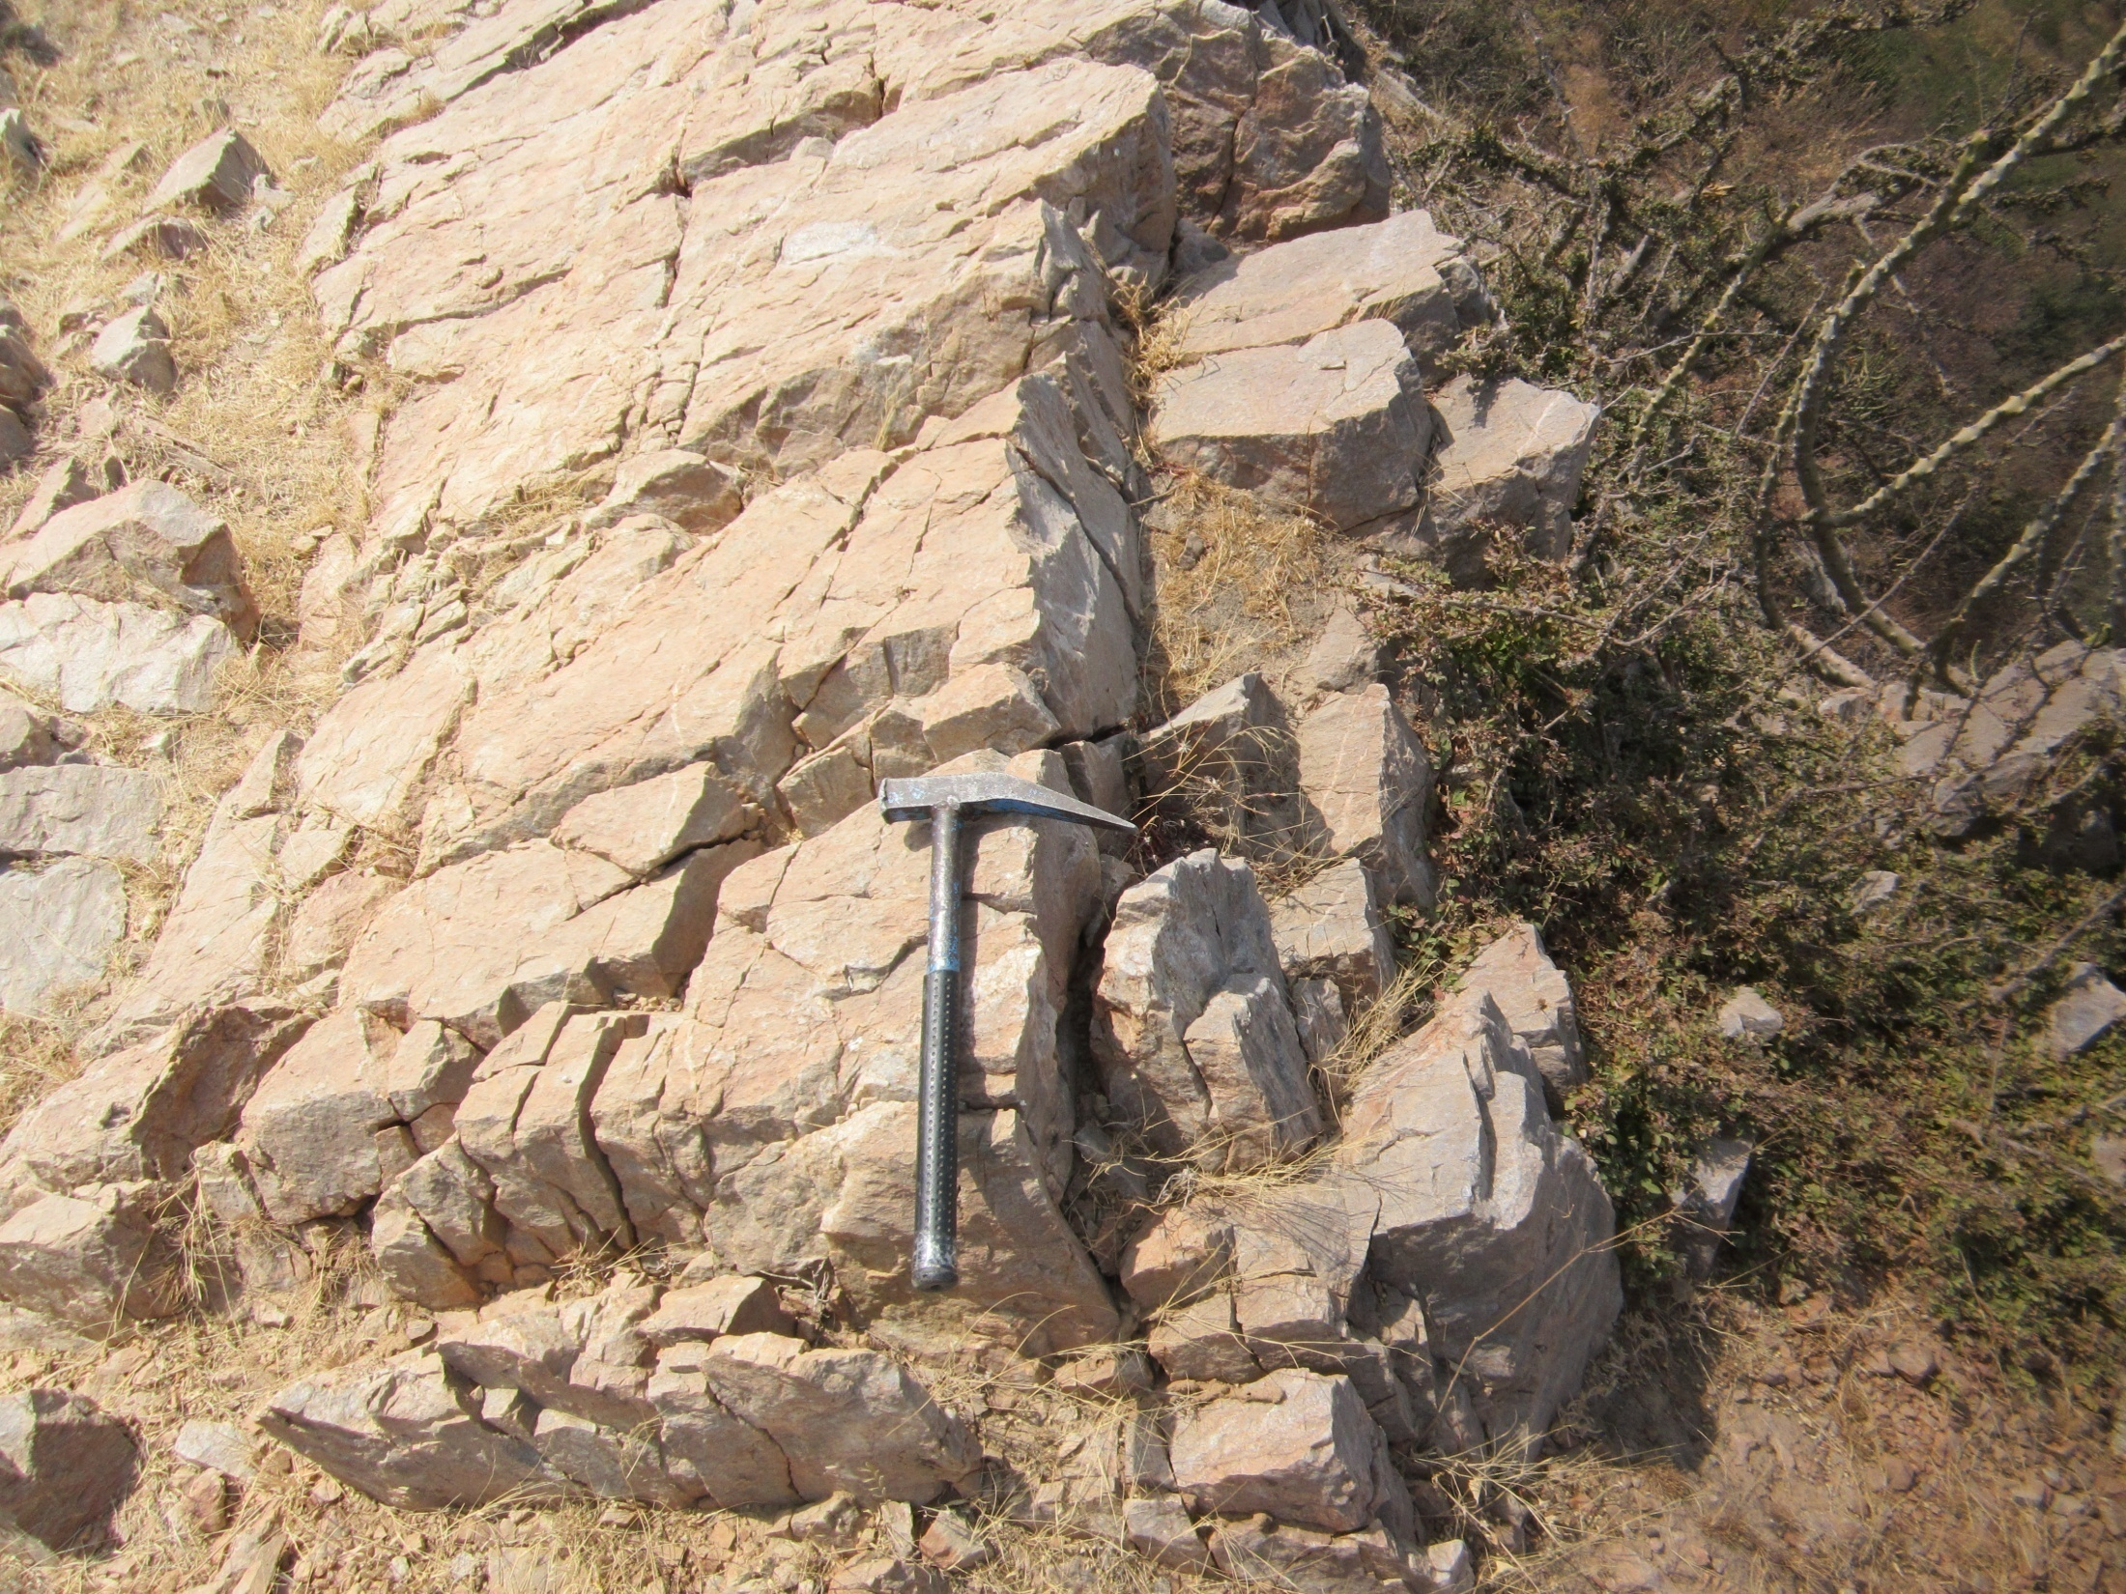

Slide 19
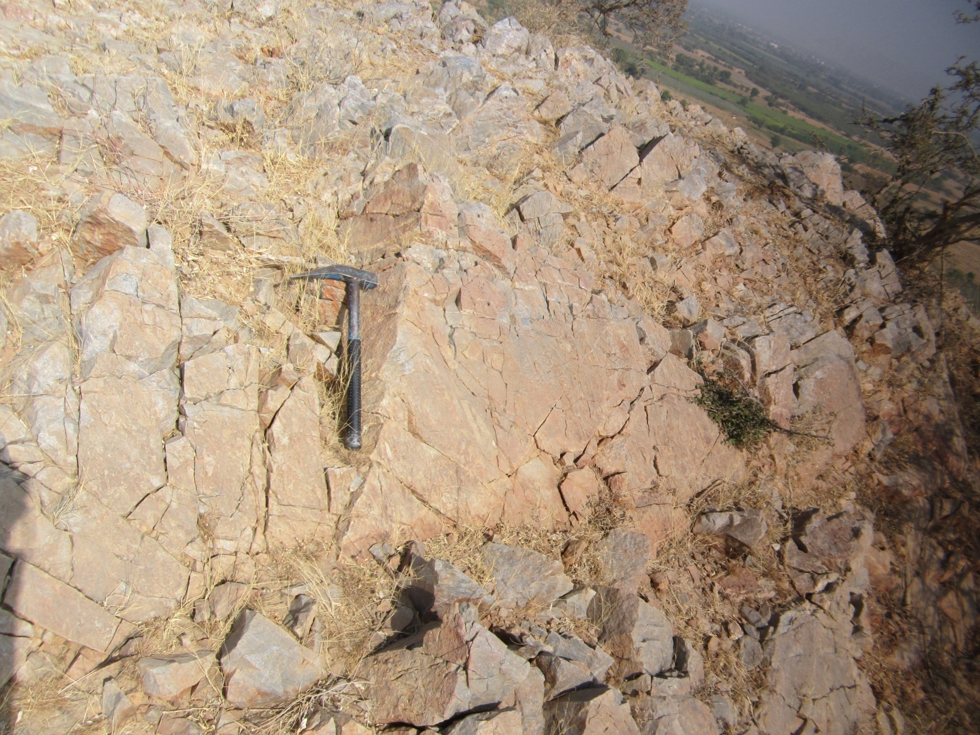

Slide 20
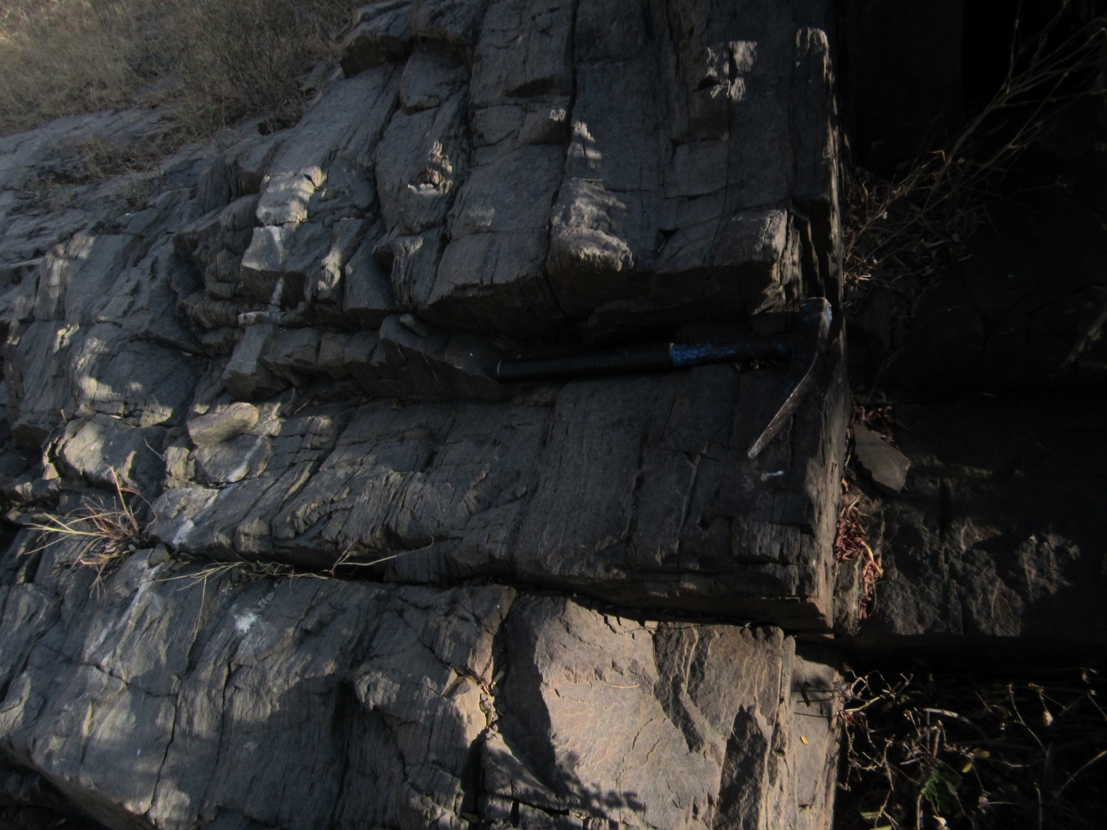

Slide 21
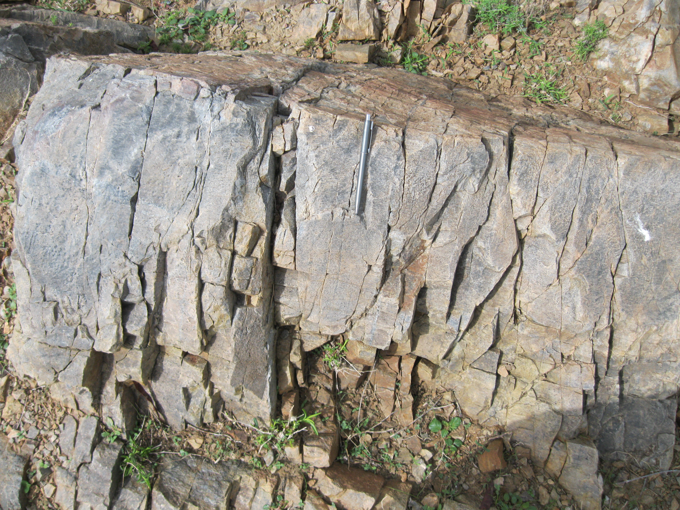

Slide 22
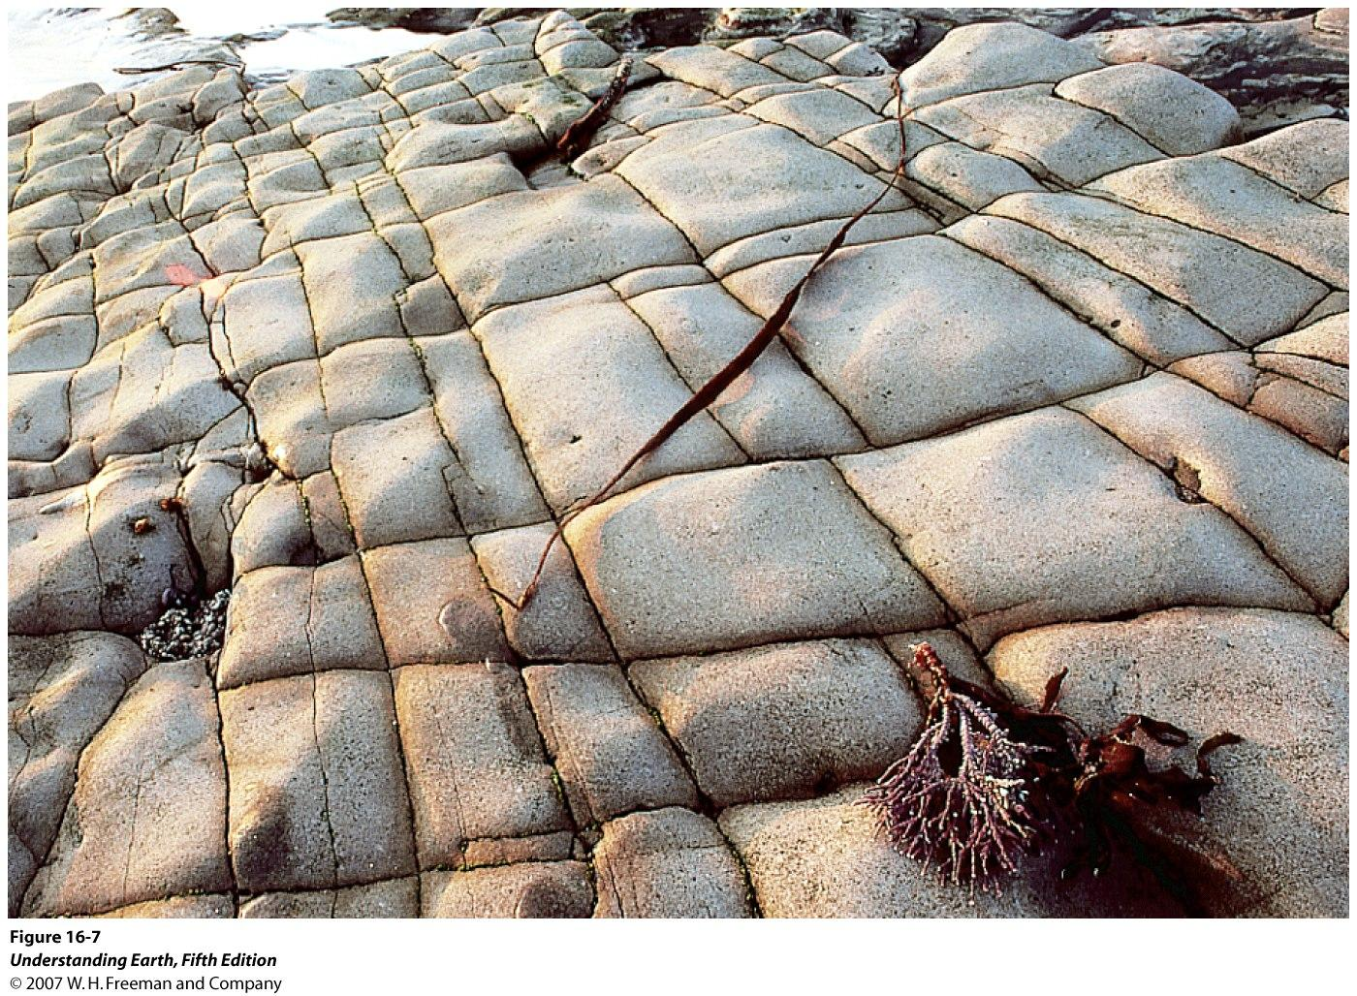

Slide 23
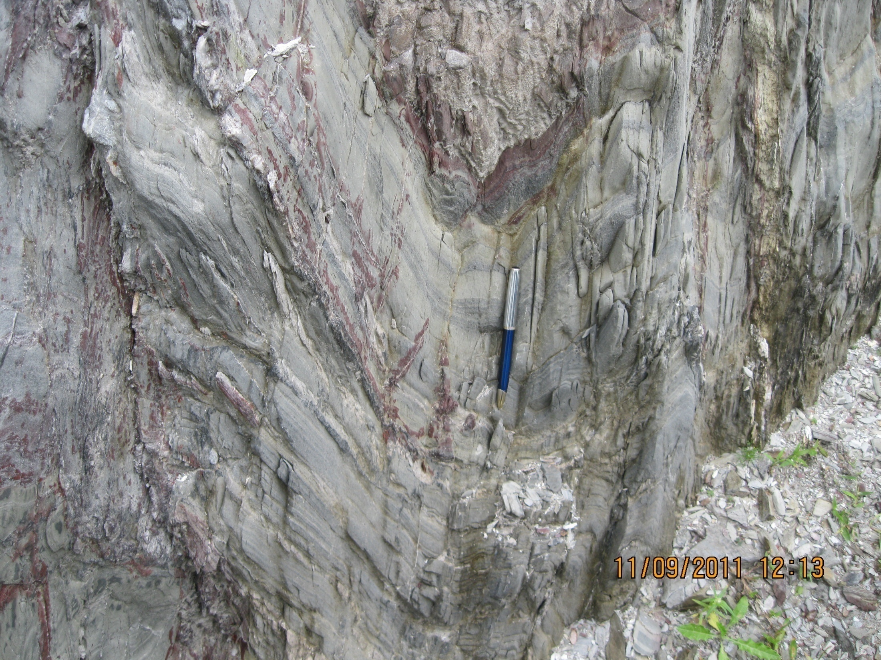

Slide 24
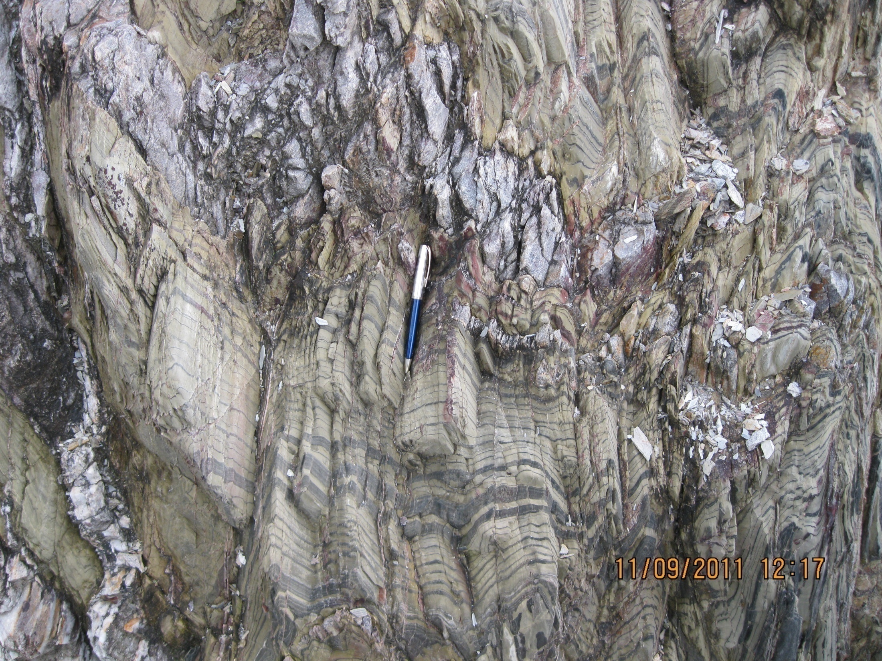

Slide 25
Outlier
A limited area of younger rocks completely surrounded by older rocks is an “Outlier”.
Inlier
A limited area of older rocks completely surrounded by younger rocks is an “Inlier”.

Slide 26
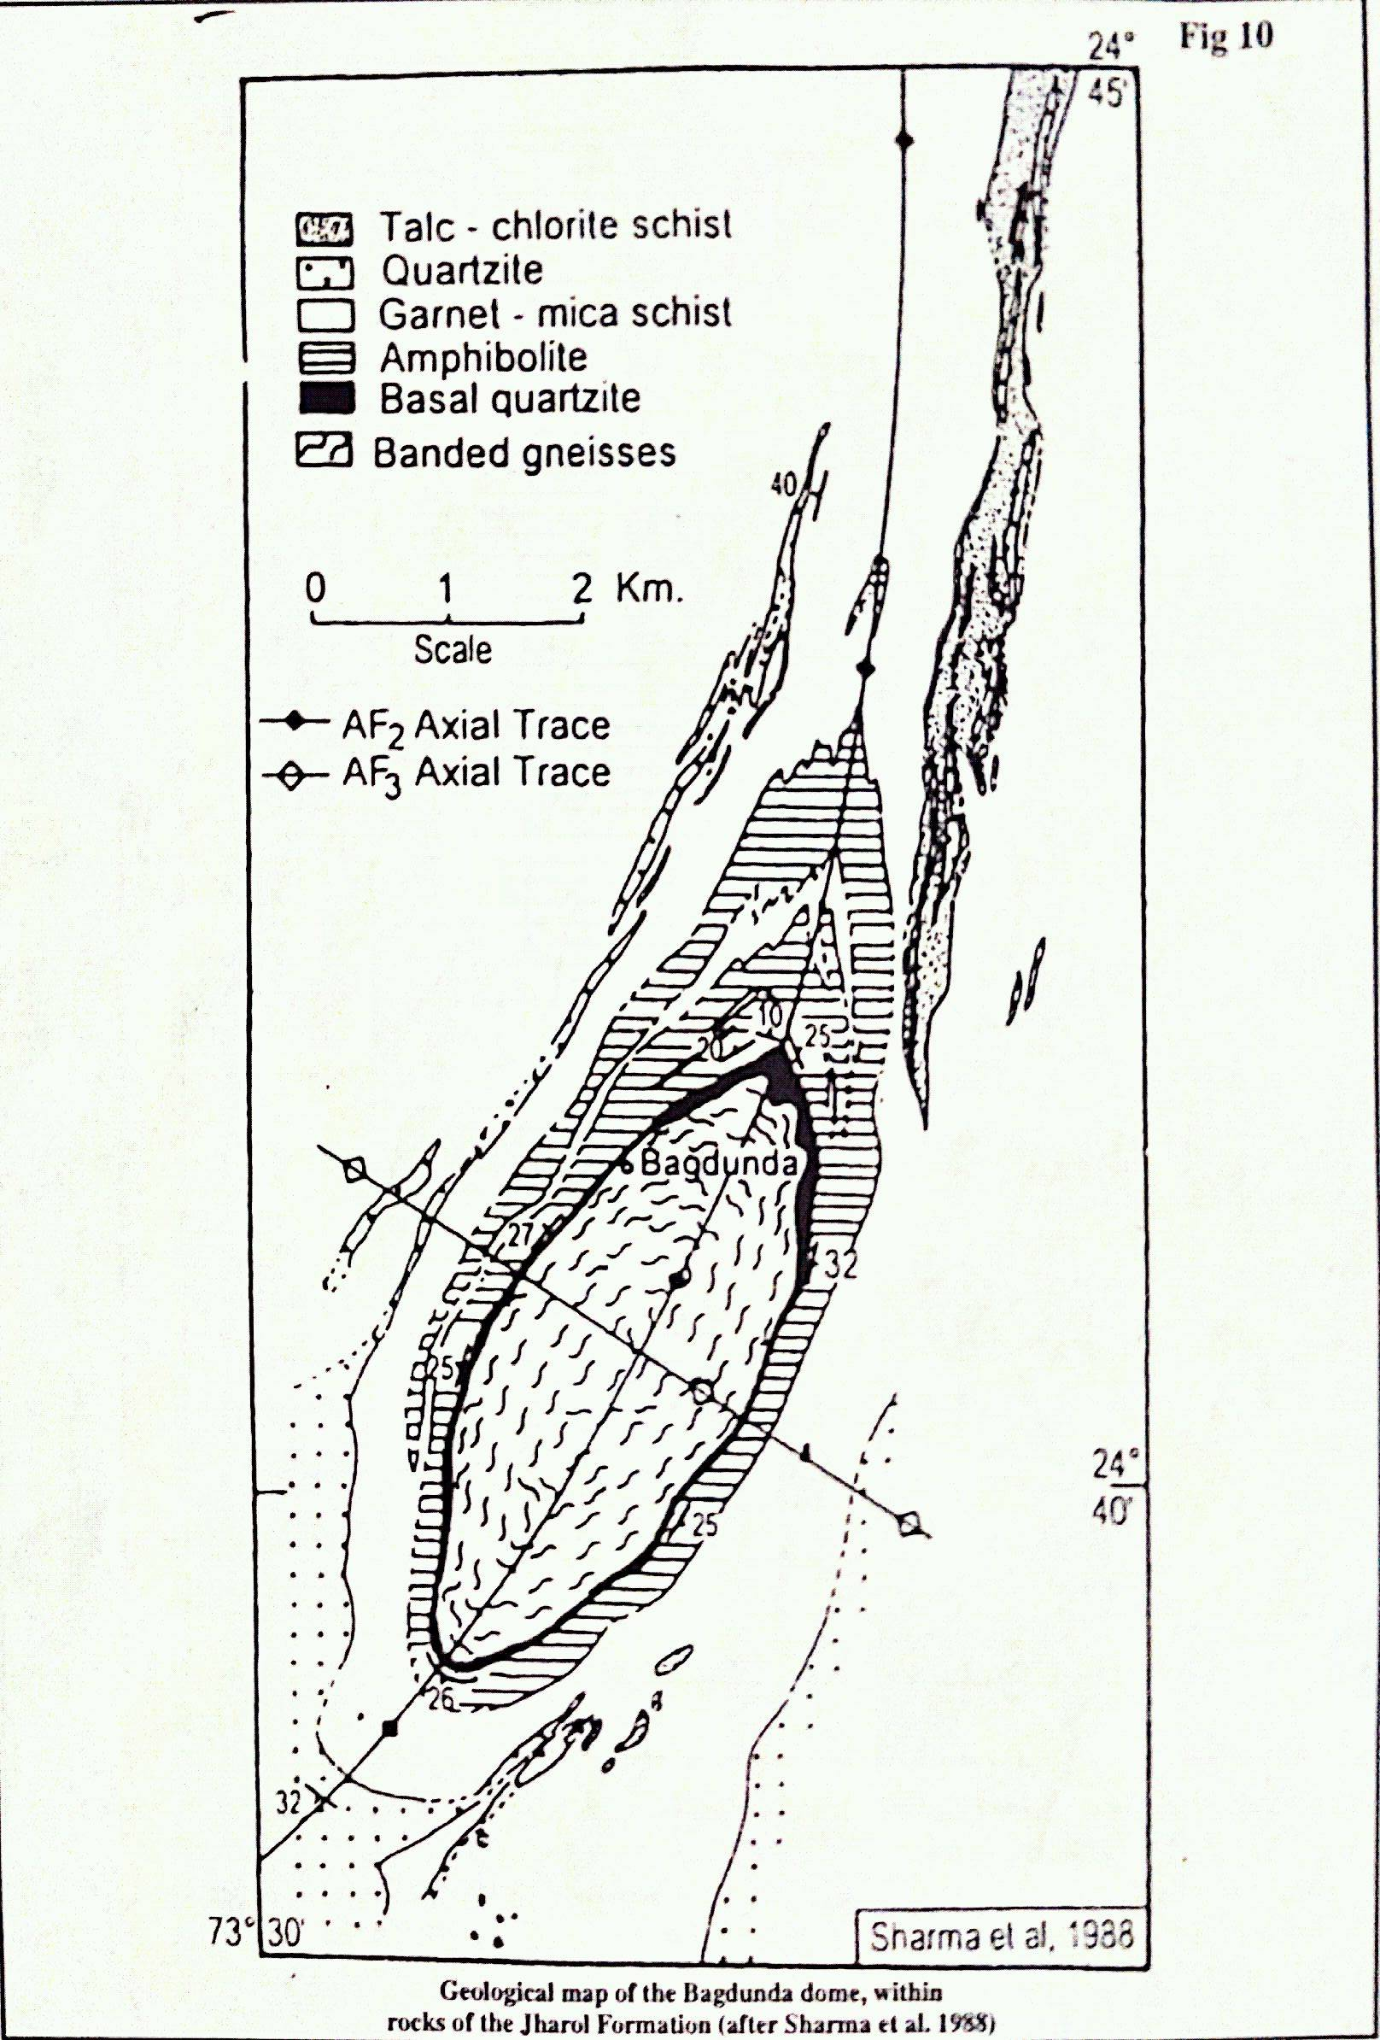
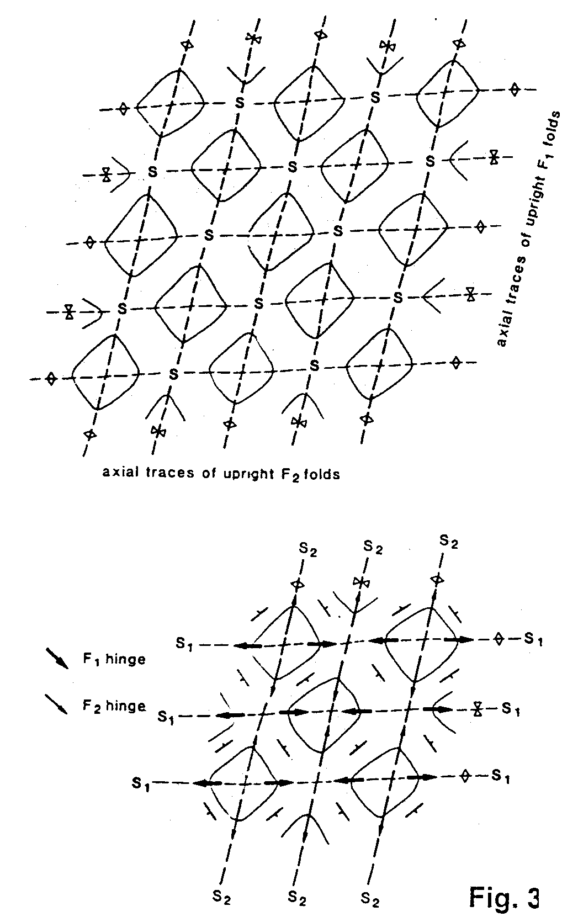

Slide 27
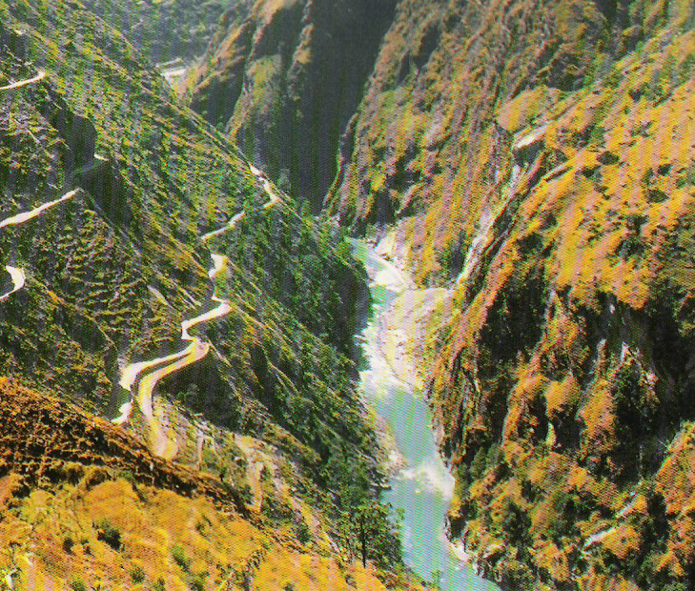
Thank You

