Slide 1
Indoor Residual Spray -INDIA
Prof. Arti Prasad
Head Department of Zoology
University College of Science
MLSU, Udaipur.
Artimlsu@yahoo.co.in
UNIT -1
CHEMICAL CONTROL OF VECTORS

Slide 2
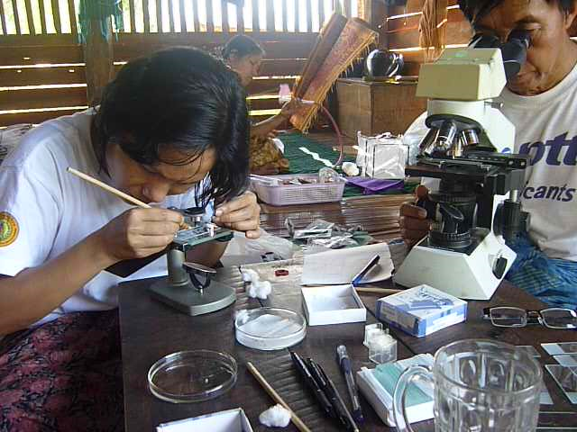
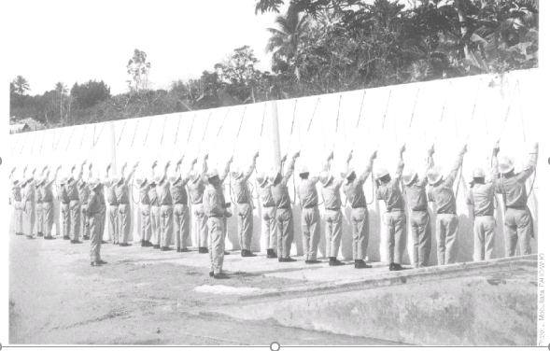
Back to our roots.
“Before DDT Malariologists were trained as problem-solvers….
After DDT, Malariologists were trained as solution-implementers“
José Antonio Nájera
Former Coordinator, WHO
Malaria, Parasitic Diseases and
Vector Control

Slide 3
Mosquitoes
Genus | World |  | India
 | No. of species | Major vector | No. of species | Major vector
Anopheles | 422 | 60 | 58 | 6
Aedes | 888 | 25 | 111 | 1
Culex | 715 | 12 | 57 | 3
Mansonia | 23 | 7 | 4 | 1
Total | > 3000 species under 38 genus |  | 255 species under 15 genus

Slide 4
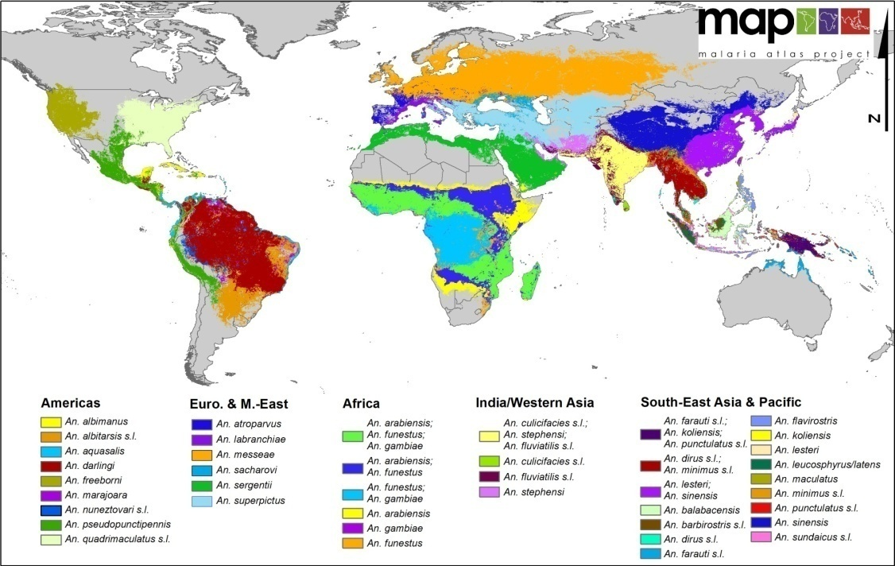
Global map of dominant malaria vector species

Slide 5
Vector Borne Diseases in India
Malaria ,Kala-azar and Filaria in Elimination mode

Slide 6
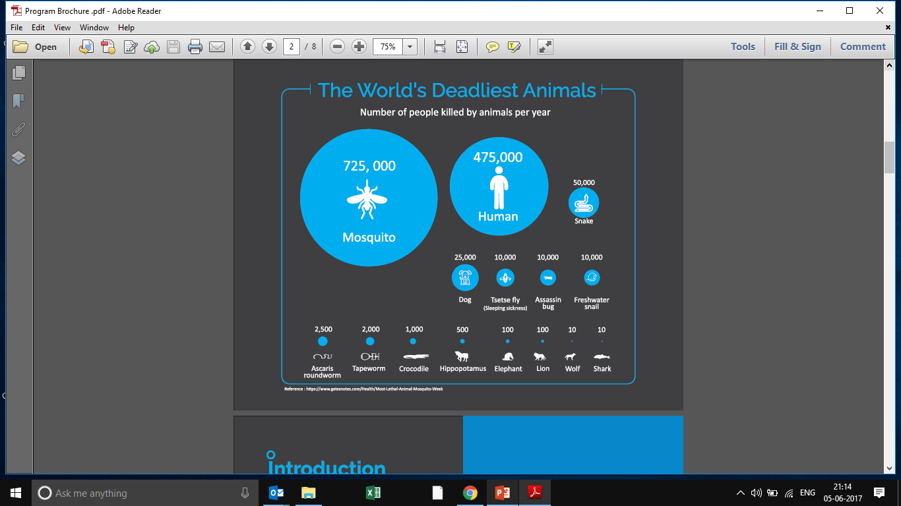
WORLD’S DEADLIEST ANIMALS-
HOW DEADLY?

Slide 7
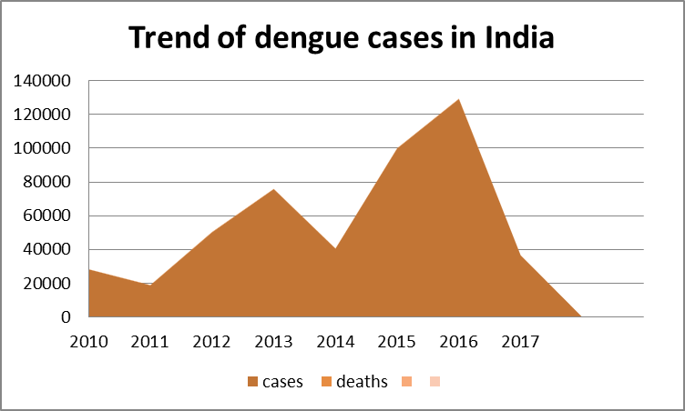
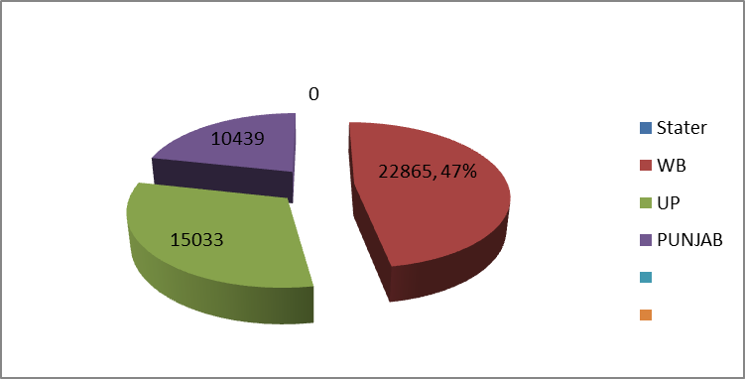
Dengue problem in the country
37 % dengue cases contributed by 3 states
50 % dengue deaths contributed by WB,UP ,MAHARASHTRA

Slide 8
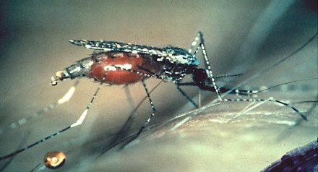
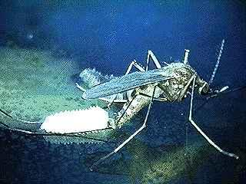
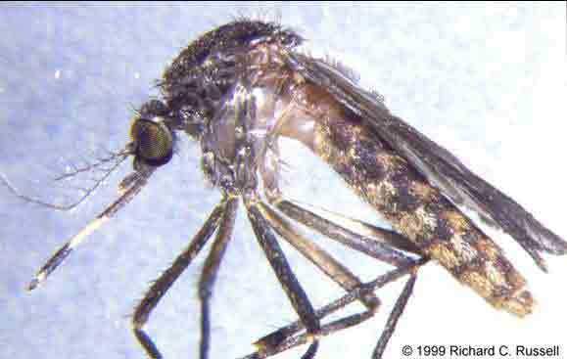
Major Disease Vectors
Malaria
An. culicifacies, An. fluviatilis, An. minimus
An. sundaicus, An. stephensi, An. dirus
Dengue & Chikungunya
Ae. Aegypti, Ae. albopictus
Lymphatic Filariasis
Cx. quinquefasciatus, Ma. annulifera
Japanese Encephalistis
Cx. vishnui, Cx. tritaeniorhyncus
Nuisance Mosquitoes
Cx quinquefasciatus, , Armigeres

Slide 9
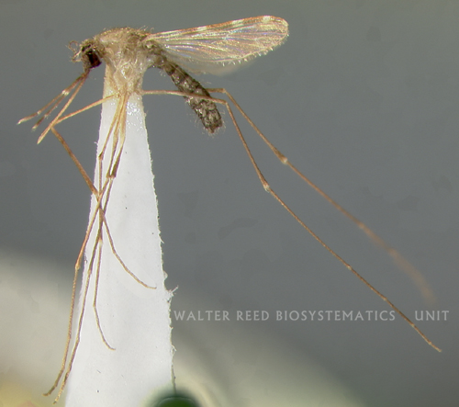
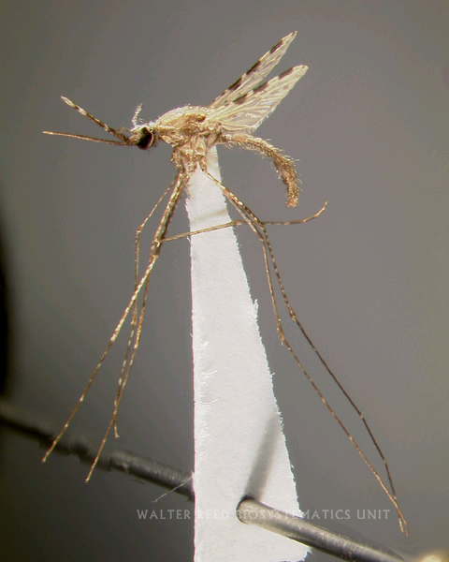
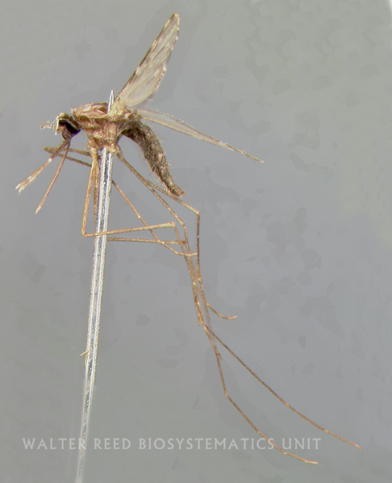
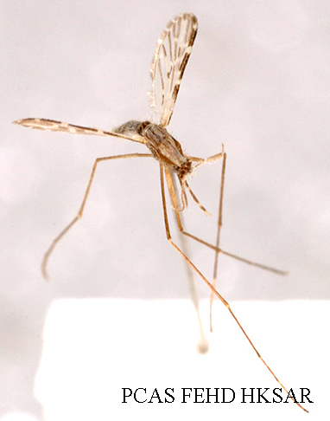
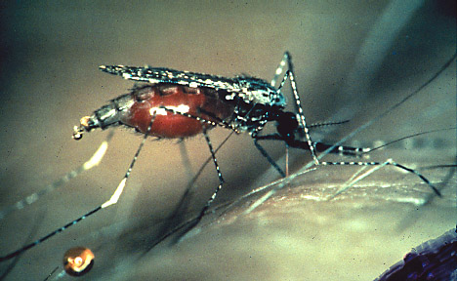
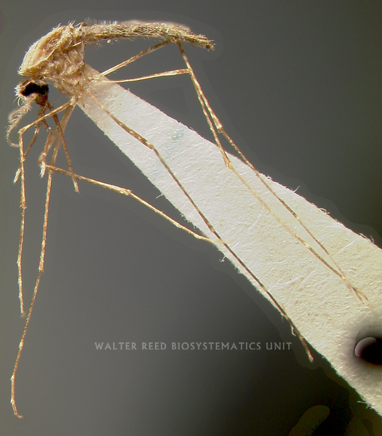
Malaria Vectors
DDT FOR MALARIA VECTORS in india
An. culicifacies | An. stephensi | An. fluviatilis
An. minimus | An. dirus | An. sundaicus
No DDT

Slide 10
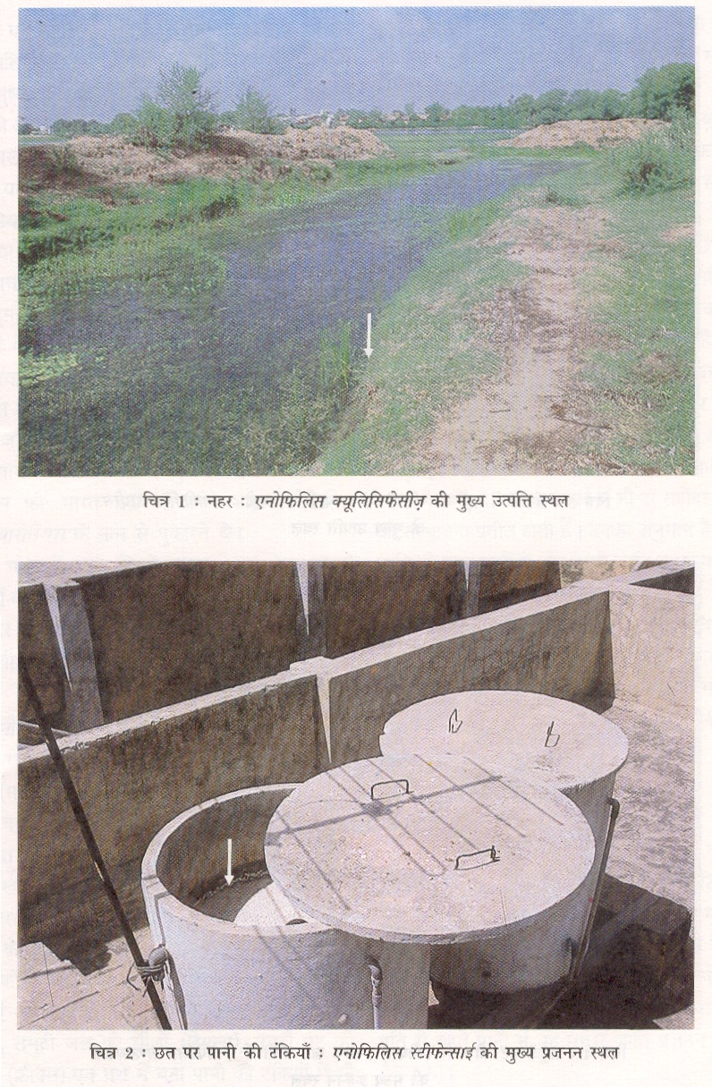
An. culicifacies
Monsoon associated species
An. culicifacies(Epidimic vector)
Monsoon associated species
An. culicifacies (Epidimic vector)
Responsible for 60-70% malaria in India

Slide 11
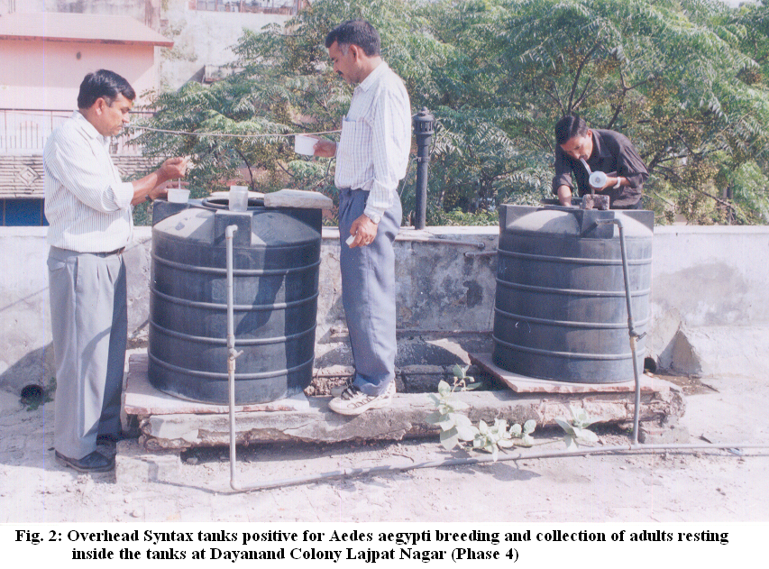
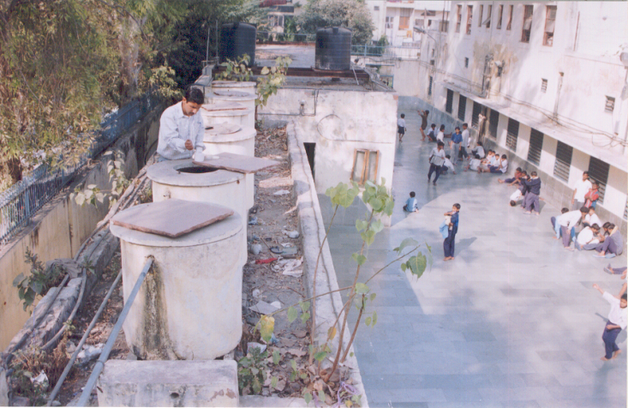
An. stephensi
Urban malaria

Slide 12
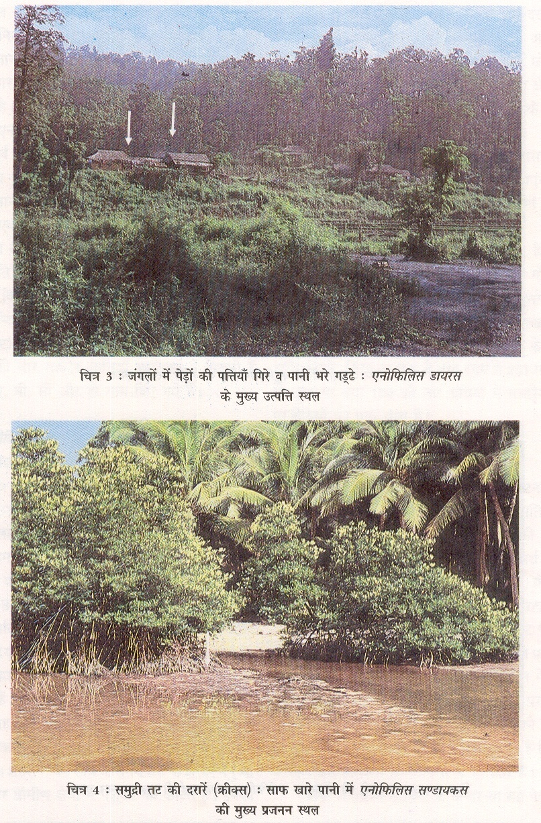
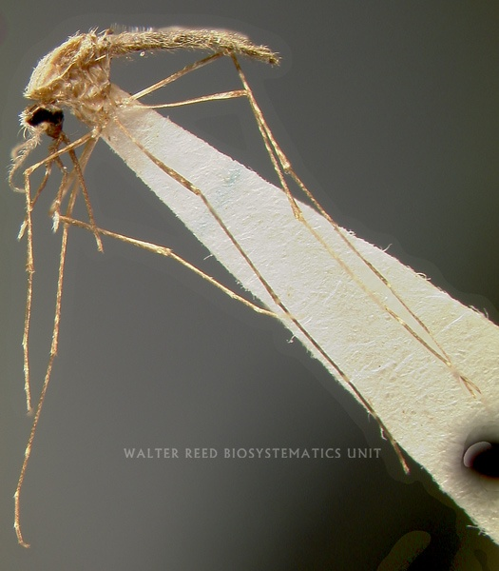
An. dirus and An. sundiacus

Slide 13
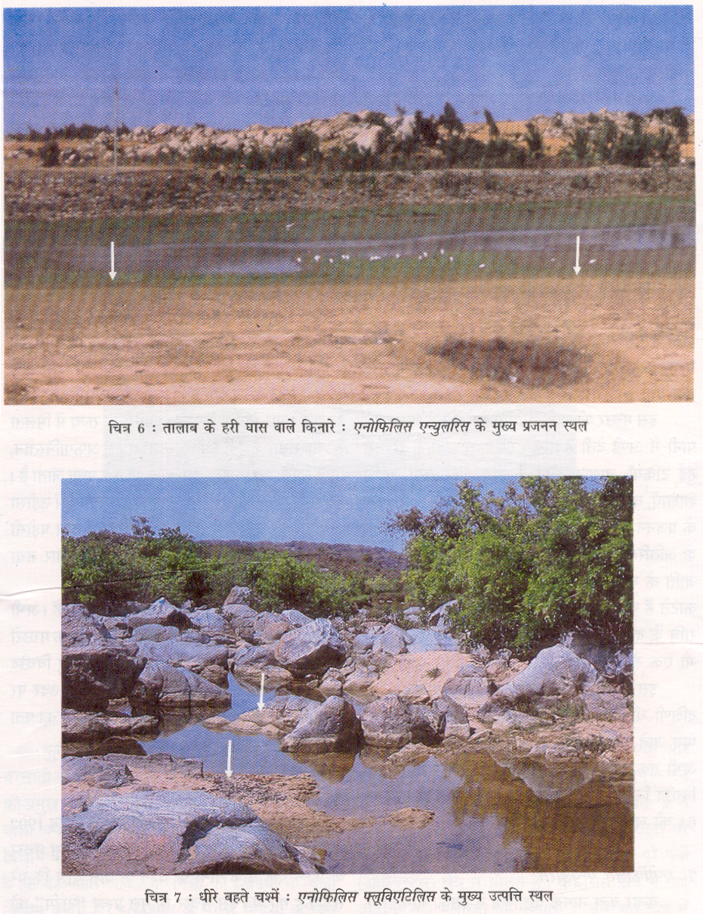

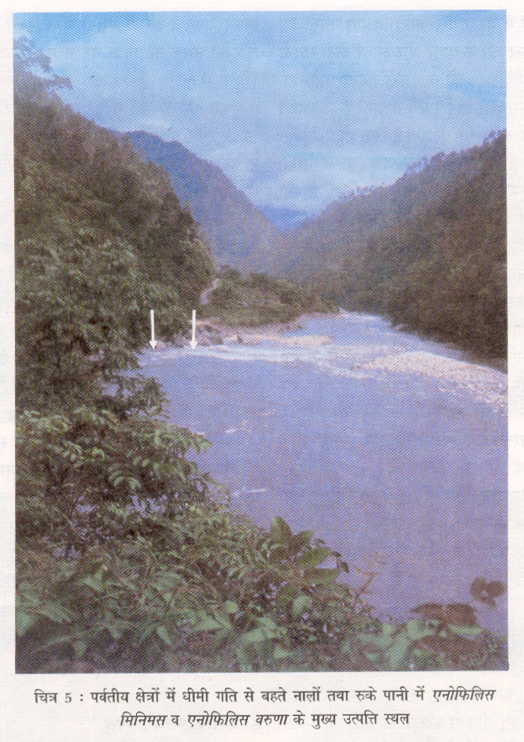
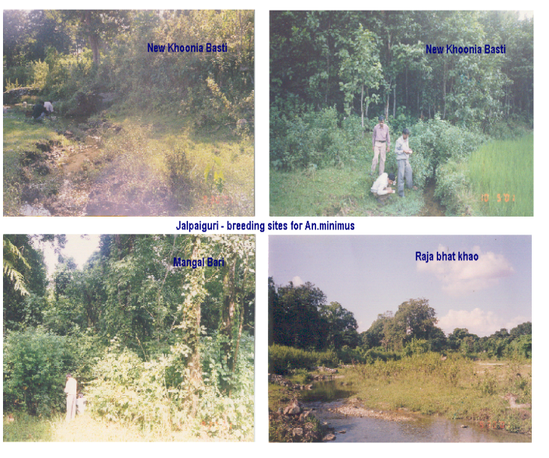
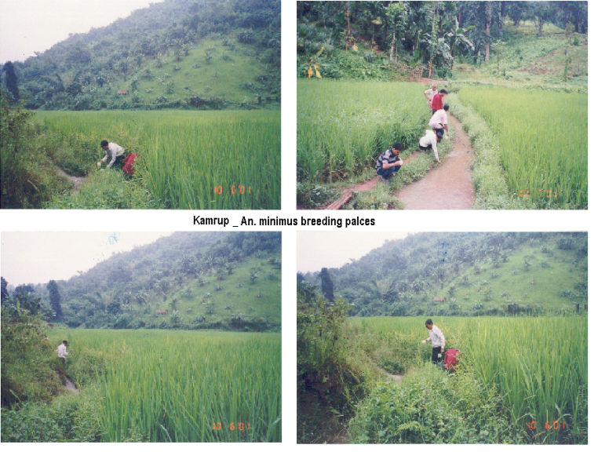
An. fluviatilis and An. minimus

Slide 14
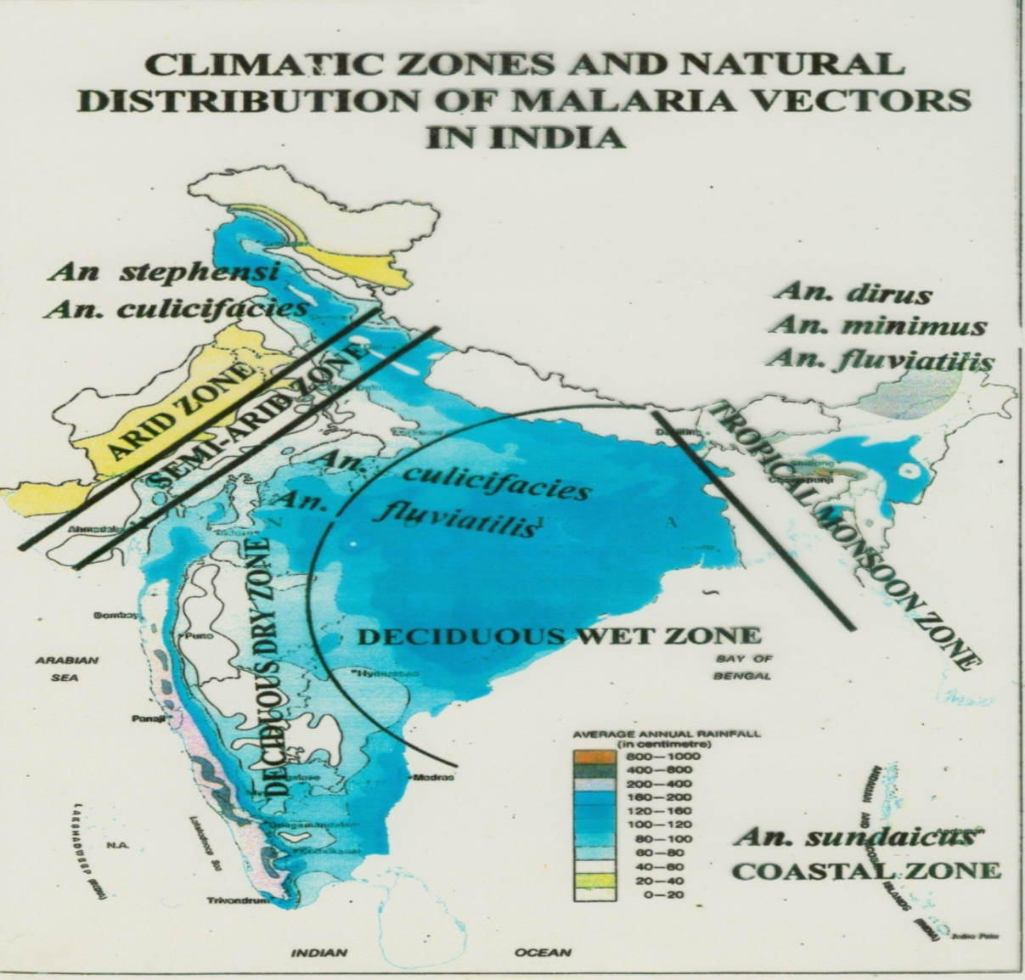
Vectors with variable Endemicity
Malaria free areas
Hyper endemic
An. minimus
and An. dirus
superimposed
Epidemic Prone
Unstable malarious
areas
1947
75 million cases and 0.8 million deaths
2013
0.44 million cases and 519 deaths
Variable endemicity
Relay transmission
NMEP-1958
0.1 million cases and no death.
1976
6.4 million cases

Slide 15
OBJECTIVE OF VECTOR CONTROL
  To Reduce female vector density to a level below which epidemic vector transmission will not occur
  Based on the assumption that eliminating or reducing the number of larval habitats in the domestic environment will control the vector
  The minimum vector density to prevent epidemic transmission is unknown

Slide 16
ASPECTS OF VECTOR CONTROL
Which mosquito species are locally important as vectors of diseases?
Which mosquito species are important as the primary source of annoyance?
What are the important breeding sites of different mosquito species?
What is the seasonal pattern of mosquito breeding?
What are the resting places of adult mosquitoes? What are the feeding preferences of vector mosquitoes?
To map out and locate all potential larval development habitats.
To identify the mosquito species present.
To predict the time and location of effective control strategies.

Slide 17
SELECTION OF VECTOR CONTROL OPTIONS
Chemical Control
Environment Management
Biological Control
Environmental Control
Legislative control
Chemical Control
Biological Control
INTEGRATED VECTOR MANAGEMENT
An Evidence-based decision making process, rationalizing the use of vector control methods and emphasizing the engagement of communities

Slide 18
Control Methods
Chemical Control
EFFICIENT & EFFECTIVE VECTOR CONTORL
Anti larval measures are taken by using ecofriendly Biolarvicide Power Sprayer Tankers are used for spraying larvicide in major drains and big ponds.
Anti Adult measures are initiated by spraying or fogging in and around 50 houses whenever a positive malaria or Dengue case is reported.
Outdoor Fogging by vehicle mounted machine is carried out whenever large number of Dengue cases or outbreak like situation is reported.
DBC- domestic breeding checking door to door

Slide 19
Chemical control
Type of Chemical
Type | Example
Organic Chemicals:
a) Organochlorine | DDT
b) Organophosphate | Malathion, Temephos(Abate), Primiphos methyl
c) Carbamate | Propoxur, Bendiocarb
d) Synthetic Pyrethroids | Deltamethrin, Cyfluthrin, Bifenthrin, Lambdacyhalothrin, Alpha-cypermethrin,
Insect Growth Regulators:
Juvenile Hormones | Methoprene,Pyriproxyfen
Chitin Synthesis Inhibitors | Diflubenzuron,
Natural Insecticides | Pyrethrum extract

Slide 20
Mode of entry and Mode of action
Most people know that insecticides kill insects. However, the way in which these chemicals work is a mystery to most of us.
How an insecticide works is called its mode of action. A complete understanding of the mode of action of an insecticide requires knowledge of how it affects a specific target site within an organism.
The target site is usually a critical protein or enzyme in the insect, but some insecticides affect broader targets.
Although most insecticides have multiple biological effects, toxicity is usually attributed to a single major effect.

Slide 21
Classification of Insecticides
Mode of entry and Mode of action
Mode of entry
  Contact Poisons
  Residual
  Stomach Poisons
  Fumigants
Mode of action
  Nerve poison
  Axonic Poisons (they poison the nerve fiber). They bind to a protein in nerves called the voltage-gated sodium channel.
  Acetyl-cholinestrase inhibitors

Slide 22
Larvicides and Adulticides Organophosphates
Organophosphorus insecticides affect the nervous system. These insecticides are synaptic poisons.
The synapse is a junction between two nerves or a nerve connection point (hence the name synaptic poison).
Specifically, organophosphorus insecticides bind to an enzyme found in the synapse called acetylcholinesterase.
This enzyme is designed to stop a nerve impulse after it has crossed the synapse.
Organophosphorus insecticides bind to and prevent the enzyme from working.
Therefore, poisoned synapses cannot stop the nerve impulse.
Consequently, continued stimulation of the nerve occurs as observed with pyrethroids. Poisoned insects exhibit tremors and uncoordinated movement.

Slide 23
Larvicides — Growth Regulators
These chemicals are typically referred to as insect growth regulators or IGRs. IGRs act on the endocrine or hormone system of insects. These insecticides are specific for insects, have very low mammalian toxicity, are non-persistent in the environment, and cause death slowly.
Most of the currently registered IGRs mimic the juvenile hormone produced in the insect brain. Juvenile hormone tells the insect to remain in the immature state.
When sufficient growth has occurred, the juvenile hormone production ceases triggering the molt to the adult stage.
IGR chemicals, such as methoprene mimic the action of juvenile hormone and keep the insect in the immature state.
Insects treated with these chemicals are unable to moult successfully to the adult stage, and cannot reproduce normally.

Slide 24
Larvicides — Bacteria
Bacillus thuringiensis var. israelensis (Bti) is a naturally occurring bacterium that produces a crystalline protein toxin (crystal) and a spore.
The larval activity of Bti formulations is due to the presence of the protein toxin. The spore has no larvicidal activity. For mosquito larvae, many factors are necessary to produce the toxic effects of Bti crystals. If the crystals are available in sufficient quantity, to suffer toxicity and die, a larva must : 1) Capture and ingest the crystals, 2) Possess a digestive tract with a highly alkaline pH, 3) Possess the enzymes capable of liberating the toxic proteins, and 4) Possess the gut membrane receptors, compatible with the solubilized toxins.
Bti-based products are not insecticides of contact. The active ingredient (crystals) must be ingested to show a toxic activity. This very specific mode of action makes it very safe for non-target organisms present in the same environment.
Bacillus sphaericus (Bs) is also a naturally occurring, spore-forming bacterium found throughout the world. At the time of sporulation, Bs produces crystallin proteins (as in Bti but different) toxic for many species of mosquito larvae upon ingestion.

Slide 25
Larvicides
Very refined oil or surfactants can be used as larvicides. These products have the ability to kill both larvae and pupae.
The surfactant used is also called monomolecular film (MMF).
Using conventional spraying methods, the invisible monomolecular film quickly spreads over standing water habitats.
The film reduces the surface tension of the water making it difficult for the mosquito larvae to attach to the surface which causes them to drown. Emerging mosquitoes are unable to fully emerge and will drown.
Mosquito larvicide are effective on all species of mosquitoes that breed in standing water and require the air/water interface in their lifecycle.

Slide 26
ULV Adulticides — Pyrethroids
Pyrethroids are synthetic chemicals whose structures mimic the natural insecticide pyrethrin.
Pyrethrins are found in the flower heads of plants belonging to the family Compositae (e.g. chrysanthemums).
These insecticides have a unique ability to knock down insects quickly.
Synthetic pyrethrins (also known as pyrethroids) have been chemically altered to make them more stable.
Pyrethroids are axonic poisons (they poison the nerve fiber).
They bind to a protein in nerves called the voltage-gated sodium channel. Normally, this protein opens causing stimulation of the nerve and closes to terminate the nerve signal

Slide 27
ULV Adulticides — Pyrethroids
Pyrethroids bind to this gate and prevent it from closing normally which results in continuous nerve stimulation.
This explains the tremors exhibited by poisoned insects. They lose control of their nervous system and are unable to produce coordinated movement.
Pyrethroids are most of the time used with piperonyl butoxide (PBO) which is a synergist that is usually incorporated within the final products.
PBO enhances the effect of pyrethroids by inhibiting an enzyme (cytochrome P450) produced by the insect to break down the pesticides.
The PBO allows the insecticides to be effective with less active ingredient than would otherwise by required.

Slide 28
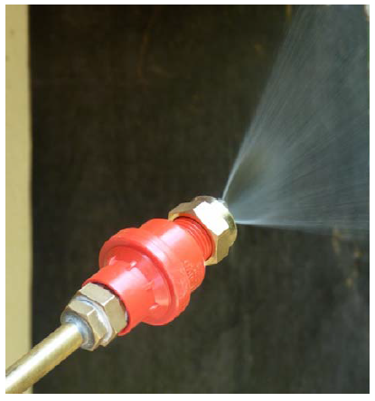
Indoor Residual Spray
This is defined as the application of an insecticide having a property of a long residual affect in some liquid form which on drying, leaves a crystalline deposit on the sprayed surface
Mosquito resting places are the primary sites of treatment. Mosquitoes rest on these sprayed surfaces, pick up and get killed
Indoor residual spraying is the most widely used vector control method
More appropriate method for rural areas

Slide 29
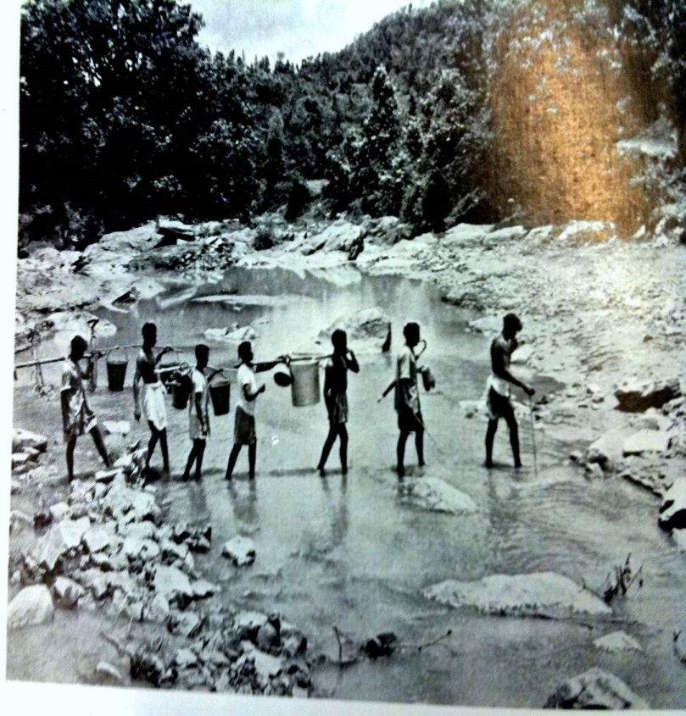
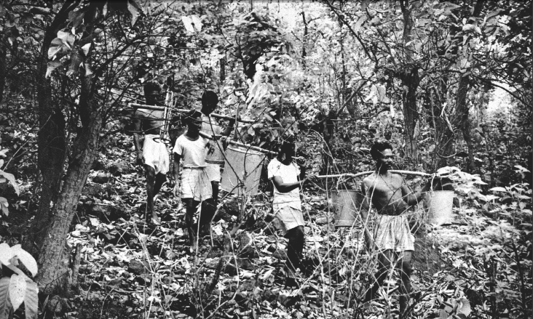
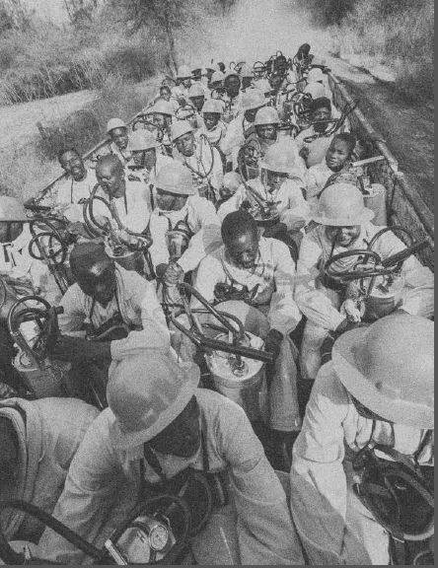
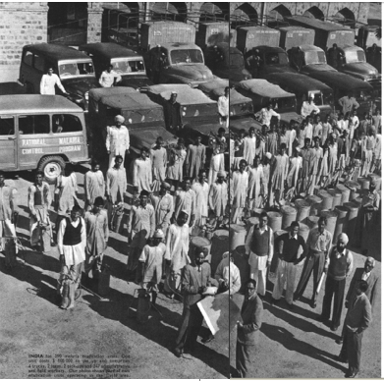
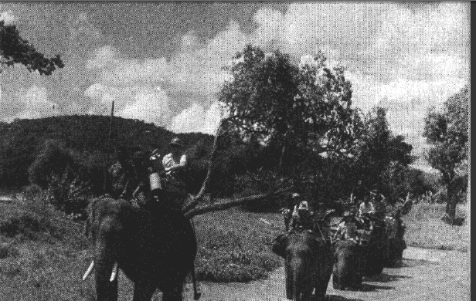
“Military” Spray Campaigns
World Malaria Report, 2016
World Health, 1960 (Mar-Apr) Special issue on Malaria (@ J.Najara)
@The Global Fund/John Rae
World Health, 1960 (Mar-Apr) Special issue on Malaria (@ J.Najara)

Slide 30
Chemical Methods of vector control
Chemicals which are used for killing insects (Disease Vectors) are known as insecticides
Chemicals which are used to kill adult insects are called as adulticides
Chemicals used for killing larvae are called as larvicides
Vector Control
Anti adult measures
Anti larval measures
Types of vector control Methods
Physical
Chemical
Biological
Environmental

Slide 31
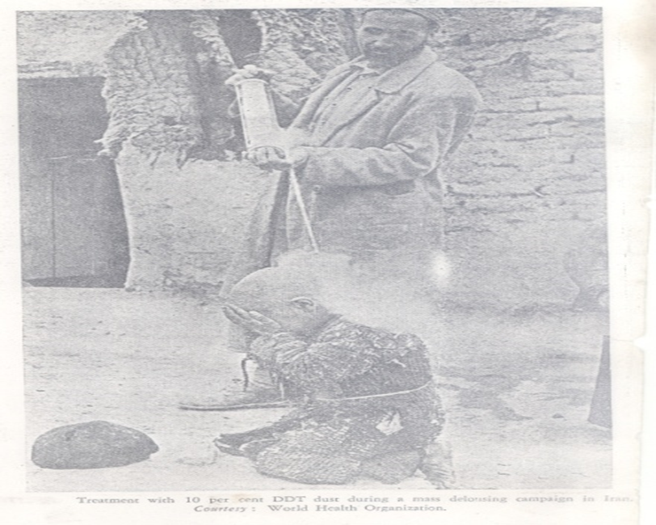
Classification of Insecticides-Type of application
Larvicides
Adulticides
Residual insecticides
Space sprays

Slide 32
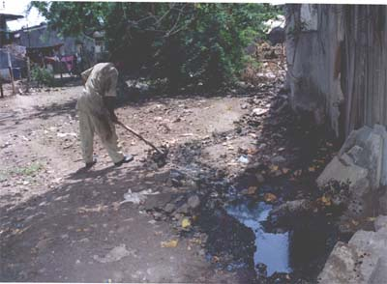
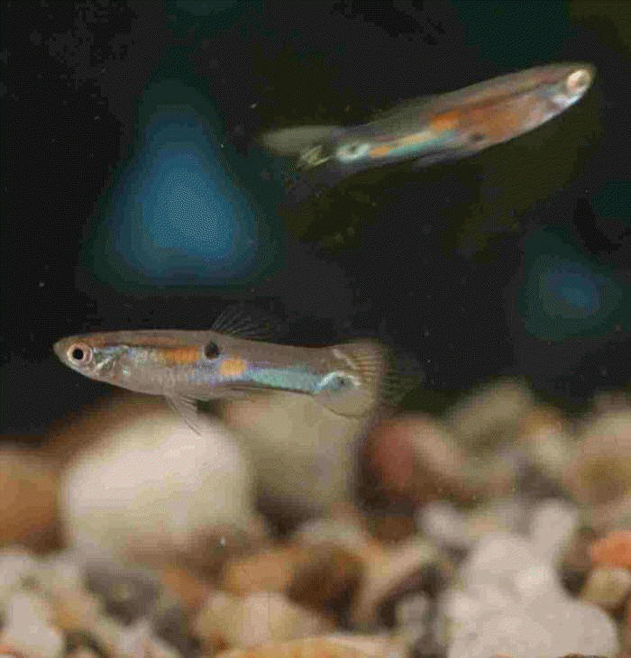
Control Strategy -urban areas in country
Larval Control
Source reduction
Chemical control
Law enforcement
Environmental
Biological control
Health Education

Slide 33
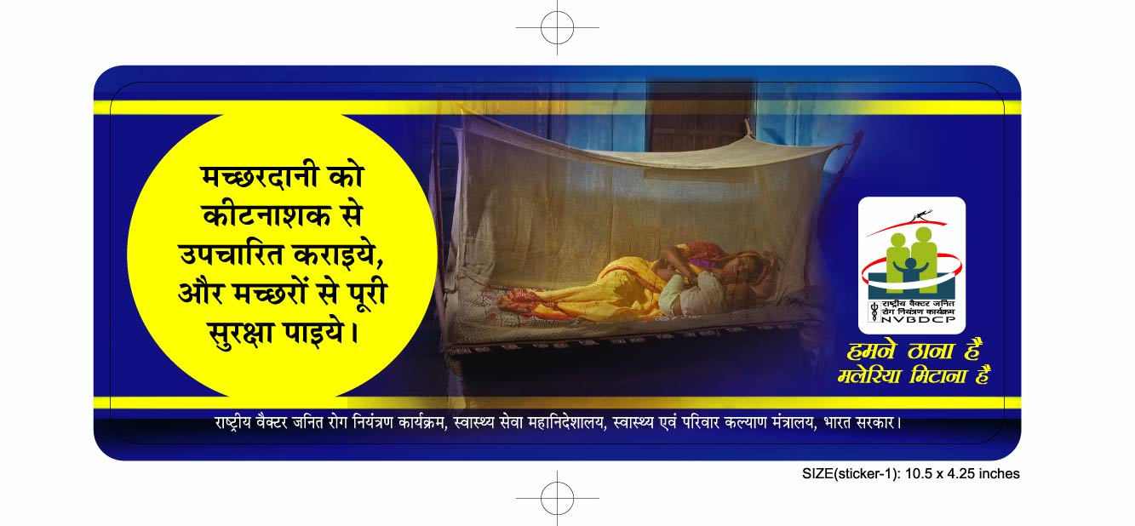
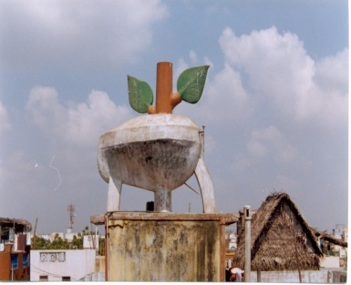
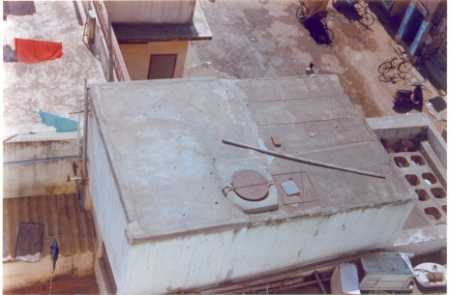
Vector Control Strategies
VECTOR CONTROL STRATEGY
Malaria
Elimination mode
Indoor Residual Spray (IRS)
Long Lasting Insecticidal Nets (LLINs)/ Insecticide- treated Nets (ITNs)
Larval Source Management (LSM)

Slide 34
Phasing of Malaria Elimination
Category 1
(15)
Chandigarh, Daman & Diu, Delhi, Goa, Haryana, Himachal Pradesh, J & K, Kerala, Lakshwadeep, Manipur, Puducherry, Punjab, Rajasthan, Sikkim, Uttarakhand
Category 2
(11)
Category 3
(10)
Andhra Pradesh, Assam, Bihar, Gujarat, Karnataka, Maharashtra, Nagaland, Tamil Nadu, Telangana, Uttar Pradesh, West Bengal
A & N Islands, Arunachal Pradesh, Chhatisgarh, Dadra & Nagar Haveli, Jharkhand, Madhya Pradesh, Meghalaya, Mizoram, Odisha, Tripura
Less than one API
States/UT less than one API and one or more districts with two API
State/Uts with more than two PI

Slide 35
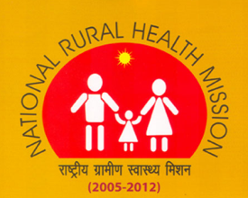
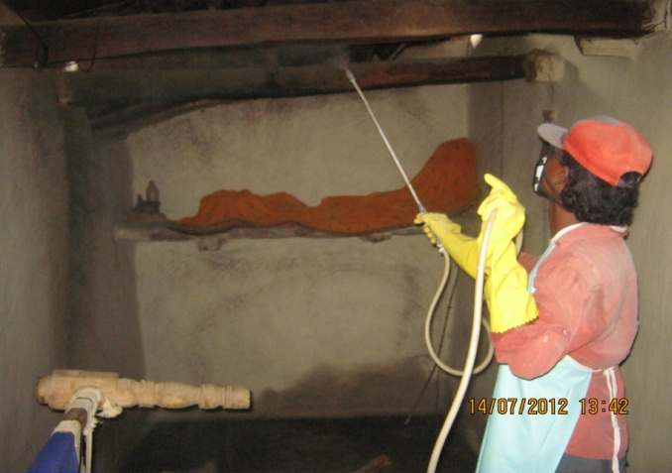
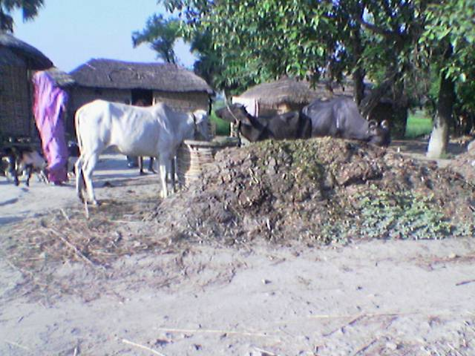
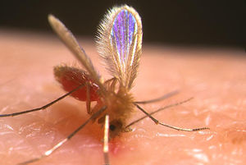
  VECTOR CONTROL STRATEGY
    Two PRONGED
    Indoor Residual Spraying with
    Synthetic pyrethroids / DDT up to
    6 feet height from the ground
    twice annually.
    Hygiene and environmental
    sanitation
Contd…/-

Slide 36
IRS - Insecticide Dosage, Dilution and Requirement
INSECTICIDE | DOSAGE PER Sq. m. (a.i.) | DILLUTION PER 10 LTR. OF WATER (covers 500 sq m area) | INSECTICIDE FORMULATION PER HOUSE (150 Sq. m) PER ROUND | AVERAGE PER 5000 POPU. (or 1000 houses)PER ROUND | TOTAL PER ANNUM
DDT 50%* | 1 gm | 1 Kg | 300 gm | 375 Kg | 750 Kg
Malathion 25% (2 coats and 3 rounds per annum) | 2 gm | 2 Kg | 1200 gm | 1500 Kg | 4500 Kg
Deltamethrin 2.5% | 20 mg | 400 gm | 120 gm | 50 Kg | 300 Kg
Cyfluthrin 10% | 25 mg | 125 gm | 37.5 gm | 46.87 Kg | 93.75 Kg
Lambdacyhalo-thrin 10% | 25 mg | 125 gm | 37.5 gm | 46.87 Kg | 93.75 Kg
Alphacyperme-thrin 5% | 25 mg | 250 gm | 75 gm | 93.75 Kg | 187.50 Kg

Slide 37
LARVICIDE FORMULATIONS AND DOSAGE
S.No. | Name of Larvicide | Commercial formulation | Preparation of ready to spray formulation | 1 square meter | 50 Linear meter | Per Heactare | Frequency of application | Equipment required | remarks
1 | MLO | 100% petroleum project product | As it is | 20 C.C. | 1 Litre | 200 Litres | Weekly | Knapsack/ hand compression sprayer | To be applied along the shore of water body
2 | Temephos (Abate) | 50% EC | 2.5 c.c. in 10 litres of potable water | 20 C.C. | 1 Litre | 200 Litres | -do- | Knapsack/ hand compression sprayer | Can be applied in clean water
3 | Bacillus thuringiensisvar israelensis WP | Wettable powder | 5 kg in 200 litres of water | - | - | 5 kg | Fortnightly | Knapsack/ hand compression sprayer | For both clean and non-potable polluted water
4 | Bacillus thuringiensisvar israelensis 12 Aqueous Suspension (AS) | Aqueous suspension 12 Aqueous Suspension | 1 litre in 200 litres of water | - | - | 1 Lit. | Weekly | Knapsack/ hand compression sprayer | Clean water
 |  |  | 2 litres in 200 litres of water | - | - | 2 Lit. | Weekly | Knapsack/ hand compression sprayer | Polluted water
In the case of Malathion, the requirement shown above, is for the three rounds

Slide 38

LARVICIDE FORMULATIONS AND DOSAGE
S.No. | Name of Larvicide | Commercial formulation | Preparation of ready to spray formulation |  |  | Per Heactare | Frequency of application | Equipment required | remarks
5 | Diflubenzuron IGR | 25% Wettable Powder | 100 gms (25 gm a.i) in 100 Litres of water (10 g in 10 litre) 100 litre Clean Water 200 gms (50 gm a.i) in 100 Litres of water (20 g in 10 litre) |  |  | 100 lit. 200 lit | Weekly | Knapsack/ hand compression sprayer | To be applied along the shore of water body Clean water ------------ Polluted water
6 | Pyriproxyfen GR | 0.5% Granular | Ready to use |  |  | 2 kg. Clean Water ------------------------------ 4 kg. polluted water | 3 weekly | Manual | clean water ------------- Polluted Water

Slide 39
Space spray-Dosage, Dilution and Requirement
INSECTICIDE | Dosage | DILLUTION
1. Pyrethrum Extract | 2% Extract | 1 part of 2% Pyrethrum Extract in 19 parts of Kerosene (50 ml in 1 litres K.Oil Used for Indoor Space Sp
2. Malathion Tec. | OP | 1:19 i.e.1 part of Malathion Tech in 19 parts of Diesel (50 ml in 1 litres diesel) Used for out door thermal fogging
3 Cyphenothrin Synthetic pyrethirod | 5%EC | 0.5 mg a.i per sq.mt. (20 ml in 1 litres K.Oil) Used for Indoor Space Sp
4. Cyphenothrin | 5%EC | 3.5 g a.i per hactare (7 ml in 1 litres diesel Out door thermal fogging

Slide 40
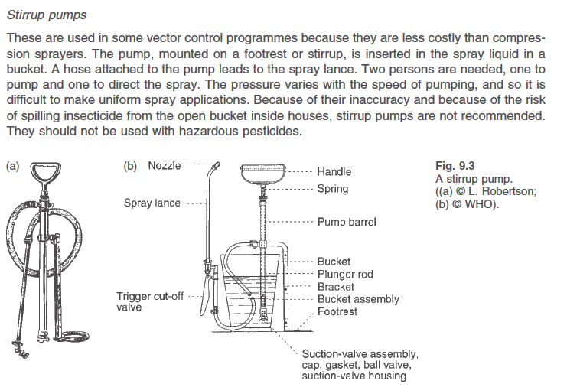
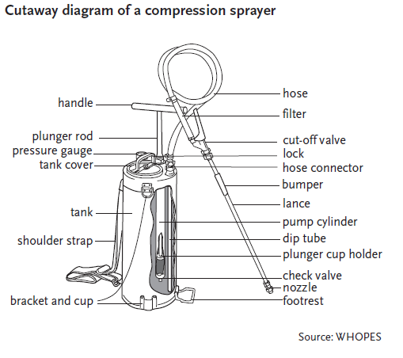
Insecticides for IRS under NVBDCP
Insecticide-formulation \ | Dosage/m² | Efficacy (Wks) | Rounds
DDT-50% WP | 1 gm | 10-12 | 2
Malathion-25% WP | 2 gm | 6-8 | 3
Deltamethrin-2.5% WP | 20 mg | 10-12 | 2
Cyfluthrin-10% WP | 25 mg | 10-12 | 2
Lambdacyhalothrin-10% WP | 25 mg | 10-12 | 2

Slide 41
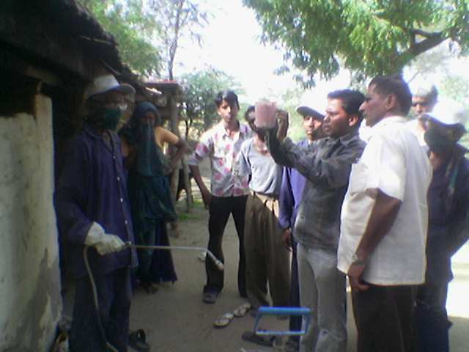
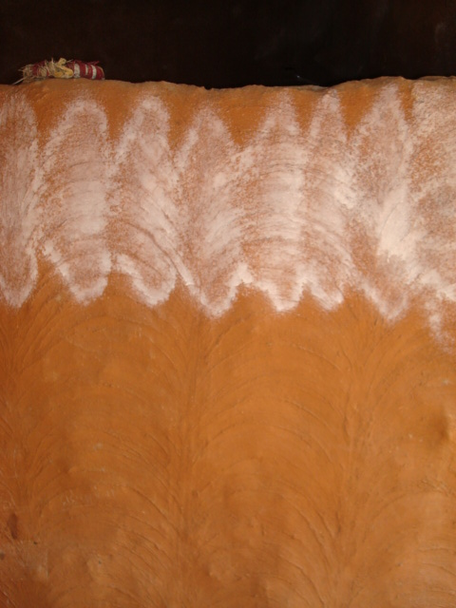
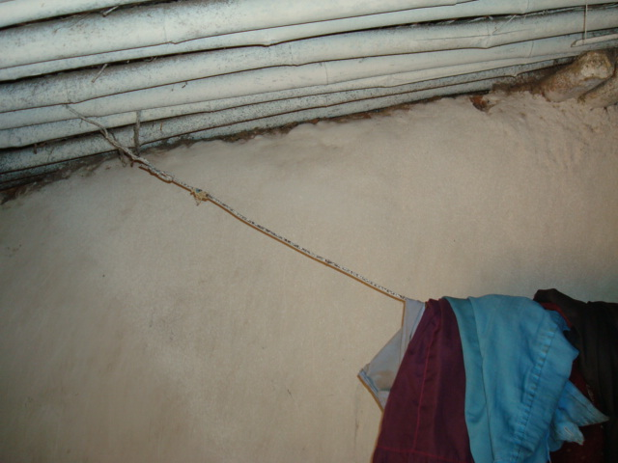
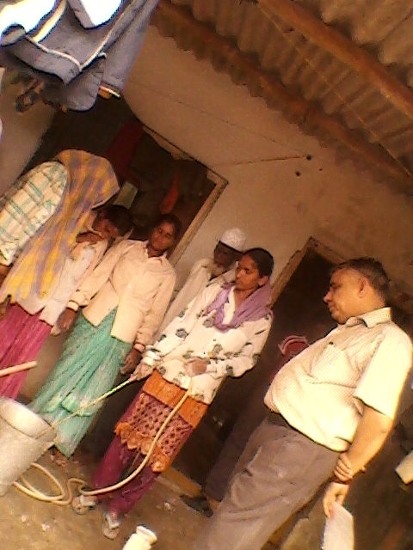
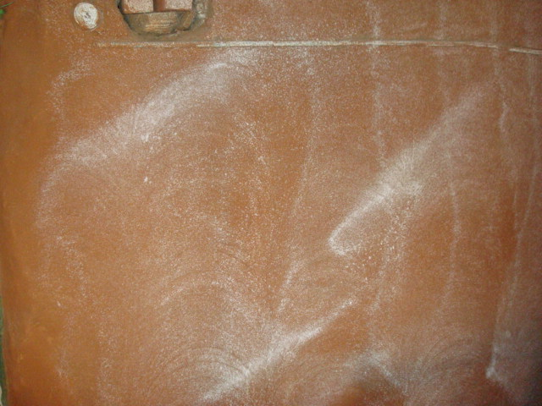
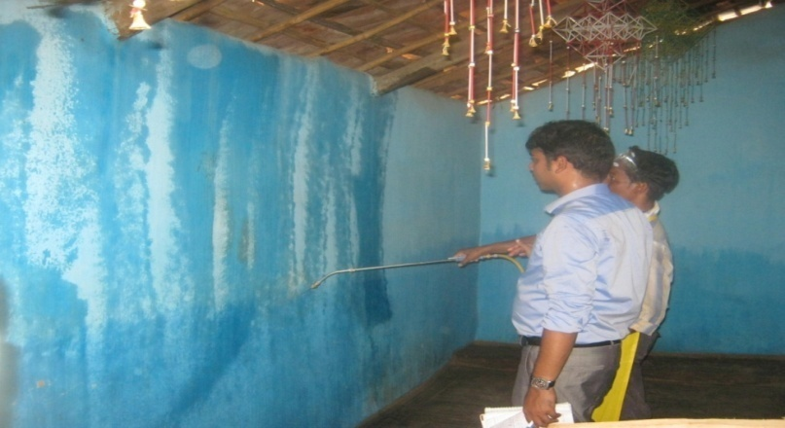
CAPACITY BUILDING FOR IRS
Spray Technique
Challenges
Vector Control
IRS
Good Quality
Change Nozzle tip

Slide 42
Space Spray
Space spraying involves the application of small droplets of insecticide into the air.
These insecticides instantly kill the mosquitoes, but lack any residual effects.
They are therefore sprayed into the air. By killing adult mosquitoes, not only bites are prevented, but breeding is also prevented, resulting in net reduction in the mosquito population.
Space sprays must be repeated often, at least once every week.
Pyrethroids are commonly used for this purpose.
Generally, there are two forms of space-sprays, namely thermal fogs and cold fogs and both can be dispensed by vehicle-mounted or hand-operated machines.

Slide 43
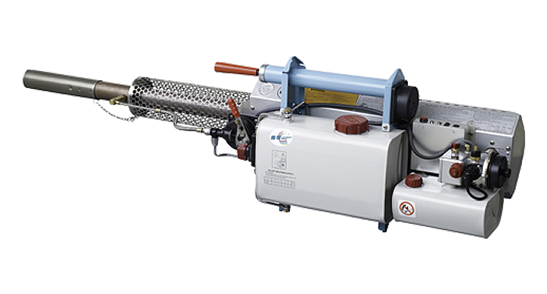
Thermal fog
  Thermal fogs are produced when an insecticide formulation condenses after being vaporized at a high temperature.
  These formulations can be oil-based or water-based; the oil (diesel)-based formulations produce dense clouds of white smoke, whereas water-based formulations produce a colorless fine mist.
  Hot gas is used to heat the pesticide spray, decreasing the viscosity of the oil carrier, and vaporizing it.
  When it leaves the nozzle the vapour hits colder air and condenses to form a dense white cloud of fog. Most of the droplets are smaller than 20 µm.
  The droplet size is affected by the interaction between the formulation, the flow rate and the temperature at the nozzle (usually > 500 °C).
  The volume of spray mixture applied in vector control is usually 5–10 litres per hectare, with an absolute maximum of 50 litres per hectare.

Slide 44


Slide 45


Slide 46


Ultra-low volume (ULV)
  ULV involves the application of a small quantity of concentrated liquid insecticides.
  The use of less than 4.6 litres/ha of an insecticide concentrate is usually considered as an ULV application.
  ULV is directly related to the application volume and not to the droplet size.
  Nevertheless, droplet size is important and the equipment used should be capable of producing droplets in the 10 to 15 micron range.
  The droplet size should be monitored by exposure on teflon or silocone-coated slides and examined under a microscope.
  Aerosols, mists and fogs may be applied by portable machines, vehicle-mounted generators or aircraft equipment.

Slide 47
JE - Vector Control Strategy
Chemical vector control is not a solution, as the breeding sites (irrigated rice fields) are extensive.
In some rice production systems faced with water shortages, however, certain water management measures (alternate wetting and drying) may be applied that reduce vector populations.
Personal protection (using repellents and/or mosquito nets) will be effective under certain conditions.
Eliminating the pig population is often a measure taken in the wake of outbreaks. Certainly, the introduction of pig rearing as a secondary source of income for rice-growing farmers in receptive areas must never be encouraged.
Fogging in domestic/peridomestic areas during outbreaks.
Control programs for JE have focused on three major areas
  Vector control
  Amplifying host (Pig) control
  Vaccination

Slide 48


Vector Control Strategies
Dengue/Chikungunya : Based on larval control
Source reduction.
Use of chemicals/Bio-larvicides
Professional management and solid waste disposal.
Space spray in Dengue Positive houses.

Slide 49






Dengue / Chikungunya
VECTOR CONTROL
vector control options :
Source reduction - elimination of Aedes aegypti breeding at weekly interval including use of Petroleum oil/ Kerosene oil/ Temephos
Mosquito proofing of water tanks ( over head & ground tanks), buildings
Use of mosquito nets ( preferably LLIN)– to prevent infection in hospital wards to others
Pyrethrum space spray/ ULV during outbreaks

Slide 50

Vector Control
Ordinary cooler
NCDC Cooler
Mosquito proof

Slide 51

VECTOR CONTROL –CHALLENGES
EVEN IN GOVERNMENT BUILDINGS THE OVER HEAD TANKS ARE BUILT VIOLATING THE PUBLIC HEALTH PRINCIPLES

Slide 52



Vector control Challenges-

Slide 53
CANTONMENTS
Environment Management Methods
(EMM)Technology
Mian Mir Cantonment- Lahore (now in Pakistan) Vector An. culicifacies-Surface pool breeder.
First ever experimented by S.R. Christopher and S.P. James
1901 1) Drainage of all stagnant waters within ½ mile of the cantonment area
2) Quinine therapy (established in 1847)
1903 Results were disappointing
1904 Canal network was found supporting heavy breeding of An. culicifacies
1905-1908 Canal network was filled by deployment of 500 soldiers and one engineering regiment.
Project did not show any success
1909 Disappointing failure resulted in establishment of “Malaria Survey of India” the first malaria Research Institute of the World.
1926 malaria was ultimately controlled by screening of all bunglows/houses, as flight range of vector species exceeded 2 kms.

Slide 54
Vector Control
PORT TOWN-Mumbai
EMM technology
1926 Severe outbreak of malaria in Alexandria Docks-Bombay
1927 Covell. made in depth study of outbreak and recommended Species sanitation- concept for control of An. Stephensi
1928 BOMBAY ACT PASSED
Development of legislative Measures aimed at prevention of stephensi breeding in
i) Overhead tanks
ii) Ground level tanks
iii) Wells
iv) swimming pools
v) Cellars/sumps of WC/floors of building under constructions
vi) Roof gutters of buildings
Larvivorous fish
i) Stocking of ornamental/ fire fighting tanks and textile mill ponds with Gambusia fish
Weekly dry day observations
All domestic/ peridomestic containers to be emptied scrubbed and refilled.

Slide 55
EXPERTISE IN ENVIRONMENT
MANAGEMENT METHODS
1940 India has attained a good deal of expertise in EMM technology & malaria control activities were covered by various by laws & Acts.
Each sector of economy carried out HIA and identified Essential Anti-Malaria Engineering Works and these were incorporated as built in component of the projects.
Each development prepared “Manuals” indicating the specifications of each Engineering works to be under taken by them viz. Irrigation, Highways, Railways, Defense.
Training courses in Malariology for Engineering were started at Malaria Institute of India in 1943
Consequently EMM earned the reputation of standard methods for control of malaria in the country.

Slide 56
WARNING AGAINST COMPLETE SWITCH OVER FROM EMM TECHNOLOGY TO DDT SPRAY
1944 Mr. Winston Churchill Former Prime Minister of England announced in British Parliament on December 2, 1944 about dispatch of DDT, a new chemical for malaria control in India. Paul Muller –Noble Prize
Army Medical Authorities at GHQ New Delhi issued the following warning.
“ DDT is a powerful new weapon. It should be stressed that it is a reinforcement and not a substitute for existing well tried systems of malaria control which on no account should be relaxed”
Unfortunately this “warning” was ignored which ruined the” EMM technology” harnessed over 40 years of experience.
But history is repeating and now we want to adopt this for control of Malaria a long term strategy

Slide 57



ENVIRONMENTAL MODIFICATION and malaria control
Environmental Control
SABARMATI RIVER’S CHANGING SCENIRIO
SCENARIO
Intervention:Channelization
Sabarmati: erstwhile
Narmada Fed Sabarmati

Slide 58



Vector control Challenges-
30% OF THE O.H.TANKS ARE IN ACCESSIBLE

Slide 59




Vector control challenges- RISK FACTORS FOR OUT BREAK
Massive constructions

Slide 60

Legislative control
Introducing Model Civic Bye-laws and Building Bye-laws for prevention and control of vector breeding
Model Civic Bye-laws: Promulgation and implementation with provision to prevent /eliminate mosquito breeding like Municipal Corporation of Greater Mumbai, NCT Delhi, Chandigarh, Bhopal, Agartala, Navi Mumbai Municipal Corporation, Thane and Goa.
Building Bye-laws: Provision to prevent mosquitogenic conditions on the exterior of the buildings and clauses in the contract to keep curing tanks free of mosquito breeding during construction phase and dismantling of the same before issuance of occupancy certificate like Navi Mumbai
Already covered in briefing session

Slide 61
Navi Mumbai Municipal Corporation
Malaria Bye-laws : (After 1996 out break of Malaria)
To reduce potential breeding places.
No Objection Certificate” from Health Department of NMMC for Occupancy Certificate.
Inspect the site for any potential breeding places at the construction.
No Objection Certificate is issued.

Slide 62

Effective IEC for VBD,s
Already covered in briefing session

Slide 63

Sri Lanka honours unsung heroes of malaria elimination
30.11.2016 Colombo: WHO
Today Sri Lanka honoured the valiant efforts of thousands of health workers towards the country’s success in achieving malaria elimination.
Anti-Malaria Campaign staff, epidemiologists, health care workers, researchers and field workers were lauded .
1 January to 21 September 2017
Sri Lanka is reporting an increased number of dengue cases this year. From 1 January to 21 September 2017, the Epidemiology Unit of the Ministry of Health, Sri Lanka reported 154,529 dengue cases, and 301 deaths with a significant number of cases (44.5%) and deaths (53%) reported from the Western Province

Slide 64
Community partnership & ISC
Fodder for thought
This is the story of four people named EVERY BODY , SOME BODY , ANY BODY , NO BODY .
There was an important job to be done and EVERY BODY was sure that SOME BODY would do it.
ANY BODY could have done it. But NO BODY did it. SOME BODY got angry about that because it is EVERY BODY job. Every thought that ANY BODY could do it but NO BODY realised that EVERY BODY do not do it.
It ended up that EVERY BODY blamed SOME BODY when NO BODY did what ANY BODY would have done it

Slide 65



Thank You
In this, O Nature, yield I pray to me.
I pace and pace, and think and think, and take
The fever'd hands, and note down all I see,
That some dim distant light may haply break.
The painful faces ask, can we not cure?
We answer, No, not yet; we seek the laws.
O God, reveal thro' all this thing obscure
The unseen, small, but million-murdering cause.
Dr.Ronald Ross, Noble Prize Winner

