Slide 1
Indoor Residual Spray -INDIA
Prof. Arti Prasad
Head Department of Zoology
University College of Science
MLSU, Udaipur.
Artimlsu@yahoo.co.in
UNIT - II : IVM approaches, importance and advantages: Fundamentals of IVM - Appropriate methods in vector management - Criteria for vector control options

Slide 2
Unit II : IVM approaches, importance and advantages: Fundamentals of IVM - Appropriate methods in vector management - Criteria for vector control options
INTEGRATED VECTOR MANAGEMENT
An Evidence-based decision making process, rationalizing the use of vector control methods and emphasizing the engagement of communities
Integrated vector management (IVM) is a rational decision-making process to
optimize the use of resources for vector control.
It requires a management approach that improves the efficacy, cost effectiveness, ecological soundness and
sustainability of vector control interventions with the available tools and resources.
Integrated approach is vital in successfully combating vector-borne diseases.
Various key elements of IVM are advocacy, social mobilization, strengthening of
regulatory and legislative controls for public health, empowerment of communities,
collaboration within health and other sectors in planning and decision-making, use
of available resources for vector control, implementation of evidence-based
strategies and capacity-building

Slide 3
OPERATIONAL AND TECHNICAL PROBLEMS
In the South-east Asian countries, malaria vector control is based heavily on indoor residual sprays with insecticides, which in the past few years covered about 33.6% of the total population of one billion exposed to the risk of malaria.
Anti-vector operations are carried out as an component of national programme of vector-borne diseases.
Great emphasis is laid on organization, system or strategy.
The government programme are coverage-oriented, and not result-oriented.
Very often, failures encountered in the control programmes are largely due to lack of operational and managerial skills rather than technical.

Slide 4
Operational research study
(Vector science forum, ICMR)

Slide 5
Vector amenability to IVM Approach
The selection of priority target species depends on local conditions such as vectorial status, Insecticide resistance, Exophilic and exophagic behaviour, making indoor residual spraying inappropriate.
Restricted and well defined vector breeding habitats as in urban and semi-arid conditions.
Some important vectors amenable to this approach are
- Ae. aegypti, in domestic containers,
- An. stephensi in urban wells and reservoirs,
- An. culicifacies in irrigation canals and pools,
- An. sundaicus in lagoons and swamps,
- Cx. quinquefasciatus in polluted urban
habitats.

Slide 6
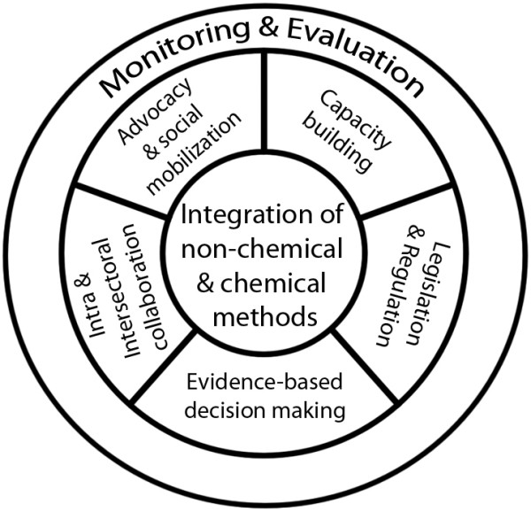
Approaches for IVM

Slide 7
WHO Global Strategic Framework for Integrated Vector Management
Defines IVM as a strategy to
Improve the efficacy, cost-effectiveness, ecological soundness and sustainability of disease vector control.
Encourage a multi-disease control approach,
Integrate with other disease control measures
Use considered and systematic application of a range of interventions
  often in combination and synergistically.
No reliance on a single method of vector control
  (e.g. chemical spraying),
Stresses the importance of first understanding the local vector ecology and local patterns of disease transmission
Then choosing the appropriate vector control tools from the range of options available.

Slide 8
Elements of IVM
Environmental management strategies
  Reduce or eliminate vector breeding grounds altogether
  Improve design or operation of water resources development projects
Biological controls
  use bacterial larvicides and larvivorous fish that target and kill vector larvae without generating the ecological impacts of chemicals
Chemical methods
When other measures are ineffective or not cost effective make judicious use of vector control chemicals
  indoor residual sprays
  space spraying
  chemical larvicides and adulticides
  reduce disease transmission by shortening or interrupting vector lifespans

Slide 9
IVM:
Personal protection/prevention
Combines the use of
    environmental management tools
    physical barriers
    chemical tools for new synergies
      e.g. insecticide-treated nets (ITNs).
  Supports more accessible and affordable disease diagnosis and treatment with effective anti-malarial drugs, within the framework of a multi-disease control approach.

Slide 10
MOST IMPORTANT ELEMENT OF IVM STRATEGIES
Micro-stratification to identify paradigms –
  Forest, irrigation, industrial, foothills, forest fringe, urban and peri-urban
Determine the dynamics of transmission
Risk factor of transmission
IVM control by utilizing old / new tools synergistically – not overlapping
Functional inter-sectoral co-ordination set up for implementation and also for resource sharing.
Community participation
IEC activities
Capacity building
Monitoring & evaluation

Slide 11
“Adaptive Management” in IVM
Periodic evaluation and reassessment of the ecological setting
Monitoring of disease incidence and transmission
Health impact assessments of new developments to be undertaken by other sectors

Slide 12
IVM
The prevention and control of Malaria, filariasis, dengue fever, Japanese encephalitis, and leishmaniasis is linked closely to various ecological factors, still depends mainly on anti-vector measures.
Many national vector control operations have been facing technical difficulties on account of increased insecticide resistance in many vector species and operational difficulties on higher cost of the alternative insecticides.
The benefit of integrated vector control approach has been widely recognized and a variety of control methods/agents are available for use.

Slide 13
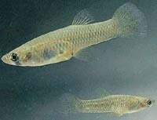
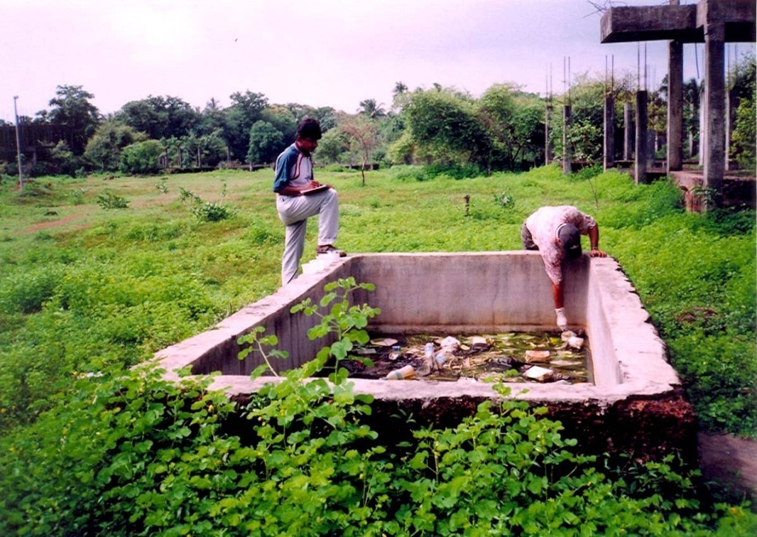
INTEGRATED VECTOR MANAGEMENT
Source reduction, filling, streamlining water bodies
Biological Control-Gambusia Fishes & Biolarvicides (Bacillus sphaericus)
Impregnated bed nets
DDT spraying in and around 30 households from a diagnosed case of malaria
IEC campaigns
GAMBUSIA FISHES
Abandoned Cement Tank

Slide 14
Anticipated roles of various sectors in IVM implementation*
1 .Agriculture
FFS approach to implement IPVM, popularizing the concept of dry-wet irrigation through extension education, pesticide management
2. Water resources development
Maintenance of canal system, intermittent irrigation, design modifications and lining of canals, weeding for proper flow, creating small check-dams away from human settlements, health impact assessment (HIA)
3. Water supply
Repair of leakages to prevent pooling, restoration of taps, diversion of wastewater to pond/pit, staggering of water supply, mosquito-proofing of water harvesting devices, repair of sluice valves.
4 Road and building sector
Proper planning as per by-laws, merging pits by breaking bunds, excavations in line with natural slope/gradient, making way for water to flow into natural depression/pond/river, follow-up actions after excavations.
5 Urban development
Implementation of building by-laws, improved designing to avoid undue water lodging, building use permission after clearance of health dept.; safe rainwater

Slide 15
Anticipated roles of various sectors in IVM implementation
6 Industry/mining
Improving drainage/sewerage system, safe disposal of solid waste/used containers, mosquito-proofing of dwellings, safe water storage/disposal, use of ITN/LLIN.
7 Railways
Proper excavations, maintenance of yards and dumps and anti-larval activities within their jurisdiction; HIA for health safeguards.
8 Environment/ Forest
Pesticide management policies, environment management policies, reclamation of swampy areas, social forestry.
9 Fisheries Institutional
help/training in mass producing larvivorous fishes, promotion of composite fish farming schemes at community level.
10 Remote sensing
Technical/training help in mapping environmental changes and disease risk using GIS.

Slide 16
Anticipated roles of various sectors in IVM implementation
11 Private pest control agencies -Judicious use of insecticides, promotion of IVM-based sustainable preventive and control methods.
12 Planning departments- Involvement of health agencies at planning stage for HIA and to incorporate appropriate mitigating actions in development projects.
13 Sea/air ports Vector surveillance and control measures.
14 Education - Developing training materials in local languages, school health activities incorporating vector control.
15 Mass media -IEC activities, advocacy.
16 Village Councils -Overall cooperation in the ongoing health programme and to ensure public participation as and when needed.
17 Local Govt. Update public health by-laws.

Slide 17
Anticipated roles of various sectors in IVM implementation
11 Private pest control agencies -Judicious use of insecticides, promotion of IVM-based sustainable preventive and control methods.
12 Planning departments- Involvement of health agencies at planning stage for HIA and to incorporate appropriate mitigating actions in development projects.
13 Sea/air ports Vector surveillance and control measures.
14 Education - Developing training materials in local languages, school health activities incorporating vector control.
15 Mass media -IEC activities, advocacy.
16 Village Councils -Overall cooperation in the ongoing health programme and to ensure public participation as and when needed.
17 Local Govt. Update public health by-laws.

Slide 18
SELECTION OF VECTOR CONTROL OPTIONS
Chemical Control
Environmental Control
Legislative control
Biological Control
INTEGRATED VECTOR MANAGEMENT An Evidence-based decision making process, rationalizing the use of vector control methods and emphasizing the engagement of communities

Slide 19
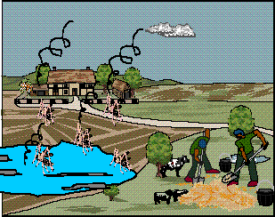
VECTOR
MANAGEMENT
Environmental Management
Personal
Protection
Biological
Control
Chemical
Control
Legislative
Measures
Health Education
Environmental
modification
Environmental
manipulation
Changes in
human habitations

Slide 20
VECTOR CONTROL MEASURES
Vector Control Measures
Protection
Anti Adult
Anti Larval
Legislative Control
Mosquito net
Space spray
Environmental
Screening
Residual spray
Biological
Repellants
LLINs
Chemical
Genetic
IGR
Civic Law

Slide 21
Elements of IVM
Environmental management strategies
  Reduce or eliminate vector breeding grounds altogether
  Improve design or operation of water resources development projects
Biological controls
  use bacterial larvicides and larvivorous fish that target and kill vector larvae without generating the ecological impacts of chemicals
Chemical methods
When other measures are ineffective or not cost effective make judicious use of vector control chemicals
  indoor residual sprays
  space spraying
  chemical larvicides and adulticides
  reduce disease transmission by shortening or interrupting vector lifespans

Slide 22
IVM:
Personal protection/prevention
Combines the use of
    environmental management tools
    physical barriers
    chemical tools for new synergies
      e.g. insecticide-treated nets (ITNs).
  Supports more accessible and affordable disease diagnosis and treatment with effective anti-malarial drugs, within the framework of a multi-disease control approach.

Slide 23
“Adaptive Management” in IVM
Periodic evaluation and reassessment of the ecological setting
Monitoring of disease incidence and transmission
Health impact assessments of new developments to be undertaken by other sectors

Slide 24
INTEGRATED VECTOR MANAGEMENT
Source reduction, filling, streamlining water bodies
Biological Control-Gambusia Fishes & Biolarvicides (Bacillus sphaericus)
Impregnated bed nets
DDT spraying in and around 30 households from a diagnosed case of malaria
IEC campaigns
GAMBUSIA FISHES
Abandoned Cement Tank

Slide 25
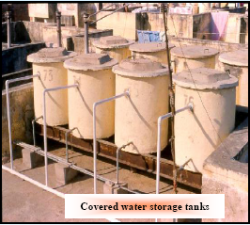
Environmental
Management
Control of immature stages of vector is important :
(i) Environmental modification:
  Long lasting physical transformation of vector habitats.
  Ex.
    Improved water supply,
    Mosquito proofing of overhead tanks, cisterns or underground reservoirs.

Slide 26
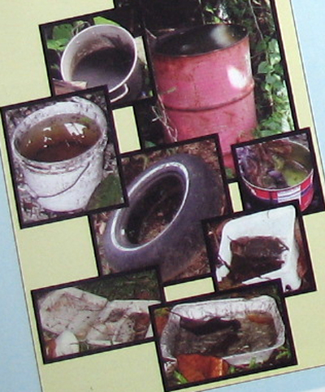
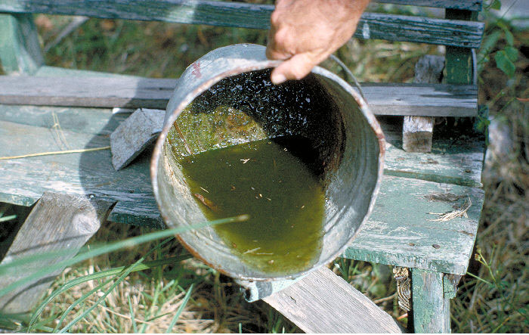
Environmental
Management
  (ii) Environmental manipulation:
  Management of essential & non-essential containers
  Management/removal of natural breeding sites.

Slide 27
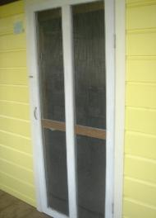
Environmental
Management
  (iii) Changes in human habitations
  Mosquito proofing of houses with screens on doors/windows.

Slide 28
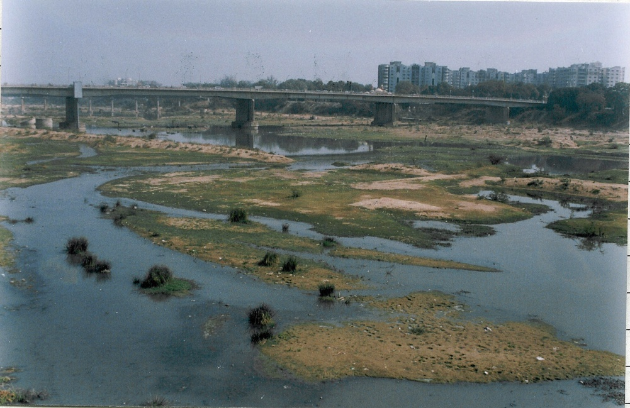
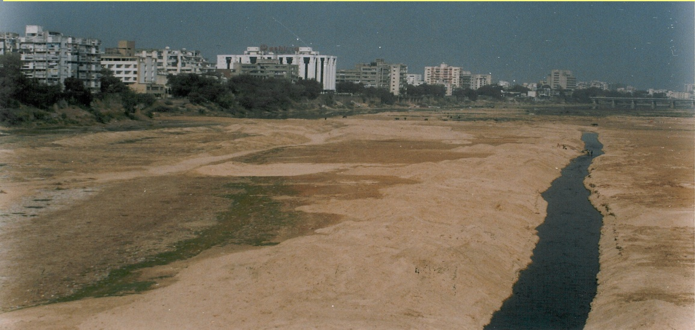
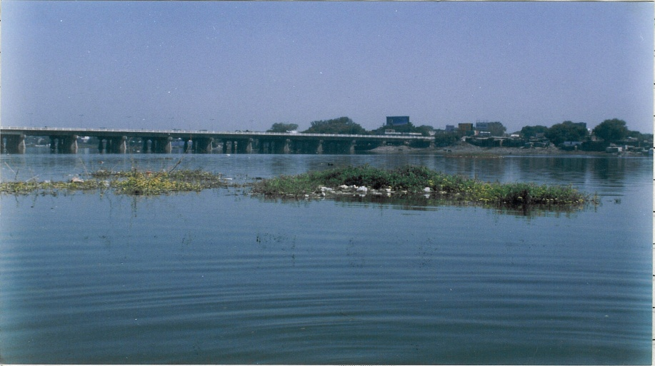
ENVIRONMENTAL MODIFICATION and malaria control
Environmental Control
SABARMATI RIVER’S CHANGING SCENIRIO
SCENARIO
Intervention:Channelization
Sabarmati: erstwhile
Narmada Fed Sabarmati

Slide 29
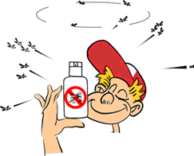
VECTOR
MANAGEMENT
Environmental Management
Personal
Protection
Biological
Control
Chemical
Control
Legislative
Measures
Health Education
Protective
clothing & repellents
Mosquito coils,
pyrethrum space spray &
aerosols
Insecticide treated
mosquito nets

Slide 30
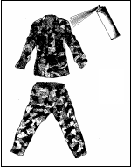
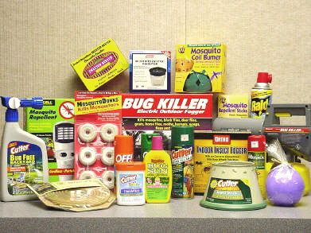
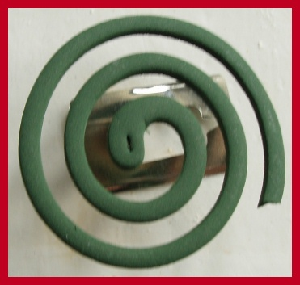
Personal Protection
Protective clothing and repellents
Household insecticide products namely, mosquito coils, pyrethrum space spray and aerosols

Slide 31
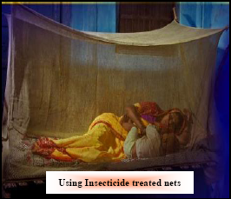
Personal Protection
Insecticide treated mosquito nets have limited utility since the vector species bite during the day time.
However, it can be effectively used to protect infants and night workers while sleeping in daytime.

Slide 32

VECTOR
MANAGEMENT
Environmental Management
Personal
Protection
Biological
Control
Chemical
Control
Legislative
Measures
Health Education
Larvivorous fish
Endotoxin producing bacteria

Slide 33
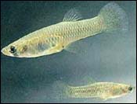
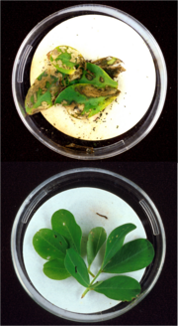
Biological Control
Larvivorous fish
(e.g., Gambusia / Guppy) in large water bodies or large water containers.
Endotoxin producing bacteria, Bacillus thuringiensis israelensis serotype H-14 (Bt H-14) has been found an effective mosquito control agent.

Slide 34

VECTOR
MANAGEMENT
Environmental Management
Personal
Protection
Biological
Control
Chemical
Control
Legislative
Measures
Health Education
Larvicide
Adulticide
Pyrethrum spray
Malathion fogging / ULV spray

Slide 35
Chemical Control
(i) Larvicide:
  Temephos (ABATE), organophosphate compound is safe, without any health hazard & is being used under the public health programme.
  Dose -
    Temephos is 1ppm (1 mg/lit. of water).

Slide 36
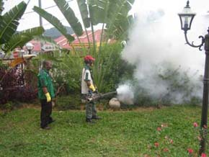
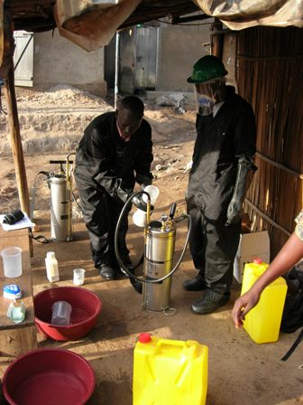
(ii) Adulticide: a) Pyrethrum spray:
Chemical Control
  Indoor use, space spray
Sprayed with Flit pump or hand operated fogging machine fitted with micro-discharge nozzle.

Slide 37
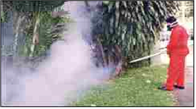
Chemical Control
    b) Malathion fogging or Ultra Low Volume (ULV) spray:
MALATHION or SUMITHION
Effective in interrupting transmission & stopping epidemics.
ULV treatments 10 days apart reduce mosquito densities by > 98%

Slide 38

VECTOR
MANAGEMENT
Environmental Management
Personal
Protection
Biological
Control
Chemical
Control
Legislative
Measures
Health Education
Model civic
byelaws
Building Construction
Regulation Act
Environmental
Health Act
Health Impact
Assessments

Slide 39
Legislative Measures
Suitable laws and byelaws for
  Regulating storage/utilization of water by communities, various agencies
  Avoidance of mosquitogenic conditions at construction sites, factories.

Slide 40
Legislative Measures
(i) Model civic byelaws: fine/punishment is imparted, if breeding is detected.
  These measures are being strictly enforced by Mumbai, Navi Mumbai, Chandigarh , Agartala, Bhopal, Delhi and New Delhi Municipal Corporations.

Slide 41
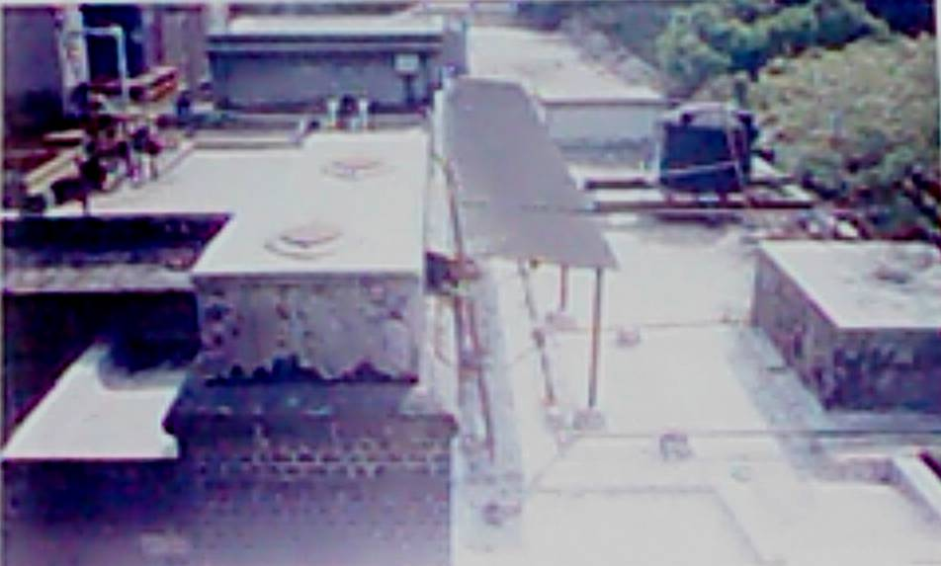
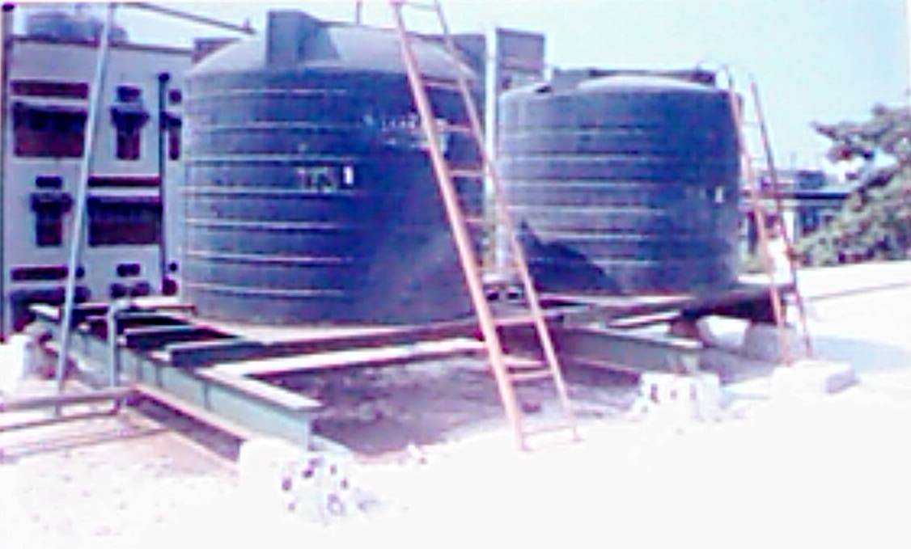
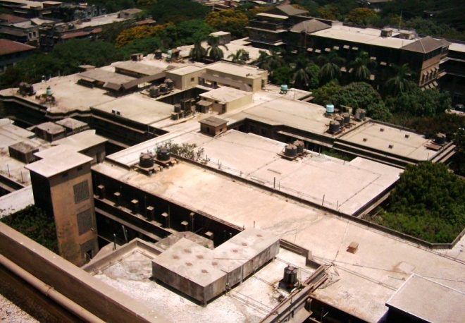
Legislative Measures
(ii) Building Construction Regulation Act:
Building byelaws for appropriate:
  Overhead / under ground tanks,
  Mosquito proof buildings & Designs of sunshades,
  In Mumbai, owners/builders deposit a fee, for controlling mosquitogenic conditions at site by Municipal Corporation.

Slide 42
Legislative Measures
(iii) Environmental Health Act:
Suitable byelaws for the proper disposal/storage of junk, discarded tins, old tyres and other debris.
(iv) Health Impact Assessments:
  Appropriate legislation for mandatory HIA prior to any development projects/major constructions.

Slide 43
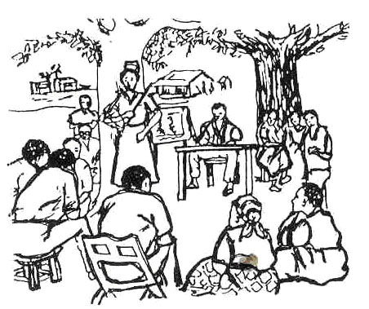
VECTOR
MANAGEMENT
Environmental Management
Personal
Protection
Biological
Control
Chemical
Control
Legislative
Measures
Health Education
At Household Level
At Community Level
At Institutional Level

Slide 44
Health Education for
Community Mobilization & Inter-Sectoral Convergence
Involvement of household, community for mosquito control is of paramount importance.
Behavior Change Communication (BCC) campaign is crucial.

Slide 45
Health Education
Special campaigns
  Mass media - local vernacular newspapers/magazines, radio & TV, outdoor publicity like hoardings, miking, rallies, etc.
Health education materials - posters, pamphlets, handbills, hoardings.
Inter-personal communication - group meetings, traditional / folk media

Slide 46

At Household Level
Use of safe aerosols - Pyrethroid-based.
Personal protection measures
Using mosquito repellents or burning neem leaves, coconut shells and husk to kill or repel the mosquitoes
Using tight-fitting screens/wire mesh on doors and windows.

Slide 47
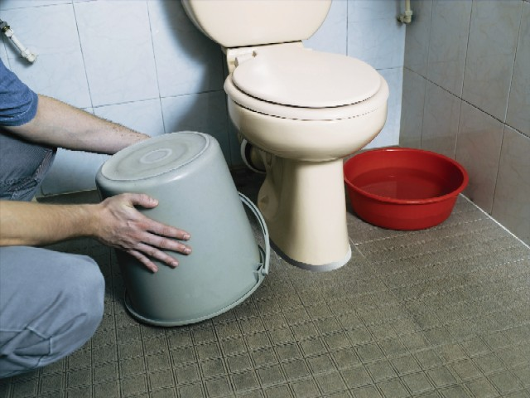
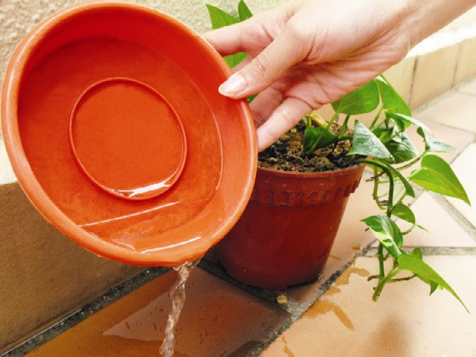
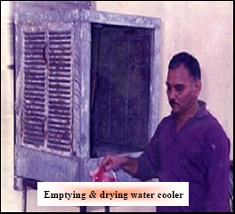
At Household Level
Emptying, drying water tanks, containers, coolers, water bowls, plant pots, drip trays at least once each week.
Covering all water containers in the house to prevent fresh egg laying by the vector.

Slide 48
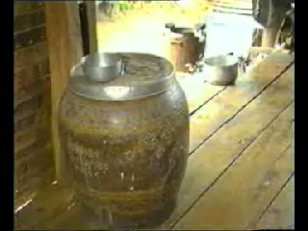
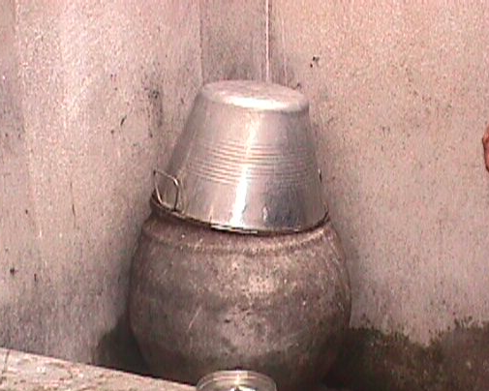
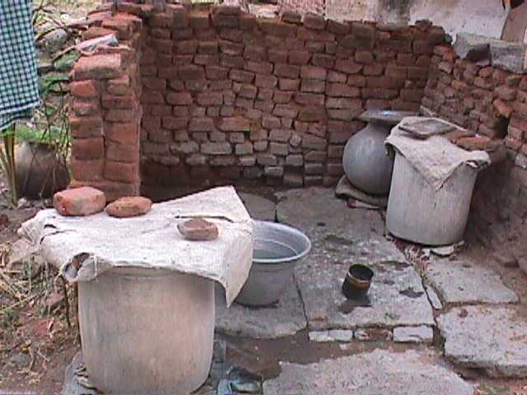
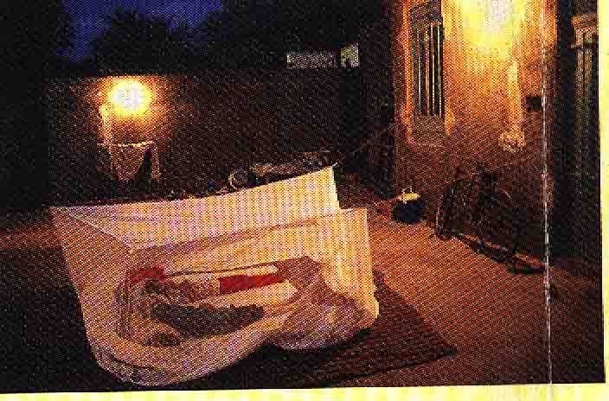

Slide 49
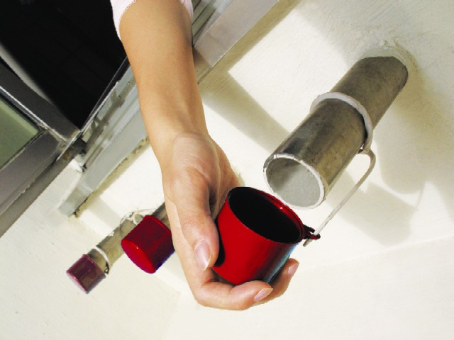
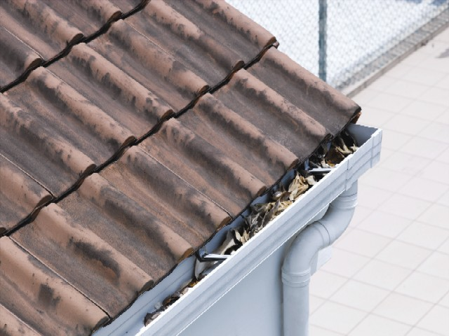
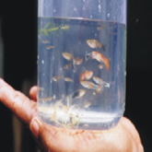
At Household Level
  Regular checking for clogged gutters & flat roofs that may have poor drainage.
  Cover bamboo pole holders when not in use
Introducing larvivorous fishes in
orrnamental water tanks/garden.

Slide 50
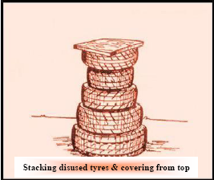
At Community Level
Groups to supplement and reinforce efforts at household level.
To identify commercial activities such as traders dealing in used tyres or small construction projects
Launch awareness campaigns

Slide 51
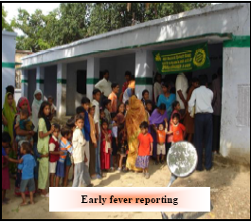
At Institutional Level
(Hospitals, Schools, Colleges, Offices, etc)
Weekly checking for Aedes larval habitats.
Ensuring source elimination
Notification of fever cases (suspected/confirmed) to concerned Health authorities & appropriate case management.

Slide 52
Health Education
To achieve sustainability of successful vector control programme its essential to focus on involvement of -
  Hospitals, non-health sector departments including schools/colleges,
  Civil society organizations e.g. NGOs, Faith Based Organizations and Community Based Organizations Residents Welfare Organizations, Self-Help Groups

Slide 53
Health Education
  Panchayati Raj Institutions/Municipal Bodies.
  Local Religious Bodies.
  Nehru Yuvak Kendras, NSS/NCC units in schools and colleges.
  Professional associations like IMA and corporate sector.

Slide 54
Health Education
  These groups should be provided information on all aspects of
    how it spreads
    role of mosquitoes
    where & how they breed/rest
    how they can be controlled

Slide 55
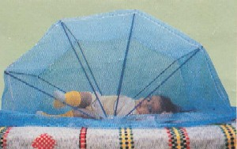
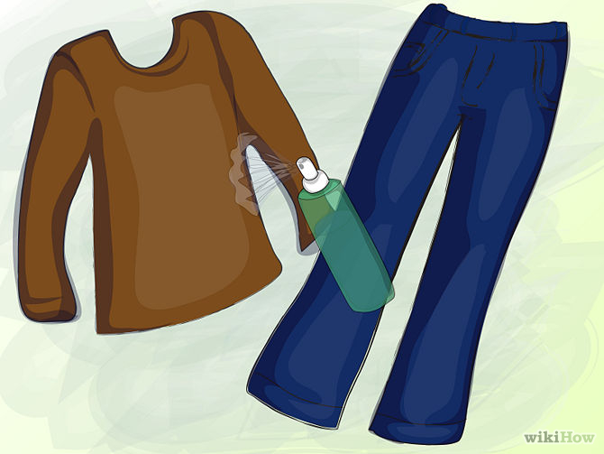

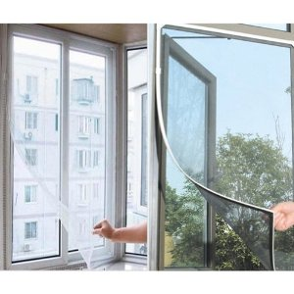
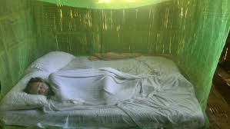
PERSONAL PROTECTION

Slide 56
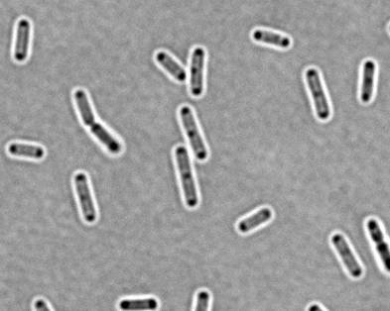
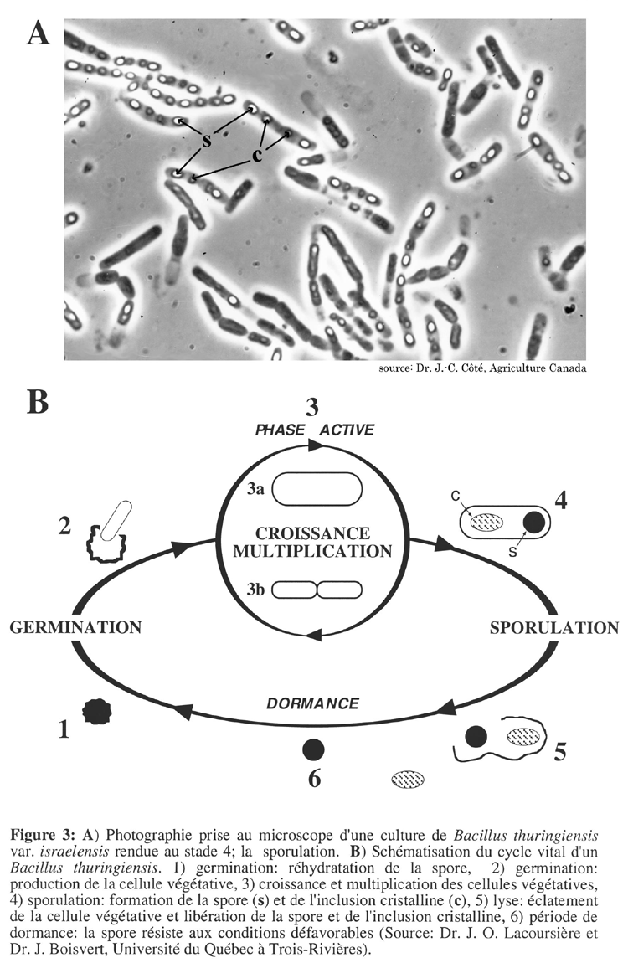
BIOLOGICAL ANTI-LARVAL CONTROL
Larvivorous Fishes
Biolarvicides
Gambusia affinis
Bacillus sphaericus
Poecilia reticulata
Bacillus thuringiensis israelensis

Slide 57
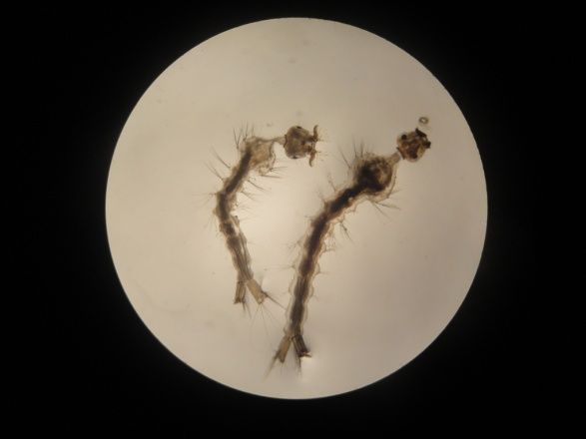
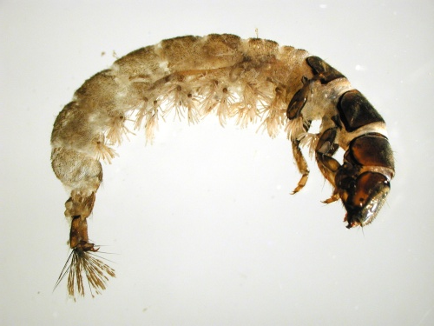
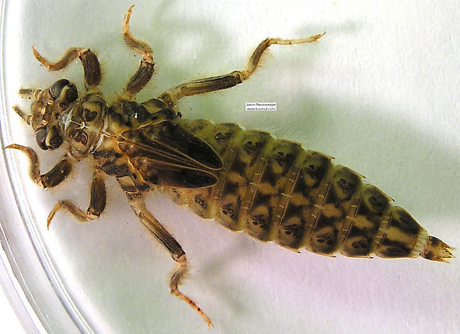
BIOLOGICAL ANTI-LARVAL CONTROL
Other predators Larval/Adults
Culex (Lutzia) fuscana, Toxorhynchites species.
Dragonfly larvae, Caddish fly larvae, certain crustaceans, Cyclopods, Hemipterans
Dragonflies and damselflies are known to prey on flying mosquitoes,
Dragonflies Larvae
Cx.fuscana Larvae
Caddish fly Larvae

Slide 58
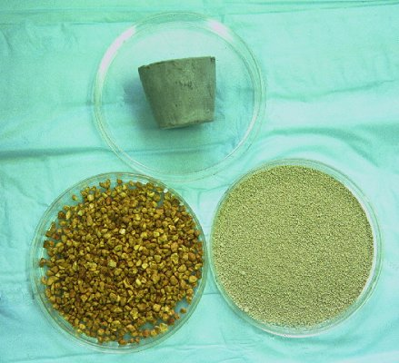
CHEMICAL CONTROL (LARVICIDE)
  Temephos
  an organophosphate compound which is safe, without any odour or colour
  have residual effect with low mammalian toxicity
  do not pose any health hazard
  They come as liquid and now in granules emulsifiable concentration (EC) and granule (GR) formulations.
  Only the granule formulation is used for mosquito larviciding in potable water at a dosage not exceeding 1 mg/l of the active ingredient.
Temephos

Slide 59
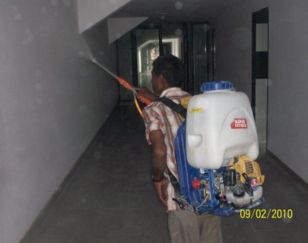
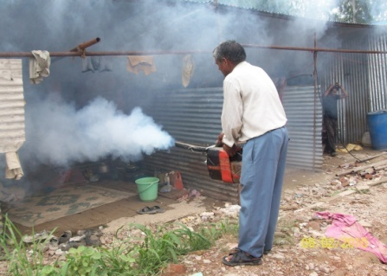
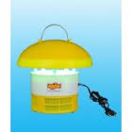


CHEMICAL CONTROL (ADULTICIDE)
Space spray: Aerosol space spray ULV, fogging
Residual spray: Synthetic Pyrethroids, Malathion
Pheromone (attractants)
LLINs: Long lasting Insecticide treated Nets Curtains etc.
Repellants: DMP, DEETS, DEPA, Mats, Coils liquid vaporizers

Slide 60






SOURCE REDUCTION
Removal of Aedes Breeding by using source reduction and temephos 1% granules

Slide 61


VECTOR CONTROL CHALLENGES
30% of the Overhead Tanks are in accessible
Even in government buildings the over head tanks are built violating the public health principles

Slide 62




SOURCE REDUCTION
Keep water containers covered with proper lids, avoid storing of water for more than 5-7 days.
Change water for vases and aquatic plants at least once a week, leaving no water under the pots or in the bottom saucers.
Scrub the container surfaces thoroughly to prevent mosquito eggs sticking on them.
Remove or puncture any dumped tyres to prevent the accumulation of stagnant water.
As the Aedes mosquito breeds in container, don’t keep any junk material or any solid waste in an around the house as well as on the roof.

Slide 63


IEC ACTIVITIES
As Aedes is a domestic mosquito it is the responsibility of the societies and community to avoid breeding of Aedes mosquito domestic and peri-domestic areas.
As Aedes mosquito breeds in every type of container, it is a duty of the community to fix a day in a week to clean and scraps all the breeding sites in and around their premises.
Community should allow the Health worker to enter their houses for checking and examining all the possible breeding containers.

Slide 64
IEC ACTIVITIES
More public cleaning up campaign
Need for community mobilization through cooperation with local leaders.
Eliminate, monitor and evaluate vector breeding sites systematically in households.
Precaution should be taken during outbreaks for unwarranted fogging conducted by unauthorized commercial providers.

Slide 65
NAVI MUMBAI MUNICIPAL CORPORATION
Malaria Bye-laws : (After 1996 out break of Malaria)
To reduce potential breeding places.
No Objection Certificate” from Health Department of NMMC for Occupancy Certificate.
Inspect the site for any potential breeding places at the construction.
No Objection Certificate is issued.
Model Civic Bye-laws: Promulgation and implementation with provision to prevent /eliminate mosquito breeding like Municipal Corporation of Greater Mumbai, NCT Delhi, Chandigarh, Bhopal, Agartala, Navi Mumbai Municipal Corporation, Thane and Goa.
Building Bye-laws: Provision to prevent mosquitogenic conditions on the exterior of the buildings and clauses in the contract to keep curing tanks free of mosquito breeding during construction phase and dismantling of the same before issuance of occupancy certificate like Navi Mumbai

Slide 66

EFFECTIVE IEC FOR VBD’S

Slide 67
INTER SECTORAL CO-ORDINATION
Review at Minister’s level during transmission
Engineering
C.S.C.
CSD
Horticulture
Delhi Govt.
Flood Control dept.
Delhi Jal Board
Railways
MCD
Public Health
Unit
M.C.D
Private Sector
Metro Railways
MTNL
D.V.B
Health Authority of
Haryana
U.P.
Rajstahan

Slide 68


VECTOR CONTROL STRATEGY
Gambussia
ITMN

Slide 69
COMMUNITY PARTNERSHIP & ISC
Fodder for thought
This is the story of four people named EVERY BODY , SOME BODY , ANY BODY , NO BODY .
There was an important job to be done and EVERY BODY was sure that SOME BODY would do it.
ANY BODY could have done it. But NO BODY did it. SOME BODY got angry about that because it is EVERY BODY job. Every thought that ANY BODY could do it but NO BODY realised that EVERY BODY do not do it.
It ended up that EVERY BODY blamed SOME BODY when NO BODY did what ANY BODY would have done it

Slide 70


Legislative control
Introducing Model Civic Bye-laws and Building Bye-laws for prevention and control of vector breeding
Model Civic Bye-laws: Promulgation and implementation with provision to prevent /eliminate mosquito breeding like Municipal Corporation of Greater Mumbai, NCT Delhi, Chandigarh, Bhopal, Agartala, Navi Mumbai Municipal Corporation, Thane and Goa.
Building Bye-laws: Provision to prevent mosquitogenic conditions on the exterior of the buildings and clauses in the contract to keep curing tanks free of mosquito breeding during construction phase and dismantling of the same before issuance of occupancy certificate like Navi Mumbai
Already covered in briefing session

Slide 71
Navi Mumbai Municipal Corporation
Malaria Bye-laws : (After 1996 out break of Malaria)
To reduce potential breeding places.
No Objection Certificate” from Health Department of NMMC for Occupancy Certificate.
Inspect the site for any potential breeding places at the construction.
No Objection Certificate is issued.

Slide 72
Effective IEC for VBD,s
Already covered in briefing session

Slide 73



In this, O Nature, yield I pray to me.
I pace and pace, and think and think, and take
The fever'd hands, and note down all I see,
That some dim distant light may haply break.
The painful faces ask, can we not cure?
We answer, No, not yet; we seek the laws.
O God, reveal thro' all this thing obscure
The unseen, small, but million-murdering cause.
Dr.Ronald Ross

