Slide 1
Indoor Residual Spray -INDIA
Prof. Arti Prasad
Head Department of Zoology
University College of Science
MLSU, Udaipur.
Artimlsu@yahoo.co.in
UNIT 111
Eco-environmental Systems: Food chain / Web – Prey and Predator interactions - Principles of an eco-epidemiological approach to address multiple vector borne diseases - Water Management UNIT

Slide 2
Unit III
Eco-environmental Systems: Food chain / Web – Prey and Predator interactions - Principles of an eco-epidemiological approach to address multiple vector borne diseases - Water Management
The adoption of a longer-term and more holistic view of the interactions between ecosystems and infectious diseases would help to ensure sustainable benefits to human well-being (high confidence).
The current division of responsibilities among institutions means that assessment and programmatic responses are within narrow disciplinary or sectoral frameworks.
The health sector usually makes reference to scientific/logistical criteria (for example, availability of programmatic resources, immediate effectiveness in reducing disease, cost-effectiveness), and social-cultural considerations (for example, public and political feasibility).
Such approaches are not ideal for a broader inter-sectoral policy that considers the effects of a particular health strategy on other ecosystem services or, conversely, the impacts of environmental and development strategies on disease transmission.
An ecosystem assessment or ecohealth approach examines strategies from a trans-disciplinary perspective, considering direct and immediate effects on disease, as well as longer-term or indirect effects that may occur via alterations to ecosystems.

Slide 3
Eco-environmental Systems: Food chain / Web – Prey and Predator interactions - Principles of an eco-epidemiological approach to address multiple vector borne diseases - Water Management
Ecosystems provide both the ‘‘disservice’’ of maintaining transmission cycles with cross-infection of humans and the ‘‘service’’ of regulating those cycles and controlling spillover into human populations.
The balance between these services and disservices is influenced by the availability of suitable habitat for vectors and of reservoir hosts of infection. Transmission cycles are generally kept in a degree of equilibrium by density-dependent processes such as acquired immunity to infectious disease and by limits on the carrying capacity of the habitat to support insect vectors and reservoir hosts.
Human activities that alter natural ecosystems also affect the transmission cycles of vector-borne infectious diseases. Human settlement and deforestation patterns; the development of dam, drainage, and agricultural irrigation schemes; and climate change are all drivers influencing patterns of disease distribution and incidence.

Slide 4
Eco-environmental Systems: Food chain / Web – Prey and Predator interactions - Principles of an eco-epidemiological approach to address multiple vector borne diseases - Water Management
Policies that influence population size, migration, patterns of energy production/consumption, food production, and overall demand for natural resources will have significant effects on transmission of infectious agents and associated consequences in terms of disease.
These changes may lead to the destabilization of natural equilibria, improved conditions for disease transmission, and disease outbreaks/elevated risks to humans,
or alternatively, to the disruption of the disease transmission cycles and decreased incidence.

Slide 5
Eco-environmental Systems: ENTOMOLOGICAL TERMS
Vector: An arthropod species which is involved in the mechanical or biological transmission of human or animal infection is termed as vector.
The diseases transmitted by the arthropod vectors are known as vector-borne diseases.
Primary Vector: It is a principal and proven vector of a disease producing organisms in man and animal in an area under natural conditions and maintained transmission annually.
Secondary Vector: Under the same circumstances, if a vector play a secondary role in disease transmission but would be unable to maintain a disease transmission in the absence of primary vector.
Pests: Pests are those living organisms which are injurious or cause damage to human beings directly or indirectly or to their food resources or belongings.

Slide 6
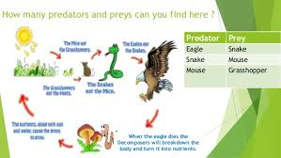
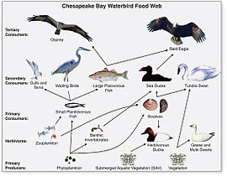
A food chain is a linear network of links in a food web starting from producer organisms (such as grass or trees which use radiation from the Sun to make their food) and ending at apex predator species (like grizzly bears or killer whales), detritivores (like earthworms or woodlice), or decomposerspecies (such as fungi or bacteria).

Slide 7
Eco-environmental Systems:
Bionomics of vector defines relationships of a given vector species with its physical environment (temperature, humidity, rainfall) essential for building up intervention measures.
Interaction of various factors in transmission of Malaria
Entomological Factors
Vector Density
Frequency of biting man
longevity
Environmental Factors
Temperature
Relative humidity
Rain fall
Determine the degree of transmission
Determine the seasonal prevalence of vector
Variation of entomological and environmental factors produced variable endemicity (hypo, meso, hyper) in different terrain system

Slide 8
FEEDING BEHAVIOUR:
Female mosquitoes need proteins for maturation of eggs hence have to feed on human / animal blood.
Time of feeding : Anopheles mosquito crepuscular species : Feeding immediately after sunset.
Nocturnal : Feeding whole night
Peaks of biting : Around midnight 1st Peak
activity At dawn 2nd Peak
C) Aedes mosquito : Two peaks – 2 hours after sunrise and 2-3 hours before sunset.
D) Place of feeding (Man-vector contact)
Human habitation : Indoor/Outdoor
Nocturnal activities of human population.
Agriculture./Security/Technical/Income generation.

Slide 9
D) Host : Human / animal
Anthropophilic species - prefer to feed on humans (An.minimus)
Zoophilic species - prefer to feed on animals (An.culicifacies)
Indiscriminate species - either host (availability) (An.subpictus)
E) Frequency of feeding (determine the degree of contact with host)
Gonotrophic cycle – time taken from blood feed to laying of eggs
Gonotrophic concordance – one feed sufficient (Ae.albopictus)
Gonotrophic discordance – require more than one feed (Ae.aegypti)
RESTING BEHAVIOUR OPTIMUM MICROCLIMATE
Movement to and from 16⁰C to 35⁰C R.H. 60% to 70%
breeding sites
Host
Orientation by host stumili
Endophily
Exophily/Vegetation near breeding sites.

Slide 10
Man
INFECTION SYSTEM
Parasite
Vector
VECTOR BORNE DISEASE TRIANGLE

Slide 11
Ecosystem
JE Virus Transmission Cycle
JE is a zoonotic disease having its natural cycle in pigs and certain species of birds viz. herons and egrets.
Pigs have been incriminated as the major amplifying hosts of J.E. virus.

Slide 13
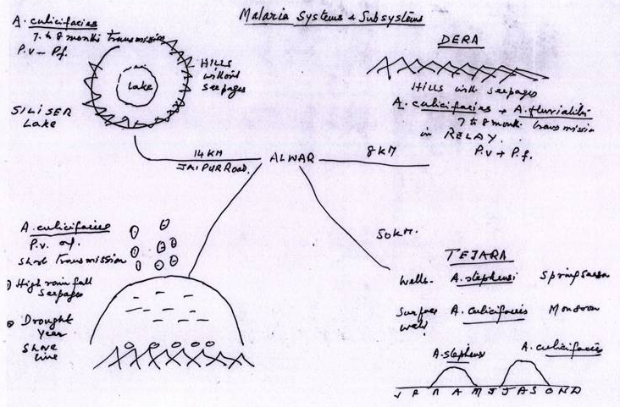

Slide 14
Bio ecology of An. minimus
Biology
Oriental Distribution.
Stream Breeder.
Highly Susceptible to Insecticides.
India has species A only.
Peak Biting Indoor 12 p.m. – 2 a.m. & Outdoors 6 p.m. – 9 p.m.
Exophilic and Endophagic in Behavior.
Amenable to Control by IRS.
Control
Selective Spraying
Drainage Improvement
Siphons.
ITMN.

Slide 15
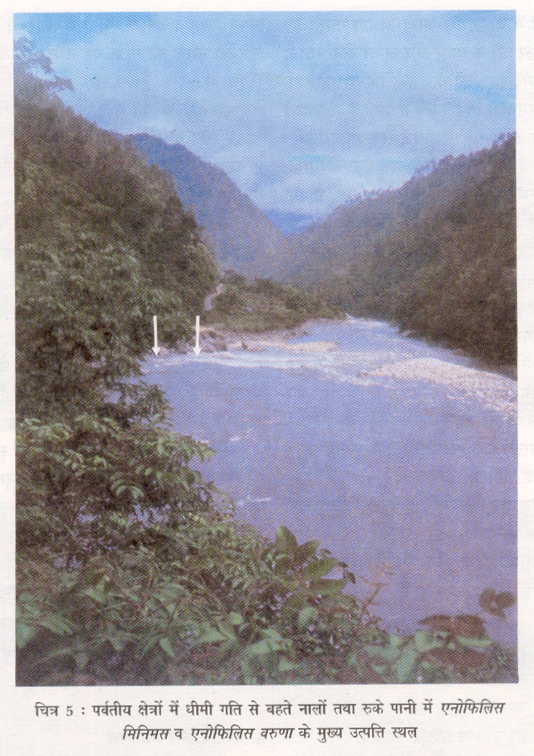
An. minimus

Slide 16
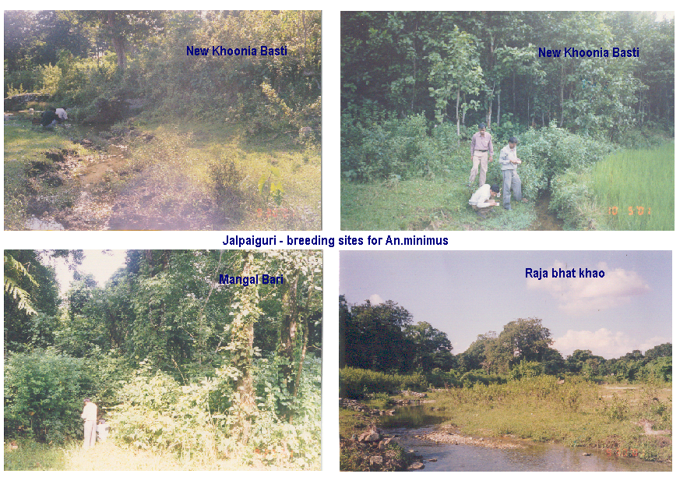
Bio ecology of vectors

Slide 17
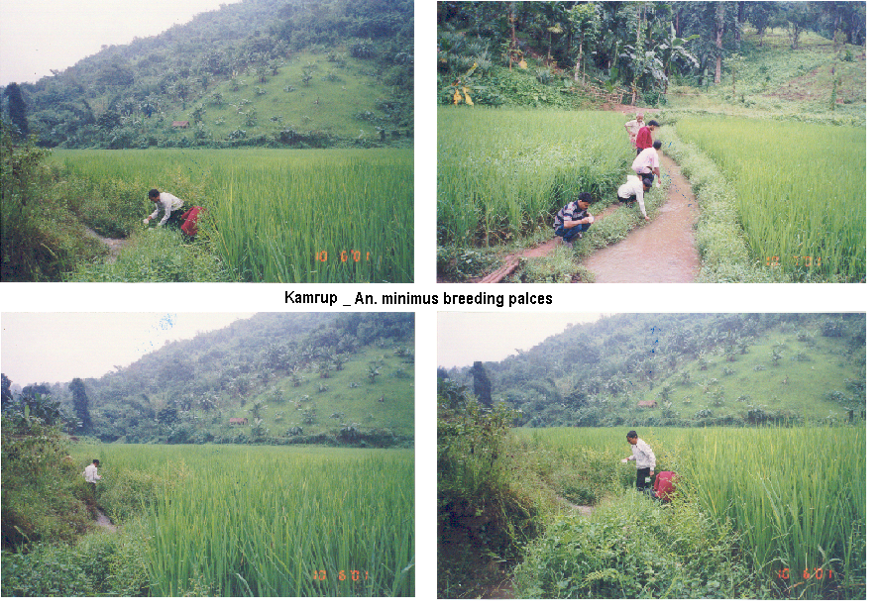

Slide 18
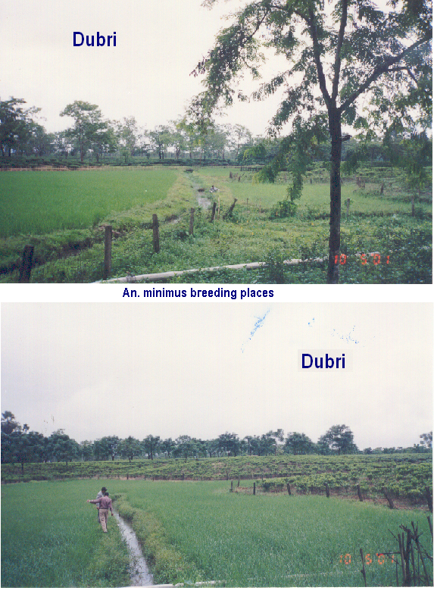

Slide 19
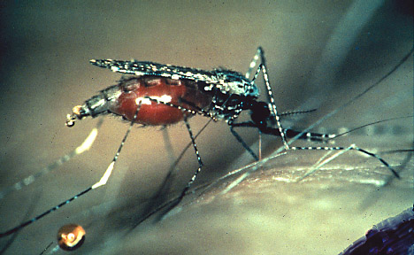
An. dirus

Slide 20
An. dirus
Biology
Distribution East Asia.
Breeds Jungle in the Puddles Under Shade.
Exophilic and Exophagic.
Susceptible to Insecticides.
IRS Not Useful in its Control
Control
Ecological Barrier Over 500 Meters.
Personal Protection Methods.
ITMN
Deforestation Leads to Replacement by An. minimus.

Slide 21
An. sundaicus
Biology
Distribution in East Asia.
Invaded India.
Vector in A & N Islands.
Susceptible to Insecticides.
Brackish Water Breeder.
Both Exophilic and Endophilic
Both Exophagic and Endophagic
Control
Installation of Sluice Gates Across Creeks.
Larvivorous Fishes.
ITMN
Encourage Mangrove Forests.

Slide 22
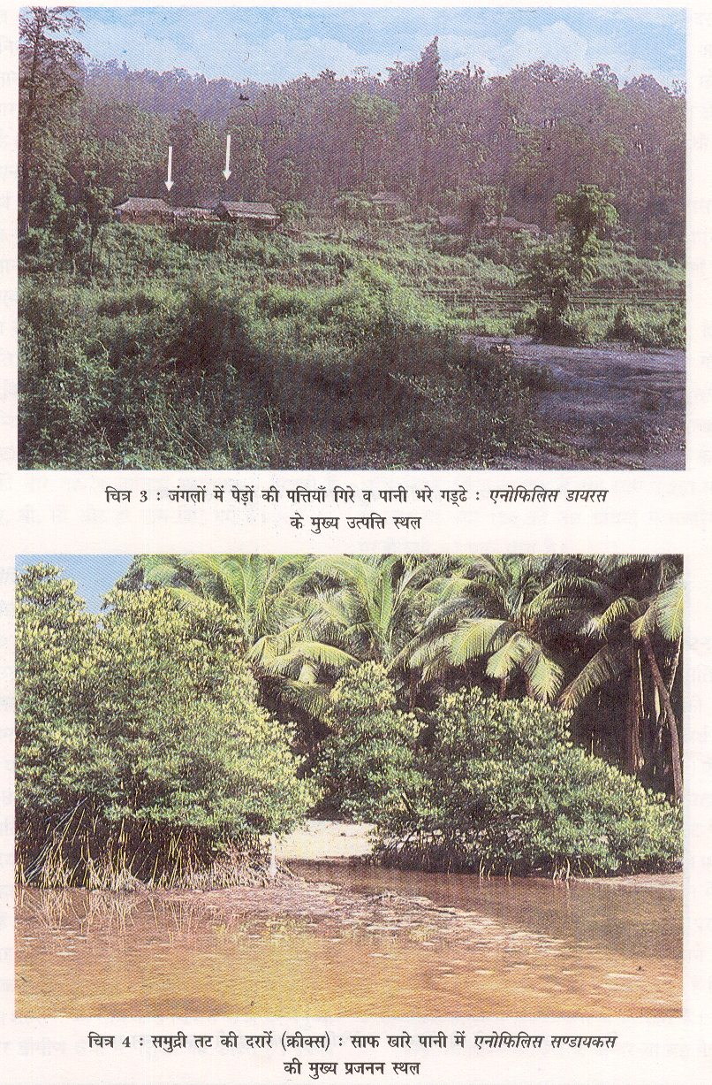
Bio ecology of An. dirus

Slide 23
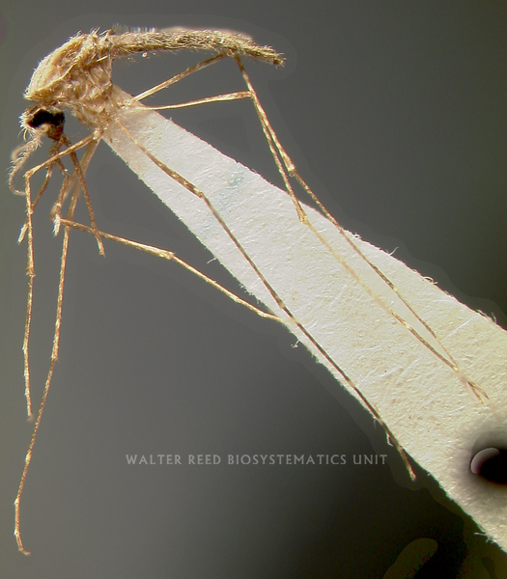
An. sundaicus
Bio ecology of An. sundicaus

Slide 24
An. sundaicus
Bio ecology of An. sundicaus

Slide 25
An. sundaicus

Slide 26
An. sundaicus

Slide 27
An. sundaicus
Biology
Distribution in East Asia.
Invaded India.
Vector in A & N Islands.
Susceptible to Insecticides.
Brackish Water Breeder.
Both Exophilic and Endophilic
Both Exophagic and Endophagic
Control
Installation of Sluice Gates Across Creeks.
Larvivorous Fishes.
ITMN
Encourage Mangrove Forests.

Slide 28
An. sundaicus

Slide 29
Environmental Drivers, Ecosystem States, and their Effects on Vector-borne Disease
An ecosystem perspective on the risks to humans from vectorborne disease and vector management requires an appreciation of the role played by broad environmental trends and by local ecosystems in sustaining vector habitats and facilitating disease transmission.
The transmission of vector-borne diseases is governed by the same principles of population dynamics as other ecological systems. Probably the most important governing concepts are the reproductive rate (often termed r) of vectors and parasites and the carrying capacity (K) of the local habitat for each of these entities
Both are influenced by broad environmental conditions. For example, in the case of malaria in an African village, seasonal temperatures affect the reproductive rate of Anopheles mosquitoes and of the Plasmodium parasites within them. Precipitation influences the availability of aquatic breeding sites.

Slide 30
Environmental Drivers, Ecosystem States, and their Effects on Vector-borne Disease
Together, such factors influence the maximum number of adult mosquitoes that can be produced and sustained in the local environment in a given time. While these large-scale climatic factors are important, their influence in any particular setting also depends upon local characteristics.
For instance, both temperature and breeding site availability are also a function of local topography and vegetation.
Finally, humans are an integral part of this system.
Agricultural practices will influence land use and the availability of animals that may provide blood meals for mosquitoes (along with or instead of humans).
Targeted vector control interventions may reduce vector abundance and longevity vector habitats and/or vector biting rates on humans and thus prevent disease transmission, even in otherwise optimal environments.
The same environmental conditions that are affected by local habitat factors also determine the vector-carrying capacity of the ecosystem, the point at which vector abundance is limited by densitydependent processes (for example, predation and competition for food).

Slide 31
Anthropogenic Change Leading to Increases in Plasmodium falciparum: P. vivax Ratios Increases in Plasmodium falciparum:
Location Tajikistan 1998 | Anthropogenic Changes Health system disruption | Reference Pitt et al. 1998
Afghanistan/ Pakistan India Rajasthan, Amazonia, Brazil | Chloroquine resistance in Pf Irrigation on large scale; establishment of Anopheles culcifacies-efficient P. falciparum vector and dominance over An. stephensi, a poor vector New breeding sites for effi- cient vectors An. darlingi through mining, deforestation, road building | Rowland and Nosten 2001 Tyagi and Chaudhary 1997 Marques 1987

Slide 32
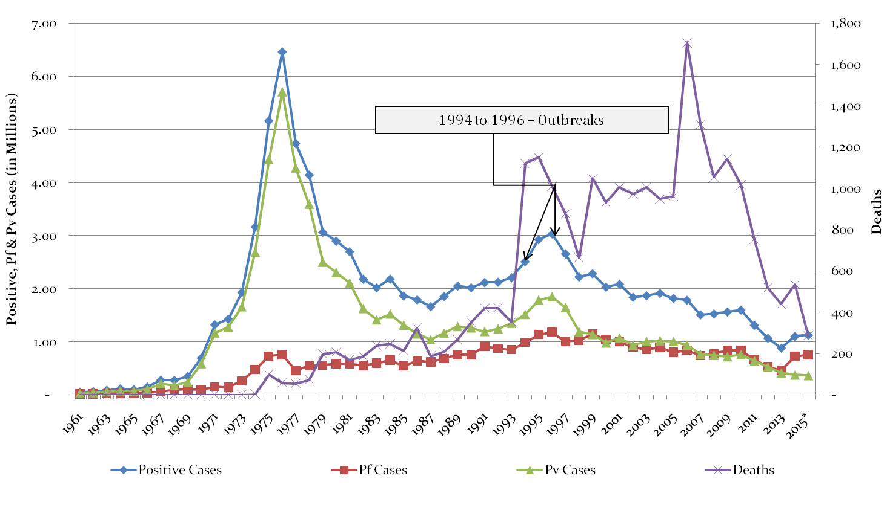
Trends of Malaria in India (1961- 2015)
Implementation of
Modified Plan of Operation -1976

Slide 33
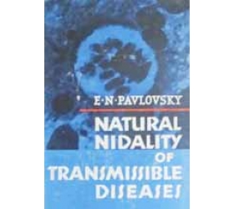
Ecological approach to vector control pre-DDT
Species Sanitation
Natural Nidality
M. Watson (Malaya/N. Rhodesia)
N. Swellengrebel (Dutch E. Indies)
Epidemiology is grounded in geography in space and time.
Avoid creation of new foci in socio-economic developments
Overlap of niches occupied by the vector, host and parasite, find and manipulate the narrowest overlap
“malaria is a local disease to be dealt with by local efforts” (N.S. 1950).

Slide 34
Bio ecology of An. dirus

Slide 35
An. sundaicus

Slide 36
An. sundaicus
Biology
Distribution in East Asia.
Invaded India.
Vector in A & N Islands.
Susceptible to Insecticides.
Brackish Water Breeder.
Both Exophilic and Endophilic
Both Exophagic and Endophagic
Control
Installation of Sluice Gates Across Creeks.
Larvivorous Fishes.
ITMN
Encourage Mangrove Forests.

Slide 37
An. sundaicus

Slide 38
CANTONMENTS
Environment Management Methods
(EMM)Technology
Mian Mir Cantonment- Lahore (now in Pakistan) Vector An. culicifacies-Surface pool breeder.
First ever experimented by S.R. Christopher and S.P. James
1901 1) Drainage of all stagnant waters within ½ mile of the cantonment area
2) Quinine therapy (established in 1847)
1903 Results were disappointing
1904 Canal network was found supporting heavy breeding of An. culicifacies
1905-1908 Canal network was filled by deployment of 500 soldiers and one engineering regiment.
Project did not show any success
1909 Disappointing failure resulted in establishment of “Malaria Survey of India” the first malaria Research Institute of the World.
1926 malaria was ultimately controlled by screening of all bunglows/houses, as flight range of vector species exceeded 2 kms.

Slide 39
Vector Control
PORT TOWN-Mumbai
EMM technology
1926 Severe outbreak of malaria in Alexandria Docks-Bombay
1927 Covell. made in depth study of outbreak and recommended Species sanitation- concept for control of An. Stephensi
1928 BOMBAY ACT PASSED
Development of legislative Measures aimed at prevention of stephensi breeding in
i) Overhead tanks
ii) Ground level tanks
iii) Wells
iv) swimming pools
v) Cellars/sumps of WC/floors of building under constructions
vi) Roof gutters of buildings
Larvivorous fish
i) Stocking of ornamental/ fire fighting tanks and textile mill ponds with Gambusia fish
Weekly dry day observations
All domestic/ peridomestic containers to be emptied scrubbed and refilled.

Slide 40
EXPERTISE IN ENVIRONMENT
MANAGEMENT METHODS
1940 India has attained a good deal of expertise in EMM technology & malaria control activities were covered by various by laws & Acts.
Each sector of economy carried out HIA and identified Essential Anti-Malaria Engineering Works and these were incorporated as built in component of the projects.
Each development prepared “Manuals” indicating the specifications of each Engineering works to be under taken by them viz. Irrigation, Highways, Railways, Defense.
Training courses in Malariology for Engineering were started at Malaria Institute of India in 1943
Consequently EMM earned the reputation of standard methods for control of malaria in the country.

Slide 41
WARNING AGAINST COMPLETE SWITCH OVER FROM EMM TECHNOLOGY TO DDT SPRAY
1944 Mr. Winston Churchill Former Prime Minister of England announced in British Parliament on December 2, 1944 about dispatch of DDT, a new chemical for malaria control in India.
Army Medical Authorities at GHQ New Delhi issued the following warning.
“ DDT is a powerful new weapon. It should be stressed that it is a reinforcement and not a substitute for existing well tried systems of malaria control which on no account should be relaxed”
Unfortunately this “warning” was ignored which ruined the” EMM technology” harnessed over 40 years of experience.
But history is repeating and now we want to adopt this for control of Malaria a long term strategy

Slide 42
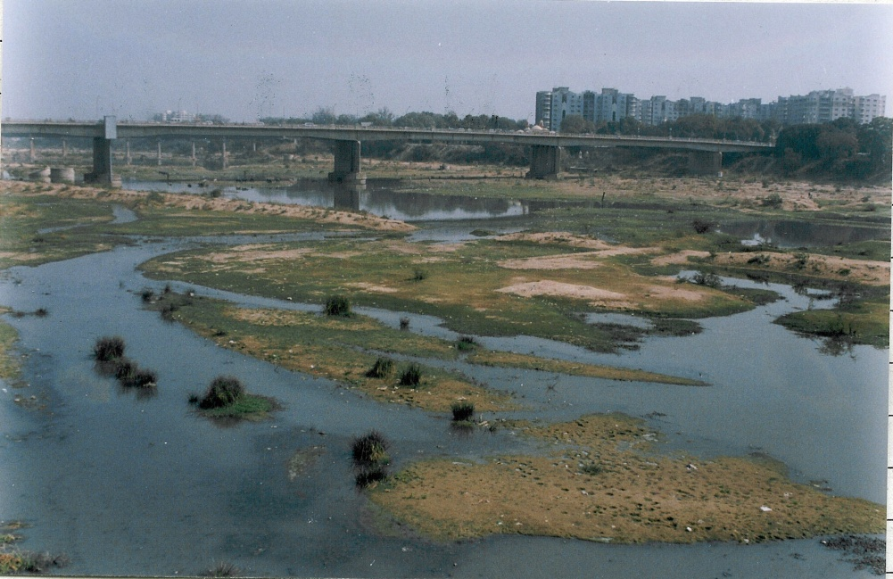
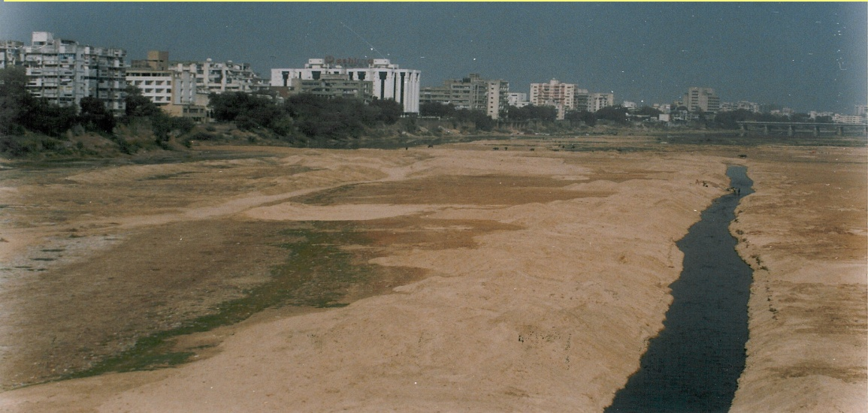
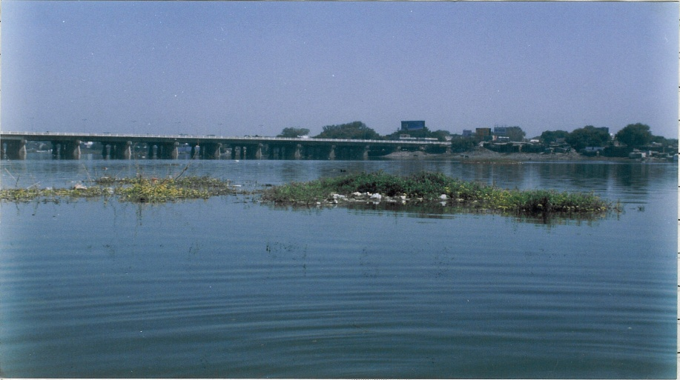
ENVIRONMENTAL MODIFICATION and malaria control
Environmental Control
SABARMATI RIVER’S CHANGING SCENIRIO
SCENARIO
Intervention:Channelization
Sabarmati: erstwhile
Narmada Fed Sabarmati

Slide 43
Vectorial Capacity Determinants: Biological, Ecological and Environmental
Elements | Aedes aegypti | Aedes albopictus
Geographic dispersal | Dispersed from Africa – 400 years ago. Active dispersal as companion to passengers on ship. Highly domesticated. Left original moorings – forests. | Dispersed from Asia passively through eggs 50 years ago Partly domesticated (suburban/rural areas). Did not leave forest moorings.
Resting | Indoors – non sprayable and secretive surfaces. | Outdoors – bushes, leaves and other situations.
Breeding | Artificial containers. | Tree holes/leaf axils, bamboo stumps, barrels, tyres in suburban/rural areas but close to natural vegetation.

Slide 44
Vectorial Capacity Determinants: Biological, Ecological and Environmentalcontd…
Elements | Aedes aegypti | Aedes albopictus
Host preferences | Highly anthropophilic. Adapted through evolutionary process. | Feeds on animals but can bite humans. Poorly anthropophilic. Can feed on humans exclusively under ecological stress.
Feeding behaviour | Nervous feeder – interrupted feeding to complete one feed. Multiple feeding. | Aggressive feeder. Can complete feed on single host. No interrupted feeding.
Gonotrophic discordance/ concordance | Discordent species. Requires more than one blood meal for each gonotrophic cycle. | Concordent species. Only one blood meal for each gonotrophic cycle.
Vectorial Capacity Determinants: Biological, Ecological and Environmental
Vectorial Capacity Determinants: Biological, Ecological and Environmental

Slide 45
Vectorial Capacity Determinants: Biological, Ecological and Environmental
Elements | Aedes aegypti | Aedes albopictus
Oral receptivity | Low. Requires high titre of viraemia. | High. Requires low titre of viraemia.
Transovarian transmission potential | Poor. Requires introduction of viruses. | High. Can maintain virus during inter-epidemic periods.

Slide 46
Ecological Changes
Population 361 m to 1 billion.
Urban Areas 2483 to 3768.
Cities (Pop. > 1 lakh) 130 to 300
Irrigation 30 m ha. to 90 m ha
Food Production 52 metric ton. to 174 metric ton.
Major Dams 160 thousand m m³ of water capacity to 234 thousand m m³
Forest Cover Reduced from 40% to 20%.
Industrialisation
1951 1992
Ind. Pro. Index 18.3 213.3
Elec. Cap.(Mn kw) 2.3 78.1

Slide 47
Ecological Changes
Use of Insecticide in vector control
Use of Pesticide in agriculture
Inadequate piped water supply leading to storage practices.
Wells have retained to fight the drought conditions.
Influx of labour population from endemic areas in construction sites (residential colonies, shopping centers, national and multinational offices etc.)
Appropriate by-laws are either lacking or are not enforced.

Slide 48
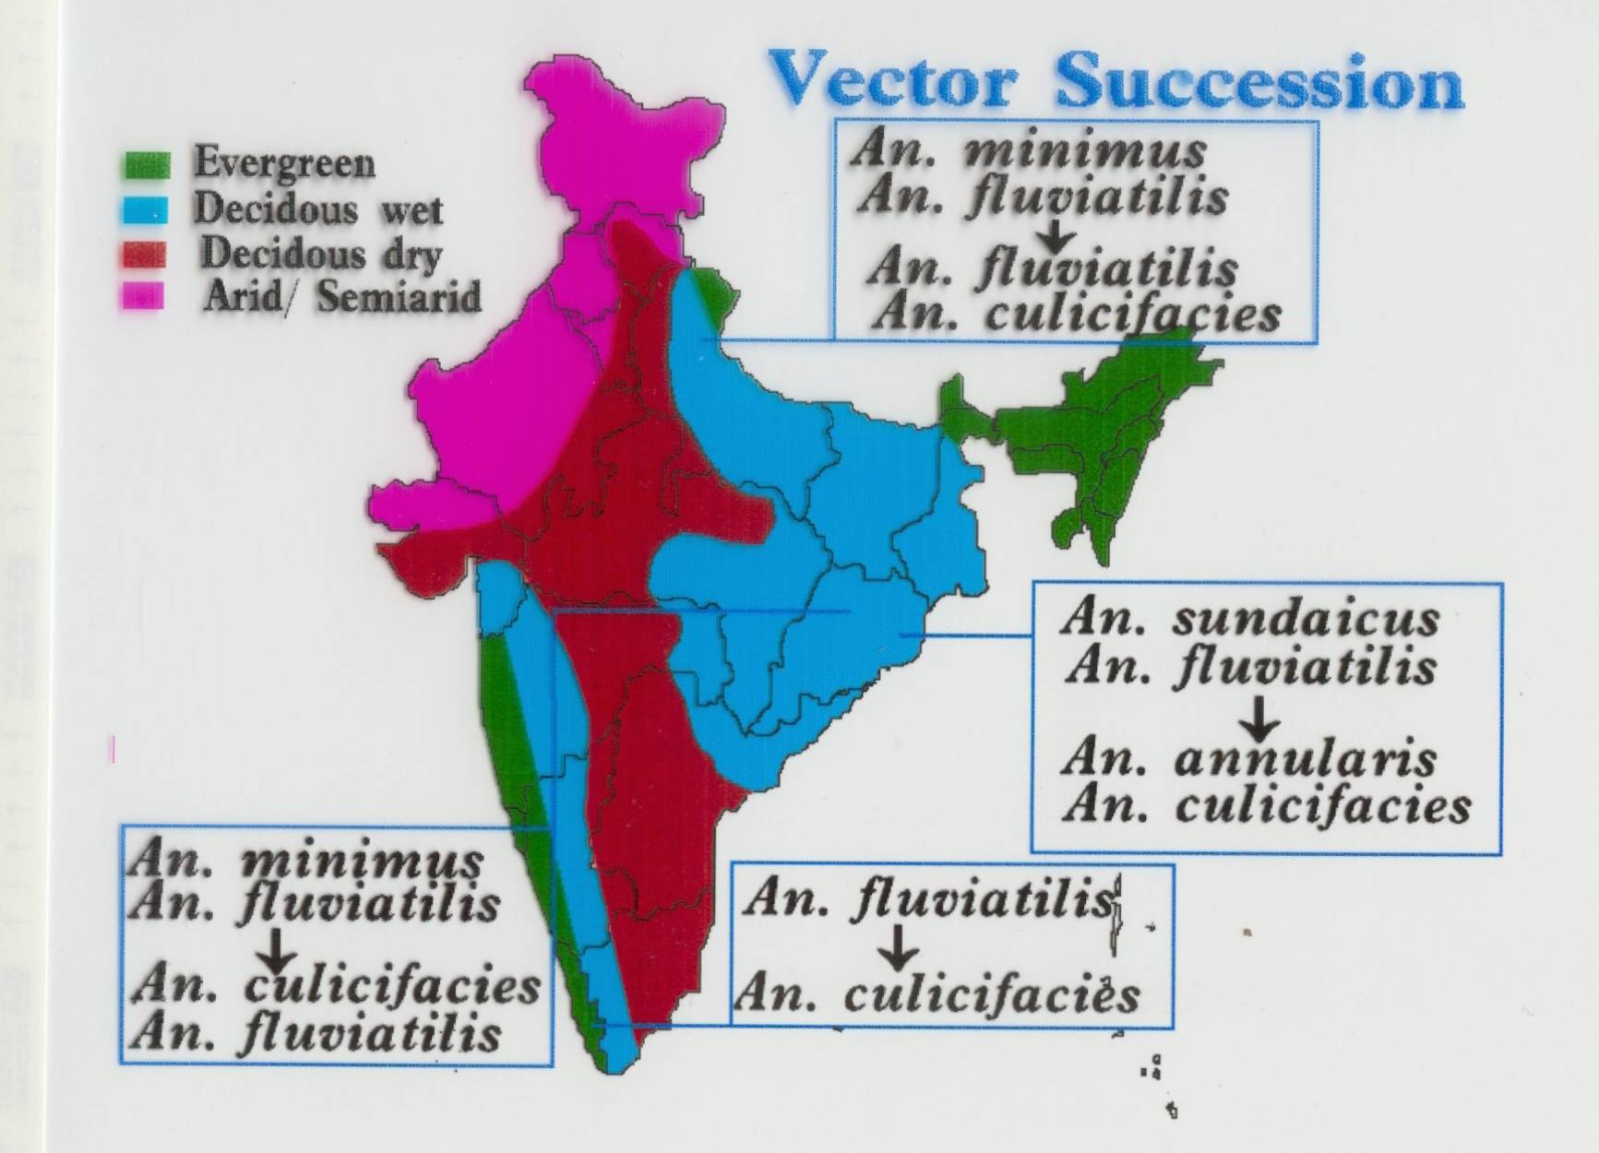

Slide 49
