Slide 1
Indoor Residual Spray -INDIA
Prof. Arti Prasad
Head Department of Zoology
University College of Science
MLSU, Udaipur.
Artimlsu@yahoo.co.in
UNIT – V- Community participation: Community participation in vector management - Community empowerment – sustenance of participation Inter-sectoral collaboration, Information, Education and Communication: KAP assessment – Communication strategies such as communication for behavioral impact (COMBI)/ behavioral change and communication (BCC)

Slide 2
Understanding community participation:
An essential understanding is that effective community participation in health entails a side-by-side involvement of community members with health care professionals and a responsible sharing of both power and responsibility.
Community participation (CP) has been defined “as a process whereby individuals, families and communities are involved in the planning and conduct of local vector control activities so as to ensure that the programme meets the local needs and priorities of the people who live in the community, and promotes community’s self-reliance in respect to development.”(WHO).

Slide 3
COMMUNITY PAERICIPATION
Community participation and empowerment is one of the most important elements of the Integrated Vector Management (IVM) strategy.
It allows the local population, who most suffers by the consequences of VBD,s, to drive effective prevention of the disease
Since no specific antiviral treatment or vaccine against dengue is available, modification of individual behaviour is essential in mosquito-control initiatives.
Individual households must accept responsibility for the control of mosquitoes in their surroundings.
Vertical vector control programmes may be ineffective if communities are not active partners in the control actions. sustainable vector

Slide 4
COOMMUNITY PARTICIPATION Challenges in Aedes Control
A range of Aedes control methods now exist, many of which have been tried and proven for different situations in different countries. •
Environmental sanitation measures to reduce mosquito breeding sites (source reduction), such as physical management of water containers (e.g. mosquito-proof covers for water storage containers, polystyrene beads in water tanks), better designed and reliable water supplies, and recycling of solid waste such as discarded tyres, bottles, and cans. •
Biological methods (e.g. fish, Copepods – small crustaceans, cyclops that feed on mosquito larvae) to kill or reduce larval mosquito populations in large water containers. •
Chemical methods against the mosquito’s aquatic stages for use in larger water containers (e.g. larvicide- Temephos, insect growth regulator – Pyriproxyfen, diflubenzuron•
Chemical methods directed against adult mosquitoes, such as insecticide space sprays. • Personal protection through use of repellents, vaporizers, mosquito coils, and insecticide-treated screens, curtains, bednets (for daytime use against Aedes) and Prevention and control of Dengue: No specific antiviral treatment or vaccine against dengue is available.
The key options for preventing and controlling Dengue are: a) To control larval habitats in and around people’s homes, workplaces, unclaimed empty spaces, dump sites and public areas such as place of worships/recreational centers, roadsides, playgrounds, and cemeteries b) To reduce human–vector contact c) To ensure prompt diagnosis of cases of fever and appropriate clinical management

Slide 5
Challenges in Aedes Control
: Though a range of Aedes control methods exists, however, many States continue outdoor space spraying (fogging) of insecticide for adult mosquito control as the strategy for Dengue control.
This is costly and its effectiveness is limited.
Ae. aegypti prefers to rest inside houses, so vehicle mounted or outdoor fogging simply does not reach mosquitoes resting in hidden places.
Home-owners in various places may refuse entry to spray teams for indoor space spraying, or shut windows and doors to prevent outdoor insecticidal fogs from entering their house, thus reducing the impact of this intervention.
Furthermore, delay in reporting or incomplete line-listings have made spraying often too late to prevent epidemic and adult mosquito populations quickly return after spraying.
Indoor space spray is thus more effective than outdoor fogging. Larval control is also challenged as the eggs can remain dormant for more than a year in dry condition and once they come in contact of water, desiccated eggs hatch and larvae emerge.
There is also evidence of vertical transmission of dengue virus from infected female mosquitoes to the next generation. Public trust and complacency in such an ineffective approach has only increased the challenge of explaining the need for community involvement in the control of larval habitats. Insecticide fogging is not recommended as a routine measure for control of Aedes mosquito.

Slide 6
Need for community participation for sustainable Dengue prevention and control:
In modern time, two countries - Cuba and Singapore, which have been successful in controlling Ae. aegypti have used a combination “top down–bottom up” approach.
Unfortunately, the “top down” methods used in the past are no longer feasible because of lack of resources.
Moreover, the vertically structured programmes of the past had little sustainability which can only come through community participation in mosquito control programmes.
In order to achieve sustainability of a successful Dengue vector control programme, it is essential to focus on larval source reduction and to have complete cooperation of community groups, to ensure community understanding and involvement in implementation.
In most of the Indian States, the aspect of community participation in dengue control needs to be strengthened further.

Slide 7
Community participation
Controlling Dengue is everyone’s responsibility
Vertical vector control programmes may be ineffective if communities are not active partners in the control actions but rather are passive participants or recipients of the control efforts.
People need to assume responsibility for inspection and control of Ae. aegypti in and around their homes.
Successful, sustainable Ae. aegypti control programme must involve a partnership between government agencies and the community.

Slide 8
Community participation and National Health Policy
The National Health Policy (Draft 2015) under its Policy Directions for preventive and promotive health for addressing the wider social and environmental determinants of health refers to the importance of community participation in health.
It states that ‘Other than its own policy action and initiatives, the Government has an obligation to build community support and capacity to enjoy Controlling Dengue is everyone’s responsibility
People need to assume responsibility for inspection and control of Ae. aegypti in and around their homes. Successful, sustainable Ae. aegypti control programme must involve a partnership between government agencies and the community.
Good health, particularly among those who are most vulnerable and have the least capacity to make choices and changes in their lifestyle or living conditions that might improve and protect their health.’ The Village Health Sanitation and Nutrition Committees (VHSNCs) and their urban equivalents that are a part of Local Government Institutions are a platform that must be strengthened and utilized for this purpose.

Slide 9
Community participation as part of the Global vector control strategy and the National Guidelines for Integrated Vector Management:
Many countries including India have adopted the global strategy of vector control and incorporated it into its programme.
The global strategy for operationalization of Aedes vector control has as one of the five major components.
Selective integrated mosquito control with community and inter-sectoral participation • Disease surveillance based on a strong health information system • Emergency preparedness • Capacity building and training • Research on vector control

Slide 10
Address Not just house holds But the Broader Community
Vector control cannot be very effective if carried out only on individual basis. Even those who do follow the recommended actions may still have Ae. aegypti or other mosquitoes in their houses and worse still, may suffer dengue infections if their neighbours do not participate in controlling domestic breeding sites, or they may get bitten by an infected mosquito at their place of work, study etc.
Therefore, the issue for vector control is not whether source reduction is effective, but whether and how community participation can be a part of that source reduction effort. Thus, multi-level, vertically and horizontally integrated programmes offer the best solution to dengue control.
For optimal effect, programmes need to include not only behaviour change efforts at the household level, but target the broader community groups including schools, work sites and other organizations within the community. There is need to adopt an expansive view of the “community” as a set of programme partners, which may include 7 householders, local leaders, commercial business owners, opinion leaders, schools, environmentalists, resident associations, Community Based Organizations (CBOs), Faith Based Organizations (FBOs), Inter-Departmental partners etc

Slide 11
Advocacy and social mobilization
There are various ways to involve communities. One approach successfully developed by the agricultural sector is IPM/IPVM.
Farmer Field School (FFS) approach, wherein farmers become experts in pest and vector control through a participatory learning approach to deal with local situations .
The other approaches are through information, education and communication (IEC) campaigns, behaviour change communication (BCC) for vector control and participation by nongovernmental organizations (NGOs)/community organizations. Important steps include developing advocacy, sensitization and participatory materials for different levels of implementation. At community level, identification of prime movers and community leaders is also necessary.
Advocacy efforts will be required to create an enabling policy environment for policyand decision-makers as well as collaborating sectors to allocate more resources for preventive actions against vectors and accept an IVM approach.
This is all the more important since policy decisions in favour of IVM, and mobilization of human and financial resources by public sectors, will involve different departments at district level and different ministries at state/provincial and nationaL

Slide 12
Information, Education and Communication: KAP assessment – Communication strategies
Advocacy, Communication (IE&C and BCC) and Social Mobilization (ACSM)
Behaviour Change Communication and Advocacy in Ghana is implemented in line with the National Malaria Strategic Plan and National communication strategy. Communication plays a vital role in changing/improving knowledge, creating positive attitudes and improving practice of desired health behaviours.
The focus of ACSM for malaria prevention and treatment is to ensure correct and consistent use of LLINs; appropriate treatment seeking behavior for malaria; compliance with the correct treatment regimen as enshrined in the Strategic Plan; improving community participation in indoor residual spraying (IRS) campaigns; and encouraging pregnant women to seek antenatal clinic services and comply with national recommendations for treatment of malaria in pregnancy.
Strategies - Case detection ,Management including LLINs, and IRS

Slide 13
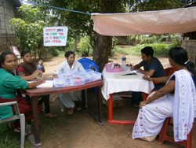
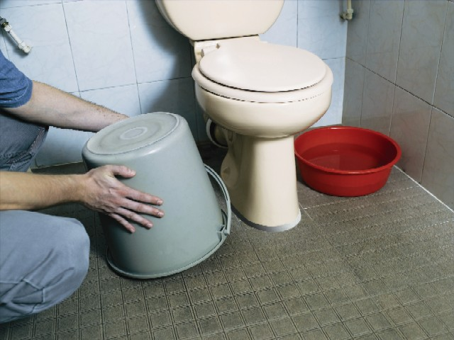
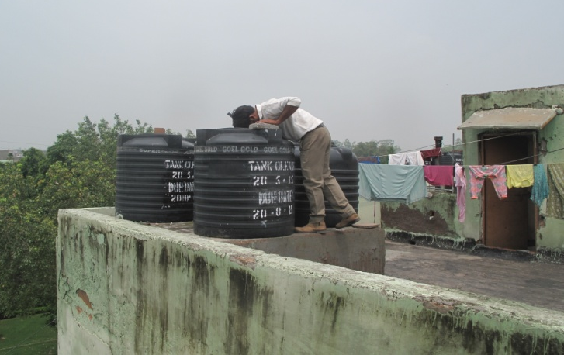
IEC ACTIVITIES
As Aedes is a domestic mosquito it is the responsibility of the societies and community to avoid breeding of Aedes mosquito domestic and peri-domestic areas.
As Aedes mosquito breeds in every type of container, it is a duty of the community to fix a day in a week to clean and scraps all the breeding sites in and around their premises.
Community should allow the Health worker to enter their houses for checking and examining all the possible breeding containers.

Slide 14
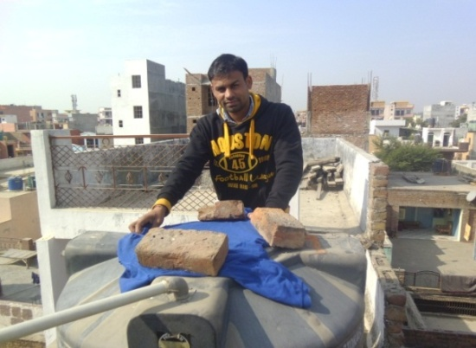
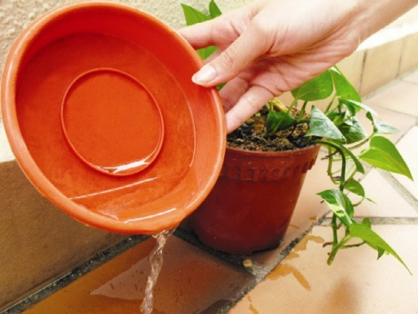
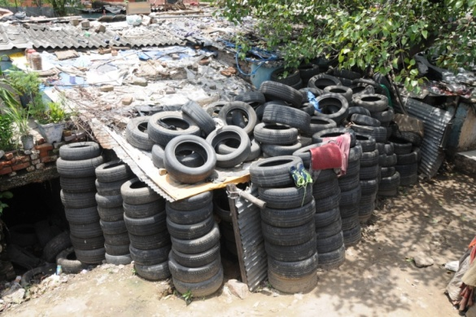
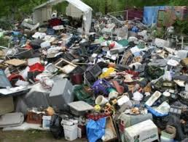
SOURCE REDUCTION
Keep water containers covered with proper lids, avoid storing of water for more than 5-7 days.
Change water for vases and aquatic plants at least once a week, leaving no water under the pots or in the bottom saucers.
Scrub the container surfaces thoroughly to prevent mosquito eggs sticking on them.
Remove or puncture any dumped tyres to prevent the accumulation of stagnant water.
As the Aedes mosquito breeds in container, don’t keep any junk material or any solid waste in an around the house as well as on the roof.

Slide 15
BCC Campaign
Behaviour Change Communication (BCC) activities carried out be included
television advertising which focused on Test, Treat and Track (T3) and should aired on in different Languages of the states.
radio commercial focusing on malaria confirmation and treatment with Treatment completion and compliance. This should placed on all radio stations across the country in local languages.

Slide 16
Social/Community Mobilization
Social/Community mobilization (community participation or engagement) should ongoing activity aimed at sensitizing the community members to accept and participate in health interventions put in place to control diseases, in this case malaria.
Some community activities were implemented through NGOs, Community Based Agents (CBAs), health personnel, etc.
They were empowered with funds to undertake community level sensitization through durbars, traditional & opinion leaders’ orientations, market, churches/mosques one-on- one and group education.
NGOs as well did house to house education of women on the need to attend Antenatal Clinics as early as they notice they are pregnant.

Slide 17
Knowledge, attitude and practice(KAP)
Mosquito-borne diseases constitute an important cause of morbidity and mortality, especially in India.
Assessment of knowledge and practices of community about prevention of mosquito borne diseases is important for designing community-based interventions. Therefore, the study was carried out to assess such information.
A community-based cross-sectional study was conducted among 350 adults selected by systematic sampling method in a rural and urban area in Delhi.
Data was collected using pretested semi-structured questionnaire after taking written informed consent. Data was analyzed using SPSS version 17. Chi-square and Fisher's Exact test was used for qualitative variables to find association and P <</i> 0.05 was considered significant.

Slide 18
Knowledge, Attitude and Practice
One hundred and forty-two (67.6%) subjects in rural and 89 (63.6%) in the urban area were able to name at least one mosquito borne disease.
Only small number of participants (from rural 28.1% and urban 18.6% areas) was aware of "fever with chills and rigor" as a symptom of malaria. Television was most common source of information in both rural and urban areas.
Desert coolers were reported to be cleaned regularly in a week in 86.4% houses in a rural area, and 88.4% houses in the urban area.
Potential breeding sites were significantly more in urban (n = 34, 24.3%) than rural (n = 13, 6.2%) houses (P = 0.01). Similarly actual breeding of mosquitoes was found significantly more in urban houses (n = 29, 20.7%) than rural houses (n = 14, 6.7%), which was statistically significant (P = 0.01).
Knowledge about mosquito borne diseases was significantly associated with education status of the participants.
Conclusion and Recommendation: Level of awareness was good; however mosquito breeding was occurring more in urban areas, which demands innovative mass media techniques to convey health messages to the public for prevention and control of mosquito borne diseases.

Slide 19
Area wise distribution of sources of information about VBD

Slide 20
knowledge, Attitude and Practice
A knowledge, attitude and practice (KAP) study was carried out in an urban and a rural area in Karnataka state of India with the objective of determining the perceived risk by the community of mosquito-borne infectious diseases and the level of knowledge regarding mosquitoes.
The study brought out that more than 90% of the people interviewed perceived mosquitoes as a problem. However, this perception was with regard to the nuisance value of mosquito bites rather than their disease-causing potential.
Malaria was known as the main disease transmitted by mosquitoes. Quite a large number of people did not know where the mosquitoes bred. Those who knew mentioned drains and stagnant water as the main breeding sites. More than one third of the interviewees did not know of any preventive measures against mosquitoes at the community level.
More than 75% were taking some kind of personal prophylactic measures against mosquito bites. Approaches based on social mobilization and communication aimed at bringing behaviour change in the communities are stressed.

Slide 21
COMMUNICATION FOR BEHAVIOURAL IMPACT (COMBI)
Behavioural and Social Communication:
a systematic and planned process of communication that addresses the way information is transmitted, perceived, understood and applied by individuals and groups in social and organizational settings.
It employs a number of different methods and strategies to achieve specific behavioural results linked to outbreak control objectives.

Slide 22
COMMUNICATION FOR BEHAVIOURAL IMPACT (COMBI)
. Behavioural and social interventions have become an essential component of efforts to mitigate the effects of outbreaks, because many interventions rely heavily on community engagement, participation and ownership and on intersectoral coordination and collaboration for prevention, control and mitigation strategies to work.
Central to this shift in approach is the commitment to integrated, technically sound strategies that include effective health communication in outbreak control objectives. Experts have come to realize that community understanding of diseases and their spread is complex,

Slide 23
COMBI
Integration of participatory approaches into veterinary and public health responses are essential to look in the right places, ask the right questions and listen more effectively before making technical recommendations and implementing interventions (JE).

Slide 24
Components of COMBI
Identifying key risk reduction actions at the household and community level to prevent and mitigate negative health consequences;
Ensuring technical outbreak prevention and control measures are community-located, feasible, appropriate and socially acceptable;
Applying multiple approaches such as social mobilization, health education/promotion in order to promote the uptake of measures to stop further disease transmission and reduce risk;
Integrating psychosocial care and mental health responses within outbreak control

Slide 25
COMBI replaces the old marketing concept of four Ps (product, price, placement and promotion) with four Cs of integrated marketing communication, which are more appropriate for health-related behavioural outcomes:
Consumers’ needs, wants and desires provide an immediate consumer focus.
The situational market analysis phase reveals what really motivates people, including First, we Hear about the behaviour then we are Informed about it, and later Convinced that it is worthwhile In time, we Decide to act on the new behaviour. and later we Act on the new behaviour We then Reinforce our action by feeling satisfied about carrying out the behaviour If all is well, we Maintain the behaviour

Slide 26
Critical dimensions of community mobilization in outbreaks
Outbreak prevention and control interventions are only as effective as the people who represent and implement the programme.
During an outbreak, trust and the credibility of the proposed interventions should be quickly established.
Fear is a common, powerful, understandable instinct that compels people to act differently from the way they would under normal circumstances.
An unknown outbreak can raise fear and cause anxiety. Ensuring that trust and credibility are maintained and that there is empathy with affected communities helps reduce anxiety, so that people are more likely to listen and understand messages and take appropriate action.

Slide 27
Ensure community feedback during and after an outbreak
Ensure community feedback during and after an outbreak Communities should be given regular feedback on how an outbreak is being managed and how the campaign is progressing.
Feedback ensures two-way communication; information received from communities (i.e. current perceptions, rumours) can strongly increase the effectiveness of social mobilization strategies.
Messages and materials should be pretested with the intended audience and any necessary adjustments made before mass production.
Ensure that the intended effect of the materials is correct and that the messages are accessible, understood and acted upon. Communities should also be informed once an outbreak has been controlled and control activities have ended.
Feedback gives a sense of closure to a period of crisis and signals that normal community life can be resumed. People will also have a sense of accomplishment that they did their part in contributing to ending the outbreak. This can be acknowledged in many ways, including ceremonies, religious services and reports in the local media

Slide 28
Dengue haemorrhagic fever programme.
xx people in (district/village) understand that there is a potential outbreak of dengue
haemorrhagic fever in their communities and to raise awareness of the seriousness of the
situation and the importance of preventive and control actions;
xx people in (district/village) and dengue volunteer inspection teams receive clear, accurate
information about the signs and symptoms of dengue, where to obtain help and what they should do;
all health-care professionals in public and private clinics serving xx people in (district/village)
are able to diagnose rapidly and give appropriate treatment and advice on dengue; and
information on the outbreak, how it is being managed and the measures being taken to
provide rapid diagnosis and treatment is communicated in a timely, relevant manner.

Slide 29
Dengue haemorrhagic fever programme
The three main behavioural objectives for reducing risk are: to prompt residents in every household in xxx district to carry out a 30-min inspection of their houses every Sunday, both inside and out, for potential mosquito larval sites over the next xx weeks (x date–x date);
to prompt every person with fever during the next xx weeks to assume that it is dengue haemorrhagic fever and to go immediately (at least within 24 h) to the nearest health clinic for diagnosis and treatment; and
to prompt every village, community or block to form a dengue volunteer inspection team to conduct weekly larval site inspections around the community (not within houses) and to take action to rid the area of the breeding sites.

Slide 30
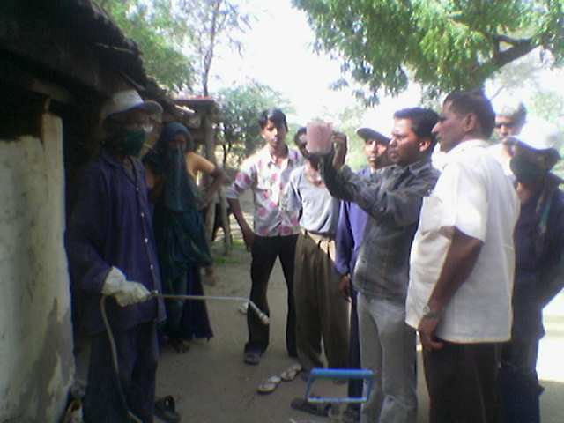
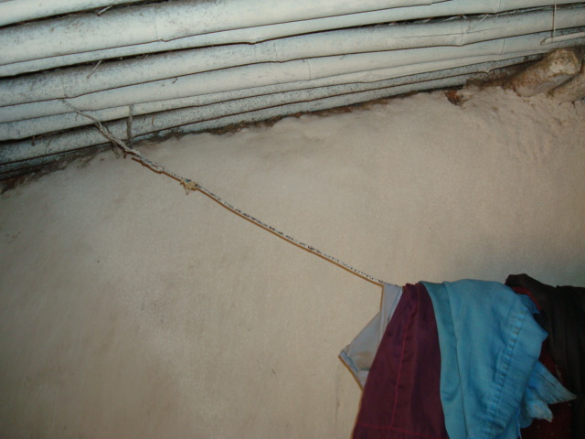
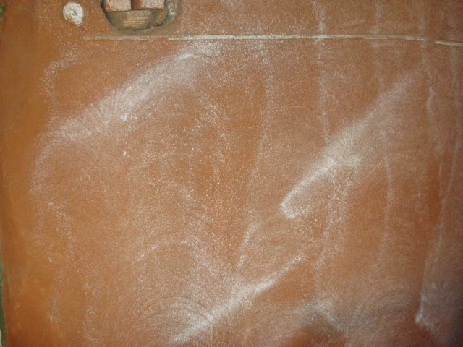
Community participation during IRS
The discharge rate should be 740 to 850 ml per minute.
To obtain the above discharge rate, the pump man should give 50 to 120 strokes per minute with 4-5 cms plunger movement at a pressure of 10 PSI (0.7 kg/sq.cm) at the nozzle tip.
Spraying into a bucket for one minute and measuring the quantity of the suspension in a graduated mug should check the correct discharge rate (740 to 850ml/minute).
The nozzle tip should be discarded if the discharge rate exceeds 850 ml per minute.
It takes about 5 minutes to spray a house with an average surface area of 150 sq. metres.
D.R.
Good Quality
Change Nozzle tip

Slide 32
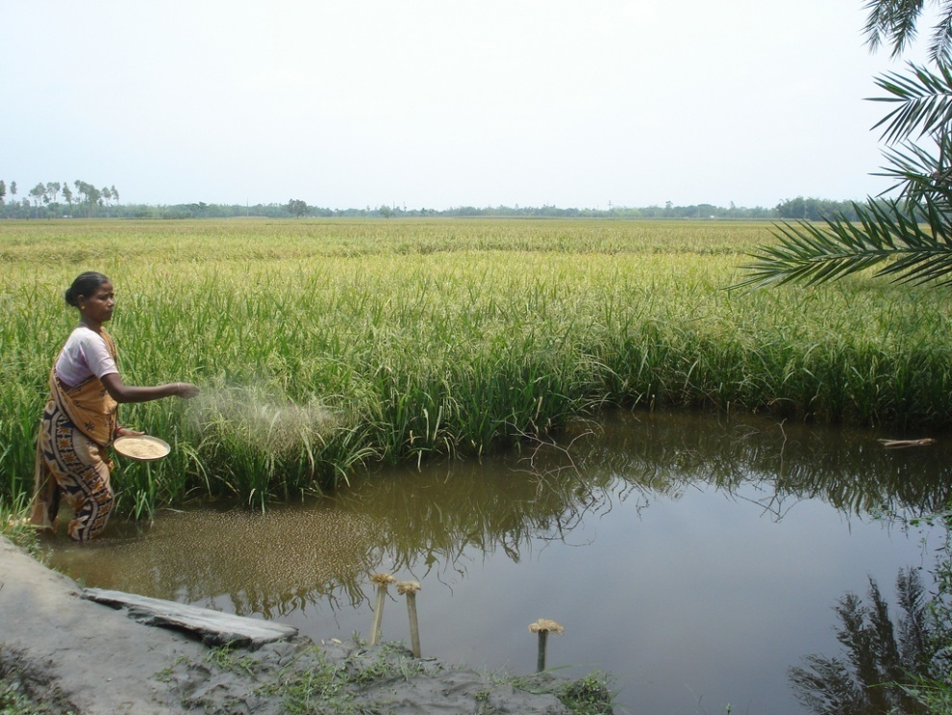
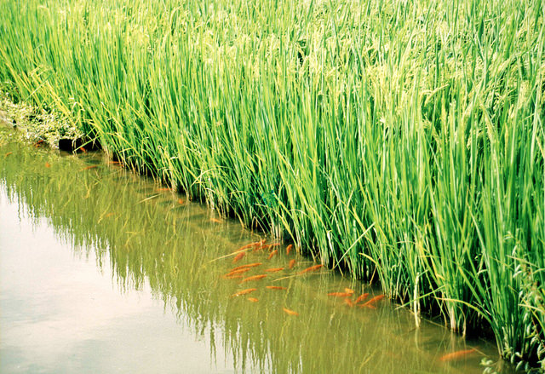
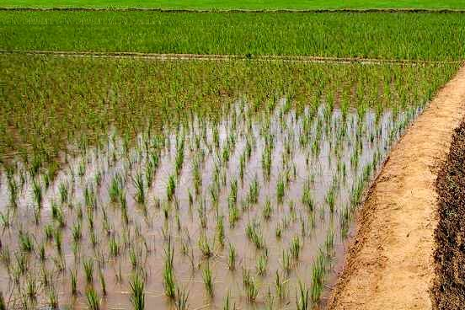
Community participation -WHERE TO USE FISH
In open mosquito breeding sites or rice fields, the fishes need to be protected from pesticides applied to crops, when used in rice fields.

Slide 33
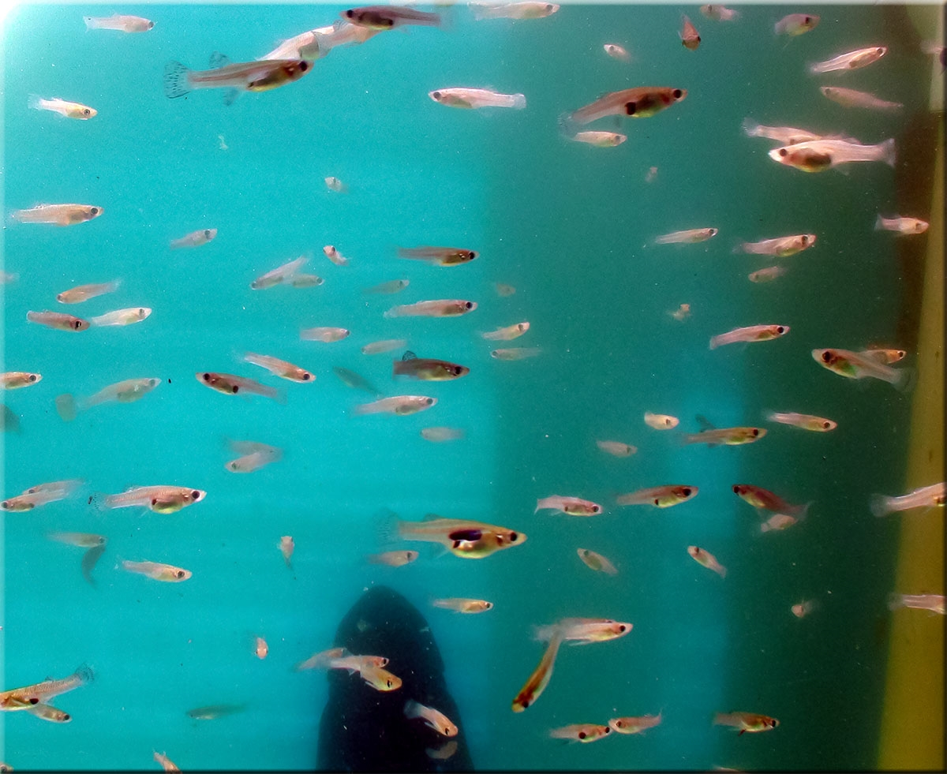
Larvivorous fish

Slide 34
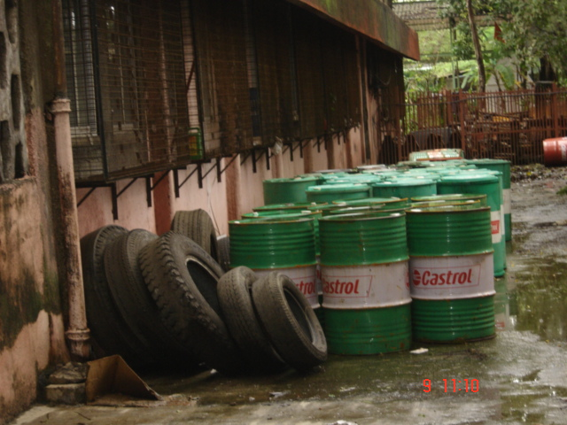
DRUMS & TYRES (holding water during monsoon)

Slide 35
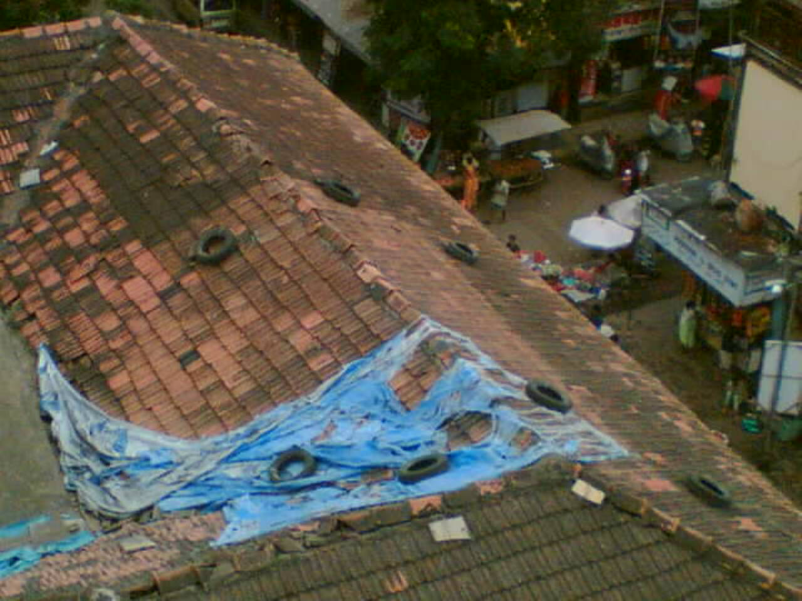
Inaccessible Tyres

Slide 36
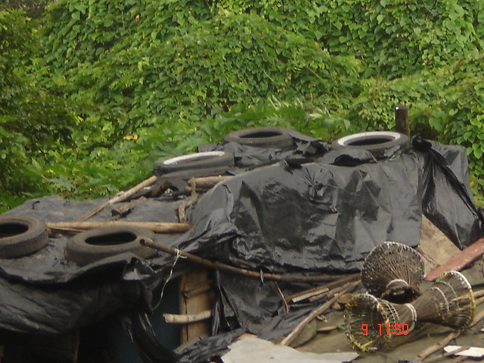
TYRES & PLASTIC ROOF

Slide 37
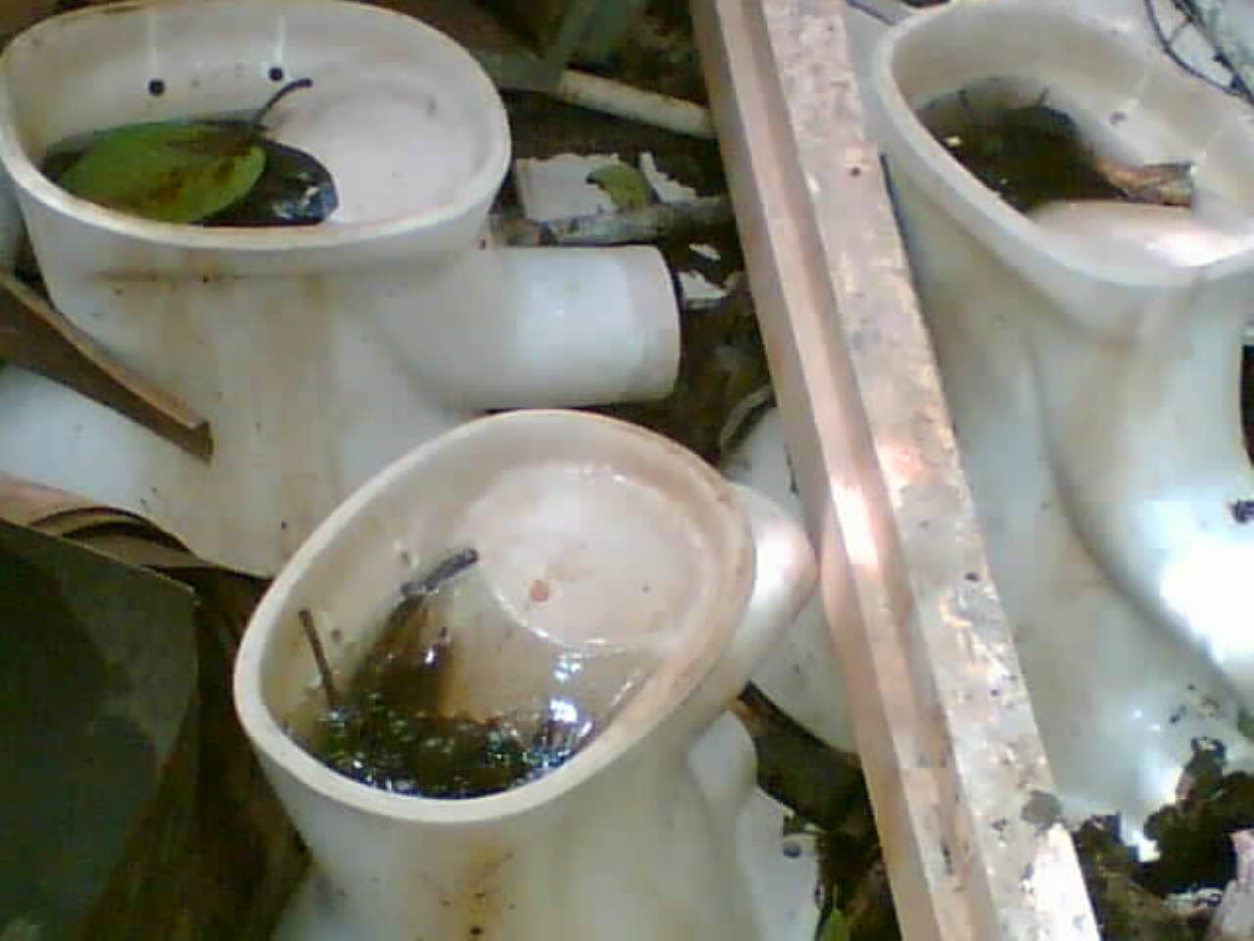
Discarded Toilet pots

Slide 38
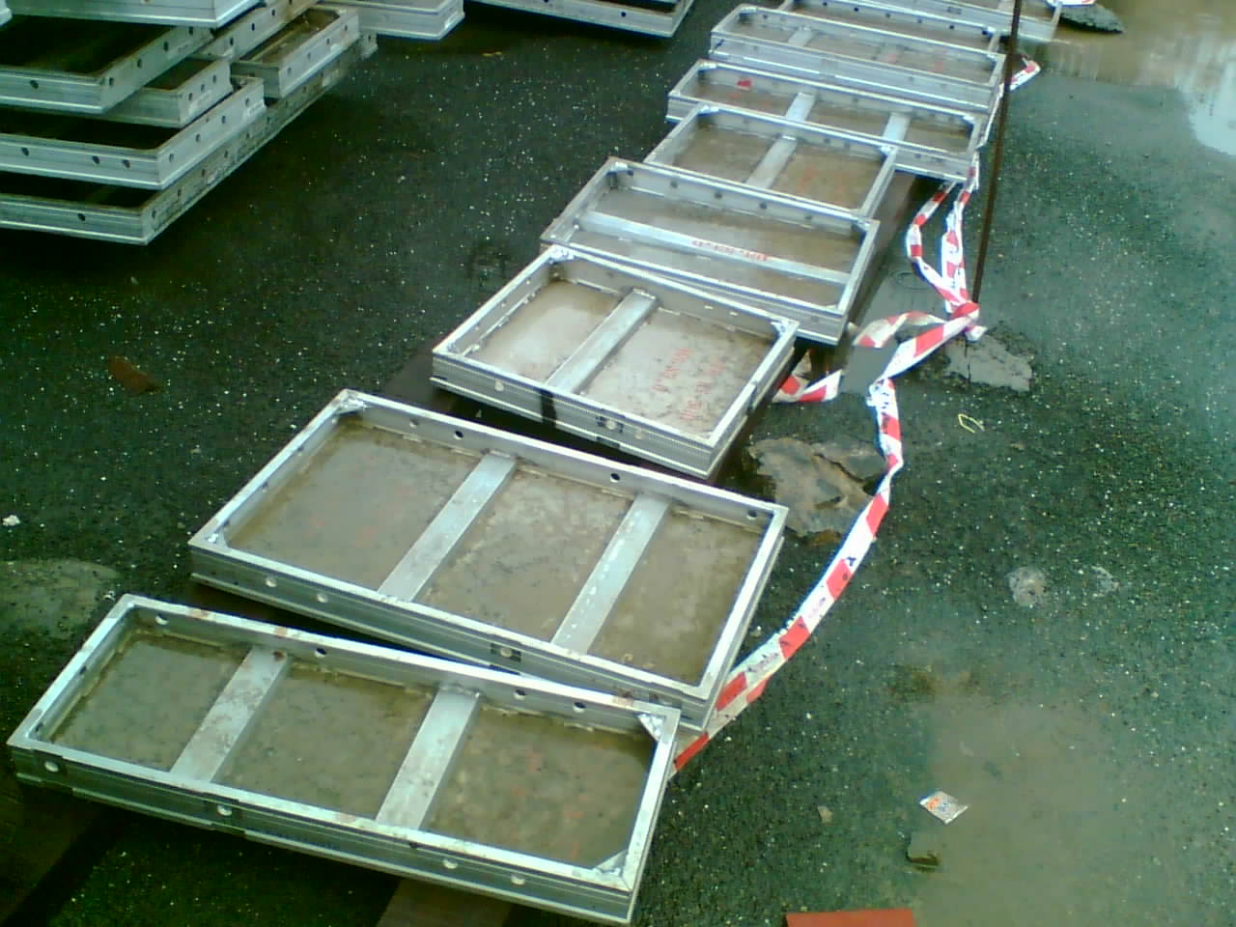
Shuttering Material for Bldg const

Slide 39
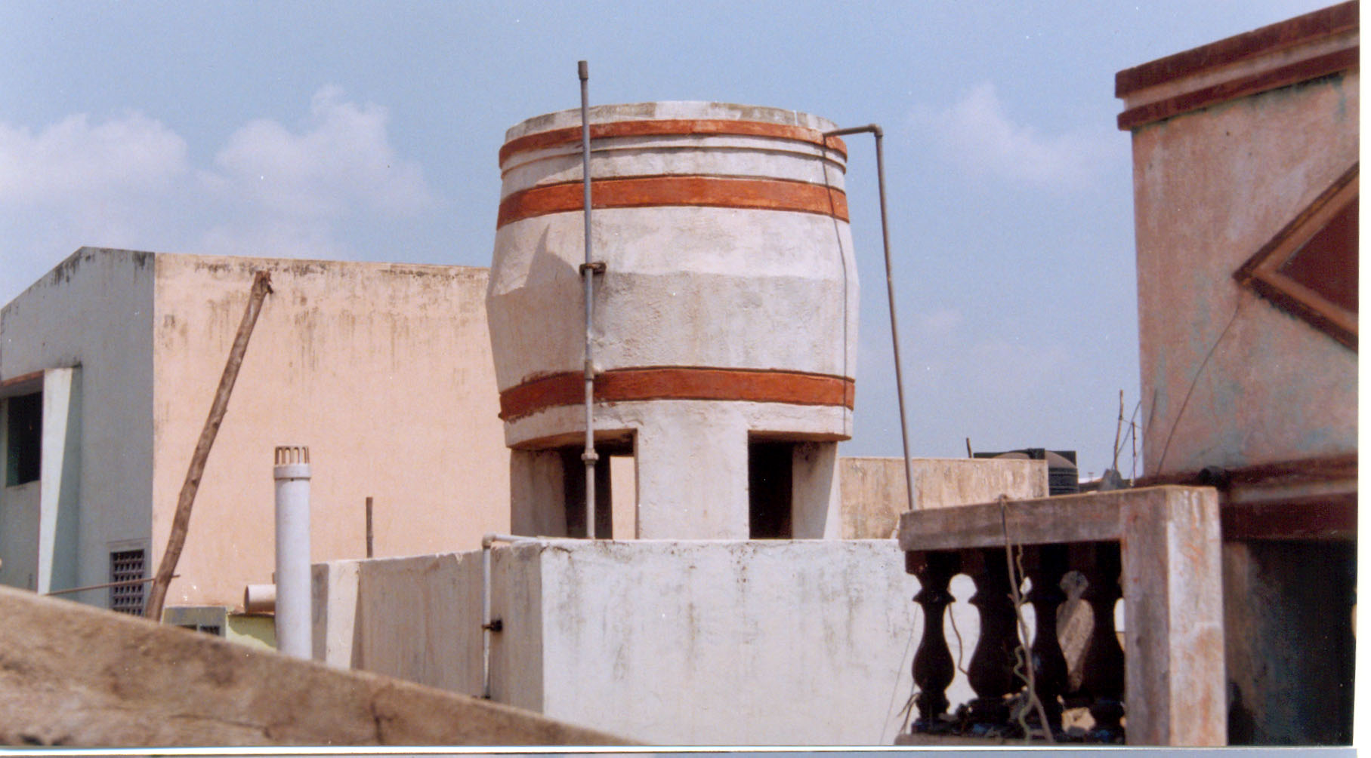
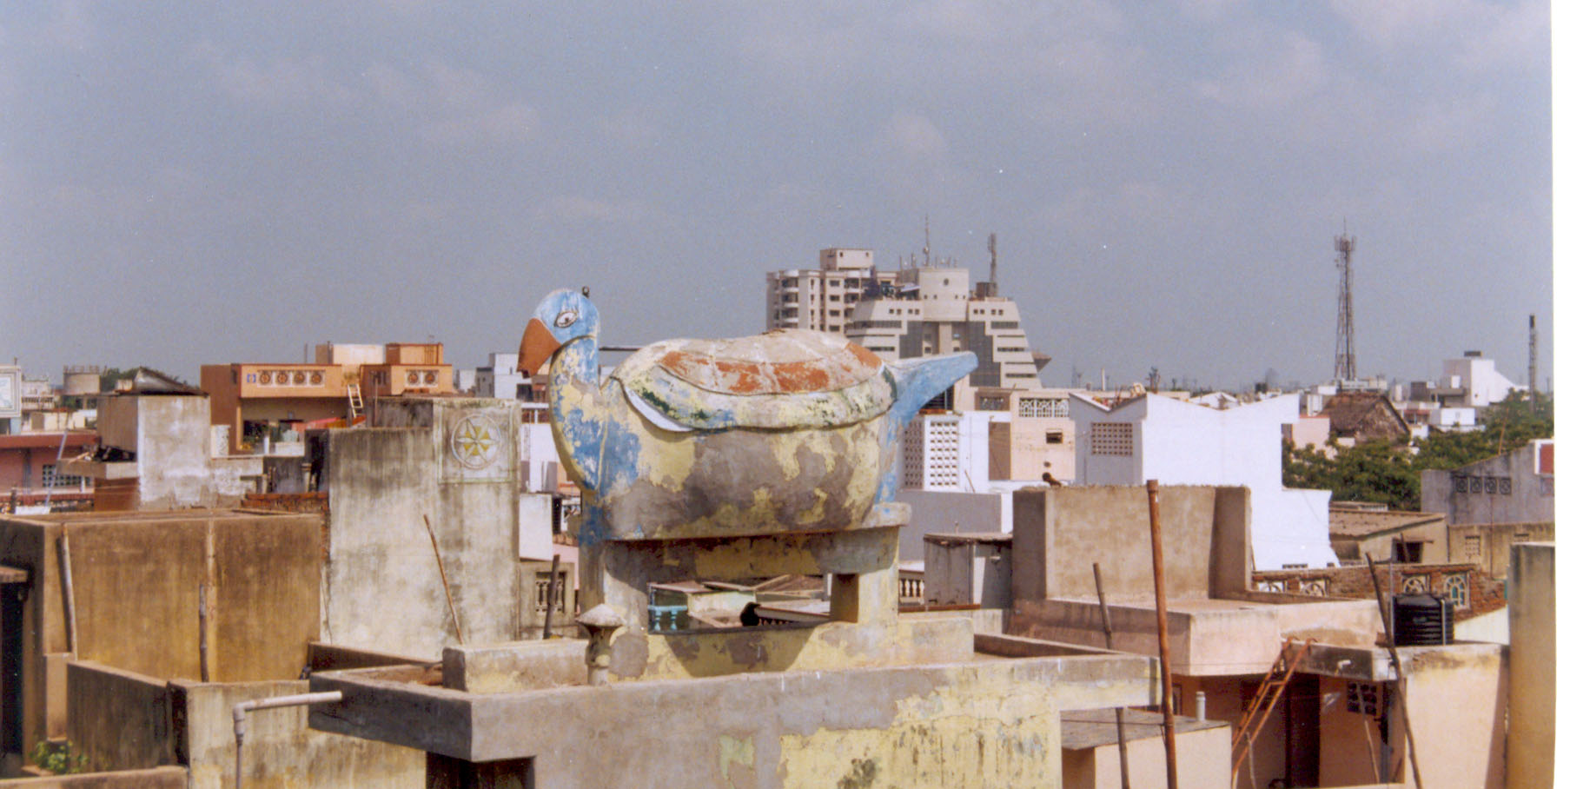
Community participation
VECTOR CONTROL CHALLENGES
30% of the Overhead Tanks are in accessible
Even in government buildings the over head tanks are built violating the public health principles

Slide 40
Community partnership-Dengue,Malaria and other VBD,s
Fodder for thought
This is the story of four people named EVERY BODY , SOME BODY , ANY BODY , NO BODY .
There was an important job to be done and EVERY BODY was sure that SOME BODY would do it.
ANY BODY could have done it. But NO BODY did it. SOME BODY got angry about that because it is EVERY BODY job. Every thought that ANY BODY could do it but NO BODY realised that EVERY BODY do not do it.
It ended up that EVERY BODY blamed SOME BODY when NO BODY did what ANY BODY would have done it

Slide 41
Further reading
1. Parks W, Shrestha S, Chitnis K (2008). Essentials for
excellence: researching, monitoring and evaluating strategic communication for behaviour and social change. UNICEF Pacific Office, Fiji. Available at: http://www.unicef. Org/cbsc/files/Essentials_for_excellence.pdf
2. World Health Organization Department of Global Capacities Alert and Response 20, Avenue Appia CH-1211 Geneva 27 Switzerland Tel. +41 (0) 22 791 4568 Fax: +41 (0) 22 791 4721 combi@who.int csr@who.int www.who.int/csr/en
3. NVBDCP-BCC/IEC

Slide 42
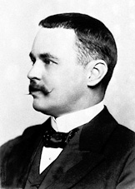
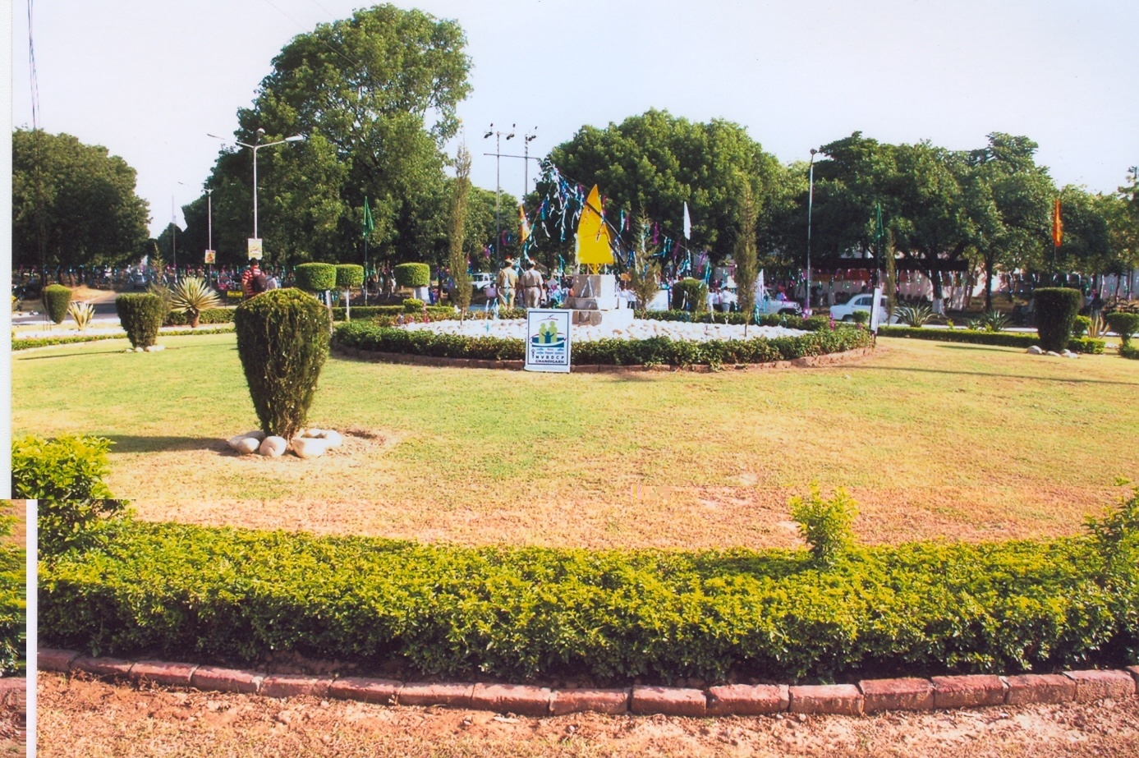
Thank You
In this, O Nature, yield I pray to me. I pace and pace, and think and think, and take The fever'd hands, and note down all I see, That some dim distant light may haply break. The painful faces ask, can we not cure? We answer, No, not yet; we seek the laws. O God, reveal thro' all this thing obscure The unseen, small, but million-murdering cause.
Dr.Ronald Ross

