Slide 1
Indoor Residual Spray -INDIA
Prof. Arti Prasad
Head Department of Zoology
University College of Science
MLSU, Udaipur.
Artimlsu@yahoo.co.in
INSECTICIDE RESISTANCE

Slide 2
SELECTION OF VECTOR CONTROL OPTIONS
Chemical Control
Environment Management
Biological Control
Environmental Control
Legislative control
Chemical Control
Biological Control
INTEGRATED VECTOR MANAGEMENT
An Evidence-based decision making process, rationalizing the use of vector control methods and emphasizing the engagement of communities

Slide 3
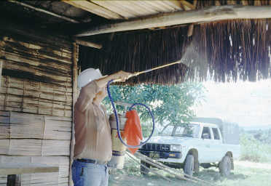
Vector Control Strategy
Gambussia
ITMN

Slide 4
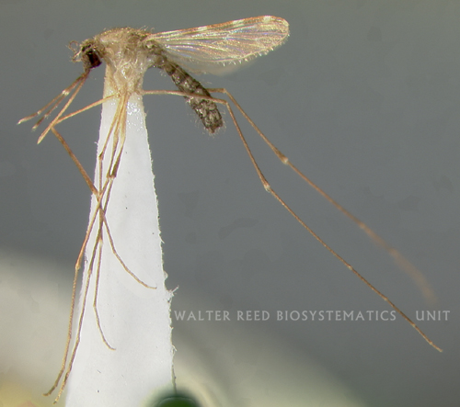
An. culicifacies
Monsoon associated species
An. culicifacies(Epidimic vector)
Monsoon associated species
An. culicifacies (Epidimic vector)
Responsible for 60-70% malaria in India

Slide 5
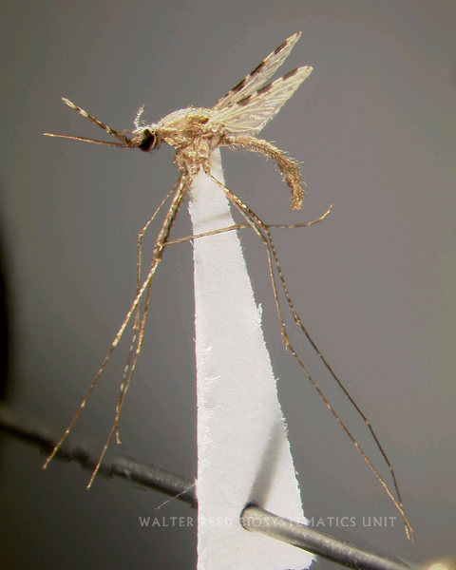
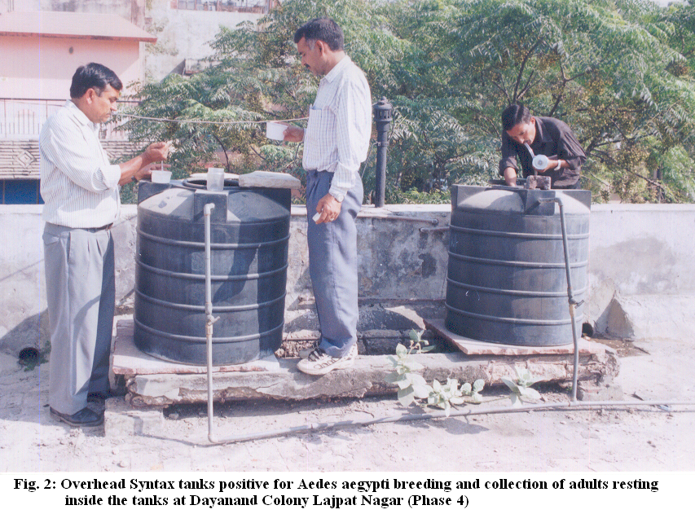
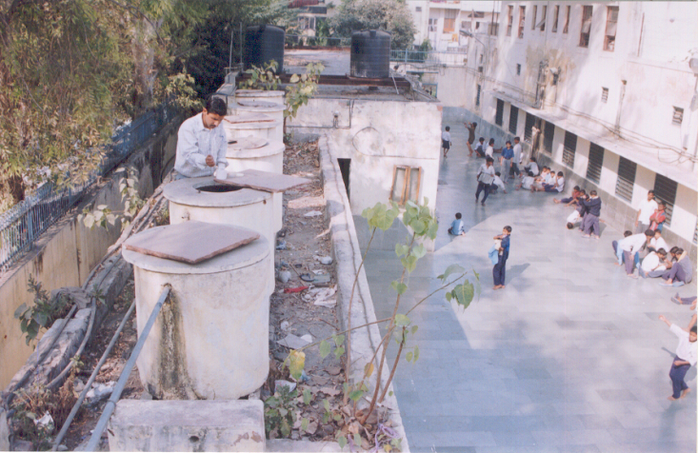
An. stephensi
Urban malaria

Slide 6
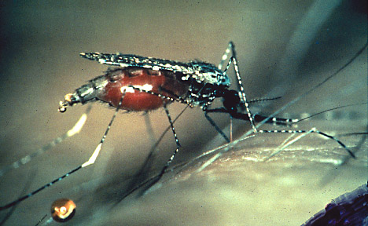
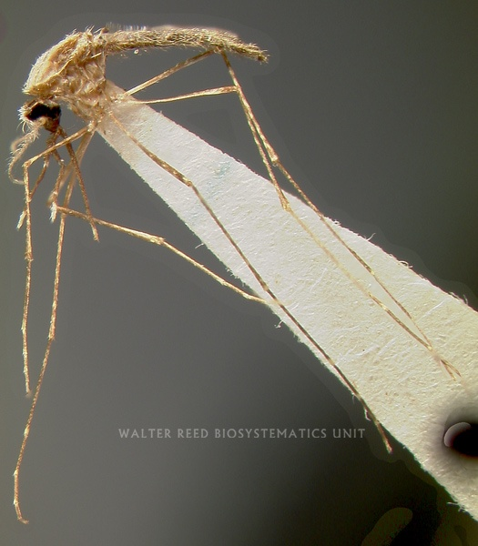
An. dirus and An. sundiacus

Slide 7
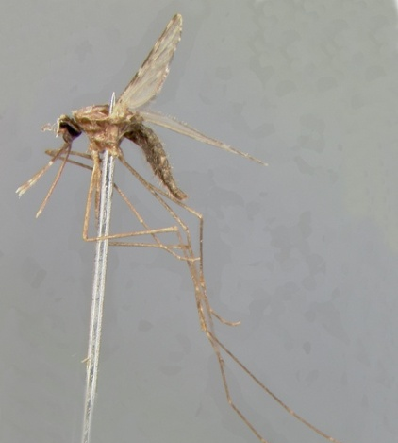
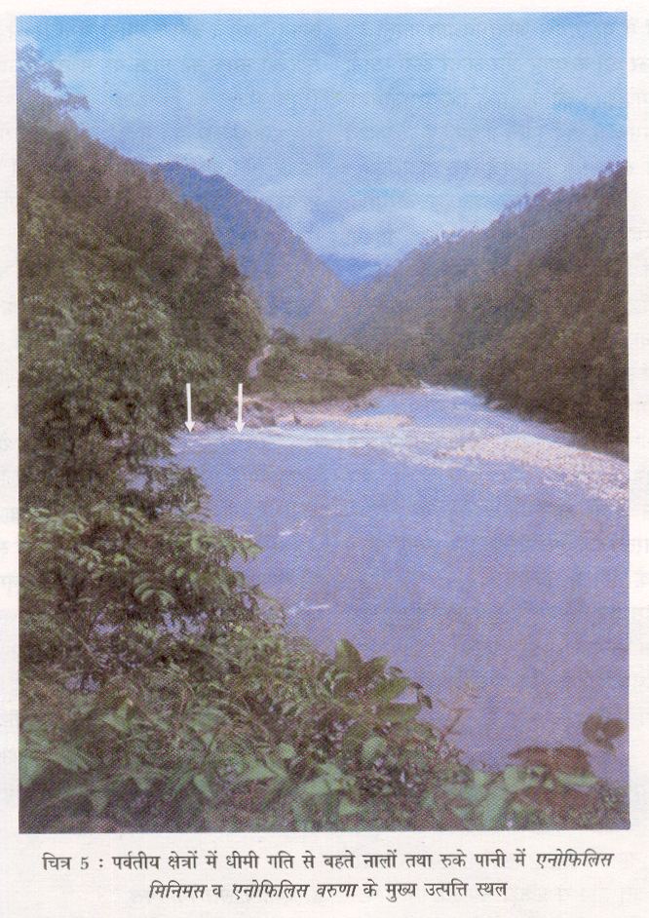
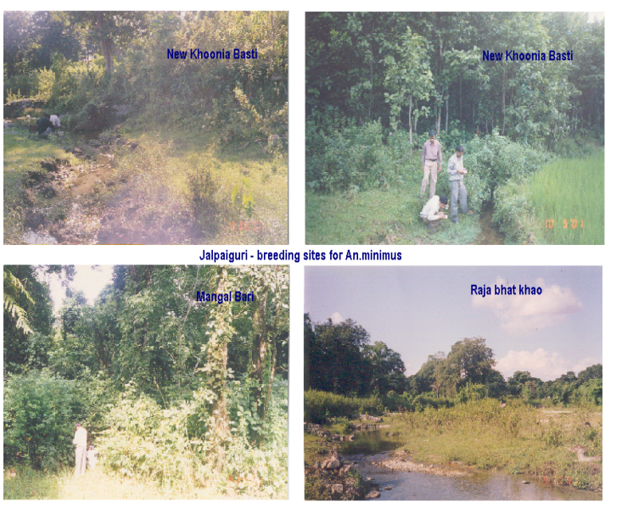
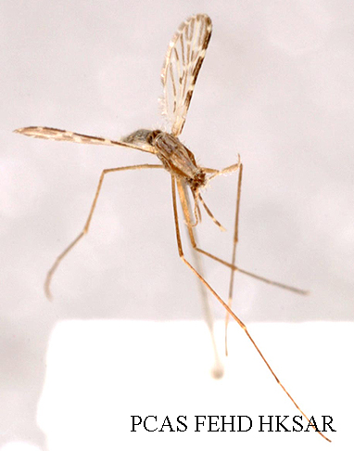
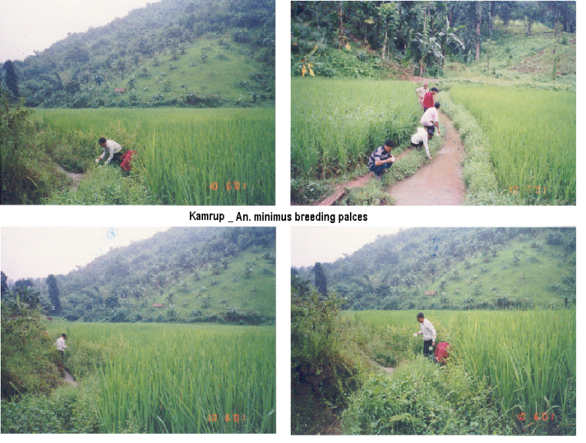
An. fluviatilis and An. minimus

Slide 8
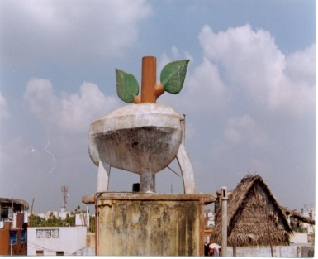
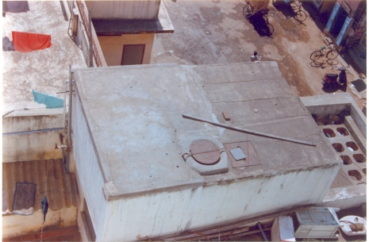
Vector Control Strategies
VECTOR CONTROL STRATEGY
Malaria
Designed on concept of Macro level Epidemiology
IRS in areas with >2 API
LLIN (Supportive)- 11 million LLINs distributed
Biological Control (Fish)
Urban- Anti-larval measures
Civic Bye-laws
Legislative measures
Model civic bye-laws: Promulgation and implementation with provisions to prevent/eliminate mosquito breeding
Building bye-laws: Provision to prevent mosquitogenic conditions and clauses in the contract to keep curing tanks free of mosquito breeding during construction phase and dismantling of the same before issuance of occupancy certificate

Slide 9
IRS - Insecticide Dosage, Dilution and Requirement
INSECTICIDE | DOSAGE PER Sq. m. (a.i.) | DILLUTION PER 10 LTR. OF WATER (covers 500 sq m area) | INSECTICIDE FORMULATION PER HOUSE (150 Sq. m) PER ROUND | AVERAGE PER 5000 POPU. (or 1000 houses)PER ROUND | TOTAL PER ANNUM
DDT 50%* | 1 gm | 1 Kg | 300 gm | 375 Kg | 750 Kg
Malathion 25% (2 coats and 3 rounds per annum) | 2 gm | 2 Kg | 1200 gm | 1500 Kg | 4500 Kg
Deltamethrin 2.5% | 20 mg | 400 gm | 120 gm | 50 Kg | 300 Kg
Cyfluthrin 10% | 25 mg | 125 gm | 37.5 gm | 46.87 Kg | 93.75 Kg
Lambdacyhalo-thrin 10% | 25 mg | 125 gm | 37.5 gm | 46.87 Kg | 93.75 Kg
Alphacyperme-thrin 5% | 25 mg | 250 gm | 75 gm | 93.75 Kg | 187.50 Kg

Slide 10
LARVICIDE FORMULATIONS AND DOSAGE
S.No. | Name of Larvicide | Commercial formulation | Preparation of ready to spray formulation | 1 square meter | 50 Linear meter | Per Heactare | Frequency of application | Equipment required | remarks
1 | MLO | 100% petroleum project product | As it is | 20 C.C. | 1 Litre | 200 Litres | Weekly | Knapsack/ hand compression sprayer | To be applied along the shore of water body
2 | Temephos (Abate) | 50% EC | 2.5 c.c. in 10 litres of potable water | 20 C.C. | 1 Litre | 200 Litres | -do- | Knapsack/ hand compression sprayer | Can be applied in clean water
3 | Bacillus thuringiensisvar israelensis WP | Wettable powder | 5 kg in 200 litres of water | - | - | 5 kg | Fortnightly | Knapsack/ hand compression sprayer | For both clean and non-potable polluted water
4 | Bacillus thuringiensisvar israelensis 12 Aqueous Suspension (AS) | Aqueous suspension 12 Aqueous Suspension | 1 litre in 200 litres of water | - | - | 1 Lit. | Weekly | Knapsack/ hand compression sprayer | Clean water
 |  |  | 2 litres in 200 litres of water | - | - | 2 Lit. | Weekly | Knapsack/ hand compression sprayer | Polluted water
In the case of Malathion, the requirement shown above, is for the three rounds

Slide 11
LARVICIDE FORMULATIONS AND DOSAGE
S.No. | Name of Larvicide | Commercial formulation | Preparation of ready to spray formulation |  |  | Per Heactare | Frequency of application | Equipment required | remarks
6 | Diflubenzuron IGR | 25% Wettable Powder | 100 gms (25 gm a.i) in 100 Litres of water (10 g in 10 litre) 100 litre Clean Water 200 gms (50 gm a.i) in 100 Litres of water (20 g in 10 litre) |  |  | 100 lit. 200 lit | Weekly | Knapsack/ hand compression sprayer | To be applied along the shore of water body Clean water ------------ Polluted water
7 | Pyriproxyfen GR | 0.5% Granular | Ready to use |  |  | 2 kg. Clean Water ------------------------------ 4 kg. polluted water | 3 weekly | Manual | clean water ------------- Polluted Water

Slide 12
Space spray-Dosage, Dilution and Requirement
INSECTICIDE | Dosage | DILLUTION
1. Pyrethrum Extract | 2% Extract | 1 part of 2% Pyrethrum Extract in 19 parts of Kerosene (50 ml in 1 litres K.Oil Used for Indoor Space Sp
2. Malathion Tec. | OP | 1:19 i.e.1 part of Malathion Tech in 19 parts of Diesel (50 ml in 1 litres diesel) Used for out door thermal fogging
3 Cyphenothrin Synthetic pyrethirod | 5%EC | 0.5 mg a.i per sq.mt. (20 ml in 1 litres K.Oil) Used for Indoor Space Sp
4. Cyphenothrin | 5%EC | 3.5 g a.i per hactare (7 ml in 1 litres diesel Out door thermal fogging

Slide 13
Salient Reasons for Poor Quality of IRS
Patchy Spray:
Due to faulty/partially clogged nozzle
No proper overlapping of spray swath(3 inches)
Improper Discharge Rate(740 to 850ml/min) of spray suspension due to improper pumping pressure/stokes
Partial Spray:
Either the ceiling or half room or half of the walls are left unsprayed.
3 rooms in a house, 1 or 2 rooms are left unsprayed.
Mostly due to the lack of pre spray intimation not given to the each house holders/ village community.
Lack of knowledge about the purpose of spray.
No mopping up operation is carried out.

Slide 14
However, susceptibility status should be continuously monitored and if the tests show development of resistance couples with loss of epidemiological impact of spray operations, the following strategy should be adopted for change of insecticide.
Resistant to | Alternative insecticide
DDT | Malathion
DDT and Malathion | Synthetic Pyrethroids.

Slide 16
Possible ways of avoiding development of insecticide resistance in field
Avoid indiscriminate use of insecticides
Avoid use of insecticides that simultaneously select resistance to other chemically related insecticides.
Avoid use of insecticides that induce development of more than one type of resistance mechanism of broad spectrum of resistance.
Avoid use of the same insecticide both against adults and larvae.
Use of non chemical control methods, e.g. biopesticides, larvivorous fish.
Use of synergist with insecticides to reduce physiological resistance

Slide 17
PROCESS OF CHANGE OF INSECTICIDE
If the change of insecticide is warranted, the state govt. should support their choice of alternative insecticide by documentation of data on vector resistance studies and field observations on epidemiological impact of spray in respect of insecticide in use.
The change of insecticide will always be decided in mutual consultation between State Programme Officer for NVBDCP, ROH&FW and the Directorate of NVBDCP with concurrence of State and Central Govts. The proposal should be discussed in the annual action plan meeting in Dte. of NVBDCP.
State Govt. submits the proposal for change of insecticide to Dte. of NVBDCP in the month of January-February.
All technical data on vector resistance, epidemiological impact of the current insecticide in use, along with financial outlay, quantity of alternative insecticide chosen, with comparative cost difference for spray operation should be included in the proposal.
The proposal should be discussed in the annual action plan meeting in Dte. of NVBDCP

Slide 19
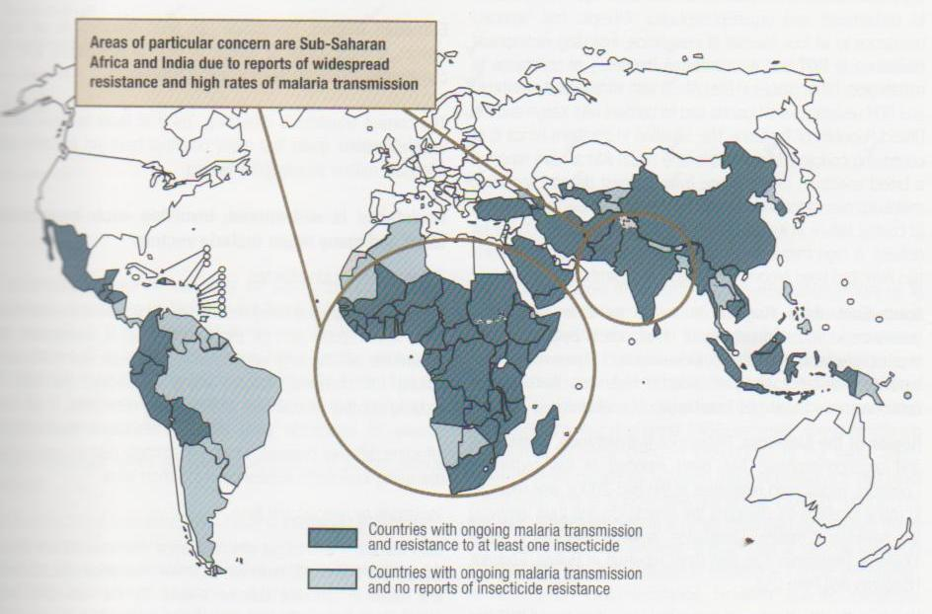
Susceptibility /Resistant status of malaria vectors with insecticides

Slide 20
SELECTION AND CHANGE OF INSECTICIDES
Several factors need to be considered in the selection of an insecticide spraying, including availability cost, residual effectiveness, safety, vector susceptibility and excito-repellency.
Anopheles culicifacies is the main vector of malaria in the country. This species showed resistance to DDT and Malathion in some states. The other main vectors of malaria i.e. An.fluviatilis, An.minimus and An.dirus are still susceptible to DDT. The main parameters for switching over to Synthetic Pyrethroids are –
A. Vector Resistant to DDT and Malathion
B. Loss of epidemiological impact

Slide 21
Community partnership & ISC
Fodder for thought
This is the story of four people named EVERY BODY , SOME BODY , ANY BODY , NO BODY .
There was an important job to be done and EVERY BODY was sure that SOME BODY would do it.
ANY BODY could have done it. But NO BODY did it. SOME BODY got angry about that because it is EVERY BODY job. Every thought that ANY BODY could do it but NO BODY realised that EVERY BODY do not do it.
It ended up that EVERY BODY blamed SOME BODY when NO BODY did what ANY BODY would have done it

Slide 22
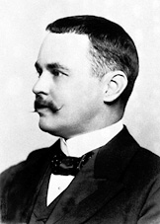
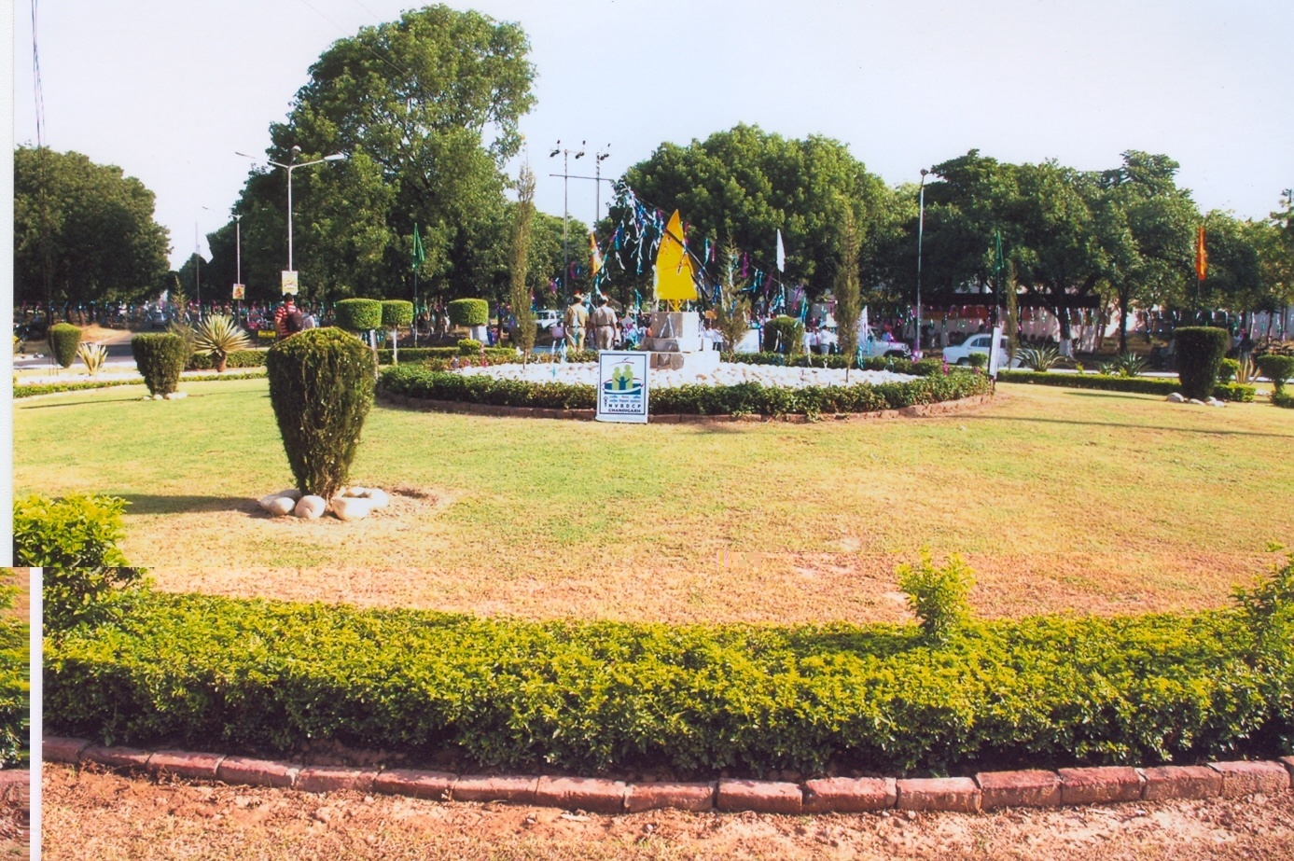
Thank You
In this, O Nature, yield I pray to me. I pace and pace, and think and think, and take The fever'd hands, and note down all I see, That some dim distant light may haply break. The painful faces ask, can we not cure? We answer, No, not yet; we seek the laws. O God, reveal thro' all this thing obscure The unseen, small, but million-murdering cause.
Dr.Ronald Ross

