Slide 1
Indoor Residual Spray -INDIA
Prof. Arti Prasad
Head Department of Zoology
University College of Science
MLSU, Udaipur.
Artimlsu@yahoo.co.in
VECTOR CONTROL

Slide 2
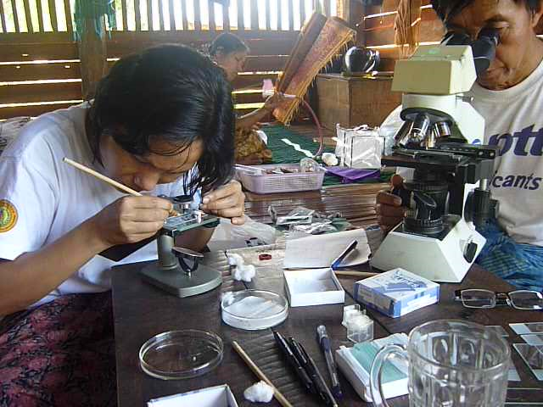
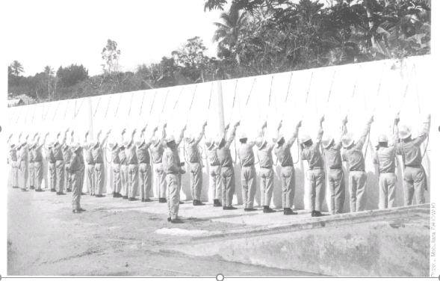
Back to our roots.
“Before DDT Malariologists were trained as problem-solvers….
After DDT, Malariologists were trained as solution-implementers“
José Antonio Nájera
Former Coordinator, WHO
Malaria, Parasitic Diseases and
Vector Control

Slide 3
MAJOR DISEASE VECTORS
Major Disease Vectors in India
Malaria
An. culicifacies, An. fluviatilis, An. minimus
An. sundaicus, An. stephensi, An. Dirus
Visceral leishmaniasis(Kala-azar)
P.argentipes
Dengue & Chikungunya
Ae. Aegypti, Ae. albopictus
Lymphatic Filariasis
Cx. quinquefasciatus, Ma. annulifera
Japanese Encephalitis
Cx. vishnui, Cx. tritaeniorhyncus

Slide 4
Objective of vector control
Objective of vector control
  To Reduce female vector density to a level below which epidemic vector transmission will not occur
  Based on the assumption that eliminating or reducing the number of larval habitats in the domestic environment will control the vector
  The minimum vector density to prevent epidemic transmission is unknown

Slide 5
J
Aspects of Vector Control
Which mosquito species are locally important as vectors of human diseases?
Which mosquito species are important as the primary source of annoyance?
What are the important breeding sites of different mosquito species?
What is the seasonal pattern of mosquito breeding?
What are the resting places of adult mosquitoes?
What are the feeding preferences of vector mosquitoes?
To map out and locate all potential larval development habitats
To identify the mosquito species present
To predict the time and location of effective control strategies.

Slide 6
SELECTION OF VECTOR CONTROL OPTIONS
Chemical Control
Environment Management
Biological Control
Environmental Control
Legislative control
Chemical Control
Biological Control
INTEGRATED VECTOR MANAGEMENT
An Evidence-based decision making process, rationalizing the use of vector control methods and emphasizing the engagement of communities

Slide 7
VECTOR CONTROL IMPLEMENTING AGENCIES
IN DELHI
MCD
NDMC
DELHI CANTONMENT BOARD
JNU
ZOOLOGICAL PARK
IIT
ALL INDIA RADIO
PRESIDENT ESTATE
NORTHERN RAILWAY
1399.26 sq Kms
31.74
32.89
Restricted area
Restricted area
Restricted area
Restricted area
Restricted area
Restricted area

Slide 8
VBD in Delhi
1845 -Royal commission first reference –little malaria in walled city Delhi
Khadar area showed spleen rate in 75% in Wazirpur village
Hodgson –Spleen rate 78% in Canal area,
66% Darbar Hall and 23% in Delhi city
1940- 1960 Delhi was virtually free from malaria
1978 - record number of 3,75,,077 malaria cases
1996 First severe Dengue outbreak with 10252 cases and more 423 deaths

Slide 9
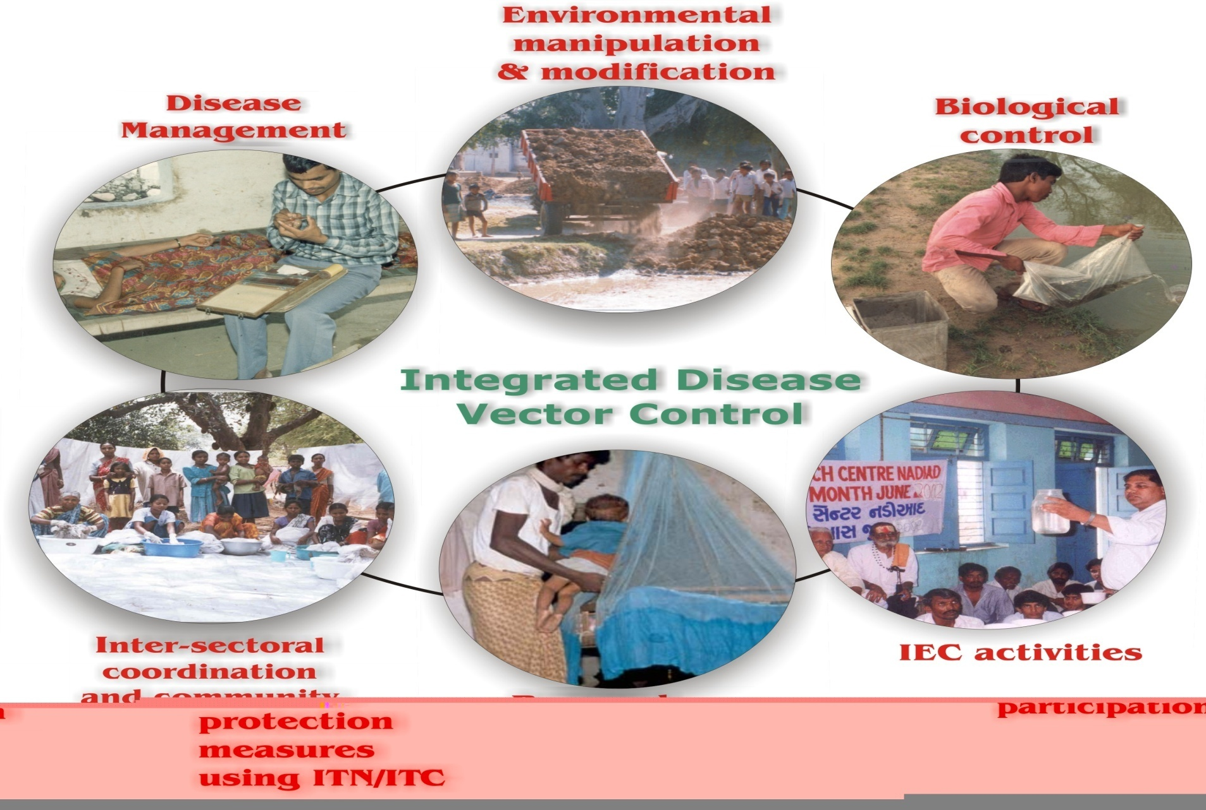
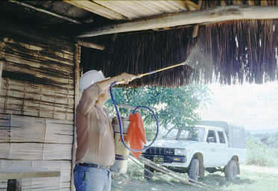
Vector Control Strategy
Gambussia
ITMN

Slide 10
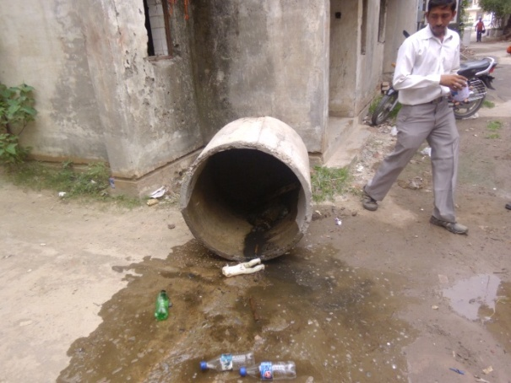
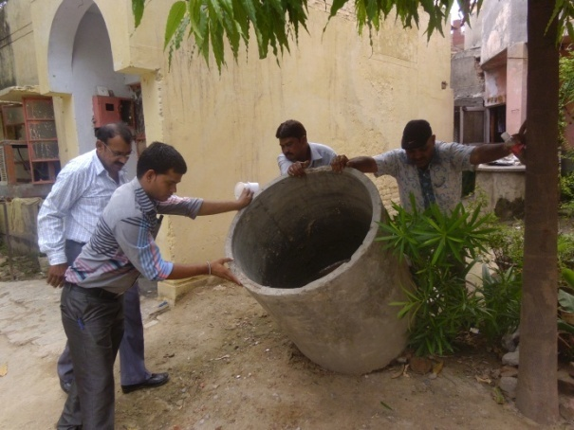
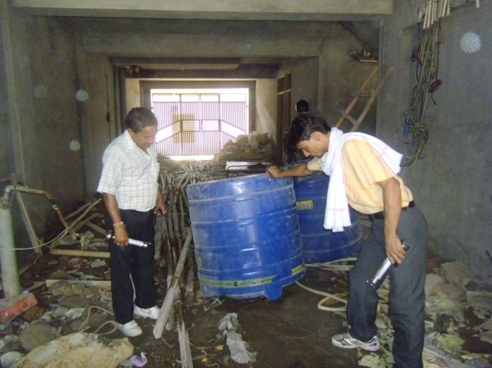
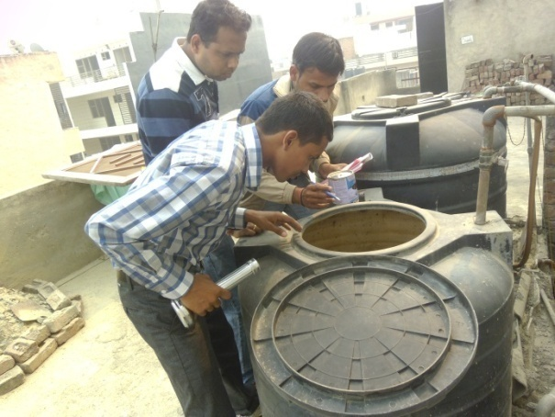
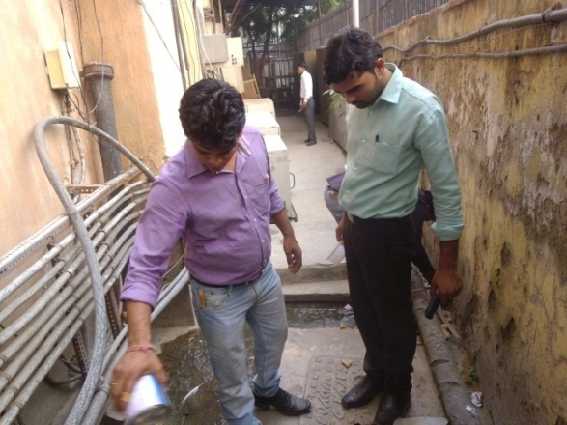
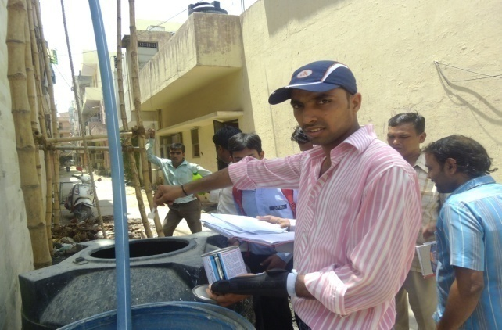
Source Reduction
Removal of Aedes Breeding by using source reduction and temephos 1% granules

Slide 11
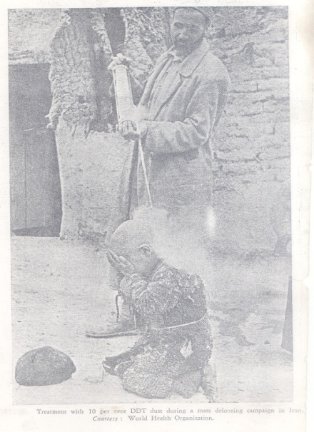
Control Strategy
Larval Control
Source reduction
Chemical control
Law enforcement
Health Education

Slide 12
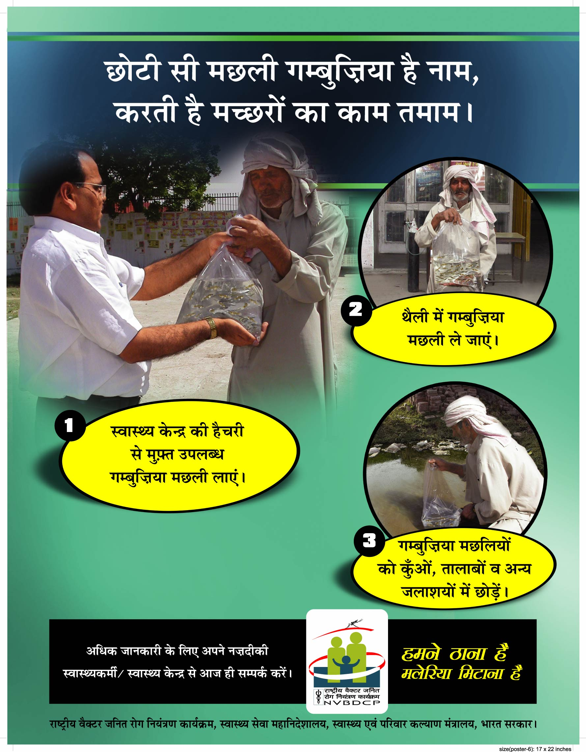
Biological Control
Use of larvivorous fish
Gambusia affinis
Poecilia reticulata

Slide 13
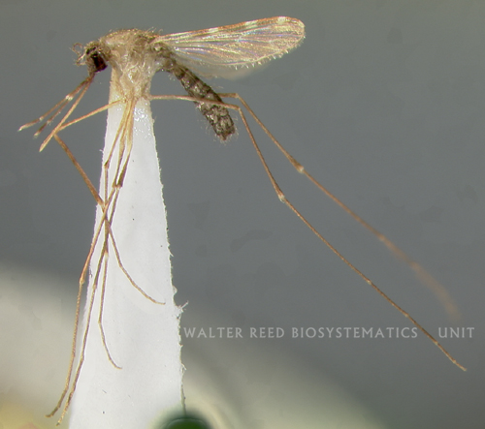
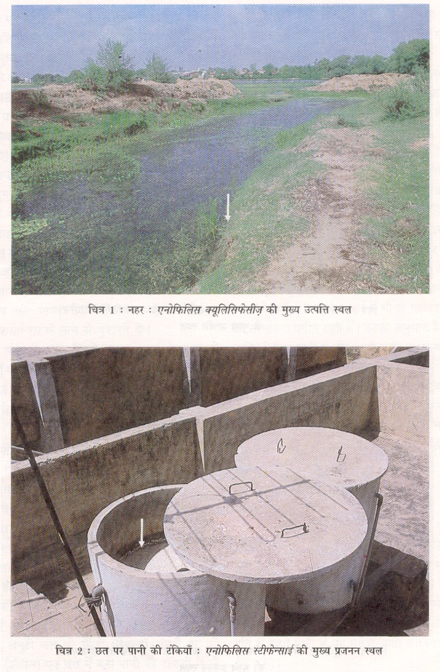
An. culicifacies
Monsoon associated species
An. culicifacies(Epidimic vector)
Monsoon associated species
An. culicifacies (Epidimic vector)
Responsible for 60-70% malaria in India

Slide 14
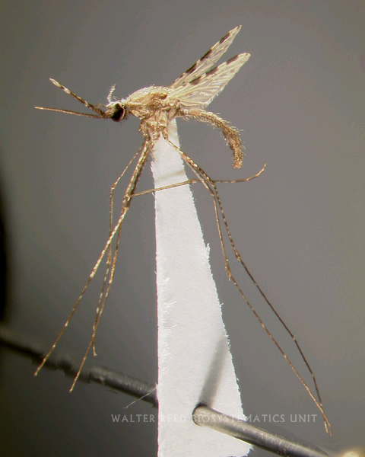
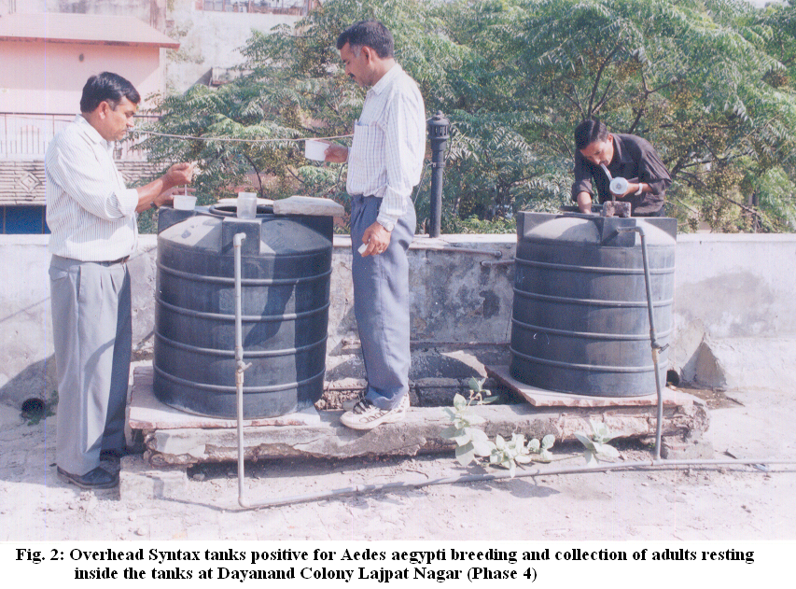
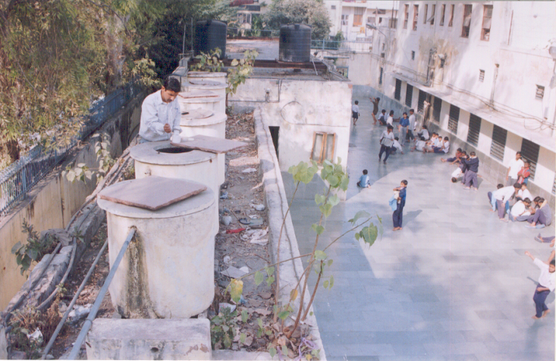
An. stephensi
Urban malaria

Slide 15
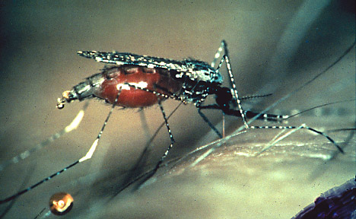
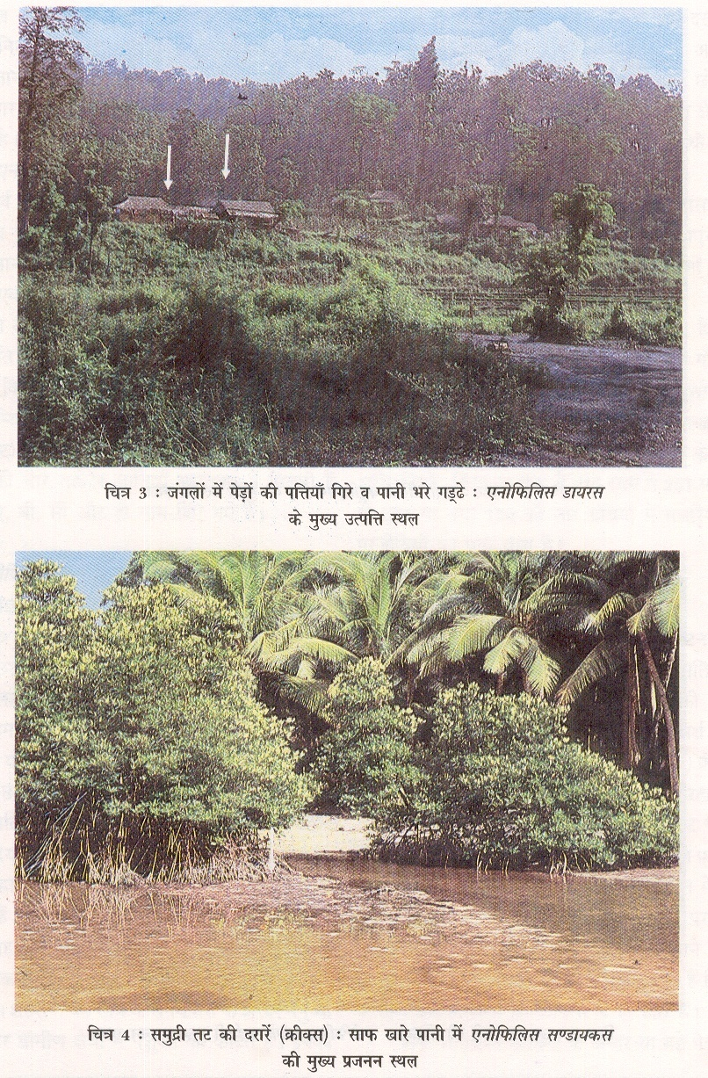
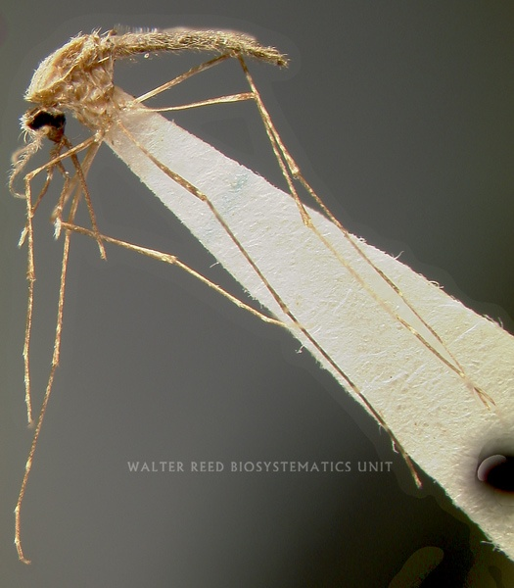
An. dirus and An. sundiacus

Slide 16
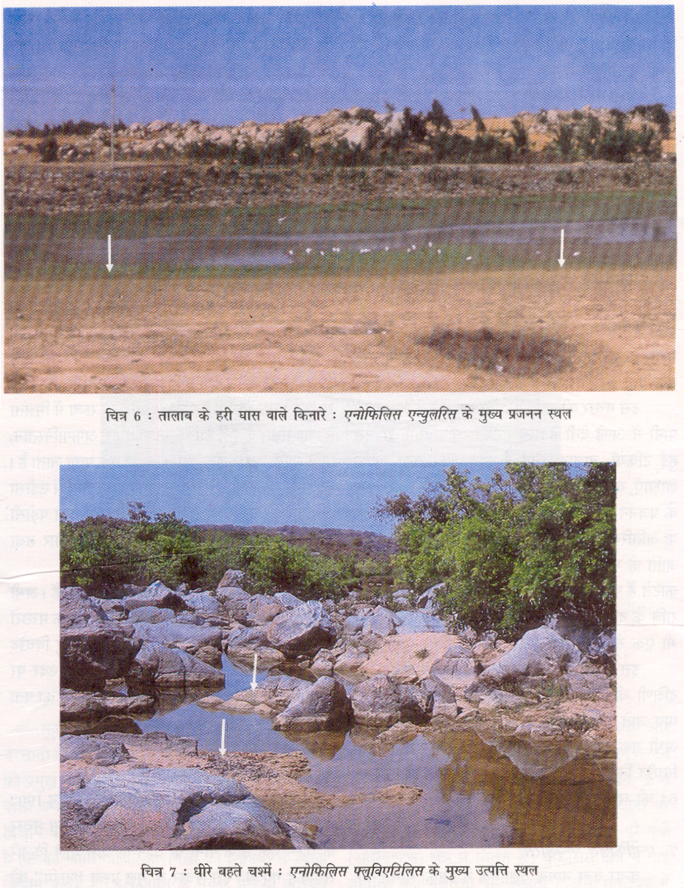
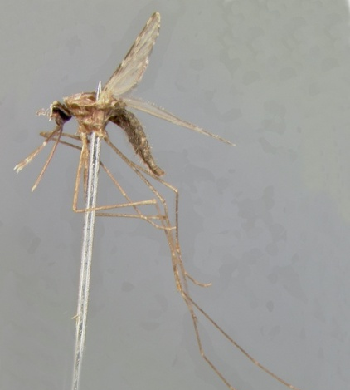
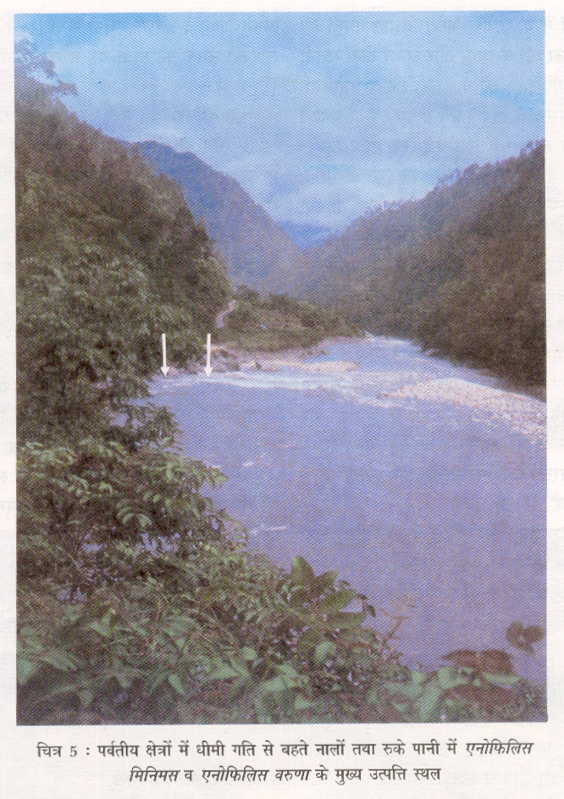
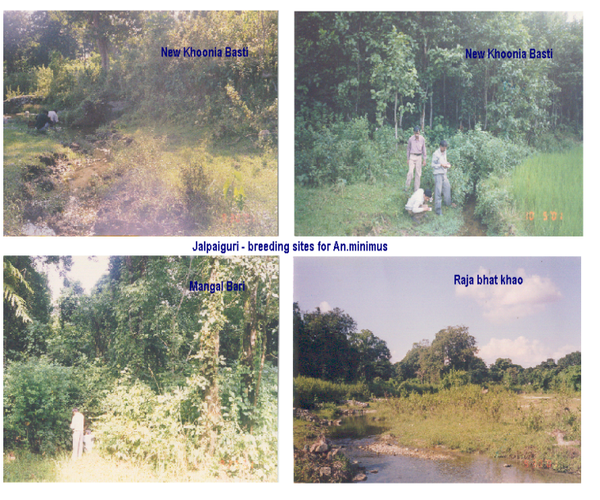
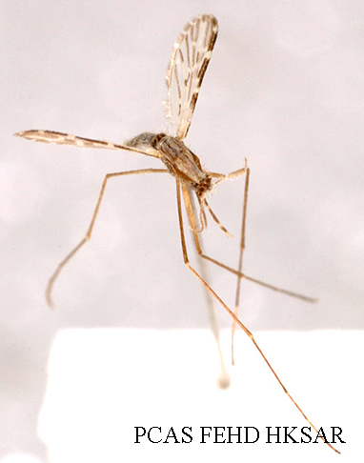
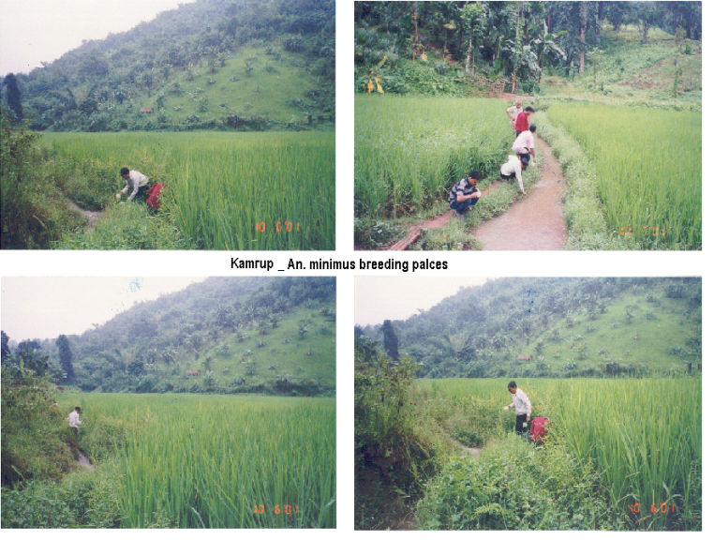
An. fluviatilis and An. minimus

Slide 17
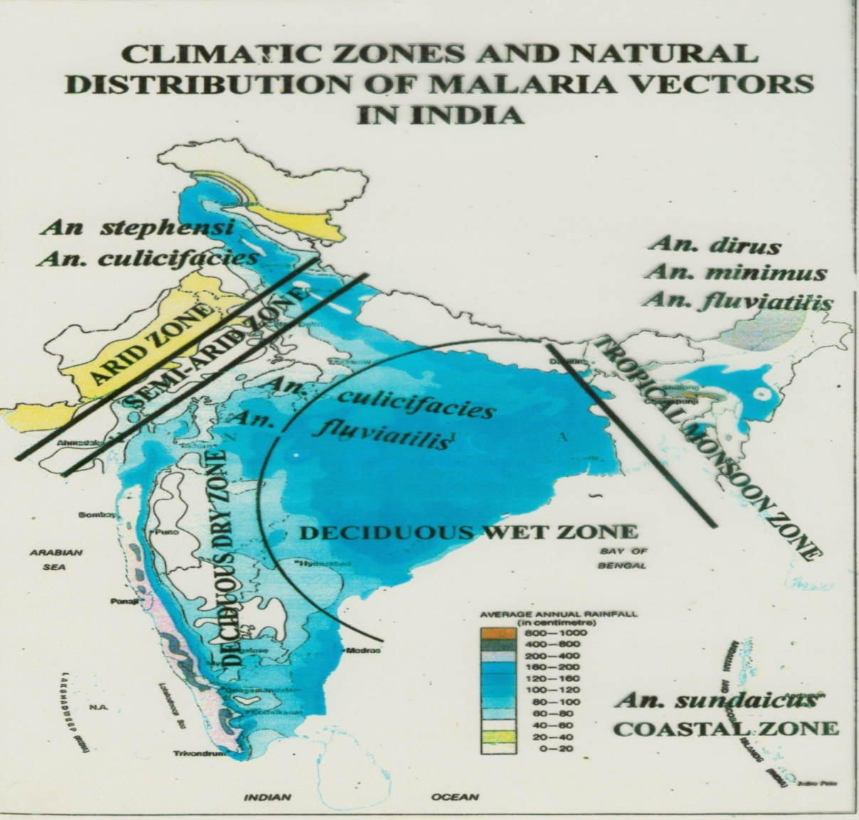
Vectors with variable Endemicity
Malaria free areas
Hyper endemic
An. minimus
and An. dirus
superimposed
Epidemic Prone
Unstable malarious
areas
1947
75 million cases and 0.8 million deaths
2013
0.44 million cases and 519 deaths
Variable endemicity
Relay transmission
NMEP-1958
0.1 million cases and no death.
1976
6.4 million cases

Slide 18
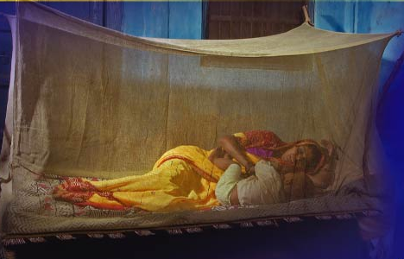
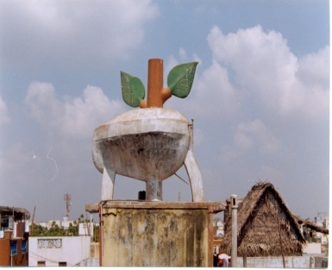
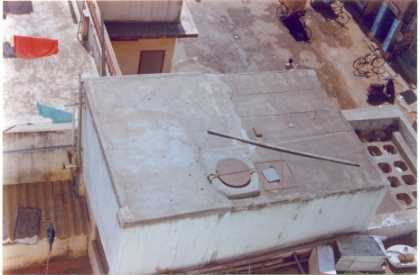
Vector Control Strategies
VECTOR CONTROL STRATEGY
Malaria
Designed on concept of Macro level Epidemiology
IRS in areas with >2 API
LLIN (Supportive)- 11 million LLINs distributed
Biological Control (Fish)
Urban- Anti-larval measures
Civic Bye-laws
Legislative measures
Model civic bye-laws: Promulgation and implementation with provisions to prevent/eliminate mosquito breeding
Building bye-laws: Provision to prevent mosquitogenic conditions and clauses in the contract to keep curing tanks free of mosquito breeding during construction phase and dismantling of the same before issuance of occupancy certificate

Slide 19
Vector Control Strategies
VECTOR CONTROL STRATEGY
Malaria
Designed on concept of Macro level Epidemiology
IRS in areas with >2 API
LLIN (Supportive)- 11 million LLINs distributed
Biological Control (Fish)
Urban- Anti-larval measures
Civic Bye-laws
Legislative measures
Model civic bye-laws: Promulgation and implementation with provisions to prevent/eliminate mosquito breeding
Building bye-laws: Provision to prevent mosquitogenic conditions and clauses in the contract to keep curing tanks free of mosquito breeding during construction phase and dismantling of the same before issuance of occupancy certificate

Slide 20

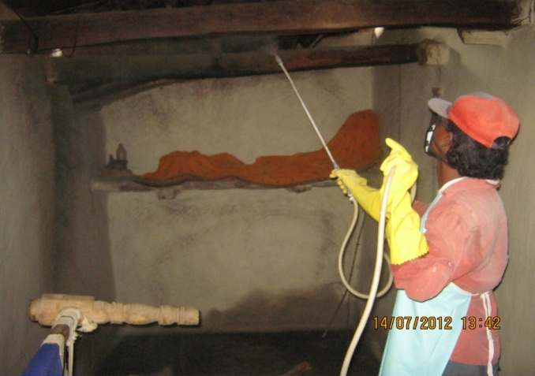
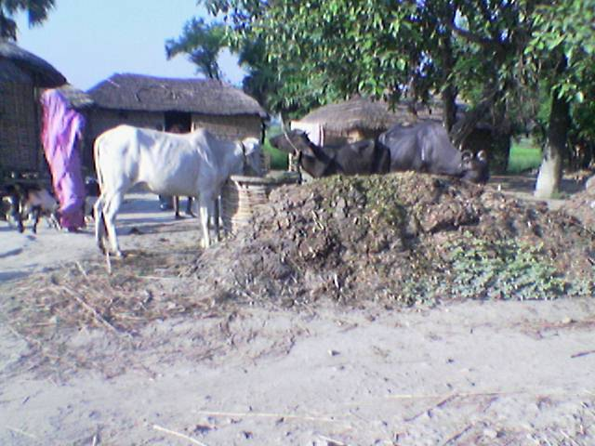
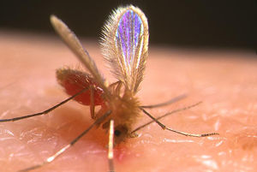
  VECTOR CONTROL STRATEGY
    Two PRONGED
    Indoor Residual Spraying with DDT up to 6 feet height from the ground twice annually.
    Hygiene and environmental
    sanitation
Contd…/-

Slide 21
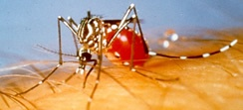
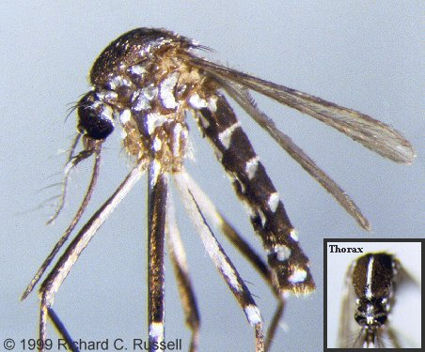
Vector Control Strategies
Dengue/Chikungunya : Based on larval control
Source reduction.
Use of chemicals/Bio-larvicides
Professional management and solid waste disposal.
Space spray in Dengue Positive houses.

Slide 22

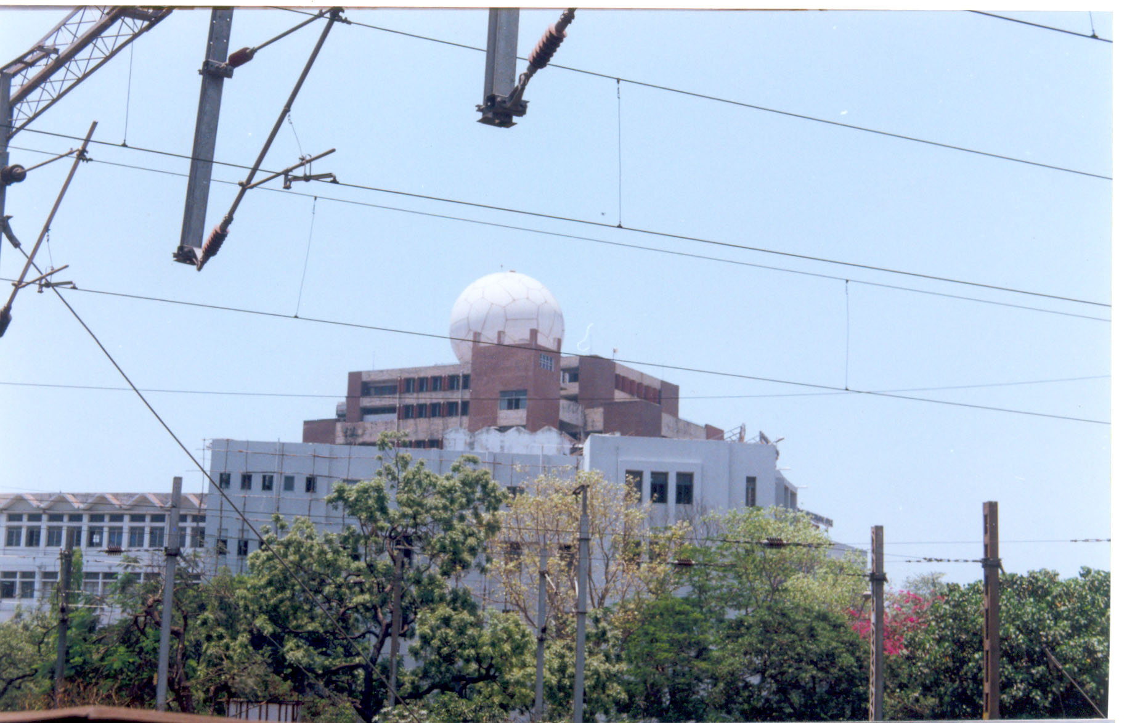
VECTOR CONTROL –CHALLENGES
EVEN IN GOVERNMENT BUILDINGS THE OVER HEAD TANKS ARE BUILT VIOLATING THE PUBLIC HEALTH PRINCIPLES

Slide 23

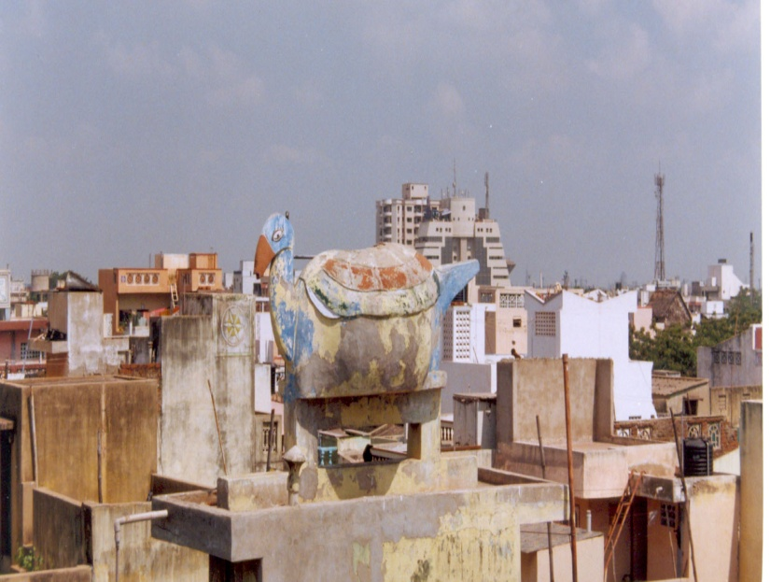
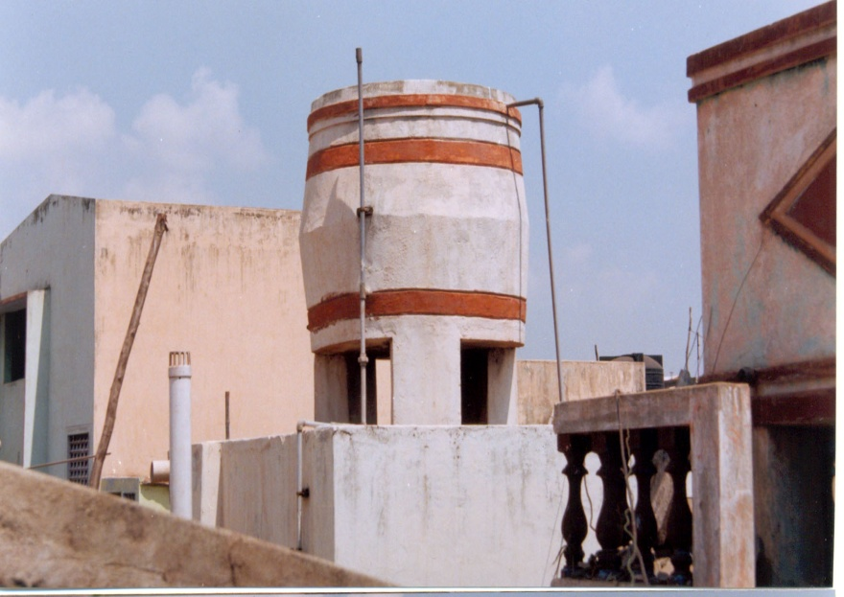
Vector control Challenges-

Slide 24



Vector control Challenges-
30% OF THE O.H.TANKS ARE IN ACCESSIBLE

Slide 25
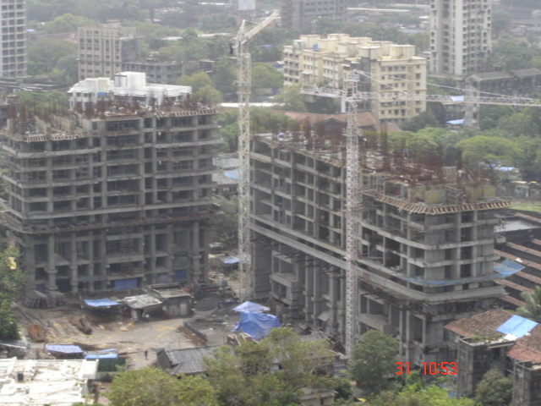
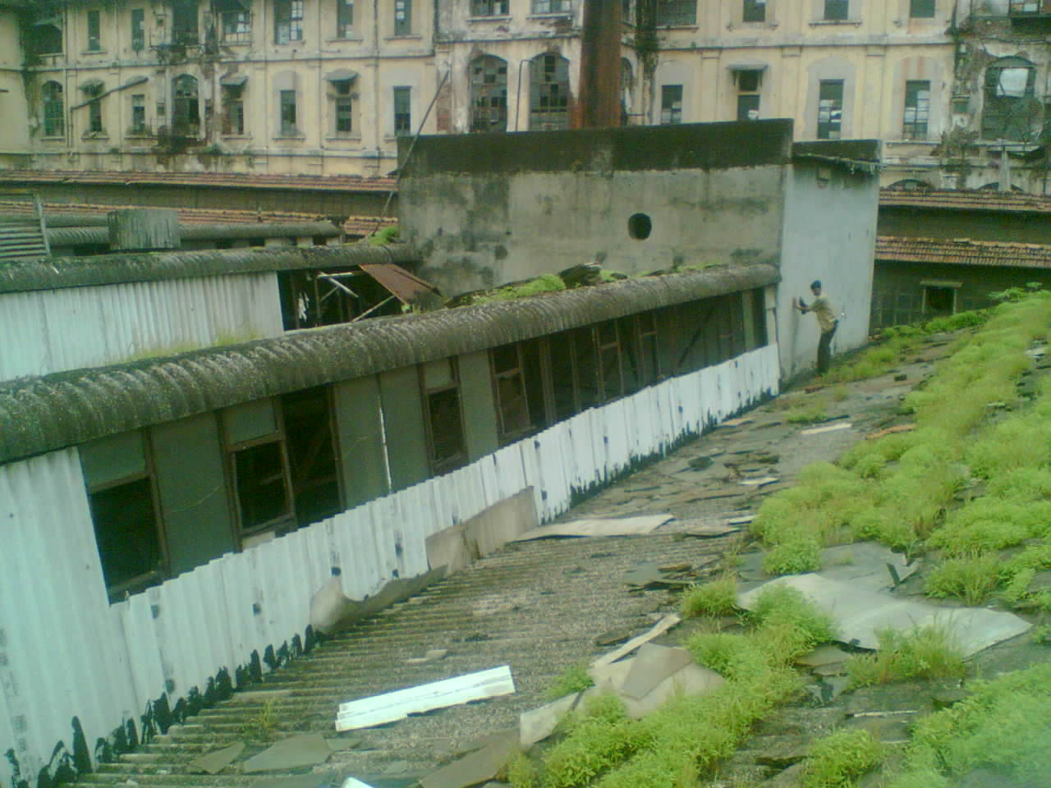
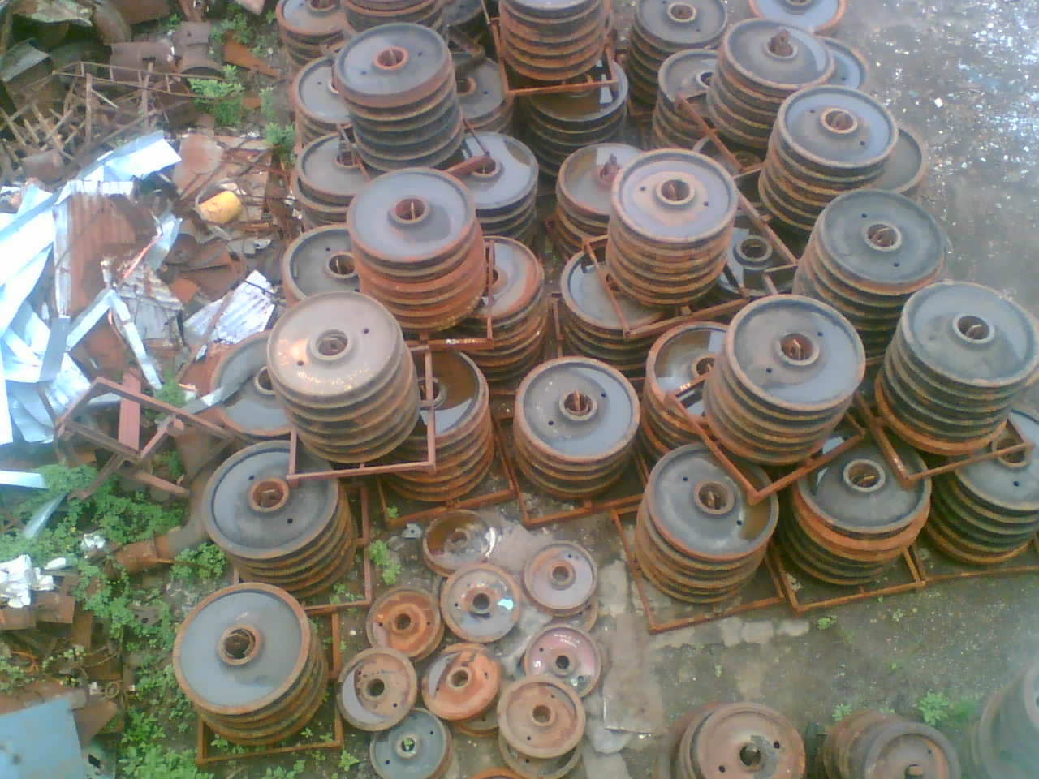
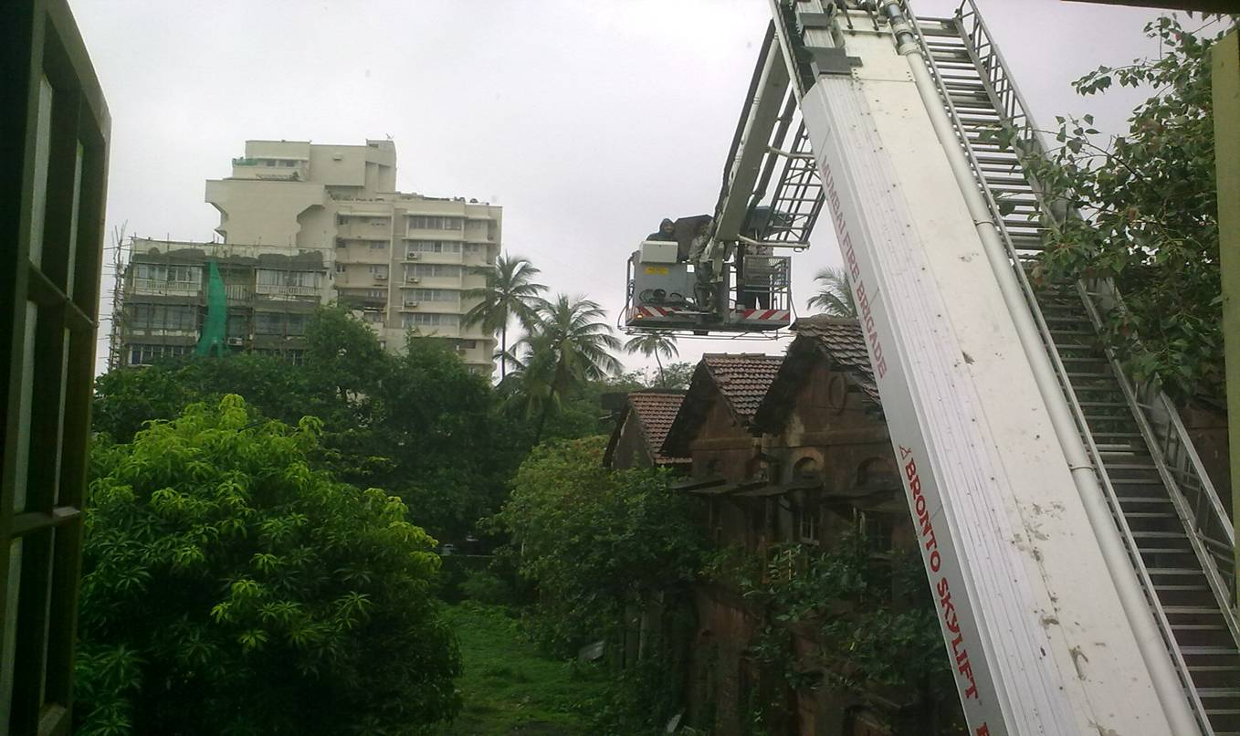
Vector control challenges- RISK FACTORS FOR OUT BREAK
Massive constructions

Slide 26
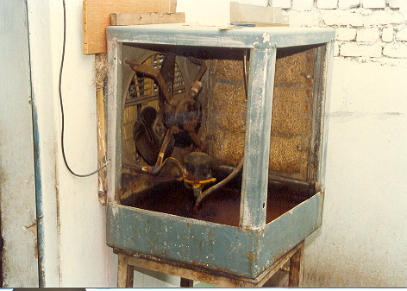
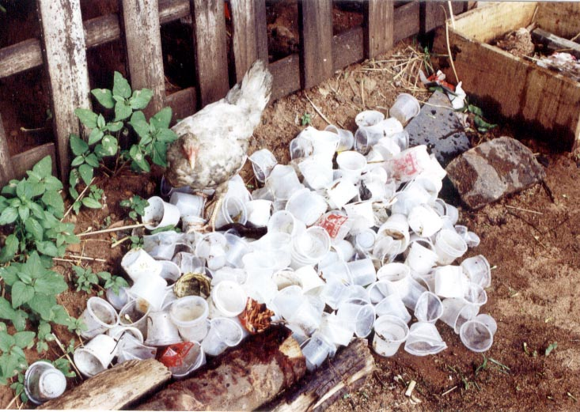
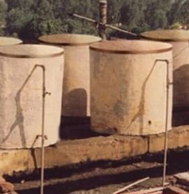
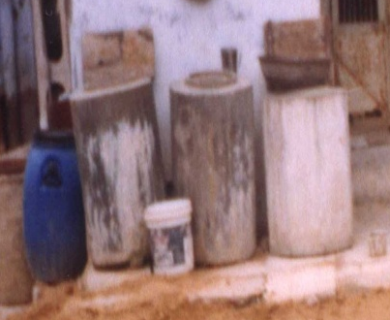
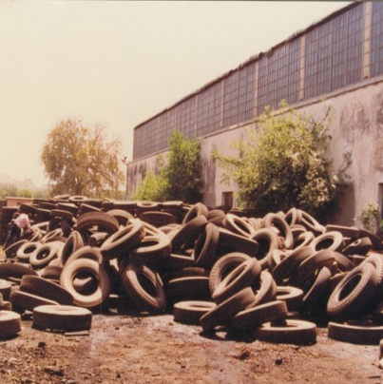
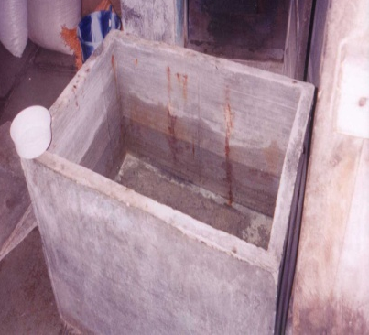
Dengue / Chikungunya
VECTOR CONTROL
vector control options :
Source reduction - elimination of Aedes aegypti breeding at weekly interval including use of Petroleum oil/ Kerosene oil/ Temephos
Mosquito proofing of water tanks ( over head & ground tanks), buildings
Use of mosquito nets ( preferably LLIN)– to prevent infection in hospital wards to others
Pyrethrum space spray/ ULV during outbreaks

Slide 27
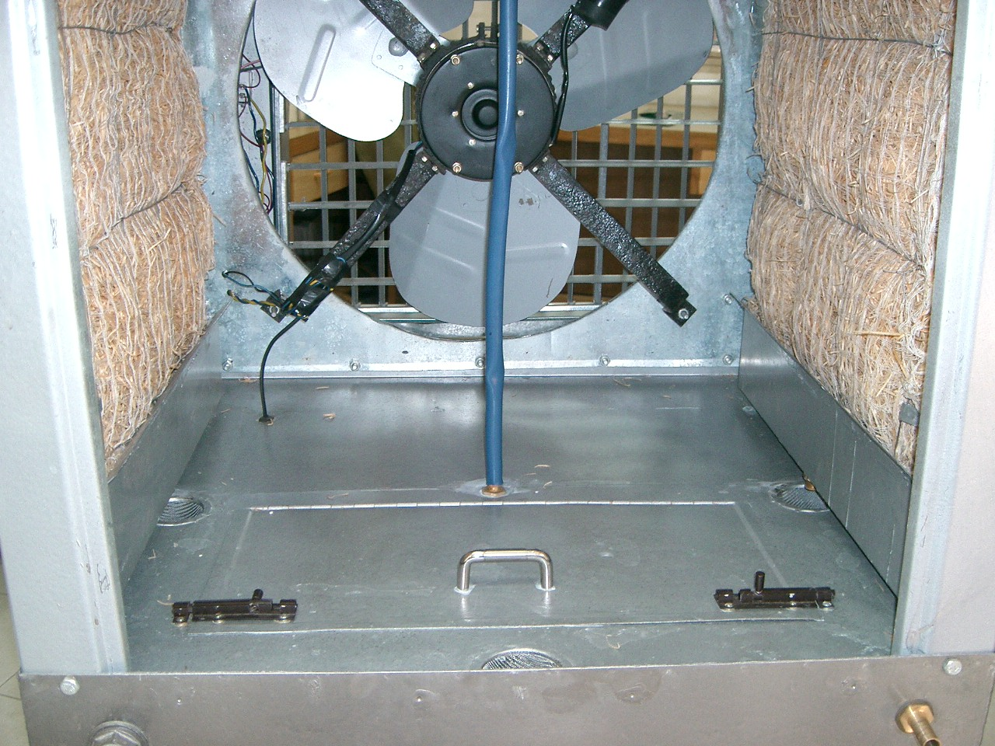
Vector Control
Ordinary cooler
NCDC Cooler
Mosquito proof

Slide 28
IRS - Insecticide Dosage, Dilution and Requirement
INSECTICIDE | DOSAGE PER Sq. m. (a.i.) | DILLUTION PER 10 LTR. OF WATER (covers 500 sq m area) | INSECTICIDE FORMULATION PER HOUSE (150 Sq. m) PER ROUND | AVERAGE PER 5000 POPU. (or 1000 houses)PER ROUND | TOTAL PER ANNUM
DDT 50%* | 1 gm | 1 Kg | 300 gm | 375 Kg | 750 Kg
Malathion 25% (2 coats and 3 rounds per annum) | 2 gm | 2 Kg | 1200 gm | 1500 Kg | 4500 Kg
Deltamethrin 2.5% | 20 mg | 400 gm | 120 gm | 50 Kg | 300 Kg
Cyfluthrin 10% | 25 mg | 125 gm | 37.5 gm | 46.87 Kg | 93.75 Kg
Lambdacyhalo-thrin 10% | 25 mg | 125 gm | 37.5 gm | 46.87 Kg | 93.75 Kg
Alphacyperme-thrin 5% | 25 mg | 250 gm | 75 gm | 93.75 Kg | 187.50 Kg

Slide 29
LARVICIDE FORMULATIONS AND DOSAGE
S.No. | Name of Larvicide | Commercial formulation | Preparation of ready to spray formulation | 1 square meter | 50 Linear meter | Per Heactare | Frequency of application | Equipment required | remarks
1 | MLO | 100% petroleum project product | As it is | 20 C.C. | 1 Litre | 200 Litres | Weekly | Knapsack/ hand compression sprayer | To be applied along the shore of water body
2 | Temephos (Abate) | 50% EC | 2.5 c.c. in 10 litres of potable water | 20 C.C. | 1 Litre | 200 Litres | -do- | Knapsack/ hand compression sprayer | Can be applied in clean water
3 | Bacillus thuringiensisvar israelensis WP | Wettable powder | 5 kg in 200 litres of water | - | - | 5 kg | Fortnightly | Knapsack/ hand compression sprayer | For both clean and non-potable polluted water
4 | Bacillus thuringiensisvar israelensis 12 Aqueous Suspension (AS) | Aqueous suspension 12 Aqueous Suspension | 1 litre in 200 litres of water | - | - | 1 Lit. | Weekly | Knapsack/ hand compression sprayer | Clean water
 |  |  | 2 litres in 200 litres of water | - | - | 2 Lit. | Weekly | Knapsack/ hand compression sprayer | Polluted water
In the case of Malathion, the requirement shown above, is for the three rounds

Slide 30
LARVICIDE FORMULATIONS AND DOSAGE
S.No. | Name of Larvicide | Commercial formulation | Preparation of ready to spray formulation |  |  | Per Heactare | Frequency of application | Equipment required | remarks
6 | Diflubenzuron IGR | 25% Wettable Powder | 100 gms (25 gm a.i) in 100 Litres of water (10 g in 10 litre) 100 litre Clean Water 200 gms (50 gm a.i) in 100 Litres of water (20 g in 10 litre) |  |  | 100 lit. 200 lit | Weekly | Knapsack/ hand compression sprayer | To be applied along the shore of water body Clean water ------------ Polluted water
7 | Pyriproxyfen GR | 0.5% Granular | Ready to use |  |  | 2 kg. Clean Water ------------------------------ 4 kg. polluted water | 3 weekly | Manual | clean water ------------- Polluted Water

Slide 31
Space spray-Dosage, Dilution and Requirement
INSECTICIDE | Dosage | DILLUTION
1. Pyrethrum Extract | 2% Extract | 1 part of 2% Pyrethrum Extract in 19 parts of Kerosene (50 ml in 1 litres K.Oil Used for Indoor Space Sp
2. Malathion Tec. | OP | 1:19 i.e.1 part of Malathion Tech in 19 parts of Diesel (50 ml in 1 litres diesel) Used for out door thermal fogging
3 Cyphenothrin Synthetic pyrethirod | 5%EC | 0.5 mg a.i per sq.mt. (20 ml in 1 litres K.Oil) Used for Indoor Space Sp
4. Cyphenothrin | 5%EC | 3.5 g a.i per hactare (7 ml in 1 litres diesel Out door thermal fogging

Slide 32
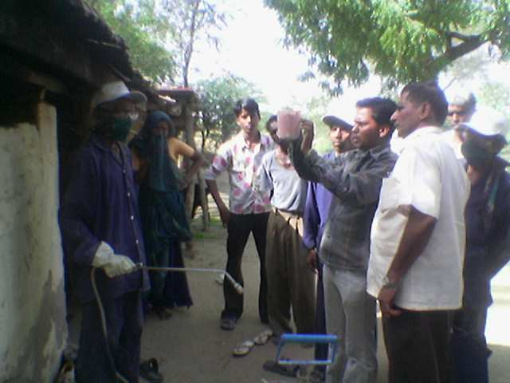





CAPACITY BUILDING FOR IRS
Spray Technique
Vector Control
IRS
Good Quality
Change Nozzle tip

Slide 33


Impact –LSM MUMBAI
Outbreak of Malaria
Construction activities
Vector density very high
Labour migration from endemic ares
11
Trend in 2009
Trend in 2010
Trend in 2011
4
7

Slide 34
CANTONMENTS
Environment Management Methods
(EMM)Technology
Mian Mir Cantonment- Lahore (now in Pakistan) Vector An. culicifacies-Surface pool breeder.
First ever experimented by S.R. Christopher and S.P. James
1901 1) Drainage of all stagnant waters within ½ mile of the cantonment area
2) Quinine therapy (established in 1847)
1903 Results were disappointing
1904 Canal network was found supporting heavy breeding of An. culicifacies
1905-1908 Canal network was filled by deployment of 500 soldiers and one engineering regiment.
Project did not show any success
1909 Disappointing failure resulted in establishment of “Malaria Survey of India” the first malaria Research Institute of the World.
1926 malaria was ultimately controlled by screening of all bunglows/houses, as flight range of vector species exceeded 2 kms.

Slide 35
Vector Control
PORT TOWN-Mumbai
EMM technology
1926 Severe outbreak of malaria in Alexandria Docks-Bombay
1927 Covell. made in depth study of outbreak and recommended Species sanitation- concept for control of An. Stephensi
1928 BOMBAY ACT PASSED
Development of legislative Measures aimed at prevention of stephensi breeding in
i) Overhead tanks
ii) Ground level tanks
iii) Wells
iv) swimming pools
v) Cellars/sumps of WC/floors of building under constructions
vi) Roof gutters of buildings
Larvivorous fish
i) Stocking of ornamental/ fire fighting tanks and textile mill ponds with Gambusia fish
Weekly dry day observations
All domestic/ peridomestic containers to be emptied scrubbed and refilled.

Slide 36
EXPERTISE IN ENVIRONMENT
MANAGEMENT METHODS
1940 India has attained a good deal of expertise in EMM technology & malaria control activities were covered by various by laws & Acts.
Each sector of economy carried out HIA and identified Essential Anti-Malaria Engineering Works and these were incorporated as built in component of the projects.
Each development prepared “Manuals” indicating the specifications of each Engineering works to be under taken by them viz. Irrigation, Highways, Railways, Defense.
Training courses in Malariology for Engineering were started at Malaria Institute of India in 1943
Consequently EMM earned the reputation of standard methods for control of malaria in the country.

Slide 37
WARNING AGAINST COMPLETE SWITCH OVER FROM EMM TECHNOLOGY TO DDT SPRAY
1944 Mr. Winston Churchill Former Prime Minister of England announced in British Parliament on December 2, 1944 about dispatch of DDT, a new chemical for malaria control in India.
Army Medical Authorities at GHQ New Delhi issued the following warning.
“ DDT is a powerful new weapon. It should be stressed that it is a reinforcement and not a substitute for existing well tried systems of malaria control which on no account should be relaxed”
Unfortunately this “warning” was ignored which ruined the” EMM technology” harnessed over 40 years of experience.
But history is repeating and now we want to adopt this for control of Malaria a long term strategy

Slide 38



ENVIRONMENTAL MODIFICATION and malaria control
Environmental Control
SABARMATI RIVER’S CHANGING SCENIRIO
SCENARIO
Intervention:Channelization
Sabarmati: erstwhile
Narmada Fed Sabarmati

Slide 39

Legislative control
Introducing Model Civic Bye-laws and Building Bye-laws for prevention and control of vector breeding
Model Civic Bye-laws: Promulgation and implementation with provision to prevent /eliminate mosquito breeding like Municipal Corporation of Greater Mumbai, NCT Delhi, Chandigarh, Bhopal, Agartala, Navi Mumbai Municipal Corporation, Thane and Goa.
Building Bye-laws: Provision to prevent mosquitogenic conditions on the exterior of the buildings and clauses in the contract to keep curing tanks free of mosquito breeding during construction phase and dismantling of the same before issuance of occupancy certificate like Navi Mumbai

Slide 40
Navi Mumbai Municipal Corporation
Malaria Bye-laws : (After 1996 out break of Malaria)
To reduce potential breeding places.
No Objection Certificate” from Health Department of NMMC for Occupancy Certificate.
Inspect the site for any potential breeding places at the construction.
No Objection Certificate is issued.

Slide 41

Effective IEC for VBD,s

Slide 42
Inter Sectoral Co-ordination
Review at Minister,s level during transmission
Engineering
C.S.C.
CSD
Horticulture
Delhi Govt.
Flood Control dept.
Delhi Jal Board
Railways
MCD
Public Health
Unit
M.C.D
Private Sector
Metro Railways
MTNL
D.V.B
Health Authority of
Haryana
U.P.
Rajstahan

Slide 43
Community partnership & ISC
Fodder for thought
This is the story of four people named EVERY BODY , SOME BODY , ANY BODY , NO BODY .
There was an important job to be done and EVERY BODY was sure that SOME BODY would do it.
ANY BODY could have done it. But NO BODY did it. SOME BODY got angry about that because it is EVERY BODY job. Every thought that ANY BODY could do it but NO BODY realised that EVERY BODY do not do it.
It ended up that EVERY BODY blamed SOME BODY when NO BODY did what ANY BODY would have done it

Slide 44



Thank You
In this, O Nature, yield I pray to me.
I pace and pace, and think and think, and take
The fever'd hands, and note down all I see,
That some dim distant light may haply break.
The painful faces ask, can we not cure?
We answer, No, not yet; we seek the laws.
O God, reveal thro' all this thing obscure
The unseen, small, but million-murdering cause.
Dr.Ronald Ross

Slide 45
Exercise No. 1
Sl. No. | Disease | Sor. Red | Larvicide |  | Fish | IRS | LLIN | ULV |  | Vac | M Treat | BCC
 |  |  | Chem | Bio |  |  |  | Thermal | Cold
1. | Mal |  | • |  | • | • | • | • |  |  |  | •
2. | Den | • | • |  |  |  |  | • | • |  |  | •
3. | Chik | • | • |  |  |  |  | • | • |  |  | •
4. | Fil |  |  | • |  |  |  |  |  |  | • | •
5. | JE |  |  |  |  |  |  | • |  | • |  | •
6. | KL |  |  |  |  | • |  |  |  |  |  | •
7. | GW |  | • |  |  |  |  |  |  |  |  | •
8. | ST |  |  |  |  |  |  |  | • |  |  | •

