Slide 1
Indoor Residual Spray -INDIA
Prof. Arti Prasad
Head Department of Zoology
University College of Science
MLSU, Udaipur.
Artimlsu@yahoo.co.in
Vector Control strategies in India

Slide 2
Milestones and Targets for Malaria Elimination
By 2020
Eliminate malaria from all 15 low transmission states and UTs (Category 1) and 3 additional progressive states and UTs of Category 2
By 2022
Eliminate malaria from all 8 moderate transmission states and UTs (Category 2)
By 2024
Reduce the incidence of malaria to less than 1 case per 1000 population in all states and UTs and their districts
By 2027
Interrupt indigenous transmission of malaria throughout the entire country, including all 10 high transmission states and UTs (Category 3)
By 2030 and beyond
Prevent the re-establishment of local transmission of malaria in areas where it has been eliminated and maintain national malaria-free status

Slide 3
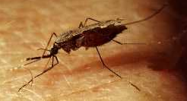
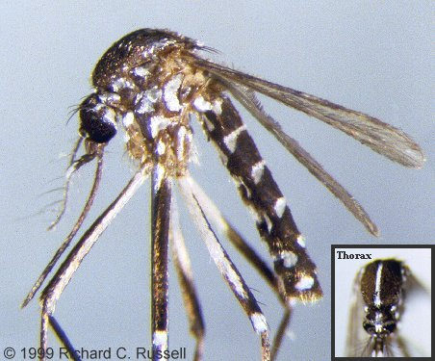
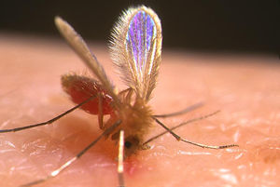
Major Disease Vectors in India
Malaria
An. culicifacies, An. fluviatilis, An. minimus
An. sundaicus, An. stephensi, An. dirus
Dengue,Chikungunya, Zika v
Ae. Aegypti, Ae. Albopictus
Filariasis
Cx. quinquefasciatus, Ma. annulifera and uniformis
Japanese Encephalistis
Cx. Vishnui gp, Cx. tritaeniorhyncus etc.
Kala azar--- Sand fly

Slide 4
OBJECTIVE OF VECTOR CONTROL
To Reduce female vector density to a level below which epidemic vector transmission will not occur
Based on the assumption that eliminating or reducing the number of larval habitats in the domestic environment will control the vector
The minimum vector density to prevent epidemic transmission is unknown

Slide 5
ASPECTS OF VECTOR CONTROL
Which mosquito species are locally important as vectors of diseases?
Which mosquito species are important as the primary source of annoyance?
What are the important breeding sites of different mosquito species?
What is the seasonal pattern of mosquito breeding?
What are the resting places of adult mosquitoes? What are the feeding preferences of vector mosquitoes?
To map out and locate all potential larval development habitats.
To identify the mosquito species present.
To predict the time and location of effective control strategies.

Slide 6
Vector Control
INDIA
National Policy for use of Insecticides :
CIB registration of any Insecticide / Larvicide for public health use is Mandatory.
Expert Group on Vector Control
Technical Advisory Committee (TAC) on VBDs
DDT Mandate Committee
Common Protocol to undertake field trials through ICMR Institutions / NCDC
Operational Research by ICMR/VBD Science Forum, NIMR, VCRC, NCDC, Universities

Slide 7
Insecticide Policy
Programme uses insecticides for indoor residual spray, indoor/ outdoor space spray, treatment of mosquito nets, LLINs, larvicides for vector borne diseases control
Change of insecticides under NVBDCP is based on susceptibility status and epidemiological impact
Introduction of New Compund:
The manufacturer/importer of new pesticides / formulation of pesticides listed under the schedule of Insecticide Act (1968) need to submit requisite data to get it registered with CIB for its use under programme
CIB & RC gives registration/approval based on the data submitted by the manufacturer as per the guidelines of the Registration Committee

Slide 8
VECTOR CONTROL Strategies
Chemical Control
Environment Management
Biological Control
Environmental Control
Legislative control
Chemical Control
Biological Control
INTEGRATED VECTOR MANAGEMENT
An Evidence-based decision making process, rationalizing the use of vector control methods and emphasizing the engagement of communities

Slide 9
IVM-Vector Control
Vector control programme in India and elsewhere, in world, mostly rely on natural and synthetic chemical molecules having potential to kill vectors
Presently different formulations of synthetic chemical insecticides are in the use for vector control.
Mainly Wettable powder (WP) formulations are used for indoor residual sprays while emulsion concentrate (EC)/granule formulations are used for larval control.

Slide 10
IRS - Insecticide Dosage, Dilution and Requirement
INSECTICIDE | DOSAGE PER Sq. m. (a.i.) | DILLUTION PER 10 LTR. OF WATER (covers 500 sq m area) | INSECTICIDE FORMULATION PER HOUSE (150 Sq. m) PER ROUND | AVERAGE PER 5000 POPU. (or 1000 houses)PER ROUND | TOTAL PER ANNUM
DDT 50%* | 1 gm | 1 Kg | 300 gm | 375 Kg | 750 Kg
Malathion 25% (2 coats and 3 rounds per annum) | 2 gm | 2 Kg | 1200 gm | 1500 Kg | 4500 Kg
Deltamethrin 2.5% | 20 mg | 400 gm | 120 gm | 50 Kg | 300 Kg
Cyfluthrin 10% | 25 mg | 125 gm | 37.5 gm | 46.87 Kg | 93.75 Kg
Lambdacyhalo-thrin 10% | 25 mg | 125 gm | 37.5 gm | 46.87 Kg | 93.75 Kg
Alphacyperme-thrin 5% | 25 mg | 250 gm | 75 gm | 93.75 Kg | 187.50 Kg

Slide 11
LARVICIDE FORMULATIONS AND DOSAGE
S.No. | Name of Larvicide | Commercial formulation | Preparation of ready to spray formulation | 1 square meter | 50 Linear meter | Per Heactare | Frequency of application | Equipment required | remarks
1 | MLO | 100% petroleum project product | As it is | 20 C.C. | 1 Litre | 200 Litres | Weekly | Knapsack/ hand compression sprayer | To be applied along the shore of water body
2 | Temephos (Abate) | 50% EC | 2.5 c.c. in 10 litres of potable water | 20 C.C. | 1 Litre | 200 Litres | -do- | Knapsack/ hand compression sprayer | Can be applied in clean water
3 | Bacillus thuringiensisvar israelensis WP | Wettable powder | 5 kg in 200 litres of water | - | - | 5 kg | Fortnightly | Knapsack/ hand compression sprayer | For both clean and non-potable polluted water
4 | Bacillus thuringiensisvar israelensis 12 Aqueous Suspension (AS) | Aqueous suspension 12 Aqueous Suspension | 1 litre in 200 litres of water | - | - | 1 Lit. | Weekly | Knapsack/ hand compression sprayer | Clean water
 |  |  | 2 litres in 200 litres of water | - | - | 2 Lit. | Weekly | Knapsack/ hand compression sprayer | Polluted water
In the case of Malathion, the requirement shown above, is for the three rounds

Slide 12
LARVICIDE FORMULATIONS AND DOSAGE
S.No. | Name of Larvicide | Commercial formulation | Preparation of ready to spray formulation |  |  | Per Heactare | Frequency of application | Equipment required | remarks
5 | Diflubenzuron IGR | 25% Wettable Powder | 100 gms (25 gm a.i) in 100 Litres of water (10 g in 10 litre) 100 litre Clean Water 200 gms (50 gm a.i) in 100 Litres of water (20 g in 10 litre) |  |  | 100 lit. 200 lit | Weekly | Knapsack/ hand compression sprayer | To be applied along the shore of water body Clean water ------------ Polluted water
6 | Pyriproxyfen GR | 0.5% Granular | Ready to use |  |  | 2 kg. Clean Water ------------------------------ 4 kg. polluted water | 3 weekly | Manual | clean water ------------- Polluted Water

Slide 13
Space spray-Dosage, Dilution and Requirement
INSECTICIDE | Dosage | DILLUTION
1. Pyrethrum Extract | 2% Extract | 1 part of 2% Pyrethrum Extract in 19 parts of Kerosene (50 ml in 1 litres K.Oil Used for Indoor Space Sp
2. Malathion Tec. | OP | 1:19 i.e.1 part of Malathion Tech in 19 parts of Diesel (50 ml in 1 litres diesel) Used for out door thermal fogging
3 Cyphenothrin Synthetic pyrethirod | 5%EC | 0.5 mg a.i per sq.mt. (20 ml in 1 litres K.Oil) Used for Indoor Space Sp
4. Cyphenothrin | 5%EC | 3.5 g a.i per hactare (7 ml in 1 litres diesel Out door thermal fogging

Slide 14
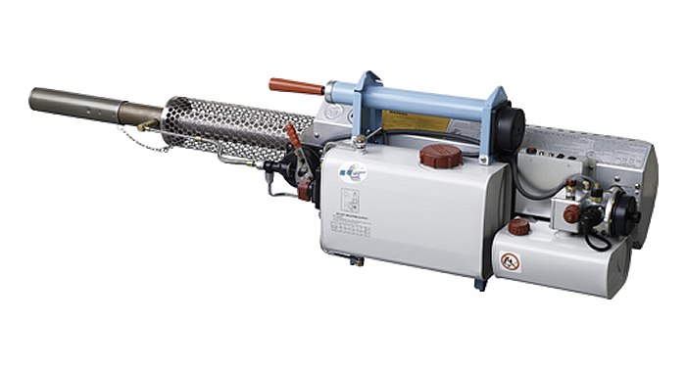
Emergency vector control
Thermal fogs are produced when an insecticide formulation condenses after being vaporized at a high temperature.
These formulations can be oil-based or water-based; the oil (diesel)-based formulations produce dense clouds of white smoke, whereas water-based formulations produce a colorless fine mist.
Hot gas is used to heat the pesticide spray, decreasing the viscosity of the oil carrier, and vaporizing it.
When it leaves the nozzle the vapour hits colder air and condenses to form a dense white cloud of fog. Most of the droplets are smaller than 20 µm.
The droplet size is affected by the interaction between the formulation, the flow rate and the temperature at the nozzle (usually > 500 °C).
The volume of spray mixture applied in vector control is usually 5–10 litres per hectare, with an absolute maximum of 50 litres per hectare.

Slide 15
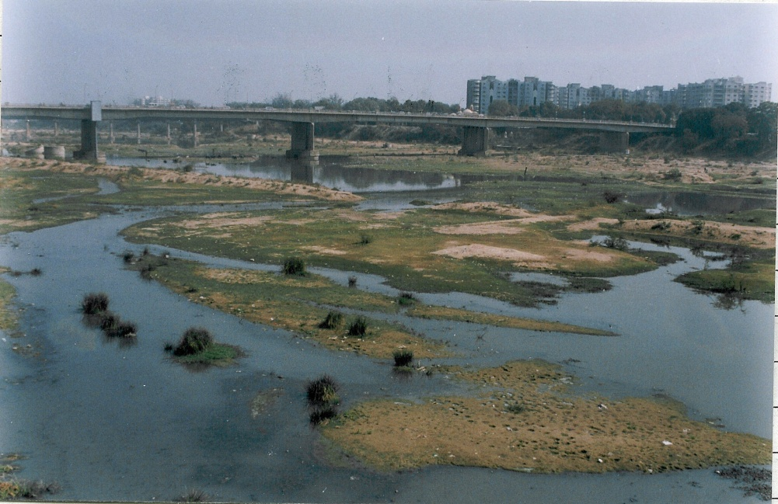
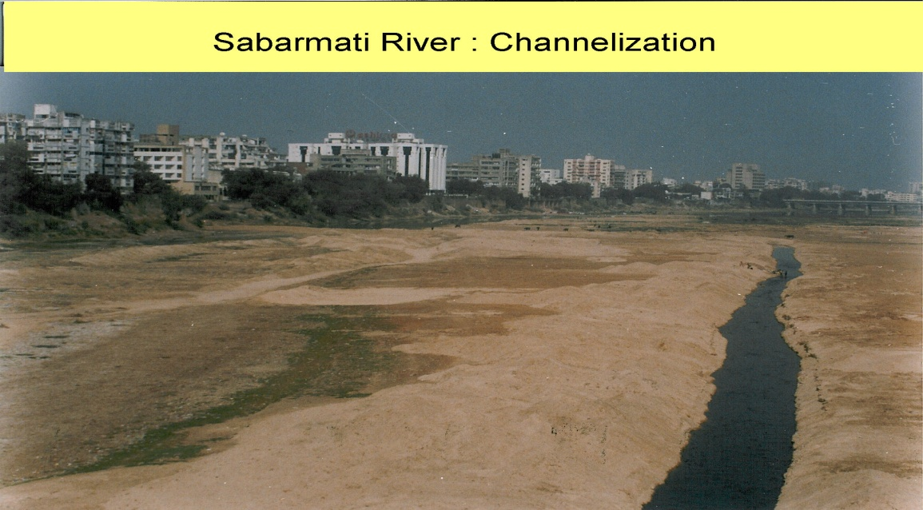
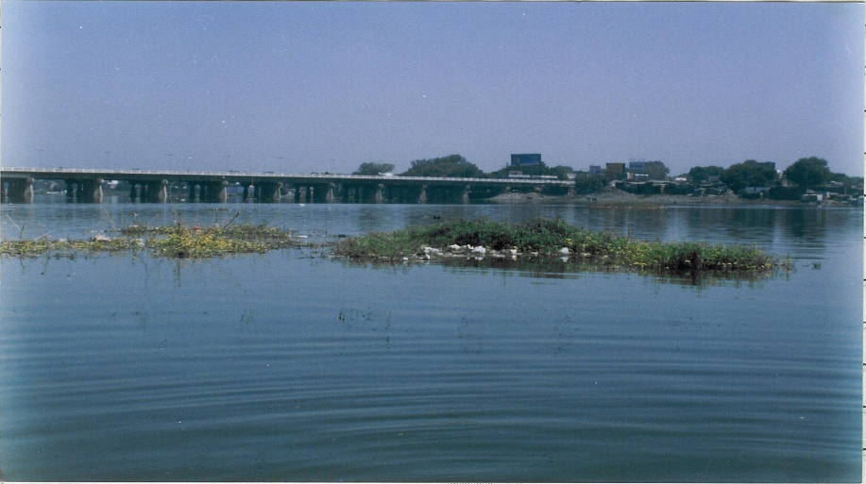
ENVIRONMENTAL MODIFICATION and malaria control
Environmental Control
SABARMATI RIVER’S CHANGING SCENIRIO
SCENARIO
Intervention:Channelization
Sabarmati: erstwhile
Narmada Fed Sabarmati

Slide 16
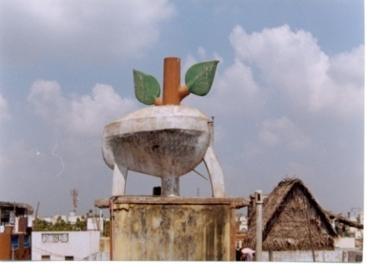
Legislative control-An. ste[phensi Model Civic Bye-laws and Building Bye-laws for prevention and control of vector breeding
Model Civic Bye-laws: Promulgation and implementation with provision to prevent /eliminate mosquito breeding like Municipal Corporation of Greater Mumbai, NCT Delhi, Chandigarh, Bhopal, Agartala, Navi Mumbai Municipal Corporation, Thane and Goa.
Building Bye-laws: Provision to prevent mosquitogenic conditions on the exterior of the buildings and clauses in the contract to keep curing tanks free of mosquito breeding during construction phase and dismantling of the same before issuance of occupancy certificate like Navi Mumbai

Slide 17
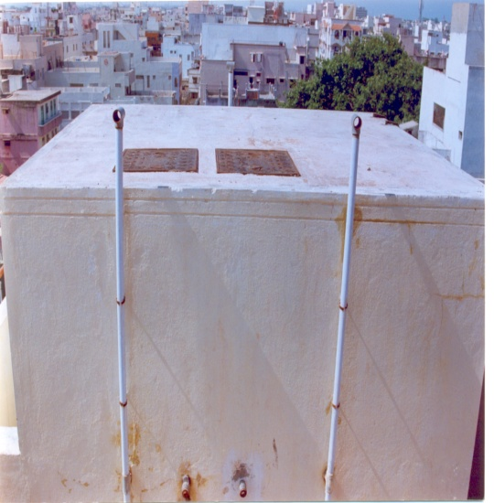
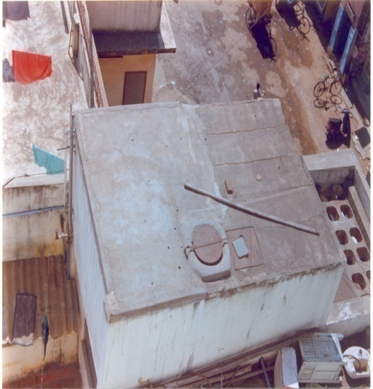
Navi Mumbai Municipal Corporation
Malaria Bye-laws :
To reduce future potential breeding places fpr Anopheles stephensi.
Inspect the site for any potential breeding places at the construction.
“No Objection Certificate” is issued from Health Department of NMMC for Occupancy.

