Slide 1
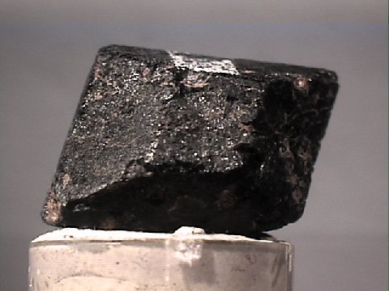
Pyroxene Group
LECTURE -2, M.Sc. ( Geology) I Semester
NIRANJAN MOHANTY
DEPARTMENT OF GEOLOGY,
MLS UNIVERSITY
UDAIPUR-313001 (RAJASTHAN)
E-mail: niranjan@mlsu.ac.in

Slide 2
Introduction
Pyroxenes are most important rock forming ferromagnesian silicates.
They are a group of minerals that are closely related structurally & in chemical composition even though they crystallize in two different crystal systems, orthorhombic & monoclinic.
Belong to Ino or single chain silicate minerals group involving sharing of 2 oxygen atoms of a tetrahedral.

Slide 3
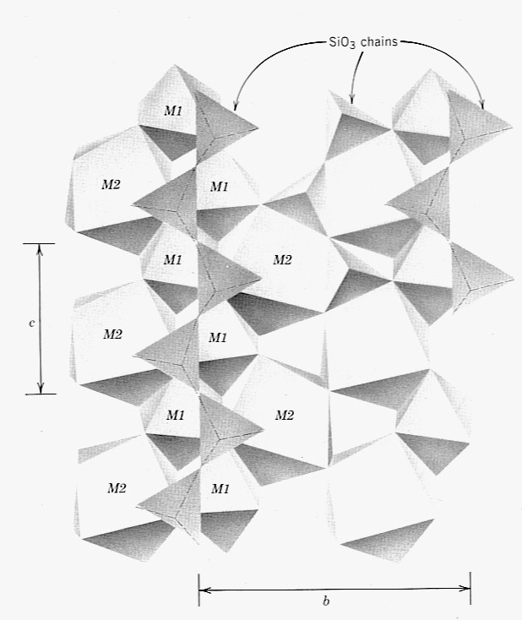
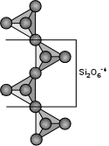
Pyroxenes (XYZ₂O₆ ) X (M₂) – Na⁺, Ca⁺⁺, Mn⁺⁺, Fe⁺², Mg⁺⁺, Li⁺ [8] Cubic Y (M₁) – Mn⁺⁺, Fe⁺², Mg⁺⁺, Fe⁺³, Cr⁺³ , Ti⁺⁴ [6] Octahedral Z (Tetrahedral site) - Al⁺³, Si⁺⁴ [4]
Single Si₂O₆ chains (the tetrahedral sites) that run parallel
to the c-axis

Slide 4
Members of Pyroxene Group
I. Orthorhombic Pyroxenes
Enstatite Mg SiO₃ or Mg₂ Si₂O₆
Ortho ferrosilite (Mg, Fe)₂ Si₂O₆ (not natural)
II. Monoclinic Pyroxenes
Clino enstatite Mg SiO₃
Clino hypersthene (Mg, Fe) SiO₃
Diopside- hedenbergite - Johannsenite series (non-aluminous series)
Diopside CaMgSi₂O₆
Hedenbergite CaFeSi₂O₆
Johannsenite Ca (Mn,Fe) Si₂O₆
Augite – Ferro augite series (aluminous)
Augite (Ca, Mg, Fe, Al)₂ (Al, Si)₂ O₆
•
Pigeonite (Ca, Mg) (Mg, Fe) Si₂ O₆
Alkali pyroxene series (alkalies)
Aegerine ( Acmite) Na, Fe³⁺ Si₂O₆
Jadiete Na, Al Si₂O₆
Spodumene LiAlSi₂O₆
Aegerine-augite

Slide 5
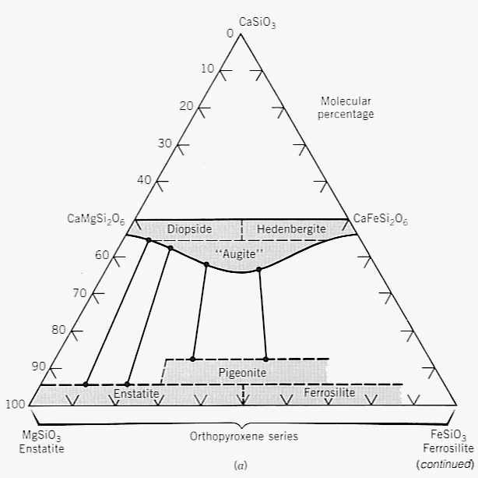
Monoclinic Pyroxenes (Clinopyroxenes - Cpx)
The Diopside- Hedenbergite series - Diopside (CaMgSi2O6) - Ferrohedenbergite (CaFeSi2O6)
Augite - (Ca,Na)(Mg,Fe,Al)(Si,Al)₂O₆ is closely related to the Diopside - Hedenbergite series with addition of Al and minor Na substitution
There is complete Mg-Fe solid solution between Diopside and (Ferro)Hedenbergite
There is also a complete Mg-Fe substitution and small amounts of Ca substitution into the Orthopyroxene solid solution series. Old name Hypersthene
Pigeonite is a high Temperature clinopyroxene
Orthorhombic Pyroxenes (Orthopyroxenes - Opx)
These consist of a range of compositions between Enstatite - MgSiO3 and Ferrosilite - FeSiO3

Slide 6
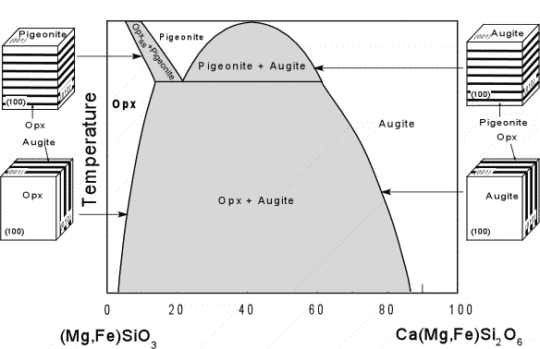
Solid immiscibility
Pigeonite (Ca,Mg,Fe)(Mg,Fe)Si₂O₆
Augite (Ca,Na)(Mg,Fe,Al)(Si,Al)₂O₆
Pigeonite crystallizes in the monoclinic system, as does Augite, and a miscibility gap exists between the two minerals.
Cpx
Opx
At lower temperatures, Pigeonite is unstable relative to Augite plus Orthopyroxene.
Pigeonite => Augite + Opx
Pigeonite is only found in hot volcanic and shallow intrusive igneous rocks, or as exsolution lamellae

Slide 7
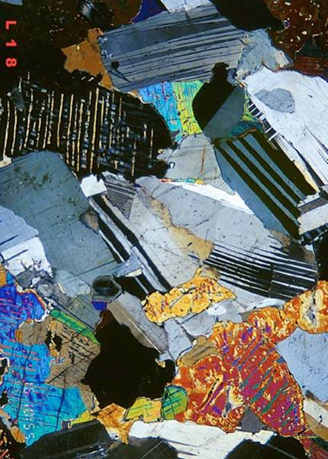
Exsolution in Pyroxene

Slide 8
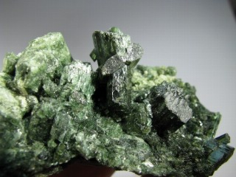
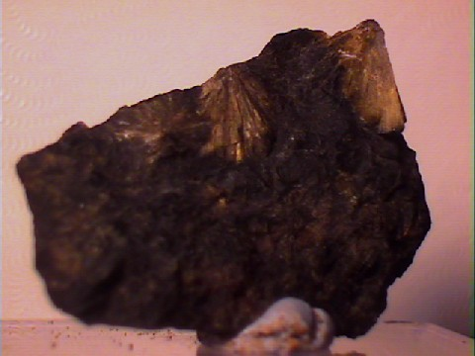
Common Pyroxene Species
Diopside (Cpx)
Augite (Cpx)
Enstatite (Opx)

Slide 9
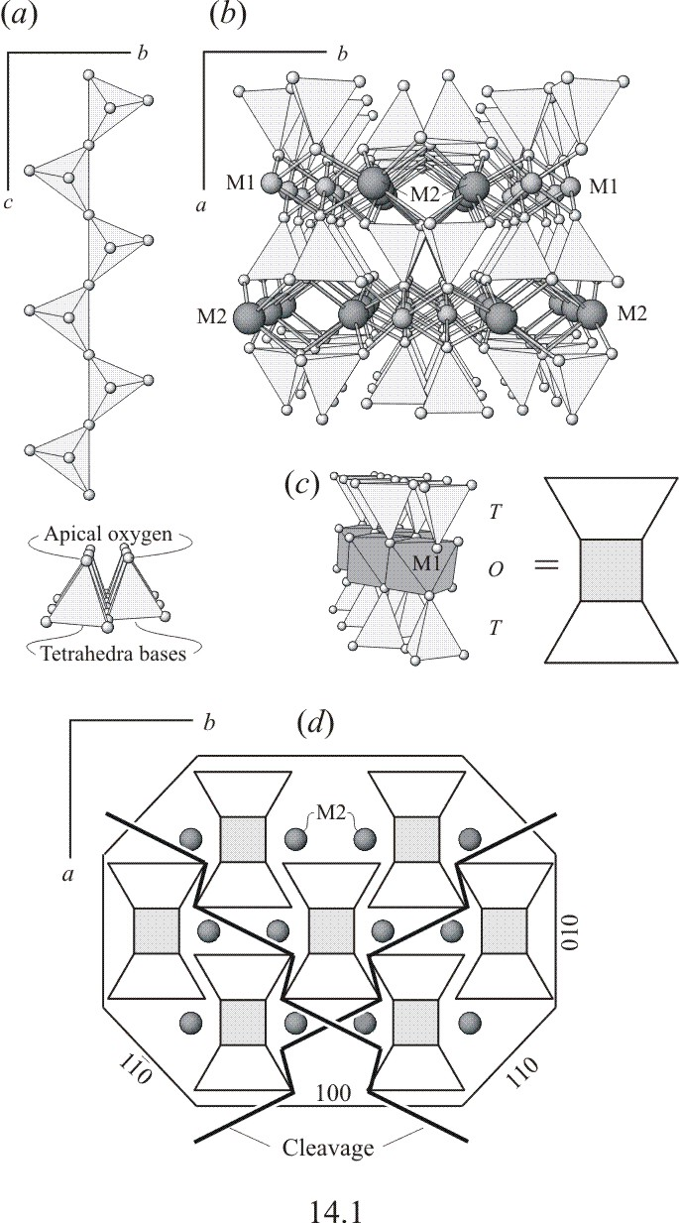
Look at these two drawings.
Is M1 = larger or smaller than M2? Recall
X (M₂) – Na⁺, Ca⁺⁺, Mn⁺⁺, Fe⁺², Mg⁺⁺, Li⁺ [8] Cubic Y (M₁) – Mn⁺⁺, Fe⁺², Mg⁺⁺, Fe⁺³, Cr⁺³ , Ti⁺⁴ [6] Octahedral
Cleavage in Pyroxenes
Look at this drawing. What axis are we looking down?

Slide 10
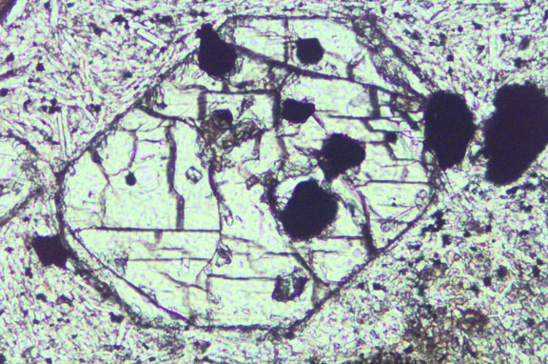
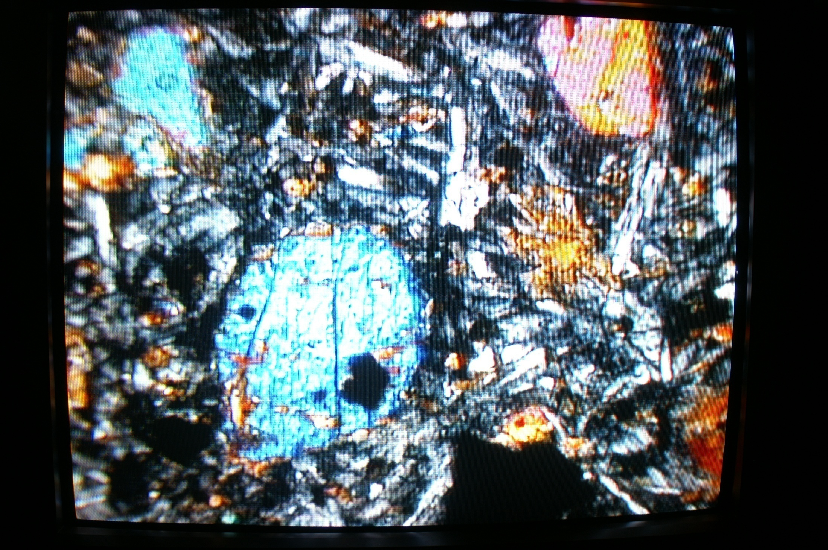
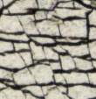
Cleavage in Pyroxenes

Slide 11
