Slide 1
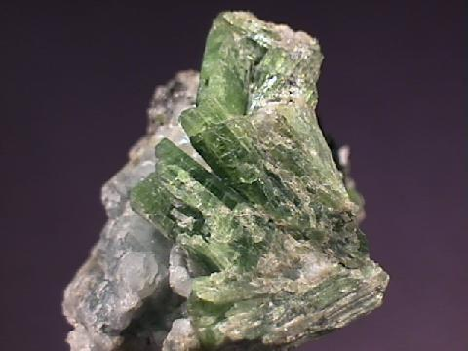
Amphibole Group
LECTURE -3, M.Sc. ( Geology) I Semester
NIRANJAN MOHANTY
DEPARTMENT OF GEOLOGY,
MLS UNIVERSITY
UDAIPUR-313001 (RAJASTHAN)
E-mail: niranjan@mlsu.ac.in

Slide 2
Structure of amphibole
Amphibole structure essentially consists of a pyroxene chain in which alternate tetrahedral in a row share an oxygen with another neighbouring chain.
Striking feature of amphibole
group is the double
linked
tetrahedral chain
laterally i.,e along b. The chains have double the width of those in pyroxenes.
The linked chain extends along c direction.
Because pattern
of characteristic i.e., alternate linked with
tetrahedral are
adjoining chain Si:O is 4:11 i.e., Si₄O₁₁ or Si₈ O₂₂

Slide 3
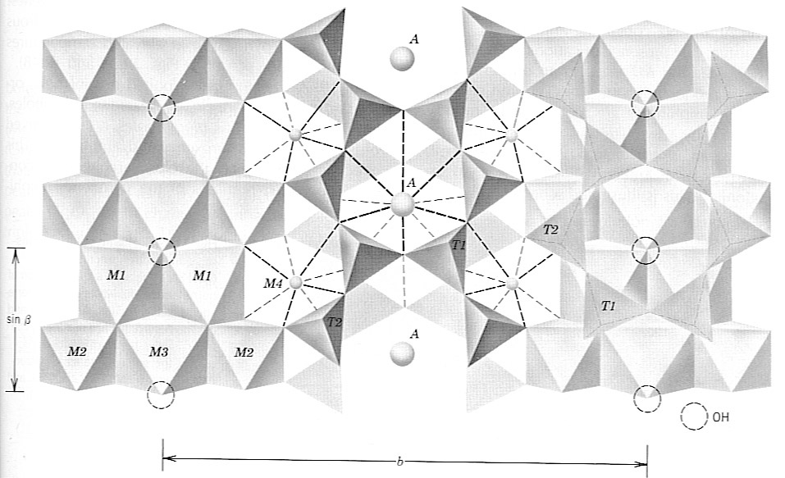
Amphiboles (A₀₋₁X₂Y₅Z₈O₂₂ (OH,F)) A-site – Na⁺, K⁺ loose coordination 10-12 Oxygens X (M₄) – Na+, Ca⁺⁺, Mn⁺⁺, Fe⁺², Mg⁺⁺, Li⁺ 8-fold Y (M₁₋₃) – Mn⁺⁺, Fe⁺², Mg⁺⁺, Fe⁺³, Cr⁺³ , Ti⁺⁴ 6-fold octohedral Z (Tetrahedral T-site) - Al⁺³, Si⁺⁴
double-chain
backbone

Slide 4
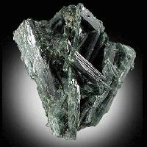
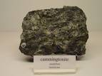
Common Types of Amphiboles

Slide 5
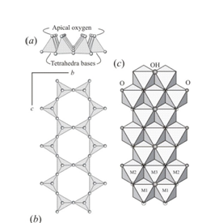
Double chains in Amphiboles

Slide 6
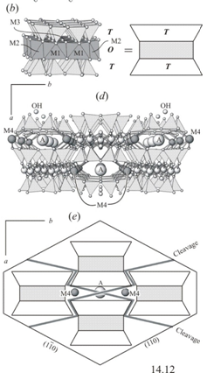
TOT stacks separated by big Na+ and K+ “A” cations
TOT – A assemblies staggered

Slide 7
Classification of amphiboles (crystal system)
I. Orthorhombic amphiboles
Anthophyllite Mg₇Si₈ O₂₂ (OH)₂
II. Monoclinic amphiboles
a) Cummingtonite- grunerite series
Cummingtonite (Mg, Fe) ₇Si₈ O₂₂ (OH)₂
Grunerite (Fe, Mg) ₇Si₈ O₂₂ (OH)₂
b) Tremolite actinolite series
Tremolite Ca₂Mg₅Si₈O₂₂(OH)₂
Actinolite Ca₂(Mg, Fe)₅Si₈O₂₂(OH)₂
c) Hornblende series
Hornblende (Ca, Na, Mg, Fe, Al) ₇₋₈ (Al, Si)₈ O₂₂ (OH) ₂ with varieties arising due to substitutions among cations
d) Alkali amphibole series
Glaucophane Na₂ (Mg,Fe) ₃ (Al,Fe⁺³) ₂Si₈ O₂₂ (OH) ₂
Riebeckite Na₂ Fe⁺² ₃ Fe⁺³₂Si₈ O₂₂ (OH) ₂
Arfvedsonite Na₃ Mg₄ Al Si₈ O₂₂ (OH) ₂
III. Triclinic amphiboles
a) Cossyrite or aenigmatite - an aluminium silicate of Na, Fe and Ti (now it is believed be a pyroxene – single chained).
•

Slide 8
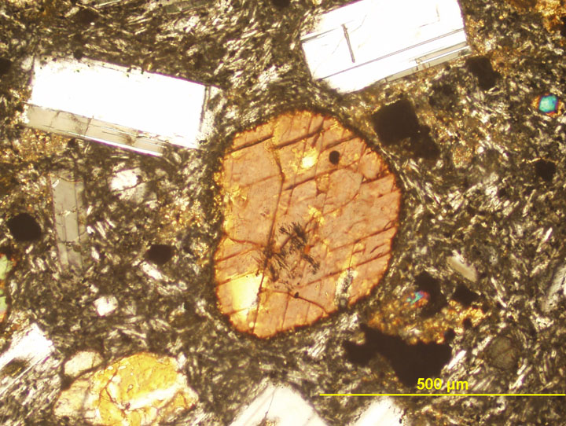
Cleavage ~120 – 60º

Slide 9
Paragenesis
Riebeckite
Igneous rocks – soda-rich granites, rhyolites and pegmatites
Metamorphic rocks as well.
Arfedsonite
Alkaline igneous rocks (nepheline syenites).
Varieties
Anthophyllite forms a asbestiform variety (Amosite). But its fibres are generally brittle and of low tensile strength. Hence it is unsuitable for spinning. It is mainly used in cement industry and as an insulating material.
Gedrite- a aluminium anthophyllite.
Tremolite also form a variety of asbestos. But it is less valuable industrially than chrysotile.
Riebeckite occurs in a asbestiform variety called crocidolite or blue asbestos.

