Slide 1
Lecture 1 Introduction to Mineralogy
NIRANJAN MOHANTY
DEPARTMENT OF GEOLOGY,
MLS UNIVERSITY
UDAIPUR-313001 (RAJASTHAN)
E-mail: niranjan@mlsu.ac.in

Slide 2
Mineralogy
The study of the chemistry, atomic structure, physical properties, and genesis of minerals

Slide 3
Some Mineralogy Topics
Crystal Chemistry – relationship of chemical composition to atomic structure
Descriptive Mineralogy – documenting physical and optical properties
Crystallography – relationship of crystal symmetry and form to atomic structure
Mineral Genesis – interpreting the geologic setting in which a mineral forms from its physical, chemical, and structural attributes and its associated minerals

Slide 4
Mineralogy is fundamental to an understanding of Geology
Petrology – the origin of rocks, evaluating the structure, texture, and chemistry of their minerals.
Geochemistry – study of the chemistry of minerals at the surface and at high P-T
Structural Geology– Deformation of a rock and the orientation and crystal structure of its minerals
Weathering – the study of how the biosphere, hydrosphere, and atmosphere interact with minerals
Economic Geology – study of the origin and concentration of ore deposits

Slide 5
Definition
A mineral is a naturally occurring solid with a highly ordered atomic arrangement and a definite (but not fixed) chemical composition. It is usually formed by inorganic processes

Slide 6
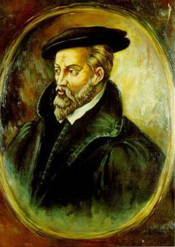
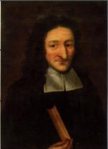
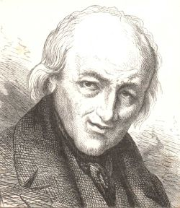
History of Mineralogy
Agricola
Mineral science begins with Renaissance (Agricola, De Re Metallica 1556 Mining and Metallurgy Methods
Nicolas Steno (Danish: Niels Stensen) Constant crystal face angles 1669)
1700’s measurements of crystal geometry and symmetry René Just Haüy concept of unit cell
Early 1800’s precise measurements of crystal symmetry heralds the field of crystallography; analytical chemistry leads to chemical classification of minerals
Late 1800’s – creation of polarizing microscope opens field of petrography and the study of optical properties of minerals
Steno
René Just Haüy

Slide 7
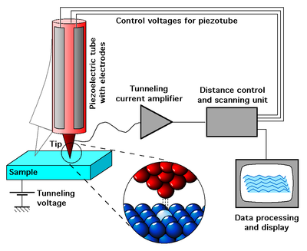
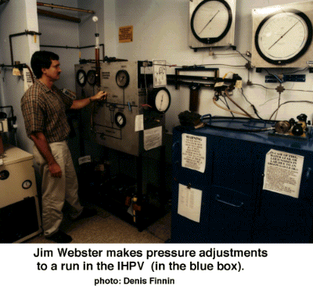
History of Mineralogy (cont.)
Early 1900’s - X-ray diffraction measurements allows for precise measurement of internal symmetry and structure of minerals, and Geothermobarometry applied to metamorphic systems.
1960 – development of the electron microprobe allows for accurate in situ analysis of mineral chemistry
1970 – development of transmission electron microscope allows for visualization of atomic structure and symmetry
1980 – ion microprobe allows for study of isotopic composition of minerals
1981 Scanning Tunneling Microscope for elements (left)
Early 2000’s to present - investigation of the role of acidic and basic fluids in metamorphism
using high P,T vessels (shown at right)

Slide 8
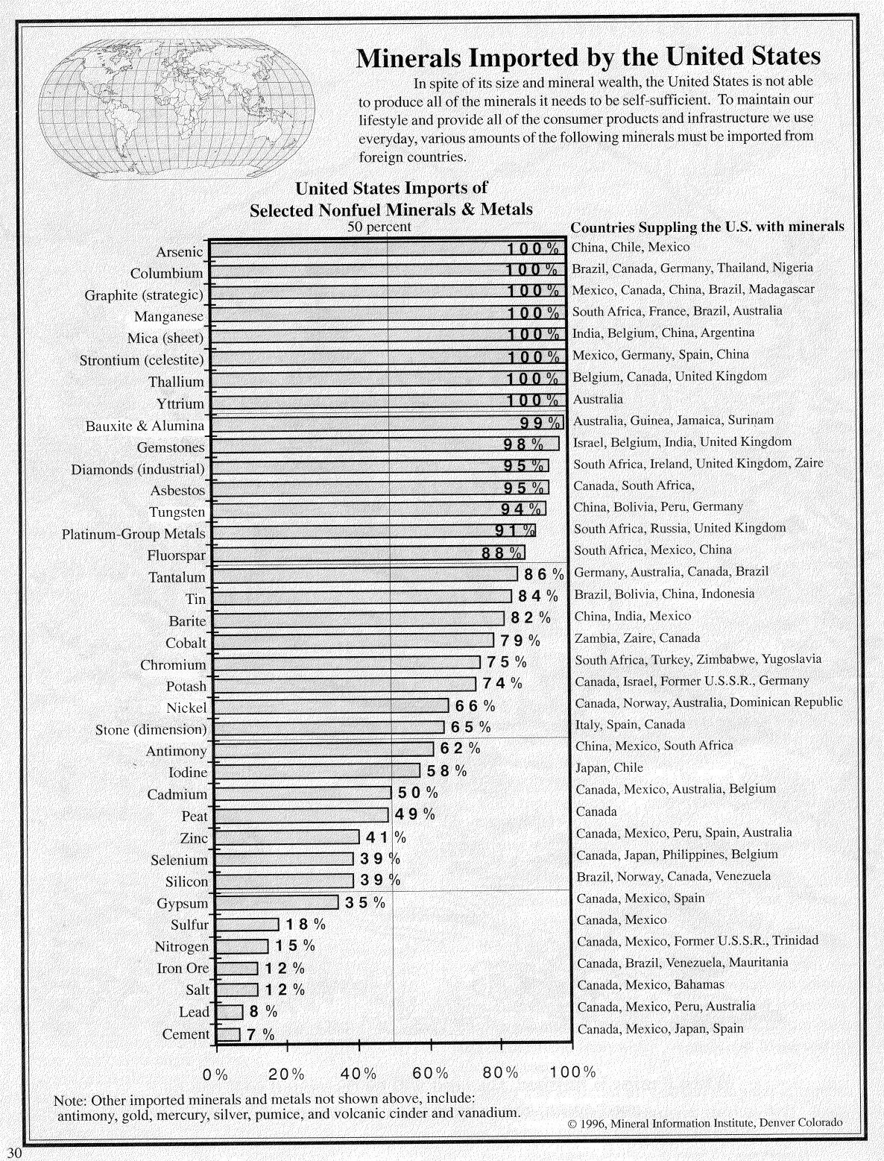
US imports most minerals

Slide 9
Classification & Naming of Minerals
Classified by anion (oxides, silicates, sulfides, halides, phosphates, ….)
Classified by internal crystal structure
Named for places, people, chemistry

Slide 10
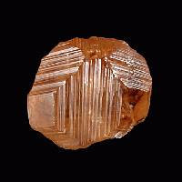
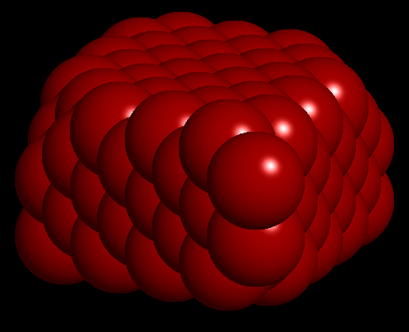
External form reflects internal form
Minerals’ atoms are regularly arranged
Arrangement controls external crystal form
Grossular Ca₃Al₂Si₃O₁₂
Mineral photos courtesy J. H. Betts
Used with permission
Diamond C

Slide 11
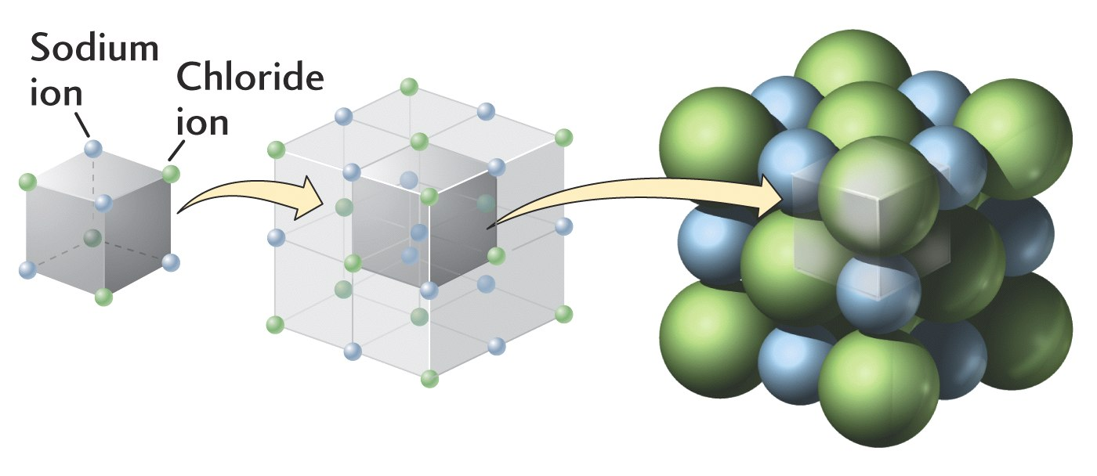
Unit Cells as building blocks
unit cell ball and stick model space filling model
Halite (salt, NaCl)

Slide 12
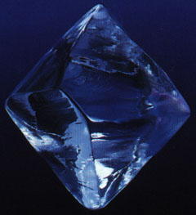
We classify crystal external form in 6 systems based on the shape of the crystal. Unit cells repeat to make external crystal form.
Crystal Systems
http://webphysics.davidson.edu/alumni/milee/JLab/Crystallography_WWW/Grown_Crystals.htm
Diamond
Steve Dutch

Slide 13
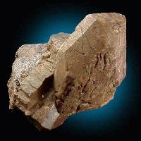
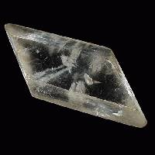
Triclinic and Monoclinic
Triclinic crystals have unequal axis lengths and angles, none are 90º.
Monoclinic crystals are more symmetrical: they have unequal axis lengths and two 90º angles.
Least symmetry
Triclinic Microcline
KAlSi₃O₈
Monoclinic Gypsum
CaSO₄
a-axis parallel first sloping face from c

Slide 14
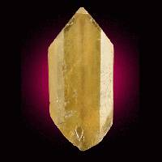
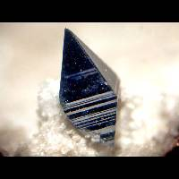
Orthorhombic and Tetragonal crystals are more symmetrical
Orthorhombic
Barite BaSO₄
Tetragonal
Anatase TiO₂

Slide 15
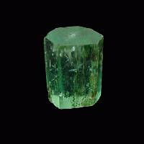
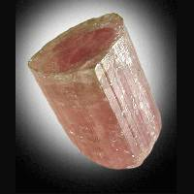
Hexagonal and Trigonal are still more symmetrical
Hexagonal
Beryl Be₃Al₂(Si₆O₁₈)
Trigonal
Tourmaline

Slide 16
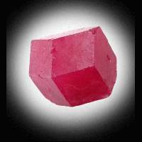
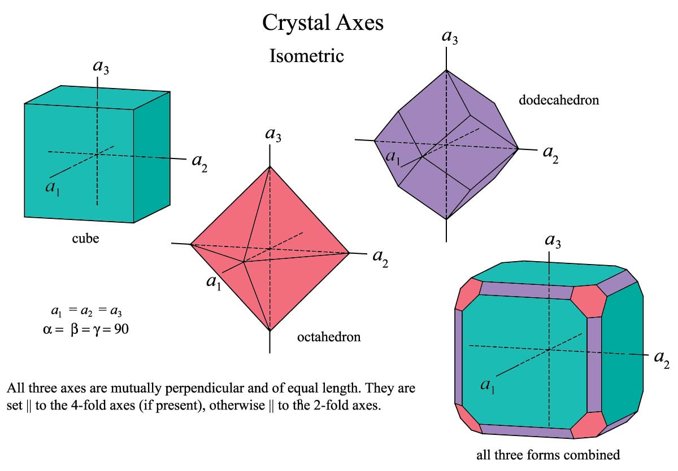
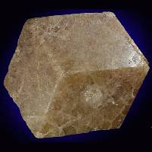
The Isometric system has the most symmetry
Grossular Ca₃Al₂Si₃O₁₂
_{dodecahedron}
Grossular Ca₃Al₂Si₃O₁₂
_{cube}

Slide 17
Reflection
Rotation
Symmetry Elements
Center of
Symmetry
Note: front back inverted front
Notice notation 2 bar
Rotation with _
Inversion note 2 = m
define: Motif

Slide 18
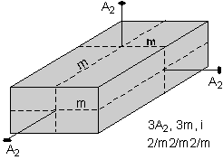
Hermann-Mauguin Symbols
Illustrations in this H-M section are from the lectures of Stephen A. Nelson
To begin, write a number representing each of the unique rotation axes present. A unique rotation axis is one that exists by itself and is not produced by another symmetry operation. In this case, all three 2-fold axes are unique, because each is perpendicular to a different shaped face, so we write a 2 (for 2-fold) for each axis, A:
2 2 2

Slide 19
Hermann-Mauguin Symbols
Next we write an "m" for each unique mirror plane. Again, a unique mirror plane is one that is not produced by any other symmetry operation. In this example, we can tell that each mirror is unique because each one cuts a different looking face. So, we write:
2 m 2 m 2 m

Slide 20
Hermann-Mauguin Symbols
If any of the axes are perpendicular to a mirror plane we put a slash (/) between the symbol for the axis and the symbol for the mirror plane. In this case, each of the 2-fold axes are perpendicular to mirror planes, so our symbol becomes:
2/m2/m2/m

Slide 21
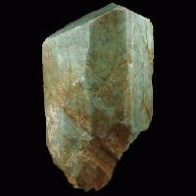
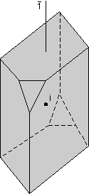
Triclinic Symmetry Class i
Microcline
Each crystal system has more than one symmetry class, but only a few are common in minerals. For example:
Pinacoidal Class, bar-1, Symmetry content: i
Center of symmetry, i : pairs of faces (Pinacoids) are related to each other through the center.
This is the pinacoidal class.
Common minerals with pinacoidal crystals are: Microcline KAlSi₃O₈, plagioclase, turquoise, and Wollastonite CaSiO₃.

Slide 22
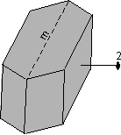
Monoclinic Symmetry class 2/m
Prismatic Class, 2/m. Symmetry content – 1 A₂ (one two-fold axis) , m (a mirror plane of symmetry), i (a center of symmetry)
Single 2-fold axis A₂ perpendicular to a single mirror plane m, so 2/m
Common minerals in 2/m are the micas (biotite and muscovite), azurite, chlorite, clinopyroxenes, epidote, gypsum, malachite, kaolinite, orthoclase, and talc.
continued
2/m

Slide 23
Orthorhombic Symmetry Class 2/m 2/m 2/m
Rhombic-dipyramidal Class, Symmetry content – 3 A2, 3 m, i
3 perpendicular 2-fold axes perpendicular to 3 mirror planes
The most common minerals in this class are andalusite, anthophyllite, aragonite, barite, cordierite, olivine, sillimanite, stibnite, sulfur, and topaz.

Slide 24
Tetragonal Symmetry Class 4/m
Tetragonal-dipyramidal Class, 4/m, Symmetry content - 1A4, 1m, i
Single 4-fold axis perpendicular to a mirror plane.
4 pyramid faces are reflected across the mirror plane to form 4 identical faces on the bottom
Scheelite and Scapolite are common minerals in this class.

Slide 25
You get the idea
As we get to more symmetric crystals they get more difficult to draw and describe.
For Hexagonal (including Trigonal) and Isometric crystal classes, please refer to your text

Slide 26
Miller Index notation for crystal face orientation
1. Pick a reference face that intersects a, b, and c axes . The intersections define the unit lengths.
2. Measure intersections of another face with the axes, write down lengths relative to the unit lengths. Use infinity if parallel.
3. Invert and clear fractions to get Miller Indices. 1/infinity = 0
Red face hits reference face at 2,2,2/3, invert, clear fractions by multiplying all by 2
Cross Section perpendicular to a-axis
1c
UPPER FACE
REFERENCE
(UNIT)
FACE
2/3c
correct
angle between
face and reference
1/3c
1b
2b
3b
Miller Indices
(1/1,1/1,1/1) = 111
(1/2,1/2,3/2) = 113
Reference face
Upper face
Reference face is shaded blue

Slide 27
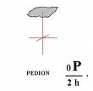
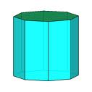
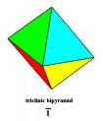
Forms and Zones
Forms: All faces required by class symmetry if one is present.
A pedion is a single plane
A pinacoid is a pair of parallel planes
A prism is a set of equivalent planes parallel to a common axis
A pyramid is a set of three or more planes all equally inclined to a common axis
A group of faces whose intersection edges are parallel constitute a Zone. Do you see any above?

Slide 28
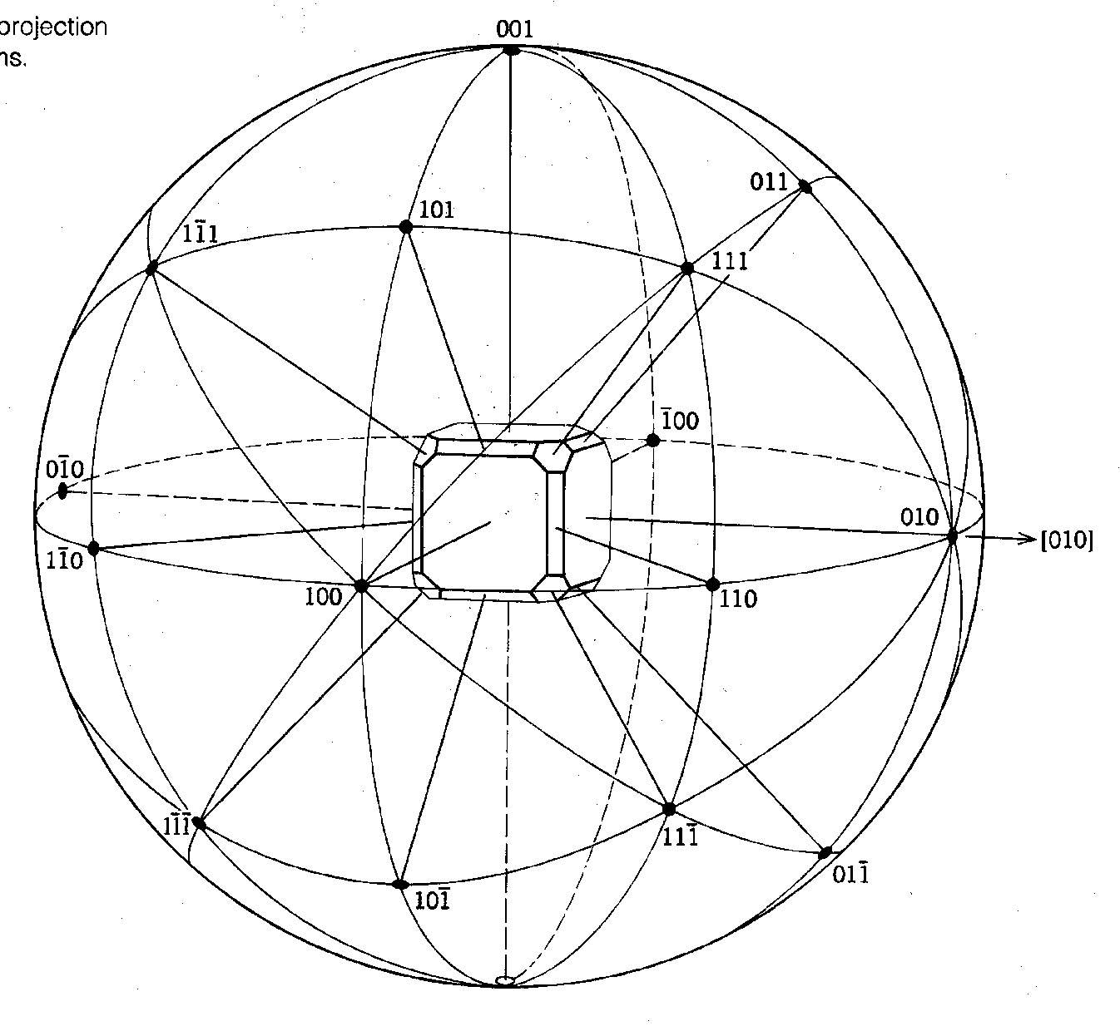
Stereo Projection
Want to represent this 3-D crystal on 2-D paper?
Use a Projection
Note poles (normals to crystal face planes) labeled with Miller Indices
Right side face cuts b but is parallel to a and c axes. Intercepts , 1,
invert 1/ , 1/1, 1/
equals 0,1,0 i.e.
Miller Index (010)
(010) Is used as the origin

Slide 29
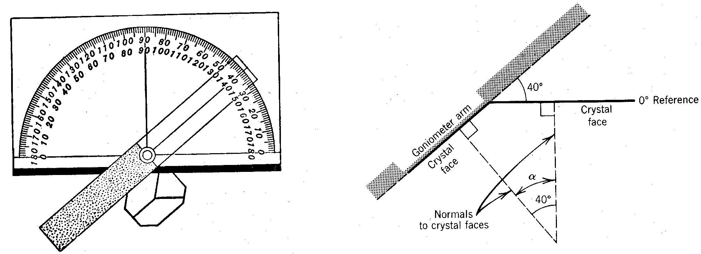
Stereographic Projection
How to make a stereographic projection of a crystal face pole
Use a contact goniometer to measure the interfacial angles with reference face (010)
From reference face (010),
Measure φ latitude and ρ longitude

Slide 30
Spherical Projection
Suppose the (111) face is at lat Φ = 45º, long ρ = 45º
Start at [010]
Plot latitude Φ
Then longitude ρ
Okay but how to
do this on a flat
sheet of paper?

Slide 31
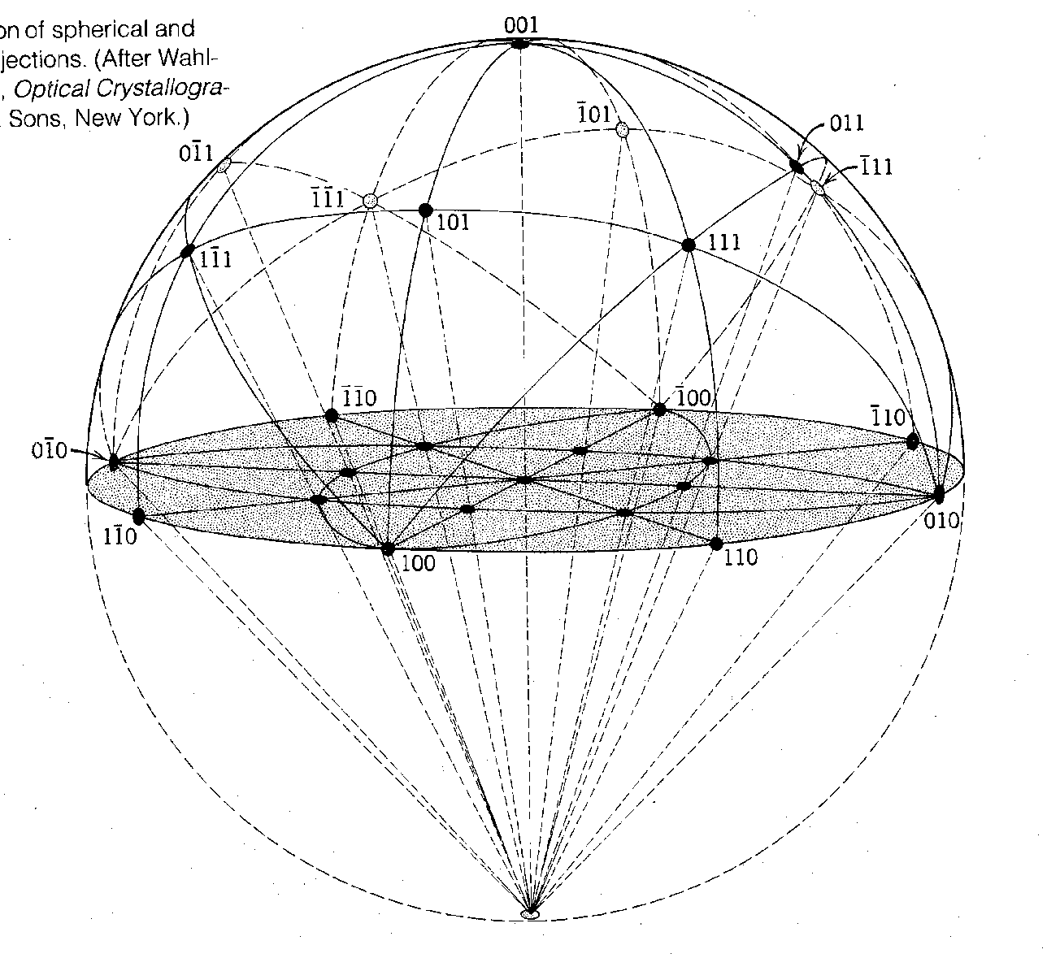
Stereographic Projection
Gray plane is our paper
We can use the angles and calculate the 2-D distances from the center to find the stereographic poles directly
Or we can use special Wulff Net paper and avoid the trigonometry

Slide 32
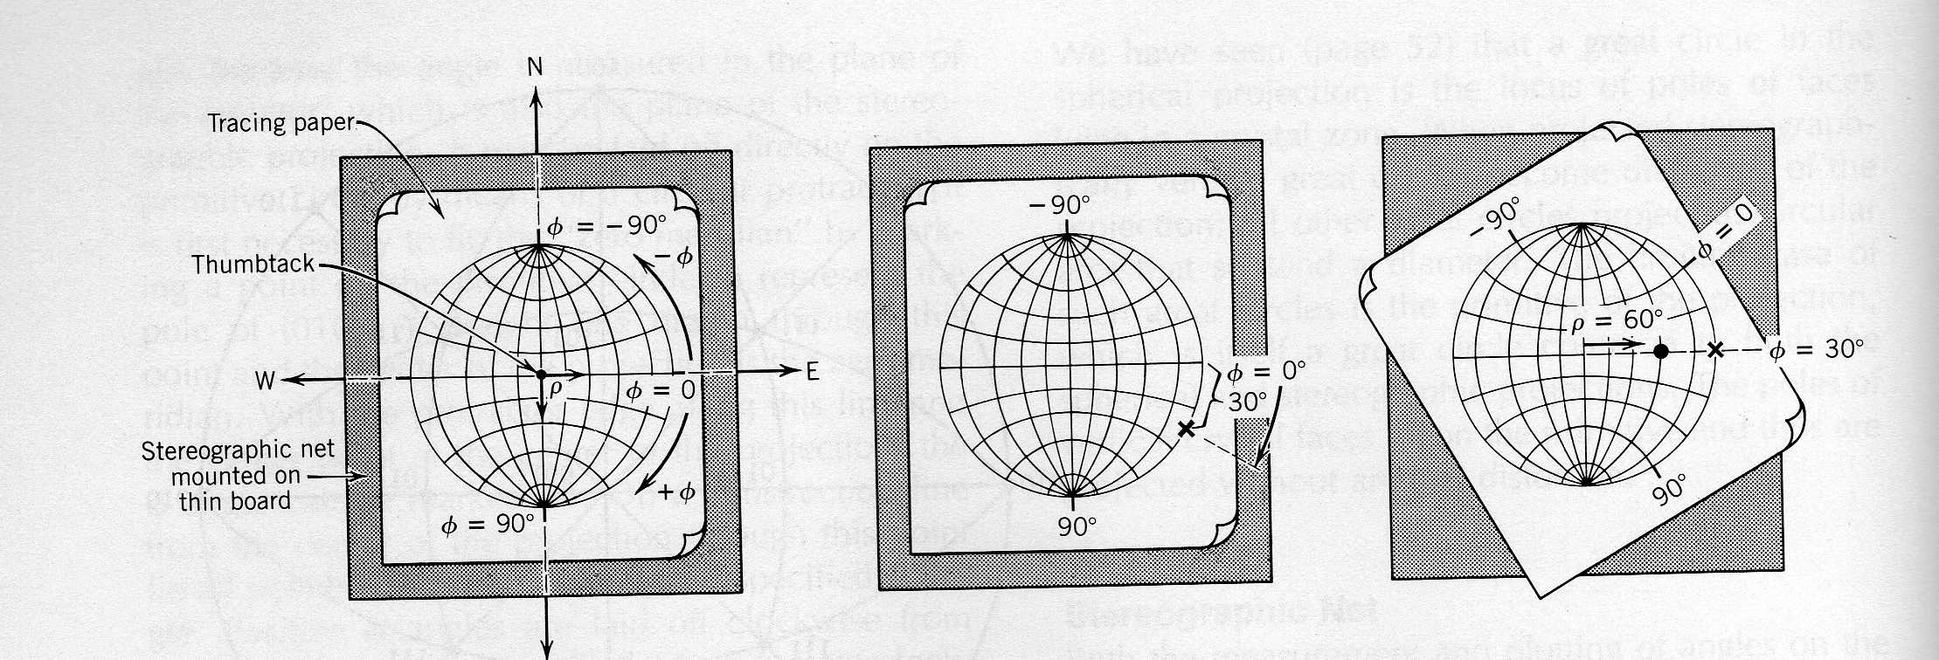
Plotting Φ and ρ
Using a Wulff Net
Suppose you measured lon ρ = 60º and lat Φ = 30º
The pole for (010) is on the eastern edge
Measure Φ = +30º clockwise along the circumference x
Rotate tracing paper so x falls over E-W diameter
Plot ρ = 60º in from center
x
Tracing paper over a Wulff Net,
rotating about a thumb tack at the center

Slide 33
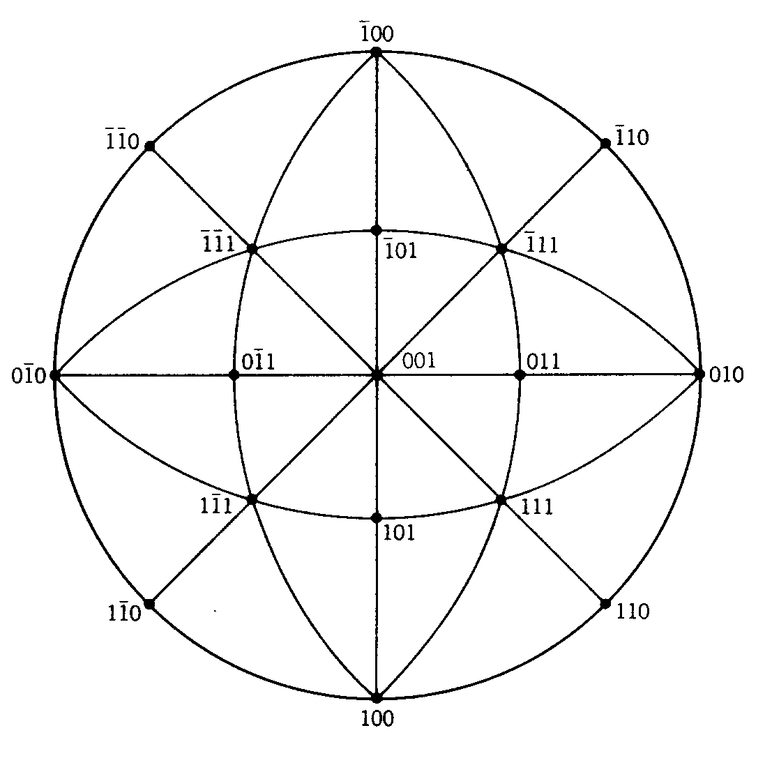
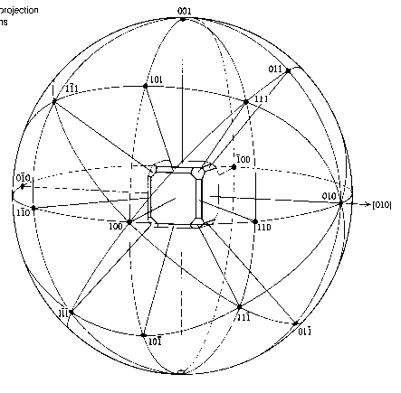
The finished product
Face poles and principal zones
If we also plot the
symmetry operations, we can
recognize the symmetry class. Mirrors are solid lines. This is 4/m 3 2/m

Slide 34
For lab:
Review of common minerals – Olivine, Zircon, Garnet, Pyroxenes and Amphiboles, Biotite and Muscovite micas, Quartz, Anorthite and Albite plagioclase, Microcline and Orthoclase K-spars, Kaolinite Hematite, Magnetite, Galena, Pyrite, Halite, Gypsum, Fluorite, Apatite, etc.
Review of simple field tests used in mineral identification of hand specimens – hardness, cleavage or fracture, luster

Slide 36
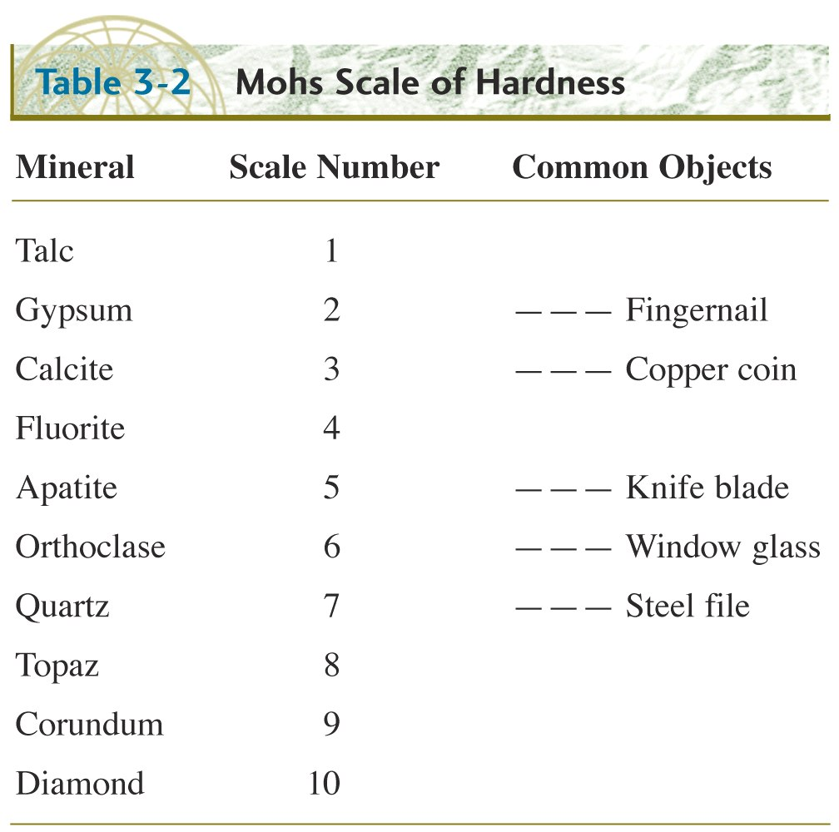

Slide 38
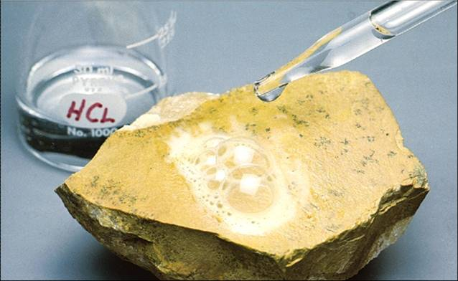

Slide 39
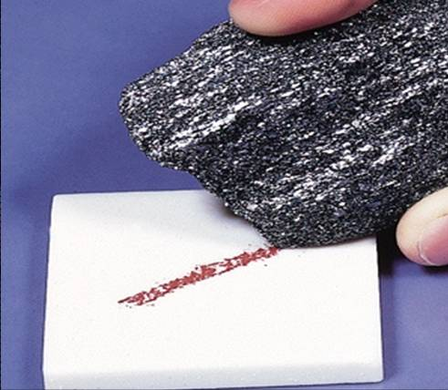

Slide 40
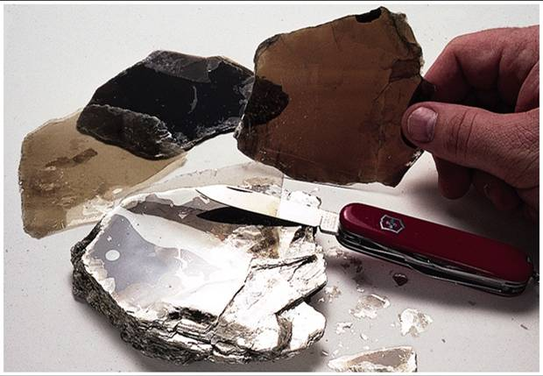

Slide 41
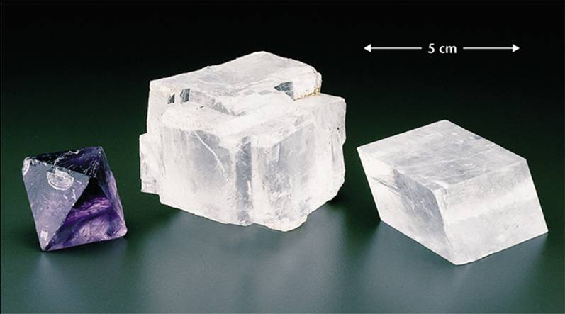
3 Cleavage planes, Fluorite, Halite, Calcite

Slide 42
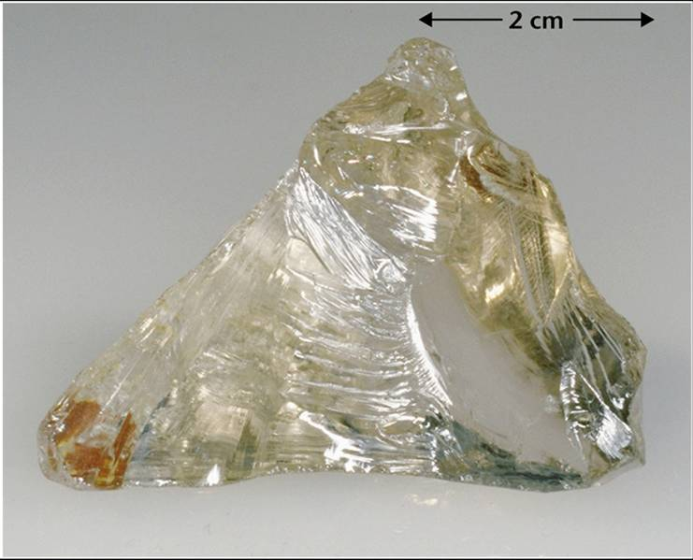
Conchoidal Fracture

