Slide 1
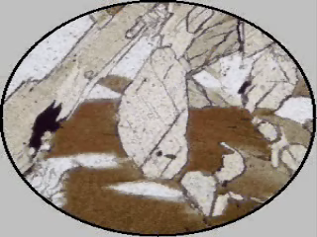
Optical Mineralogy
LECTURE -6, M.Sc. ( Geology) I Semester
NIRANJAN MOHANTY
DEPARTMENT OF GEOLOGY,
MLS UNIVERSITY
UDAIPUR-313001 (RAJASTHAN)
E-mail: niranjan@mlsu.ac.in

Slide 2
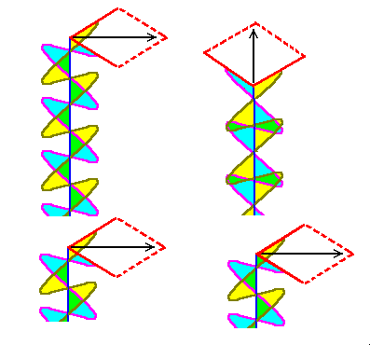
Integral Retardation
If the retardation is a whole number of wavelengths, the beams recombine with the same orientation as when they entered the crystal
These wavelengths will be blocked by the upper polarizer

Slide 3
Half-integral Retardation
If the retardation is a whole number of wavelengths plus one-half, the beams recombine with an orientation perpendicular to the original direction of polarization
These wavelengths will be fully transmitted by the upper polarizer

Slide 4
Birefringence
The greater the difference between the indices of refraction, the more intense are the interference colors produced
The difference in the index of refraction in two viewing directions is called the birefringence

Slide 5
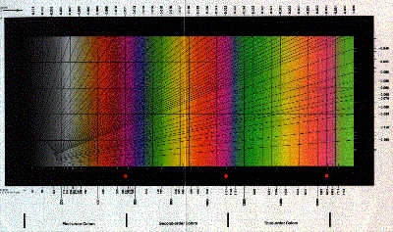
Michel-Lévy Color Chart
First order colors are to the left, with orders increasing to the right

Slide 6
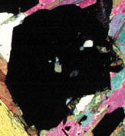
No Birefringence
Garnet is isometric
Birefringence is zero
Therefore the interference color is black
This is also known as being “in extinction”

Slide 7
Weak Birefringence
Quartz has very low birefringence
Colors are very muted
1° grays and white

Slide 8
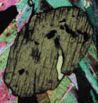
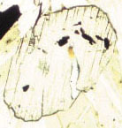
Low Birefringence
Kyanite shows some color
Kyanite grain in center is surrounded by muscovite, biotite, and opaque minerals
Lower image is in pp – note that kyanite is colorless

Slide 9
High Birefringence
Muscovite shows high interference colors
Highest colors (4° and beyond) are pastels

Slide 10
Extinction Angle
The angle formed by one line of the crystal with the extinction position
Either the longest dimension of the mineral or the system of cleavage lines are generally used as this line of reference

Slide 11
Determination of Extinction Angle
Initially, view the crystal in pp
The reference line is rotated so it coincides with the direction of the polarizer (E-W)
The analyzer is inserted
The stage is rotated and turned slowly until extinction occurs
The rotation angle is the extinction angle

