Slide 1
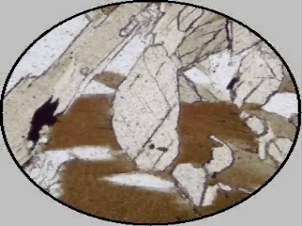
Optical Mineralogy
LECTURE -7, M.Sc. ( Geology) I Semester
NIRANJAN MOHANTY
DEPARTMENT OF GEOLOGY,
MLS UNIVERSITY
UDAIPUR-313001 (RAJASTHAN)
E-mail: niranjan@mlsu.ac.in

Slide 2
Path Differences In Crystals
Waves entering an anisotropic crystal will generally experience two indices of refraction in two perpendicular directions
Even plane-polarized radiation will be split into the Ordinary (O) and Extraordinary (E) vibrating ⊥

Slide 3
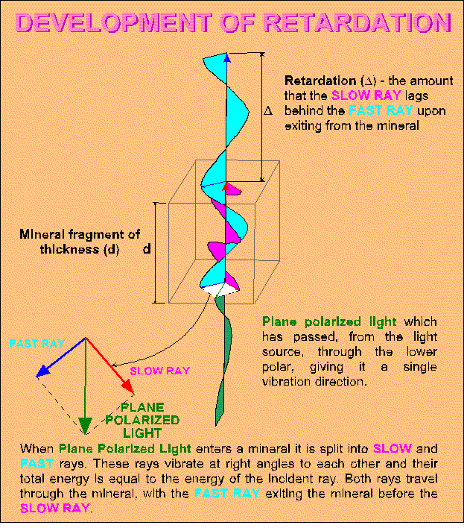
Retardation
Path differences upon passing through a crystal are called retardation (of the slower ray relative to the faster)
Δ = λ in this case
Notes:
Diagram: http://www.brocku.ca/earthsciences/people/gfinn/optical/retard6.gif

Slide 4
Accessory Plates
Quartz sensitive tint, gypsum plate, 1st order red has Δ = 550 nm
Mica or quarter-wave plate has Δ = 150 nm
Quartz wedge has variable Δ
Generally, the slow direction is indicated on the plate (N) – the fast direction (n) is unmarked, but is perpendicular

Slide 5
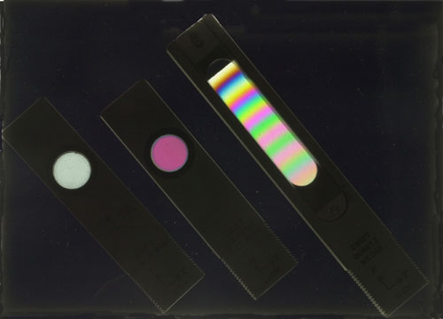
Accessory Plate Photo
Left to right: Quarter wave plate; full wave sensitive tint plate; quartz wedge
Viewed in crossed-nicols
Notes:
Image: http://www.msm.cam.ac.uk/doitpoms/tlplib/optical-microscopy/plates.php

Slide 6
Quartz Sensitive Tint Plate
Usually made of gypsum, mica, or quartz
Mineral is cut parallel to the optic axis of the crystal, to such a thickness that the O-rays and E-rays for green light (l = 540 nm) are out of phase by exactly one wavelength
The analyzer therefore extinguishes green light, but permits other wavelengths to pass through to some extent
When using white light this causes the field of view to appear red (white light minus green light)
Isotropic, non-birefringent materials also appear red
Notes:
Source: http://www.msm.cam.ac.uk/doitpoms/tlplib/optical-microscopy/plates.php

Slide 7
Quarter-wave Plate
Made form a flake of mica that is cleaved to such a thickness that the O-rays and E-rays emerge a quarter of a wavelength out of phase
This corresponds to a pale grey interference color
This plate is especially useful for examining specimens showing bright interference colors, because they are moved only a short distance along the scale
The plate can be used to enhance the contrast between regions of the specimen

Slide 8
Quartz Wedge Plate
The quartz wedge is cut so that it varies in thickness from about 0.01 mm to about 0.08 mm and covers several orders of retardation colors
As the wedge is inserted into the slot in the microscope it produces progressively higher retardations, and the position at which complete extinction occurs is noted
Michel Levy produced a color chart which plots the thickness of an isotropic specimen, its birefringence and its retardation in nanometers
Once two of these variables is known, the third can be easily determined

Slide 9
Calculating Δ
Δ = c (T_{N} - T_{n})
Where
  T_{N} = time for the slow wave to pass through the xtal
  T_{n} = time for the fast wave to pass through the xtal
If the thickness of the crystal is t, then:
  c_{N} = t/T_{N} and c_{n} = t/T_{n}

Slide 10
Calculating Δ continued
Δ = c (t/c_{N} – t/c_{n}) = t (c/c_{N} – c/c_{n})
But N = c/c_{N} and n = c/c_{n}
Therefore, Δ = t(N –n)

Slide 11
Sample Calculation
For quartz, N = 1.553 and n = 1.544
Thickness of a standard section = 30 microns = 0.03 mm
Δ= (1.553 – 1.544) x 0.03mm = 2.7 x 10⁻⁴ mm = 270 nm
For calcite, N = 1.658 and n = 1.486
Δ = (1.658 – 1.486) (0.03) = (0.172) (0.03) = 5.160 x 10⁻³ mm = 5160 nm

Slide 12
Transmission of Light
Crystal viewed 45 ̊ off extinction (where interference colors are brightest) with nicols crossed
  L = 100 sin² Δ/λ 180 ̊
    (L = percent transmission)
For parallel nicols
  L = 100 cos² Δ/λ 180 ̊

Slide 13
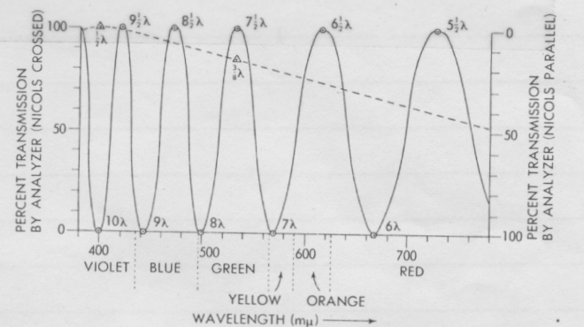
Plot of Transmission vs. λ
Note: Curves labeled 10 λ, 9λ, etc. should say 10 Δ/λ, 9 Δ/λ, etc.
Solid line, Δ = 4000 nm
Dashed line, Δ = 200 nm

Slide 14
Use of Accessory plates
Anisotropic crystals will show their most intense, or brightest, interference colors at a position 45 ̊ off extinction
When an accessory plate is inserted into the light path, with the fast direction of the crystal and accessory plate parallel, the retardations produced by each will add

Slide 15
Example of Addition
If the crystal Δ= 250nm (1 ̊ yellow) and the accessory Δ = 550nm the total retardation will be 800nm (2 ̊ green)
The accessory will always raise the retardation color to a higher retardation if the fast directions are parallel

Slide 16
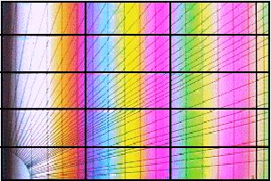
Michael Levy Color Chart
As retardation increases, we see colors in order from blue to red
After one set of colors, the pattern repeats, so we get first-order, second-order, etc.

Slide 17
Subtraction
If the slow direction of the crystal is parallel to the fast direction of the accessory plate, we will see a retardation color equal to the absolute value of the difference of their Δ values

Slide 18
Example of Subtraction - 1
Δ crystal = 300nm (1 ̊ yellow)
Δ accessory = 150nm
|300 – 150 | = 150 (1 ̊ gray)

Slide 19
Example of Subtraction - 2
Δ crystal = 200nm (1 ̊ gray)
Δ accessory = 550nm
|200 – 550| mm = 350nm (1 ̊ yellow)
In this case the subtraction has enhanced the color!
However, if we rotate the stage 90 degrees, so that the fast directions are parallel, the addition process will occur and Δ total = 550 + 200 = 750 (2 ̊ blue - green)

Slide 20
Relation Between Addition and Subtraction
Thus, the addition process always produces a higher color than the subtraction process

Slide 21
Sign of Elongation
Crystals which are elongated are said to be length - slow if the slow direction of the crystal is parallel to the long direction of the crystal
Elongated crystals are length – fast if the fast direction of the crystal is parallel to the long direction of the crystal

Slide 22
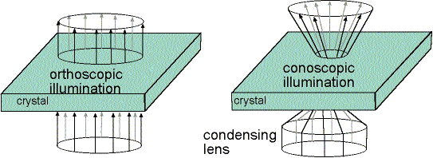
Orthoscopic Observation
Normal use of a microscope is on the orthoscopic mode – the light from the source of illumination is parallel, or as nearly parallel as is possible
Notes:
Diagram: http://www3.uakron.edu/geology/friberg/optical/lecnotes/lec10.html

Slide 23
Conoscopic Observation
An alternate way of using the microscope involves conoscopic illumination
In this case the condensing lens is moved closer to the objective lens, and the illumination occurs along the surface of a cone
Notes:
Diagram: http://www3.uakron.edu/geology/friberg/optical/lecnotes/lec10.html

Slide 24
Objective Lenses
Most petrographic microscopes have at least three interchangeable objective lenses of different magnifications and numerical apertures
Aperture is the opening, or width, of a lens

Slide 25
Angular Aperture
Aperture may be measured in terms of the angular aperture
Numerical Aperture = n sin μ
  Where n is the lowest index of refraction of any medium filling the gap between the objective and the thin section
  Generally this medium will be air (dry case) or an immersion oil

Slide 26
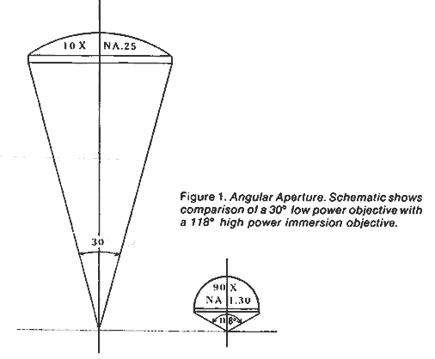
Angular Aperture Diagram
Angular aperture is the size of the cone of light that the lens can accept (30° or 118°)

Slide 27
Maximum N.A. Value
Sin function has a maximum value of 1.0, so N.A. values cannot exceed 1.0 for the dry case
Oil immersion lens are available with magnification of 100x and N.A. values of 1.30

Slide 28
Importance of N.A.
Orthoscopic – determines the resolution (smallest detail can be distinguished) of a microscope
  The higher the N.A, the better the resolution
Conoscopic – determines how much of an interference figure can be seen
  The larger the N.A. value, the more of the figure you can see
  This makes identification easier

Slide 29
Oil Immersion Lens
To use the very high power, larger N.A. lens it is necessary to use immersion oil with n >1.3
The condensing lens must have an N.A. comparable with the objective lens

Slide 30
Properties of Immersion Oils
Oils used are generally organic oils of various types
Oils higher than 1.8 often contain poly-chlorinated biphenyls (P.C.B.’s) and must be used with great caution
P.C.B.'s have been shown to be powerful carcinogens

Slide 31
Depth of Focus
The depth of focus is the range over which objects are in focus
It is an inverse function of N.A.
Low power lens are typically easy to focus
High power lens have a very small (10 microns for a 40-45x objective) depth of focus

Slide 32
Extinction Angle
Non-isotropic substances will go into extinction (show 1 ̊ black interference colors) four times as the stage is rotated in a full circle, or once every ninety degrees
Frequently a grain will have a prominent linear feature which can serve as a reference line
Such linear features are generally either crystal faces or the lines of intersection of cleavage planes with the crystal plate surface
The latter are called cleavage traces

Slide 33
Parallel Extinction
The crystal direction is parallel to the cross-hair at extinction
τ = 0 ̊
Also called straight extinction
Not possible in triclinic crystals

Slide 34
Symmetric Extinction
When a crystal shows two crystal directions (such as cleavage traces) the extinction position may bisect the angle between the crystal directions
τ ≠ 0 ̊
Not possible in triclinic crystals

Slide 35
Inclined Extinction
A single crystal direction will not be parallel to a crosshair at extinction
This can occur only in biaxial crystals
τ ≠ 0 ̊

Slide 36
Undulatory Extinction
Extinction will look like a wave passing across a crystal as the stage is rotated
Often results from deformation of a crystal
Quartz frequently shows undulatory extinction

Slide 37
Natural Color
Many minerals are transparent at the standard thickness of a thin section (30 microns)
Absence of color is not reported
Presence of color should be reported as natural color, when viewed in plane polarized light

Slide 38
Absorption
Minerals displaying natural color may change the intensity of their color as the stage is rotated
Example: A light green color may become darker green
Such a change can be noted as a change in absorption

Slide 39
Pleochroism
Many colored anisotropic minerals, viewed in PP light, will show a change in color as the stage is rotated
The change in color is called diachroism or pleochroism (literally meaning many colors)

Slide 40
Describing Pleochroism
For pleochroic minerals the observed color range should be reported
For example:
  Inky blue to dark brown
  Colorless to light yellowish-green

