Slide 1
Optical Mineralogy
LECTURE -8 , M.Sc. ( Geology) I Semester
NIRANJAN MOHANTY
DEPARTMENT OF GEOLOGY,
MLS UNIVERSITY
UDAIPUR-313001 (RAJASTHAN)
E-mail: niranjan@mlsu.ac.in

Slide 2
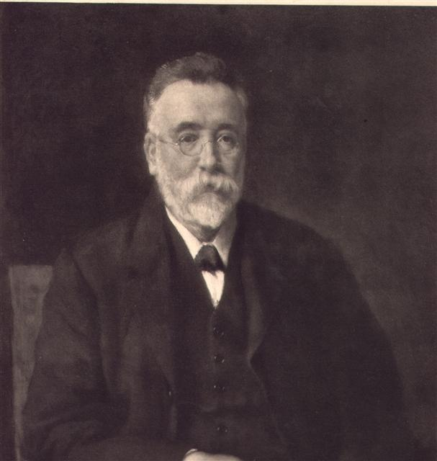
Geometrical Representation
The geometrical representation is called an indicatrix
The idea of a geometrical representation of the variance of the index of refraction goes back to Sir Lazarus Fletcher (1854-1921) in The Optical Indicatrix and the Transmission of Light in Crystals (London, 1892)

Slide 3
Types of Indicatrix
There are three general types of indicatrix
These are
Isotropic
Uniaxial
Biaxial

Slide 4
Constructing the Indicatrix
A vector, equal in magnitude to the index of refraction, can be assumed to originate at some origin
The direction is arbitrary
The heads of an infinite collection of such vectors, all pointing outward from the origin, would describe the geometrical figure called the indicatrix

Slide 5
Isotropic Indicatrix
The index of refraction is equal in all directions
In the case of an isotropic substance, the indicatrix is a perfect sphere
Notes:
Image: http://www.tulane.edu/~sanelson/geol211/isotropic_minerals.htm

Slide 6
Dependence on Wavelength
The magnitude of the vector, representing the index of refraction, will change depending on the wavelength of the light
Thus, the size of the sphere will change, but the isotropic indicatrix remains a sphere

Slide 7
Viewing Isotropic Minerals
An isotropic crystal viewed in crossed nicols always remains in extinction
Notes:
Image: http://www.tulane.edu/~sanelson/images/isotroppolmicroscope.gif

Slide 8
High-Order Axes
Crystals of the hexagonal and tetragonal systems have a unique high order axis (6 or 3–fold, hexagonal; 4-fold, tetragonal).
It was discovered that rhombohedral calcite crystals give rise to not one but two refracted rays when light is incident on the surface

Slide 9
Double Refraction
Notes:
Image: http://www.brocku.ca/earthsciences/people/gfinn/optical/calcite3.jpg

Slide 10
Explanation of Double Refraction
Can be explained using the indicatrix theory if it is assumed that the index of refraction varies in different directions

Slide 11
Uniaxial Crystals
For a uniaxial crystal it is found that the indicatrix is an ellipsoid, rather than a sphere
Light propagating perpendicular to the c-axis direction (light vibrates parallel to the c-axis) will experience an index of refraction called ε (epsilon)
Light which vibrates perpendicular to the c-axis will experience, in any plane, an index of refraction called ω (omega)

Slide 12
Uniaxial Indicatrix

Slide 13
Atomic Environment

Slide 14
Uniaxial Positive
Ellipsoid is prolate, like a football
EGO is POSITIVE (Epsilon Greater than Omega)

Slide 15
Uniaxial Negative
Ellipsoid is oblate, like a hamburger

Slide 16
Optic Axis
Optic axis of a uniaxial crystal is the high-order symmetry axis
Notes:
Image: http://edafologia.ugr.es/optmine/intro/ejeoptw.htm

Slide 17
Circular and Principle Sections
Notes:
Image: http://www.brocku.ca/earthsciences/people/gfinn/optical/unindctx.htm

Slide 18
Random Sections
The principle axis will be ω and ε’, where ε’ is intermediate to ω and ε in value
Notes:
Image: http://www.brocku.ca/earthsciences/people/gfinn/optical/unindctx.htm

Slide 19
Calculation of ε’
θ is the angle between the plane which cuts the ellipsoid and the c-axis

Slide 20
Wave Normal
Notes:
Image: http://ruby.colorado.edu/~smyth/G3010/c6/wavepath.jpg

Slide 21
Wave Front
Green lines show the wave front
Notes:
Image: http://www.uwgb.edu/dutchs/petrolgy/IndicatrixU.HTM

Slide 22
Quartz Uniaxial Figures
Diagram shows the variation of the indices of refraction with viewing direction in quartz

Slide 23
Lack of Symmetry Restrictions
Crystals which belong to the orthorhombic, monoclinic, or triclinic systems possess no axis higher than 2-fold
There is nothing in the crystal symmetry which requires the index of refraction in the a-b plane to have a single value
A₂ fold takes a into –a, b into –b
Whereas A₄ fold takes a into b, etc.

Slide 24
Biaxial Crystals
Crystals which belong to the orthorhombic, monoclinic and triclinic systems are known as biaxial crystals
The index of refraction is triaxial ellipsoid

Slide 25
Triaxial Ellipsoid

Slide 26
Optical Axes in Biaxial Crystals
The direction of the fastest ray is called X, and the slowest is called Z
These directions are perpendicular
A third direction, perpendicular to XZ plane, is called Y

Slide 27
Biaxial Indices of Refraction
α is the lowest (X - direction)
β is intermediate (Y - direction),
γ is highest (Z - direction)
These correspond to crystal directions but not in a particular order

Slide 28
Birefringence
Numerical difference γ - α is called the birefringence
This value will be experienced by a ray traveling perpendicular to the X-Z plane
Note that β is not the average of α & γ but merely a value in between these two

Slide 29
Optic Axial Plane
This plane, often abbreviated OAP, shows the maximum birefringence

Slide 30
Biaxial Principal Sections

Slide 31
Indices of Principle Axes

Slide 32
Location of n_{β}

Slide 33
Circular Sections

Slide 34
Biaxial Positive

Slide 35
Biaxial Negative

Slide 36
Extreme Cases

Slide 37
V_{z} and α, β, and γ

Slide 38
2V and 2E

