Slide 1
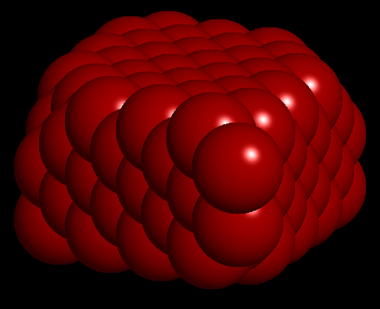
X-ray Crystallography
LECTURE -8 , M.Sc. ( Geology) I Semester
NIRANJAN MOHANTY
DEPARTMENT OF GEOLOGY,
MLS UNIVERSITY
UDAIPUR-313001 (RAJASTHAN)
E-mail: niranjan@mlsu.ac.in

Slide 2
Discovery of X-rays
Wilhelm Conrad Roentgen discovered x-radiation in 1895
In 1912, Friedrich, Knipping, and von Laue demonstrated diffraction of x-radiation passing through a crystal
The wavelength of x-radiation ranges from 10⁻⁶ to 10⁻¹ nm

Slide 3
Einstein Equation
E = hυ = hc/λ
where
E = energy
h = Planck's constant
υ = frequency
c = speed of light
λ = wavelength.

Slide 4
Conversion to Kinetic Energy
If all the kinetic energy of an electron is converted to X-ray quanta, we can rewrite the equation as:
eV = hc/λ
Replacing constants gives:
λ(nm) = 1.24/kV
Where kV = kilovolts

Slide 5
White Radiation
Effect of excitation potential on minimum wavelength

Slide 6
X-ray Tube
X-ray tube schematic diagram
Notes:
Fig. 135, p141, Battay

Slide 7
Electron Shells
Electron infall from outer to inner shells

Slide 8
Copper X-ray Spectrum

Slide 9
Copper Energy Levels
Energy-level diagram for electron transitions in Cu

Slide 10
Copper X-ray Spectrum

Slide 11
Absorption Edge
Absorption edge of Ni in relation to the emission spectrum of Cu

Slide 12
Scattering
Scattering of X-rays by a row of equally spaced, identical atoms

Slide 13
Reflection
Condition for reflection

Slide 14
Path Difference
Path difference = 2d sin θ
Notes:
Fig. 139b, p143, Battay

Slide 15
Bragg Equation
nλ = 2d sin θ
where
n is an integer
d is the distance between successive parallel planes (the "interplanar" spacing)
θ = glancing angle of incidence
This is the condition for successful reinforcement of waves reflected off different layers

Slide 16
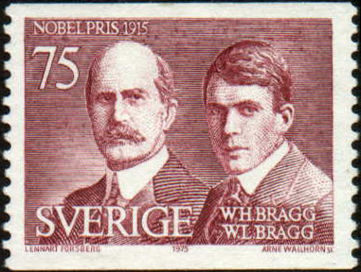
W.H. and W.L. Bragg
Derived by English physicists Sir William Henry Bragg and his son Sir William Lawrence Bragg
Shared Nobel Prize in Physics, 1915

Slide 17
Diffracted X-ray Cones
Diffraction cones from a row of atoms
Notes:
Fig. 7.36, p312, Klein

Slide 18
Cone Intersection
Diffraction cones from three noncoplanar rows of scattering atoms, intersecting in a common line
Notes:
Fig. 7.37, p312, Klein

Slide 19
Figure 12
Arrangement for a powder photograph
Notes:
Fig. 141, p145, Battay

Slide 20
Powder Pattern
Diagram showing the formation of lines from a powder

Slide 21
Laue Method
a) Obtaining a Laue photograph with a stationary crystal
b) Laue photograph of vesuvianite, taken along the A₄ axis. Axial directions a₁ and a₂ were inked onto the photograph after development.
Notes:
Fig. 7.39, p313, Klein

Slide 22
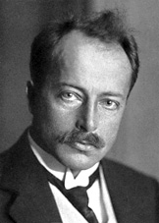
Laue Film
Laue photograph, mineral unknown
Named for its developer German physicist Max von Laue, who won the Nobel Prize in Physics in 1914 for the discovery of diffraction of X-rays by crystals

Slide 23
Weissenberg Rotation Method
Austrian physicist Karl Weissenberg developed a rotating-crystal method which also translated the film, allowing unambigious index of each refraction

Slide 24
Precession Camera
Buerger precession camera

Slide 25
Martin Julian Buerger
American Crystallographer who developed the precession camera
Crystal and the film move
Film shows an undistorted replica of the corresponding reciprocal lattice plane
Each diffraction may be indexed

Slide 26
Precession Film of Wavellite
A precession photograph is quickly indexed since it shows very clearly the symmetry content of the reciprocal lattice
Indeed the distance between the spots on the film is simply the reciprocal lattice distance between two nodes, scaled by the X-ray wavelength and the camera radius

Slide 27
Four Circle Diffractometer
A crystal is randomly set on the goniometric mount
Computer will measure and calculate the exact value that each of four angles has in order to observe the reflections of a specific set of planes (hkl)

Slide 28
Mounting Methods for Powders
Placed in fine capillary tube of 0.2mm bore
Coated on a fine glass fiber - the fiber is dipped in a liquid such as alcohol and then rolled in the powder
Mixed with gum arabic and rolled between slips of glass into a fine spindle or a tiny ball, no more then 0.3 mm in diameter
Sprinkled on a piece of tape mounted over a hole drilled in a circular piece of metal

Slide 29
Powder Method Advantages
Fast - an analysis is completed in two hours or less
Requires very small sample amounts, which is especially important in cases where the material is rare
Sample preparation times are usually small
The cost per analysis is low, although there is an initial investment in the X-ray equipment and associated computer

