Slide 1
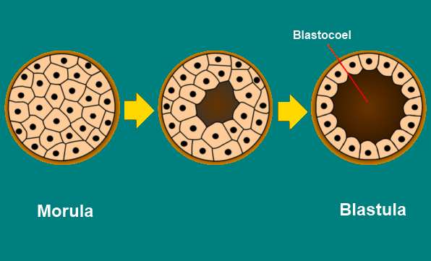
Blastulation

Slide 2
Blastulation in isolecithal egg

Slide 3
Blastulation in mesolecithal egg

Slide 4
Blastulation in polylecithal egg

Slide 5
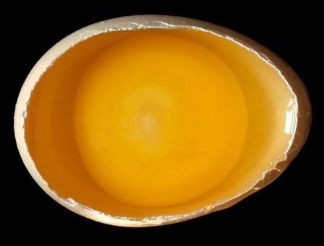

Slide 7
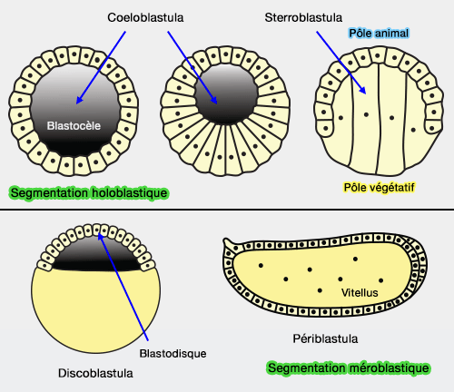
Types of Blastula
Coeloblastula
Steroblastula
Peribalstula
Discoblastula
Amphiblastula
Blastosyst

Slide 8
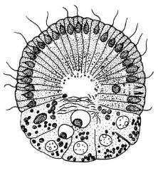
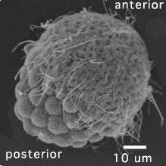
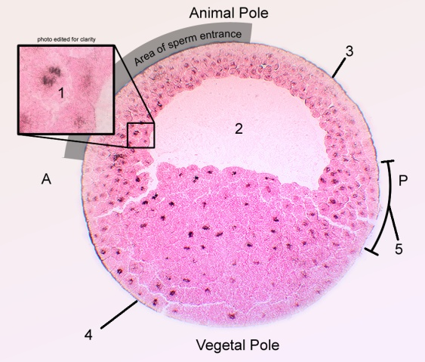
Amphiblastula

Slide 9
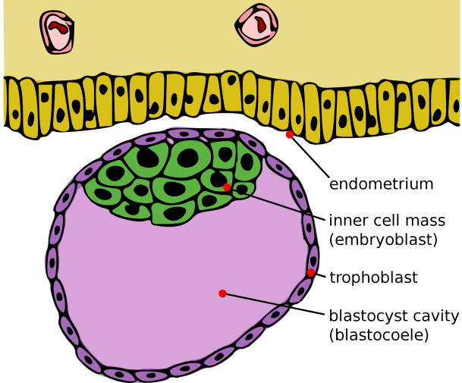
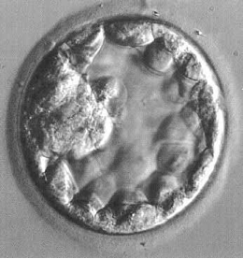
Blastosyst

