Slide 1
Cleavage

Slide 2
Definition: Division in zygote in called cleavage.
Functions of cleavage:
Produce many cells
To lay the foundation of differences
Characteristics of cleavage
All division are mitotic
Early division occurs synchronously
Number of cells are increasing but size is progressively decreasing.
Somatic Nuclear to Cytoplasmic Ratio change
1:500 -> ->-> 1:6
Gas exchange become more efficient because surface/volume ratio is decreasing.
During cleavge, blastomere do not move as start in gastrula
No growth occurs, only chemical conversion of reserve food material (yolk, glycogen and ribonucleotides)

Slide 3
DNA synthesis
M-phase
Peculiarity of cleavage
A blastomere does not increase in size
Interphase remain short
Karyokinesis follows cytokinesis

Slide 4
Plane of cleavage
Meridional
Vertical
equatorial
Latitudinal

Slide 5
Pattern of cleavage
On the basis of arrangement of blastomere
Radial cleavage (when cleavege plane cut straight through the egg)
2. Biradial: first two cleavage meridional and third vertical

Slide 6
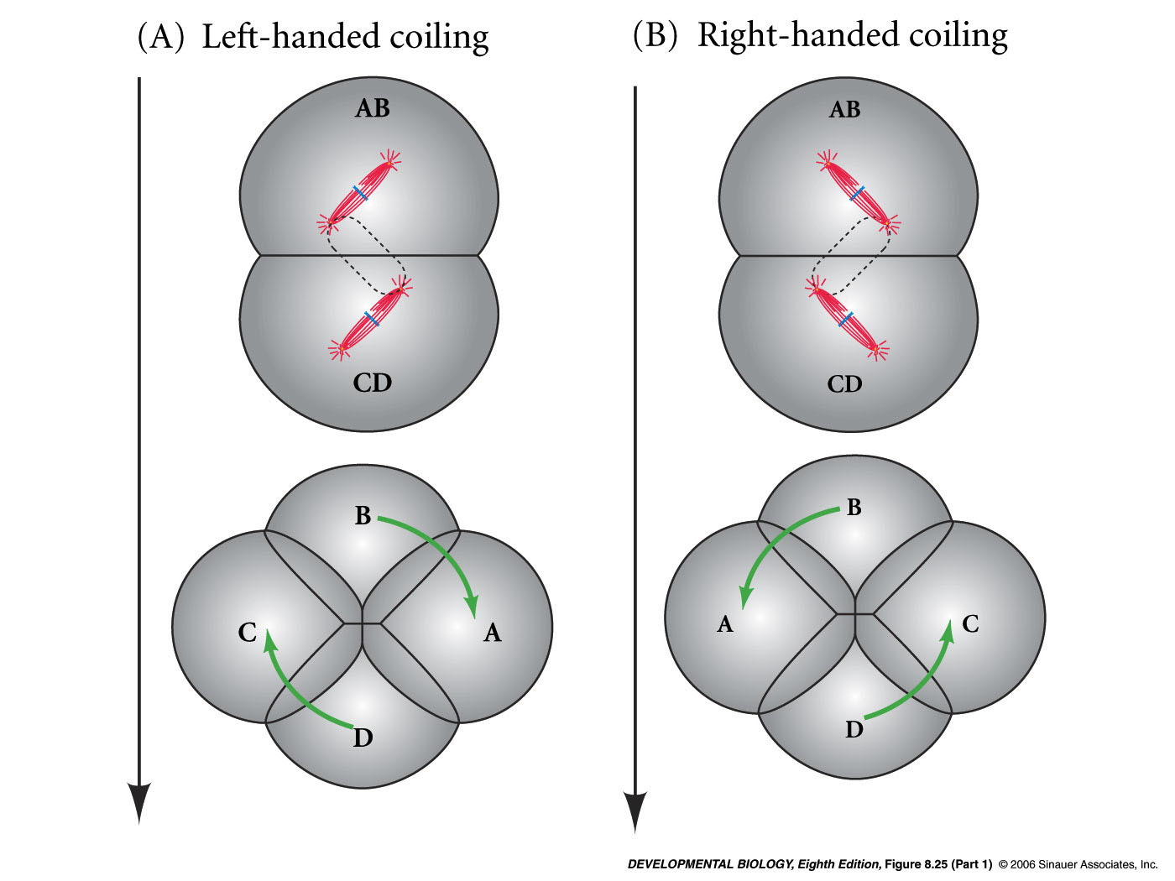
3. Spiral cleavage

Slide 8
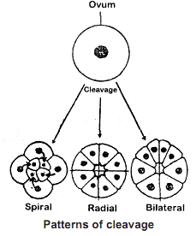
4. Bilateral cleavage
Form micromeres and macromeres

Slide 9
Types according to fate of blastomere
Determinate
Indeterminate
Influence of yolk on cleavage
Holoblastic ceavage
Equal holoblastic
Unequal holoblastic
Discoidal (meroblastic)
Superficial cleavage

Slide 13
Laws of cleavage
Sach’s laws (1877)
Cells tend to divide into equal daughter cells
Each new division plane tend to intersect the preceding plane at right angles.
Hertwig’s law (1881)
Nucleus and spindle mostly located in active cytoplasmic part.
Axis of spindle occupies the longest axis of protoplasmic mass
Balfour’s law (1885)
Speed and rate of cleavage found inversely proportional to the amount of yolk.
Pfluger’s law
The mitotic spindle always elongates in the direction of least resistance

Slide 14
Significance of cleavage
Division of zygote
Start preparation of development
Start of prepare presumative area of development
Formation of blastomeres
Formation of blastocoel

Slide 15
Blastulation
After cleavage process, hollow, spherical and uniephithelial thick embryonic stage called blastula.
Effect of Yolk on Blastulation:

Slide 19
Types of Blastula
Coeloblastula
Stereoblastula
Periblastula/superficial blastula
Discoblastula
Amphiblastula
Blastocyst

Slide 21
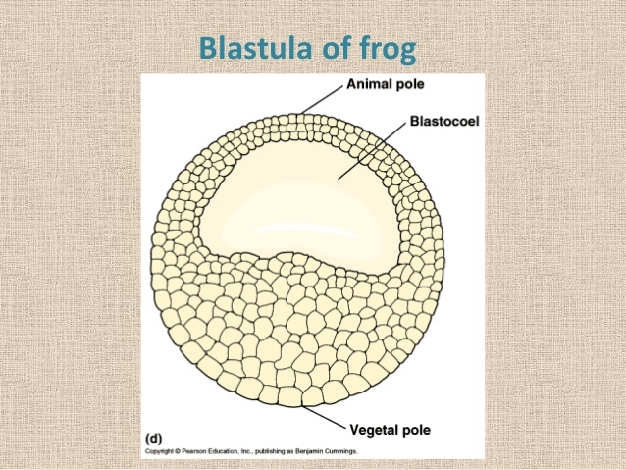
Blastula of amphioxus

Slide 22
Blastocyst

