Slide 1
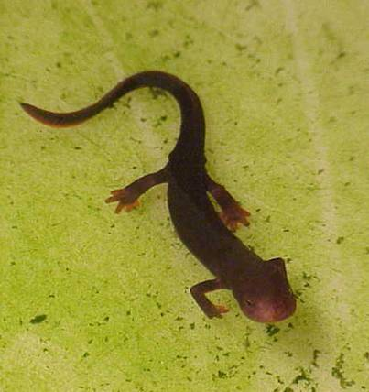
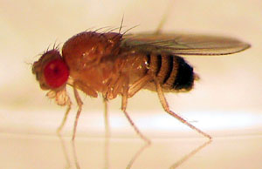
Embryonic induction

Slide 2
Inductor
Responsive tissue
Morphogen
(Chemical substances)

Slide 3
Type of induction
Endogenous
Exogenous
  Homotypic
  heterotypic

Slide 4
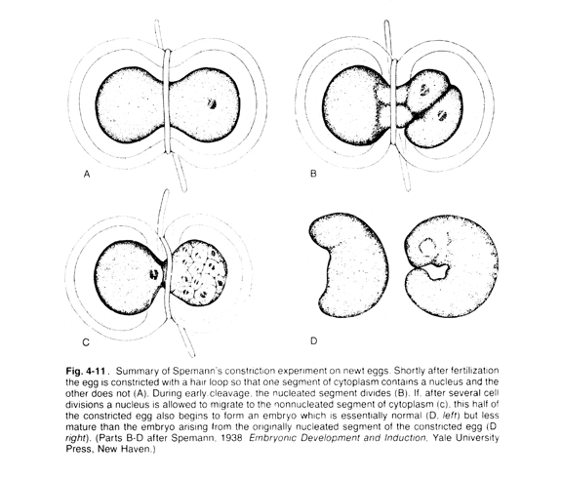
Spemann experiment

Slide 5
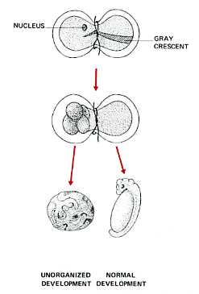

Slide 6
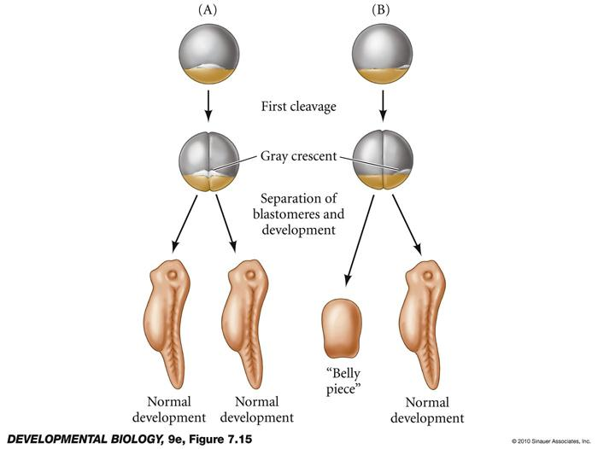

Slide 7
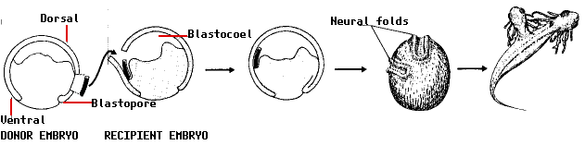
Neural induction

Slide 8
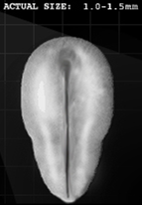
Neural tube formation

Slide 9
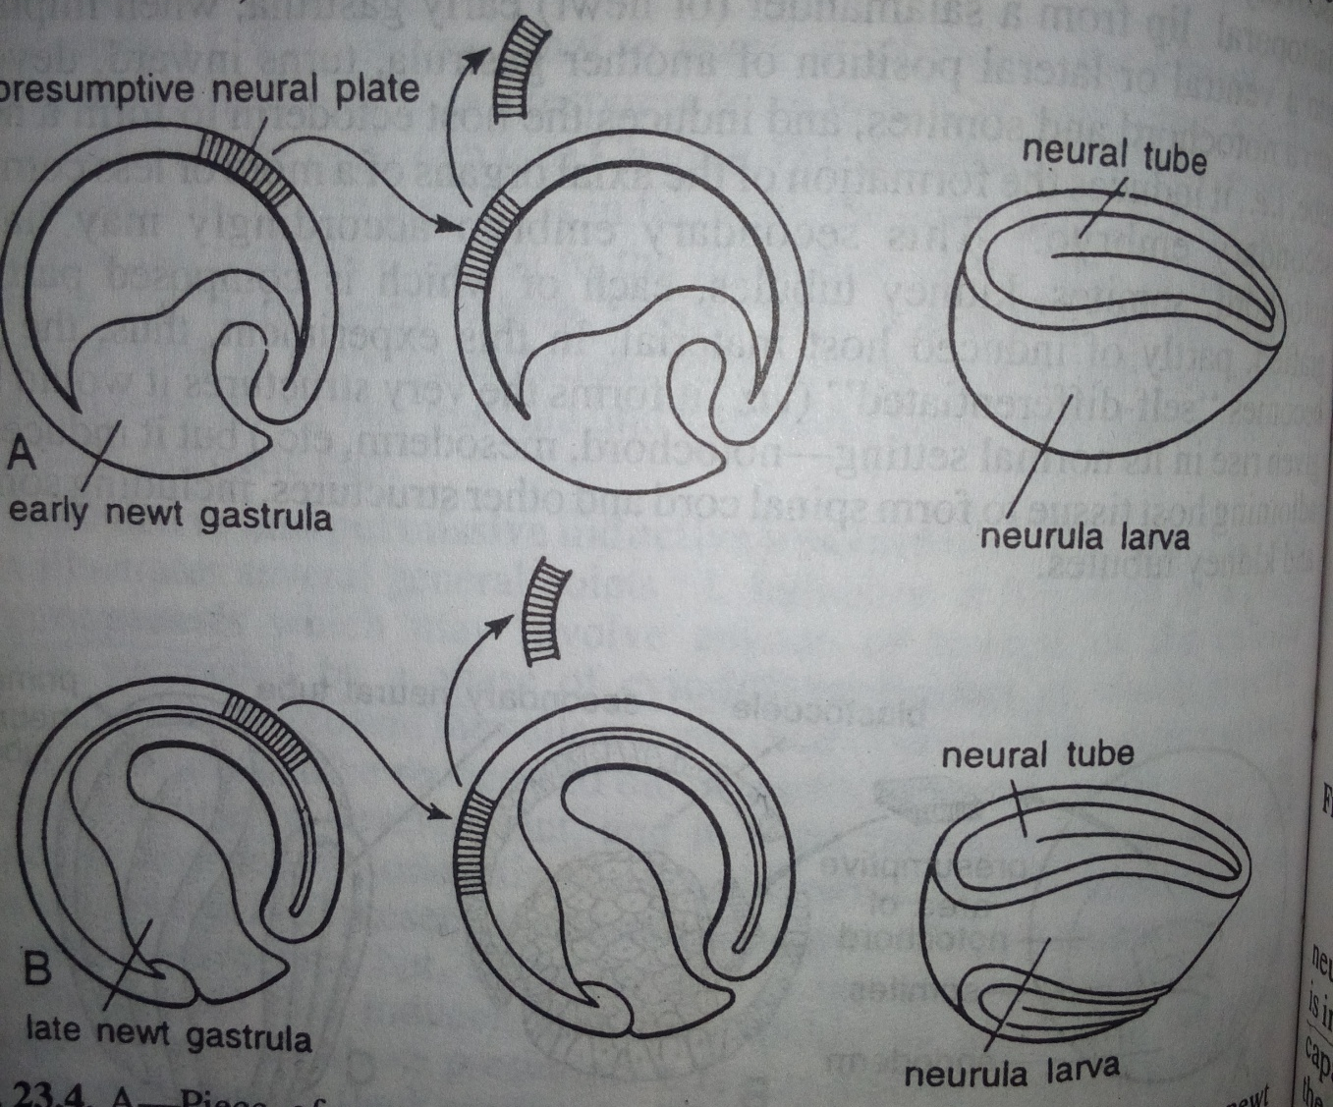
Timing of neural induction

Slide 10
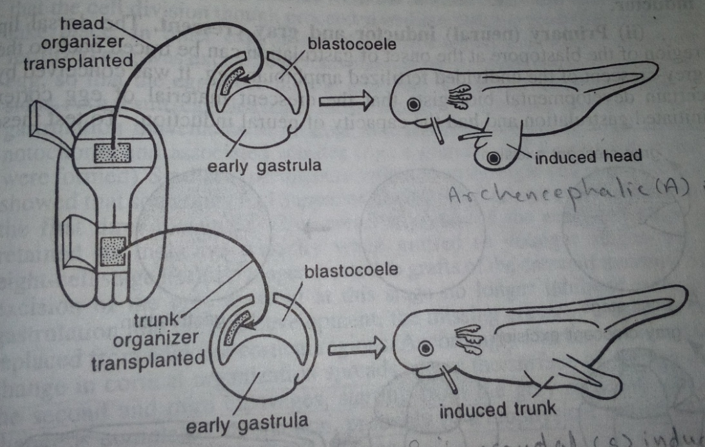
Regional differentiation of neural inductor
Regional differentiation of neural tissue
Head inductor
  Archencephalic (fore-brain, eye, nasal pit)
  Deuterencephalic (hind-brain, ear vesicle)
trunk inductor (Spinocaudal inductor)

Slide 11
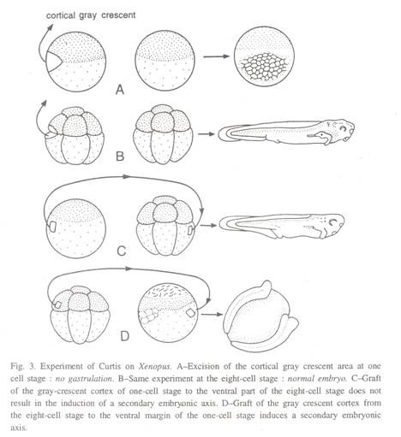

Slide 12
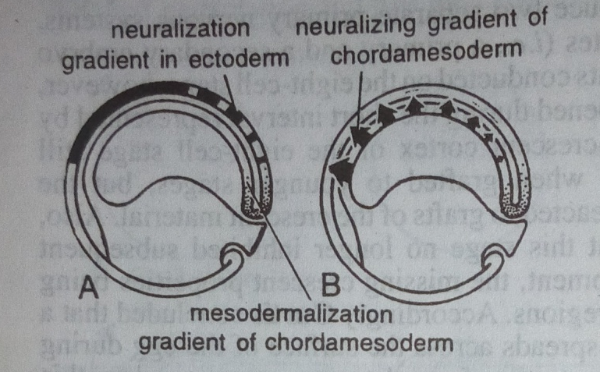
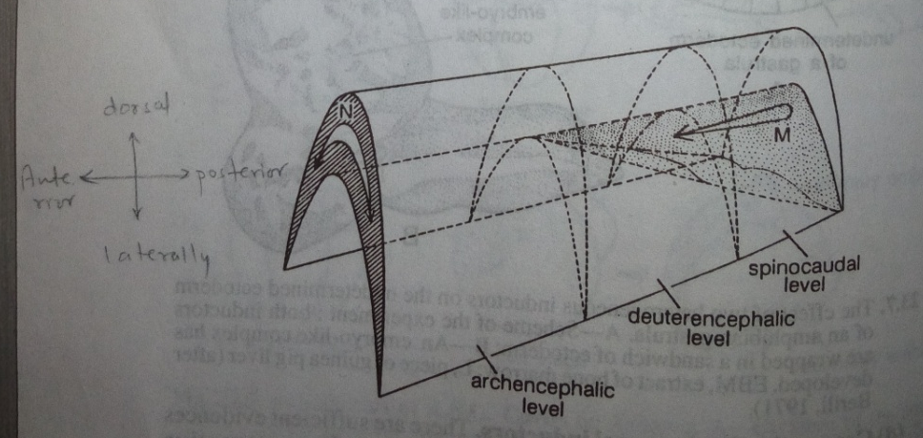
Different theories
1. Surface interaction theory
M – Mesodermal morphogen
N – Neuralizing morphogen

Slide 13
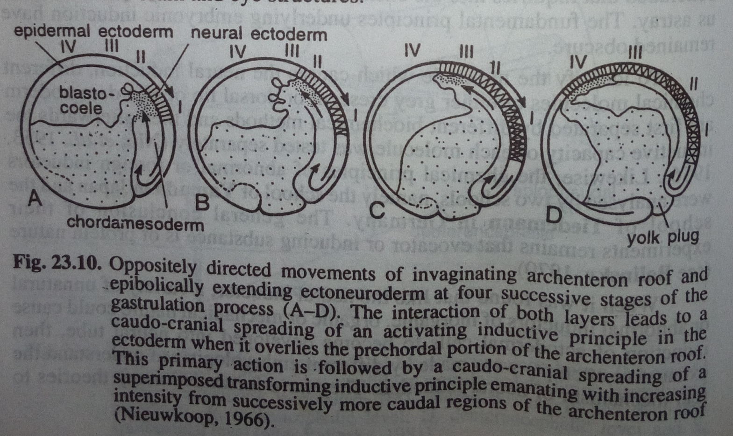
One factor hypothesis

Slide 14
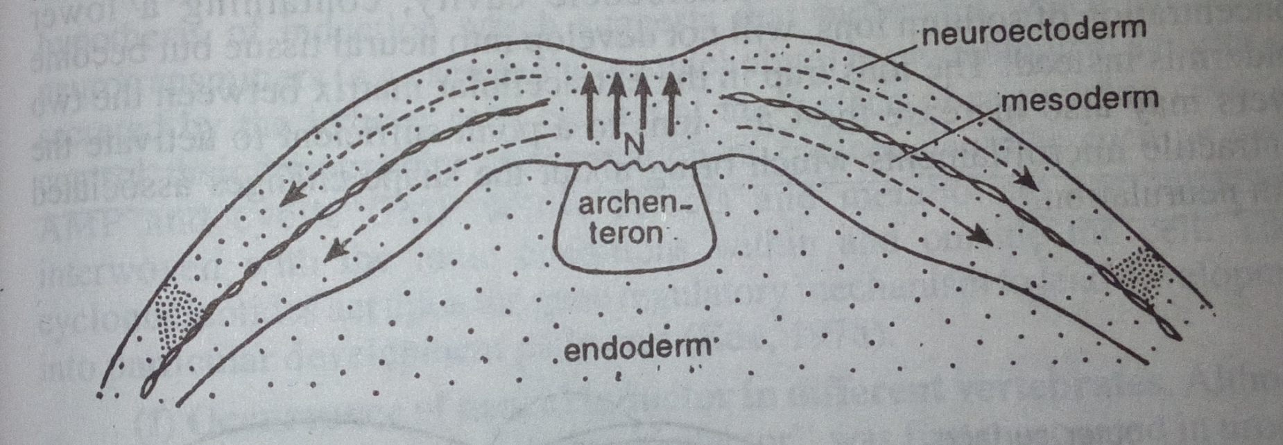
Sexen and Toivonen-1962
Medio-lateral spreading of an inductive action

Slide 15
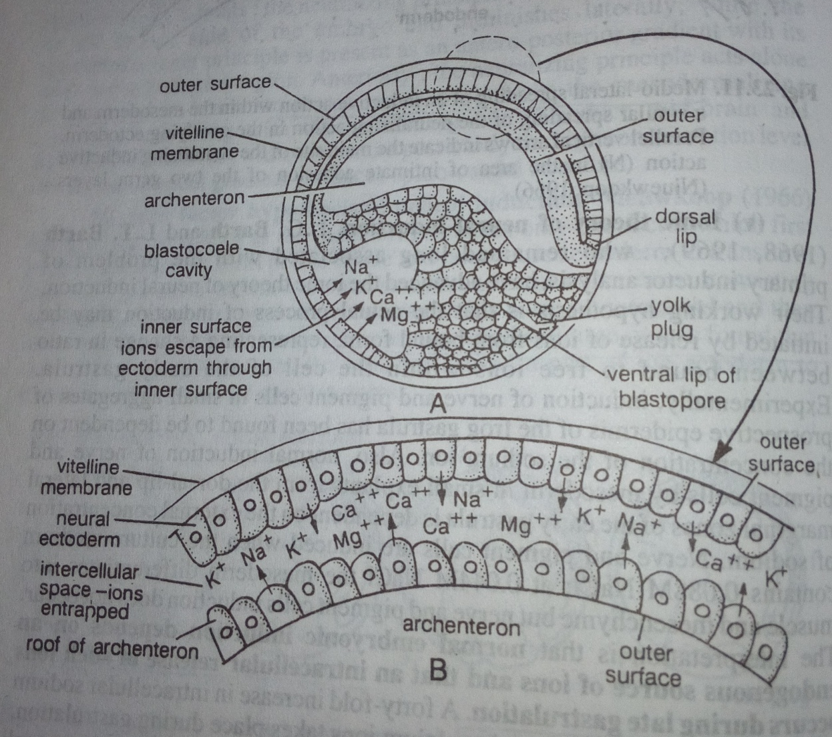
Ionic theory of neural induction

Slide 16
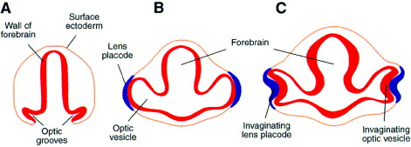
Eye lens induction

Slide 17
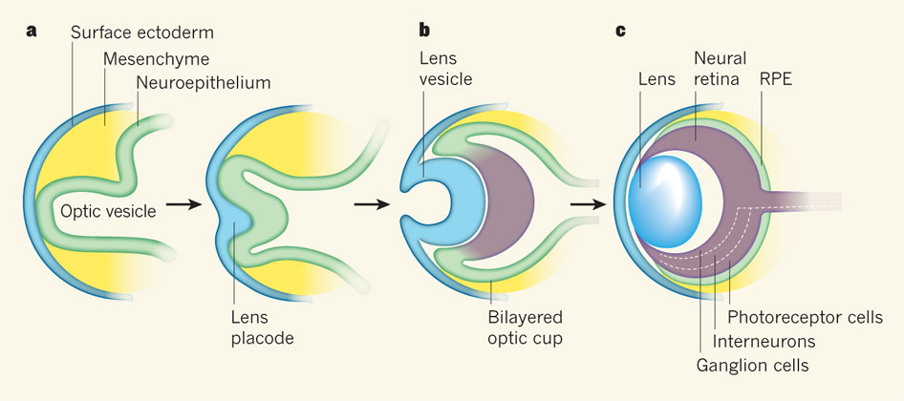
Chordo-
mesoderm
Optic area
Optic vesicle
Optic
cup
lens
Cornea
(Primary)
(Secondary)
(Tertiary)

