Slide 1
Fate maps

Slide 2
Construction of blastula map based on the trajectories of tagged or marked cells. They showed the fate of every region of blastula under normal developmental conditions are referred as “fate map”.
The area of the future germ layers during the blastula stage is referred as “presumptive”.

Slide 3
Methods of preparation of fate maps
  Construction of fate map by natural marking
  Construction of fate map by artificial marking
    Vital stain marking
    Carbon particle marking
    Radioactive labeling method
  Histochemical and cytological methods
  Genetic method

Slide 4
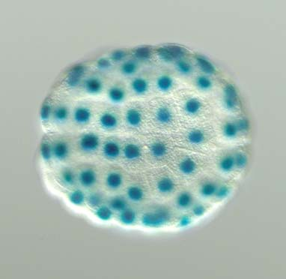
  Construction of fate map by natural marking
The cytoplasm of fertilized eggs of some animals such as ascidian has natural color differences in its various region.
On the basis of Pigment differentiation

Slide 5
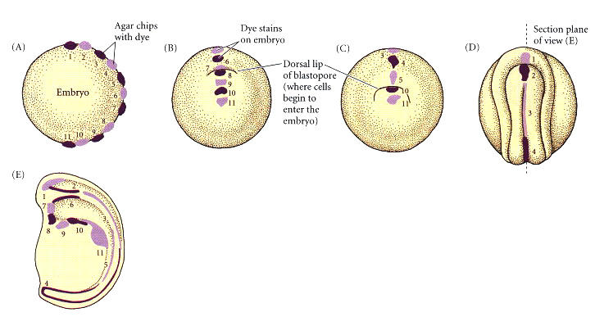
Construction of fate map by artificial marking
    Vital stain marking

Slide 6
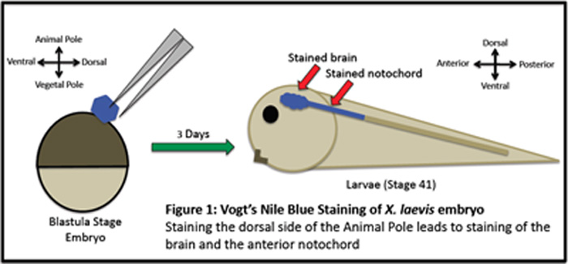

Slide 7
    Carbon particle marking
method developed by Spratt in 1946.
Tiny particles of carbon applied to the surface of the embryo.
Instead of carbon, other type of adhering particles such as chalk can also used.
Radioactive labeling method
This is doing with the help of autoradiography.

Slide 8
Histochemical and cytological methods
  Variety of natural markers (specific molecules of cells) used in the fate map construction with success such as:
    Melanin granules (chick retinal pigment cells)
    Glycogen (can stained with acid-schiff reagent or PAS)
    Alkaline phosphatase
  Such markers reflect metabolic activity of the cell which might change during the observation.
Genetic method:
  This method used in genetic mosaics (gynandromorphs) by Hotta and Benzer (1972) to construct map in Drosophila melanogaster.

Slide 9
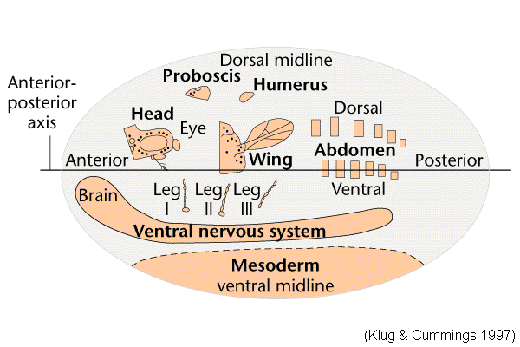
Fate map of Drosophila

Slide 10
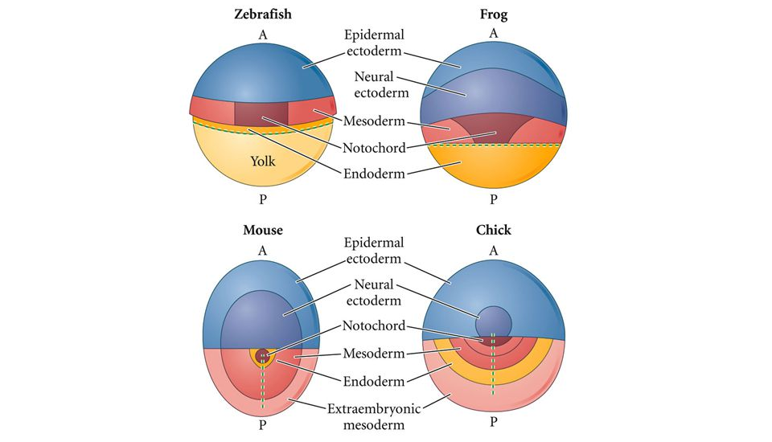

Slide 11
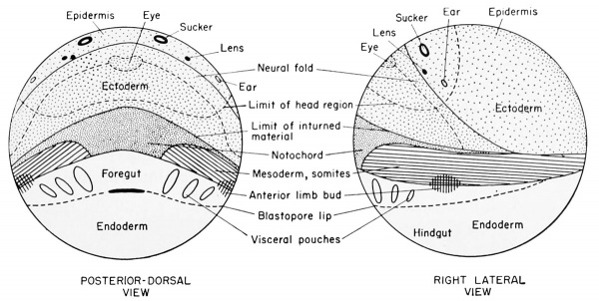
Frog

Slide 12
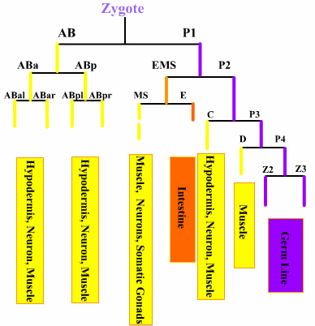
Uses of fate maps
Following the mechanism of gastrulation.
Know the position of local tissues.
Cell lineage study (cytogeny)

Slide 13
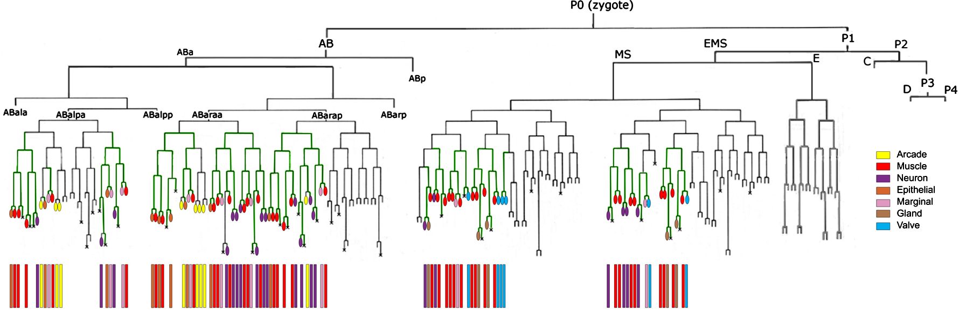

Slide 14


