Slide 1
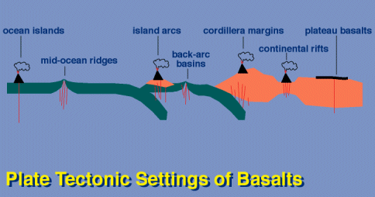
Basalt
M.Sc. ( Geology) III Semester
NIRANJAN MOHANTY
DEPARTMENT OF GEOLOGY,
MLS UNIVERSITY
UDAIPUR-313001 (RAJASTHAN)
E-mail: niranjan@mlsu.ac.in

Slide 2
What is a Basalt?
Definition:
A basaltic rock is a volcanic rock characterized by the presence of clinopyroxene and plagioclase as essential minerals. Olivine, orthopyroxene and silica-rich glass may be present as accessory minerals along with iron oxides (magnetite & ilmenite).

Slide 3
Texture of Basalt
Three types of textures are common:
Ophitic Texture: lath shaped plagioclases included in larger pyroxenes.
Sub-ophitic Texture: Here pyroxenes are smaller.
Porphyritic texture: phenocrysts (coarser) in a fine groundmass e.g. olivine basalt

Slide 4
Global abundance of Basalts
Basalts are found in
Mid Oceanic Ridges (MORB)
Ocean Islands (OIB)
Orogenic continental margins & island arcs (associated with subduction zones) (Bimodal volcanics along with andesites)
4. Continental plates (not associated with subduction) (Plume or rifting related)
Most abundant igneous rock types & hence most well studied experimentally & in field
Most of the models of mantle melting is based mostly on the study of basalts.

Slide 6
Classification of Basalts
There are a number of compositional variations in basalts resulting in their wide variety.
Yoder & Tilley (1962) recognized the importance of representing principal magma types in terms of simple basalt system and introduced concept of basalt tetrahedron.
According to them, phases in the quaternary system - diopside (Di)-forsterite (Fo)-nepheline (Ne)-quartz (qz) contains the principal components of all the major and common minerals in basalt group.

Slide 7
Basalt Tetrahedron
The tetrahedron is dissected by two planes viz.,
Plane 1: Di-Ab-En plane or CPx- Pl-Opx (Plane of silica saturation)
Plane 2: Di-Ab-Fo plane or Cpx-Pl-Ol- plane or (Plane of critical silica undersaturation)

Slide 8
Five compositional types of Basalts
The two planes divide basalts into five unique groups on basis of normative components:
Quartz Tholeiite (oversaturated): Characterized by normative quartz & hypersthene
Hypersthene tholeiite (saturated): characterized by normative hypersthene but no quartz.
Olivine-tholeiite (undersaturated): Normative olivine & hypersthene
Olivine –basalt (undersaturated): Normative olivine but no hypersthene.
Alkali olivine basalt or alkaline basalts (strongly undersaturated): Normative olivine & nepheline
Most basalts, excepting those contaning normative acmite (peralkaline basalts), are represented in basalt tetrahedron.

Slide 9
Basalt Tetrahedron – dissection!

