Slide 1
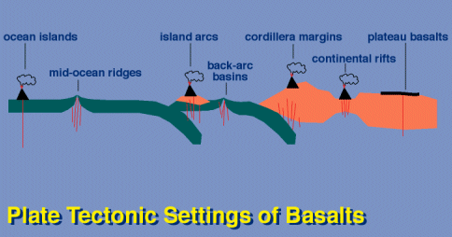
Basalt
M.Sc. ( Geology) III Semester
NIRANJAN MOHANTY
DEPARTMENT OF GEOLOGY,
MLS UNIVERSITY
UDAIPUR-313001 (RAJASTHAN)
E-mail: niranjan@mlsu.ac.in

Slide 2
Alkali vs Tholeiitic basalts
Tholeiites
Alkaline basalts
Olivine
Present as phenocrystal phase only
Both as phenocryst & as groundmass
K-Feldspar
Absent
Minor phase in groundmass
Plagioclase
Abundant calcic variety (labradorite)
Abundant (labradorite to andesine)
Pyroxene
Augite/subcalcic augite as phenocryst.
Titanifeorus augite
Opaque oxide minerals
titanomagnetite
Titanomagnetite with ilmenite
Nodules
Peridotite nodules absent
Occasionally present
Vesicles
Silica mineral
Analcite or zeolite fillings

Slide 3
BASALT MAGMATISM IN RELATION TO PLATE TECTONIC ENVIRONMENTS
Basalts are UNIVERSAL and are found in almost every tectonic environment.
Based on major element & trace element discriminations, basalt geochemistry can be used to RECONSTRUCT palaeotectonic settings.
Such re-constructions strictly apply to Phanerozoic settings only even though the operation of plate tectonics in Precambrian times is now better understood.
Three major magma series are recognized & have distinct distribution when considered in terms of plate tectonics:
Tholeiites
Calc-alkaline
Alkaline
Notes:
Ophoiolites tell us that plate-tectonics occur in archean age............

Slide 4
Some salient points on basalt tectonic settings
1. Tholeiites of Divergent margins are very poor in K compared to those in convergent margins or in continental plate settings.
2. MORB’s are ‘purest basalts’ and are least modified & have restricted range of composition (e.g. SiO2 = 50.19-50.93 wt%), MgO (7.10-7.69 wt%) & uniformly low K2O content (0.14-0.17 wt5).
3. MORBs are classified into three types:
N-MORB (depleted normal MORB)
P-MORB (enriched plume MORB)
T-MORB (transitional MORB)
First two members are principal end members and the third one is intermediate. There is compositional gradation between them.
Notes:
Due to in convergent margin crustal rock subducted which is enriched in k.......so tholeits un diverging margin is very poor in K.
MORB is from depleted mantle i.e-upper mantle

Slide 5
The Mid-Ocean Ridge System

Slide 6
N-MORB vs E-MORB
Incompatible-rich and incompatible-poor mantle source regions for MORB magmas
N-MORB (normal MORB) taps the depleted upper mantle source
Mg# > 65: K₂O < 0.10 TiO₂ < 1.0
E-MORB (enriched MORB, also called P-MORB for plume) taps the (deeper) fertile mantle
Mg# > 65: K₂O > 0.10 TiO₂ > 1.0

Slide 7
REE diagram for N-MORB & E-MORB

Slide 8
N-MORB vs E-MORB
E-MORBs (squares) enriched over N-MORBs (red triangles): regardless of Mg#
Lack of distinct break suggests three MORB types
E-MORBs La/Sm > 1.8
N-MORBs La/Sm < 0.7
T-MORBs (transitional) intermediate values

Slide 9
Petrogenesis of Basalt magma

Slide 10
Possible Parents of Basalt magma
1. Melting of Eclogite : same range of composition as basalt; high pressure metamorphic equivalent of basalts.
2. Peridotite melting: nodules brought up by basalt are peridotitic in composition.
3. Mantle plumes as sources of basalt.

Slide 11
Lherzolite as a possible source for Basalt genesis
15
Tholeiitic basalt
Types of peridotites:
Lherzolite is probably fertile unaltered mantle
Dunite and harzburgite are refractory residuum after basalt has been extracted by partial melting
10
Partial Melting
Wt.% Al₂O₃
5
Lherzolite
Harzburgite
Residuum
0
Dunite
0.0
0.2
0.4
0.6
0.8
Wt.% TiO₂

Slide 12
Lherzolite: A type of peridotite with Olivine > Opx + Cpx
What is a Lherzolite?
Olivine
Dunite
90
Peridotites
Wehrlite
Harzburgite
Lherzolite
40
Orthopyroxenite
Olivine Websterite
Pyroxenites
10
10
Websterite
Orthopyroxene
Clinopyroxenite
Clinopyroxene
After IUGS

Slide 13
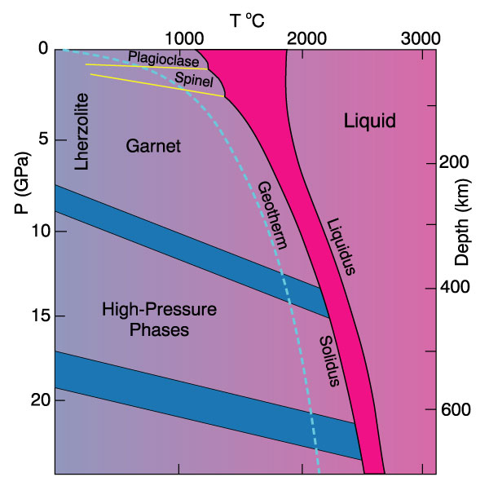
Phase diagram for aluminous 4-phase lherzolite
Al-phase =
Plagioclase
shallow (< 50 km)
Spinel
50-80 km
Garnet
80-400 km
Si → VI coord.
> 400 km
Phase diagram of aluminous lherzolite with melting interval (gray), sub-solidus reactions, and geothermal gradient.

Slide 14
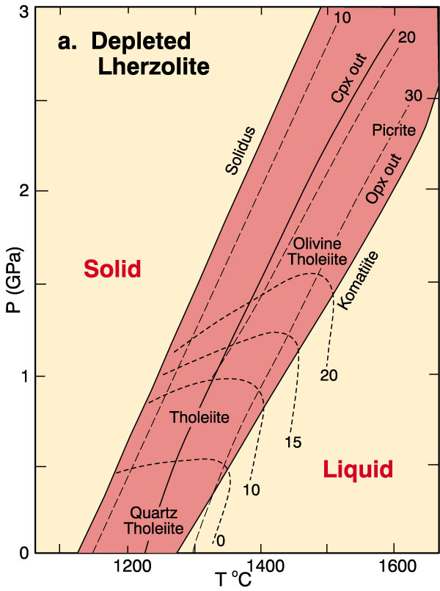
Experiments on melting enriched vs. depleted mantle samples:
1. Depleted Mantle
Tholeiite easily created
by 10-30% partial melting
Tholeiites are more silica saturated at lower pressures
Grades toward alkalic
at higher Pressures
Results of partial melting experiments on depleted lherzolites. Dashed lines are contours representing percent partial melt produced. Strongly curved lines are contours of the normative olivine content of the melt. “Opx out” and “Cpx out” represent the degree of melting at which these phases are completely consumed in the melt.

Slide 15
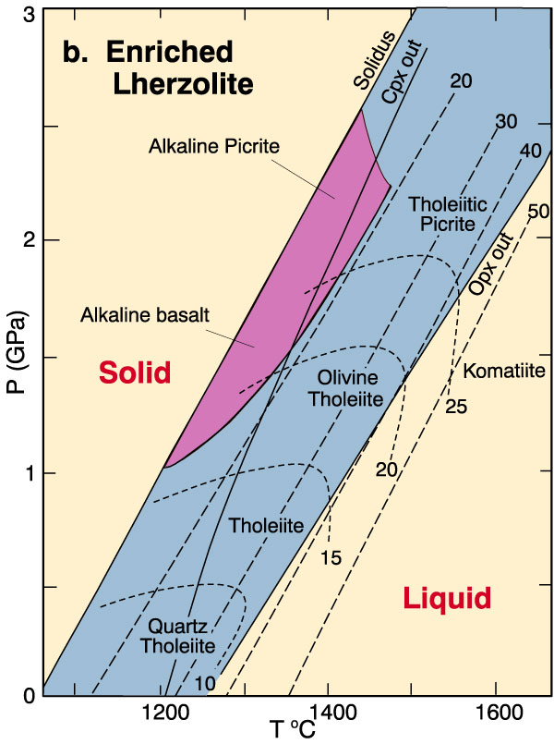
Experiments on melting enriched vs. depleted mantle samples:
2. Enriched Mantle
Tholeiites extend to
higher Pressures than for DM
Alkali basalts are generated by 5-20% partial melting of fertile lherzolite
Conclusion: Increased alkalinity correlates with lower percentages of partial melting & greater depths
Generation of alkaline basalts from a depleted mantle is difficult
Results of partial melting experiments on fertile lherzolites. Dashed lines are contours representing percent partial melt produced. Strongly curved lines are contours of the normative olivine content of the melt. “Opx out” and “Cpx out” represent the degree of melting at which these phases are completely consumed in the melt. The shaded area represents the conditions required for the generation of alkaline basaltic magmas.

Slide 16
Spilites
These are basic lavas in which plagioclase is albite instead of normal labradorite and in which chlorite partially or completely takes place of normal ferromagnesian minerals.
They typically occur as submarine lava flows, often as pillow lavas.
The pillows are typically zoned – with margin and core differing in composition.
Margins are glassy (devitrified).
Vesicles are abundant & filled with chlorite & calcite.
No dykes of sills of spilites are known .
They are restricted in their distribution & are mostly found in pre-orogenic sediments of orogenic belts. Recent spilites are found in Mid-Atlantic Ridge & in Indian ocean.

