Slide 1
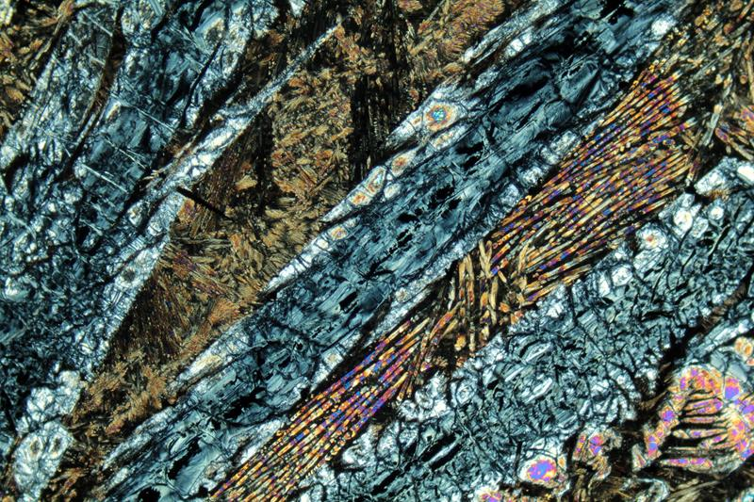
KomatiiteS
Lecture M.Sc Geology (III Semester)-2018
Niranjan Mohanty
Assistant Professor
Department of Geology
MLSU, Udaipur-313001
nmohantyngribhu@gmail.com

Slide 2
Introduction
Ultramafic, Mg-rich lava, volcanic rock
Mainly restricted to Archean and Paleoproterozoic greenstone belts.
characterized by spinifex texture – platy or skeletal crystals of olivine set in a glassy matrix.
Komatiites resemble peridotites and have high MgO but low SiO2, TiO2 (<1 wt %), K2O (<0.5 wt %) and incompatible trace element contents.
It provides information on thermal evolution of Archean Earth.
host locally significant magmatic Ni-sulfide (Ni-Cu-PGE)mineralization.

Slide 3
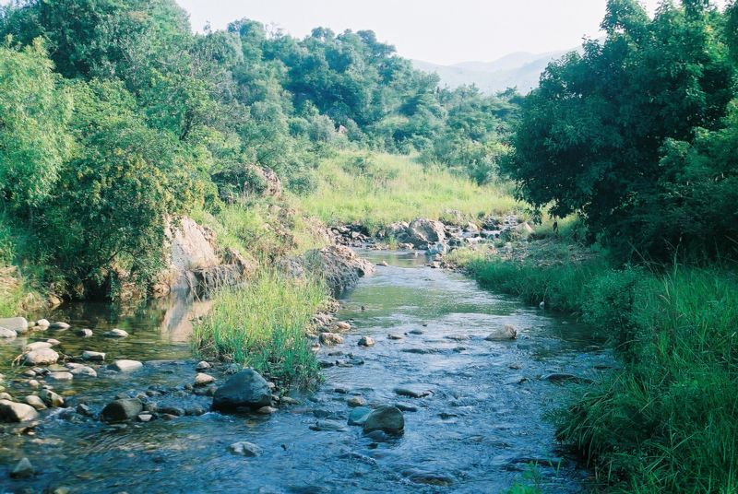
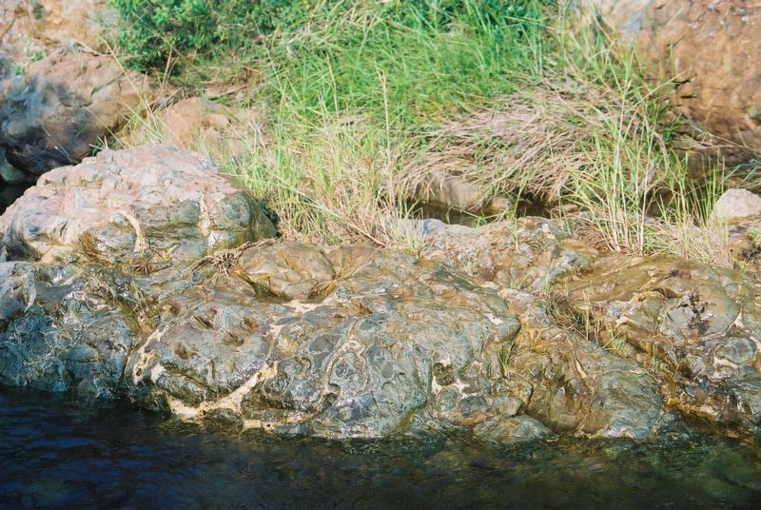
Named after the Komati River in South Africa. first described by Morris and Richard for ultramafic units in the Barberton Greenstone belt of South Africa.

Slide 4
Komatiites
These are ultramafic lavas (very rich in MgO) restricted almost to Pre-cambrian.
They were first described from Barberton mountains in South Africa.
Two types of komatiites are distinguished:
Those with >18% MgO are called Komatiites &
Those with <18% but containing >10% MgO are called komatiititc basalts.
They show a characteristic texture known as SPINIFEX texture wherein acicular crystals of olivine and rarely cpx are present. This texture is suggested to be due to quenching of a liquid.

Slide 5
Texture & Mineralogy
It shows a characteristic texture known as spinifex texture where in acicular crystals of olivine and rarely clinopyroxene are present.
This texture is suggested to be due to quenching of a liquid/ rapid cooling of Mg rich lava.
Olivine grains are less closely packed, randomly distributed and poorly sorted whereas pyroxene some times show zoning.
Most komatiites are altered- olivine to chlorite or serpentine; Pyroxene is partially replaced by tremolite and chlorite; and glass to secondary hydrous minerals.
Some silicates confined in matrix between olivine grains like augite, plagioclase or Ni–Fe sulphides and in some case quartz.
Two types of Komatiites are distinguished: Those with >18% MgO are called Komatiites & Those with <18% but containing >10% MgO are called komatiititc basalts.

Slide 6
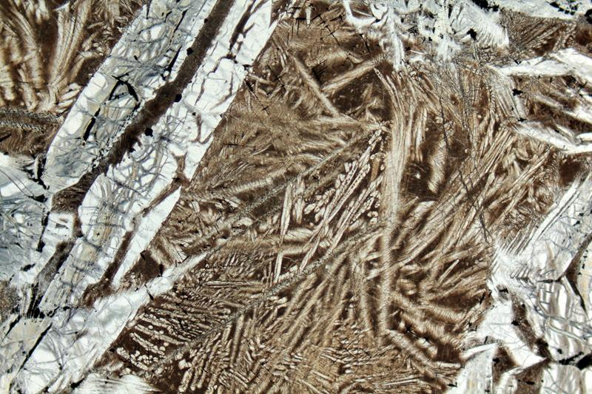
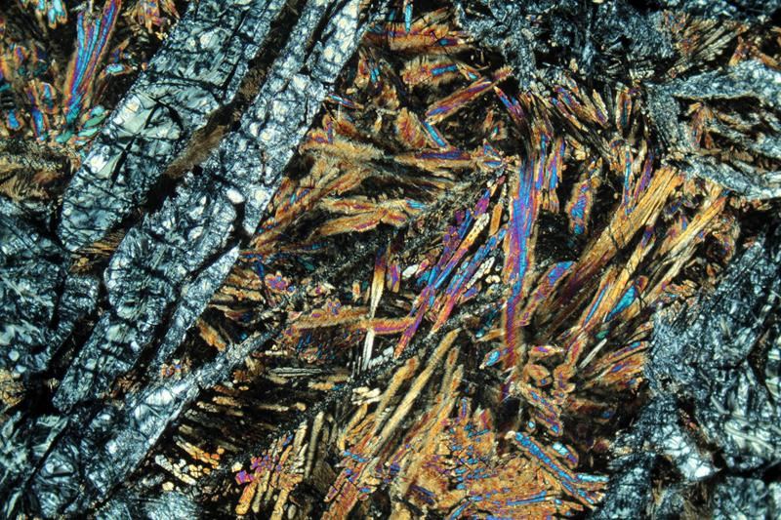
Skeletal olivine crystals (Serpentinized) in a groundmass of skeletal Pyroxenes. (PPL)
Skeletal olivine crystals (Serpentinized) in a groundmass of skeletal Pyroxenes. (XPL)

Slide 7
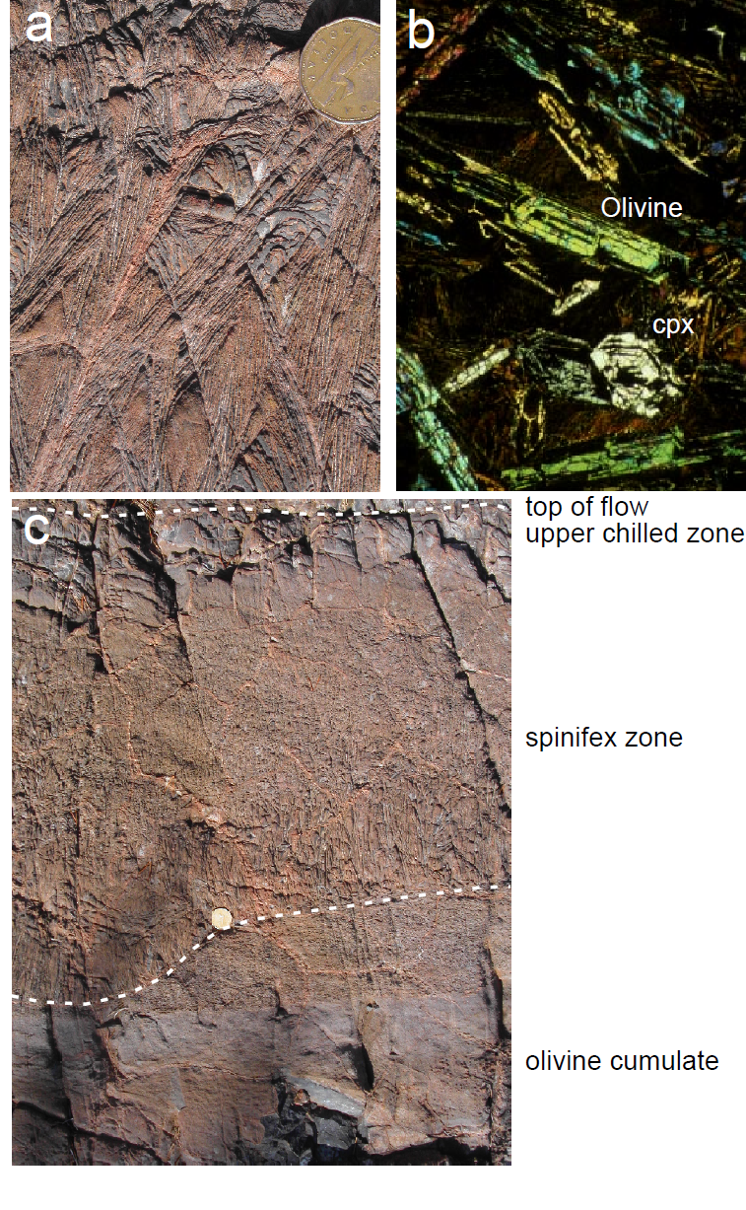

Slide 8
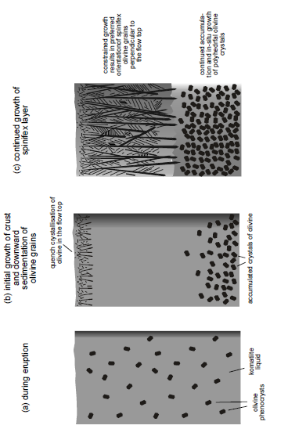

Slide 9
Geochemistry
ultramafic mantle-derived volcanic rocks.
Chemically distinctive in being highly magnesium (18% < MgO < 32% ) , low SiO₂, low K₂O, low Al₂O₃.
komatiites are usually subdivided into two major types;
Aluminium (Al)-undepleted (Munro type, Abitibi greenstone belt) and Aluminium-depleted (Barberton-type).
Al-undepleted komatiites (AUK) are characterized by ratios of Al₂O₃/TiO2 ~ 20 and CaO/Al₂O₃ ~ 1 whereas Al-depleted komatiites (ADK) are lower in Al₂O₃ and have low Al₂O₃/TiO₂ (~ 10–12) but high CaO/Al₂O₃ (~2–2.5).

Slide 10
Genesis/ Origin
Mantle origin
High degree of anhydrous melting of mantle plumes.
Hydrous melting , shallow depth, subduction environment.

Slide 11
Associations
Komatiites occur with other mafic and ultramafic high-magnesium rocks such as:
Pillow basalts.
Peridotite.
Picrites
Calc–alkaline felsic volcanics rocks in subduction zone.

Slide 12
Komatiites occurrences in world and India
The Greenstone Belt of Barberton South Africa.
The Pilbara Block and the Yilgarn Craton, Western Australia.
Munro Township, Ontario.
Abitibi Greenstone Belt in Canada.
Lion Hills Vetreny belt, Russia.
The Belingwe belt in Zimbabwe.
The Archaean Greenstone Belt of Kolar Schist, Karnataka
Greenstone Belt of Singhbhum Craton, Odisha.
Dhanjori greenstone belt of Eastern India.
Sukinda valley, Orissa
Chitradurga greenstone belt of Karnataka.

Slide 13
Mineral deposit associated in Komatiite
primary magmatic Sulphide deposits which mined for their nickel (about 18%of global sulphide nickel ) content with minor product of Cu and PGEs mineralization.
secondary laterite deposits enriched in nickel and cobalt, developed over thick olivine cumulate units.

