Slide 1
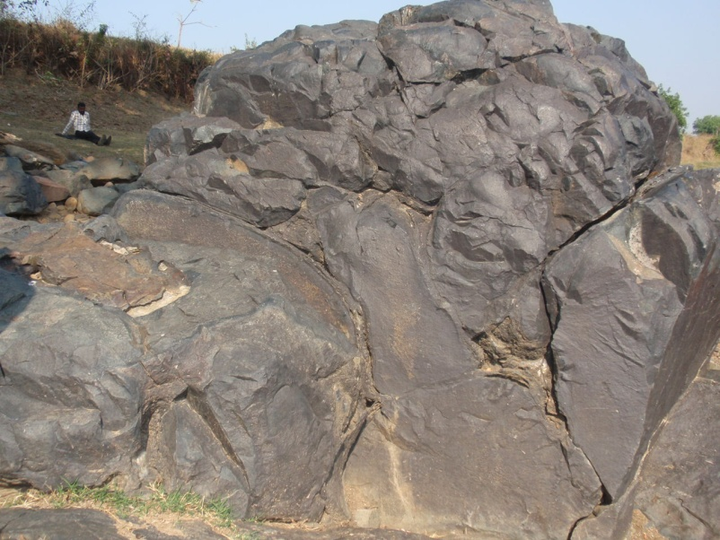
OPHIOLITES
Lecture M.Sc Geology (III Semester)-2018
Niranjan Mohanty
Assistant Professor
Department of Geology
MLSU, Udaipur-313001
nmohantyngribhu@gmail.com

Slide 2
Introduction
Ophiolites are suites of temporally and spatially associated ultramafic mafic, and felsic rocks that are interpreted to be remnants of ancient oceanic crust and upper mantle.
It shows an evidences for magmatic, tectonic, and hydrothermal processes associated with seafloor spreading prior to 170 Ma.
It shows significant variations in their internal structure, geochemical fingerprints, and emplacement mechanisms.
Subduction zone tectonics is thus the most important factor in the igneous evolution of ophiolites and their emplacement into continental margins.

Slide 3
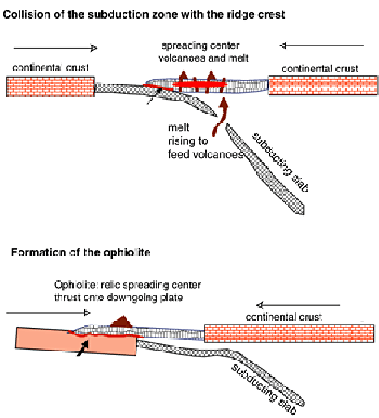
Obduction mechanism

Slide 4
Ophiolite suite & seismic layer of oceanic crust
(a ) Deformed (tectonised) peridotite (b) Layered cumulate rock (c) Sheeted dyke complex
(d) Basaltic volcanic member ( e) Radiolarian chert/ marine sediments.

Slide 5
Terminology related to ophiolite complex
Olistrome/ Tectonic melange:
Mylotinised peridotite & green schist facies.
Obduction: Oceanic crust thrusted during continental collision and subduction.
Seismic moho: Boundary between oceanic crust and upper mantle.
Petrological moho : Layered peridotite to massive peridotite in upper mantle
Steinmann trinity : ultramafic, mafic and pelagic sediments.

Slide 6
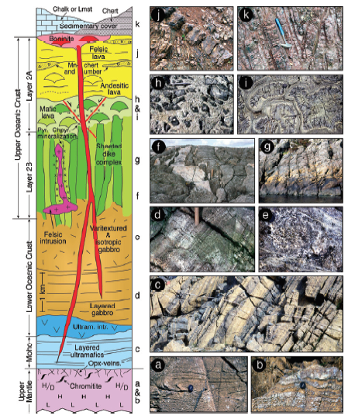

Slide 7
Ophiolites and Tectonic setting

Slide 8
Samail Ophiolite
It extends to over 650 kms.
It has 30,000 sq km of outcrop
Stratigraphic thickness of 18 km.
All members of ophiolite sequence are well exposed.

Slide 9
Ophiolite sequence at samail,Oman

Slide 10
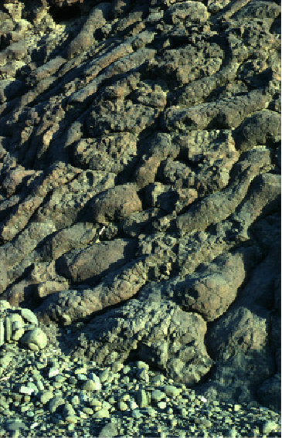
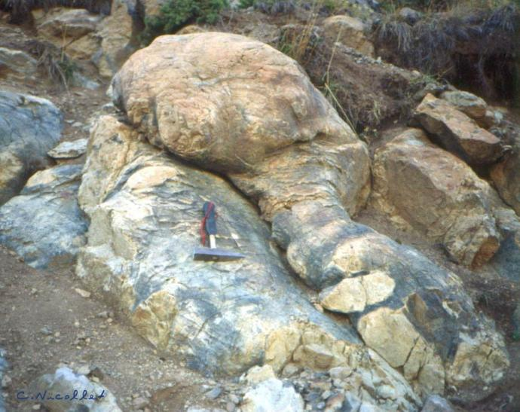
Pillow lavas

Slide 11
Sheeted Dykes

Slide 12
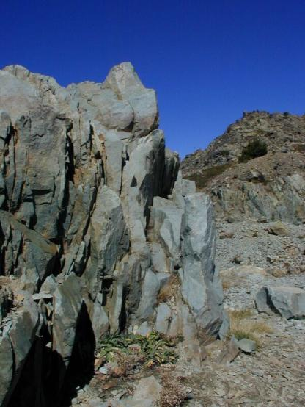
Layered Gabbros & Plagiogranite

Slide 13
Occurrences of ophiolite in world & India
Semail ophiolite in Oman (Mesozoic),
Troodos ophiolite in Cyprus (Mesozoic),
Papua ophiolite in Papua-New Guinea (Mesozoic),
Bay of Islands ophiolite in Newfoundland (Palaeozoic)
Part of a continental Ophiolite zone passes from Baluchistan arc-Kashmir syntaxis- Tsang-Po- Naga & Manipur hills- Burma – Andamans- Indonesia.
Various names;
Indus-ophiolite belt
Shyok ophiolite belt
Malla Johar ophiolite belt of Uttaranchal/UP

Slide 14
Economic importance
Massive Sulphide
massive Sulphide associated in Ophiolites have well developed gossans (bright colored iron oxide, hydroxides, and sulfides) which is very rich in gold.
Chromite
Stratiform (be tabular or pencil shape) or podiform (irregular shape) within ultra-mafic rocks.
Other deposits are developed on serpentinite peridotite
Laterites (nickel and iron)
Asbestos
Talc
Magenesite

Slide 15
Thank You

