Slide 1
Igneous Petrology
M.Sc. ( Geology) III Semester
NIRANJAN MOHANTY
DEPARTMENT OF GEOLOGY,
MLS UNIVERSITY
UDAIPUR-313001 (RAJASTHAN)
E-mail: niranjan@mlsu.ac.in

Slide 2
Problems in Geological Science
- Two major problems
1. Inaccessibility (Erosion and uplift destroys older rocks)

Slide 3
How far we have drilled?
continental crust
Kola, Russia
12.2 km deep hole
15 years to drill
ocean crust
East Pacific
2.2 km deep hole
10 years to drill

Slide 4
How do we know what lies below Earth?
Xenoliths
Geophysics
Experiments conducted at elevated temperatures and pressures

Slide 5
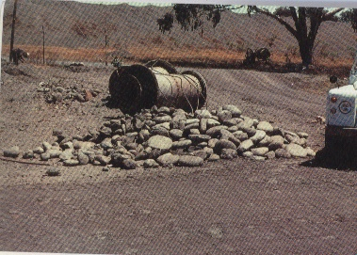
Xenoliths
Eclogite xenolith boulders

Slide 6
Geophysics
Most of what we know of Earth’s interior is from Geophysics
Remote sensing of Earth’s interior
Seismic waves
Gravity methods
Magnetic field
Heat flow

Slide 7
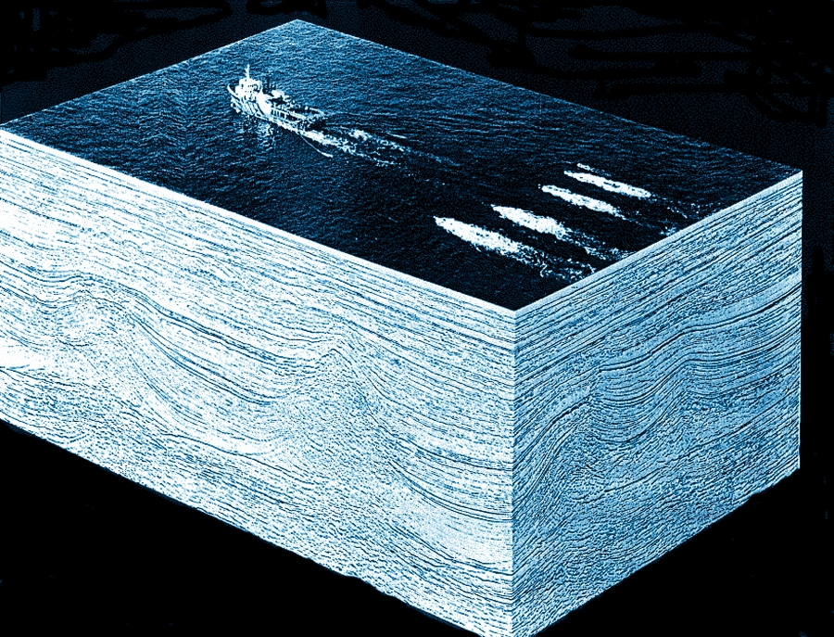
Geophysics
Seismic Geophysical surveys

Slide 8
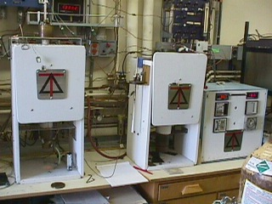
Experimental Petrology
CALTECH experimental petrology lab
Institute for study of Earth’s interior, Japan
Geophysical Lab, Carnigie Institute of Washington
Bristol- centre for study of theoretical & exprimental study of Earths’ interior
National Centre for Experimental Petrology, Allahabd
Depart of Geology, Mysore University

Slide 9
Problems in Geological Science
2. Temporal inaccessibility
We cannot reproduce experiments
Observe the results and infer what the experiment was (Inversion…)
Science is inferential and deductive

Slide 10
How geology changed over the years?
Microscope
Isotopes
Seismic tomography
High pressure experiments (synthetic materials)

Slide 11
What is Petrology?
Petra-rock; logos-explanation (Greek word)
Study of rocks & processes that produce them
Our lab is Earth – is true ground to test them.
Most elegant theories, experiments and models if not proven in field are useless.

Slide 12
What is Igneous petrology?
Study of melts (magma) and rocks that crystallize from them.
Separation of crust from mantle is a igneous process!

Slide 13
How to know whether a rock is igneous or not?
Field criteria: Cross-cutting country rocks truncating external structures such as foliation, bedding, baking of country rocks, chilled margins , lava flows etc
Chilled margin: the edges of an igneous intrusion as it is cooled by contact with the surrounding colder rocks. The margin is marked by a zone of finer-grained crystals.
Textural criteria: Rapid cooling (glass), lava flows, porphyritic textures etc.

Slide 14
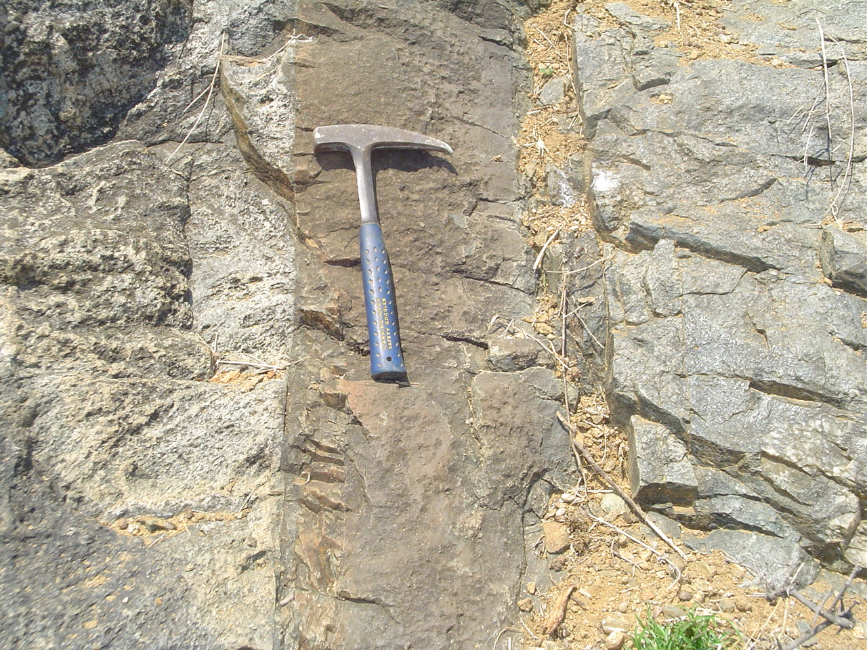
Igneous Intrusion

Slide 15
Another.. Important Criteria - Mineralogy
Chlorite, epidote, actinolite, cordierite – typically metamorphic minerals.
Carbonate, clay, chert, jasper – typically sedimentary minerals.
Field, Mineralogy, texture, geochemistry and even isotopes, at times, are required!

Slide 16
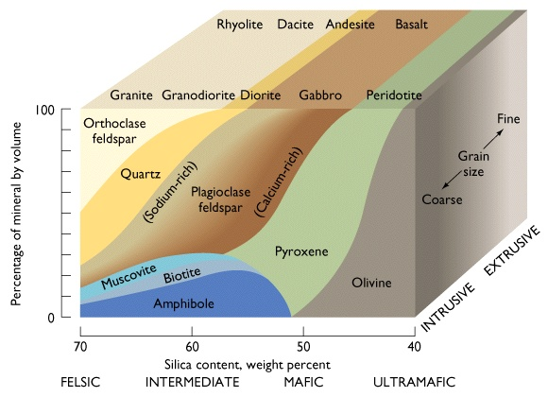
Major minerals of Igneous rocks

Slide 17
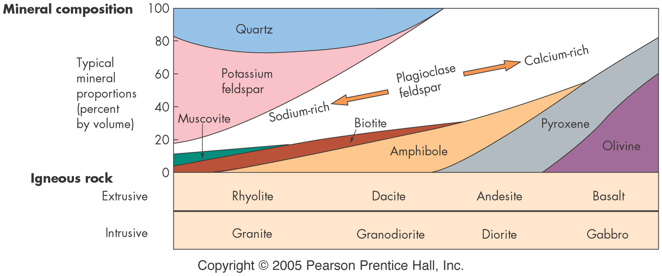
Major minerals of Igneous rocks

Slide 18
Terminology
Petrography – study of rocks in thin sections
Petrogenesis – study the origin of rocks
Microphotographs- Photographs generated by microscope (optical or electron)

Slide 19
Books in Igneous petrology
An introduction to igneous & metamorphic petrology by J.D.Winter, Prentice Hall
Igneous Petrology – Anthony Hall
Igneous petrology by – McBirney
Igneous petrology – M.K.Bose (Indian Egs)
Igneous petrogenesis – Marjorie Wilson

Slide 20


