Slide 1
History Of The Hotel Industry

Slide 3
THE STORY OF THE
TAJ GROUP OF HOTELS

Slide 4
The Taj Group of Hotels is one of the largest chain in india with several hotels in abroad also. The present hotel, Taj Mahal Palace & Towers Mumbai is rated among the tenth best in the world. The Founder of the house of tatas Mr. Jamshedji Ratan Ji Tata in 1897, Formed the indian hotel company. & Built the very beautiful Taj Mahal Hotel in Mumbai. The Door Opened in 1903 & has been an important landmark opposite the gateway of India ever since.

Slide 5
In 1971,the 220 room taj mahal hotel in mumbai was converted into a 325 room hotel,& a multi storey structure was built adjoining the origional property.
In 1972,the lake palace at udaipur & rambagh palace in jaipur were linked to the Taj & a chain was born.
In 1974,a new company was floated,which created the Taj coramandel in chennai.In the same year the chain broadned with acquisition of the FORT AGUADA BEACH RESORT in GOA.

Slide 6
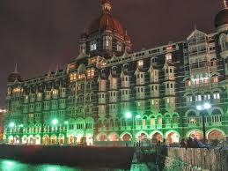

Slide 7
IN 1976,The fisherman cave was built. It is a 30 minutes drives from Chennai on the bay of Bengal with a private beach.
In the same year the Taj group opened the taj flight kitchen in Mumbai catering to both domestic & international flight.
In 1978, the glittering Taj Mahal Hotel was opened in Delhi & this was followed two years later in Varanasi by the Taj Ganges.

Slide 8
The 1980’s saw the rapid expansion of the group-Taj palace in New delhi,another flight kitchen in new Delhi airport ,the Taj residency in banagalore,at ooty & Taj view hotel in agra,srilanka.And the chain continues to expand.

Slide 9
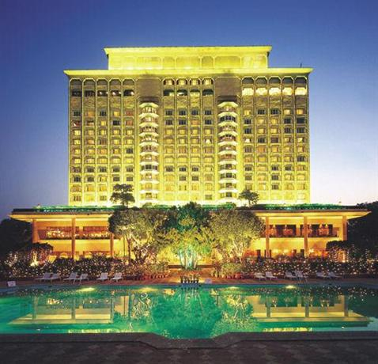

Slide 10
SUMMARY-------------------
1903-Taj mahal hotel
1971-the 220 room hotel was converted into 325 room hotel
1972-Rambagh palace jaipur,lake palace at Udaipur were linked to Taj.
1974-Taj coramandel in Chennai, fort aguada beach resort goa.
1976-fisherman’s cave,chennai.as well as taj flight kitchen in Mumbai catering to both domestic & international flights.
1978-Taj mahal hotel in Delhi.
1980-Taj Ganges.
Rapid expansion of the group

Slide 11
TAJ OVERVIEW {AT PRESENT}
India’s & south Asia's largest.
73 locations
103 hotels total
operating in 5 continent & 14 countries.
14500 guest rooms.
Licensed bar HARBOUR BAR {1st time in India}

Slide 12
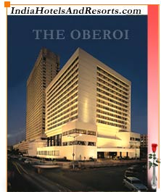

Slide 13
OBEROI HOTELS
The story of Rai Bahadur M.S.Oberoi-
Rai Bahadur Mohan Singh Oberoi,Chairman in 1922& founder of Oberoi Hotel was born in august 1900 in bhaun,a small village which is now in pakistan.Soon after his marriage in 1922 he arrived in shimla,& found a job as a front office clerk in the CESIL HOTEL at a salary of rupees 40 PER MONTH. Some years later he moved to clerk hotel {also in shimla} & gained experience in all aspects of the hotel operations. In 1934 he bought clerk hotel by mortgaging all his assets & selling his wife’s jewellery.

Slide 14
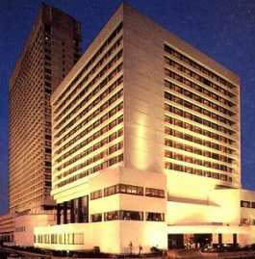

Slide 15
In the early 1930’s a cholera epidemic struck Calcutta & grand hotel, the largest in the city was forced to close. In 1938 mr.oberoi acquired the grand and converted it into a profitable business venture. The oberoi grand remains to this day Calcutta's leading hotel.
in 1943 mr.oberoi took over the associate hotel of India (AHI) with eight hotels in northern India including the Cecil in shimla maidens and imperial in Delhi, and 4 hotels now in pakistan.the oberoi chain grew rapidly with hotels in Darjeeling,chandigarh and Srinagar.
The oberoi international in new Delhi, which opened in 1965 was the first modern luxury hotel in the capital. The 35 storey oberoi towers opened in Mumbai in 1978,the tallest building in india.

Slide 17
Mr. oberoi’s dedication to the industry is evident from the oberoi centre of learning & development based in Delhi.
Oberoi is now part of the international chain of hotels with has properties not only in India but also in australia,Indonesia,singapore,& Nepal.
Mr. oberoi was named as ‘Man of the world’ in 1983 at the annual convention of the international hotel association in new York & selected as the outstanding hotelier of the year by the Hotels & Restaurant International.
M

Slide 18
INDIA TOURISM DEVELOPMENT CORPORATION {ITDC}
ITDC that runs the largest chain of India has largely contributed in the development of tourism industry in India. It was founded in 1965.ITDC after its formation put in exceptional effort to promote the hotel industry as well as tourism by developing new hotels & tourism spots.
ITDC launched it’s own project for a five star hotel in Bangalore that is Bangalore Ashok & soon launched another hotel in Delhi in the name of Akbar hotel & thus started the unending story of grouping upcoming new hotels all over India.
The ashok group of hotel is one of the services provided by the state –owned by the ITDC.It has the largest network of hotels in the country.

Slide 19
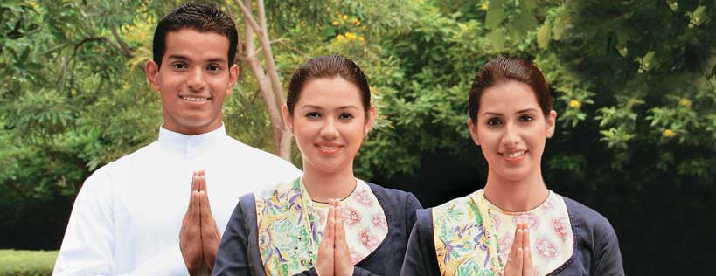

Slide 20
ASSIGNMENTS FOR PRACTICALS
NAMES OF FIVE STAR HOTELS {ONLY 20}
BANGALORE- 5 EACH
DELHI- 5 EACH
MUMBAI- 5 EACH
UDAIPUR- 5 EACH
ALSO WRITE-TOTAL NO. OF RESTAURANT WITH THEIR NAMES…..
WITH THE SPECIALITY RESTAURANT………….

Slide 21
THE ASHOK GROUP-
The ashok group of hotel has been India's gracious & regal host to leading national & international visitors. The group is known for its unique mix of traditional Indian facilities that are beyond compare. The hotels have now been classified into three categories –Elite, classic & comfort .
The hub of the ashok group’s activities is in new delhi,india’s ancient capital. It has been also called the ‘conventional capital of asia’largely due to the presence of the ashok group, which offers over 2000 rooms in it’s various hotels strategically located across the capital.
The ashok group offers a complete Indian experience with an ever increasing network, taking care of its guest with a combination of dependable comfort & traditional Indian hospitality.

Slide 22
WELCOME GROUP HISTORY---------------------------------------------------------
Welcome group is the hotel division of ITC Ltd.ITC entered the field of hoteliering in 1975 with the opening of chola in chennai.Two more hotels,mughal in Agra in 1976 & maurya in new Delhi in 1977 followed in rapid succession, firmly establishing welcome group as one of the fastest growing groups in India. After 1977 welcome group went into the management operation & marketing of hotels owned wholly by other entrepreneurs, or jointly with ITC.

Slide 23
ITC Sheraton management signed an exclusive agreement with welcome group in 1979 in the field of marketing & reservation for the first three hotels of welcome group. In 1987 welcome group Windsor manor & sea rock were sheratonised.Rajputana palace Sheraton Hotel in jaipur has also been brought under the Sheraton banner.
All welcome group hotels are equipped to meet the most stringent international standard of efficiency service & state of art technology. In every hotel, local Indian elements are blended beautifully with the most sophisticated comfort & facilities.

Slide 24
TYPES OF CATERING ESTABLISHMENTS---------------------------
1.HOTEL is a place where the guest is provided boarding & lodging.
2.MOTEL is a hotel situated on a highway along with services or garage & station.
3.BOATEL A houseboat hotel.
4.FLOATEL A luxury hotel on a luxury liner.
5.LOTEL Hotel with helipad facilities.
6.KIOSK Stall on roadsides for snacks.
7.SODA FOUNTAINS Outlet selling aerated drinks.
8.RESTAURANTS-A place where one can eat, pay for the same & go.

Slide 25
FOOD & BEVERAGE OUTLETS IN A HOTEL-
1.
FOOD AND BEVERAGE OUTLETS Food and beverage outlets are the areas in a hotel where food and beverage are sold to both in-house and outside guests. The following types of food and beverage can be seen which may or may not attach to a hotel. Specialty restaurant These restaurants deal in a particular type of cuisine like Chinese, Italian or French etc. Each and every aspect of the restaurant is typical and related to the area of region of community whose food is being served. The food, service, uniform, décor etc. are ethnic and authentic of the area whose cuisine the restaurant specializes upon. When one enters into such kind of restaurant one can feel the culture and tradition of that area. These restaurants may be attached to a hotel or may independently exist. They have specific hours of function and normally more expensive than ordinary restaurants.

Slide 26
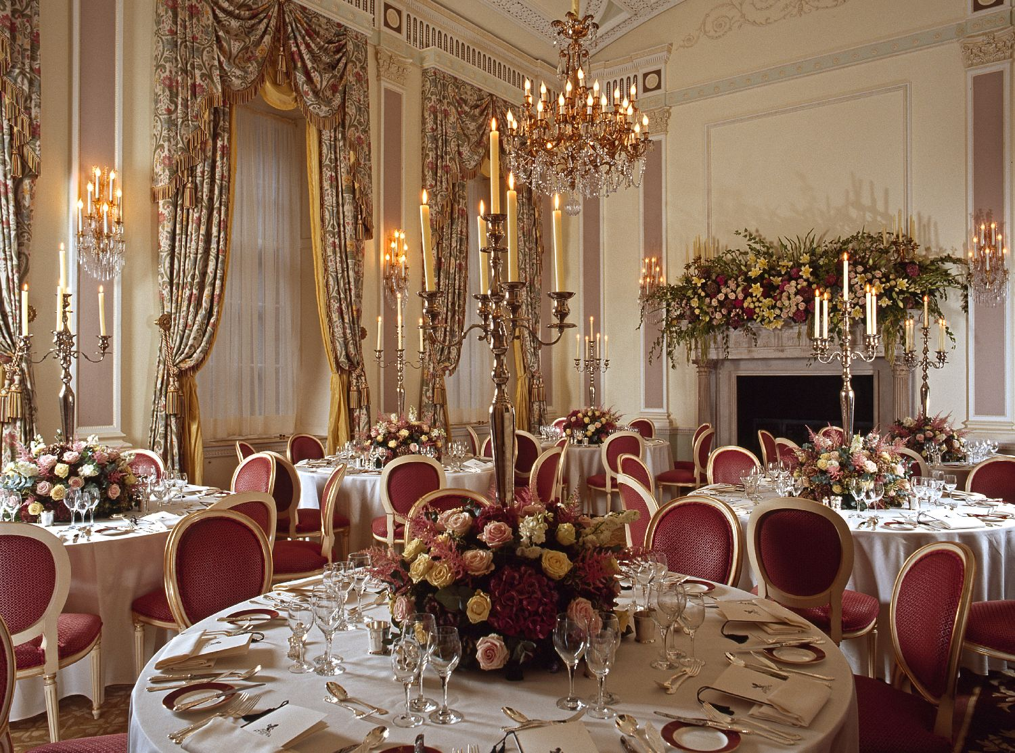

Slide 27
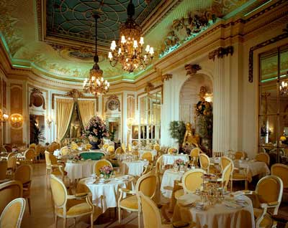

Slide 28
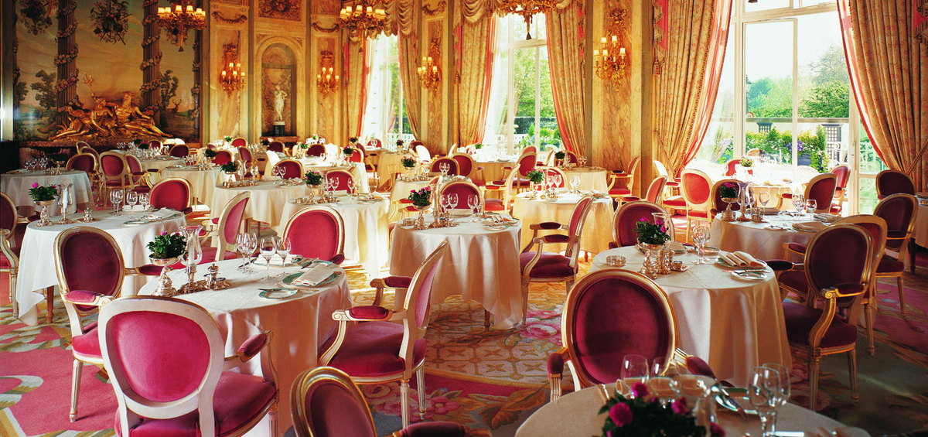

Slide 29
Multi cuisine restaurant These restaurants deal with more than one cuisine like Indian, Chinese and Continental etc. They are not as exclusive as the specialty restaurants. There is no emphasis on adherence to the culture and tradition of a particular area of region or community. They may be attached to a hotel or may independently exist. They generally have specific time of operation when attached to a hotel. They may be operating on a straight shift from morning till night when independently existing. They are not as highly priced as a speciality restaurant.

Slide 30
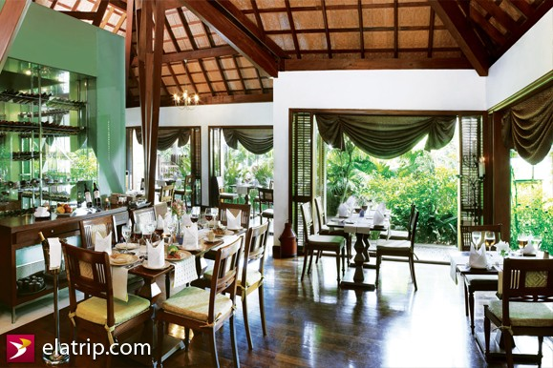

Slide 31
Bar These food and beverage outlets deal with the alcoholic beverages only. They may be attached to a hotel or independently existing. They have certain specific hours of operation and the law strictly governs the operation. Their hours of operation, inventory, location and client to whom they should serve etc are governed and regulated by the law-enforcing agency. Room Service This food and beverage outlet is attached to a hotel and caters to the F and B requirements of the guests who are staying in the hotel only. These F and B outlets cannot independently exist. The service in room service is always in trays and trolleys. In a five star hotel the room service operates round the clock. The prices in the room service are generally more than the coffee shop.

Slide 32
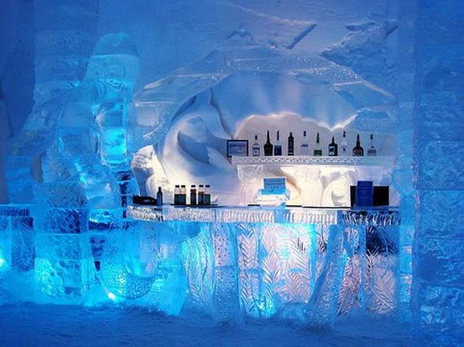

Slide 33
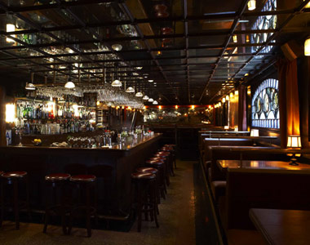

Slide 34
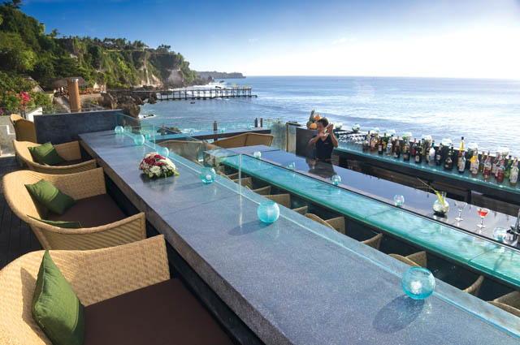

Slide 35
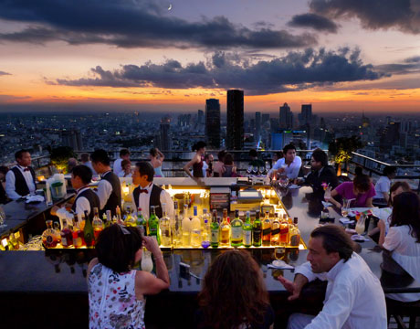

Slide 36
Banquets This is generally attached to a hotel of restaurant. This outlet generally caters to a huge gathering of people who assemble in the banquet hall for events like reception, marriage party, birthday, conference, seminar etc. The service is generally from a buffet when a lot of guests have to be served within a short span of time. Sometimes formal lunch, dinner etc also takes place in banquet halls. This is the highest revenue producing F and B outlet in any commercial hotel. Sometimes banquet halls can independently exist where an outside contractor does the catering part.

Slide 37
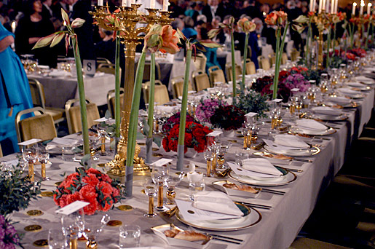

Slide 38
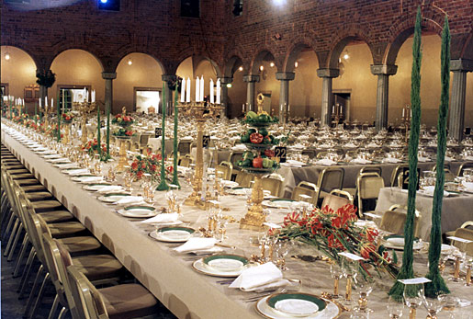

Slide 39
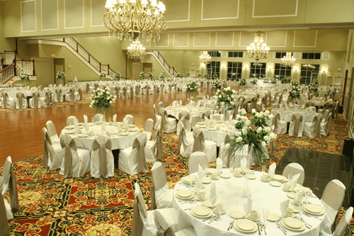

Slide 40
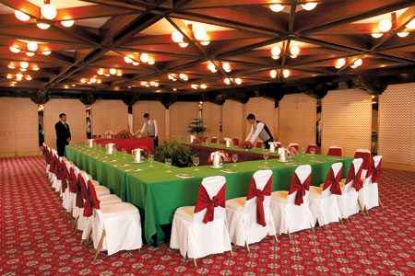

Slide 41
Coffee Shop This is generally attached to a hotel. In a five star hotel the coffee shop operates round the clock. It cannot independently exist. The service is very informal and emphasis is on pace of service. Service is generally snacks and very light meals. The meals part is not as elaborate as the restaurant. Prices are not as exorbitant as the restaurants. Although the coffee shop is operational round the clock there are meal timings when the certain items are available which are not available at other times. There are some dishes, which are available all 24 hours.

Slide 42
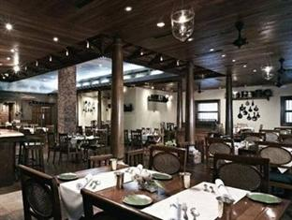

Slide 43
Pub A pub generally independently exists, which serves only beer. The atmosphere in a pub is generally very informal most pubs have a very informal seating arrangement and generally designed to suit the likings and requirements of the youth. They also have specific hours of operation and the law like a bar governs operations. Books of inventory and accounts are maintained as per the government regulation and are supposed to produce them before the concerned authority as and when required.
Discotheque This may be attached to a hotel or may independently exist. The ones, which independently exist, are open to anybody who can pay but most allow only couples. The ones, which are attached to the hotels, are not only opened to the members but guests accompanied by members are also allowed. They also have specific hours of operations and are normally attached with a bar.

Slide 44
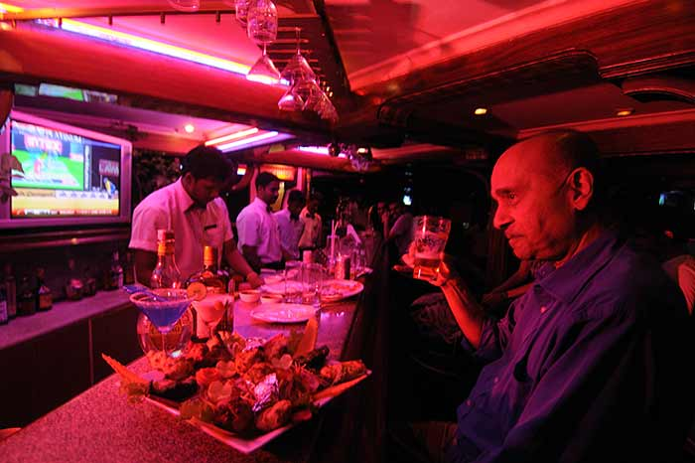

Slide 45
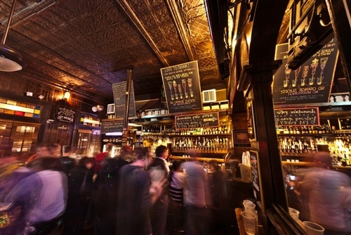

Slide 46
Pastry shop They may be attached to a hotel or may independently exist. They deal with only pastry or pastry related products. Those, which are attached to hotels, deal with pastry prepared in the same hotel. The ones, which are not attached to hotels, have their own bakery either in the same premises of outside the premises. Service is done across the counter. Very limited seating arrangements may be provided if space permits.

Slide 47
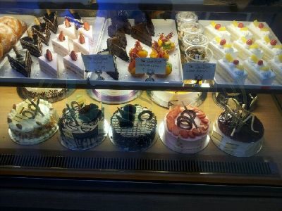

Slide 48
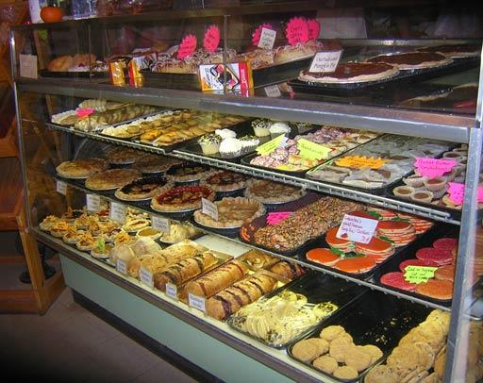

Slide 49
Cafeteria These generally independently exist and are found in railway stations and airports etc. The service is generally self-service. Food is displayed in the counter and the guests helps himself in picking up the food as per his liking as he moves along the counter and finally pays the bill at the end of the counter. Sometimes payment of the bill may be through coupon also. Very informal atmosphere exists in these outlets and prices are not very high. Poolside barbeque These are generally attached to the hotels and operate near the poolside. They generally operate for lunch and dinner only. There are adequate lighting arrangements to take care of the dinnertime. The menu is not very elaborate and comprises a lot of grilled and barbequed items. Some light meals are also available. These outlets are generally attached with their own kitchens, which are more often than not makeshift. A bar may be attached to the outlet or alcoholic beverages may be served from the service bar. Once again the décor is very informal like a coffee shop. Service is very much similar to the coffee shop as well.

Slide 50
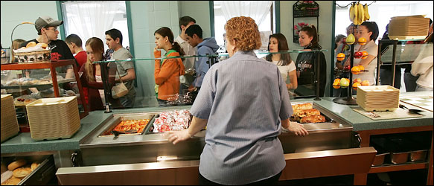

Slide 51
Grill Room These kinds of hotels are generally attached to the star hotels although they can be found independently existing also. They specialize in grills and barbequed items only. The kitchen is separated from the service area by a glass partition so that guest can see the chef preparing the food. This give rise to impulse buying. The guests are normally assured of better hygienic condition as they can see the actual food preparation.
Night Club They are generally attached to hotels and are open to members only. The operation starts late in the evening and goes on till late in the night. Stripes, cabarets and floorshows etc. are performed as a part of the entertainment. These are not seen in recognized star and commercial hotels. An elaborate menu is offered and the service is quite formal and extensive. It opens only for members. Alcohol is served to the members.

Slide 52
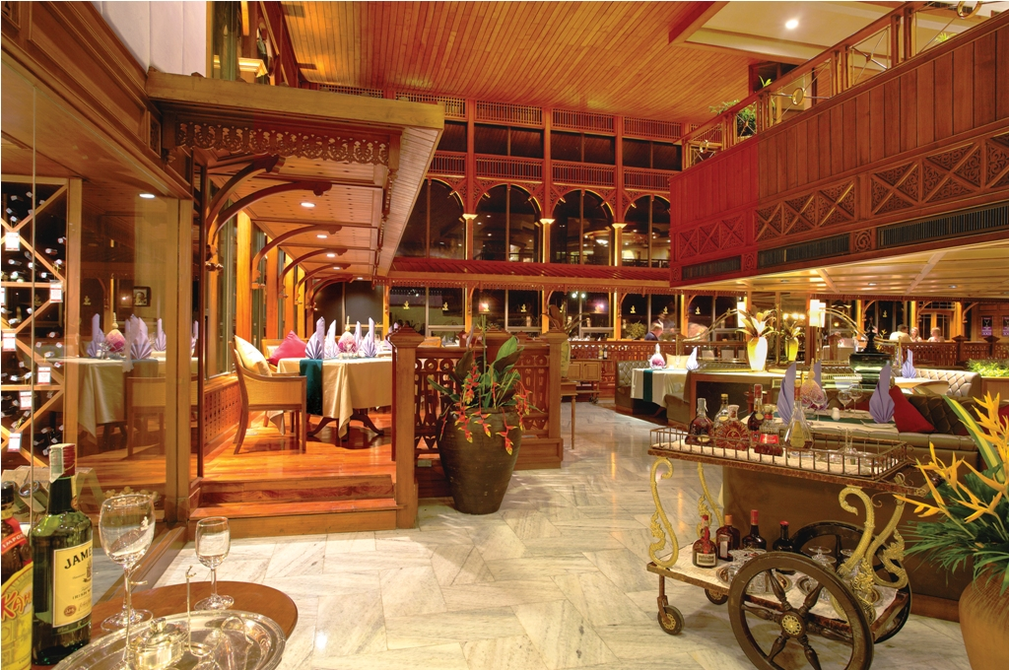

Slide 53
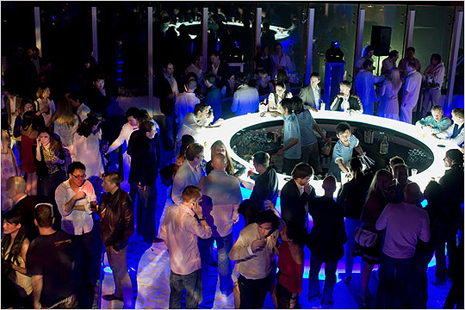

Slide 54
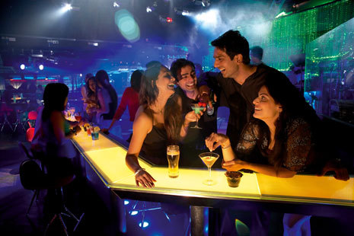

Slide 55
Fast Food Outlets They are generally not attached to a hotel and are found independently existing. They serve fast foods, which are easy to prepare to easy to carry and eat. These outlets provide very limited seating arrangements and people are not encouraged to sit and pass time in these places. Service is done in disposable plates and packets. Patrons are supposed to get their food from across the counter. There may be one person to look after the clearance and cleanliness of the place. Very limited service is provided. Coffee Bar: This is a very recent development and becoming very popular. These outlets deal with only coffee. They specialize in different types of coffee. Both alcoholic and non-alcoholic coffees are served here. The alcoholic coffees are commonly called as speciality coffee.

Slide 56
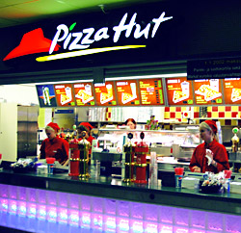

Slide 57
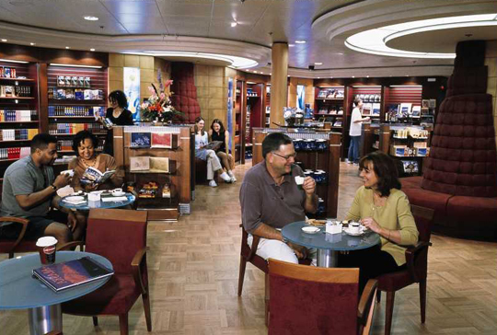

Slide 58
Still Room-The still room is responsible for the provision of coffe,tea,fruit juices,assorted breads,toasts,Breakfast cereals,Breakfast rolls,Breakfast egg preparataion etc.It may function throughout the day depending on the size & location of the hotel & it is very busy during breakfast time.It is located near In Room Dining & Restaurants,slightly away from the main kitchen but works under the control of chef de cuisine.
Silver Room-Silver room stores & mainains the complete stock of silver & other service equipments required for catering operation.It maintains record of stock received & issued to various outlets.Surplus stocks are neatly & item wise for easier access & control.Banquet silver & other equipments are kept sepratley.

Slide 59
Hot Plate-This is the food pick up counter in the kitchen & acts as a contact point between kitchen & service staff.It is controlled by the aboyeur {barker}.

Slide 60
RESTAURANT SERVICE EQUIPMENT—
Service equipment includes furniture,fixtures,linen,cutlery,crockery,hollowware & glassware. Each of these components reflects the style, quality & standard of the restaurant. Several factors are considered when purchasing them-
standard of the Restaurant
Type of service
Décor & theme of the Restaurant.
Type of clientele
Durability of equipment
Ease of maintenance
Availability when stock runs out
Price factors
Standardisation

Slide 61
Equipment category & its Examples-
Furniture--------Tables,Chairs,Sideboards
Linen---------- Table cloth, buffet cloth, napkins {Serviettes},tray cloth, waiter’s cloth, Slip cloth, Satin Cloth
Crockery-------- Quarter plate, half plate, full plate, Soup bowl, cup & saucer
Glassware-------Water goblets, wine glasses, champagne tulip, beer mug, Cocktail glass, Tom collins,old fashioned, high ball pilsner glass & so on

Slide 62
5.Table ware
A-Flatware-spoons & forks {Cutlery & Silverware}
B-Hollowware-Coffee pots, Tea pots,water jugs, entrée dishes, Sugar pot,creamer,butter dish & so on
6.Miscellaneous equipment—Bud vase, Table no. menu stand,cruets,ash trays & so on
7.Disposables-Paper napkins, disposable plates,cups,place mats,doilies,coaster,gloves & so on.

Slide 63
Table sizes & their capacities------
s.no | Size in Inches | Shape | Covers | Position of Covers
1 | 30 inches | Square | 2 | Opposite
2 | 36 inches | Square | 4 | One on each side
3 | 30*48 inches | Rectangle | 4 | Two on either side
4 | 30*72 inches | Rectangle | 6 | Three on either side
5 | 36 diameter | Round | 4
6 | 48 diameter | Round | 5
7 | 60 diameter | Round | 8

Slide 64
Heights of the Chair
From floor to the seat-18 inches
From floor to the top of the chair-39 inches

Slide 65
Table cloth size-
S no | Table size | calculation | Size
1 | 2’6’’ square | 48’’ | 48’’*48’’
2 | 3’ square | 54’’ | 54’’*54’’

Slide 66
CROCKERY SIZE—A wide size of crockery items are available & their exact sizes will vary according to the manufacturer & the design produced. As guide, the sizes are as under---------------
Side plate- 15cm{6in}diameter
Sweet plate- 18cm{7in}diameter
Fish plate- 20cm{8in}diameter
Soup plate- 20cm{8in}diameter
Tea cup & saucer-6 -2|3 FL Z.
Coffee cup & saucer {Demitasse}-3 1|2 FLZ

Slide 67
FLATWARE {CUTLERY OR SILVERWARE}------
Flatware is the term for those tools in dining that help cut, mix & hold food in sizes & portions that are easy to eat. The flatware used in up market restaurant is called sterling silver which consists of 92.5% silver & 7.5% cooper to harden & strengthen the silver. Naturally such silverware is expensive & needs to be carefully controlled in storage, in use & while washing. Most other restaurant use silver-plated flatware, such flatware is made from base metal such as steel which is then coated with a thin layer of silver to give it rich look. Economy restaurants use stainless steel which is economical & easy to maintain.
The types of commonly used in restaurants are--

Slide 68
Soup spoon-For service of soup served in cups or soup bowls.
Fish knives & forks-for fish & hors d’oeuvres.
Large knives & forks-for main courses
Fruit knives & forks-for fresh fruit.
Coffee spoons-for coffee
Tea spoons-for tea, fruit cocktails, grapefruit & boiled egg.
Service spoons & forks-for transferring food from platters to the guest plate
Cheese knife-for cutting cheese.

Slide 69
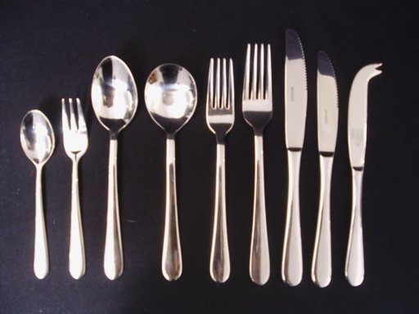

Slide 70
HOLLOW-WARE-This is a term used for metal or ceramic containers of food when brought to the guest’s table from the kitchen. Hollowware consists of any other item, apart from flatware& cutlery, for example ,Tea pots, milk jugs, sugar basins, serving dishes.

Slide 71
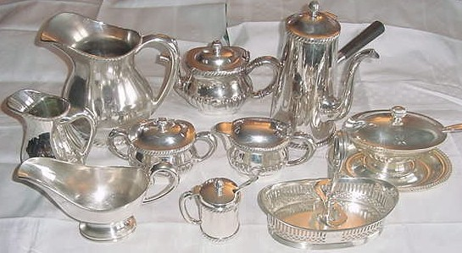

Slide 72
GLASSWARE-There are two main types of glass, lead crystal & soda lime. Lead crystal is the best & has a good finish. In the catering industry soda lime glass is used more as it can be mass produced & is hardy & resistant to impact the thermal shock.
TYPES-The importance of glass in relation to wine can not be over emphasized. Wine is appreciated by colour,aroma & taste.& the shape & type of glass used helps to enhance these characteristics.
TEXTURE-A glass should be sufficiently thin for the lip to help the palate to enjoy the wine’s flavor.
COLOUR-A wine glass should be good clear glass.
SHAPE-A glass should be curved at the top so that the aroma is trapped.

Slide 73
HANDLING-
A glass is always lifted by its stem or at the base.
A glass is never picked up with the rim between thumb & finger.
Broken\chipped glasses should be removed to the dustbin immediately.

Slide 74
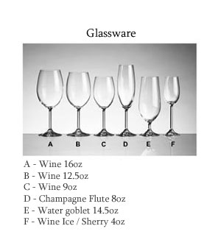

Slide 75
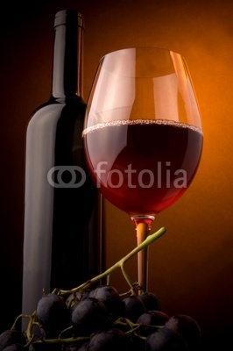
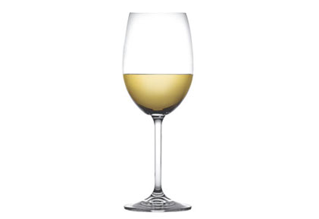
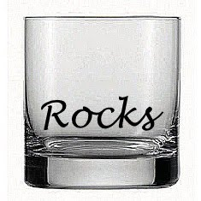

Slide 76
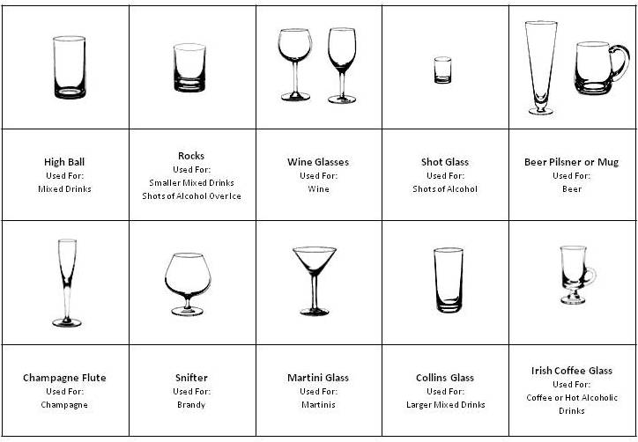

Slide 77
DISPOSABLE-This type of tableware can be used for outdoor catering. It is usually made of paper or plastic. It includes –
Napkins
Placemats & coasters
Knives, forks,& spoons
Cups, glasses & plates.

Slide 78
SERVICE TROLLEYS-Trolleys in a restaurant are an important part of food & beverage. They are mobile display units that are wheeled to the tableside to stimulate {encourage}sales.The no. of service trolleys are as under..
Wine trolley
Hors d’oevres trolleys
Salad Trolley
Gueridon trolley
Fruit trolley
Liqueur Trolley
Cheese Trolley
Pastry trolley.

Slide 79
LINEN-Most linen is standardised to serve the restaurants,bars,room service & banquets. Some standard dimension are-
Table cloths-To fit 2’6” table 54” * 54”
To fit 3’ square table 72” * 72”
To fit rectangular table 72” * 96”
{2Sides are equal-RECTANGULAR}
{4Sides are equal-SQUARE}
Slip cloth- To cover stained table cloth 36” * 36”
Napkins- Also called serviettes- 18” * 18”
20” * 20”
Buffet cloths-minimum size- 6’ * 12”

Slide 80
S no | Name | Size | Uses | Notes
1 | Quarter Plate | 6’’ | Bread,Cheese,Underliner for bowls | Also known as B&B{Bread &Butter plate},cheese plate,Side plate
2 | Soup plate | 8’’ | For thick soups & Breakfast Cereals | Half plate is used as underliner when soup plate is used
Crockery their sizes &uses---

Slide 81
3 | Soup cup | 250 ml | For thin soups,also known as consomme cup | Has two handles
4 | Soup Bowls | 250 ml | For thick & thin soups,breakfast cereals | Most restaurants use soup bowl for serving all kinds of soup instead of investing money on soup cups & soup plates

Slide 82
5 | Half plate | 8’’ | Starter,&fish,Pasta,Meats,&vegetables when not served as main course,sweet,dessert | Also known as fish plate, dessert plate, Sweet plate
6 | Full plate | 10’’ | Main course | Dinner plate,joint plate,large plate,&meat plates are other names
7 | Breakfast cup & saucer | 250-300 ml | For all tea & coffee served during breakfast | Largest of all cups & saucer

Slide 83
8 | Tea cup & saucer | 200 ML | For Tea & coffee served during the day{Except breakfast& after lunch & dinner}
9 | Demitasse & saucer | 100 ML | For coffee served after lunch & dinner

Slide 85
EQUIPMENT CATEGORY & ITS EXAMPLE------
FURINTURE-Tables,chairs,sideboards
LINEN-Table cloth, buffet cloth, napkins {serviettes},tray cloth, waiter’s cloth
CROCKERY-Quarter plate, full plate, soup plate, soup bowl ,cup & saucer
GLASSWARE-Water goblets, wine glasses, champagne tulip, beer mug, cocktail glass, Tom collins,old fashioned, highball, pilsner glass & so on.

Slide 86
TABLEWARE-
Flatware-spoons,Forks
cutlery-knives
Hollowware-coffee pots,teapots,water jugs,sugar bowls,creamers,butter dish & so on.
MISCELLANEOUS EQUIPMENT-Bud vase, menu stand, cruets, ash trays, caviar knife, oyster fork & so on.
DISPOSABLES-Paper napkins, disposable plates,cups,coasters,spoons,forks,knives & so on.

Slide 87
ASSIGNMENTS FOR PRACTICALS----------
Top 20 restaurants in India
Fine dining Restaurants or award winning Restaurants.
BANGALORE
NEW DELHI
MUMBAI
CHENNAI OR GOA

Slide 88
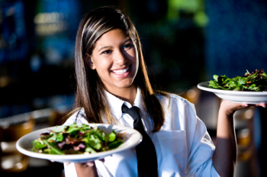

Slide 89
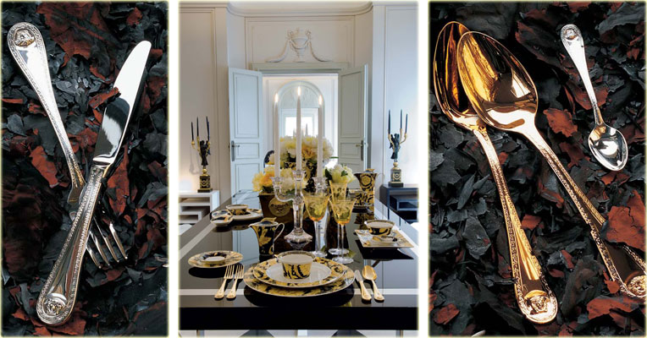

Slide 90
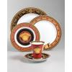

Slide 91
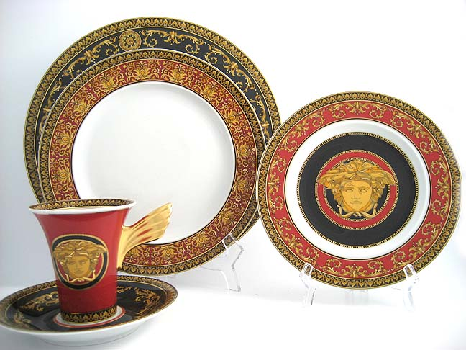

Slide 92
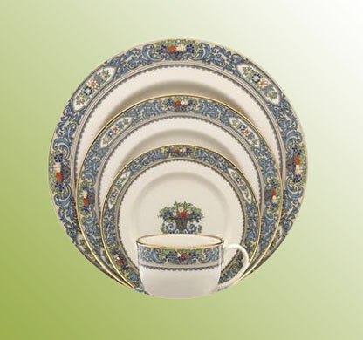

Slide 93
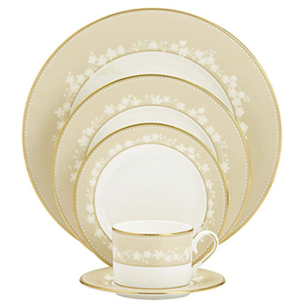

Slide 94
FOOD & BEVERAGE SERVICE PERSONNEL----{UNIT-4}
Designation of Restaurant Organization in french & English
Directeur du Restaurant {Restaurant Manager}
Maitre d’hotel {Senior Captain}
Maitre d’hotel de carre {Captain}
Chef de rang {Steward}
Demi-chef de rang {Assistant Steward}
Commis de rang {waiter}
Commis debarrasseur {Apprentice}{Trainee}
Sommelier {Wine waiter}

Slide 95
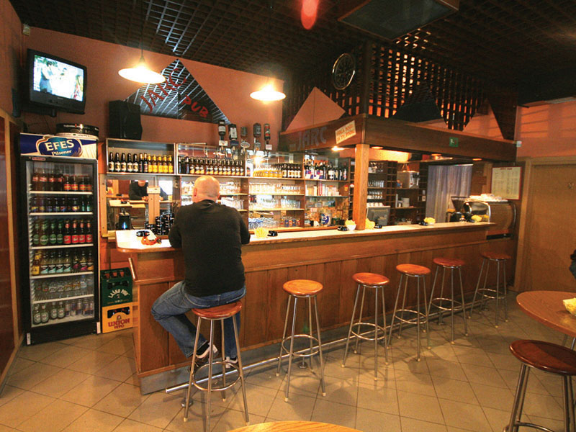
PUB Image

Slide 96
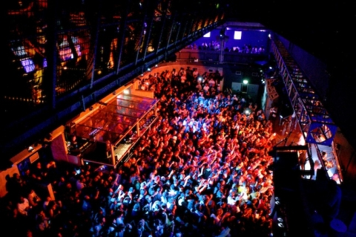
Fabric night club in London

Slide 97
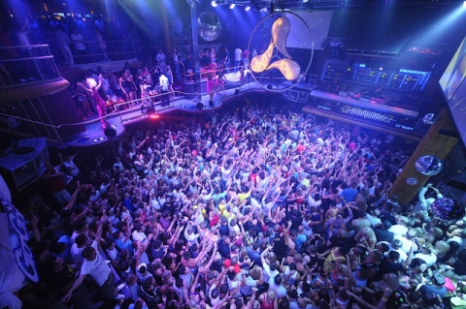

Slide 98
Let Examine the roles of each job position ------
Restaurant Manager-He\She is responsible for the commercial viability of the Restaurant. He\she is given a sales target by the owner & employs measures to achieve those revenue figures by active selling in the market; in house selling;upselling;good service;hygiene & sanitation standards;safety standards;& making sure that guest pay their bills.The Restaurant manager must exihibit leadership qualities to motivate & maintain staff discipline.
Senior captain-Known as ‘Restaurant supervisor’ or ‘maitre de Hotel'. He\she overseas the work of all Restaurant captains & their service standards. Service standards include cleanliness, service preparedness, staff turnout, briefing & training, service flow between kitchen & restaurant;& salesmanship.

Slide 99
Captain-Known as ‘Head Waiter’ or ‘Chef de rang’ .The captain is responsible for a set of tables called station. The station has a sideboard, also called a ‘Dummy Waiter’ that is equipped with the crockery,cutlery,Linen & service ware for a station. The captain leads a team of waiters & sales targets of a station .The restaurant will,therefore,have more then one captain based on number of stations.
Hostess-She is the person who makes table reservations, receives the guest at the restaurant door, allots tables ensuring a balanced workload at each station, seats guest, presents the menu,& periodically checks with the guests if the standards of service meets their expectations.

Slide 100
WINE BUTLER---Known as the Sommelier in french.he is a specialist in wines & spirits & provides beverage service at the table-side from a wine trolley. Such service is found in up-market restaurants where beverage service is viewed as a fine art.
CARVER-Known as a Trancheur in french,a carver is a specialist in carving roasts at the table-side.He has a trolley equipped with a cutting board,platters,knives & forks for serving roasts that he cuts. We will find carvers in up market restaurants that include roasts as essential features of the restaurant menu.

Slide 101
STEWARDS-Also known as ‘Waiters’ Servers’ or Commis de rang., Are the ones who provide the actual service to the guests. Being contact persons, they have to exhibit good customer skills along with technical ability to provide food & Beverage service of high standards. They have to be hygienically clean & up sell to get the extra dollar from the guest.
BUSBOYS-They clear Tables & replenish the sideboard with supplies.

Slide 102
REVIEW QUIZ
The person who clears the tables Is called-
The french term for a Senior Captain is-
The french term for a wine Butler is-
Another name for a sideboard is-
A group of tables serviced by a captain & his crew is called a-

Slide 103
A formal document that specifies the duties & responsibilities of a job holder is called-
The profile of the person to do a particular job is called-
The person who cuts the roasts at the table-side is called-

Slide 104
TEST QUIZ REVIEW
Which was the first Hotel of Taj group & which year it was opened?
The 1st Hotel of Taj group was Taj Mahal in Mumbai,& It was opened in 1903.
Who is the Chairman of Taj group of Hotels?
Mr.Ratan Novel Tata.
Taj Group is managed by which Company?
IHCL-Indian Hotels Company Limited.
Write any two luxury Hotels of Taj.
Taj Lake Palace
Taj Rambagh Palace

Slide 105
Write any 2 luxury Villas of Oberoi’s.
Oberoi Udaivillas-Udaipur
Oberoi Raj villas-Jaipur.
Oberoi group is managed by which company?
EIH-East India Hotels
Who was the founder of Oberoi’s?
Rai Bahadur Mohan Singh Oberoi
What do you understand by ITC,ITDC,& RTDC?
ITC-Indian Tobacco Company
ITDC-Indian Tourism Development Corporation
RTDC-Rajasthan Tourism Development Corporation.

Slide 106
Explain the following-
Grill Room-

Slide 107
French term for-
Captain-Maitre d’hotel de carre
Wine waiter-Sommelier
Restaurant Manager-Directeur du Restaurant
What is hollow-ware?
Hollow-ware consists of any other item, apart from flatware & cutlery, for example,Teapots,milk jugs, sugar basins, serving dishes.
What do you understand by Dummy waiter?
It holds all the necessary cutlery,crockery,hollow-ware,menu cards etc.It is also known as Side board or side station.

Slide 108
What are the sizes of Side plate & Tea cup?
Side plate-15 cm.{6in}in diameter
Tea cup-6 2\3 fl.oz
What do you understand by Demi tasse?
Coffee cup is also known as Demi tasse.
Explain the following-
Mise en place-Refers to keeping evrything ready for service
Mise en scene-Refers to the activities related to keeping the area clean,presentable,& comfortable for the guest.

Slide 109
UNIT-5 MENUS & COVERS
INTRODUCTION----A menu is the range of food & Beverage items offered by a food service outlet. The menu cover {Card}is a written document, which lists the menu. The menu also clearly defines the chef’s tasks. He can-----
Order appropriate raw materials without having to keep high inventories,
Design the menu around the chef’s skills;
Plan his production schedule for the day;
Gear the kitchen with the appropriate equipment & supplies required.

Slide 110
A menu is a list of dishes that are available for sale in a food service outlet or that can be served at a meal. In French Menu means ‘in minute detail’ & in English, it is also termed as ‘Bill of fare'. It is believed that the term Menu was 1st used in 1541,when duke Henry of Brunswick was seen referring to a sheet paper during a feast. On being asked what he was referring to, he replied that it was a kind of programme of dishes,& by consulting it he could reserve his appetite for the dishes he liked the best. This Idea gained popularity & was used in all the banquets. It is assumed that menu developed from that event.

Slide 111
Difference between A’la carte & Table D’hote Menu----
Food is kept in a semi prepared form & takes time to serve.
Portions served are large.
There is a vast choice. The menu is elaborate.
Food is kept in fully prepared & can be served immediately.
Portions served are small.
There is a limited or no choice.The menu is comparatively small.

Slide 112
A’la carte Table D’hote
Food items are individually served & guest pay for what the orders.
Silver is laid according to the dishes ordered.
Menu is collectively priced & the customer has to pay for the full menu whether he consumes acertain dish or not.
Silver for the whole menu is laid in advance as the menu is known in advance.

Slide 113
Points to be considered while planning menu—
Several factors are considered while planning a menu. Some of this points are as under----
standard of the Restaurant
Type of service
Décor & theme of the Restaurant.
Type of clientele
Durability of equipment
Availability when stock runs out
Price factors
Standardisation

Slide 114
CHAPTER------7--------F&B SERVICE METHODS
There are several main forms of Restaurants service from simple plated meals to elaborate forms of Gueridon service. The principle types of service are as under
FRENCH SERVICE-The fundamental element of French service is that it gives guests the opportunity to help themselves to the dishes. Refinements or simplifications depends upon the grade of the restaurant.
ENGLISH SERVICE-This form of service originated in the English tradition of the ‘Master’ of family. Head carving or portioning & serving all at the table. The waiter

Slide 115
UNIT 8 CONTROL METHODS
CHECKING METHODS-------Some important checking methods are as follows-
{1} DETAILED CHECK PAD SYSTEM----Some establishments operates menus which do not change. In such cases checking & billing may be simplified. The check {with a carbon duplicate}can serve as a bill pad & receipt.
{ 2}CARBON COPIES----Duplicate, Triplicate, or single check system may be adopted, but triplicate checks are usually used.
Single carbon---One single carbon is used to prepare 2 copies one of which goes to the kitchen & the other is kept at the station which is later sent to the restaurant cashier.

Slide 116
DOUBLE CARBON-----This method is mainly used in Restaurant offering a’la carte menus. Copies are made in the 1+2 formats I.E. Original & 2 carbon copies. The original copy or KOT is sent to the kitchen. The 1st carbon copy is kept at the station for record & the other goes to the cashier for preparing final check ,KOT Bill.
TRIPLET CARBON----The Triplicate system involves one short transparent paper so that the waiter has an original & 2 copies. To avoid 2 carbon paper in the triplicate system one double sized carbon is used. The second copy is the flimsy tissue which takes the carbon impression of the reserve.

Slide 117
TRIPLICATE CHECKING SYSTEM-A book or pad having a 3 pages with the same no.& arranged consecutively is provided at each station. The waiter writes down the information such as date,station,no of covers, table no, guest's name & number.7 then sign this. Here KOT is the original copy.
COPY 1-The original copy of KOT is given to the abroyeur who has a table no board, shouts the order to the respective chefs & put the KOT on the table no board against the particular table numbered spike.
COPY 2-{Record’s Copy}-Is kept at the sideboard or later taken for records & analysis.
COPY 3-{Restaurant cashier’s copy}-The Restaurant cashier makes the bill in accordance with this particular copy. Later this copy is also sent to F & B controls for checking if discrepancies are suspected.

Slide 118
CHECK PAD SYSTEM
In this system 5 self carboned copies are made by National Cash Register Machine {NCR Machine}
Copy 1-Goes to kitchen
copy 2-Goes to cashier
Copy 3-Goes to Accounts department
Copy 4-Goes to F & B Controls
Copy 5-Goes to steward for his personal record.

Slide 119
WINE & OTHER CHECKING-----Checks from dining room to kitchen do not constitute the whole checking system in a hotel or Restaurant. They are also required for wines & liqueurs to complete an accurate customer bill & reduce confusion. One copy goes to Dispense Bar or Cellar man to prepare the drinks ordered. One copy goes to cashier.
Shortly before the conclusion of the meal, information on the wine check is entered on the customer’s bill{together with details provided by checks of other departments}.
Computerized system of Billing-Remanco Refers to Restaurant Management company. In this a Calculator like equipment known as the Electronic Server’s pad {ESP} is used. The waiter enters the quantity of food with the code no of dish.

Slide 120
POS –POINT OF SALE------------In this system every sideboard has a computer terminal. The programme which is run is multi functional & multi channeled.
Some other type of special checks---
En suite or suivant-This check is prepared when it is necessary to write out more then one food check for a meal. Example-Where a dessert check is to be written out after the first & main course has been served.
2.Supplement-When an Extra portion of food is required because sufficient quantity has not been sent from the kitchen. A special check must be written out headed ‘Supplement ‘ –This means to supplement what has already been previously sent.

Slide 121
3.Retour-Where a wrong dish has been ordered & has to be sent back to the kitchen & replaced special check must be made out.
4.Accident-It occasionally happens that the waiter\waitress may have an accident in the room & perhaps some vegetables are dropped. Here a check must be completed headed ‘Accident'. It will show the no of portion vegetables required & should be signed by the Head waiter or supervisor in charge.
No Charge{N\C} is made.
5.Extra charges-If a guest wishes to have a dish which the restaurant does not serve normally & the chef is willing to help this then an extra charge check is prepared which accounts for the special dish.

Slide 122
Void-Due to certain acceptable reasons, the guest may have to cancel an order. Then the original check is to be made ‘VOID’.

Slide 123
GUERIDON SERVICE- This is also termed as Trolley Service. In this style of service ,dishes are prepared,carved,dressed,or flambéed on a trolley in front of the guest & served with service spoon & fork. It is a very effective tool for merchandising{merchandising refers to the way businesses organize the sale of their product}Restaurants may have trolleys specially constructed for various jobs such as carving, flambéing & presentation. This type of service is practiced in luxury,upmarket restaurants.

Slide 124
ADVANTAGES-
Highly personalized service
High level of Guest’s satisfaction as the dishes are prepared, carved, or flambéed in their presence
Good merchandising device
Wait staff can exhibit their culinary, carving,& service skills
High average spending power {High revenue cover}

Slide 125
LIMITATIONS-------
Slow service
Low seat turnover
Expensive style of service as it requires more service area & highly skilled staff
Chance of accidents are more
More investment on service equipment
cooking in the service area may leave odour

Slide 126
Self service-This the simplest form of service methods where members of service staff do not serve guests. Guests help themselves with display dishes they would like to consume. Self service is classified into
Cafeteria
Counter service
Vending
Counter service-Guests select the dishes they want to have from the menu displayed, buy tokens. They may consume the dishes either in the premises or get them packed as takeaway.Cafeteria,fast food outlets,canteens,food courts, kiosks & so on, follow this style.

Slide 127
Advantages------
Quick service
Low labor cost
Service skill not required
High seat turnover
Less staff required.
Limitations-----
No personalized service
No scope for talented wait staff to show their skill

Slide 128
Vending Machine-----------
In this style, guests get the dishes from Machines. Customer buy tokens or coins & insert them into the vending machine & get whatever they wish to have by selecting appropriate option. Vending machines are installed in busy areas such as railways & bus stations, Airports hospitals & so on.
KIOSK------
A small structure on a sidewalk or highway with three sides open, serving snacks & beverages.

Slide 129
Royal Continental Breakfast
Seasonal fresh fruit juice or fresh fruit platter
Selection of breakfast cereals served with hot or cold milk
Corn flakes, wheat flakes, all bran, rice crispies,chocos
Baker’s basket- choose from croissant,Muffins,danish pastry,brioche,doughnuts
Whole wheat bread or White bread served with preserves & butter
selection of Leaf tea or freshly brewed coffee

Slide 130
American Breakfast-
Seasonal fresh fruit juice
Fresh fruit platter
Selection of breakfast cereals served with hot or cold milk
Corn flakes, wheat flakes, all bran, rice crispies,chocos
Two eggs any style with choice of breakfast meats & toast
Baker’s basket
Whole wheat bread or white bread served with preserves & butter
Selection of leaf tea or freshly brewed coffee

Slide 131
English Breakfast-
Seasonal fresh fruit juice
Stewed fruits (Apples,prunes,Apricot,guavas)
Selection of breakfast cereals served with hot or cold milk
Corn flakes, wheat flakes, all bran, rice crispies,chocos
Choice of Eggs (Boiled,Fried,poached,omlette)
Fish (grilled kippers, smoked haddock, grilled herrings)
Meats (Forced meats-Bacon,Ham,Sausages)
Breads(breakfast rolls,toast,bread)
fresh fruit platter
Selection of leaf tea or freshly brewed coffee

Slide 132
Indian Breakfast-
Choice of home style lassi or seasonal fresh fruit juice
A choice of:
Aloo paratha served with butter, pickle & yoghurt
Steamed idli with sambar & coconut chutney
Masala leaf tea or coffee

