Slide 1
Palaeontology

Slide 2
What is palaeontology? From Greek: Palaeo ) old, ancient ( ont (being, creature (and logy )Science).It is the study of prehistoric life. It includes the study of fossils to determine:organisms' evolution Interactions with each other Their environments (paleoecology). Palaeontology: is the study of ancient life through its fossil remains or the traces of its activity as recorded by ancient sediments. By studying the fossils in older rocks, the paleontologist attempts to establish an account of how all the animals and plants, which make up the modern biosphere evolved from their earliest beginnings. Hashemite university

Slide 3
Palaeontology: divided into: Micropaleontology: is the branch of palaeontology that studies microfossils. Palaeobotany: The study of fossil plants. Palaeoecology: the study of fossil communities environment. Palynology: the study of pollen and spores What is a fossil? A fossil is an impression, cast, original material or track of any animal or plant that is preserved in rock after the original organic material is transformed or removed. There are two types of fossil: Body fossils: the actual remains of organisms.Trace fossils: are indirect signs of life; dinosaur footprints, worm burrows (trilobite grazing trails) and other evidences of life processes, such as fossil excrement (examples:coprolites , stomach dung) and Gastroliths (highly polished stone used by reptiles).

Slide 5
What are the conditions that are favorable for fossil preservation? 1. possession of hard parts vastly increases an animals’ chance of being successfully fossilized. 2. Rapid burial and/or lack of oxygenencourages good preservation. Fine grained sediments are also good for preserving fossils, on account of their low oxygen content. Organisms living in water, especially seawater, always have the best preservation potential. Animals and plants living on land stand the poorest chance of preservation. Of what materials are "hard parts" composed?Invertebrate animals may have durable (دائم) external skeletons such as shells أصداف And even soft-bodied invertebrates such as worms may have some resistant components (jaw فك). Common, preservable skeleton substances include:Silica (SiO2) silicon dioxide; highly resistant material which forms the skeletal elements (spicules اشواك) of certain sponges. Calcite (CaCO3), calcium carbonate; calcite is stable crystal form.Aragonite CaCO3; less stable out of seawater than calcite, it is very common shell material. After burial, aragonite may change to calcite or be dissolved out and replaced by another mineral. Many Molluscs (الرخويات)have aragonitic shells.

Slide 6
Chitin: is a polysaccharide-a complex, insoluble organic substance made of carbon, nitrogen, hydrogen and oxygen atoms joined in chains to form long molecules. It is commonly preserved. Insects (الحشرات)exoskeletons are made of chitin.
The trilobites possessed chitinous carapaces درع which were further strengthened by impregnation تتشرب with mineral substances. Scleroprotein بروتين صلب : another group of complex substances, insoluble in water, which form tough covering of certain animals. Substances such as Keratin and Collagen fall into this group. They are fibrous proteins and they formed the skeletons of the graptolites. Molluscas also make use of fibrous protein; Conchiolin. By Natural refrigeration under glacial conditions
In Siberia and Alaska has preserved the carcases جثث of Mammoth (large hairy kind of elephant) and Rhinoceros وحيد القرن2
. Amber is fossilized tree resin صمغ, and since it is very sticky when it first emerges, insects are often captured upon its surface and later entombed .

Slide 7
3. Peat bogs, decay are seriously inhibited in peat bogs, and animals may be beautifully preserved. 4. In areas where natural petroleum seeps to the surface, tar pools or asphalt lakes may form, they are dangerous traps for animals of all kinds. 5. In very hot, dry regions, the corpses (body) of animals may be dried so quickly as to prevent decay. The skeleton is preserved "mummification".

Slide 8
What are the main changes during fossilization "diagenesis"?Mode of fossils preservationRecrystallization: molluscan groups; gastropods and cephalopods, have aragonitic shells. Aragonite is unstable out of seawater. No sedimentary rock older than Mesozoic will contain aragonite. Aragonite may invert to the stable polymorph of calcium carbonate; Calcite. In such cases, the original microstructure of the shell may be preserved in the new mineral. More commonly, the aragonite will dissolve to leave a void. Replacement: the void left by the dissolution of an aragonite is called mold قالب. This mold may be infilled at a later date by the precipitation of another mineral (Cast). This may be calcite, but it could also be silica.If dissolution and replacement are separated by a void stage, all the original microstructure is lost. What are molds and casts?The sediment, which bears the imprint of the shell’s outer surface is referred as the external mold. The sediment which filled the body cavity and bears the imprints of the internal features, is referred to as the internal mold, it is also sometimes called by the German name Steinkern. If percolating solutions should precipitate some mineral within the void, then the resulting replica of the fossil is called cast. Replacement by another minerals such as iron minerals: pyrite=Iron sulphide; (FeS2), siderite (iron carbonate= FeCO3), limonite (iron oxide= FeO), and hematite (iron oxide =Fe2O3) is commonly seen .Only Pyrites forms well-preserved fossils, and these must be protected from oxidation once they have been removed from the rock.

Slide 9
Permineralization: this is the partial replacement or impregnation of original material by mineral salts.Bone and wood are highly porous andso is susceptible to this form ofpetrifaction.Carbonization – tissue material is decomposed or reduced to a film of carbon

Slide 10
How do fossils "date" rocks? Stratigraphy: is the study of how layered rocks and their contained fossils are distributed in space and time.But, beds of rock are very frequently found to have been disturbed by folds and faults; and over large distances, any particular bed may change in thickness and composition. Thus it may not be possible to match beds of the same age in distance places, and even if we could, the fact that the rocks have the same composition is no guarantee that they were formed at the same time. Fossils provide us with an answer to this problem. Since life is forever changing through time, with species continuously arising and becoming extinct, it is possible to identify strata by means of their enclosed fossils, since these fossils may not occur in bed either older or younger.In practice, strata are actually zoned by the first appearance of the zone fossil, an event which extends like a "time contour" through rocks of that age everywhere.

Slide 11
Index fossils 1.Worldwide distribution, occurring in all sediments irrespective of depositional environment.In the sea, free-living swimmers or floaters will live independent of bottom conditions, and should therefore be good zone fossils if preserved such as "pollen & spores". 2. Species should be short-lived, i.e. the forms should display rapid evolution. This is necessary for the correlation to be a fine one, indicating precise equivalence rather than broad ones. In the lower Paleozoic , the graptolites provide perhaps the best example of zonal macrofossils, and in the Mesozoic the ammonites provide a time stratigraphy which is almost unrivalled Fossils occurring in situOrganisms which are fossilized in the place where they lived and died are said to occur in situ. Fossils which have been moved from their habitat to another area for burial are said to be transported. Derived fossilsThe erosion of a fossiliferous rock may release fossils into streams, and may deposit in younger sediments, so could be a source of confusion when a stratigrapher tries to date the younger sediments. This is not common, but fossils recycled in this way are called derived fossils.

Slide 13
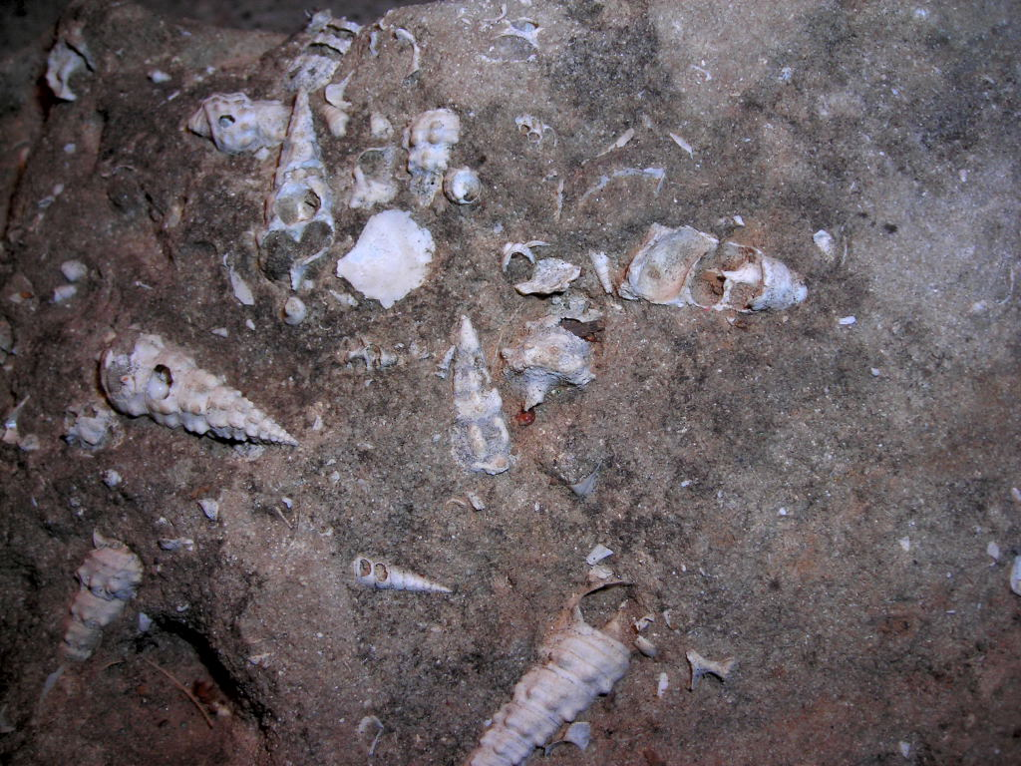
PALAEONTOLOGY
The study of fossils

Slide 14
Dating of Sedimentary Rock
© 2016 Paul Billiet ODWS

Slide 15
Relative dating
Sedimentary rock is laid down in layers or strata the deepest usually being the oldest
This sequence forms the stratigraphy of the rock and together with the fossils and artefacts which are present, give a relative dating
However, due to earth movements in the past and to the great time spans and migrations of some organisms, this method is not very accurate.

Slide 16
Absolute dating
Accurate dating can be obtained using radiometric dating
This uses the phenomenon of radioactive decay of isotopes
When sedimentation occurs radioactive isotopes are incorporated
These decay to form other atoms at a known rate
This rate is measured as the half-life of the isotope, defined as the time taken for half the parent atoms to decay to the daughter atoms
© 2016 Paul Billiet ODWS

Slide 17
Potassium-Argon Method
Potassium-40 (40-K) decays to form Argon-40 (40-Ar), which is trapped in the rocks
The amount of argon is measured, so that this is known as an accumulation method
The half-life of 40-K is 1.3 x106 years, so it is useful for dating very old rock (as old as the Earth), the minimum age being 100 000 years.
The limitation is the degree of precision of the measuring devices
As these improve more recent events may be dated
© 2016 Paul Billiet ODWS

Slide 18
Potassium-Argon Method
Volcanic rock is particularly useful for this technique
When it melts the rock releases any 40-Ar it has in it, setting the clock to zero
Then when the molten rock crystallises it becomes impermeable which traps 40-Ar gas so it cannot escape
With time the 40-Ar builds up and the 40-K diminishes
Volcanic rock, however, does not contain fossils
So when fossils are dated using this method their association with the lava flow or ash fall needs to be established
© 2016 Paul Billiet ODWS

Slide 19
Carbon-14 Method
Carbon-14 (14-C) decays to form nitrogen-14
Carbon-14 is formed in the upper atmosphere by the action of cosmic rays on Nitrogen-14
14-C is oxidised to 14-CO₂ that gets taken up by plants in photosynthesis. The 14-C becomes incorporated in living tissue and travels up the food chain like other isotopes of Carbon (e.g. 12-C)
Whilst an organism is living it incorporates a known amount of carbon-14
At death, no more is taken in, and so the amount declines as the 14-C decays back to 14-N
Death starts the clock!
© 2016 Paul Billiet ODWS

Slide 20
Carbon-14 Method
The ratio of 14-C to 12-C is measured. 12-C is a stable isotope, which does not decay. So as time goes by the ratio of 14-C/12-C gets smaller.
The half-life of 14-C is 5 730 years, so it is used to date very recent remains, the maximum age being 50 000 years (there is not much 14-C left after 9 half-lives).
The amount of 14-C in the atmosphere varies with the amount of bombardment of the atmosphere by cosmic rays. Therefore, correction factors are used which have been calculated using other methods (e.g. dendrochronology –tree ring dating).
© 2016 Paul Billiet ODWS

Slide 21
Carbon-14 Method
Amount | Years
1 | 0
0.5 | 5730
0.25 | 11460
0.125 | 17190
0.0625 | 22920
© 2016 Paul Billiet ODWS

