Slide 1
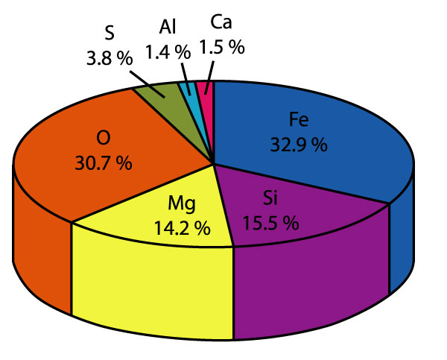
Fundamentals of Geochemistry Niranjan Mohanty
Assistant Professor
Department of Geology
MLS University, Udaipur nmohantyngribhu@gmail.com

Slide 2
Geochemistry
Geochemistry – branch of earth sciences which concerns with the chemistry of the earth and its components.
Inorganic geochemistry – inorganic substances
Organic geochemistry – coal geochemistry
Cosmochemistry – chemistry of the universe.

Slide 3
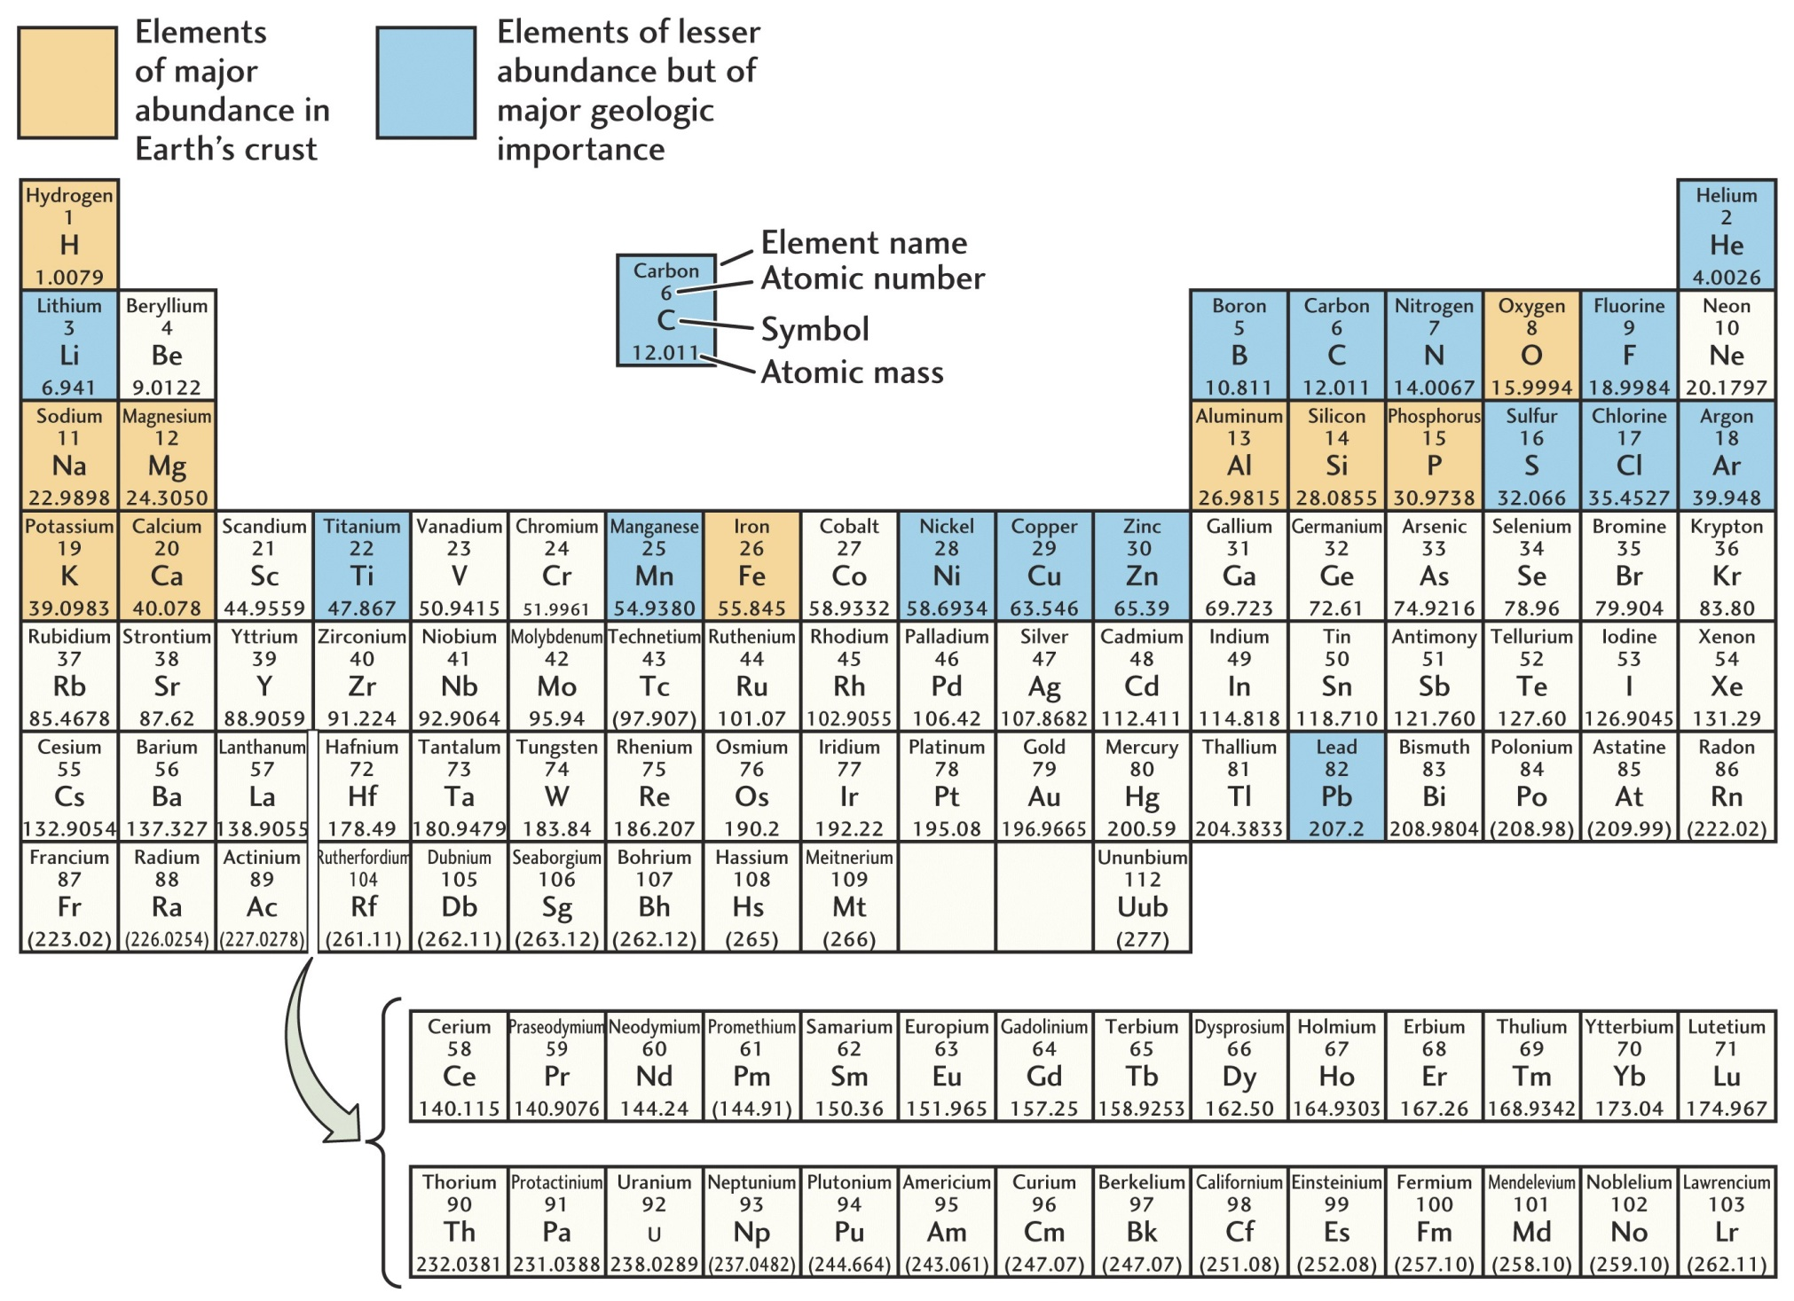
Periodic table of the elements
Similar
properties
Inert elements
Elements gain electrons
Elements lose electrons
Increasing atomic number
& electrons in outer shell.
Fig. 3.3

Slide 4
Abundance of the Elements (wt. %)
Crust Whole Earth
Oxygen (O) 46.3 % 29.5%
Silicon (Si) 28.2% 15.2%
Aluminum (Al) 8.2% 1.1%
Iron (Fe) 5.6% 34.6%
Calcium (Ca) 4.1% 1.1%
Sodium (Na) 2.4% 0.6%
Potassium (K) 2.1% 0.1%
Magnesium (Mg) 2.3% 12.7%
Titanium (Ti) 0.5% 0.1%
Nickel (Ni) trace 2.4%
All others trace 2.6%
Others: Hydrogen (H), Carbon (C ), Sulfur (S), Mangenese (Mn),
Lead (Pb), Uranium (U), Argon (Ar), Phosphorous (P), Zirconium (Zr)

Slide 5
Geochemistry of Elements-1
Major Elements: >1.0 wt% (Si, Al, Fe, Mg, K, Ca, Na, O)
Minor Elements: 01-1.0 wt% (Ti, Mn, Ni, P etc)
Trace Elements: <0.1 wt% (REE, Zr, Nb, Ta etc) (ppm)
1 wt% = 10,000 ppm
MAJOR ELEMENTS- control the mineralogy & crystallizing/melting behaviour in igneous systems
They also control viscosity, density, diffusivity etc of magmas.
MINOR ELEMENTS – substitute for an element in principal mineral (for eg. Mn substituting for Fe or Mg in mafic minerals)
They can form accessory minerals if they are in sufficient amounts.
Zircon, Apatite, Rutile or Ilmenite
TRACE ELEMENTS – cannot form a separate phase(they are so dilute) and they STRICTLY OCCUR as substitutes for major or minor elements.

Slide 6
Geochemistry of Elements-2
Cr is a minor element in ultramafic rocks but it is a trace element in crustal rocks.
Fe is the only major element that occurs in TWO oxidation states (Fe⁺³ or ferric iron) and (Fe ⁺² or ferrous iron).
Titration is required to quantify both form of iron.
Other wise, total Fe is determined where all iron is converted mathematically to FeO* or Fe2O3*.
Asterick means all iron is converted to FeO or Fe2O3 as the case may be.

Slide 7
Elements & Igneous Processes
As a result of different roles played by major, minor & trace elements, they provide distinct insights into various igneous processes.
Major Elements- classification of rocks, study chemical evolution of melts (and minerals) during crystallization or melting process
Trace Elements – they are also used to study evolution of magmas but they are particularly effective as TRACERS to constrain magma sources or to DISCRIMINATE between some magmatic processes.

Slide 8
How to determine elemental concentration in igneous rocks?
Wet Chemical methods (volumetric or gravimetric)
Time consuming
Experience needed
Only Major & minor elements can be determined
Instrumental techniques (based on ability of atoms to either to emit or absorb radiation with frequencies characteristic of element responsible)
They are also called SPECTROSCOPIC TECHNIQUES (Electromagnetic spectrum)

Slide 9
Various Instrumental techniques -1
Flame Photometry- for Na, K
Atomic absorption spectrometry (AAS) – for Minor elements
X-Ray fluorescence spectrometry (XRF) – for major and minor elements
Inductively coupled Plasma (ICP) – for trace and minor elements
Plasma = sample + argon gas
Instrumental Neutron activation analysis (INAA) – for trace elements

Slide 10
Various Instrumental techniques -2
Mass spectrometers – for measuring isotopic ratio
Electron Micro Probe Analyzer (EPMA) – for mineral chemistry
Scanning Electron Microscopy (SEM) – for magnification & surface topography of minerals
Ion Microprobe – for elemental as well as isotopic analysis in minerals.

Slide 11
Electron Micro Probe Analyzer (EPMA)

Slide 12
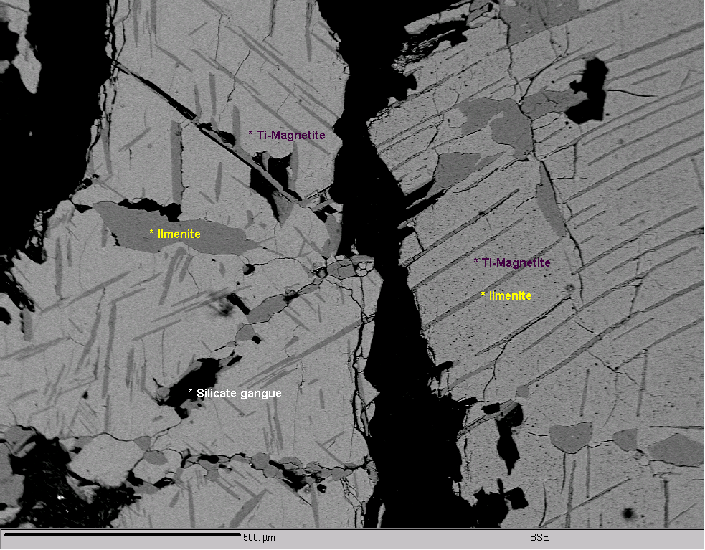
Ilemnite & Magnetite

Slide 13
Gold grains in Sukinda Chromite

Slide 14
Three variables of instrumental techniques
Every instrumental technique is a function of three aspects
PRECISION (repeatability & reproducibility)
ACCURACY (how close the obtained value is to that of REAL value)
DETECTION LIMIT (minimum concentration of an element that can be ‘SEEN’ by instrument)

Slide 15
Some terminalogy
H₂O is the most common volatile in rocks & minerals.
H₂O⁺ = structural water (water in hydrous minerals like mica, amphibole etc)
H₂O⁻ = Adsorbed water along grain boundaries
This can be driven off if you heat the sample for ~100ºC
LOSS on IGNITION (LoI) is the heating of a sample to ~800ºC. It drives away all the volatiles in the sample (H2O, CO2 etc).
LoI includes structural + adsorbed water.

Slide 16
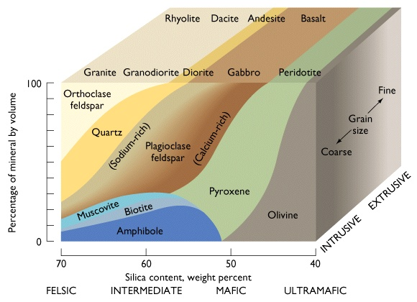
Major Minerals of Igneous Rocks

Slide 17
VARIATION DIAGRAMS
If we go from peridotite to rhyolite, MgO will decrease, FeO* will decrease, SiO2, alkalies and Al2O3 will increase.
This variation is a reflection of its mineralogy !
Data presentation in a table makes hard to see variations (norm)
If you plot it, then relationships are obvious.
Variation diagrams are used to test various hypothesis of magma origin and in classification of rocks.
Geochemical data when plotted in such a pattern so that they reflect systematic variations are called VARIATION DIAGRAMS.
They can be bi-variate or triangular diagrams.

Slide 18
Bi-variate diagrams
P2O5
P2O5
TiO2
TiO2
Al2O3
Alkalies
Alkalies
FeO
CaO
SiO2
Harker diagram – when
SiO2 is on absicca

Slide 19
TRIANGULAR DIAGRAMS
Three parameters can be represented at three corners.
They are only approximate amounts but not absolute concentrations.
Since they are all normalized to 100.

Slide 20
Types of magmas- from variation diagrams
PRIMARY MAGMAS – derived directly by partial melting of some source but they do not have characteristics to reflect effects of differentiation.
How to distinguish that ?
Mg no = 65-80; Cr>500 ppm, Co = >50 ppm, Ni = >500 ppm
EVOLVED or DERIVATIVE MAGMAS – some form of chemical differentiation.
These are of two types:
Primitive magma – not very evolved.
Parent magma – most primitive magma. From this magma, all the suites in that area are derived.

Slide 21
DALY GAP
Volcanics with SiO2 content between 48-58 wt% are less common than basalts (<48%) and trachytes and rhyolites (>58%). This compositional gap in volcanic series is called Daly gap (after Reginald Daly).

