Slide 1
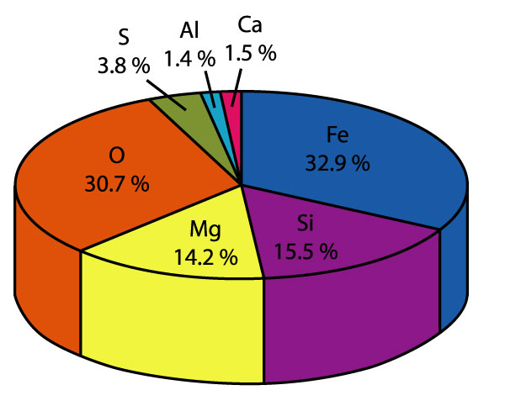
Major, REE, & Trace element in Geochemistry
Niranjan Mohanty
Assistant Professor
Department of Geology
MLS University, Udaipur
nmohantyngribhu@gmail.com

Slide 2
Trace elements & igneous processes
Because different minerals selectively incorporate or exclude trace elements with much greater selectivity than for major elements TRACE ELEMENTS are far more SENSITITIVE TO igneous fractionation processes.
Origin and evolution of magmas can be better constrained by using trace elements than by major elements.

Slide 3
Goldschmidt
V.M.Goldschmidt – FATHER OF GEOCHEMISTRY
International Goldschmidt conferences are held every two years.
He has classfied trace elements and also gave certain rules which predict their behaviour in magmatic systems

Slide 4
Classification of elements in periodic table by Goldschmidt
• In the classification scheme of Goldschmidt, elements are divided according to how they partition between coexisting silicate liquid, sulfide liquid, metallic liquid, and gas phase… Melting a chondrite gives 3 immiscible liquids plus vapor:
•
Gas Phase
Atmophile
H, He, N, Noble gases
Alkalis, Alkaline Earths, Halogens, B, O, Al, Si, Sc, Ti, V, Cr, Mn, Y, Zr, Nb, Lanthanides, Hf, Ta, Th, U
Silicate Liquid
Lithophile
Sulfide Liquid
Chalcophile
Cu, Zn, Ga, Ag, Cd, In, Hg, Tl, As, S, Sb, Se, Pb, Bi, Te
Metallic Liquid
Siderophile
Fe, Co, Ni, Ru, Rh, Pd, Os, Ir, Pt, Mo, Re, Au, C, P, Ge, Sn
Some elements show affinity for more than one group because distribution of an element is also dependent on temp, pressure and chemical environment of system as a whole.
For eg Fe, Co, Ni = Siderophile but also chalcophile & lithophile in earth’s crust.
•

Slide 5
Goldschmidt categories are well-grouped in the periodic table of the elements

Slide 6
Goldschmidt rules – trace element distribution
1. When a minor element has same charge & ionic radius as a major element then this substitution is called CAMOFLAUGE e.g. Rb in K (K-feldspars), Ni in Mg in (olivine).
2. When a minor element has similar ionic radius but a higher charge than that of a major element then it is said to be CAPTURED by lattice of major element e.g. Ba+2 in K+
3. When a minor element has same or similar ionic radius but lower charge than a major element then it is said to be ADMITTED into the crystal lattice of the major element. E.g. Li+ in Mg++
It should be remembered that in CAPTURE & ADMITTANCE ions of different charge, balance has to be maintained by concomitant substitution elsewhere in the structure.

Slide 7
Henry’s Law
In particular the behavior of the trace element does not depend on its own concentration
Depends on -
Composition of minerals
substituted element (ionic radii, charge etc)
Temperature
Pressure

Slide 8
Compatible & Incompatible trace elements
When Earth’s mantle is melted, trace elements display a preference either for a melt phase or a solid (mineral) phase.
Trace elements whose preference is for mineral phase are COMPATIBLE trace elements.
Those elements which show preference for melt are called INCOMPATIBLE trace elements.
Incompatible elements (are not compatible in mineral structure) and will leave at FIRST opportunity.
Incompatible elements are also called HYGROMAGMATOPHILE elements.

Slide 9
Illustration of compatibility & incompatibility
The degree of compatibility & incompatibility of trace elements vary in melts of different composition.
Phosphorous is incompatible element in mantle mineralogy & during partial melting gets quickly concentrated in melt.
Phosphorous is compatible in crustal rock like granite since it is accomodated in apatite.
Incompatible trace elements are of two types based on ratio of valency to ionic radius:
High Field Strength Elements (HFSE) – these are smaller but highly charged e.g. REE, Th, U, Zr, Hf, Ti etc
Large Ion Lithophile Elements (LILE) or Low field strength elements – these are larger but has less charge e.g. K, Rb, cs, Ba, Pb etc
LILE are more MOBILE compared to HFSE
(Indices of alteration, metamorphism)

Slide 10
Partition coefficient or Distribution coefficient - 1
It is assumed that at equilibrium, the ratio of concentration of a trace element in a solid phase (C_{s)} to its concentration in liquid (C_{L}) is a constant (D):
D= C_{s}/C_{L}
The constant is called PARTITION COEFFICIENT or DISTRIBUTION COEFFICIENT or NERNST PARTITION COEFFICIENT.
It is also denoted as K_{D}
Eg: Silicate melt
500 ppm of Sr in a plagioclase phenocryst
125 ppm of Sr in glassy matrix
K_{D} of Sr for that melt is 4

Slide 11
Partition coefficient or Distribution coefficient - 2
If K_{D} = 1, then trace element is equally distributed between mineral and melt
If K_{D} = > 1, then trace element has a ‘preference’ for mineral phase & in the mineral-melt system under investigation and is a compatible trace element.
If K_{D} = < 1, then trace element has a ‘preference’ for melt phase & in the mineral-melt system under investigation and is a incompatible trace element.

Slide 12
BULK PARTITION COEFFICIENT
A rock is an aggregate of minerals, so the Bulk distribution coefficient for a rock for a specific element can be calculated from partition coefficients of constituent minerals weighed according to their proportion. It is defined by expression
D_{i} = x₁ K_{d1} + X₂K_{d2} + X₃K _{d3}…
D_{i} = bulk partition coefficient for element I
X₁ = modal proportion of mineral 1 etc
K_{d1} = parition coefficient for element i in mineral1
For eg. In a rock containing 50% olivine, 30% Opx & 20% cpx, the bulk partition coefficient would be
D_{i} = 0.5 K^{ol}_{d1} + 0.3K^{opx}_{d2} + 0.2K^{cpx} _{d3}…

Slide 13
What controls value of partition coefficients in mineral/melt systems?
Melt composition (elements partition differently in a acidic or basaltic melt)
Temperature (they are a function of temperature)
Pressure
Oxygen fugacity (activity of oxygen)
Water content of melt
Crystal chemistry (structure)

Slide 14
Partial Melting – application of trace elements
Partial melting – localization of present day volcanism shows that Earth’s mantle melts only partially.
It means that required conditions of mantle conditions are available only locally & accessible temperature in earth are not sufficient to melt earth totally!
Why earth’s mantle melts?
The composition of melt depends on
(I) mineralogy & chemistry of source
(ii) residual mineralogy
(iii) depth & degree of melting
(iv) type of melting process

Slide 15
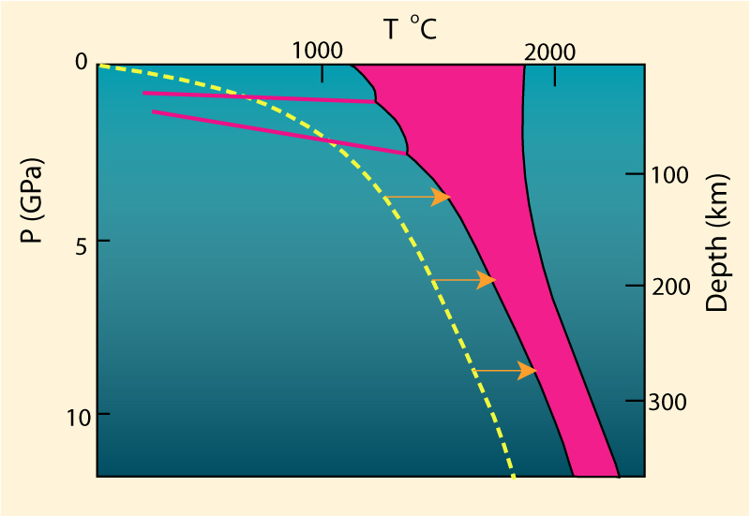
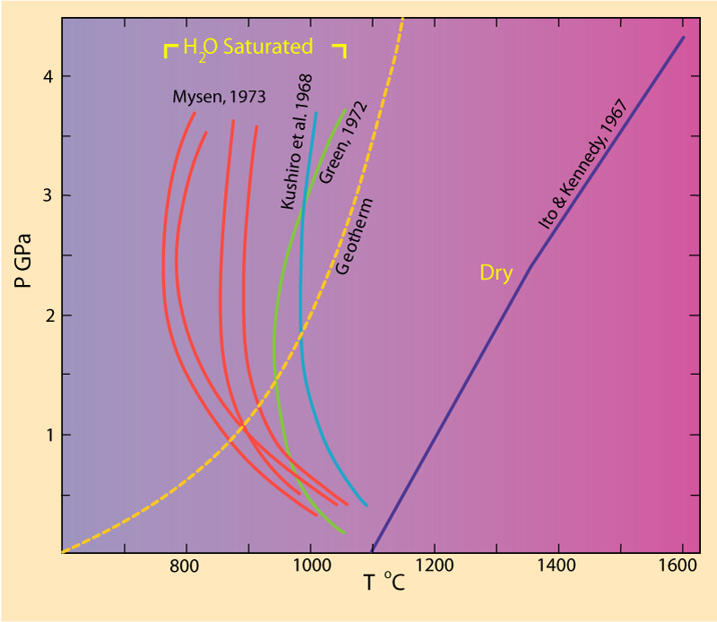
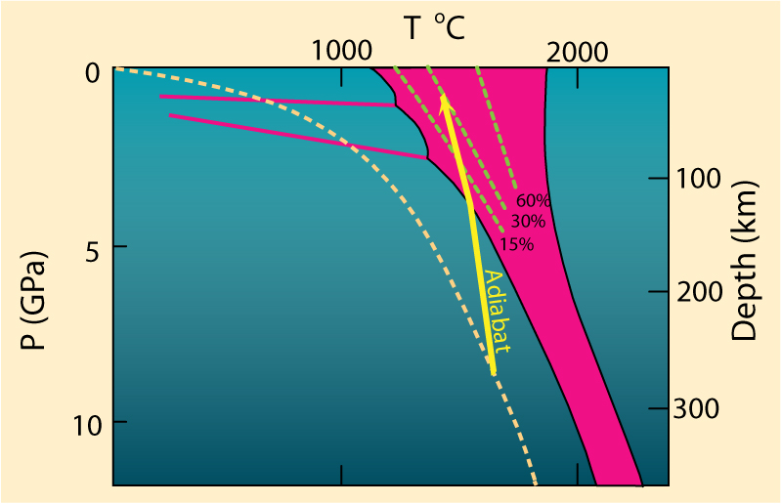
Why Earth’s mantle melts?
Rise Tº
Addition of volatiles
Lower P

Slide 16
Different types of partial melting – based on observations on trace element compositions of basalts
Four types of partial melting processes are known:
Batch melting or Equilibrium melting or equilibrium fusion melting – after a certain fraction of melting , the melt is extracted mechanically from the solid phases in a single batch .Chemical equlibrium is achieved between solid and melt and bulk composition of system remains unchanged until melting is completed).
Fractional melting or Rayleigh melting – here small melt fractions are continuously & completely extracted as the melting proceeds. Only the last drop of liquid is thought to be in equilibrium with the residue.
Continuous melting or disequilibrium melting – intermediate process between batch & fractional melting where instantaneous melt is continuously but not completely removed as melting proceeds. Here, a part of melt always remains in residue.
Dynamic partial melting – a composition of melts produced by both batch melting and continuous melting of a chemically homogeneous source.
They show both LREE enriched and LREE depleted patterns with crossing REE patterns.

Slide 17
Trace elements- igneous petrogenesis
Element | Use as a petrogenetic indicator
Ni, Co, Cr | Highly compatible elements in olivine, spinel and cpx; High concentrations indicate a mantle source; limited fractionation.
V, Ti | Compatible elements; Show parallel behaviour in melting & crystallization;They are useful indicators of fractionation of Fe-Ti oxides (ilmenite or ti-magnetite).If they show divergent behaviour, then Ti substitution into rutile or spheneis indicated.
Zr, Hf | Classic incompatible elements; do not substitute into any major silicate phase; high contents – enriched source
Ba, Rb | Incompatible elements; substitutes for K in KF, Biotite and Hbl; K/Ba or K/Rb indicate role of these phases in petrogenesis.
Sr | Substitutes for Ca in plagioclase (not in pyroxene) and rarely K in KF; behaves as compatible element at low pressure (where plagioclase forms early) but as incompatible element at high pressures (Plg is unstable).
REE, Y | Incompatible elements; myriad used in petrogenesis; HREE >LREE occur in garnet; LREE>HREE in sphene and plagioclase; Eu +2 is strongly partitioned in plagioclase

Slide 18
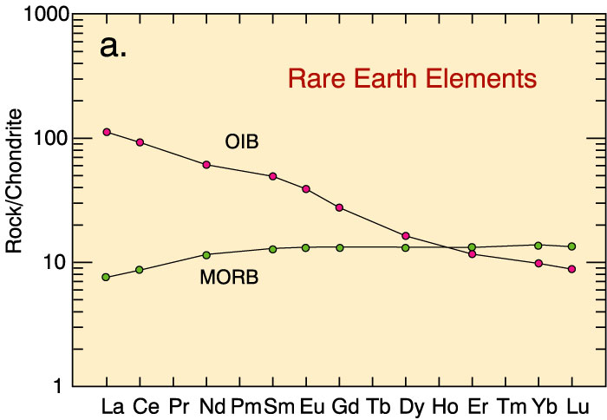
Rare Earth Elements
increasing incompatibility

Slide 19
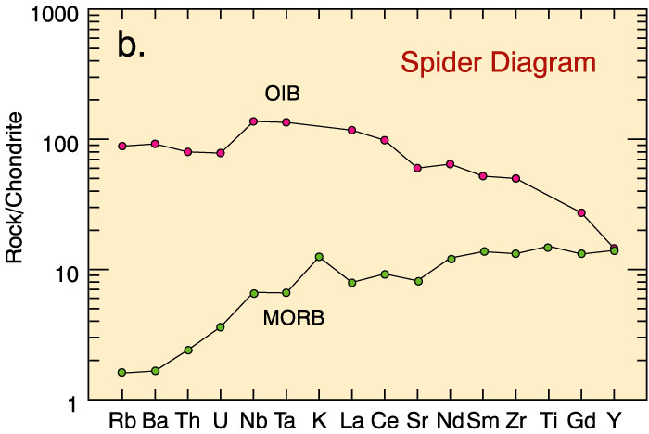
Spidergrams or Spider-diagrams
Thank you
increasing incompatibility

