Slide 1
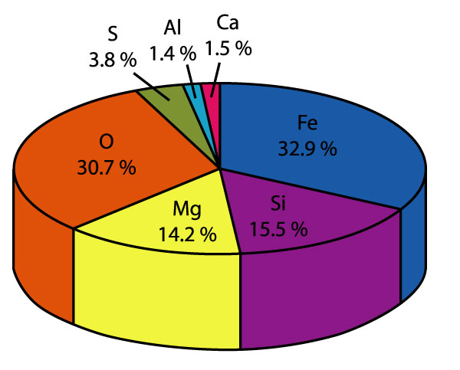
Thermodynamics in Geochemistry Niranjan Mohanty
Assistant Professor
Department of Geology
MLS University, Udaipur nmohantyngribhu@gmail.com

Slide 16
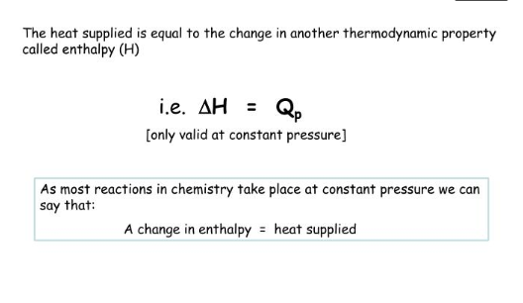

Slide 21
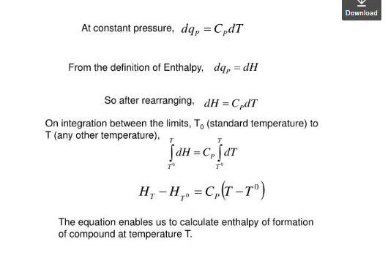

Slide 24
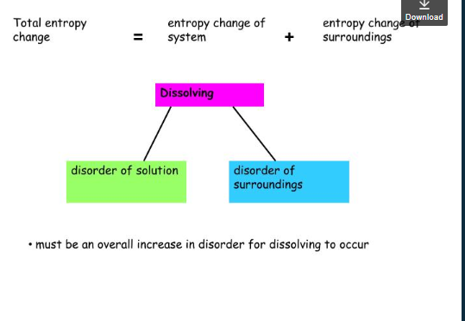

Slide 34
Gibbs free energy
dE=dQ-PdV
On integrating the above equation
∫dE= ∫dq-P∫dV
E=q-PV
E+PV=q
E+PV=H (Enthalpy)
So, H=q
From second law of thermodynamics
Q_{res}/T=S (Entropy)
Or Q_{res}=TS
By equation 2 put the value of q in equation 3
H=TS
Or
H-TS=0
Now introducing the new functions of gibbs free energy (G) in the expression at the equilibrium
The quantity G is called gibbs free energy
G=H-TS

Slide 35
For changes in Gibbs free energy from initial to final state
∆G= ∆ H- T ∆ S ( T, temp is constant)
For any reaction
∑∆ G=∑ ∆ G_{product}- ∑∆ G_{reactant}
At standard state equation is written as
∆ G˚= ∆ G ˚ -T ∆ S ˚
Variation of Gibbs free energy change with temperature and pressure
We know G= H-TS & H= E+PV
Now substituting value of H from the above equation
G= E+PV-TS
Differentiating the above equation, we have
dG=dE+PdV+VdP-TdS-SdT
From the 1st law of thermodynamics for infinitesimal change
dE=dq-dW
dE= dq-PdV
dE+PdV=dQ
Entropy dS=dQ/T
dQ=TdS
Substituting the value of dq from equation b to equation a, we have
dE+PdV=TdS

Slide 36
Substituing the value of dE+PdV from equation
dG=TdS+VdP-TdS-SdT
dG=VdP-SdT
This equation give change of free energy, when a system undergoes revesibly, a change of pressure as well as change of temprature

