Slide 1
Meteorites: what are they ?
Shooting stars or Falling stars or Fire balls.
Natural object from outspace falling on the Earth`s surface.
Disintegrated fragments survived upon entering Earth‘s atmosphere.
They may be derived from meteoroids (smaller) or even asteroids (bigger).
They may also be derived from other planets such as Mars or even Moon.

Slide 2
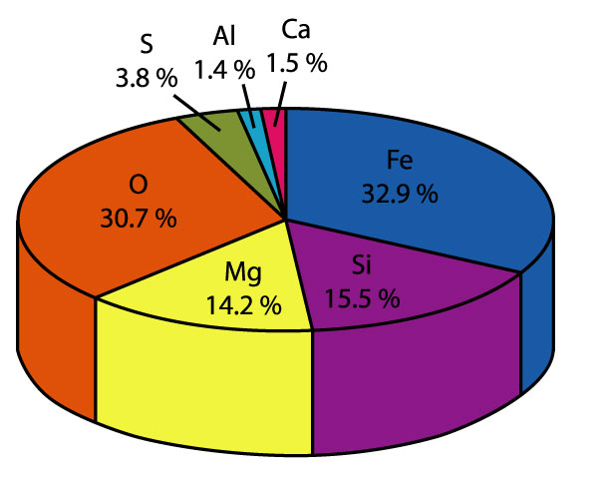
Introduction to Meteorites
Niranjan Mohanty
Assistant Professor
Department of Geology
MLS University, Udaipur
nmohantyngribhu@gmail.com

Slide 3
Meteoroids vs Asteroids vs Meteors vs Comets
Meteoroids: any object which orbits around the sun on a collision course with another planetary object.
Meteor: Bright streak of light in the sky due to burning of a planetary object on entering the Earth`s atmosphere. Flash of light!
Comet: An asteroid or meteroid which glows when close to the Sun; it should have a tail like a comma (e.g., Halley‘s comet).
Asteroid: it is bigger than a meteroid and orbits around the sun (e.g., Shoemaker levy)

Slide 4
Why are they important ?
They provide direct information on the early conditions of the solar system.
They provide direct information on the interiors of the planets and asteroids.
They also tell us about the planets or asteroids that have long disappeared and constitute only ever sources of information.
The age of formation of the solar system (condensation of solid material from gas and cloud ) is based on ages of meterorites.
The age of the Earth is based on measurements of dating on hundreds of meteorites (4.47-4.57 Ga).
They are the oldest materials we have from the solar system.
Meteorites are Poor man‘s space probes!!!

Slide 5
Smaller meteorites -2
Wethersfield, Connecticut,
November 8, 1982.
6-pound meteorite crashed
through roof.

Slide 6
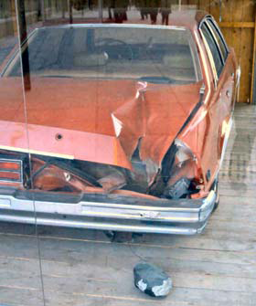
Smaller meteorites -1
Peekskill Meteorite
Now in the
Smithsonian Museum of natural
history!

Slide 7
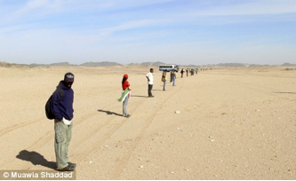
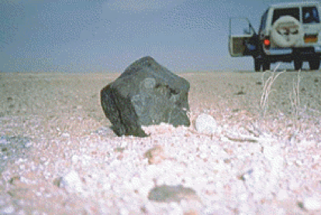
Where to look for meteorites?
Anywhere (ocean bottoms to mountain tops!)
Best places are deserts and…

Slide 8
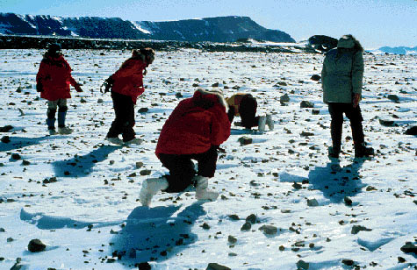
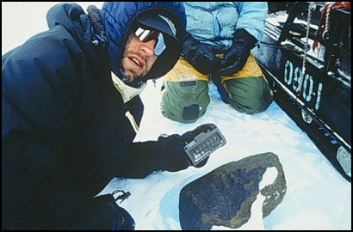
Where to look for meteorites?
Antarctica!

Slide 9
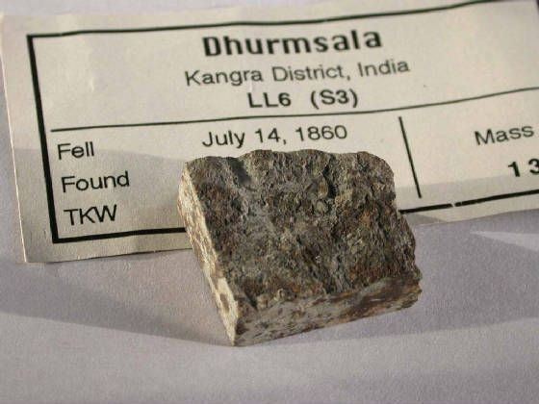
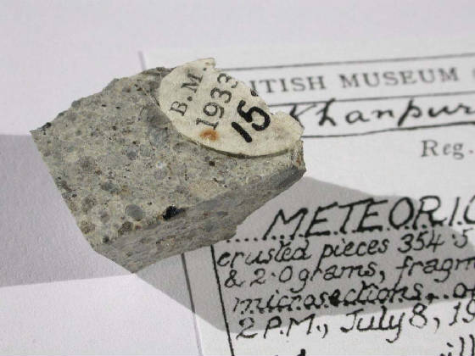
Some Indian Meteorites
Khanpur 1933
Dharamshala 1860

Slide 10
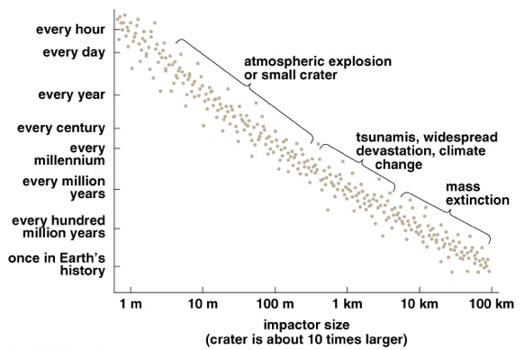
What can be the size of the meteorites?

Slide 11
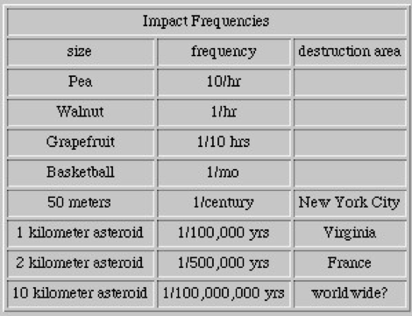
What meteorite impacts can cause?

Slide 12
How to recognize a meteorite?
Fall : a meteorite actually observed falling
Find: a meterorite not seen to fall but found sometime later (even 2 Ga!)
1000 falls and 31,000 finds as on 2006.
So, falls are rarer than finds.

Slide 13
How to know you have got a meteorite?
They have high iridium and other metal contents considerably higher than those known in terrestrial samples.
Many other metal contents are also higher.

Slide 14
How meteorites are named?
Name of the place:
e.g. Prairie dog Creek (USA);
Murchison meteorite (Victoria, Australia) organic compounds
Kendrapara (India)
Allende (Mexico)

Slide 15
Four major types of meteorites (Mason and Moore)
Siderites or Irons (avg 98% metal)
Siderolites or Stony irons (50% metal; 50% silicates)
Aerolites or Stones (silicates)
Tekites (75% made of tektosilicates)

Slide 16
Siderites or Irons
Made of Ni-Fe alloy (Ni is 4-20 %)
Other accesories such as FeS (troilite), schreibersite [(Fe, Ni, Co)₃ P] and graphite.
Widmanstatten figure is displayed normally (etch the polished surface with alcoholic solution of HNO₃)
Lamellae are parallel to octahedral faces (exsolution due to very slow cooling)
Lamellae are made of kamacite (Ni-Fe alloy with 6% Ni) bordered by taenite (Ni-Fe alloy with 30% Ni)
Such meteorites are called Octahedrites.
Hexahedrites = dominated by kamacite.

Slide 17
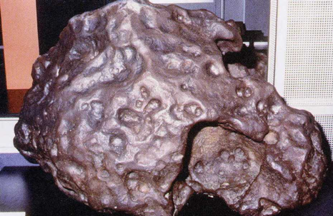
Iron meteorites

Slide 18
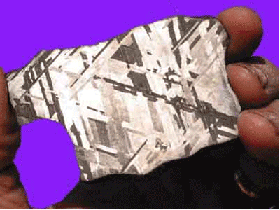
Widmanstatten structure

Slide 19
Siderolites or Stony Irons
They have Ni-Fe and silicates in approximately equal proportions.
Two groups are recognized:
Pallasites
Mesosiderites
Pallasites have a continuous base of Ni-Fe and enclose olivine grains of euhedral forms.
Mesosiderites have a discontinuous base and silicates are Plagioclase and pyroxene with accessory olivine.

Slide 20
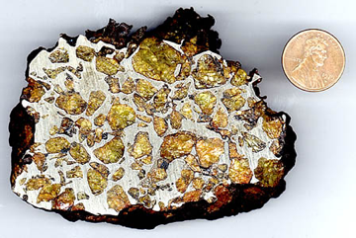
Stony Iron meteorites

Slide 21
Aerolites or Stones
Two groups:
Chondrites (primitive and non-differentiated or unmelted)
Achondrites (differentiated or melted)
Chondrites have chondrules or chondri (small rounded bodies of up to 1mm in diameter) made of olivine and pyroxene. Unique to meteorites and never found in terrestrial rocks.
Avg composition: 40% Olivine, 30% pyroxene, 10-20% nickel-iron, 10% plagioclase and 6% troilite.
A group of chondrites are carbonaceous chondrites consists of complex organic compounds (origin is controversial).
Responsible for life and water on Earth!

Slide 22
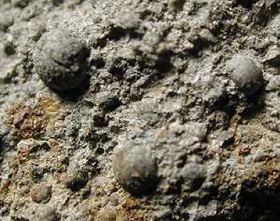
Chondritic meteorites

Slide 23
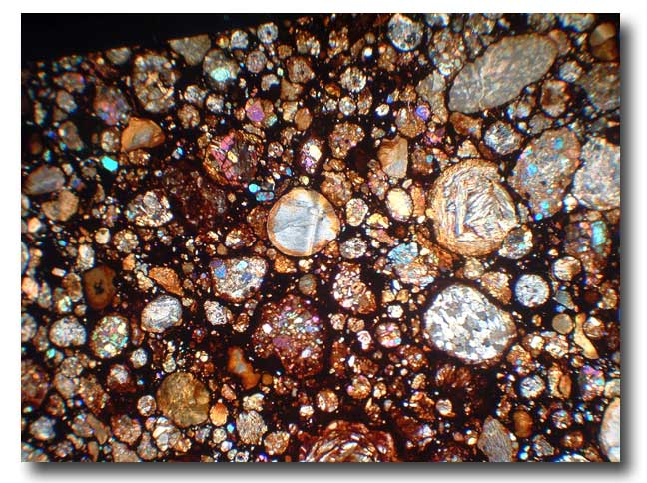
Chondrites in microscope

Slide 24
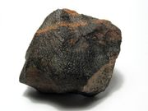
Achondrites
Donot contain chondrules and are more coarse grained
Resemble terrestrial silicate rocks and hence probably crystallized from a silicate melt.
Similar to basalts and gabbros.
They are differentiated meteorites.

Slide 25

Chondrites = Bulk Earth
+
=
Crust+
Mantle+
Core

Slide 26
Tektites
Made of silica-rich glass (75% SiO2)
Resembles obsidian but still different
Also have Al, K, and Ca.
Very low Mg and Na.
Driest glasses (0.005% water)
Unusual in composition.
Usually small (200-300gm) and occur in areas where no volcanic activity is known.
Nobody has seen them as falls so their origin is controversial.
But the precuror material is of terrestrial orgin (chemistry and isotopes)

Slide 27
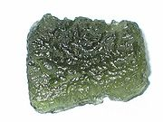
Tektite

Slide 28
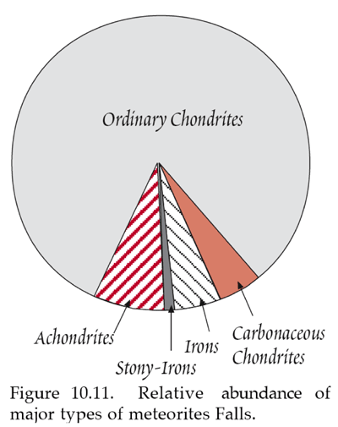
Relative abundances of falls

Slide 29
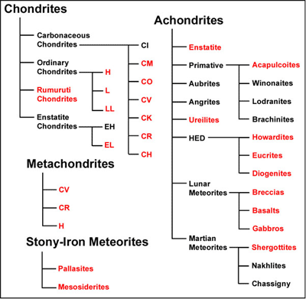
Classification of meteorites

