Slide 1
Chapter 19 Alcoholic Beverages
At the end of the class, you will be able to
define alcoholic beverages
know the method of making alcoholic beverages
classify alcoholic beverages with examples
Understand various scales used in measuring the alcoholic strength

Slide 2
Alcoholic Beverages
A potable liquid containing ethyl alcohol or ethanol (C2H5OH) of 0.5 per cent or more by volume is termed as an ‘alcoholic beverage’.
Alcoholic drinks are produced by the following methods:
Fermentation • Distillation
Fermentation is the process in which sugar is converted to alcohol and carbon dioxide by yeast. This process is the basis for producing all types of alcoholic beverages.
Distillation is the process of separating elements in a liquid by vapourization and condensation. In the distillation process, the alcohol present in the fermented liquid is separated from water.

Slide 3
Fermentation
The following are necessary for fermentation to take place:
Sugar
Yeast
Temperature
In the absence of any of these, fermentation will not occur.

Slide 4
Distillation
In the distillation process, the alcohol which is present in the fermented liquid (alcoholic wash) is separated from water.
Brandy, whisky, gin, rum, vodka, tequila are examples of spirits which are prepared from the alcoholic wash as given in the following.
Brandy—fermented grape juice
Rum—fermented molasses
Gin, whisky—fermented cereal
Vodka—fermented potatoes or cereal
Tequila: fermented sap of agave Tequilana weber

Slide 5
Types of Still
There are two types of still used for distilling spirits:
The pot still
The patent or continuous still

Slide 6
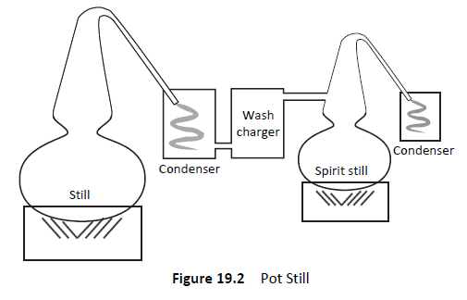
Pot Still

Slide 7
Pot Still
Pot still method is the oldest method of distillation and most of the finest spirits are made by pot distillation.
Cognac, malt whisky, Dutch gin, Irish whiskey, tequila, liqueurs, and dark rums are pot stilled.

Slide 8
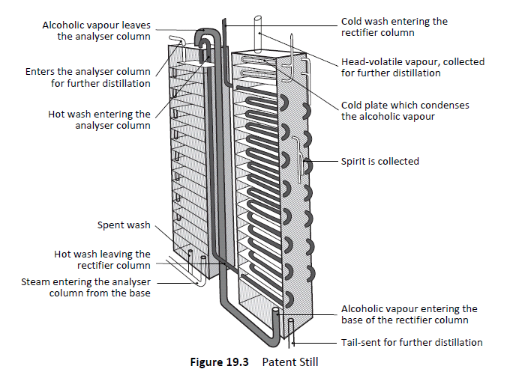
Patent Still

Slide 9
Patent Still
The patent still is also termed as continuous still or coffey still. In this system, the alcohol is separated from the liquid by hot steam and the end product is ‘congener-free’; it has high alcohol content.
Light spirits, such as gin, vodka, white rum, neutral spirit, grain whiskey, etc. are prepared in this method.

Slide 10
Classification of Alcoholic Beverages
Alcoholic drinks are classified into three broad categories as
Fermented drinks (wines, cider, Perry)
Brewed and fermented drinks( Beer, Sake)
Distilled drinks (Spirits, Liqueurs, Eaux-de-vie)

Slide 11
Alcoholic Strength
There have been traditionally three main scales used in measuring the alcoholic strength of the drinks. They are in the following.
1. The Sikes scale
2. The Gay–Lussac (GL) scale
3. The American scale

Slide 12
Points to Remember
Alcoholic beverage is a potable liquid containing ethyl alcohol or ethanol (C2H5OH) of 0.5 per cent or more by volume.
Alcoholic drinks are produced by the following methods:
Fermentation • Distillation
Pot still and Patent still are the two types of distillation
Alcoholic drinks are classified as fermented, brewed and fermented, and distilled drinks
Sikes scale, Gay–Lussac scale and American scale are the three scales used to measure the alcoholic strength

