Slide 1
Fundamentals of Management
&
Organizational Behaviour

Slide 2
Organization
A group of individuals who work together toward common goals.
Is a social entity that is goal directed and deliberately structured.

Slide 3
Organization
Organizations are groups of people, with ideas and resources, working toward common goals.
OR
A systematic arrangement of people brought together to accomplish some specific purpose is called organization.
Characteristics of Organization
Distinct Purpose
Deliberate
Structure
People
Notes:
21

Slide 4

Manager
  A manager is someone whose primary responsibility is to carry out the management process within an organization to achieve the organizational goals.
  Changing nature of organizations and work has blurred the clear lines of distinction between managers and non-managerial employees.
Notes:
4

Slide 5
Manager
  Someone who plans and makes decision , organizes ,leads and controls human, financial physical and information resources.

Slide 6
MANAGEMENT
Management is the first modern institution to shape the society.
It regulates man’s productive energies.
It organizes factors of production.
Peter Drucker- without leadership, countriies resources remain resources and never become production.
Mgt. converts mob’s into an organization and human efforts into performance.

Slide 7
Concepts/Viewpoint of Management
Concepts of Management
Career
Discipline
Class or elite
System of authority
Economic resource
Process

Slide 8
Management is the force that unifies human as well as non human resources in the service of organizational goals. It is a process of getting results with and through people.
Management as a unifying force
Management
Manpower
Materials
Methods
Money
Machinery
Market

Slide 9
Managers use resources effectively and efficiently to satisfy customers and to achieve goals.
  Efficiency: A measure of how well resources are used to achieve a goal.
  Effectiveness: A measure of the appropriateness of the goals chosen (are these the right goals?), and the degree to which they are achieved.

Slide 10
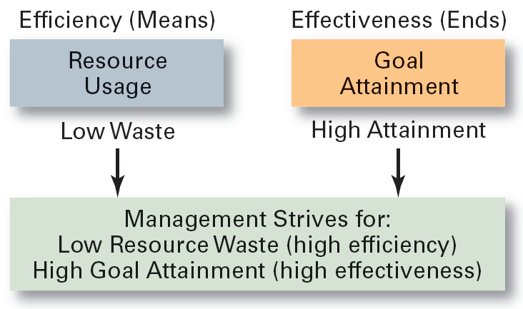
Effectiveness and Efficiency in Management

Slide 11


Efficiency - getting the most output from the least amount of inputs
  “doing things right”
  concerned with means
  Achieving the objectives in time
Effectiveness - completing activities so that organizational goals are attained
  “doing the right things”
  concerned with ends
  Achieving the objectives on time

Slide 12
DEFINITION-MANAGEMENT
F.W. Taylor -“Art of knowing what you want to do and then seeing that it is done the best and cheapest way”.
Henry Fayol –“To Manage is to forecast, to plan, to organise, to command, to co-ordinate and to control”.
Peter F.Drucker –”Management is work and as such it has its own skills, its own tools and its own techniques”.
“Management is the art of getting things done through and with people”.

Slide 13
Different context of defining management:
There are four such orientations have been adopted in defining management process:
  Production-or efficiency-oriented,
  Decision-oriented,
  People-oriented, and
  Function-oriented.

Slide 14
Production- or Efficiency-oriented Definition (F.W. Taylor ):
“Management is the art of knowing what you want to do and then seeing that it is done in the best and cheapest way”

Slide 15
Decision-oriented Definition (Prof. Clough):
“Management is simply the art and science of decision making and Leadership”

Slide 16
People oriented Definition (Lawrence):
“Management is the accomplishment of results through the efforts of other people”

Slide 17
Function /Process oriented Definition (Henry Fayol):
“To manage is to forecast and to plan, to organize, to coordinate and to control”

Slide 18
  These definitions imply that-
  1. Management is Dynamic.
  2. Management is Continuous.
  3. Management is Universal.
  4. A primary task of managers is to Perform.

Slide 19
Characteristics/Features of Management
  Art as well as Science
  Management is an activity
  Management is a continuous process
  Management achieving pre-determined objectives
  Organized activities
  Management is a factor of production
  Management as a system
  Management is a discipline

Slide 20
  Management is a distinct entity
  Management aims at maximizing profit
  Management is a purposeful activity
  Management is a profession
  Universal application
  Management is getting things done
  Management is needed at all levels

Slide 21
Administration: The overall determination of policies, the setting of major objectives and the laying out of broad programmes.

Slide 22
1. Administration is broader than Management
According to this American school of thought , Writers like Ordway Tead, Oliver sheldon, William Spriegel .
2. Administration is part of Management
According to English school of thought, represented by E.F.L.Brech, Kimball and Kimball and Henry Fayol, management is a wider concept than administration.
3. Management and Administration are identical
Writers like William Newman, Harold Koontz

Slide 23
To resolve the controversy Drucker suggested that, management is applicable in business enterprise while administration is applicable in government offices, military organizations, social and cultural institutions.
Difference between Administration and Management
Basis of Difference | Administration | Management
Nature Scope Level Skills needed Represents | Thinking function (what is to be done and when). Determines broad objectives and policies (broad and conceptual). Top level function. Conceptual and human skills. Owners who invest capital and receive profits. | Doing function (who should do it and how). Implements plans and achieves goals through people (narrow and operational). Middle and lower level function. Technical and human skills. Paid individuals who work for remuneration

Slide 24
NATURE OF MANAGEMENT

Slide 25
Mgt. as an Art
Mgt. as a Science
Mgt. as a Universal Concept
Mgt. as a Profession
Mgt. as a System
Mgt as a Social Responsibility

Slide 26
1. Management as an Art
Management is a Art as it is concerned with the application of knowledge and skills (personal qualities like music, painting etc.) to achieve results.
The essential features are:
Art requires learning of theory and know-how
It involves practical application of theoretical knowledge
It is result oriented
It is personal skill
It encompasses creativity and innovation

Slide 27
Science Vs Art
Science | Art
Advances by knowledge Proves Predicts Defines Measures Impresses | Advances by practice Feels Guesses Describes Opines Expresses

Slide 28
2. Management as a Science.
Management is a Science as it has a systematized body of knowledge, concepts and principles (like the motion-studies, morale, motivation, leadership)
Management scholars accept mgt. as a science on following grounds:
It has systematic body of knowledge.
It constitutes principles and theories.
Mgt. principles tend to be true in most managerial solutions.
Manager also takes decision using scientific methodology.
Its functions and principles are universally applied.
Modern managers use quantitative techniques.

Slide 29
Management has got two faces like a coin; on one side it is art and on the other it is science.
Management has got scientific principles which constitute the elements of Science and Skills and talent which are attributes of Art.

Slide 30
3. Management as a Profession.
It is an -
Occupation for which specialized knowledge, skills and training are required
These skills are used for larger interest of the society
The success of these skills is not measured in monetary terms always.
Management is not a full fledged Profession because:
(a) there is no university organized degree to become a
manager,
(b) there is no all India body to regulate the practices of managements
(c) there is no widely expected code of conduct.

Slide 31
4. Management as a Universal Concept.
The concept of universality has the following implications –
Mgt. Process is universal (ie Plg, Org, Dir, Controlling etc)
Mgt. Knowledge is universal (common laws, principles, concept)
Mgt. is applicable to all levels of Organization.
Mgt. Knowledge is transferable.
Managers can be developed.
Managers can adapt and adjust to the new environment.
Basic principles and functions are universally applicable but practice varies from situation to situation and is culture bound.

Slide 32
5. Management as a System.
A system is an organised or complex whole.
As a system, mgt. is an integrated view of ideas, things and people.
When Mgt. is regarded as a system it has following implications-
Linking Element (co-ordinates subsystems to plan, org, lead & control)
A Social System (represents pattern of work and human relationships)
An Open System (gets inputs, energy and materials from env.)
Adaptive (to meet needs of changing world)
Dynamic (moving towards growth and expansion)
Organic (flexible…full of life)
Multilevel and Multidimensional (system within system)
Complex whole (parts are interrelated and creates synergy)

Slide 33
External environment
Input
the physical, human, material,
financial &
info process
Conversion
comprise the tech used to convert inputs to outputs
Output
the original inputs as & changed by transformation process
Feedback
info about a system’s status & performance

Slide 34
Principles of Management

Slide 35
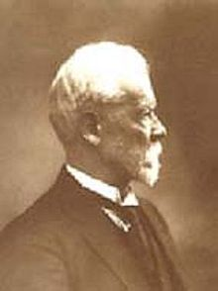
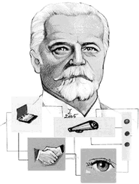
Fayol’s Principles of Management
Henri Fayol (1841-1925)
He has proposed that there are six primary functions of management and 14 principles of management, Forecasting, Planning, Organizing, Commanding, Coordinating, controlling
There are 14 Principles of Management described by Henri Fayol.

Slide 36

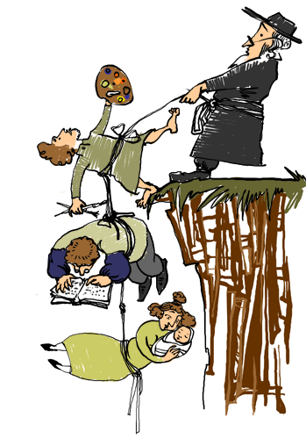
1. Division of Labor
14 Principles of Henri Fayol
Work of all kinds must be divided & subdivided and allotted to various persons according to their expertise in a particular area.
2. Authority & Responsibility
Authority refers to the right of superiors to get exactness from their sub-ordinates.
Responsibility means obligation for the performance of the job assigned.
Note that responsibility arises wherever authority is exercised

Slide 37
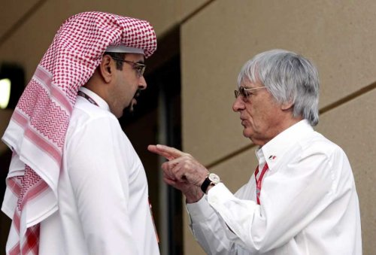

4. Unity of Direction
14 Principles of Henri Fayol Cont’d
3. Unity of Command
A sub-ordinate should receive orders and be accountable to one and only one boss at a time.
He should not receive instructions from more than one person
People engaged in the same kind of business or same kind of activities must have the same objectives in a single plan.
Without unity of direction, unity of action cannot be achieved.

Slide 38
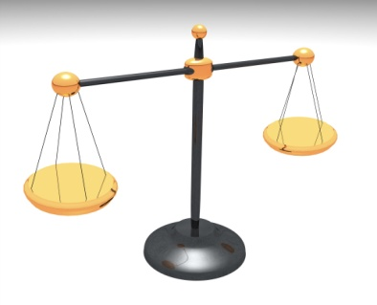
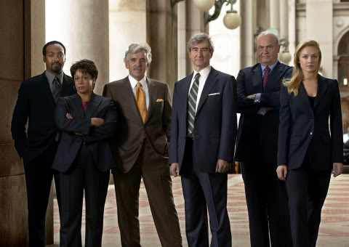
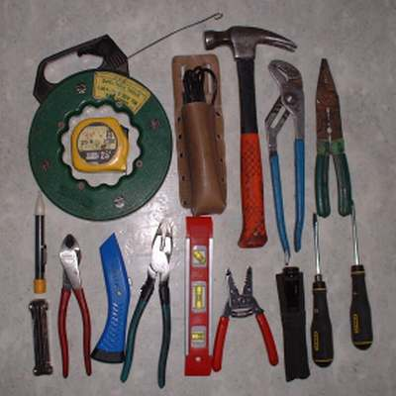
5. Equity
14 Principles of Henri Fayol Cont’d
Equity means combination of fairness, kindness & justice.
The employees should be treated with kindness & equity if devotion is expected of them.
6. Order
This principle is concerned with proper & systematic arrangement of things and people.
Arrangement of things is called material order and placement of people is called social order.

Slide 39

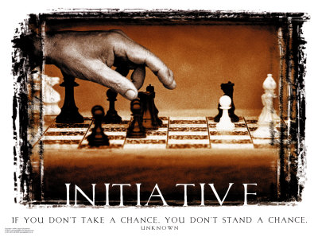
7. Discipline
14 Principles of Henri Fayol Cont’d
Discipline means sincerity, obedience, respect of authority & observance of rules and regulations of the enterprise.
Subordinate should respect their superiors and obey their order.
8. Initiative
Initiative means eagerness to initiate actions without being asked to do so.
Management should provide opportunity to its employees to suggest ideas, experiences& new method of work.

Slide 40


9. Remuneration
14 Principles of Henri Fayol Cont’d
Remuneration to be paid to the workers should be fair, reasonable, satisfactory & rewarding of the efforts.
It should accord satisfaction to both employer and the employees.
10. Stability of Tenure
Employees should not be moved frequently from one job position to another i.e. the period of service in a job should be fixed.

Slide 41
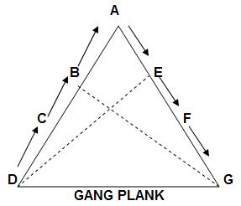

11. Scalar Chain
14 Principles of Henri Fayol Cont’d
Scalar chain is the chain of superiors ranging from the ultimate authority to the lowest.
Communications should follow this chain. However, if following the chain creates delays, cross-communications can be allowed if agreed to by all parties and superiors are kept informed.
12. Sub-ordination of Individual Interest to common goal
An organization is much bigger than the individual it constitutes therefore interest of the undertaking should prevail in all circumstances.
The interests of any one employee or group of employees should not take precedence over the interests of the organization as a whole.

Slide 42


13. Espirit De’ Corps
14 Principles of Henri Fayol Cont’d
It refers to team spirit i.e. harmony in the work groups and mutual understanding among the members.
Espirit De’ Corps inspires workers to work harder.
14. Centralization
Centralization refers to the degree to which subordinates are involved in decision making. Whether decision making is centralized (to management) or decentralized (to subordinates) is a question of proper proportion. The task is to find the optimum degree of centralization for each situation.

