Slide 1
Export Finance

Slide 2
EXPORT FINANCE
Exports earn valuable foreign exchange for the country
Exports are a preferred sector, getting several concessions and benefits
Banks (members of Foreign Exchange Dealers’ Association) should achieve a level of 12 % of net credit as export credit.
Classified into 2 types:
  Pre shipment finance.
  Post shipment finance.

Slide 3
PRE SHIPMENT CREDIT
Pre-shipment or Packing credit: is granted as a working capital advance.
Objectives are:
  Procure raw materials.
  Carry out manufacturing process.
  Provide a secure warehouse for goods and raw materials.
  Process and pack the goods.
  Ship the goods to the buyer.
  Meet other financial cost of the business.
Notes:
Stages of export:
1.Order received. 2. Procurement of raw materials. 3. Processing 4. Packing 5. Shipment 6. Payment Received.

Slide 4
PRE SHIPMENT CREDIT
Issued to exporters who have a valid Importer-Exporter Code (IEC) allotted by DGFT.
Exporter should have an export order in his own name and should not be in the caution list of RBI.
Goods to be exported should not fall under restricted category.
Period of advance is 180 days
Repayment is either out of export proceeds or by negotiation of bills under LC
Notes:
Some of the prohibited items of exports are all forms of wild animals, exotic birds, beef, sea shells, human skeleton, peacock feathers, etc.

Slide 5
PCFC- Foreign Currency
Packing credit is available in two forms:
Packing credit in Indian Rupees
Packing Credit in foreign currency (PCFC).
PCFC is self-liquidating; after shipment the borrower (exporter) submits bills for discounting and the account under the export order closes.
The interest rate is linked to LIBOR.
Sources of funds for banks for extending PCFC facility are forex balances available in EEFC (exchange earners foreign currency) , RFC (resident foreign currency) and NRFC (non-resident foreign currency) accounts.

Slide 6
Advances Against Duty Drawback
Excise duty (customs, sales tax and others) on raw materials used in exports is refunded to exporters according to government entitlements.
Banks can grant advances at concessional rates of interest on this entitlement for up to 90 days.
Amount of advance is adjusted after receiving the drawback amount.

Slide 7
Post Shipment Credit
Post shipment finance is provided to meet working capital requirements after the actual shipment of goods.
It bridges the financial gap between the date of shipment and actual receipt of payment from overseas buyer thereof.
Generally for export duties/taxes, advertisement, after sales service, fright and shipping expenses, marine insurance etc.

Slide 8
Post Shipment Credit
Also called documentary credit.
Documents required are:
  Commercial invoice
  Bill of Exchange
  Packing list
  Certificate of Origin
  Quality certificate
  Bill of Lading/ Airways bill
  Dock receipt

Slide 9
Post Shipment Credit- Types
Export bills purchased/ discounted.
Export bills negotiated.
Advance against export bills sent for collection basis.

Slide 10
Export Bills Purchased / Discounted
The finance or loan can be obtained by the exporter based on the bills of the purchase made by the importer or overseas company.
Export bills (non-LC bills) are used in indisputable export transactions. These bills can be purchased (sight/demand bills) or can be discounted(usanse bills).
Export Bills Rediscounted (EBR) account gets debited and is eventually liquidated out of the proceeds of bill payment by the overseas buyer.
In the case of any default, the finance company (Bank) will compensate about 80% of the default amount. It is considered as post shipment finance.
Notes:
Simultaneously, Export Bills Rediscounted (EBR) account gets debited and is eventually liquidated out of the proceeds of bill payment by the overseas buyer.
EBR is post-shipment credit.

Slide 11
BILL NEGOTIATION-
Letter of Credit
An LC is an undertaking by a bank (issuing bank) acting on behalf of a customer (applicant) to make payment to a third party (beneficiary) or to pay, accept or negotiate bills of exchange drawn by the beneficiary under the terms of the credit.

Slide 12
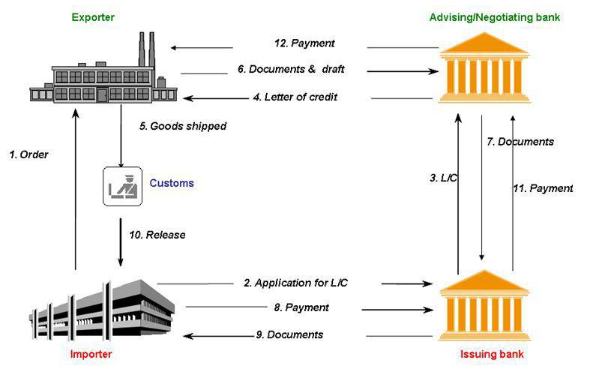
N

Slide 13
Banking considerations- LC
LC is issued against collateral- FDs, property
Bank charges fee for LC issuance
Process based on the guidelines issued by ICC (International Chamber of Commerce).
Correctness of LC- Name of seller, date, amount, product name, type, quantity etc. to be clear and precise.
All banks deal in only documents and not the actual goods.

Slide 14
LC- Risk factor for banks
Issuing bank faces the insolvency risk of the applicant (importer).
In case of nonperformance by the exporter, when he is unable to meet his terms and conditions, the issuing banks do not honor the letter of credit.
The negotiating bank faces the documentary risk where the issuing bank refuses to honor its commitment. This is non- reimbursement risk i.e. credit amount not received by issuing bank although it has already paid to its beneficiary (exporter).
Notes:
So, it is important for the negotiating bank, and the lending bank to properly check all the necessary documents before submission.

Slide 15
ADVANTAGE OF LCS
Provides assurance to both - the seller and the buyer by routing dealings through recognized banks
Buyer/importer’s bank on receiving the documents can scrutinize them and ensure that the they are in conformity with the agreed terms under the LC. Buyer has certainty of receiving the goods.
Shows the solvency of buyer.
Seller is assured of payment if he has complied with the agreed terms.
Ensures compliance with statutory requirements – obtention of import licence.

Slide 16
Bills sent for Collection
Bill collection is a trade transaction in which the exporter hands over the task of collecting payment for goods supplied to his or her bank, which sends the shipping documents to the importer's bank together with payment instructions.
A margin of 10 to 25% is stipulated in such cases.
  Generally availed when the assistance available under foreign bills purchased is exhausted; or
  When some export bills drawn under L/C have discrepancies; or
  Where it is a customary practice in the particular line of trade.

Slide 17
Factoring
Factoring, receivables factoring or debtor financing, is when a company buys a debt or invoice from another company.
Accounts receivable are discounted in order to allow the buyer to make a profit upon the settlement of the debt.
Essentially factoring transfers the ownership of accounts to another party that then chases up the debt.
It relieves the first party of a debt for less than the total amount providing them with working capital to continue trading.

Slide 18
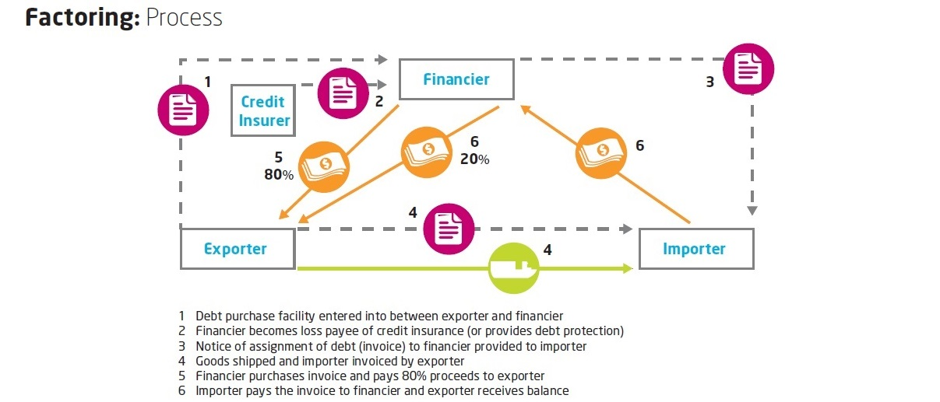
Factoring - Process

Slide 19
Factoring - Process
Debt purchase facility entered into between exporter and financer(bank).
Financer becomes the loss payee of credit insurance.
Notice of factoring provided to the importer.
Goods shipped and importer invoiced by the exporter.
Financer purchases invoice and pays 80% to the exporter.
Importer pays to the financer and exporter receives balance amount.
The factor (financer) charges the seller a service charge, as well as interest based on how long the factor must wait to receive payments from the debtor.

Slide 20
Deemed Export Finance
"Deemed Exports" refers to those transactions in which the goods supplied do not leave the country and the payment for such supplies is received either in Indian rupees or in free foreign exchange.
Example: Supply of goods to Export Oriented Units (EOUs) or Software Technology Parks (STPs) or Electronic Hardware Technology Parks (EHTPs) or Bio Technology Parks (BTP).
Supply to projects funded by UN agencies.

Slide 21
Deemed Export Finance
Export finance given to deemed exports i.e., in free trade zones at Mumbai, Chennai, Calcutta, Delhi, Cochin and Vizag, the suppliers of goods to foreign exporters are given finance.
In these free trade zones, the value of the goods exported should be not less than 50% from the domestic market. Hence, the suppliers are provided finance under deemed export finance.

Slide 22
Finance against Deferred Payment Export
Contracts for export of goods and services against payment to be secured partly or fully beyond 180 days are treated as deferred payment exports.
Enable realization of export proceeds over a period exceeding six months.
Generally in case of civil and engineering goods and services, technical and consultancy services.

Slide 23
BANK GUARANTEES
Non-fund based facility.
There is no immediate outlay of funds.
Is a contingent liability (Contingent liability turns into a liability in case of default).
Issued in lieu of security deposit and earnest money deposit to Government Departments.
Issued to suppliers on behalf of their distributors/retailers.

Slide 24
TYPES OF GUARANTEES
Most guarantees are financial guarantees. Bank commits itself to a fixed financial liability.
Performance guarantees implies guarantee of the performance of the contract which is difficult for banks to evaluate. Hence normally banks give only financial guarantees.

Slide 25
GUARANTEE TERMS
Period is 12 months/15 months.(also 10 yrs)
Bank undertakes to pay immediately in case of a claim from the beneficiary.
The claim should be lodged with the bank before the stipulated expiry date in the guarantee.
When a claim is made, the guarantee is said to be invoked.
Bank obtains a counter guarantee from the customer to compensate it in case the borrower fails to pay the claim under the guarantee.

Slide 26
Features of Export Finance
Eligibility
  Should be an approved trader ie IEC holder (issued by Director General of Foreign Trade).
  No negative list item. Approved country of export.
2. Documentary Evidence
  Confirmed export order/contract ; and/ or
  An irrevocable letter of credit opened in favor of the exporter
  Original message exchanged between exporter and buyer
Notes:
SWIFT (Society for Worldwide Interbank Financial Telecommunication) -SWIFT is a vast messaging network used by banks and other financial institutions to quickly, accurately, and securely send and receive information, such as money transfer instructions.

Slide 27
Cont’d
Purpose
  Acquire raw materials for export production
  Improve quality of goods to conform to international standers
  To adapt product to foreign markets, product addition and extension
  To store the goods in warehouses before shipment
  To pay for internal transportation and marine freight
  To pay for export documentation

Slide 28
Cont’d
4. Amount of finance
  : Need Based Finance, on three factors-
  • The nature of order
  • The nature of the commodity
  • The capability of exporter to bring in the requisite contribution
5. Period of credit & Rate of interest
  • Maximum duration – 180 days. Extension upto 90 days.
  • Concessional rates of interest

Slide 29
Cont’d
6. Disbursement of Packing Credit Advance
  Loan Agreement
7. Maintenance of Accounts, Monitoring & Repayment
  • Separate accounts
  • Strict use for the purpose which it is granted finance.

