Slide 1
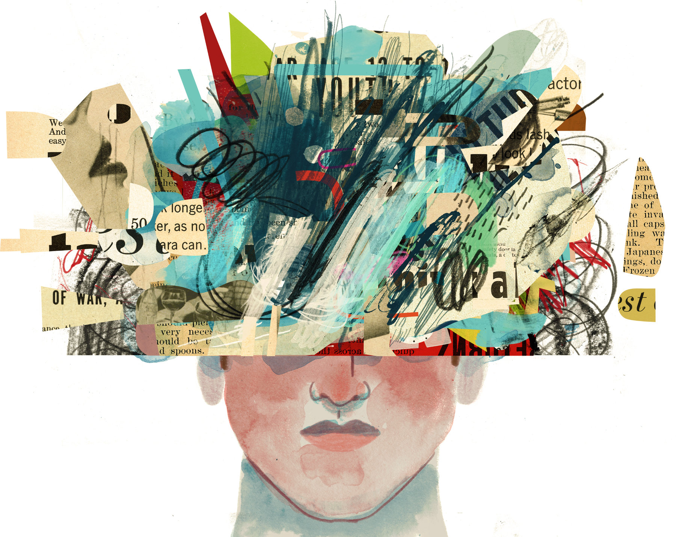
STRESS & Health

Slide 2
STRESS
SYMPTOMS
Stress is a feeling of emotional or physical tension. It can come from any event or thought that makes you feel frustrated, angry, or nervous. Stress is your body's reaction to a challenge or demand.
INSOMNIA
LOSS OF MENTAL CONCENTRATION
ABSENTEEISM
DEPRESSION
EXTREME ANGER AND FRUSTRATION
FAMILY CONFLICT
MIGRAINE, HEADACHES AND BACK PROBLEM

Slide 3
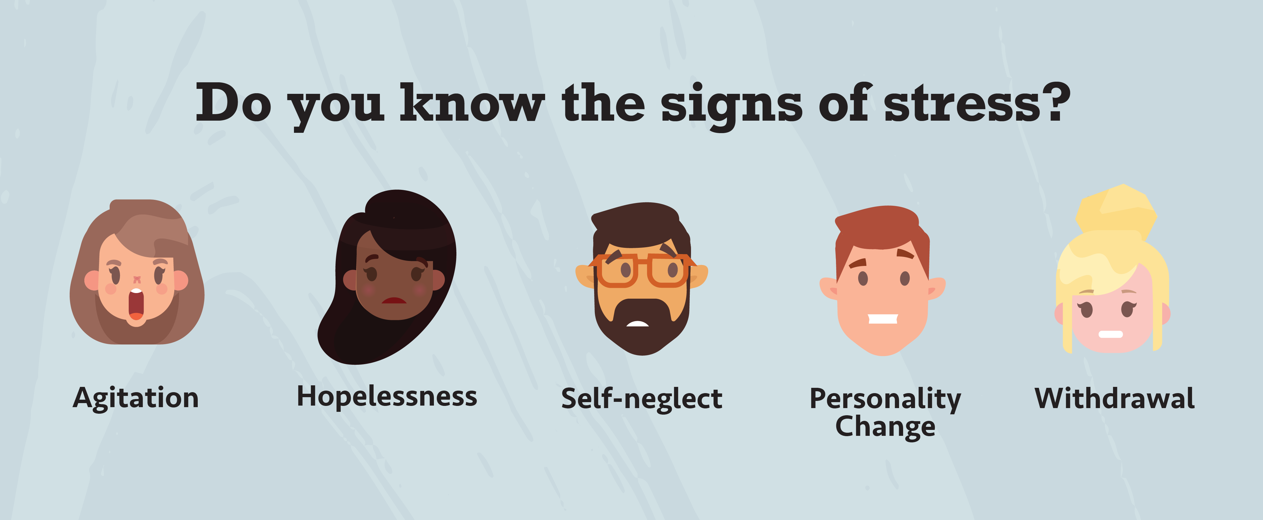
SIGNS OF STRESS
PHYSICAL SIGNS
MENTAL SIGNS
BEHAVIOURAL SIGNS
JOB STRESS SIGNS

Slide 4
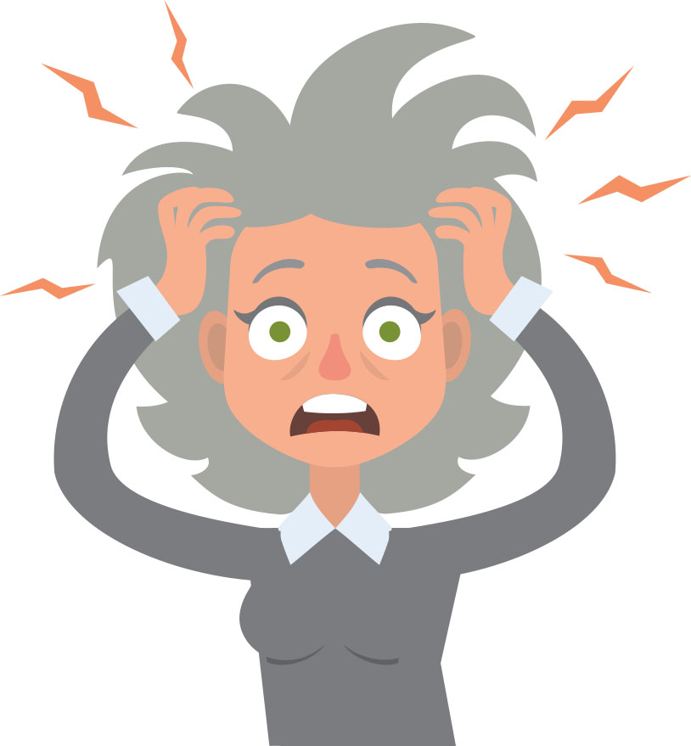
CAUSES OF STRESS
JOB INSECURITY
HIGH PERFORMANCE DEMAND
BAD BOSS
WORKPLACE CULTURE
PERSONAL AND FAMILY PROBLEMS
TECHNOLOGY

Slide 5
TYPES OF STRESS
EUSTRESS
DISTRESS
Motivates and Focuses energy
Is short term
Feels exiting
Improves performance
Is perceived as within coping abilities
Cause anxiety and concern
Can be short or long term
Is perceived as outside of our coping abilities
Feels unpleasant
Decreases performance
Can lead to mental and physical performance

Slide 6
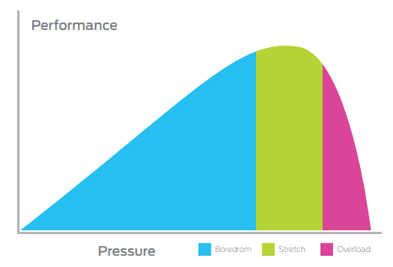
Stress and performance chart

Slide 7
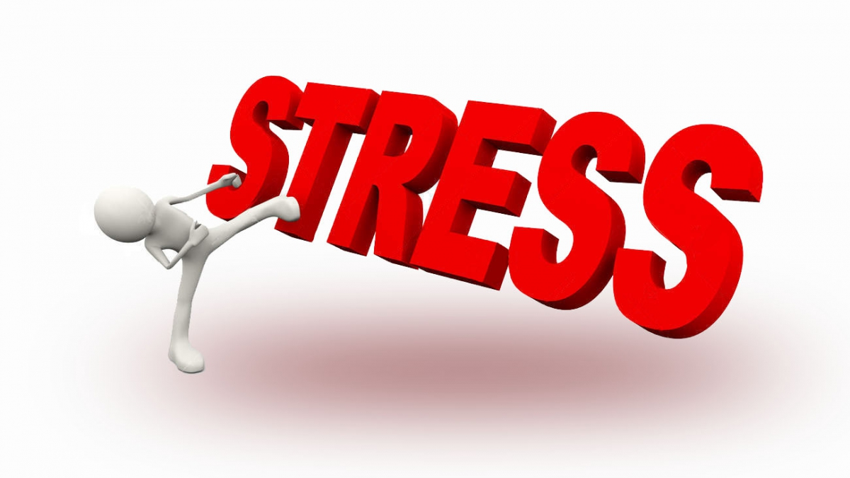
Stress management
Stress management is a wide spectrum of techniques and psychotherapies aimed at controlling a person's level of stress, especially chronic stress, usually for the purpose of and for the motive of improving everyday functioning.

Slide 8
Stress and their effects on health
Acute stress
Chronic stress
An acute stress reaction occurs when symptoms develop due to a particularly stressful event. The word 'acute' means the symptoms develop quickly but do not usually last long. The events are usually very severe and an acute stress reaction typically occurs after an unexpected life crisis
Chronic stress is a prolonged and constant feeling of stress that can negatively affect your health if it goes untreated. It can be caused by the everyday pressures of family and work or by traumatic situation

Slide 9
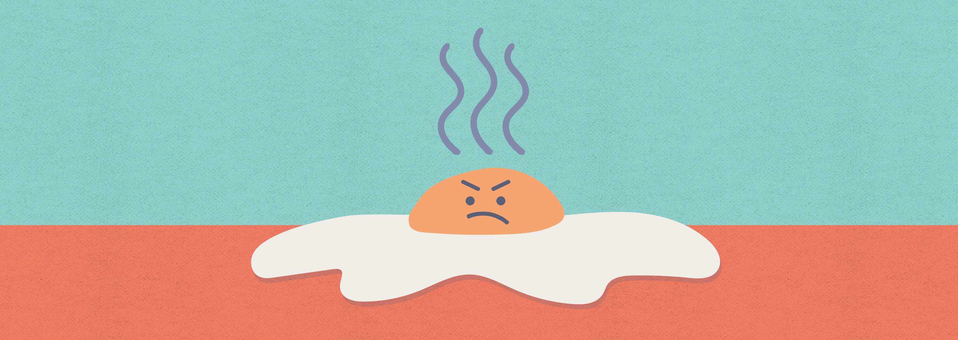
disadvantage
Stress is a disadvantage because it can potentially increase your heart rate and weaken your immune system. Also it can be a factor in poor decision making because under stress we may not think logically and consider the consequences of choices we make.

Slide 10
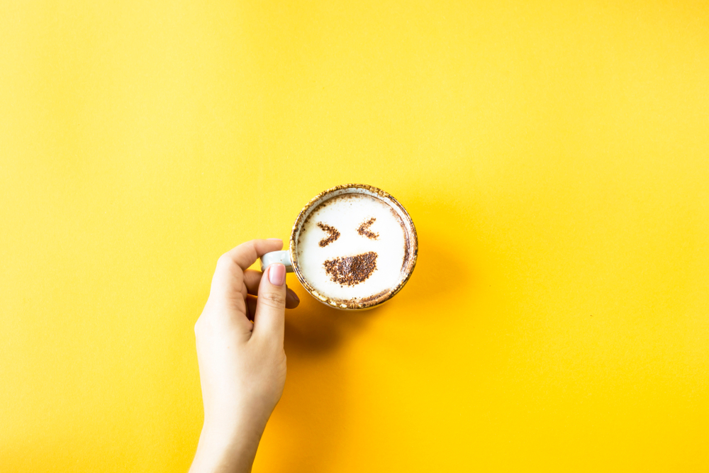
Different techniques of stress management
Laughter
A good laugh has great short-term effects. When you start to laugh, it doesn't just lighten your load mentally, it actually induces physical changes in your body.
Laughter can stimulate many organs. Laughter enhances your intake of oxygen-rich air, stimulates your heart, lungs and muscles, and increases the endorphins that are released by your brain.
Activate and relieve your stress response. It can increase and then decrease your heart rate and blood pressure. The result? A good, relaxed feeling.
Soothe tension. Laughter can also stimulate circulation and aid muscle relaxation, both of which can help reduce some of the physical symptoms of stress.

Slide 11
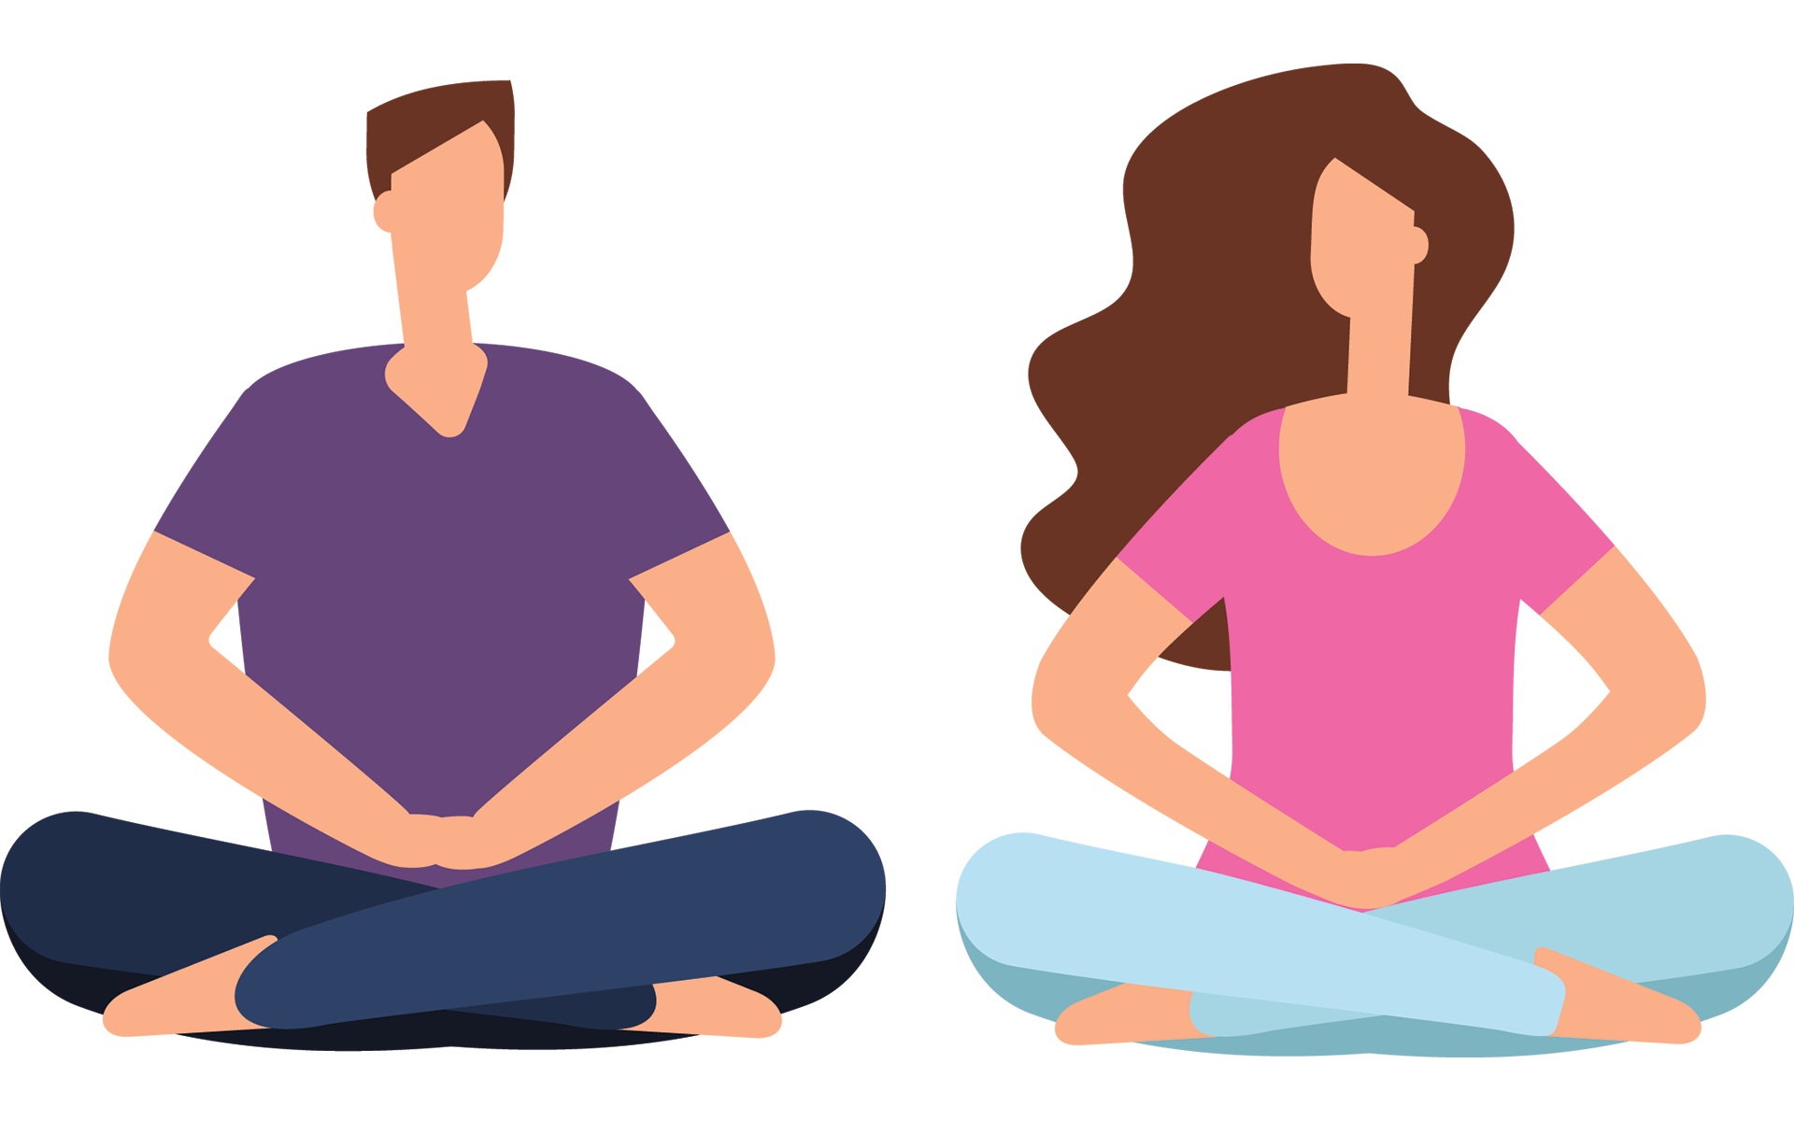
meditation
Meditation can produce a deep state of relaxation and a tranquil mind. During meditation, you focus your attention and eliminate the stream of jumbled thoughts that may be crowding your mind and causing stress. This process may result in enhanced physical and emotional well-being.

Slide 12
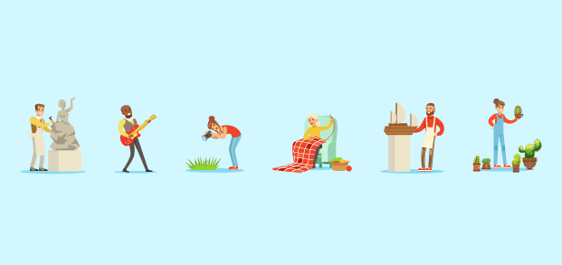
Getting a hobby
Hobby is an activity or interest that is undertaken for pleasure or relaxation, typically done during ones leisure time.eg: collecting, games, outdoor recreation, gardening, performing the arts, reading, cooking and etc.

Slide 13
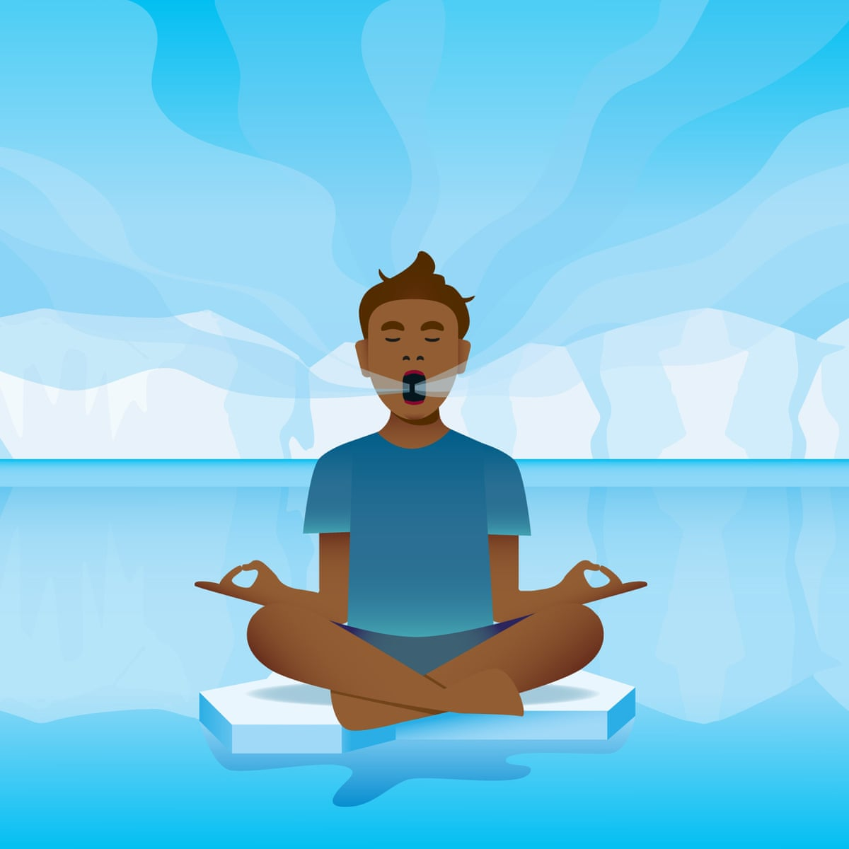
Breathing exercise
Diaphragmatic breathing exercise for raising oxygen levels in the blood and energy in the body is to take several negative breaths, immediately followed by an equal number of positive breaths. Positive breaths increase the oxygen in ones blood. Although not always taught, continuing to breathe into the chest at the same time can provide an ever more "fulfilling" exercise. The goal is to have the entire torso move in & out when breathing, as if one is surrounded by an expanding and contracting inner tube.

Slide 14
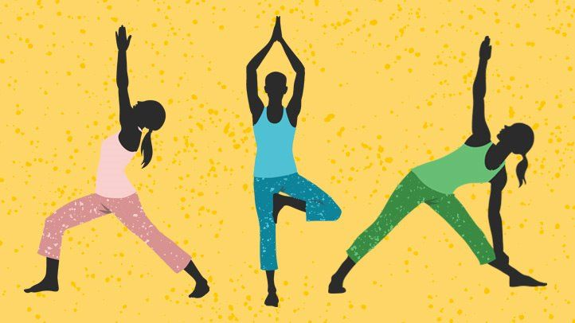
yoga
The practice of yoga relaxation has been found to reduce tension and anxiety. The autonomic symptoms of high anxiety such as headache, giddiness, chest pain, palpitations, sweating, abdominal pain respond well.

Slide 15
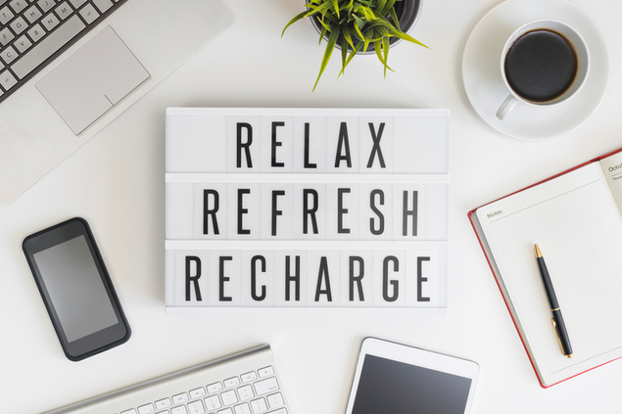
Other techniques
Listen to good music
Daily exercises and walk
Visualize and communicate your vision
Learn to say no to things you can not do.

Slide 16
Thank you
Harshwardhan Singh Rajpurohit

