Slide 1
TYPE A AND TYPE B PERSONALITY

Slide 2
PERSONALITY?
The word personality comes from the Latin word persona.
Personality, a characteristic way of thinking, feeling, and behaving. Personality embraces moods, attitudes, and opinions and is most clearly expressed in interactions with other people. It includes behavioral characteristics, both inherent and acquired, that distinguish one person from another and that can be observed in people’s relations to the environment and to the social group.

Slide 3
RESEARCH BACKGROUND
Friedman and Rosenman (both cardiologists) actually discovered the Type A behavior by accident after they realized that their waiting-room chairs needed to be reupholstered much sooner than anticipated. Unlike most patients, who wait patiently, the cardiac patients seemed unable to sit in their seats for long and wore out the arms of the chairs. They tended to sit on the edge of the seat and leaped up frequently
Friedman and Rosenman (1976) labeled this behavior Type A personality. They subsequently conduced research to show that people with type A personality run a higher risk of heart disease and high blood pressure than type Bs.
Although originally called 'Type A personality' by Friedman and Rosenman it has now been conceptualized as a set of behavioral responses collectively known as Type A behavior Pattern

Slide 4
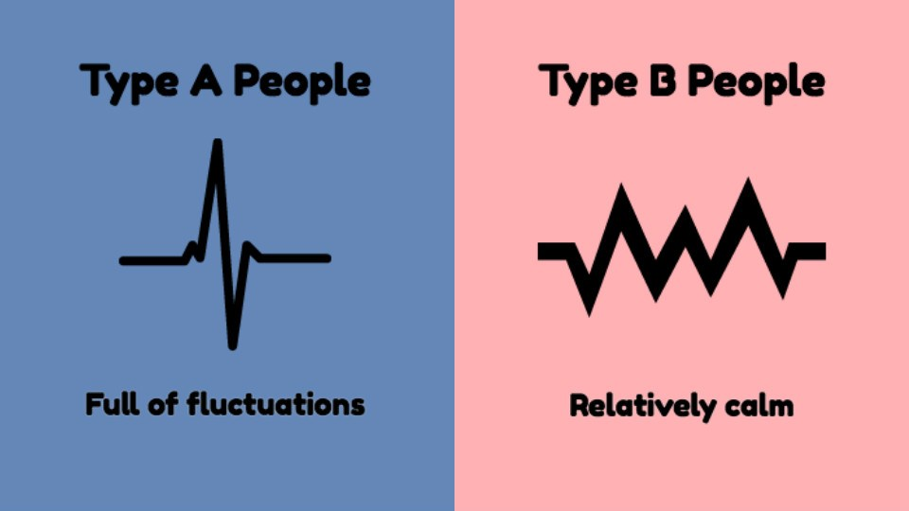
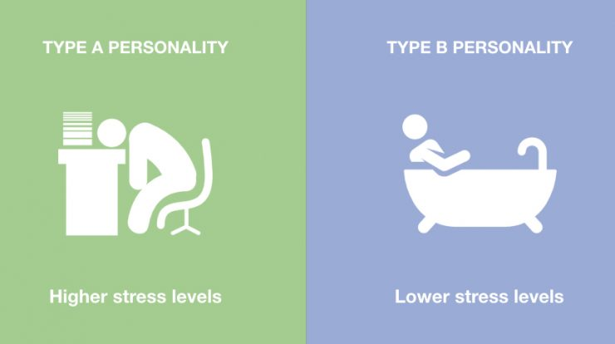
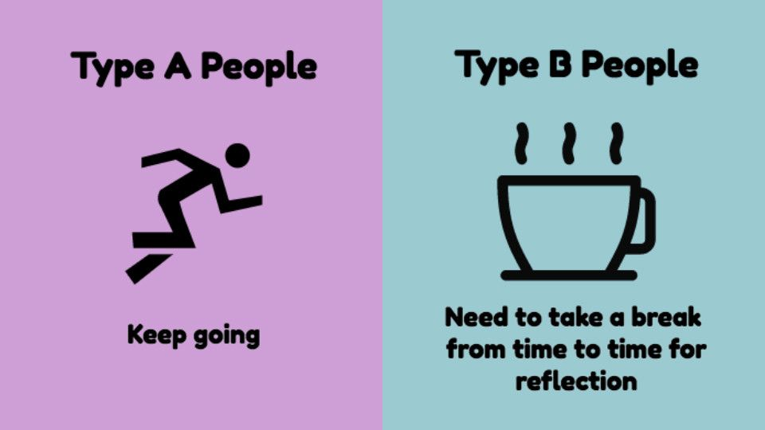
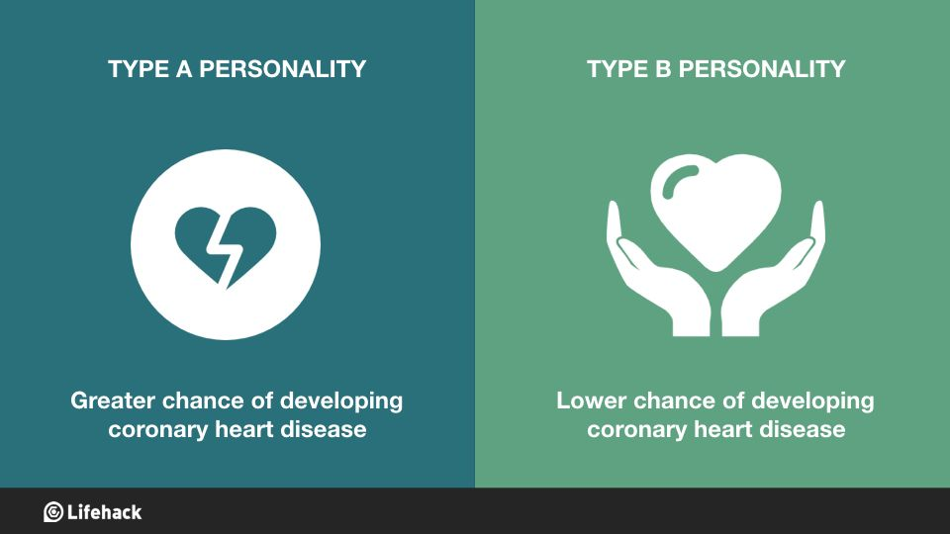
TYPES OF PERSONALITIES

Slide 5
Type A Behavior Pattern (TABP)
Competitive
Punctual
Domineering
Overly ambitious
Hostile
Impatient
Rigidly organized

Slide 6
EFFECTS OF TYPE A BEHAVIOR
Hypertension: Although the relationship between personality types and high blood pressure is complex, there has been some association between hypertension and Type A personalities.
Heart disease: Some research shows that there is a causal relationship between TABP and coronary heart disease.﻿ However, recent analysis has failed to confirm this.
Job stress: Type A people often have stressful, demanding jobs (and sometimes the jobs create the Type A behavior), which can lead to stress-related health problems.
Social isolation: Those with TABP often alienate others, or spend too much time on work and focus too little on relationships, putting them at risk for social isolation and the increased stress that comes with it.

Slide 7
What are cardiovascular diseases?
Cardiovascular diseases (CVDs) are a group of disorders of the heart and blood vessels and they include:
coronary heart disease – disease of the blood vessels supplying the heart muscle;
cerebrovascular disease – disease of the blood vessels supplying the brain;
peripheral arterial disease – disease of blood vessels supplying the arms and legs;
rheumatic heart disease – damage to the heart muscle and heart valves from rheumatic fever, caused by streptococcal bacteria;
congenital heart disease – malformations of heart structure existing at birth;
deep vein thrombosis and pulmonary embolism – blood clots in the leg veins, which can dislodge and move to the heart and lungs.

Slide 8
CVD AND TYPE A PERSONALITY
The Type A personality types behavior makes them more prone to stress-related illnesses such as CHD, raised blood pressure, etc.
Such people are more likely to have their ”flight or fight” response set off by things in their environment.
As a result, they are more likely to have the stress hormones present, which over a long period of time leads to a range of stress-related illnesses.

Slide 9
Type B Behavior Pattern (TBBP)
Even-tempered
Patient
Adaptable
Creative
Flexible
Laid-back
Low stress levels

Slide 10
EFFECTS OF TYPE B BEHAVIOR
Tend to have a lower risk of developing heart disease and high blood pressure.
May have better immunity because of lower stress levels and better stress management skills.
Not free from challenges.
Warm, supportive, and patient in their relationships.

Slide 11
THANK YOU
PRESENTED BY: PRACHI JAIN

