Slide 1
Health psychology Unit - 2
Models of Health

Slide 2
What is Health Psychology?
Health psychology is the study of psychological and behavioral processes in health, illness, and healthcare.
It is concerned with understanding how psychological, behavioural, and cultural factors contribute to physical health and illness.
It deals with the subject of health and illness by merging all knowledge of biological, behavioral, social and psychological Sciences.
Health Psychology is basically applying the psychological theory to health related practices.

Slide 3
Models of Health
Bio – Psychosocial Model of Health
Socio Cultural Model of Health
The Health Belief Model HBM
Protection Motivation Model
Leventhal’s self regulatory Model
The Theory of Planned Behaviour TPB
Schwarzer’s Health Action Process approach HAPA
The Transtheoretical Model

Slide 4
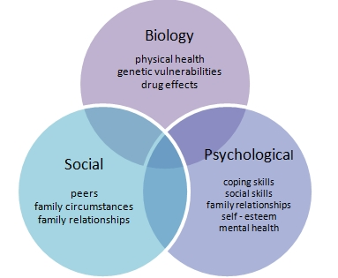
Bio-Psychosocial Model
The Bio-Psychosocial Model views health and illness behaviours as products of biological characteristics (such as genes), behavioural factors (such as lifestyle, stress, and health beliefs), and social conditions (such as cultural influences, family relationships, and social support).
The model specifically examines how these aspects play a role in topics ranging from health and disease models to human development
This model was developed by George L. Engel in 1977.

Slide 5
Focal area
Bio-psychosocial model
What causes illness?
Biological (virus) , psychological (beliefs, behaviour) and social (unemployment)
Individuals should be held responsible for his/her health and illness
Who is responsible for illness?
Who is responsible for treatment?
The focus is the whole person to be treated not just their physical illness; the patient is therefore responsible for their treatment (e.g. taking the medication or changing their behaviour).
What is the relationship between health and illness?
Health and illness exist on a continuum. Individuals progress along this continuum from health to illness and back again

Slide 6
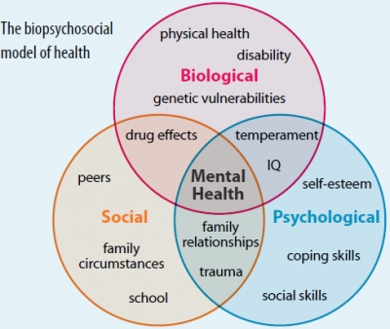
Focal area
Bio-psychosocial model
What is the relationship between the mind and the body?
The focus is on an interaction between the mind and the body. The mind and body interact
Psychological factors not only as possible consequences of illness but as contributing to it at all stages along the continuum from healthy to being ill
What is the role of psychology in health and illness?

Slide 7
Socio – Cultural Model of Health
The beginning of the 20th century featured an understanding of health that was dominated by a biomedical perspective, characterized by a reductionist point of view in which health was defined as the absence of illness.
This view has long been replaced by a bio psychosocial model that emphasizes the role played by socio-cultural forces in the shaping of health (and illness) and related psychological experiences (Engel 1977).
In 1948, the World Health Organization (WHO) defined health as a complete state of physical, mental and social well-being and not merely the absence of disease or infirmity, calling attention to the complexity and multidimensionality of the concept.

Slide 8
Socio-cultural Theory
Sociocultural theory is an emerging theory in psychology that looks at the important contributions that society makes to individual development.
This theory stresses the interaction between developing people and the culture in which they live.
Sociocultural theory also suggests that human learning is largely a social process.

Slide 9
Socio- Cultural Model Of Health
Aristotle said “ Man is an social animal, He cannot live without society. People live in the social world. They form many relationships like a family, friends etc
The term social cultural means something that involves the social and cultural aspects. Society affects a person’s health by promoting certain values of culture. As members, we can express the values of the society by writing our thoughts in the media, T.V, newspapers.
Our community is made up of people who live very close to each other such as living in the same city. These people influence each other where these effects can be seen prominently in the community, research has been conducted and it has been found that social health practices such as smoking cigarettes , drinking alcohol etc.
E.g.. Anthropology – Sociocultural is knowing about the people around you and their family backgrounds.

Slide 10
Health Belief Model
It is the oldest known and most widely used model of health behaviour around which all models developed. It was initialized by Rosenstok 1966 and then refined by baker and maiman in 1975.
The health belief model (HBM) is a social psychological health behaviour change model developed to explain and predict health-related behaviours, particularly in regard to the uptake of health services.
The health belief model suggests that people’s beliefs about health problems, perceived benefits of action and barriers to action, and self-efficacy explain engagement (or lack of engagement) in health-promoting behaviour.

Slide 11
Health Belief Model

Slide 12
Health Belief Model

Slide 13
The HBM derives from psychological and behavioral theory with the foundation that the two components of health-related behavior are 1) the desire to avoid illness, or conversely get well if already ill; and, 2) the belief that a specific health action will prevent, or cure, illness.
There are six constructs of the HBM. The first four constructs were developed as the original tenets of the HBM. The last two were added as research about the HBM evolved:-
Perceived susceptibility - This refers to a person's subjective perception of the risk of acquiring an illness or disease. There is wide variation in a person's feelings of personal vulnerability to an illness or disease.
Perceived severity - This refers to a person's feelings on the seriousness of contracting an illness or disease (or leaving the illness or disease untreated). There is wide variation in a person's feelings of severity, and often a person considers the medical consequences (e.g., death, disability) and social consequences (e.g., family life, social relationships) when evaluating the s\severity.
Perceived benefits - This refers to a person's perception of the effectiveness of various actions available to reduce the threat of illness or disease (or to cure illness or disease). The course of action a person takes in preventing (or curing) illness or disease relies on consideration and evaluation of both perceived susceptibility and perceived benefit, such that the person would accept the recommended health action if it was perceived as beneficial.
___

Slide 15
4. Perceived barriers - This refers to a person's feelings on the obstacles to performing a recommended health action. There is wide variation in a person's feelings of barriers, or impediments, which lead to a cost/benefit analysis. The person weighs the effectiveness of the actions against the perceptions that it may be expensive, dangerous (e.g., side effects), unpleasant (e.g., painful), time-consuming, or inconvenient.
5. Cue to action - This is the stimulus needed to trigger the decision-making process to accept a recommended health action. These cues can be internal (e.g., chest pains, wheezing, etc.) or external (e.g., advice from others, illness of family member, newspaper article, etc.).
6. Self-efficacy – This refers to the level of a person’s confidence in his or her ability to successfully perform a behavior. This construct was added to the model most recently in mid-1980. Self-efficacy is a construct in many behavioral theories as it directly relates to whether a person performs the desired behavior.

Slide 16
Limitations of Health Belief Model
There are several limitations of the HBM which limit its utility in public health. Limitations of the model include the following:-
It does not account for a person's attitudes, beliefs, or other individual determinants that dictate a person's acceptance of a health behavior.
It does not take into account behaviors that are habitual and thus may inform the decision-making process to accept a recommended action (e.g., smoking).
It does not take into account behaviors that are performed for non-health related reasons such as social acceptability.
It does not account for environmental or economic factors that may prohibit or promote the recommended action.
It assumes that everyone has access to equal amounts of information on the illness or disease.
It assumes that cues to action are widely prevalent in encouraging people to act and that “health” actions are the main goal in the decision-making process.

