Slide 1
Stress and health, types of stress, stress managemnt techniques, causes and consequences of stress
HEALTH PSYCHOLOGY -

Slide 2
2
Contents
●
●
●
●
●
●
●
●

Slide 3
It's not stress that kills us, It is our reaction to it.
- Hans Selye, M.D.
”
3

Slide 4
4
WHAT IS STRESS ?
●
●
●

Slide 5
5
MODELS OF STRESS
➔ RESPONSE BASED MODEL
➔ STIMULUS BASED MODEL
➔ TRANSACTIONAL MODEL OF STRESS

Slide 6
6
RESPONSE BASED MODEL
●
●
●

Slide 7
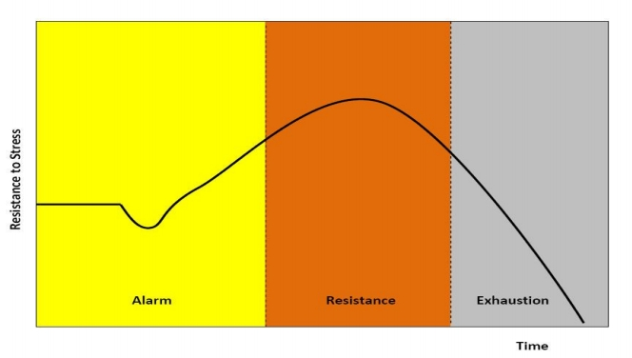
7
GENERAL ADAPTATION SYNDROME MODEL

Slide 8
8
GENERAL ADAPTATION SYNDROME STAGES
STAGE 1
STAGE 2
STAGE 3
Alarm
Resistance
Exhaustion

Slide 9
9
STIMULUS BASED MODEL
●
●
●
●

Slide 10
10
TRANSACTIONAL MODEL OF STRESS
●
Richard Lazarus developed the transactional theory of stress and coping
(TTSC) which presents stress as a product of a transaction between a
person (including multiple systems: cognitive, physiological, affective,
psychological, neurological) and his or her complex environment.
●
●
●
●

Slide 11
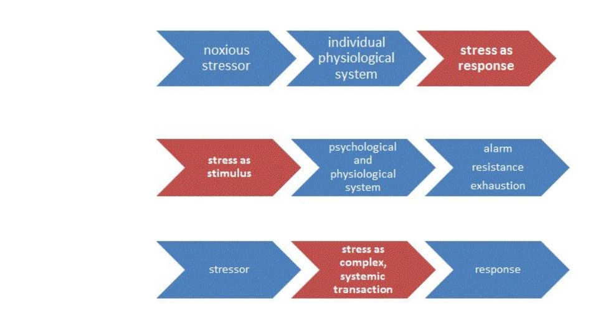
11
THEORIES OF
STRESS AS A
RESPONSE,
STIMULUS,
AND
TRANSACTION

Slide 12
12
TYPES OF STRESS
➔
➔
➔

Slide 13
13
ACUTE STRESS
●
●
●
●
●

Slide 14
14
EPISODIC ACUTE STRESS
●
●
●
●
●

Slide 15
15
CHRONIC STRESS
●
●
●
●
●
○
○
○
○
○
○

Slide 16
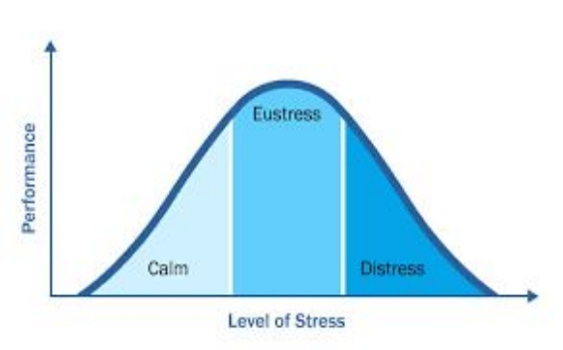
16
LEVELS OF STRESS

Slide 17
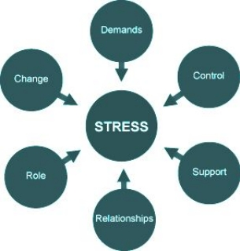
17
STRESSORS
●
●

Slide 18
18
TYPES OF STRESSORS
●
●
○
○
○
○
○

Slide 19
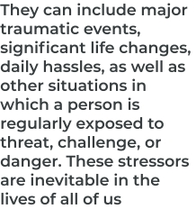
19
TYPES OF STRESSORS
CATACLYSMIC
PERSONAL
BACKGROUND
STRESSORS
STRESSORS
STRESSORS

Slide 20
20
CAUSES OF STRESS
●
●
●
●
●
●
●
●
●
●
●
●

Slide 21
21
CAUSES OF STRESS

Slide 22
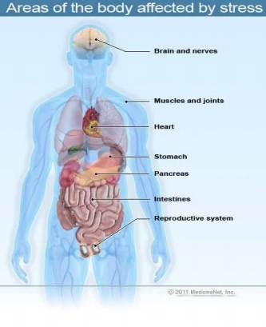
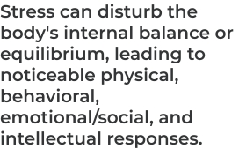
22
SIGNS/SYMPTOMS OF STRESS
●

Slide 23
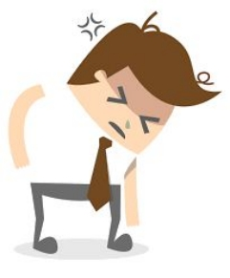
23
PHYSICAL SYMPTOMS
●
●
●
●
●
●

Slide 24
24
BEHAVIORAL SYMPTOMS
●
●
●
●
●
●

Slide 25
25
EMOTIONAL/SOCIAL SYMPTOMS
●
●
●
●
●
●

Slide 26
26
COGNITIVE SYMPTOMS
●
●
●
●
●
●

Slide 27
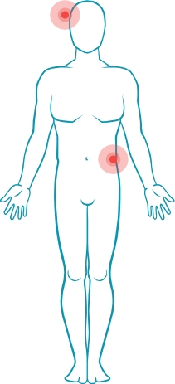
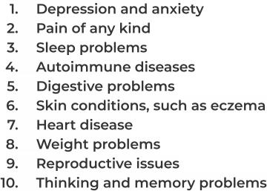
27
HEALTH EFFECT OF STRESS
●
●

Slide 28
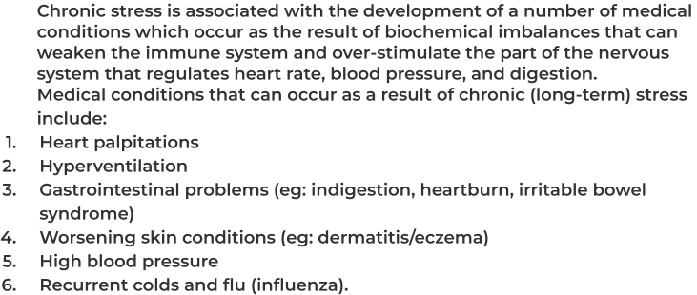
28
HEALTH EFFECT OF STRESS
●
●

Slide 29
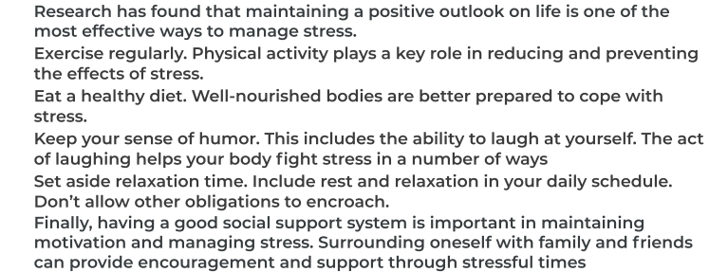
29
STRESS MANAGEMENT AND COPING
●
●
●
●
●
●

Slide 30
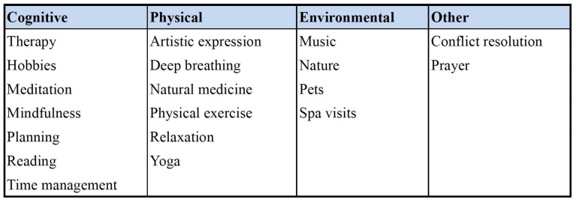
30
STRESS MANAGEMENT AND COPING
●

Slide 31
31
STRESS MANAGEMENT AND COPING
CORONAVIRUS AND STRESS
●
●
●
●
●

Slide 32
THANK YOU

