Slide 1
Unit-1
The Marketing Environment and Environment Scanning
By
Mrs Sarika Singh
Faculty of Management Studies MLSU Udaipur

Slide 2
Marketing Environment
“A company’s marketing environment consists of the actors and forces outside of marketing that affect marketing management ability to build and maintain successful relationships with target customers”. – Philip Kotler”.
From the above definition we can extract that marketing environment consists of factors that are internal and external which may pose threats to a firm or provide opportunities for exploitation.

Slide 3
Importance of Marketing Environment
1) Essential for planning
2) Understanding Customers
3) Tap new trends
4) Keep a check on threats
5) Harp on the opportunities
6) Understand the competition
7) Helps building strategy
8) Innovation

Slide 4
For Example
The mobile technology brand Nokia had a stronghold in the market till the time the management of the company was paying due attention to the Importance of Marketing Environment. But with the changing spheres of business dynamics and the overall marketing environment, the company was not able to keep up with the developing choices of its customers and technological advancements and slowly and gradually the brand started losing its major chunk of market share to the new and technological advanced mobile brands such as Apple, Blackberry, and Samsung that bought the revolution of smartphones. Nokia slowly lost its battle and eventually vanished from the market.

Slide 5
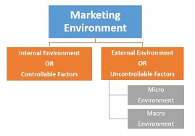
CONSTITUENTS OF MARKETING ENVIRONMENT

Slide 6
INTERNAL ENVIRONMENT

Slide 7
EXTERNAL ENVIRONMENT
MICROENVIRONMENT
Microenvironment:
The micro-component of the external environment is also known as the task environment. It comprises of external forces and factors that are directly related to the business. These include
Suppliers
Market intermediaries
Customers
Partners
Competitors
Public

Slide 8
External Environment
Macro Environment:
The Macro environment is the uncontrollable factor of the company. For this reason, it has to structure its policies in the limits set by these factors.
Macro-environment on the whole deals with
Demographic environment
Economic environment
Technological environment
Natural enviornment
Socio-cultural environment
Politico-legal environment

Slide 9
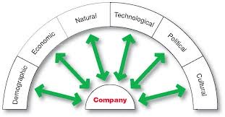

Slide 10
1. Demographic environment
Demography is the study of human populations in terms of size, destiny, location, age, gender, race, occupation, and other statistics.
This is the very important factors that help the marketer to divide the population into different market segments and target markets.
Demographic data helps in preparing geographical marketing plans, age, and sex-wise plans.

Slide 11
2. Economic Environment
Economic Environment is those macro factors that affect consumer buying power and spending patterns.
It includes the level of income, policies, and nature of an economy, economic resources, trade cycles, distribution of income and wealth.
When the income of a family or country (per capite income) changes it also changes the buying behavior and spending pattern of the family or country.

Slide 12
3. Physical/Natural Environment
Physical environment includes the climate, atmosphere, environmental change, accessibility of water, accessibility of raw materials etc.
A company has to implement its policies contained by the restrictions set by nature.
Nature offers resources, however, in a restricted way.
The product manager has to use it proficiently. Companies must discover the best mix of products for productive usage of the accessible assets.

Slide 13
4. Technological Environment
Technological forces are perhaps the most dramatic forces which are changing rapidly. These macro-environmental forces create a new product, new markets and marketing opportunities for marketers.

Slide 14
5. Social & Cultural Environment
The vast majority of Consumers buy in light of the impact of cultural & social elements.. Every society has its own culture. Culture is a blend of different variables which are exchanged from more established eras & which are gained. Consumer’s conduct is guided by the way of life, family, instructive foundations, dialects, and so on. Social components are the cultural and social viewpoints, which incorporate health cognizance, the growth rate of population, age distribution, career approach and the importance of security.
The society is a mix of different groups with diverse cultures & subcultures. Every society has its conduct. The marketing manager of a company must study the society in which he works. Eg: In India, we have distinctive cultural groups like Kashmiris, Punjabis, Assamese, and so forth. The manager of marketing of a company ought to observe these distinctions before finalizing the marketing schemes.

Slide 15
6.Political and legal Environment
It includes government actions, government legislation, public policies, and acts which affect the operations of a company or business.
For example, if the government specifies that certain products need mandatory packaging then it will boost the cardboard and packaging companies but it will add to the cost of the product.
Regulations in advertising, like a ban on advertisement of certain products like liquor, cigarettes and pan masalas and hoarding of food products, gas and kerosene are the reality of today’s business. Business legislations ensure specific purposes to protect business itself as well as the society from unfair competitions; to protect consumers from unfair business practices
In India business is regulated through certain laws like Monopolies and Restrictive Trade Practices Act, 1969 (MRTP Act), Foreign Exchange and Regulation Act, 1973 (FERA), Partnership Act 1932, Consumer Protection Act, 1986 (CPA), and Companies Act, 1956 etc. A businessman needs to understand various policies and political ideologies because these have a profound impact on the functioning and success of the busines
.

Slide 16
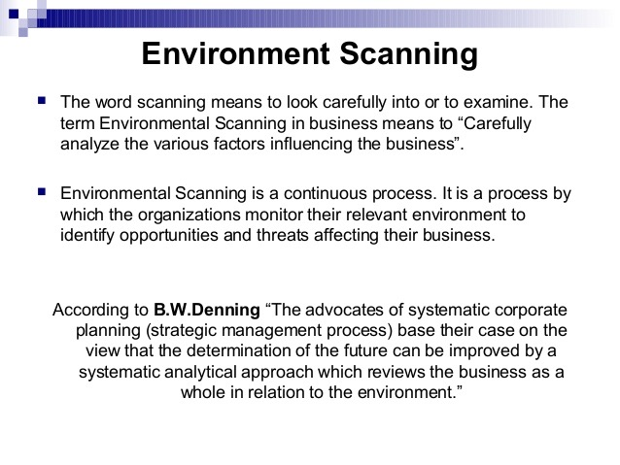

Slide 17
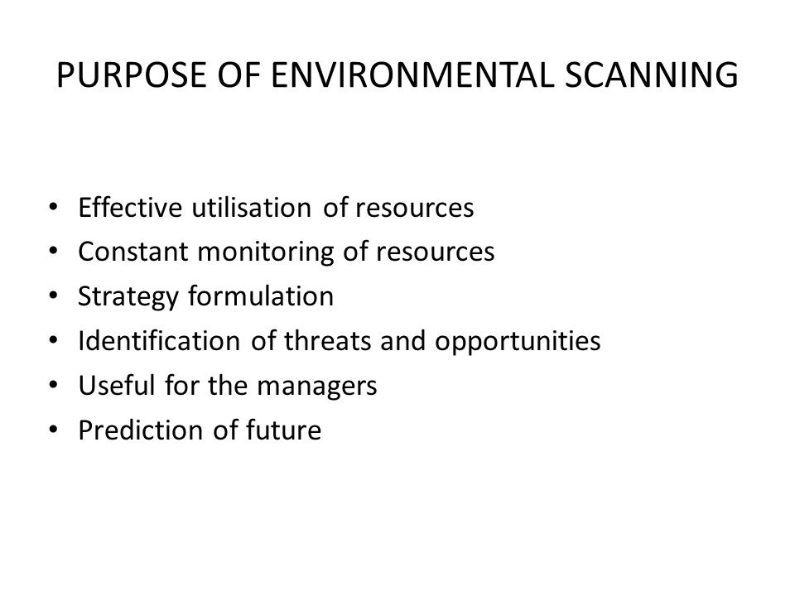

Slide 18
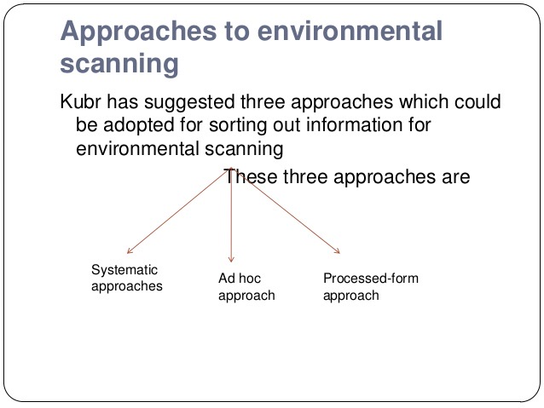

Slide 19
1.Systematic Approach
Under this approach, information for environmental scanning is collected systematically. Information related to markets and customers, changes in legislation and regulations that have a direct impact on an organization’s activities, government policy statements pertaining the organization’s business and industry, etc, could be collected continuous updating such information is necessary not only for strategic management but also for operational activities.

Slide 20
2. Ad hoc Approach:
Using this approach, an organization may conduct special surveys and studies to deal with specific environmental issues from time to time. Such studies may be conducted, for instance, when organization has to undertake special projects, evaluate existing strategy or devise new strategies. Changes and unforeseen developments may be investigated with regard to their impact on the organization.

Slide 21
3. Processed-form Approach:
For adopting this approach, the organization uses information in a processed form available from different sources both inside and outside the organization. When an organization uses information supplied by government agencies or private institutions, it uses secondary sources of data and the information is available in processed form.

