Slide 1
MARKETING SEGMENTATION ,TARGETING AND POSITIONING
By :Mrs Sarika Singh
FMS MLSU Udaipur

Slide 2
Marketers must adopt three steps of target marketing:
(a) Identify and profile different group of consumers who differ in their preferences (segmentation).
(b) Select one or more market to enter (market targeting)
(c) For each target segment, establish and communicate the major distinctive benefits of the company’s market offering (market positioning)
(Source: Philip Kotler, Marketing Management)

Slide 3
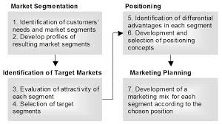

Slide 4
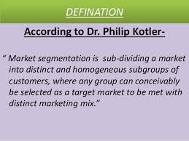
MARKET SEGMENTATION

Slide 5
LEVELS OF MARKET SEGMENTATION
a)Mass Marketing
b) Segment Marketing
c) Niche Marketing
d) Local Marketing
e) Individual Customer Marketing

Slide 6
Mass marketing
Mass marketing refers to the strategy of targeting the entire potential customer market by means of a single marketing message. The marketing strategy used in this segmentation does not target the specific requirements or needs of customers. Mass marketing strategy, instead of focusing on a subset of customers, focuses on the entire market segment that can be a probable customer of a product.

Slide 7
Segment Marketing
Segment marketing refers to a strategy where the company divides its target audience into different segments based on their unique needs and requirements. This way the company targets different messages to different segments, appealing them towards the unique features the product offers. This strategy creates product differentiation for customers with similar needs and preferences, based on their gender, age, income and location.

Slide 8
Niche Marketing
This strategy of marketing focuses on a narrower customer segmentation. Customers may want or desire a product that is not met completely by the products offered in a market. When companies move forward and develop highly specialized products to offer these customers their specific needs, they offer distinct products in a market that caters to specific customer segments only.

Slide 9
Micro Marketing
Micro marketing is that type of marketing strategy which tends to target a specific group of customers within a niche market.

Slide 10
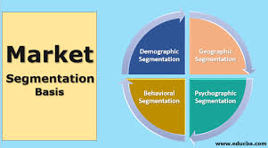
BASES FOR SEGMENTATION

Slide 11
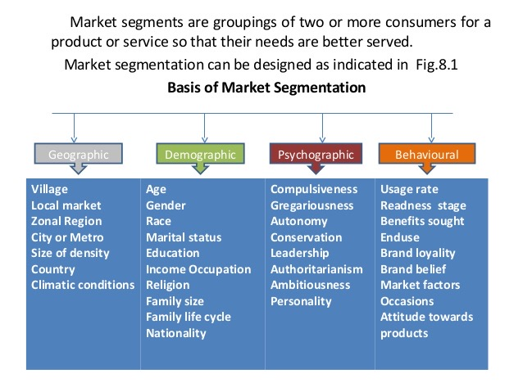

Slide 12
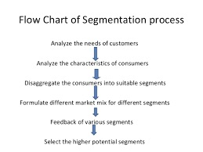

Slide 13
CRITERIA FOR EFFECTIVE TARGETING OF MARKET SEGMENTS
To be an effective target, a market segment should be
(I) identifiable
(2) sufficient (in terms of size),
(3) stable or growing,
(4) reachable (accessible) in terms of media and cost.

Slide 14
APPROACHES FOR SELECTING TARGET MARKETS:
(a) Undifferentiated Approach
(b) Concentration Approach
(c) Multi-segment Approach

Slide 15
Undifferentiated Approach
In the undifferentiated (or total- market) approach, a company develops a single marketing mix and directs it at the entire market for a particular product. This approach is used when an organisation defines the total market for a particular product as its target market.

Slide 16
Concentration Approach
When an organisation directs its marketing efforts toward a single market segment through a single marketing mix, it is using a concentration approach.

Slide 17
Multi Segment Approach
An organisation using the multi- segment approach directs its marketing efforts at two or more segments by developing a marketing mix for each segment.

Slide 18
Once the market has been segmented and attractive segments have been identified, the next task is to work within a targeted segment to position the product in the minds of the consumers and develop a marketing mix that will satisfy the consumer.

Slide 19
PRODUCT POSITIONING
Product positioning is the creation of a clear image in the minds of consumers within the targeted segment about the nature of the product and the benefits to be gained from purchasing the product.

Slide 20
STRATEGIES TO POSITION PRODUCTS
Position on Product Features
Position on Benefits :Toothpaste advertising often features the benefit approach, as the examples of crest (decay prevention), close-up (sex appeal through white teeth and fresh breath), and Aquafresh (a combination of these benefits) illustrate.
Position on Usage
Position on User
Position Against Competition

