Slide 1
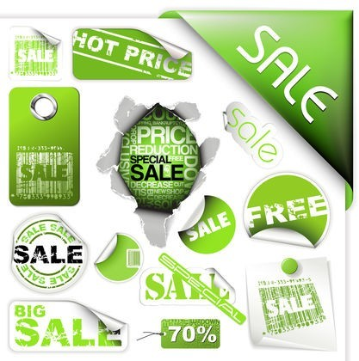
“SALES PROMOTION”
By Mrs Sarika Singh
Faculty of Management Studies MLSU udaipur

Slide 2
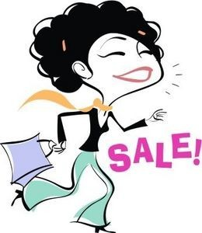
What is Sales Promotion?
“Short term incentives offered to customers to encourage buying.”
Its aim is to inform, to persuade and to remind.

Slide 3
SALES PROMOTION OBJECTIVES:
To increase brand awareness.
To attract new customers and retain existing one.
To maintain sales of seasonal products.
To meet the challenge of competition.

Slide 4
PROMOTIONAL TECHNIQUES:
SALES PROMOTION TOOLS
CONSUMER PROMOTIONS
TRADE PROMOTIONS

Slide 5
CONSUMER PROMOTIONS:
λ
“It is used to boost short-term customer buying and involvement or to enhance long term customer relationships.”
Major tools are samples, coupons, premiums, point of purchase, sweepstakes and event sponsorship.
λ

Slide 6
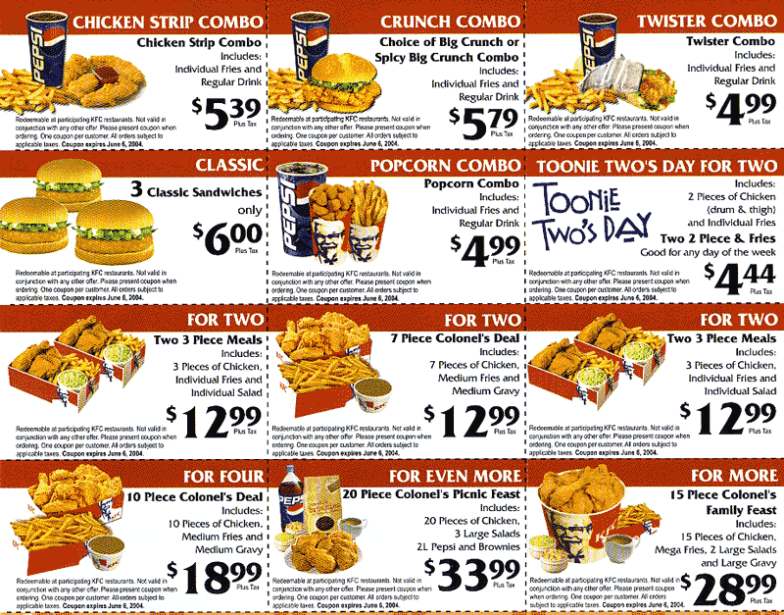
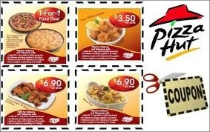
COUPONS:
^{λ} It is a discount certificate that is given to buyer for purchase of a specific product.

Slide 7

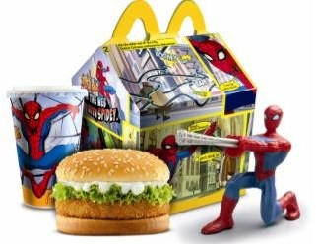
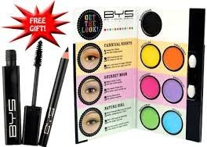
PRICE OFF AND PREMIUMS:
Free gifts or other special offer reductions offered to customers.
It may be in or on package premium such as toys in cereal etc.

Slide 8
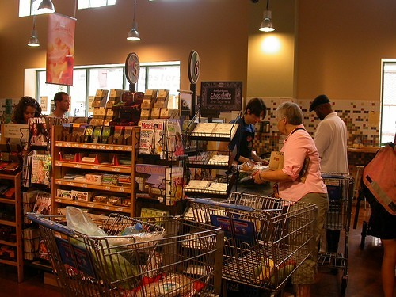
POINT OF PURCHASE:
It contains display and demonstrations at mostly check out points.
Special displays are also used in stores.

Slide 9

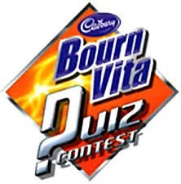
SWEEPSTAKES AND CONTESTS:
It gives customers chance to win like scratch n win offers.
In contest consumers compete on skills and win.

Slide 10
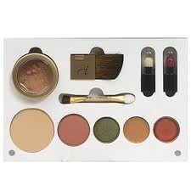
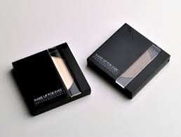
SAMPLES:
Samples are trial of a product. It is delivered door to door, through stores, via mail and by trial offers.
Samples are mostly in small quantity in sachet form or mini packaging of the product.

Slide 11

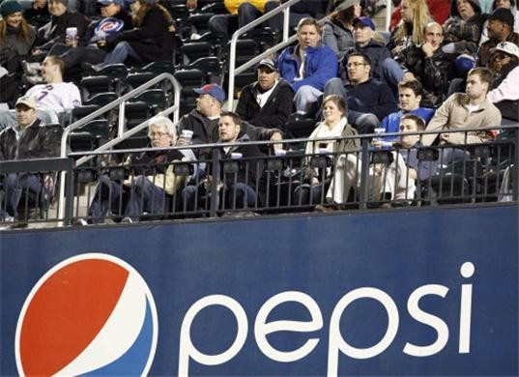
EVENT SPONSORSHIP:
^{λ} Events like TV shows, matches and sitcoms are sponsored by various products to increase demand.

Slide 12
TRADE PROMOTIONS:
Trade promotions are marketing activities executed between manufacturers and retailers.
Trade promotions help companies to differentiate a product, increase product visibility and increase the product purchase rate

Slide 13
Trade promotions include:
1.Trade allowances are incentives used to encourage a retailer to stock a product such as cash discounts or promotional incentives.
2.Dealer loaders are incentives given to a dealer to display a product, such as in-store displays, premiums, or rebates.

Slide 14
3.Trade contests are used to encourage retailers to sell products, as the retailer who sells the most wins a prize.
4.Point of purchase display (POP) is an end cap or center store display where retailers can show the products to customers to increase awareness.
5. Training programs to teach employees or retailers the benefits and uses of a product.
6.Push money is an extra commission paid to encourage the stocking and selling of a product.

Slide 15
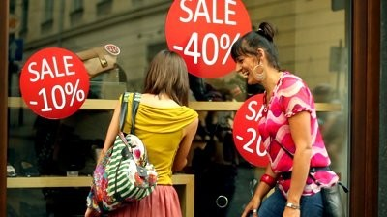
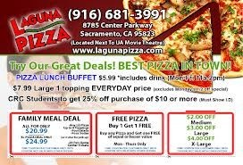
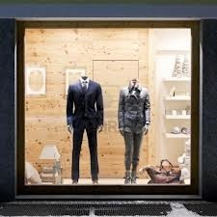


Slide 16
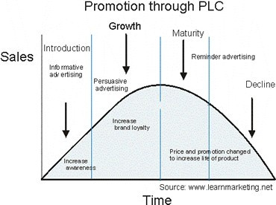
PLC & SALES PROMOTION:
^{λ} The product life cycle is entirely affected by promotional techniques.

