Slide 1
PROMOTIONAL DECISIONS
By : Mrs Sarika Singh
Faculty of Management studies MLSU Udaipur

Slide 2
INTRODUCTION
Promotion also know as marketing communications are the means by which firms attempt to inform, persuade, and remind consumers directly or indirectly about the products and brands they sell.

Slide 3



PROMOTION MIX
According to Kotler& Kevin Keller there are eight modes of communication
○
Advertising
○
Sales promotion
○
Events and experience
○
Public relations and publicity
○
Direct marketing
○
Interactive marketing
○
Word of mouth marketing
○
Personal selling

Slide 4



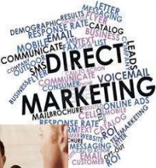
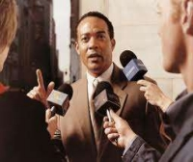
For simplicity and easy analysis the elements has been grouped into five
○
Advertising
○
Personal selling
○
Sales promotion
○
Publicity
○
Direct marketing

Slide 5
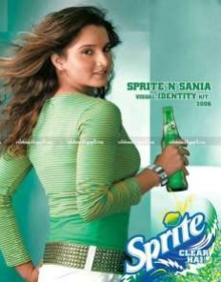
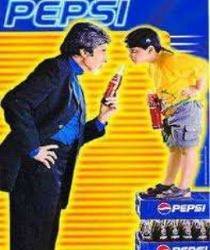
ADVERTISING
○ Any paid form of non personal presentation and promotion of ideas, goods and services by identified sponsor.
○ TV ad
○ Radio ad
○ Online ad
○ Billboards
○ Flyers

Slide 6


PERSONAL SELLING
Face to face interaction with one or more prospective purchasers for the purpose of making presentation and answering questions
Person to person
Sales meeting
Sales presentations

Slide 7


SALES PROMOTION
A variety of short-term incentives to encourage trial or purchase of product or service for a specific time
Seasonal discount
Reduction sales
Samples
Premiums and gifts
Contests games

Slide 8
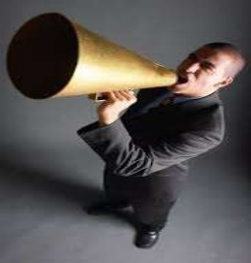

PUBLICITY
Programs designed to promote or protect a company’s image or its individual products
Press conference
Speeches
Publication
Seminars
Annual reports

Slide 9
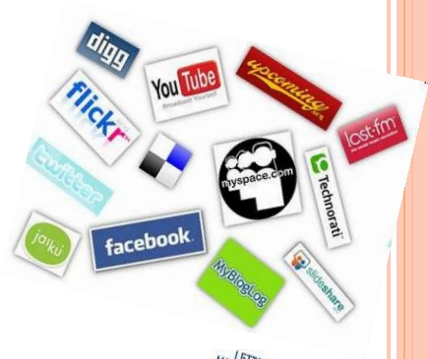
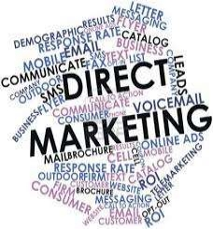

DIRECT MARKETING
Communicating directly with and soliciting response or dialogue from specific customers and prospects
Mailings
Telemarketing
Fax mail
Voice mails

Slide 10
FACTORS AFFECTING PROMOTION MIX
(a) Nature of the product
(b) Nature of the Market
(c) Overall marketing strategy :Push or pull strategy
(d) Buyer readiness stage
(e) Product life cycle stage

