Slide 1
1
TITLE:
DIGITAL IMAGE PROCESSING

Slide 2
Introduction
2
 Visual image interpretation techniques have certain disadvantages and may require extensive training and are labor intensive.
In this technique, the spectral characteristics are not always fully evaluated because of the limited ability of the eye to discern tonal value and analyze the spectral changes.
If the data are in digital mode, the remote sensing data can be analyzed using digital image processing techniques and such a data base can be used in Raster GIS.
In applications where spectral patterns are more informative, it is preferable to analyze digital data rather than pictorial data.

Slide 3
Definition
3
 Digital Image Processing is the manipulation of the digital data with the help of the computer hardware and software to produce digital maps in which specific information has been extracted and highlighted.

Slide 4
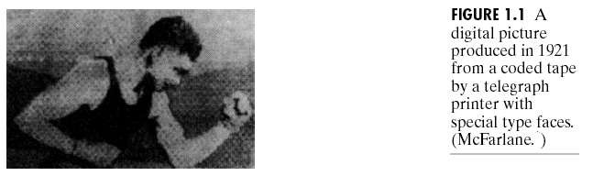
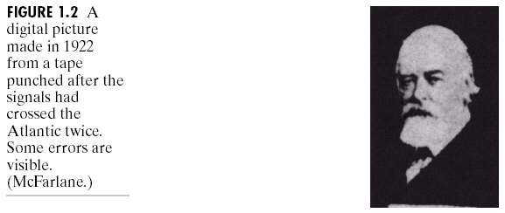
The Origin of Digital image Processing
4
. The first application was in newspaper industry in 1920s

Slide 5
Different Stages in Digital Image Processing
5
 Satellite remote sensing data in general and digital data in particular have been used as basic inputs for the inventory and mapping of natural resources of the earth surface like forestry, soils, geology and agriculture.
Space borne remote sensing data suffer from a variety of radiometric,
atmospheric and geometric errors, earth’s rotation and so on.
These distortions would diminish the accuracy of the information extracted and reduce the utility of the data. So these errors required to be corrected.

Slide 6
In order to update and compile maps with high accuracy, the satellite digital data have to be manipulated using image process techniques.
Digital image data is fed into the computer, and the computer is programmed to insert these data into an equation or a series of equation, and then store the results of the competition of each and every pixel.
These results are called look–up–table (LTU) values for a new image that may be manipulated further to extract information of user’s interest.
Virtually, all the procedure may be grouped into one or more of the following broad types of the operations, namely,
pre – processing, and
Image Processing.

Slide 7
Pre – processing
7
 Remotely sensed raw data generally contains flaws and deficiencies received from imaging sensor mounted on the satellite. The correction of deficiencies and removal of flaws present in the data through some methods are termed as pre–processing methods this correction model involves to correct geometric distortions, to calibrate the data radiometrically and to eliminate noise present in the data. All the pre–processing methods are consider under three heads, namely,
Radiometric correction method
Atmospheric correction method
Geometric correction methods

Slide 8
Radiometric correction method
8
 Radiometric errors are caused by detected imbalance and atmospheric deficiencies. Radiometric corrections are transformation on the data in order to remove error, which are geometrically independent. Radiometric corrections are also called as cosmetic corrections and are done to improve the visual appearance of the image. Some of the radiometric distortions are as follows:
Correction for missing lines
Correction for periodic line striping
Random noise correction

Slide 9
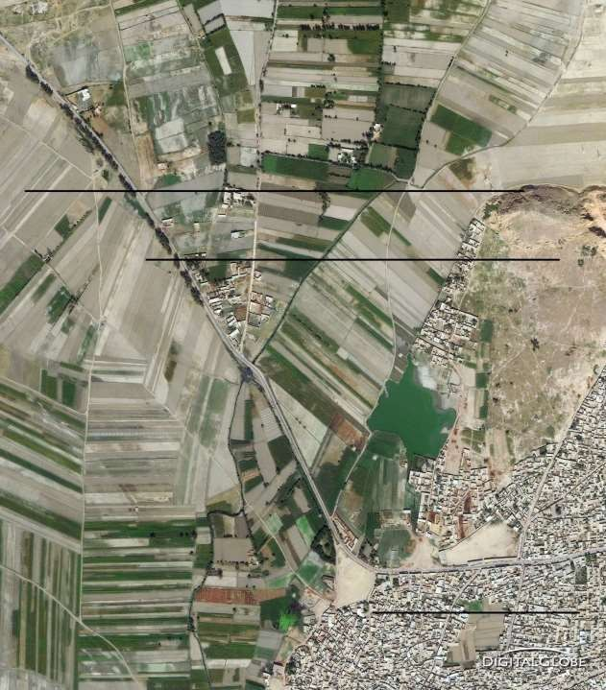
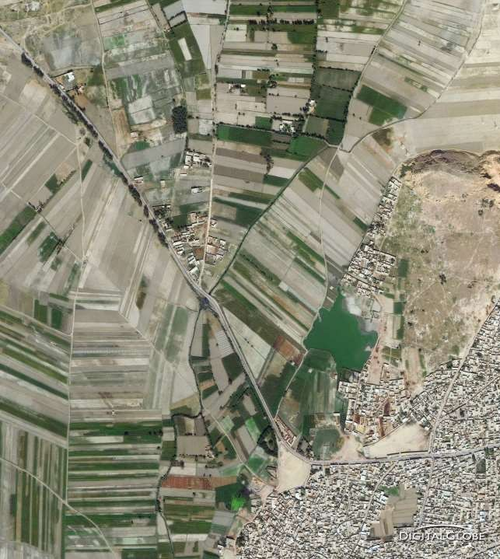
Correction for Missing Lines
9

Slide 10
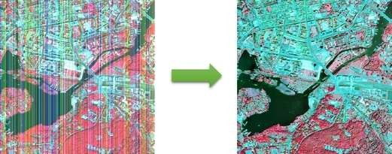
10
Figure 1.3a: Random noise correction

Slide 11
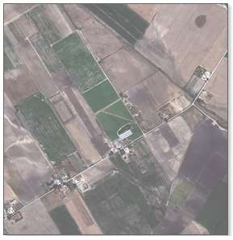
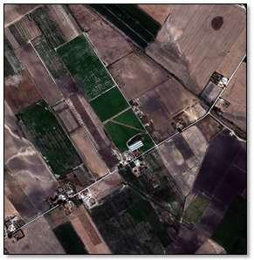
11
Figure 1.3b: Random noise correction

Slide 12
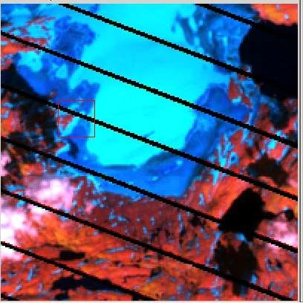
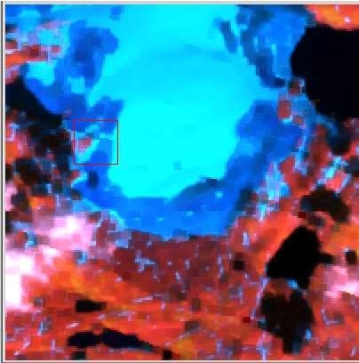
12
Figure 1.4: Correction for periodic line striping

Slide 13
Atmospheric correction method
13
 The value recorded at any pixel location on the remotely sensed image is not a record of the true ground – leaving radiant at that point, for the signal is attenuated due to absorption and scattering.
The atmosphere has effect on the measured brightness value of a pixel. Other difficulties are caused by the variation in the illumination geometry.
Atmospheric path radiance introduces haze in the imagery where by decreasing the contrast of the data.

Slide 14
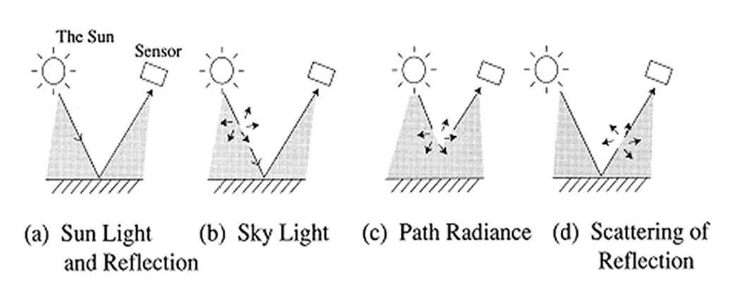
14
Figure 1.5: Major Effects due to Atmosphere.

Slide 15
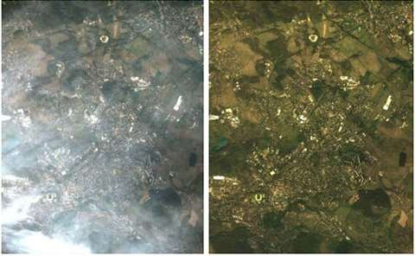
15
Figure 1.6: Atmospheric correction

Slide 16
Geometric correction methods
16
 Remotely sensed images are not maps. Frequently information extracted from remotely sensed images is integrated with the map data in Geographical Information System (GIS). The transformation of the remotely sensed image into a map with the scale and projection properties is called geometric corrections. Geometric corrections of remotely sensed image is required when the image is to be used in one of the following circumstances:
To transform an image to match your map projection
To locate points of the interest on map and image.
To overlay temporal sequence of images of the same area, perhaps acquired by different sensors.
To integrate remotely sensed data with GIS.

Slide 17


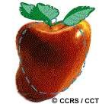
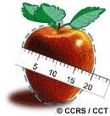
What is Geometric correction?
17

Slide 18
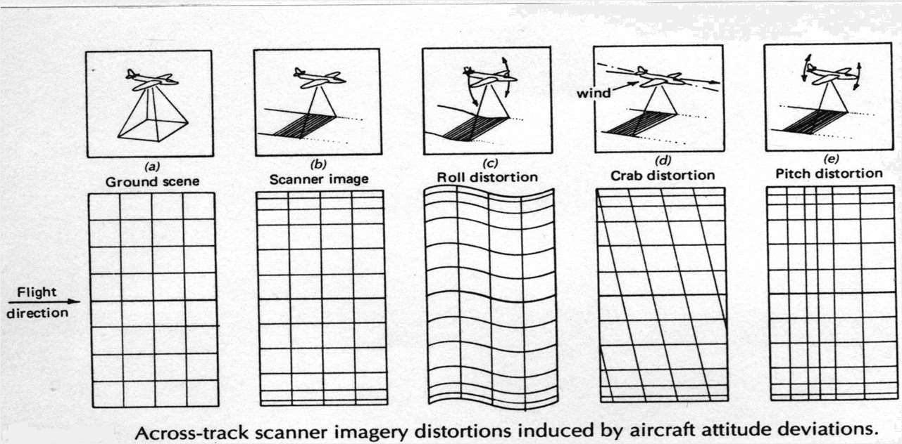
18
Figure 1.7: Sample Geometric Distortions

Slide 19
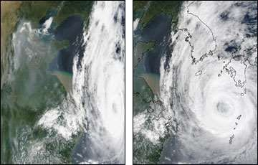
19
Figure 1.8: Geometric correction

Slide 20
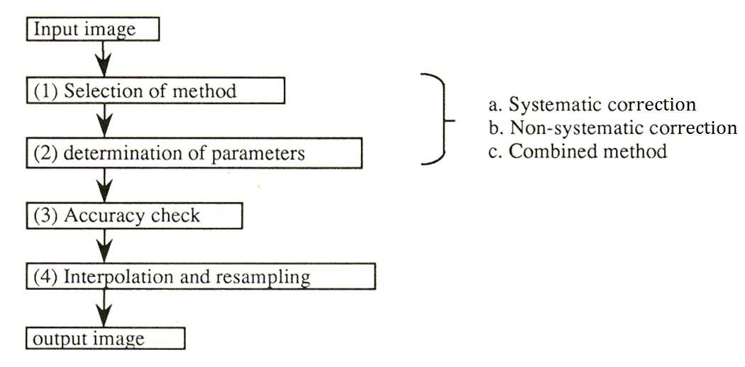
20
Figure 1.9: The flow of geometric correction

Slide 21
 Systematic Correction: when the geometric reference data or geometry of sensor are given or measured, the geometric distortion can be systematically avoided. Generally systematic correction is sufficient to remove all errors.
21
Non-systematic Correction: polynomials to transform from a geographic coordinate system, or vice versa, will be determined with the given coordinates of the ground control points using the least square method.
The accuracy depends on the order of the polynomials and the number and distribution of ground control points.
Combined method: Firstly systematic correction is applied, then the residual errors are reduced using lower order polynomials. Usually the goal of geometric correction is to obtain an error within plus or minus one pixel of its true position.

Slide 22
To correct sensor data with GIS internal and external errors must be determined and be either predictable or measureable.
Internal errors are due to sensor effects, being systematic or stationary.
External errors are due to platform perturbations and scene characteristics which are invariable in nature and can be determined from ground control and tracing data.
In order to remove the haze component due to these disturbances to simple techniques are applied:
Histogram Minimum Method, and
Regression Method.
22

Slide 23
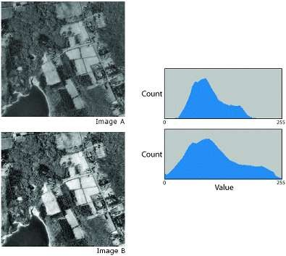
23
Fig 1.10: It is an example of a contrast stretch. Histogram A represents the pixel values in image A. By stretching the values (shown in histogram B) across the entire range, you can alter and visually enhance the appearance of the image (image B).

Slide 24
Image Processing:
24
 The second stage in Digital Image Processing entails five different operations, namely,
Image Registration
Image Enhancement
Image Filtering
Image Transformation
Image Classification
All these are discussed in details below:

Slide 25
Image Registration
25
Image registration is the translation and alignment process by which two images/maps of like geometrics and of the same set of objects are positioned co-incident with respect to one another so that corresponding element of the same ground area appear in the same place on the registered images.
This is often called image to image registration. One more important concept with respect to geometry of satellite image is rectification. Rectification is the process by which the geometry of an image area is made planimetric.
This process almost always involves relating Ground Control Point (GCP), pixel coordinates with precise geometric correction since each pixel can be referenced not only by the row or column in a digital image, but it is also rigorously referenced in degree, feet or meters in a standard map projection whenever accurate data, direction and distance measurements are acquired, geometric rectification is required.
This is often called as image to map rectification.

Slide 26
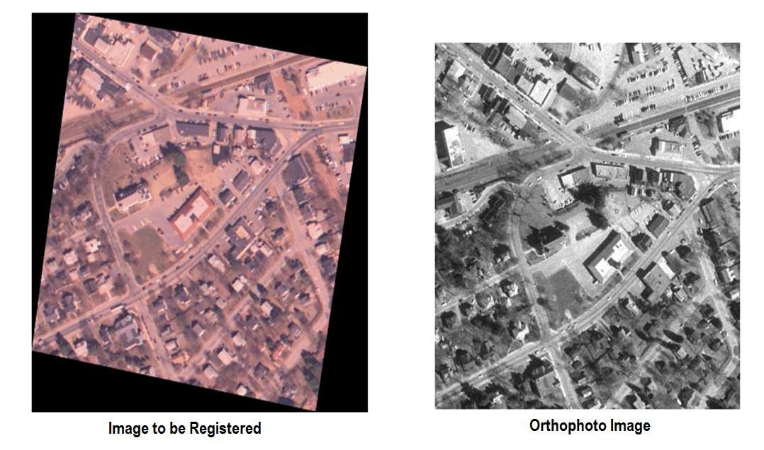
26
Figure 1.11: Image Registration

Slide 27
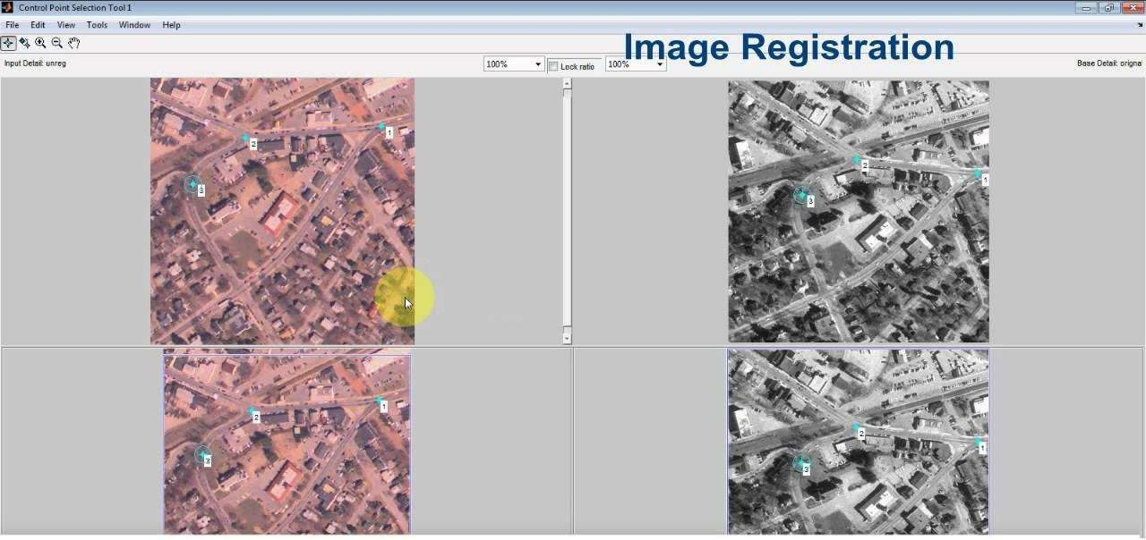
27
Figure 1.12: Image Registration

Slide 28
Image Enhancement
28
Low sensitivity of the detector, weak signal of the objects present on the earth surface, similar reflectance of different objects and environmental conditions at the time of recording are the major causes of low contrast of the image. Another problem that complicates photographic display of digital image is that the human eye is poor at discriminating the slight spectral or radiometric differences that may characterize the feature.
Image enhancement techniques improve the quality of an image as perceived by human eye. There exist a wide variety of techniques for
improving image quality. contrast stretch, density slicing, edge
used
enhancement, and spatial filtering are the most commonly techniques.
 Image enhancement method are applied separately to each band of a multispectral image.

Slide 29
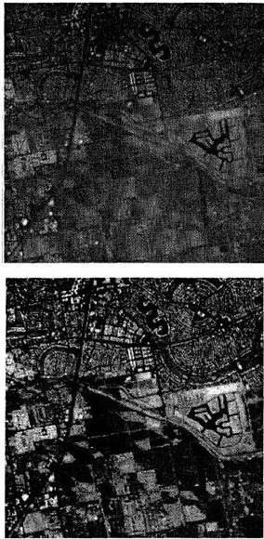
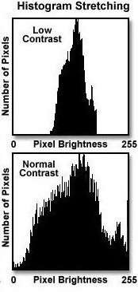
29
Figure 1.13: Contrast Enhancement by Histogram Stretch

Slide 30
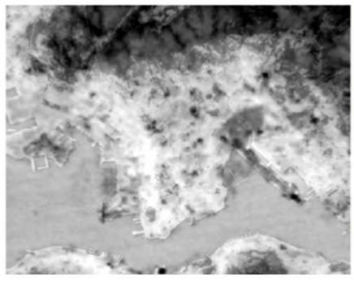
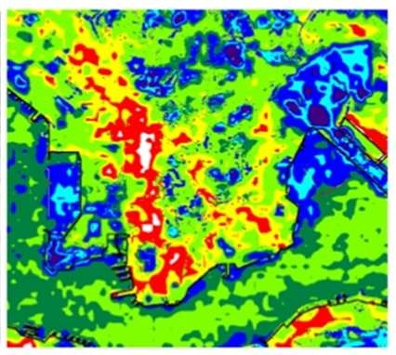
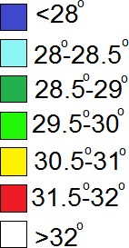
30
Figure 1.14: Density Slice for Surface Temperature Visualization

Slide 31
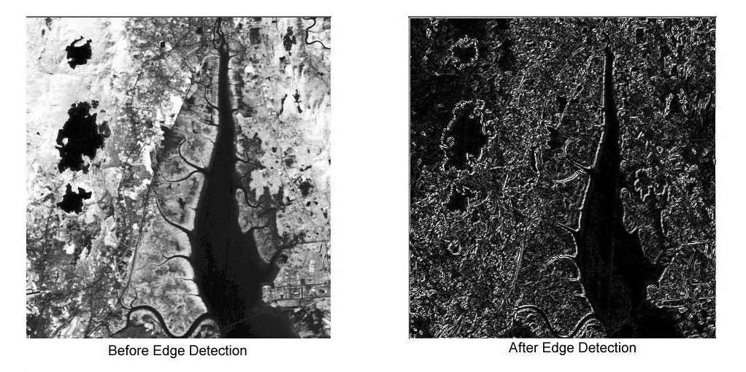
31
Figure 1.15: Edge Enhancement

Slide 32
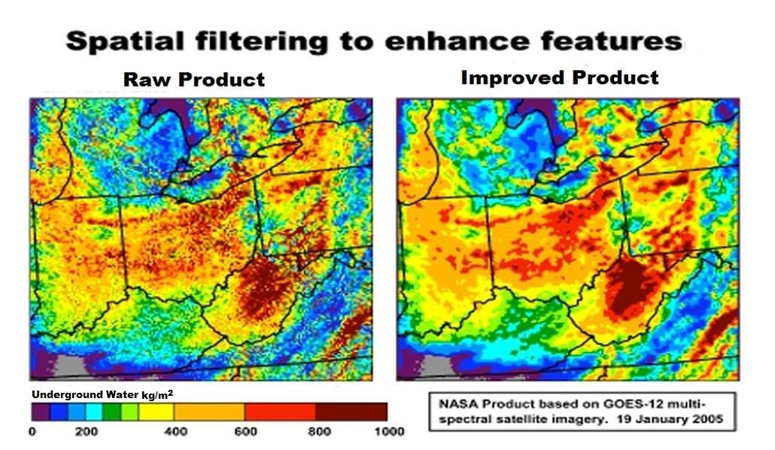
33
Figure 1.16: spatial filtering

Slide 33
Image Filtering
34
 A characteristic of remotely sensed images is a parameter called spatial frequency, defined as number of Changes in brighter value per unit distance for any particular part of an image. Few brighter changes in an image considered as low frequency, conversely, the brighter value changes dramatically over short distance, this is an area of high frequency.
 Spatial filtering is the process of dividing the image into its constituent spatial frequency and selectively altering certain spatial features. This technique increases the analyst’s ability to discriminate details. The three types of spatial filters used in remote sensor data processing are:
Low Pass Filters,
Band Pass Filters, and
High Pass Filters.

Slide 34
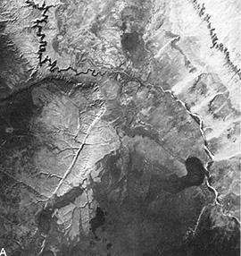
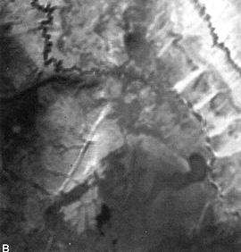
35
Contrast-stretched
Image
Low Pass Filter Image

Slide 35
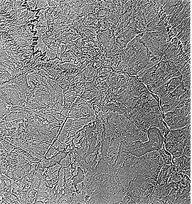
3
6
Original Image
High Pass Filter Image

Slide 36
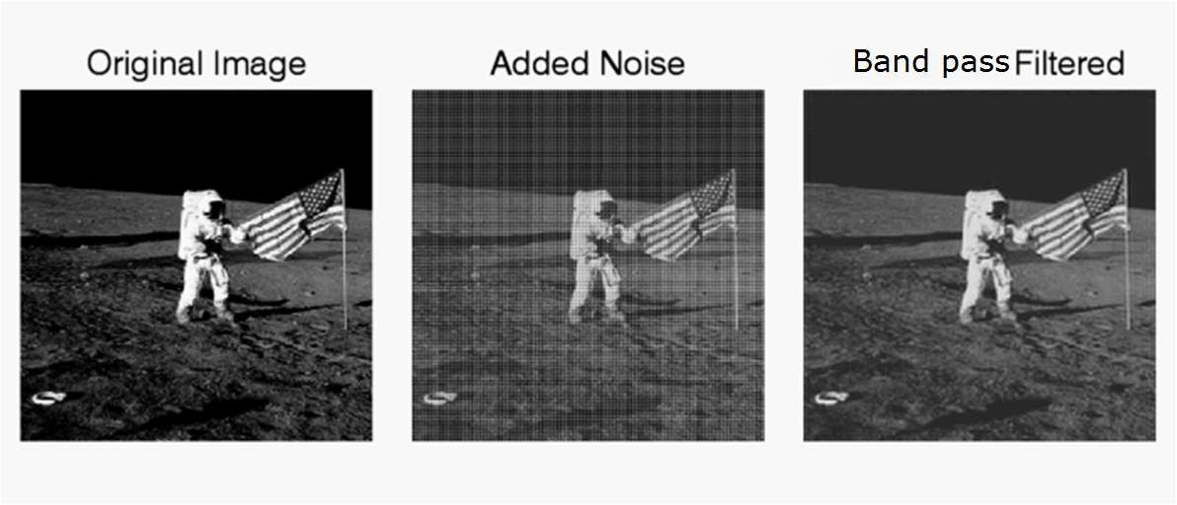
37
Figure 1.17: In the example, we add some sinusoidal noise to an image and filter it with Band Pass Filter

Slide 37
Image Transformation
38
All the transformations in an image based on arithmetic operations. The resulting images may will have properties that make them more suited for a particular purpose than the original.
The transformation which is commonly used as follows:
Principal Component Analysis (PCA)

Slide 38
Principal Component Analysis (PCA)
42
 The application of Principal Component Analysis (PCA) on raw remotely sensed data producing a new image which is more interpretable than the original data. The main advantage of PCA is that it may be used to compress the information content of a number of bands into just two or three transformed principal component images.

Slide 39
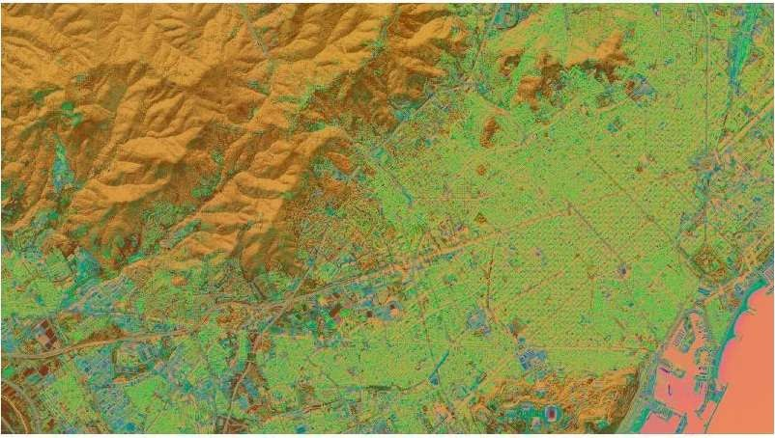
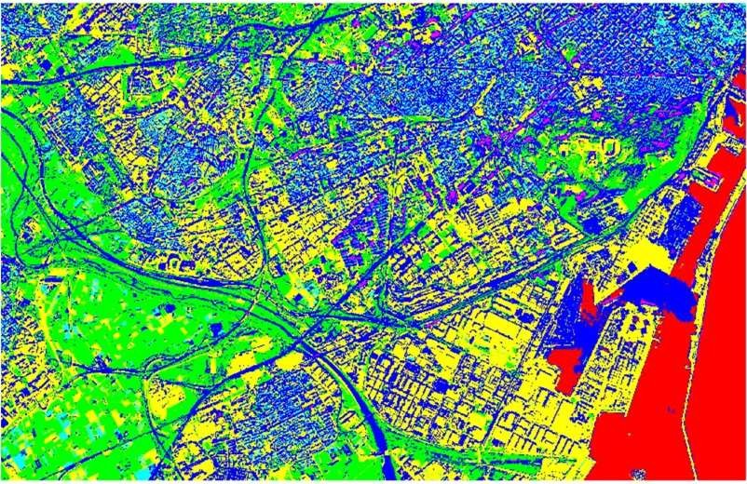
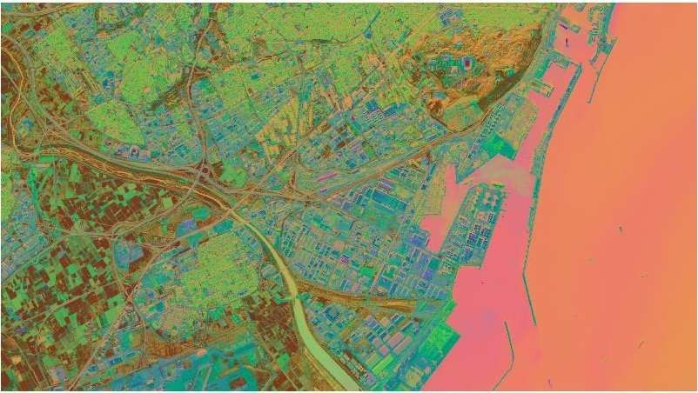
43
Figure 1.20: The application of Principal Component Analysis (PCA) on raw remotely sensed data of Urban Area by Unsupervised Classification.

Slide 40
Image Classification
44
Image Classification is a procedure to automatically categorise all pixel in an image of a terrain into land use and land cover classes. This concept is dealt under broad subject, namely, “pattern recognition”. Spectral pattern recognition refers to the family of classification procedures that utilises this pixel-by-pixel spectral information as the basis for automated land cover classification. Spatial pattern recognition of image on the basis of the spatial relationship with pixel surrounding.
Image classification technique are grouped into two types, namely,
Supervised Classification , and
Unsupervised Classification.

Slide 41
Supervised Classification
45
 Different phases in supervised Classification technique are as follows:
(i) Appropriate classification scheme for analysis is adopted. (ii)Selection of representative training sites and collection of
spectral signatures.
(iii)Evaluation of statics for the training site spectral data. (iv)The statics are analyzed to select the appropriate features to
be used in classification process.
(v)Appropriate classification algorithm is selected. (vi)Then classify the image into ‘n’ number of classes.

Slide 42
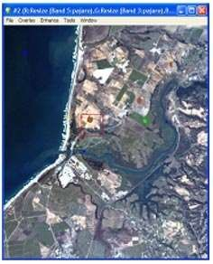
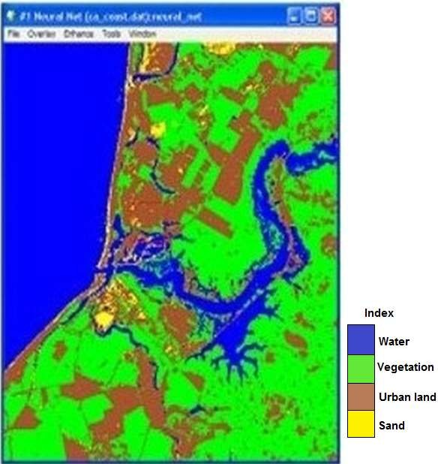
4
6
Figure 1.21: Supervised Classification

Slide 43
Unsupervised Classification
47
The Unsupervised Classifiers do not utilize training data as basis for classification. These classifiers examine the unknown pixel and aggregate them into a number of class based on natural grouping or clusters present in the image values. The classes that result from unsupervised classification are spectral classes.
The analyst must compare the classified data into some form of reference data to identify the informational value of the spectral classes.
 It has been found that in areas of complex terrain, the unsupervised approach is preferable. In such conditions, if the supervised approach is used, the user will have difficulty in selecting training sites because of variability of spectral response within them each class.
Consequently, group data collected but it is very time consuming. Also, the supervised approach is subjective in the sense that the analyst tries to classify information categories, which are often composed of several spectral classes, whereas spectrally distinguishable classes will be revealed by the unsupervised approach.
Additionally, the unsupervised approach has potential advantage of revealing discrimination classes unknown from the previous supervised classification.

Slide 44
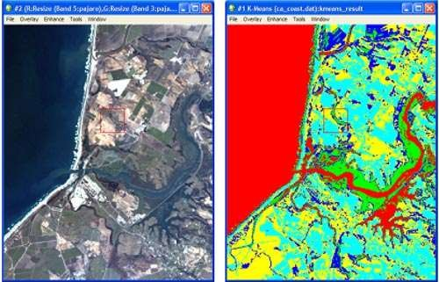
48
Figure 1.22: In an unsupervised classification, a thematic map of the input image is created automatically in ENVI without requiring any pre-existing knowledge of the input image. The unsupervised classification method performs an automatic grouping; the next step in this workflow is for the user to assign names to each of the automatically generated regions (for
example, the red class would be named “Water”).

Slide 45
References
49
Campbell, J.B. and Wynne, R. H. (2010). Introduction to Remote Sensing, The Guilford Press, New York. pp.
Jayaraman, S., Esakkirajan, S. and Veerakumar, T. (2016).
Digital Image Processing, McGraw Hill Education (India) pvt. Ltd., New Delhi. pp. 243-297
Bhatta, B.(2015). Remote Sensing and GIS, Oxford university press, New Delhi. pp. 196–223

