Slide 1
PRICING
By Mrs Sarika Singh
FACULTY OF MANAGEMENT STUDIES MLSU UDAIPUR

Slide 2
PRICE
The money charged for a product or service
Everything that a customer has to give up in order to acquire a product or service
Usually expressed in terms of Rs

Slide 3
Four views of price
Economists view: Price is set by the forces of supply and demand
Accountant’s view: Price should cover costs so that a view profit can be made
Customer’s view :Price has to represent goods value
Marketer’s view: Pricing is an opportunity to gain a competitive advantage

Slide 4
Factors affecting Pricing
Costs of production
• Marketing mix
• Competitors’ prices
• Stage in the product life
• Customer perception of value
• State of the economy
• The firm’s objectives
• Expectations of distributor
• Customer demand
• Price elasticity of
• State of competition in the market.
Target market
• Likely reaction from customers

Slide 7
Pricing Methods,Stategies and Tactics

Slide 8
Pricing methods
1.MarKet Based Pricing
Customer value Pricing
Psychological price
Going rate pricing
2.Cost based pricing
Full cost pricing
Mark up Pricing
Contibution pricing

Slide 9
Market based methods
1 Customer perceived value – What customers value the product at – Price is set at an estimate of the product’s value to customers
2 Psychological price – A price beyond which customers will not go – Prices are set based upon the psychological expectation of customers about price
3. Going rate pricing – Price set after taking competitors into account – Method favoured by new entrants to a market since it avoids price wars – Makes use of the expertise of established firms – But it assumes that competitors set the correct price and it ignores the fact that firms have different cost bases

Slide 10
Cost Based Pricing
1 Full Cost Pricing
Full cost of making the product plus a % mark up
• Price is set by calculating the full costs (variable/direct plus fixed/indirect cost) of a product and adding a profit margin

Slide 11
Mark up Pricing

Slide 12
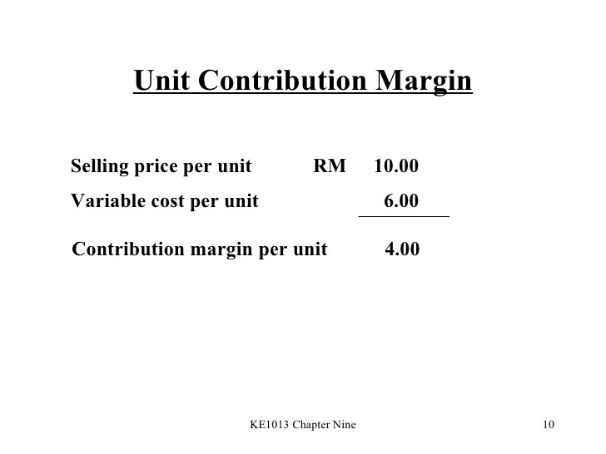
Contribution Pricing
Contribution (marginal) pricing
Contribution margin - also called gross profit - is the sales price received minus the variable cost.

Slide 13
Pricing Strategy
• Pricing strategy refers to method companies use to price their products or services.
• The price of the products and services are set on the basis their expenses
• They add on a certain percentage so they can make a profit.
• There are several different pricing strategies to fulfil their objectives

Slide 14
Types of pricing strategy
1. Penetration Pricing
2. Skimming Pricing
3. Competition Pricing
4. Economy Pricing
5. Bundle Pricing (Combo)
6. Psychological Pricing
7. Premium Pricing
8. One price policy
9. Discounting Pricing
10. Discriminatory Pricing
11. Promotional Pricing
12. Product line Pricing
13 Predatory Pricing

Slide 16
1. PENETRATION PRICING

Slide 17
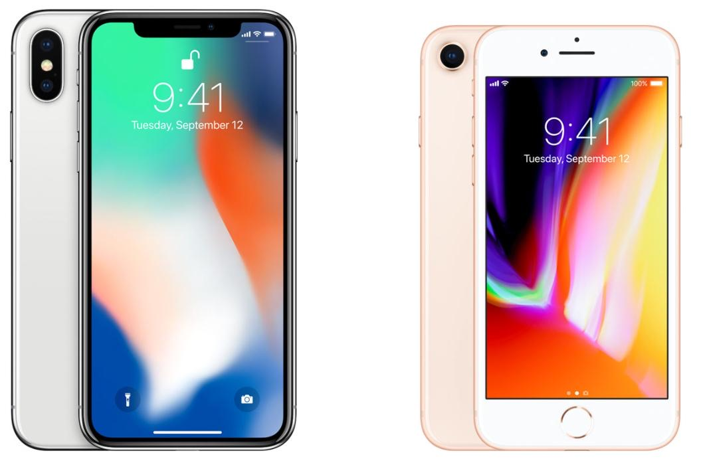
2. SKIMMING PRICING

Slide 18
3. COMPETITION PRICING
Competitive pricing is a pricing strategy in which the competitors' prices are taken into consideration when setting the price of the same or similar products. The focus is on competition-driven prices rather than production costs and overheads.

Slide 19
4. ECONOMY PRICING
An economy pricing strategy sets prices at the bare minimum to make a small profit. Companies minimize their marketing and promotional costs. The key to a profitable economy pricing program is to sell a high volume of products and services at low prices.

Slide 20
5.BUNDLE PRICING

Slide 22
6. PSYCHOLOGICAL PRICING
Psychological pricing (also price ending, charm pricing) is a pricing and marketing strategy based on the theory that certain prices have a psychological impact. Retail prices are often expressed as "odd prices": a little less than a round number, e.g. $19.99 or £2.98.

Slide 23
7.PREMIUM PRICING
A premium pricing strategy involves setting the price of a product higher than similar products. This strategy is sometimes also called skim pricing because it is an attempt to “skim the cream” off the top of the market.

Slide 24
8. ONE PRICE POLICY
A one price policy is a strategy in which the seller offers the same price to every customer. ... It is the opposite of a differential pricing approach or a variable price policy. With a one price policy, customers cannot negotiate the price. They cannot negotiate the price because the company won't allow it.

Slide 25
9. DISCOUNTING PRICING
Discount pricing is one type of pricing strategy where you mark down the prices of your merchandise. The goal of a discount pricing strategy is to increase customer traffic, clear old inventory from your business, and increase sales

Slide 26
10. DISCRIMINATORY PRICING
Price discrimination is a selling strategy that charges customers different pricesfor the same product or service based on what the seller thinks they can get the customer to agree to. In pure price discrimination, the seller charges each customer the maximum price he or she will pay.

Slide 27
11. PROMOTIONAL PRICING
Price promotions or promotional pricing is the sales promotion technique which involves reducing the price of a product or services in short term to attract more customers & increase the sales volume.

Slide 29
12. PRODUCT LINE PRICING

Slide 30
13.PredatoryPricing

Slide 31
Pricing Tactics
A short term attempt to manipulate the price of a good or service in order to achieve a particular business objective. For example, a price tactic might involve temporary price cutting or another financially motivated sales strategy to help increase product sales in the short term and convert new customers.

