Slide 1

By Mrs Sarika Singh
Faculty of management Studies MLSU Udaipur

Slide 2

CHANNELS OF DISTRIBUTION
• Channel of distribution is the path through which products move from the place of production to the place of ultimate consumption. It is the connecting link between the producer and the consumer to sell the products.
• It creates the utilities of time, place and possession by bridging the gap between the point of production and the point of consumption.

Slide 3

Functions of Distribution channel • 1. Sorting: The middlemen collect goods from
various sources. These goods are different in
• quality, size, nature, colour etc.
• The intermediaries sort these foods into homogeneous groups on the basis of the size, quality, nature etc.
• 2. Accumulation: This function involves accumulation of goods into larger homogeneous stocks, which maintain continuous flow of supply.

Slide 4

Functions of Distribution channel
3. Allocation: Allocation involves breaking homogeneous stock into smaller marketable lots.
4. Assorting: Middlemen procure variety of goods from different sources and deliver them in combinations desired by the customers.
A retailer collects a variety of consumer goods and delivers them to households.

Slide 5

Functions of Distribution channel
5. Product promotion: The middlemen advertise the product kept with them. They also do certain sales promotion activities like demonstrations; special displays etc. to increase the sale of products.
6. Negotiation: They negotiate and try to reach agreement on price and other terms of sale.
7. Risk taking: They bears the risk of changes in demand, damage in transit, theft, spoilage,
destruction etc.

Slide 6

TYPE OF CHANNELS/
CHANNEL LEVELS

Slide 7
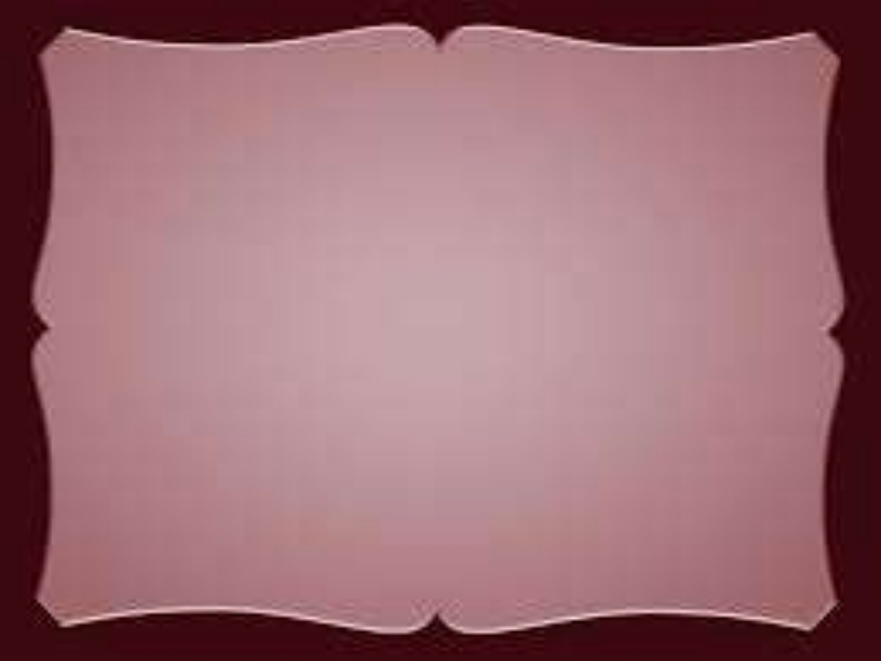
TYPE OF CHANNELS/ CHANNEL LEVELS
A distribution channel connects the producer and the consumer. Several intermediaries function in between them. The number of intermediaries determines the length of a channel. It is also called channel levels or type of channels.

Slide 8
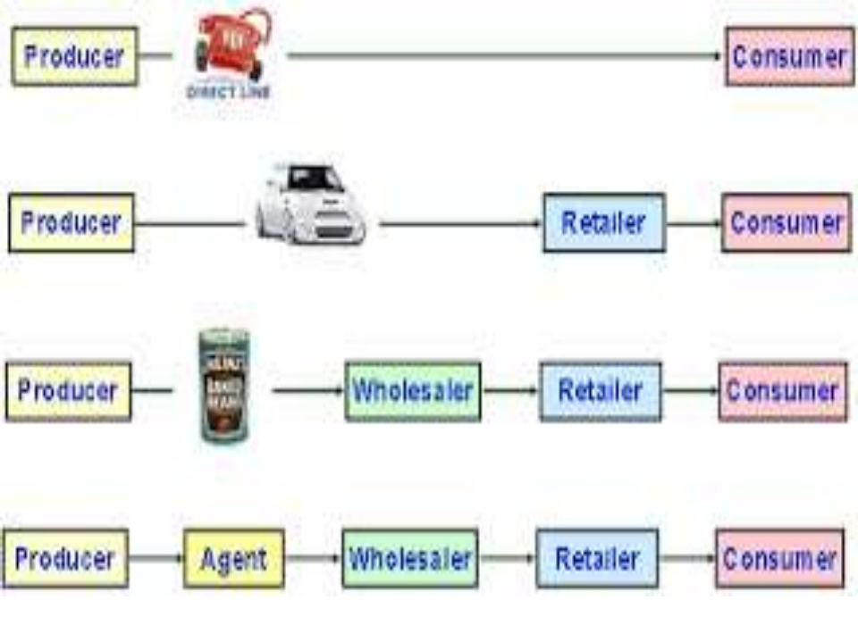
DIRECT CHANNEL/ZERO LEVEL
ONE LEVEL
TWO LEVEL CHANNELS
THREE LEVEL CHANNELS

Slide 9

1. Direct Channel/ZERO level/ Direct
marketing
Direct channel of distribution means making goods available to consumers directly by the manufacturer, without involving any intermediary. Eg: Mail order selling, Internet selling, Selling through own sales force/ own retail outlets ( eg. Bata, McDonald, Eureka Forbes etc.)

Slide 10

2. Indirect Channels
Indirect channels of distribution mean making goods available to the consumers by employing one or more intermediaries. Following are the different types of channels under indirect channels
1.One level
2.Two level channels
3.Three level channels

Slide 11

ONE LEVEL
In this type, the intermediary is the retailer firm directly supplies the product to retailer who sells the product directly to customers.
Eg: Maruti Udyog sells its cars through company approved retailers

Slide 12
TWO LEVEL CHANNELS Under this channel, the manufacturer sells
to one or more retailers who in turn sell to the ultimate consumers. This is the most commonly adopted distribution network for most consumer goods like soaps, oils, clothes,rice,sugar etc

Slide 13

4.Three level Channels
This is the longest Channel of distribution. In this path, one more middlemen is added . So there are three intermediaries’ involved-agents, wholesalers and retailers. Manufacturers use their own selling agents or brokers who connect them with wholesalers and then the retailers.

Slide 14
Factors determining Choice of
channels
It is essential to make right choice of channel of distribution. The choice of the appropriate channel depends on various factors
1. Product related factors
2. Market related Factors
3. Company Related factors
4. Competitive factors
5. Environmental Factors

Slide 15

1. Product Related Factors (a) Nature of Product:
The Industrial products are usually technical, and expensive products purchased by few customers. It requires shortest channel (Direct Channel). Consumer product are standardized products which can be easily sold through intermediaries.

Slide 16

b) Perishable Vs Non - perishable
products
Perishable products like fruits, vegetables and dairy products are best sold through short channels. While non-perishable products like
soaps, toothpaste etc. require longer channels to reach wide spread consumers.

Slide 17

(c) Unit value
When unit value of a product is high direct channel is effective.
Eg: Gold, jewelry, Car etc..
On the other hand less costly product like cosmetics, detergents, soaps are sold through longer channels.

Slide 18

2.MARKET RELATED FACTORS
The following factors relating to the market are particularly significant in the choice of a channel of distribution.
a. Nature of Market: In a consumer market longer channels are used whereas in industrial market shorter channels are preferred.

Slide 19

MARKET RELATED FACTORS b. Size of the market: In case the number of buyers is small , shorter channels are used. But indirect channels are required when the market consists of large number of customers. c. Geographical situation: If the buyers are concentrated in a limited area, direct selling can be used. But widely scattered customers require the use of middlemen.

Slide 20

MARKET RELATED FACTORS
d. Size of order: If the size of order is small, as in the case of most consumers products,
large number of intermediaries may be used. But if size of order is large, direct channels may be used.

Slide 21

3. Company related factors
The characteristics of the company influences the choice of distribution channels. They are
(a) Financial strength: A company having large amount of funds can create its own channel of distribution. But financially weak companies will have to depend upon middlemen.

Slide 22

(b) Desire for control: Companies which want a tight control over distribution prefer direct channels. Otherwise indirect
channels may be used.
(c) Management: If the management of a firm has sufficient knowledge and experience of distribution, it may prefer direct selling. On the other hand, firms whose management has not sufficient knowledge have to depend on middlemen.

Slide 23

4. Competitive factors
The choice of channel is also affected by the channel selected by competitors in the same industry. If the competitors have selected a particular channel, the other firm may also like to select the similar channel. Sometimes, we may avoid the channels used by the competitors

Slide 24

5. Environment factors
Environmental factors include factors such as economic condition and legal constraints.
eg: In a depressed economy, marketers use shorter channels to distribute their goods.

Slide 25
CHANNEL CONFLICT
Channel conflict can be explained as any dispute, difference or discord arising between two or more channel partners, where one partner’s activities or operations affect the business, sales, profitability, market share or similar goal accomplishment of the other channel partner.

Slide 26
CONFLICT MANAGEMENT
To manage channel conflict marketer must understand-
the type;
nature or the cause;
and magnitude of the conflict.
He should also appreciate that conflict cannot be totally eliminated. It can only be minimized.

Slide 27
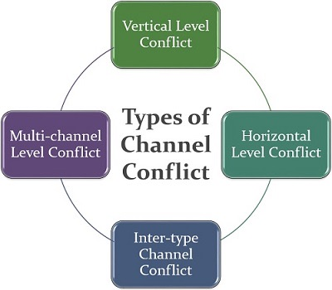
TYPES OF CONFLICTS

Slide 28
Types of Conflict
(i) The Vertical Level Conflict: Vertical level conflict occurs when the channel member at one level is in conflict with another member at the next higher or lower level. For example, a conflict between the wholesaler and the manufacturer is a vertical level conflict or the major retailers in the town conflicting with the distributor over entitlements.

Slide 29
(ii) Horizontal Level Conflict: Conflict at the same level between channel members is called horizontal level conflict. Hence, inter stockist conflict or conflict at the retail level among retailers on issues like pricing and territory jumping are examples of horizontal level conflict

Slide 30
iii) Multichannel Level Conflict: Sometimes the middlemen come in conflict with the manufacturer, using both direct and indirect means of distribution. Such a conflict is called multichannel level conflict.
For example, the firm may have its own franchise outlet or its own shop in an area, where, it may also be distributing the product through established middlemen. The former is direct distribution while the latter is indirect distribution.

Slide 31
Nature or Causes of Conflict
Channel conflict occurs largely due to financial and non-financial reasons. These in turn may be traced to the following causes:
(i) Goal incompatibility: A major factor causing conflict between manufacturers and wholesalers is the perceived goal incompatibility between them. For example, while the manufacturer perceives his goals to be market share and profit maximization in the long run, wholesalers perceive their goal to be sales maximization and thereby profit maximization

Slide 32
(ii) Role ambiguity: Many a time conflict has occurred because of role ambiguity.
A well known automobiles component manufacturer had such a conflict when one of its distributors started directly selling to retailers, through his mobile van bypassing large wholesalers in the territory. The wholesalers revolted and started pushing the competitors’ products. Lack of role clarity of any of the channel members can be a source of potential conflict.

Slide 33
(iii) Differences in Perceptions of the Market: Different perceptions of the market and economy may also create a conflict between the manufacturer and middlemen.
For example, a manufacturer may perceive an opportunity in the booming Indian middle class market and, hence introduce new products, multiple brands and even appoint wholesalers in distant areas. The existing dealers of this firm may not see the picture this way and may perceive the appointment of multiple dealers and downsizing their (former dealers) territory as dilution of their control over the market.

Slide 34
Managing the Conflict
(i) Communication
(ii) Dealer councils
iii) Superordinate goals
iv) Arbitration and mediation

