Slide 1
INFORMATION PROSSING THEORY
Priti sharma
M.A. 4th sem

Slide 2
CONTENT
Information processing model
Environment stimuli
Sensory memory (ecohic, Iconic)
forgotten
Attention (perception)
Short term memory (working memory)
Reharsal
Encoding
Retrival
recall
Long term memory ( declrative,procedural)

Slide 3
Information processing theory-
The multi store model of memory (also known as the modal model) Was proposed by Atkinson and shiffrin (1968) and is a Structural model.
They proposed that memory consisted of three stores: a sensory register, short- term memory(STM), and long- term mamory (LTM)

Slide 4
Information processing model

Slide 5
Environment stimuli
Information is detected by the sense organs and enters the sensory memory.

Slide 6
Sensory memory
Sensory information is stored in sensory memory. Humans have five basic senses: sight, hearing, taste, smell, touch.
The sensing organs associated with each sense send information to the brain to help us understand and perceive the world around us.
Records information From the sense for up to 3 seconds

Slide 7
Sensory memory
Sensory register - Information enters the sensory register via our senses and a very limited duration of less than one second.
Sensory information store:-sensory information is being taken in by sensory receptors and processed by the nervous system.
Echoic :- ears
Iconic :- eyes
Duration – 1-3sec.
Stability – fleeting
Capacity- limited

Slide 8
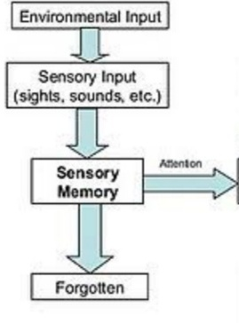
Forgotten
to not be able to remember something
Information may be lost from working
memory through Interference or decay

Slide 9
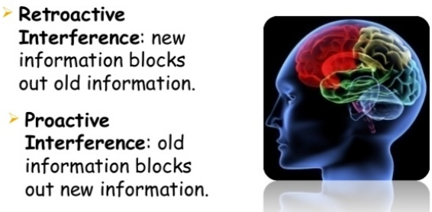
Forgotten interference
Decay – The weakening and fading of memory with the passage of time.
Interference – Processing new information interferes With old
Information
There are two types of
interference:-
retroactive and proactive.

Slide 10
Attention
Attention is the behavioral and cognitive process of selectively concentrating on a discrete aspect of information, whether considered subjective or objective, while ignoring other perceivable information
Perception :- The process of Detecting a stimulus & assigning meaning to it.

Slide 11
Short- term memory (Working memory)
Short term memory holds information for a limited amount of time and holds a limited amount of information.
Automatic and effortful processing
Duration 30 seconds
Stability:- easily disrupted
Capacity :- limited ( 7+-2 items)
Mneumonics :- make it easier to remember

Slide 12
Short-term memory forgetting

Slide 13
Encoding – processing incoming information so it can be entered into memory. Three main ways in which information can be encoded. Visual encoding: Information is represented as a picture Acoustic encoding: Information is represented as sounds Semantic encoding: Information is represented by its meaning to you

Slide 14
Storage – maintaining information in memory for a period of time Retrieval – accessing or recalling stored information from memory so it can be used. Reharsal – attempting to learn something by repeating it over and over:,repetition Maintenance Reharsal:-Involves repeating the information In our mind(phone number or a location on a map)

Slide 15
Elaborative reharsal :- involves connecting the information, you are typing to remember with something you already now with knowledge from long time memory (ex:- you meet someone at a party whose name in the same as your brother’s --- you make the ASSOCIATION

Slide 16
Long-term memory
Permanent store of knowledge
Unlimited store house of
information
Duration :- unlimited
Stability :- not easily disrupted
Capacity :- unlimited

Slide 17
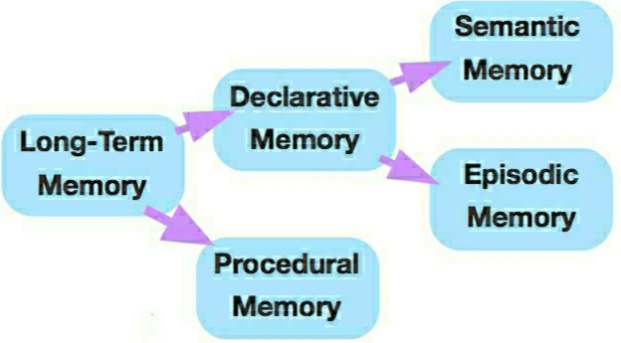
Long- term memory
Declarative knowledge :- Is knowledge that can, be declared through words and symbol Systems of all kinds, verbal information facts, “knowing that” something is the case
Procedural knowledge :- knowledge that is demonstrated when we perform a task, “knowing how”

Slide 18
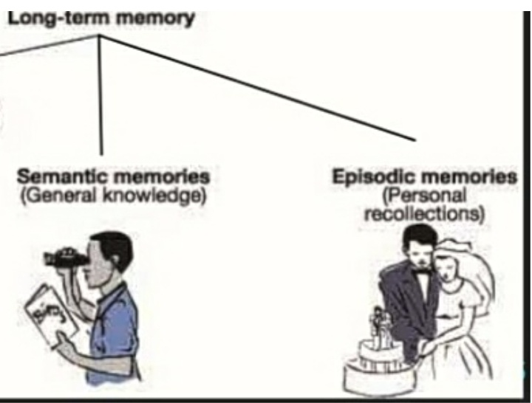
Semantic memory :- these are memories of facts, concepts, names,and other general knowledge information. Episodic memory:- these are your long-term memories of specific events, such as what you did yesterday or your high school graduation. (your own experience)

