Slide 1

CYTOSKELETON

Slide 2

CONTENTS
History & Introduction of Cytoskeleton.
Structural elements of Cytoskeleton.
Types of cell junctions & its components.
Epithelial – connective tissue interface.
Clinical considerations.
References.

Slide 3

HISTORY
In 1903, Nikolai K Koltsav proposed that the shape of cells was determined by a network of tubules which he termed the Cytoskeleton.
The term Cytosquelette (in french) was first introduced by French embryologist Paul Wintrebert in 1931.

Slide 4

INTRODUCTION
Every cell has a supporting framework of minute filaments and tubules, known as the Cytoskeleton, which maintains the shape and polarity of the cell.
The various cells & tissues that compose the oral cavity are complex entities that exhibit unique developmental and functional characteristics.
However, they have several structural features in common with other cells.
The Cytoskeleton is a cellular “scaffolding” or skeleton contained within a cells cytoplasm and is made out of protein.

Slide 5
The cell membrane and the intracellular organelles are not rigid or static structures but are in a constant state of movement to accommodate processes such as endocytosis, phagocytosis and secretion.
Muscle cells are highly specialised for contractility.
In addition, cell division is a process which involves extensive reorganisation of cellular constituents.
The cytoskeleton incorporates features which accommodate all these dynamic functions.
Cells possess a cytoskeleton that provides :
  a structural framework
  facilitates intracellular transport,
  plays a major role in cell division,
  supports cell junctions
  transmits signals about cell contact, adhesion & permits motility.

Slide 6

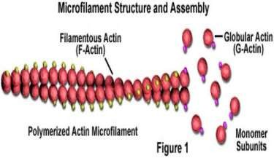
The three structural elements of the cytoskeleton are :
Microfilaments,
Intermediate filaments, and
Microtubules.
All are dynamic structures assembled from protein subunits and also contain accessory proteins linking these structures to one another, to plasma membrane & to the membranes of intracellular organelles.
Microfilaments:
Microfilaments are 6 to 8 nm
in diameter and consist of globular actin ( G- actin) molecules polymerized
into long filaments which are Interwined in a helix ,
creating filamentous form of the protein ( F- actin).

Slide 7

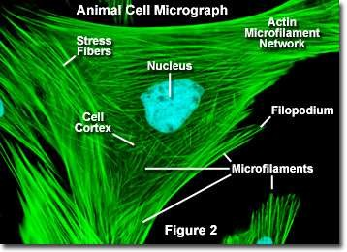
They form tracks for the movement of myosin and serve as
intracellular “muscles” for maintenance of cell shape, movement, and contractility.
They are typically present at the plasma membrane ; therefore the periphery of a cell contains the highest concentration of microfilaments.
Beneath the plasma membrane actin in association with other transmembrane and linking proteins
( filamin) forms a supporting meshwork called
cell cortex which protects against deformation
& yet can be rearranged to accommodate changes in cell morphology.

Slide 8

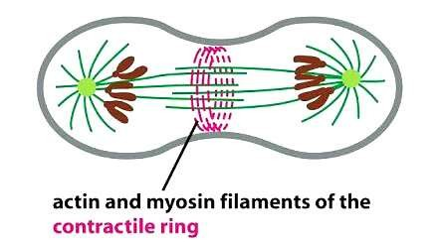
They are present as the structural “core” of microvilli, filopodia, and lamellipodia.
Actin interacts with the other two components of the cytoskeleton.
During the telophase of mitosis the plasma membrane around the spindle equator becomes indented to form a circumferential cleavage furrow around the cell where a ring of microfilaments organize themselves beneath this furrow and constricts the cell to be cleaved
into two daughter cells.

Slide 9

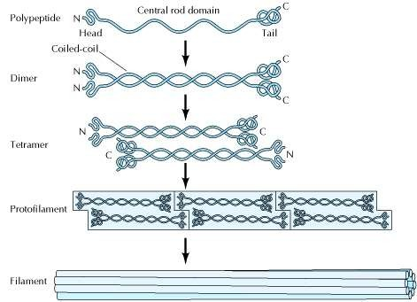
Intermediate filaments
Intermediate filaments are approximately 10 nm in diameter and have a diverse protein composition.
They are not contractile ( static) but are important in the maintenance of cell shape and contact between adjacent cells and the extracellular matrix.
Assembly of intermediate filaments:
.

Slide 10
In humans more than 50 different types of intermediate filaments have been identified.
But these can be divided into 6 different groups based on similarities between their aminoacid sequences.
They are most commonly known as support system or scaffolding for the cell.
The keratin filaments of epithelial cells are tightly anchored to the plasma membrane at two areas of specialized cell contacts, desmosomes and hemidesmosomes.

Slide 11

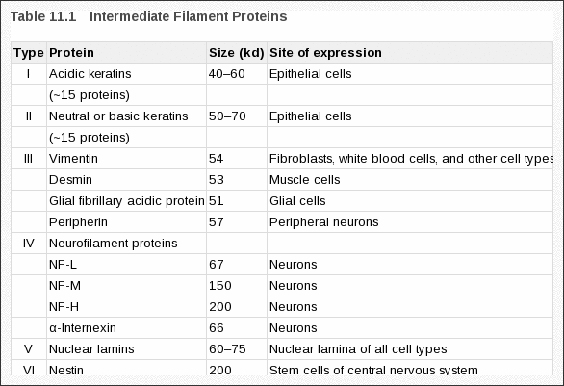

Slide 12
In epithelial cells, intermediate filaments consist of cytokeratins. These filaments form bundles, called tonofilaments, which anchor onto desmosomes.
They type I (acidic) and type II (neutral/basic) keratin, which copolymerize to form filaments.
The type III intermediate filament proteins include vimentin which are present in cells of mesenchymal origin, such as fibroblasts and osteoblasts .
Another type III protein, desmin, is specifically expressed in muscle cells, where it connects the Z discs of individual contractile elements.
other type III intermediate filament protein is glial fibrillary acidic protein in glial cells.

Slide 13
The type IV intermediate filament proteins include the three neurofilament (NF) proteins.
These proteins form the major intermediate filaments of many types of mature neurons. They are particularly abundant in the axons of motor neurons and are thought to play a critical role in supporting these long, thin processes, which can extend more than a meter in length.
The type V intermediate filament proteins are the nuclear lamins. They are components of the nuclear envelope and aid in the disintegration of nuclear envelope in the late prophase due to phosphorylation of the nuclear lamins which results in disassembly of the nuclear lamina and breakdown of the nuclear envelope during mitosis.
The single type VI intermediate filament protein nestin is expressed even earlier during the development of neurons, in stem cells of the central nervous system ( can be used as a stem cell marker).

Slide 14

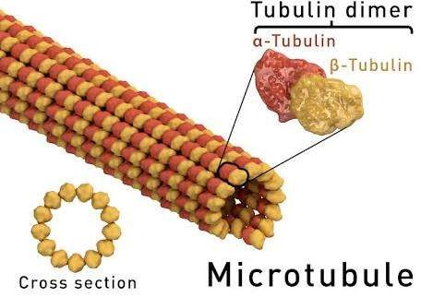
7. Their expression patterns have been used to determine the relationship between cell types and as an indication of the origin of various tumors.
Microtubules
Microtubules are tubular or cylindrical structures with an average diameter of 25nm. They are composed of the protein tubulin which have two subunits alpha & beta tubulin which polymerise to form a hollow tubule when seen in a cross section 13 tubulin molecules make up a circle.

Slide 15


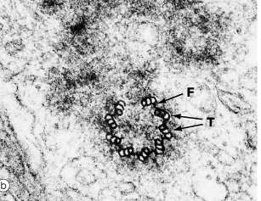
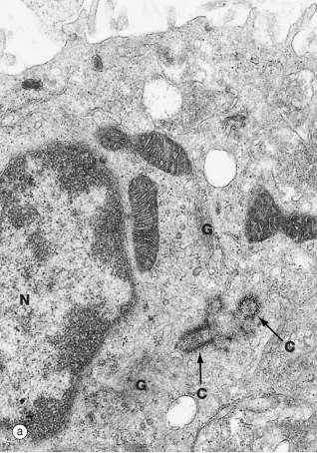
Microtubules originate from a specialised microtubule organising centre,
the centriole, found in the centrosome which is a zone of cytoplasm distinguishable by its different texture, usually located adjacent to the nucleus in a cell.
The centrosome, consists of a pair of centrioles; Each centriole consists of nine triplets of microtubules arranged in cylindrical manner. The two cylinders are arranged at right angles to one another.

Slide 16

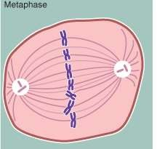
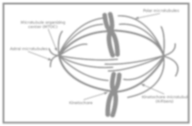
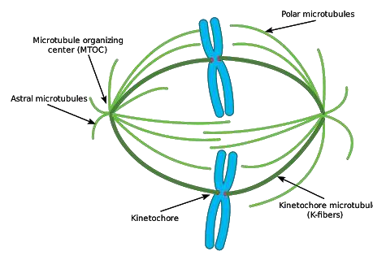
Centrosome acts as a nucleation centre for microtubular function.
They organise the microtubules of the cell spindle during cell division which contols the distribution of chromosomes to daughter cells.
several microtubules radiate from the centrosome towards the cell periphery.

Slide 17

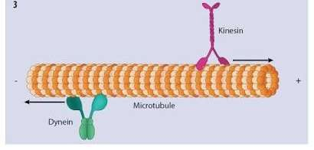
Microtubule-associated proteins (MAPs) stabilise the tubular structure and include capping proteins, which stabilise the growing ends of the tubules.
The motor proteins dynein and kinesin move along the tubules towards and away from the cell centre, and attaches it to membranous organelles there by providing movement in the cytoplasm.

Slide 18
In summary the micro filaments and micro tubules are labile and dynamic structures (except in muscle & cilia where they perform specialised functions).
Where as Intermediate filaments serve a more static supporting function.

Slide 19
Cell Junctions
When cells are attached to one another, and sometimes with the extracellular matrix, specialized junctions form at specific sites on the long term contacting cell membranes.
These specialized junctions are classified as follows:
Tight junctions (zonula occludens)
Adhesive junctions
  Cell-to-cell
    Zonula adherens
    Macula adherens (desmosome)
  Cell-to-matrix
    Focal adhesions
    Hemidesmosomes
Communicating (gap) junctions

Slide 20


Components of cell junctions
On the molecular level, intercellular junctions consist of three components:
Transmembrane adhesive protein
Cytoplasmic adapter protein, and
Cytoskeletal filament.
These three components differ depending on the type of junction.

Slide 21

Tight junctions:
In occluding, or tight junctions the opposing cell membranes are held in close contact by the presence of transmembrane adhesive proteins arranged in anastomosing strands that encircle the cell.
The intercellular space essentially is obliterated at the tight junction.
The transmembrane adhesive proteins of tight junctions - Occludin (members of the claudin family)
In some tissues Junctional adhesion molecule interact homotypically with the same proteins on the adjacent cell.
Cytoplasmic proteins of the tight junctions bind to actin filaments.

Slide 22


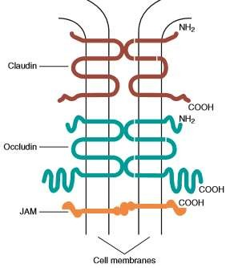
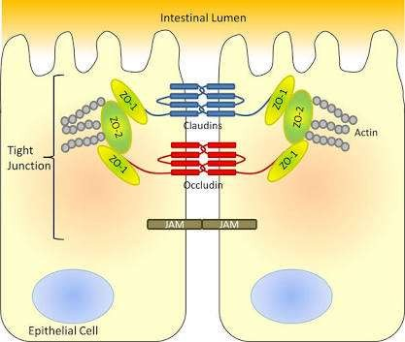

Slide 23
Several cytoplasmic proteins associate with the intracellular portions of the transmembrane proteins & these include:
cell polarity related proteins,
vesicular transport related proteins, 3.kinases,
4.transcription factors, and a tumor suppressor protein.
They have an important role as a “fence” to define and maintain the two major domains of the cell membrane, the apical and baso lateral surfaces.

Slide 24
The “tightness” of the junction to water and ions is due to claudins present and is correlated with the number of strands of transmembrane proteins.
For example : tight junctions joining salivary gland secretory cells have only two or three junctional strands and are relatively permeable to water,
whereas those joining salivary gland striated duct cells may have six to nine strands and are relatively impermeable to water.
The permeability of tight junctions in some tissues may be regulated by certain neurotransmitters and hormones.

Slide 25


Adhesive junctions:
CELL-CELL JUNCTION:
Adhesive junctions hold cells together or anchor cells to the extracellular matrix.
The intercellular space in cell-cell adhesive junctions is maintained at approximately 20nm.
Adhesive junctions also are important in cellular signaling.
Their cytoplasmic components may interact with the cytoskeleton, triggering changes in cell shape or motility.
In cell-cell adhesive junctions the principal transmembrane proteins are members of the Cadherin family.
Cadherins are calcium ion–dependent proteins that interact homotypically with cadherins on the adjacent cell.

Slide 26
The cytoplasmic adapter proteins are members of the Catenin family.
Catenins interact with the transmembrane cadherin molecule, the cytoskeleton, and with a number of other proteins, including kinases, and tumor suppressor molecules that are associated with adhesive junctions.
ZONULA ADHERENS:
In zonula adherens the cadherin family is
E-cadherin.
α- and β-catenin are the cytoplasmic adapters. Actin filaments are the cytoskeletal component



Slide 27

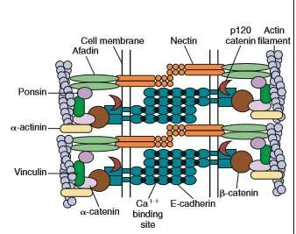
The catenins and actin filaments are concentrated on the cytoplasmic side of the cell membrane at the zonula adherens to form a dense web that is continuous with the terminal web of actin at the end of the cells.
Another transmembrane adhesive protein present in the adherens junction is Nectin, a member of the immunoglobulin superfamily.

Slide 28
Nectin has an important role during junction formation, establishing the initial adhesion site and recruiting E-cadherin and other proteins to the junction.
Other cytoplasmic proteins associated with the zonula adherens include p120 catenin , a signaling molecule associated with E- cadherin that is important in stabilizing the junction;
Afadin, which links nectin to the actin cytoskeleton; vinculin and α- actinin, which are actin-binding proteins; and ponsin, which links afadin and vinculin.

Slide 29
MACULA ADHERENS / DESMOSOME:
In the desmosome the cadherins are desmoglein and desmocollin.
The interaction of these transmembrane proteins with the adjacent cell results in a dense line in the middle of the intercellular space at the desmosome.
The catenins are desmoplakin, plakoglobin, and plakophilin, which form an electron-dense plaque on the cytoplasmic side of the desmosome.
This plaque serves as an attachment site for the cytoskeletal components, which in the case of the desmosome are intermediate filaments.

Slide 30

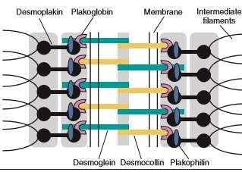

Slide 31
CELL-MATRIX JUNCTION
Cell-matrix junctions have a structural organization similar to that of cell-cell adhesive junctions, but they use different molecular components and attach the cell to the extracellular matrix.
1. FOCAL ADHESIONS:
The Transmembrane component is a member of the Integrin family of adhesion molecules.
Integrins are heterodimers of different alpha and beta subunits that occur in
different combinations with specificity for various extracellular matrix molecules.
Cytoplasmic adapter proteins, include the actin binding proteins α-actinin, vinculin, and talin.
They link the transmembrane integrins to the actin cytoskeleton.
Binding of the integrin to collagen, laminin, fibronectin, and other extracellular matrix proteins results in recruitment and remodeling of the actin cytoskeleton.
.

Slide 32
2. Hemidesmosomes:
Hemidesmosomes link the cell to the basal lamina and, through additional extracellular molecules to the rest of the extracellular matrix.
The transmembrane adhesive molecules are the Integrin α6β4, which binds specifically to the basal lamina glycoprotein laminin, and collagen XVII (also identified as BP180).
The cytoplasmic adapter proteins are the bullous pemphigoid antigen 230 (BP230) and plectin, form a dense plaque on the cytoplasmic surface of the hemidesmosome, which functions as an attachment site for intermediate filaments.

Slide 33

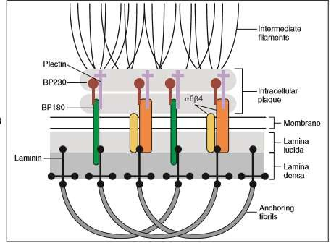

Slide 34

GAP JUNCTIONS:
Gap junctions are plaque-like regions of the cell membrane where the intercellular space narrows to 2 to 3 nm.
Transmembrane proteins are of the connexin family, which form aqueous channels between the cytoplasm of adjacent cells .
These proteins have specific tissue and cellular distributions and confer differing permeability properties to the gap junctions.
Six connexin molecules form a connexon, which has a central channel approximately 2 nm in diameter.

Slide 35

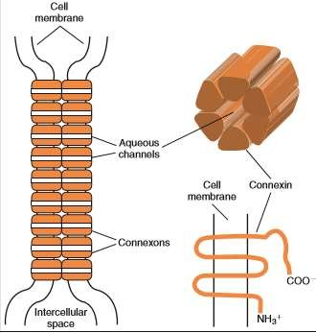
The connexons in one cell pair with connexons in the adjacent cell to create a patent channel.
Small molecules, such as ions and signaling molecules, can move readily from one cell to another.
Gap junctions electrically couple cells and allow for a coordinated response to a stimulus by the cells that are interconnected.

Slide 36



EPITHELIUM–CONNECTIVE TISSUE INTERFACE
All epithelia are separated from the underlying connective tissue by a layer of extracellular matrix organized as a thin sheet immediately adjacent to the epithelial cells.
This is basal lamina, which is a product of the epithelium and connective tissue.
The basal lamina, along with hemidesmosomes attaches the epithelium to the underlying connective tissue.
Functions as a filter to control the passage of molecules between the epithelium and connective tissue, and acts as a barrier to cell migration.

Slide 37
The basal lamina also has important signaling functions, which are essential for epithelial differentiation and the development and maintenance of cell polarity.
The basal lamina has an overall thickness of 50 to 100 nm.
It consists of two structural components, the lamina lucida (clear zone) adjacent to the basal cell membrane, and the lamina densa(dark zone), In epithelia, there is a third layer, the lamina fibroreticularis closely associated with the lamina densa.
The lamina lucida is a 20-40 nm wide glycoprotein layer that attach the cell to the basal lamina, and contains laminin 332 & BP 180 antigen and also interacts with portions of hemidesmosome-associated membrane proteins integrin.

Slide 38
The lamina densa consists chicken wire network of polymers of type IV collagen and laminins. Additional proteins such as heparan sulfate proteoglycan and fibulin are also present.
Fibronectin, an adhesive glycoprotein, type III collagen (reticular fibers), type VII collagen (anchoring fibrils) secreted by fibroblasts present in fibroreticularis and help maintain the attachment of the basal lamina to the underlying connective tissue.
Most of the basal lamina components are synthesized by the epithelium (some components of the lamina fibroreticularis are produced by connective tissue cells such as fibroblasts).

Slide 39

CLINICAL CONSIDERATIONS:
Gene mutations that interfere with the normal assembly of keratin filaments ( k5 & k14) resulted in Epidermolysis bullosa simplex ,a serious blistering skin disorder.
Studies revealed that mutations in other keratins were responsible for several other inherited skin diseases, which are similarly characterized by abnormal fragility of epidermal cells.
Amyotrophic lateral sclerosis (ALS) also known as Lou Gehrig's disease results from progressive loss of motor neurons, which in turn leads to muscle atrophy, paralysis, and eventual death is characterized by the accumulation and abnormal assembly of neurofilaments.
Cell-cell and cell-matrix junctions have important roles in the differentiation, development, and function of normal cells, tissues, and organs.

Slide 40
However, the functions of these junctions may be altered or disrupted by genetic abnormalities of junctional or cytoskeletal proteins or by autoimmune diseases in which circulating antibodies to junctional proteins are present.
Mutations of connexin genes have been identified as the bases for certain types of deafness, congenital cataracts, a demyelinating disease (Charcot-MarieTooth), and oculodentodigital dysplasia,
a disease that exhibits craniofacial abnormalities, syndactyly, conductive hearing loss, and hair and nail abnormalities.
Epidermolysis bullosa ( junctional , dystrophic, kindler form) have shown to be caused by mutations of the genes for various desmosomal, hemidesmosomal junctions.

Slide 41
Pemphigus vulgaris and pemphigus foliaceus, blistering diseases of the oral mucosa and skin are caused by autoantibodies to desmoglein-3 and desmoglein-1, the cadherin in desmosomes.
Bullous pemphigoid, results from the presence of autoantibodies to the hemidesmosomal components collagen XVII (BP180) and BP230.

Slide 42
THANK YOU

