Slide 1
Quinine
Isolated from cinchona bark
Used for treatment of malaria

Slide 2
Structure determination of quinine
M.F. = C₂₀H₂₄N₂O₂
Functional group test:
Nature of Nitrogen: both tertiary (consumes 2 eq. MeI)
-OH group present, Nature: Secondary (forms ketone on oxidation)
One MeO- group present ( librates MeI or MeCl on treatment with HI or HCl)
One vinyl group present: Adds 1 eq Br₂, H₂ and delivered formic acid in oxidation
Alkali fusion: confirms the presence of quinoline moiety in quinine
Oxidation of quinine

Slide 3
Characterization of Quininic acid
Formation of 6-hydroxyquinoline confirmed the presence of 6-methoxyquinoline moiety in quininic acid.
Position of –COOH group ???
Formation of pyridine-2,3,4-tricarboxylic acid confirmed the position of –COOH group at C-4 carbon.

Slide 4
Synthesis of Quininic acid

Slide 5
Structure determination of Meroquinene
DBEs = 3
F.G. identification
-COOH group present, 1 –COOH gp (forms monosodium salt)
Secondary amino group present (forms monobenzoyl derivative)
Both N-atom were found tertiary in quinine.
1 Vinyl group present (same as quinine)
M.F. = C₉H₁₅NO₂
On the basis of above the plausible structures of Meroquinene are,

Slide 6
Structure determination of Meroquinene
Structure (I) found to be correct on the basis of following reactions,

Slide 7
Synthesis of Cincholoiponic acid

Slide 8
Linkage between Quininic qcid and Meroquinene in Quinine
There is no –COOH gp in quinine but Quininc acid and Meroquinene both have –COOH gp, indicating
both must be connected through their –COOH gp C-atom.
There are only tertiary N-atoms in Quinine so the secondary N-atom in Meroquinine should be attached to –COOH C-atom.

Slide 9
Linkage between Quininic qcid and Meroquinene in Quinine
Therefore the precursor of Meroquinene should be quinuclidine type moiety as shown below,
Position of –OH group in Quinine
On the basis of above the proposed structures of Quininone and Quinine is as below,

Slide 10
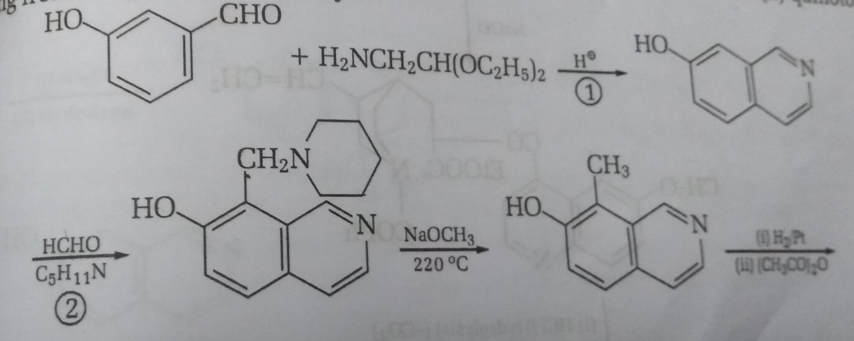
Synthesis of Quinine

Slide 11
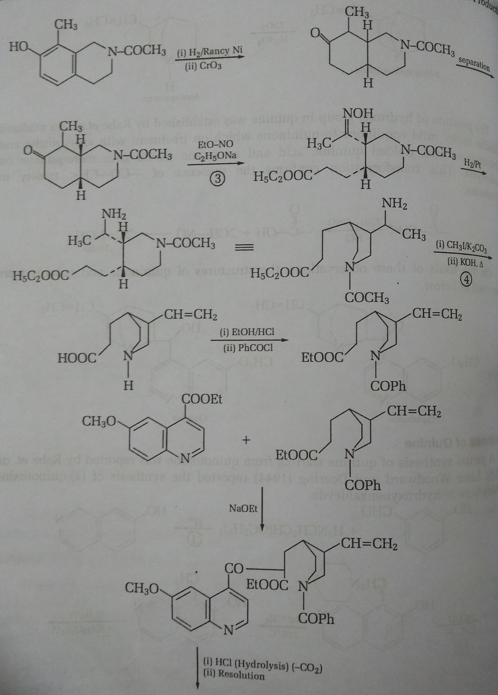
Synthesis of Quinine

Slide 12
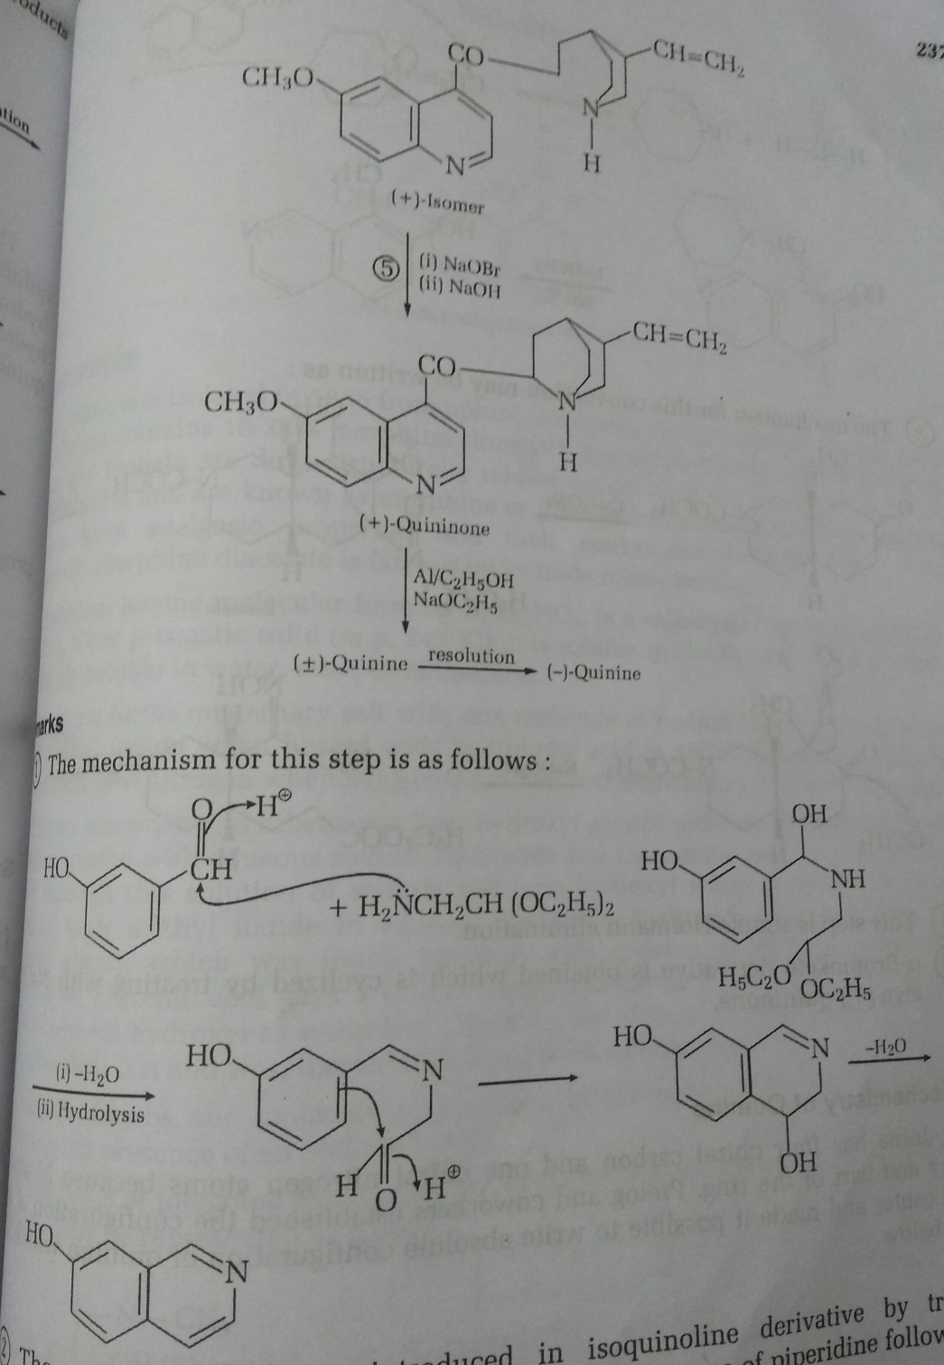
Synthesis of Quinine

Slide 13
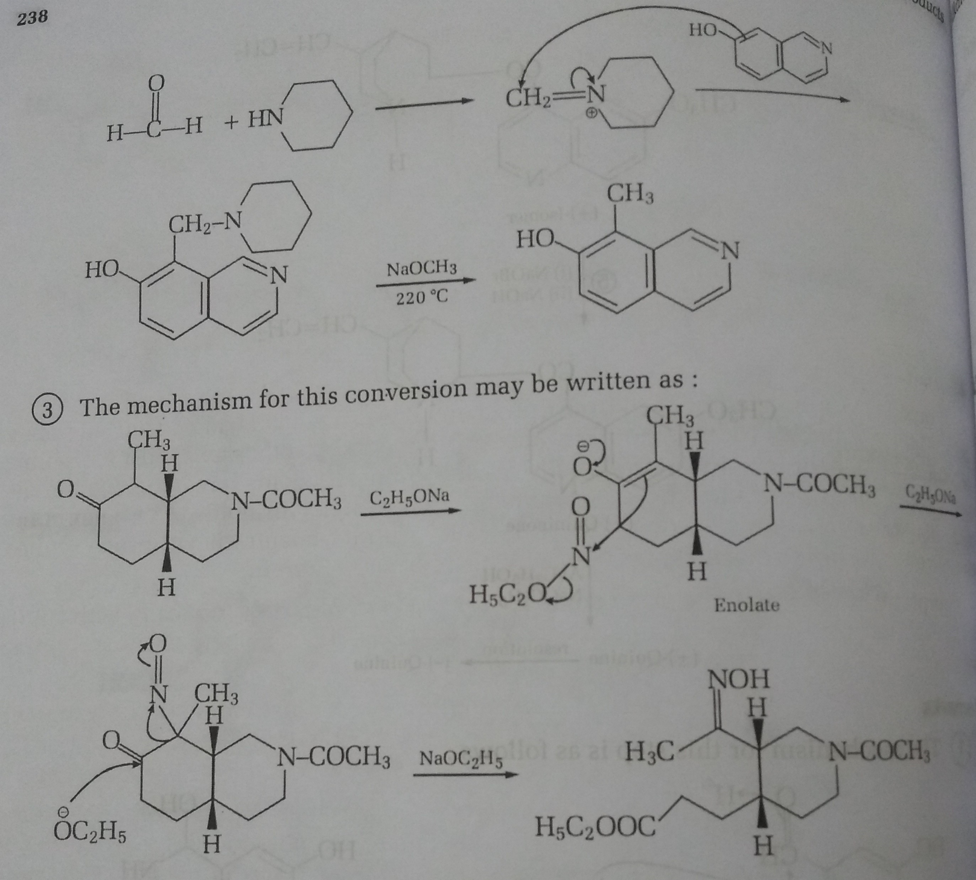
Synthesis of Quinine

