Slide 1
Foreign Direct Investment
Dr.Shilpa Vardia

Slide 2
Why do Firms Invest ABROAD
New source of demand
Exitance of various market imperfections
Economies of Scale
Use foreign raw material and foreign technology
Exploit monopolistic advantage
Diversify internationally
Political safety seekers
Knowledge seeking

Slide 3
HOW TO INVEST ABROAD: METHODS TO INCREASE INTERNATIONAL BUSINESS
JOINT VENTURE
MERGERS AND ACQUISITIONS
LICENSING
FRANCHISING

Slide 4
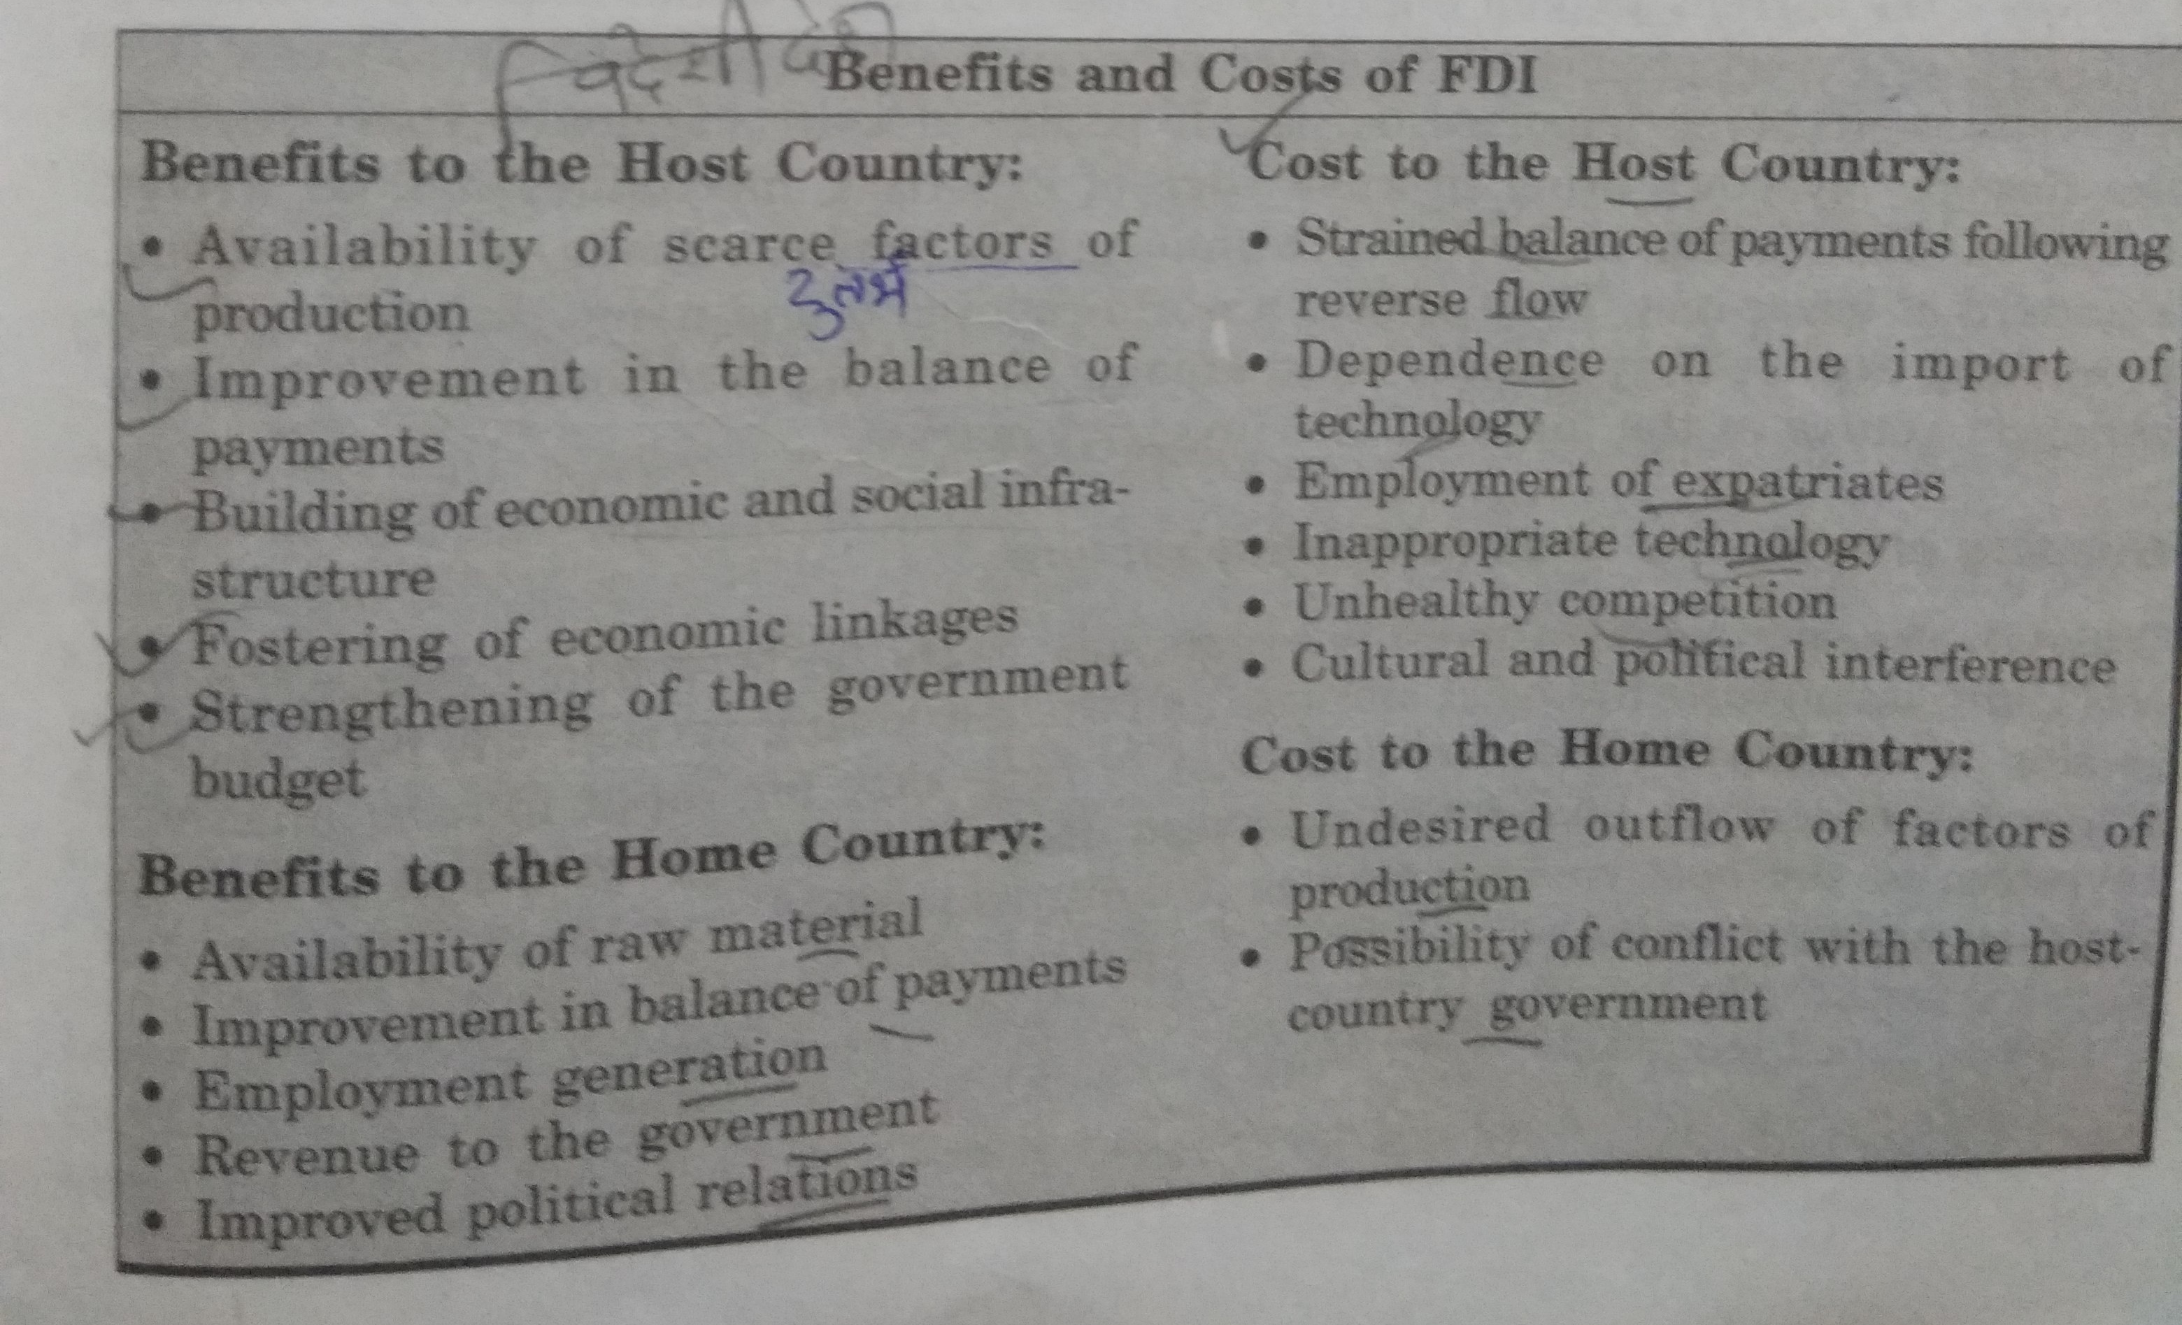
Costs and Benefits of FDI

Slide 5
CONTROL OF MNCs
Conflicts with home country and measures of control
Conflicts with host country and measures of control

Slide 6
International Working Capital Management
Dr. Shilpa Vardia

Slide 7
The Concept
Gross working Capital
Net Working Capital

Slide 8
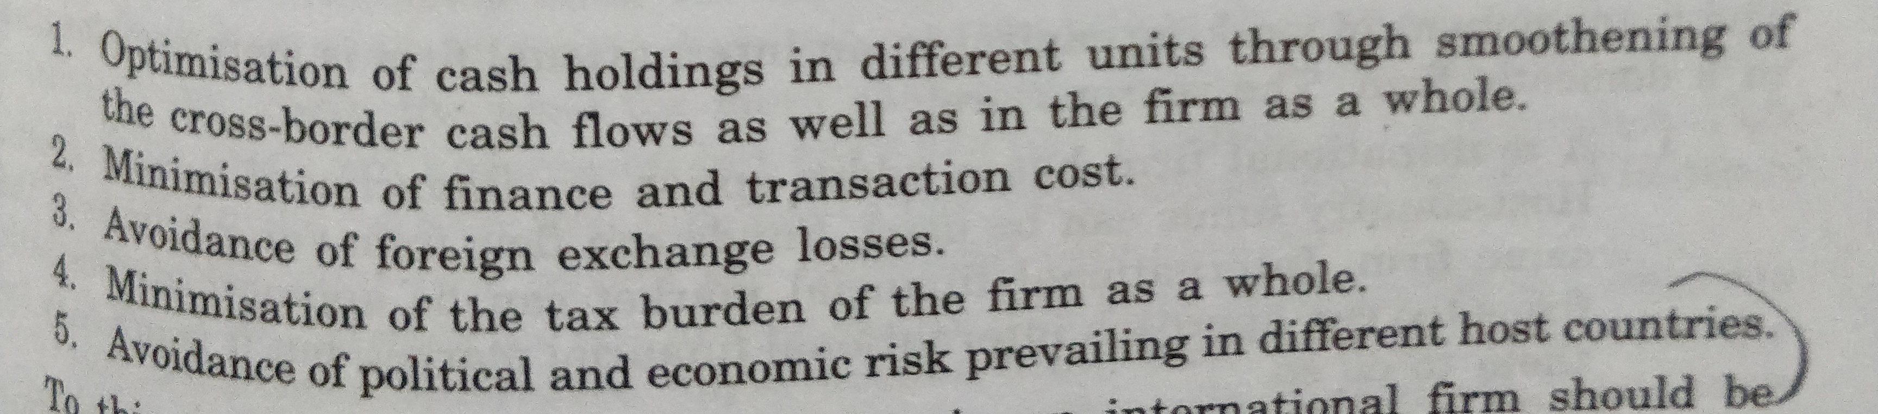
Objectives of working Capital Management in An International Firm

Slide 9
Complexity in International firm
Multi-directional flow of funds
Exchange rate risk
Political risk
Complexities of cash
Varying environment in host country
Varying interest and tax rates among countries

Slide 10
Why does firm hold cash
Transaction Motive
Speculative motive
Precautionary Motive

Slide 11
Intra- Firm flow of fund
From parent to subsidiary
From subsidiary to parent
Among different subsidiaries

Slide 12
Forms of transfer of funds
Transfer Pricing
Parallel loans
Leads and lags
Changes in rates of royalty and other fees
Changes in dividend pay-out ratio
Use of blocked funds

